Slide 1
CERN Operational Radiation Protection
CERN ALARA rule and dedicated RP computing tools
Yann PIRA
05 July 2022
EDMS reference

Slide 2
Summary
CERN regulatory landscape in matter of Radiation Protection and Radiation Safety.
Dosimetry data summary.
ALARA rule applied to interventions at CERN.
IMPACT coordination tool and dedicated RP applications.
CERN area classification and dedicated classification database tool.
CERN Operational dosimetry system and computing tools.

Slide 3

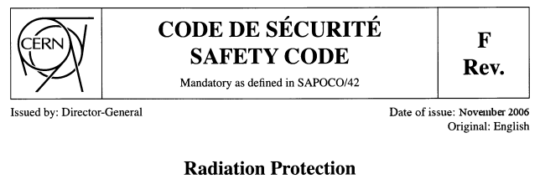
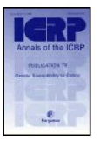





CERN Radiation Protection Legal Framework
CERN is an intergovernmental Organization subject not to national but international law. Its status has been recognized by its host states where it must ensure their safety and security.
CERN has the right to establish its own rules as necessary for the proper functioning of the Organization, among others, Safety Rules.
CERN agrees to follow best practices in matters of radiation protection and radiation safety taking into account the legislation of its host states, as well European and international standards. Their implementation is discussed between the host states authorities, ASN (F) and OFSP (CH), and CERN according to a "Tripartite Agreement” signed in 2010.
CH
IAEA
EU
F

Slide 4
Radiation Protection – Radiation Safety
Radiation Protection
  Responsibility of the Radiation Protection Group (HSE-RP)
  The duties of CERN’s Radiation Protection Group include operational radiation protection which comprises assessment of radiological risks, classification of work places in radiation zones, implementation of control measures, monitoring radiation levels for different radiation areas and impact of radiation on the environment, monitoring the implementation of regulations and of specific rulings, approval of ALARA plans, control and characterization of radioactive material and waste.
Radiation Safety
  Responsibility of every CERN Department owning radiation sources or using radiation sources put at its disposition.
  These Departments are in charge of implementing the requirements laid down in CERN’s Safety rules and documents or specified by HSE-RP in order to ensure the safe operation of their existing and future installations (accelerators, beams, experiments). The Departments are also in charge of training their personnel in matters of Radiation Protection according to the rules specified by HSE-RP.

Slide 5
General Principles of Radiation Protection
Justification
Any exposure of persons to ionizing radiation has to be justified
Limitation
The personal doses have to be kept below the legal limits
Optimization
The personal doses and collective doses have to be kept as low as reasonably achievable (ALARA)

Slide 6

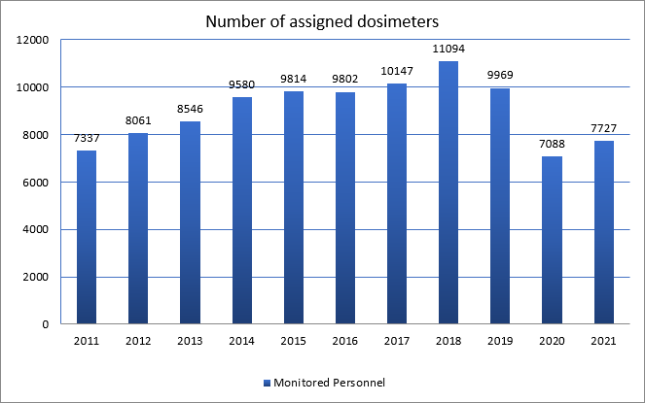
Personal Dosimetry
 | Dose interval (mSv) | Year
 |  | 2011 | 2012 | 2013 | 2014 | 2015 | 2016 | 2017 | 2018 | 2019 | 2020 | 2021 (until 31/10.21)
 | 0 | 5315 | 6002 | 6273 | 7616 | 8704 | 8788 | 9034 | 9824 | 8462 | 6272 | 6302
 | 0.1-0.9 | 1984 | 2030 | 2188 | 1816 | 1108 | 1003 | 1110 | 1260 | 1494 | 799 | 695
 | 1.0-1.9 | 31 | 29 | 82 | 133 | 2 | 11 | 3 | 10 | 13 | 17 | 15
 | 2.0-2.9 | 7 | 0 | 3 | 14 | 0 | 0 | 0 | 0 | 0 | 0 | 0
 | 3.0-3.9 | 0 | 0 | 0 | 1 | 0 | 0 | 0 | 0 | 0 | 0 | 0
 | 4.0-4.9 | 0 | 0 | 0 | 0 | 0 | 0 | 0 | 0 | 0 | 0 | 0
 | 5.0-5.9 | 0 | 0 | 0 | 0 | 0 | 0 | 0 | 0 | 0 | 0 | 0
 | > 6.0 | 0 | 0 | 0 | 0 | 0 | 0 | 0 | 0 | 0 | 0 | 0
Collective dose (mSv) | gamma | 527 | 494 | 687 | 755 | 214 | 215 | 219 | 232 | 275 | 192 | 155
 | neutron | 2.6 | 4.5 | 0 | 0 | 0 | 0 | 0 | 0 | 0 | 0 | 0
Total number of persons |  | 7337 | 8061 | 8546 | 9580 | 9814 | 9802 | 10147 | 11094 | 9969 | 7088 | 7012
1 mSv = 0,1 Rem

Slide 7
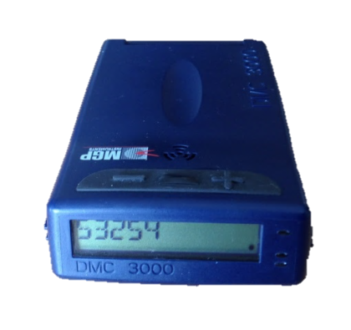
Operational Dosimetry
Collective operational dose
Until
15/11

Slide 8
ALARA rule applied to interventions at CERN : Dose Optimization at CERN
CERN workers
Population
Unacceptable risk
Radiation
Workers
Other
Workers
Class A: 20 mSv/yr
Class B: 6 mSv/yr
Dose limit
1 mSv/yr
300 µSv/yr
Tolerable risk
Dose constraint
3 mSv/yr
100 µSv/yr
10 µSv/yr
Individual risk level
ALARA Level
Optimization process
Acceptable risk
1 mSv = 0,1 Rem

Slide 9
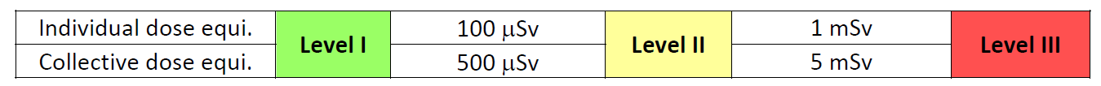
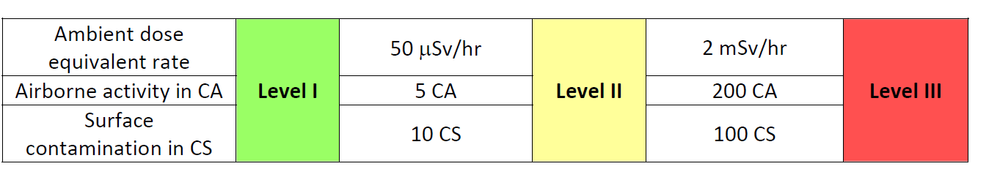
ALARA rule applied to interventions at CERN : ALARA Criteria and Levels
Optimization is a legal requirement if accumulated dose exceeds 100 μSv (ALARA)
Optimization includes different areas/aspects: work coordination, work procedures, handling tools, design, material choices,…
Reference: “ALARA Rule applied to interventions at CERN”, EDMS 1751123
Group 1 criteria define the ALARA level
Group 2 criteria are the bases of a radiological risk assessment (including accidents and incident scenarios) by the RSO and HSE-RP prior to the final ALARA level classification of the intervention.

Slide 10
ALARA rule applied to interventions at CERN : DIMR Workflow
ALARA Committee
Level |  | DIMR‐1 | DIMR‐2 | DIMR‐3
Owner |  | Applicant (i.e. equipment owner, work coordinator, contract or activity responsible)
Preparation (iterative) | WDP template | Optional Applicant (or RSSO) | Mandatory Applicant (or RSSO) | Mandatory Applicant (or RSSO, RSO)
 | Provides dose rates | RP | RP | RP
 | Sets DIMR level | RP and RSSO | RP and RSSO (or RSO) | RP and RSO
 | Documented work optimization process | Optional RSSO | Mandatory RP and RSSO | Mandatory Applicant and RSSO, RP and RSO
Inform PCR (if applicable) |  | on request | Yes | Yes
Approval |  | RSSO and RP | Dept. GL and RP and RSO | Complex manager (ALARA‐c)
 | Veto rights | RP Group leader | Leader of the HSE unit | Director General
Follow up | Feedback | Optional RSSO | Mandatory RP and RSSO | Mandatory RSO and RP and intervention supervisor
 | Closure of WDP | Optional: RSSO | Mandatory: RP | Mandatory: RP
 | Closure of intervention (DIMR) | RSSO | RSO | ALARA‐committee responsible
Controls |  | Optional RSSO | Mandatory RSSO | Mandatory RP and RSO
ACRONYMS :
DIMR: Dossier d’Intervention en Milieu Radioactif (English: RWP)
IMPACT: Intervention Management Planning & Activity Coordination Tool
PCR: Personnes compétentes en radioprotection
RP: Radiation Protection
RPE: Radiation Protection Expert
RPO: Radiation Protection Officer
RSO: Radiation Safety Officer
RSSO: Radiation Safety Support Officer
RWP: Radiological Work Permit (French: DIMR)
WDP: Work and Dose Planning

Slide 11
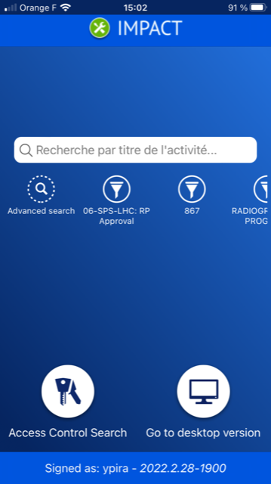
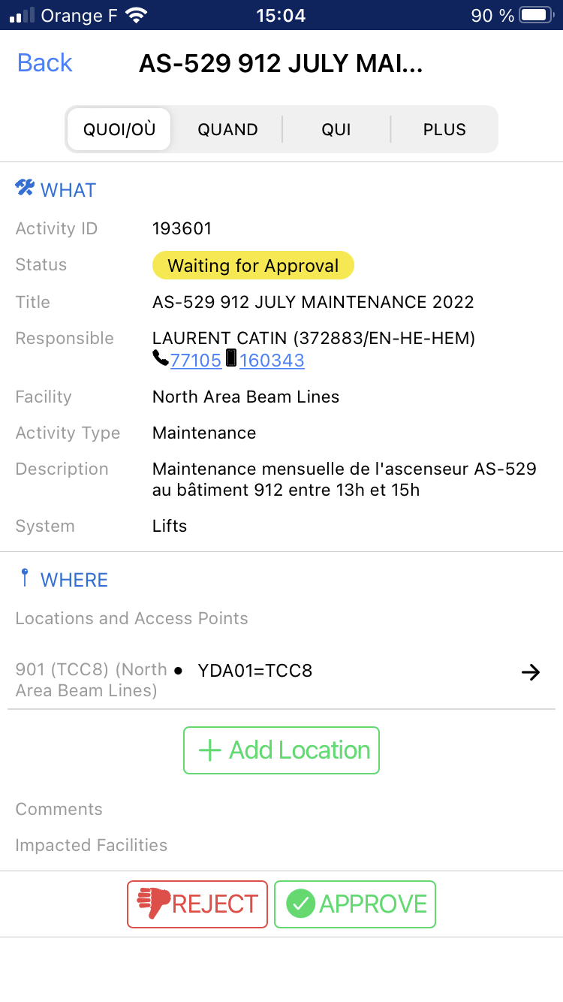
The IMPACT tool (Intervention Management Planning & Activity Coordination Tool)
IMPACT is a web-based tool:
  That must be used to declare and approve the work activities with the concerned coordination team and officer (Building safety officer, RP officer,…)
  That can be used to prepare works and link all the safety related aspects in it (Work procedures, modus operandi, common safety visits, Fire Permits, DIMRs, …)
  That can be used to build the history of activities performed in a facility or building
DIMR: Dossier d’Intervention en Milieu Radioactif (English: RWP)

Slide 12
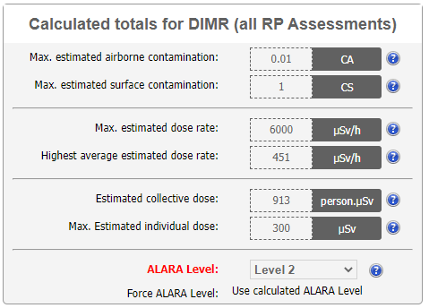
The IMPACT tool (Intervention Management Planning & Activity Coordination Tool)
Along with the activity declaration form, two other forms related to radiation protection exists:
WDP
  Stands for Work and Dose Planning
  Allows the activity responsible, with the help of other stakeholders, to carry out dosimetric estimates for one or more activities
DIMR
  Stands for Dossier d’Intervention en Milieu Radioactif (English: RWP = Radiological Work Permit )
  Consists of a dosimetric evaluation (= linked with corresponding WDP) and other radiation risk assessment of each activity subject to an individual radiological risk analysis
  Formalizes the final ALARA level of the concerned activity (1, 2, 3)

Slide 13
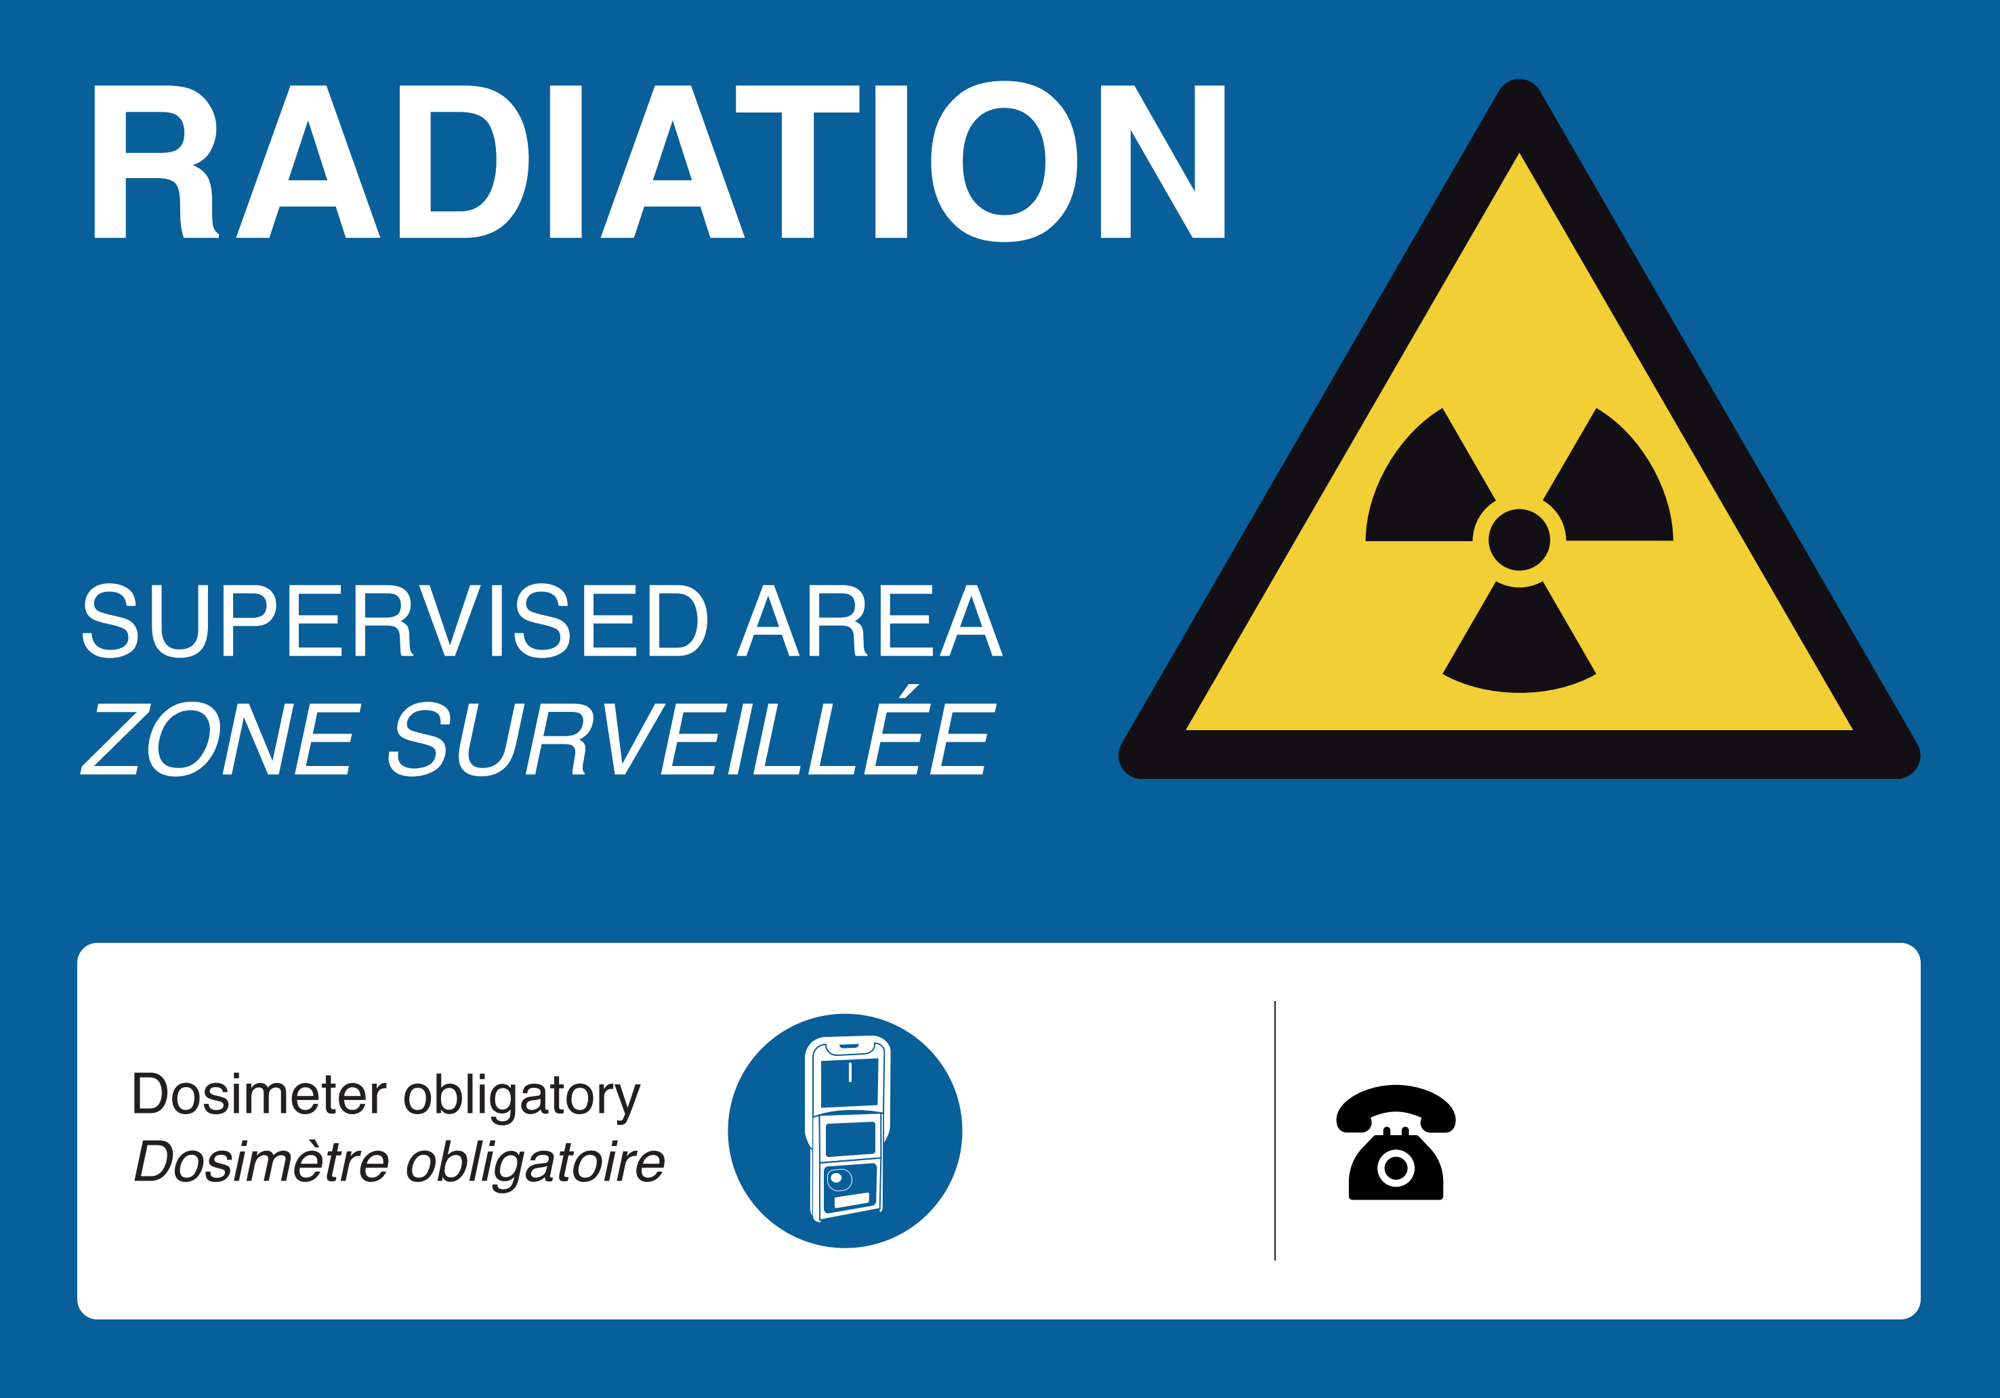
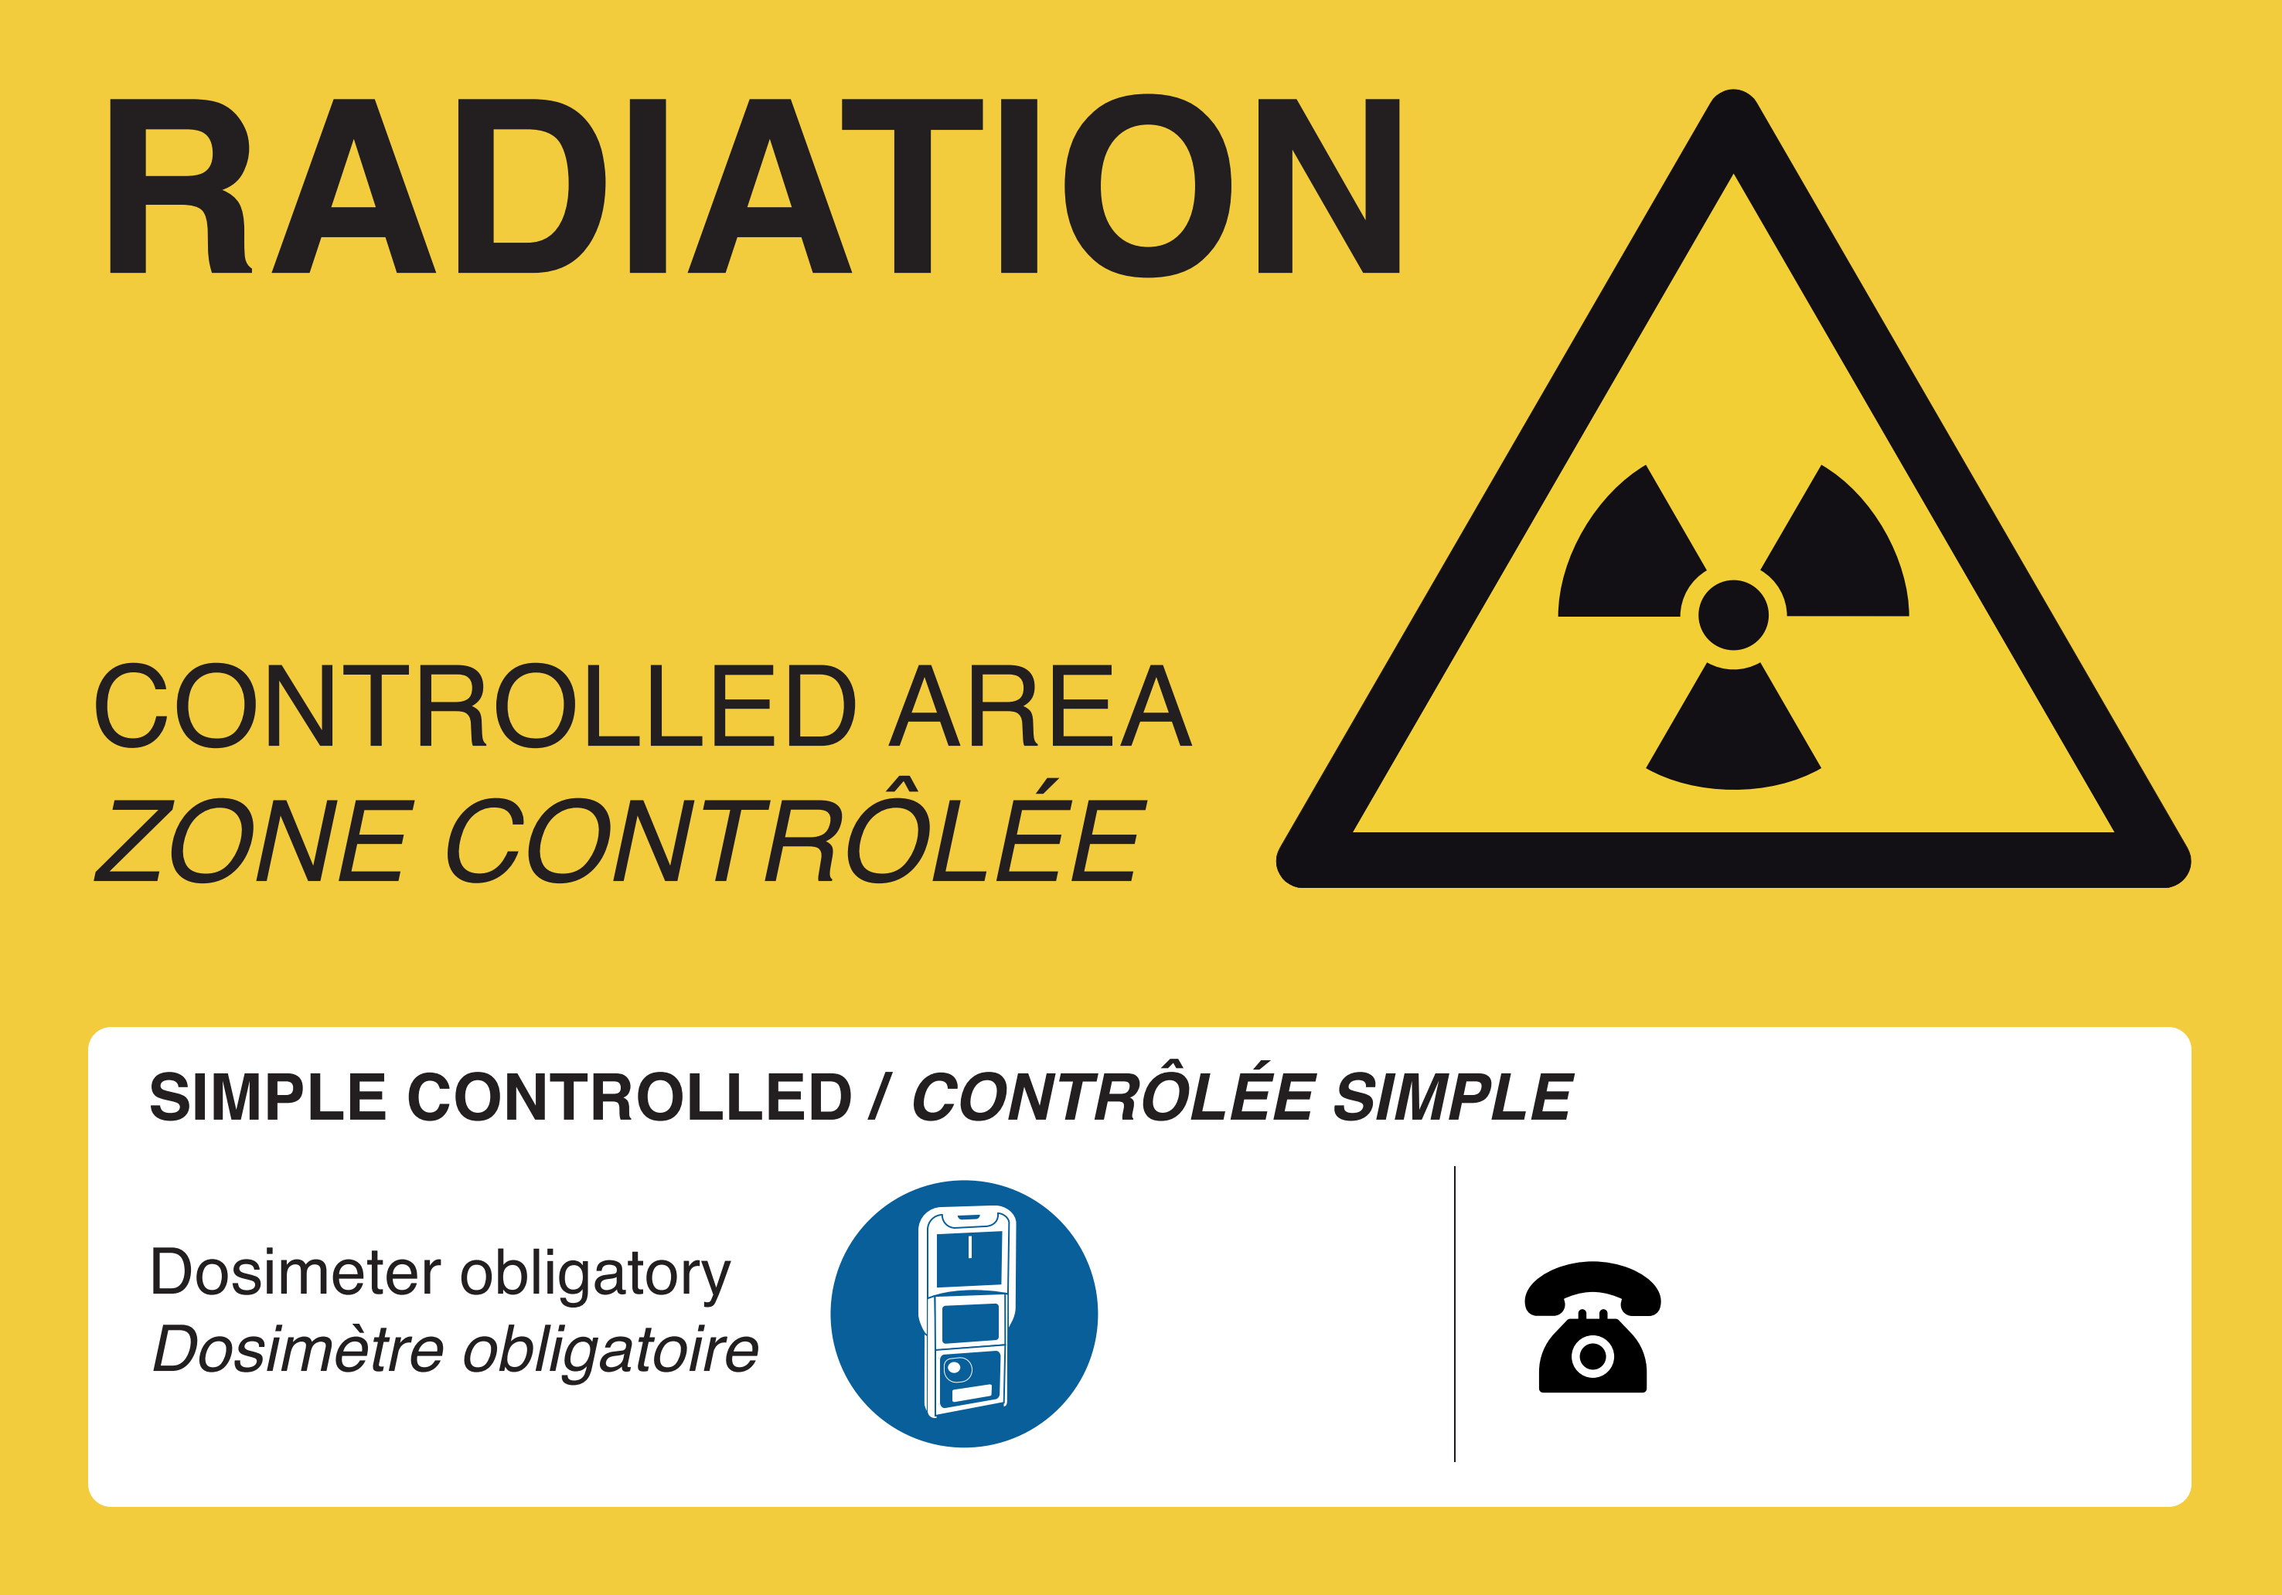
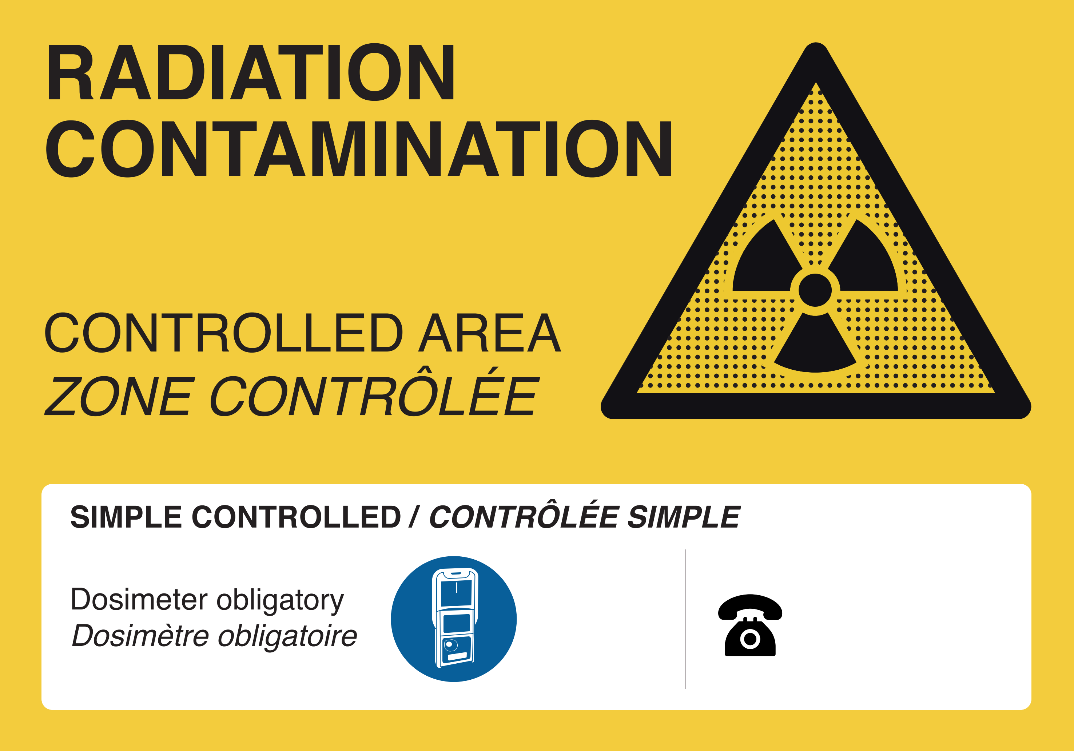
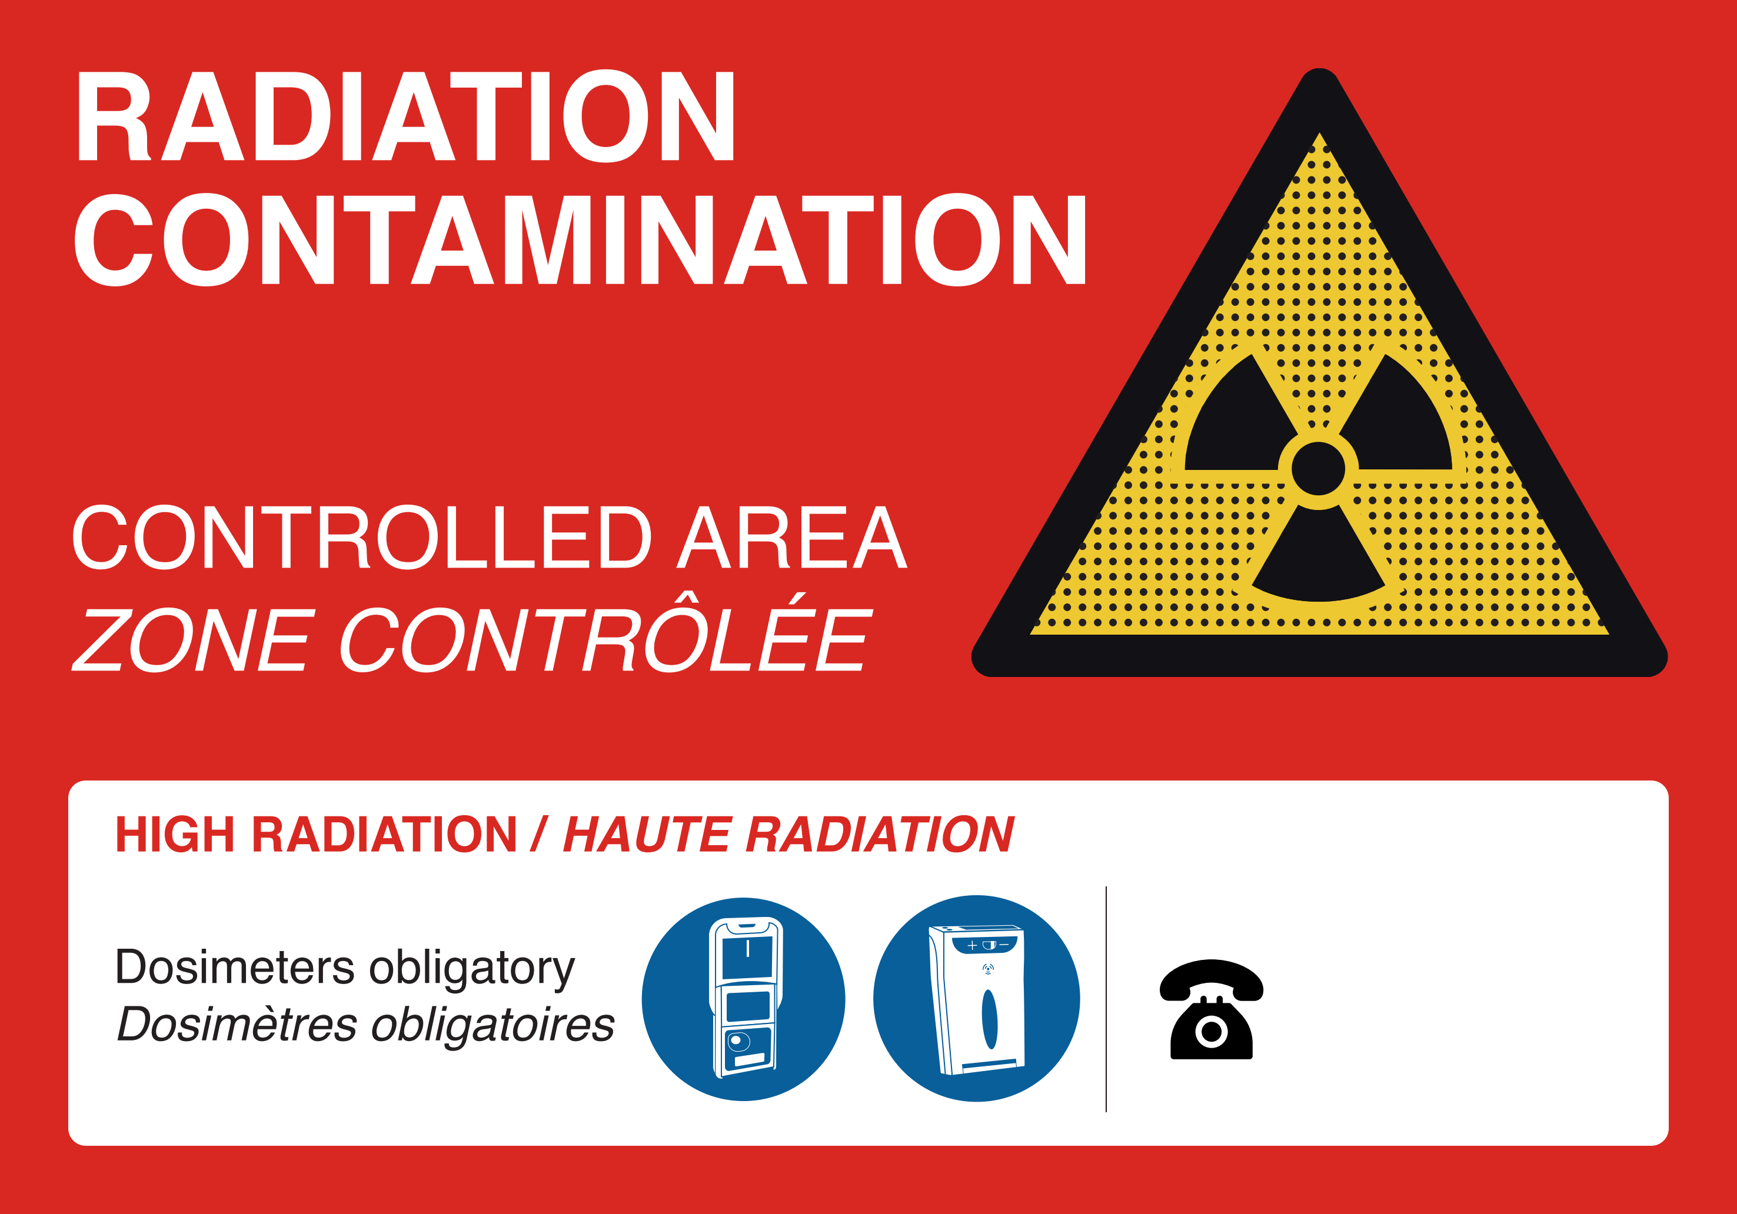
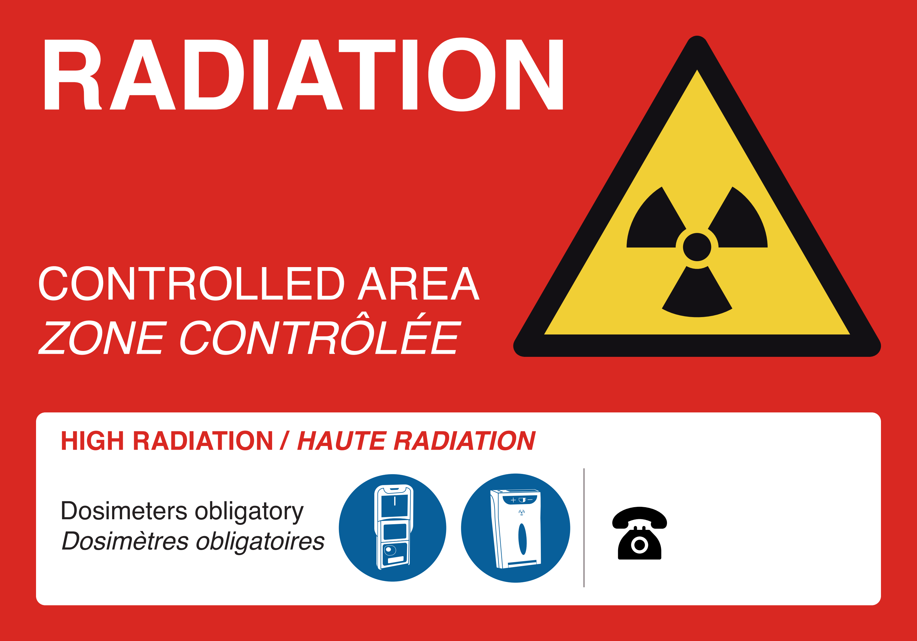
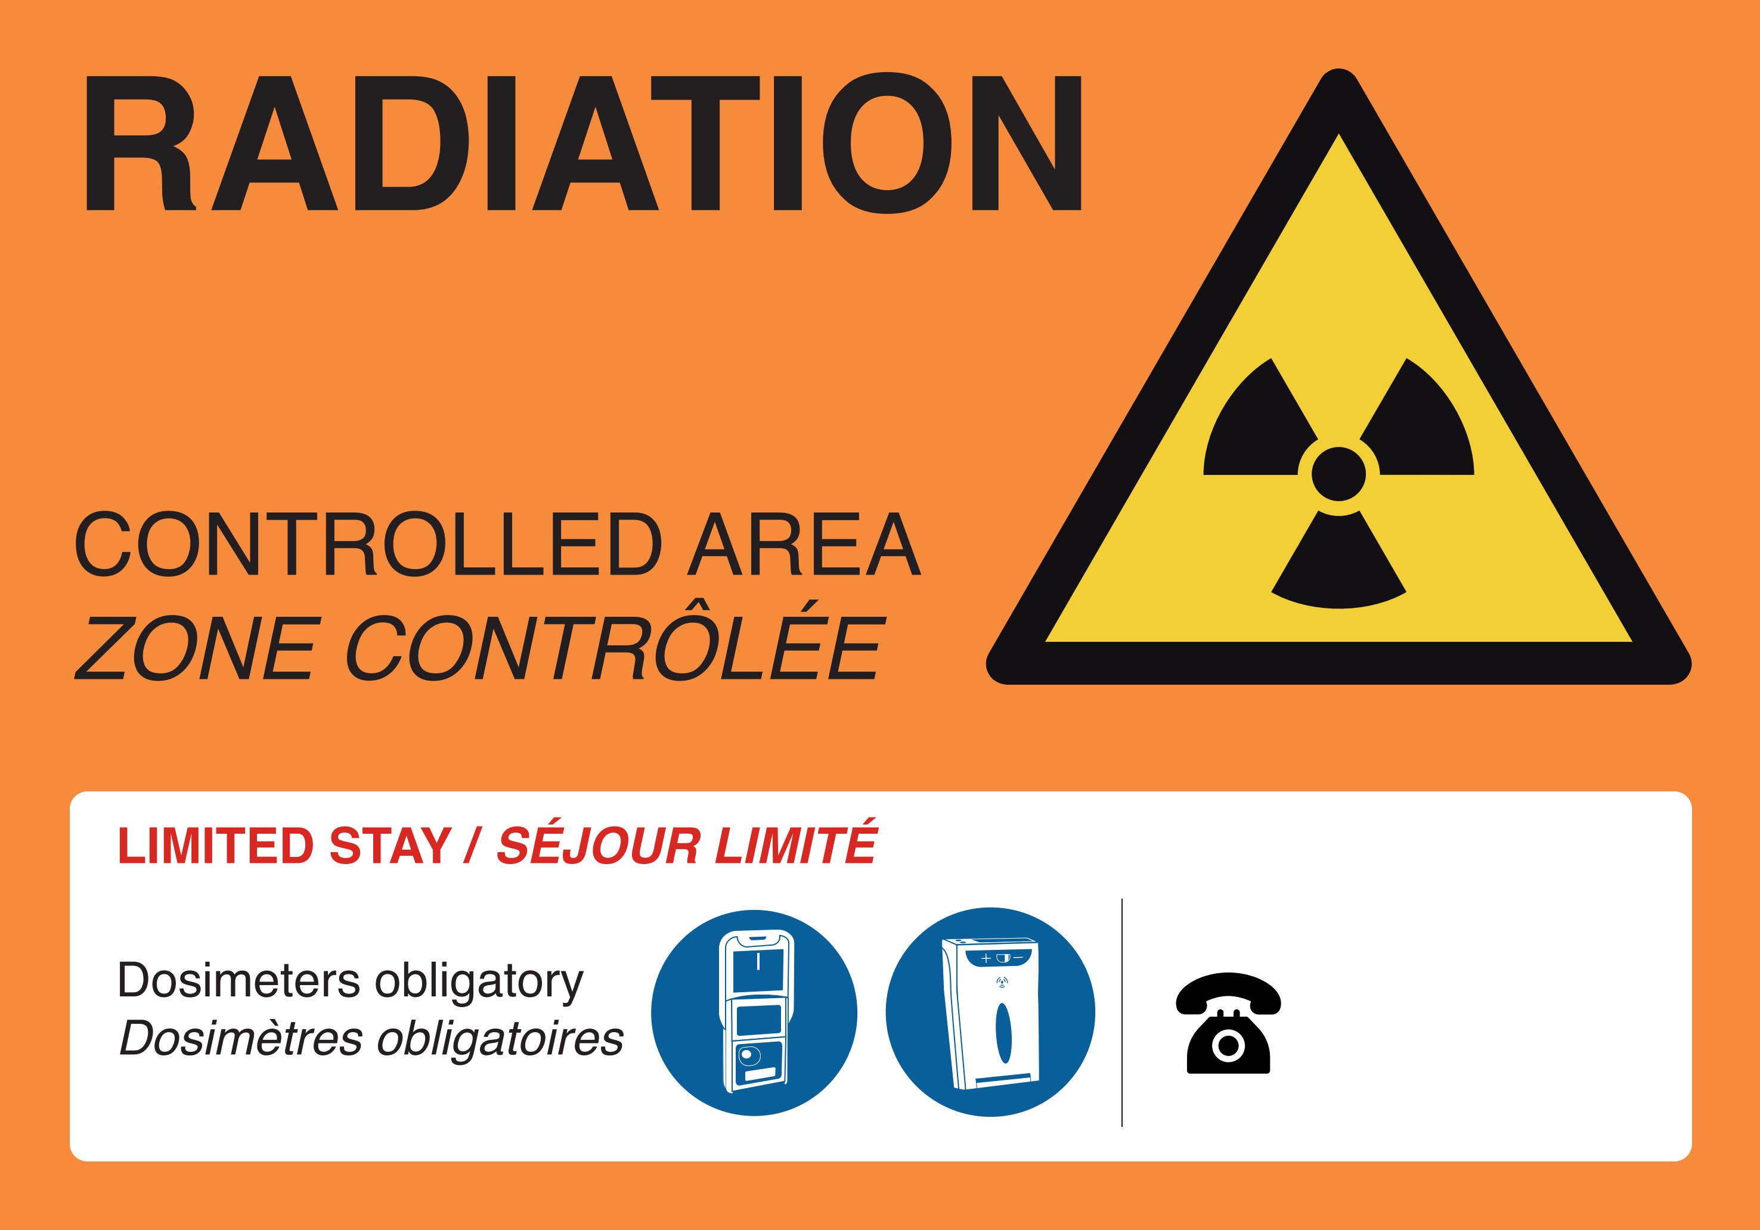
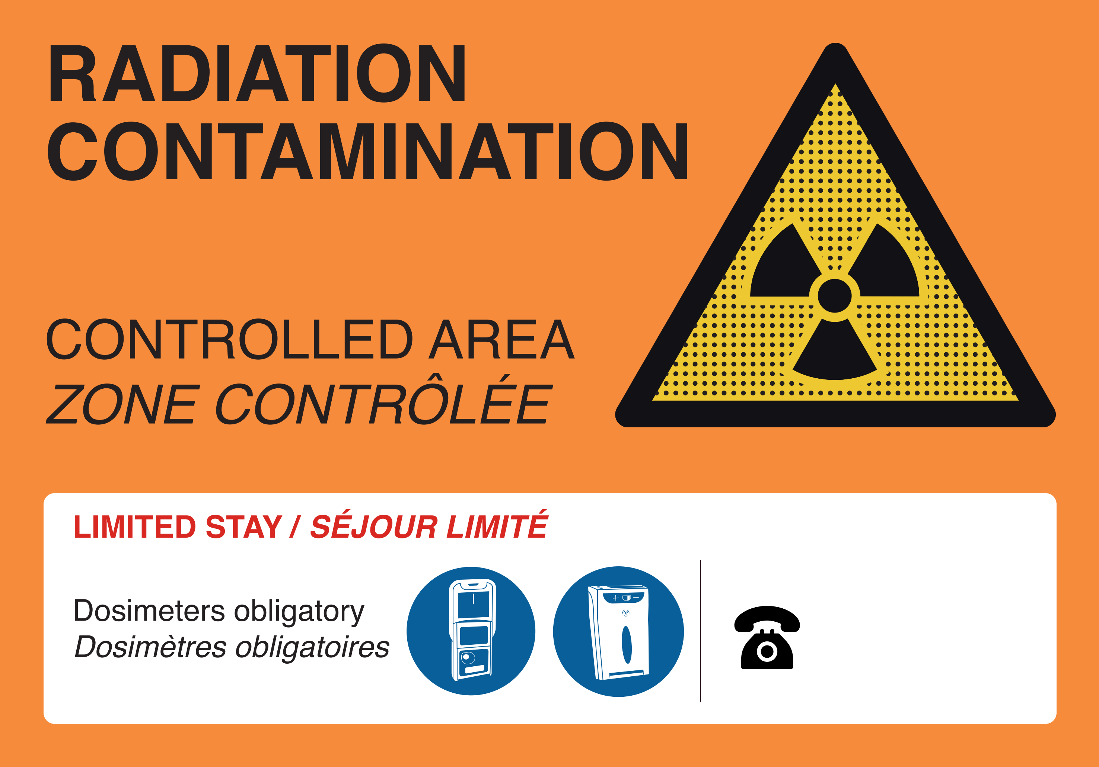
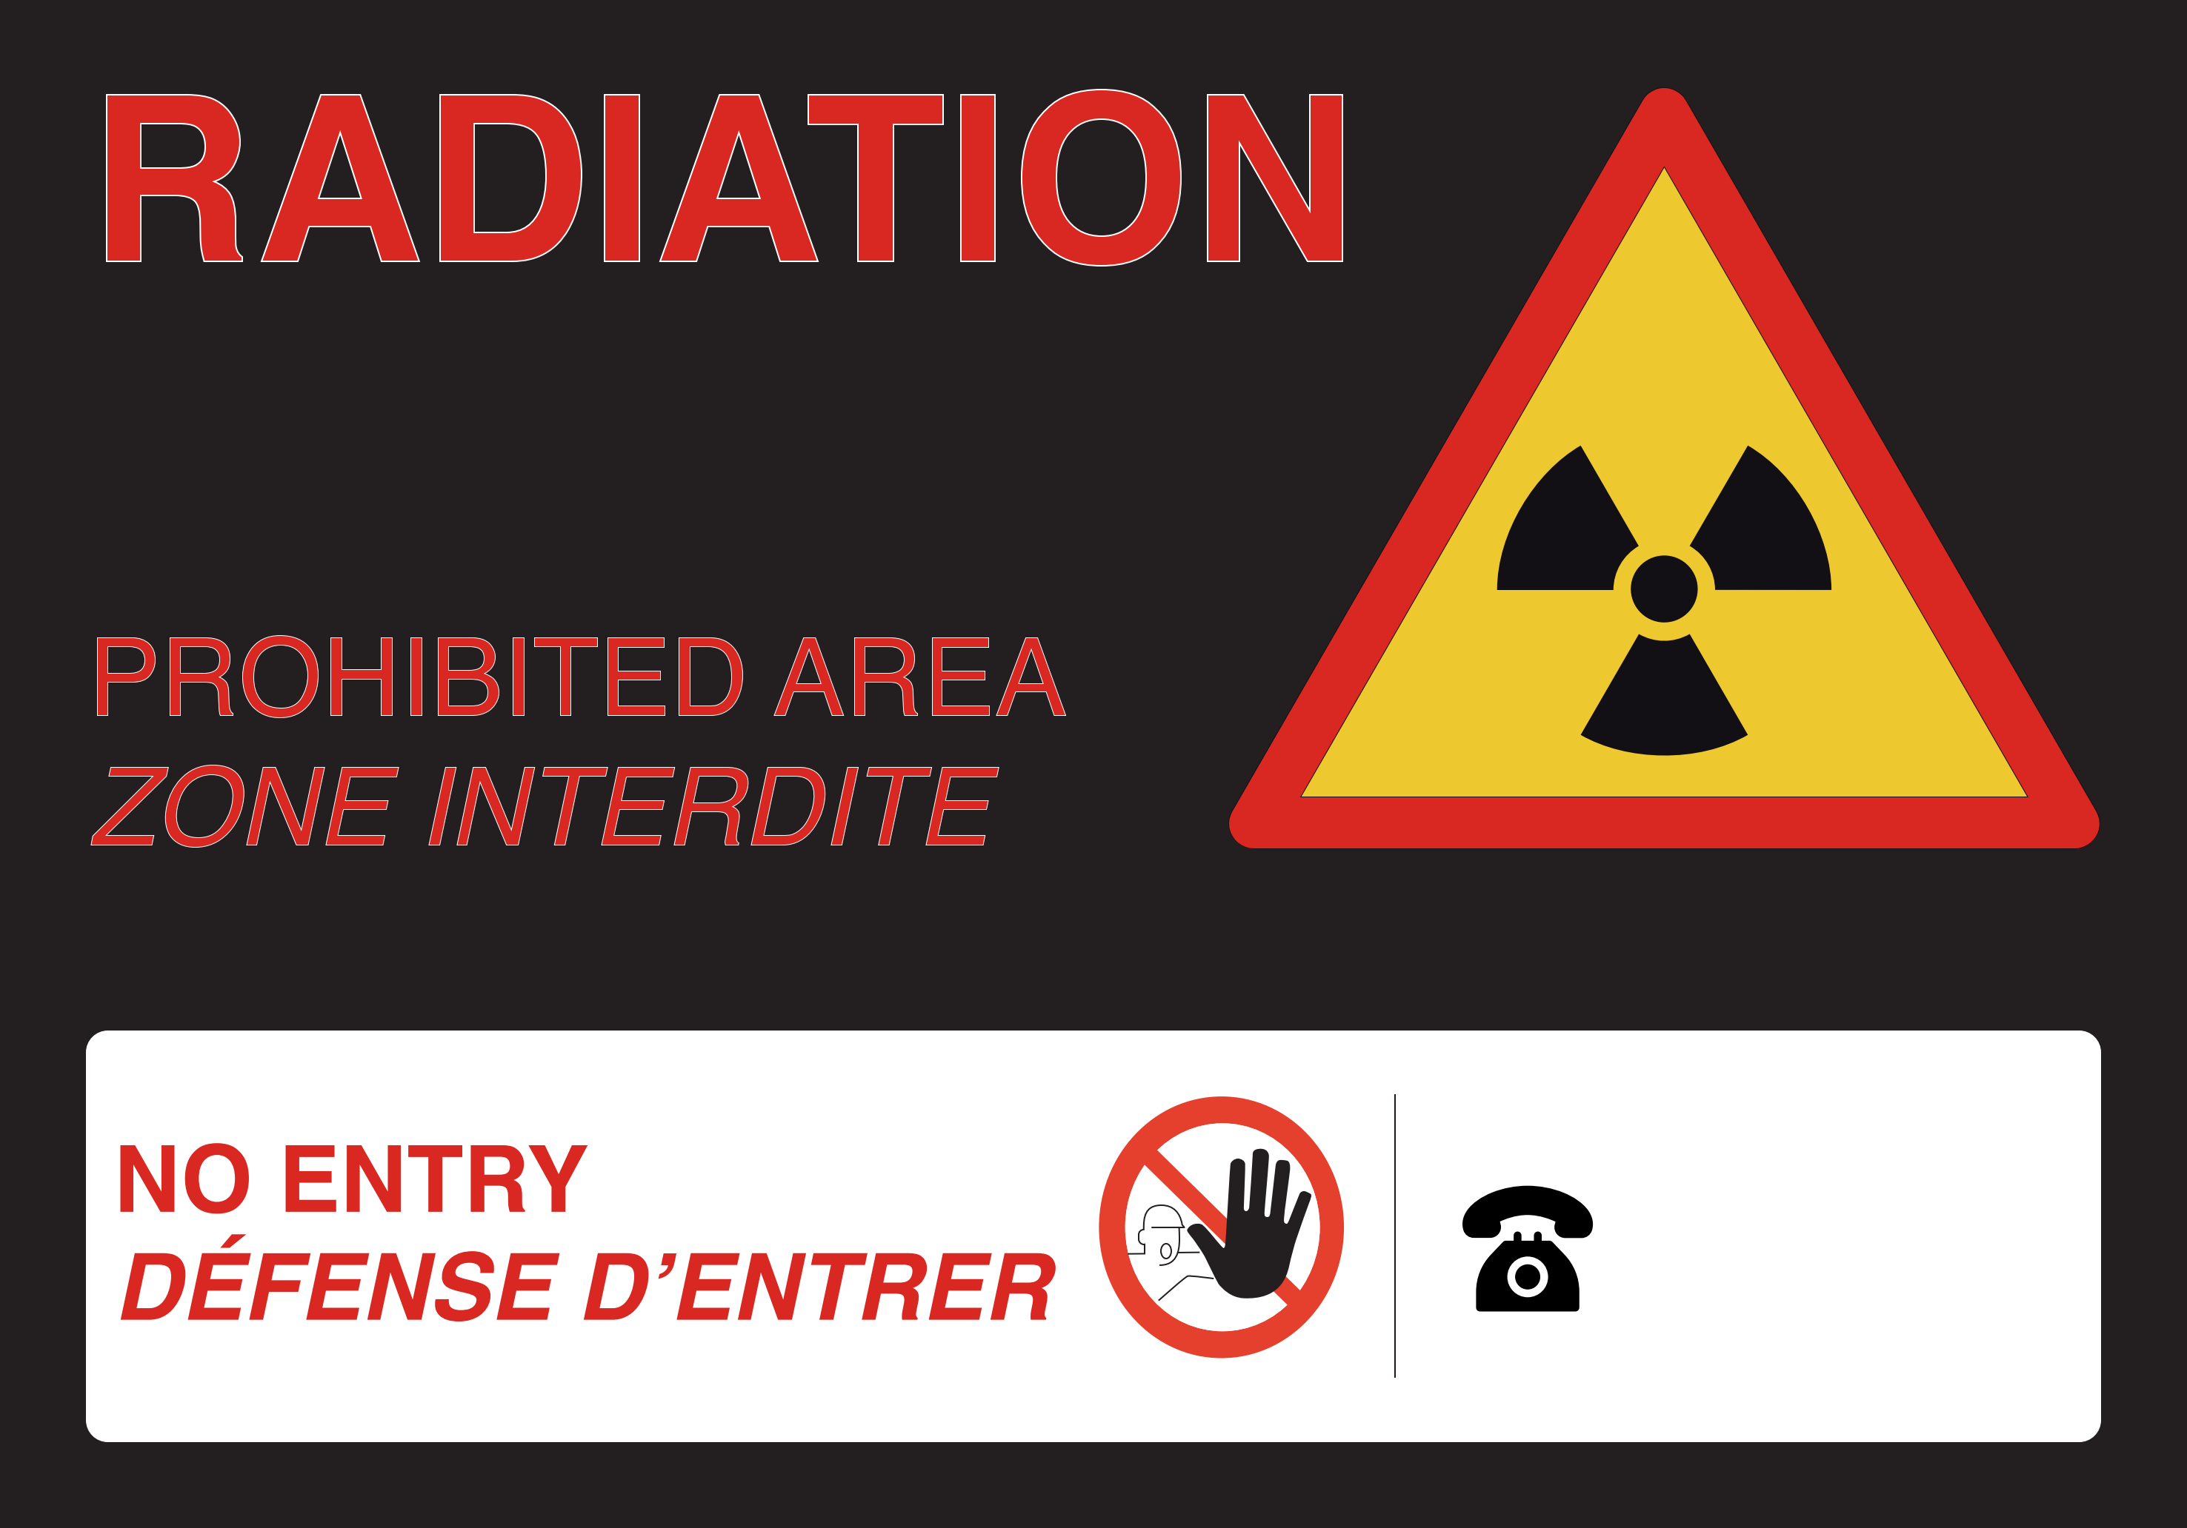
CERN area classification
CERN’s radiation areas are divided between:
Supervised Areas
Controlled Areas
  Simple
  Limited Stay
  High Radiation
  Prohibited

Slide 14
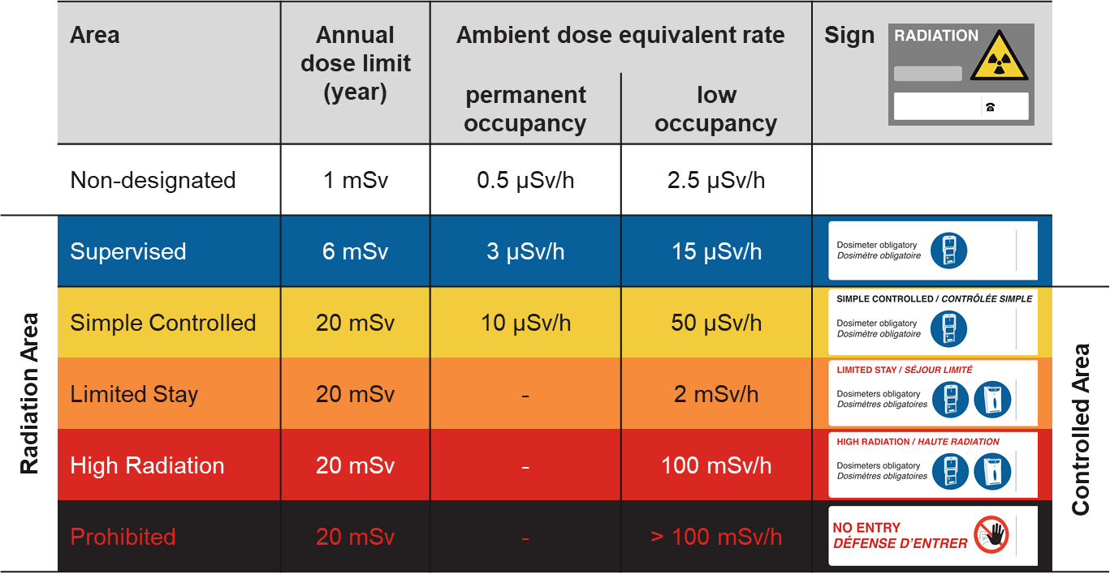
CERN area classification
Operational Dosimetry mandatory

Slide 15
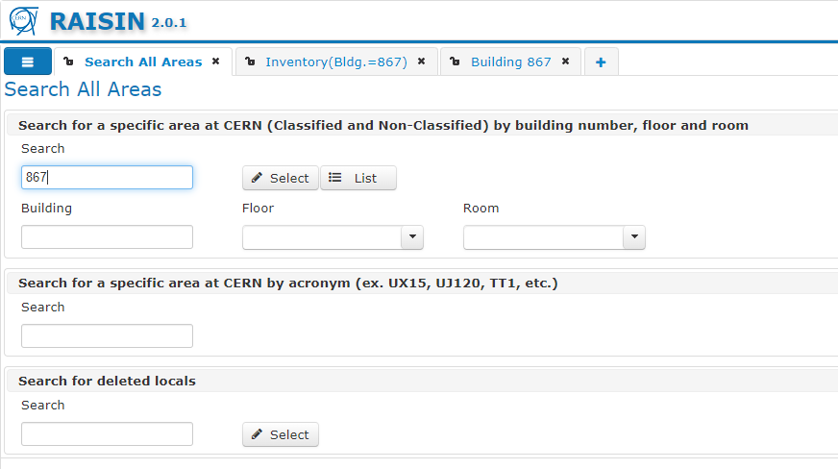
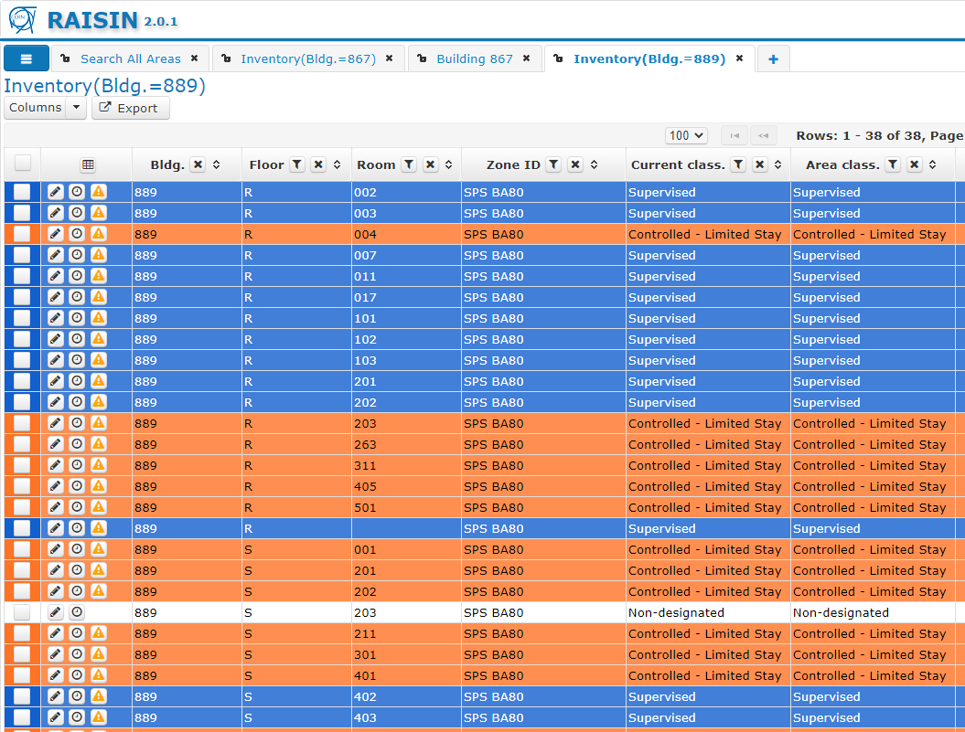
CERN area classification : the RAISIN database (RAdiological rISk areas INventory)

Slide 16
CERN area classification : How the area classification and other RP parameters drives the IMPACT workflow
Type of activity (e.g. radiography or guided visit in controlled areas)
Access point linked to RP approval
RAISIN start-of-work flag set to yes
DIMR parameters are set such that:
  The activity includes contaminating works
  The total collective working time is above 500 person·h and works are located in controlled areas
  The individual collective working time is above 100 h and works are located in controlled areas
  Presence of short-term workers is declared and works are located in controlled areas

Slide 17
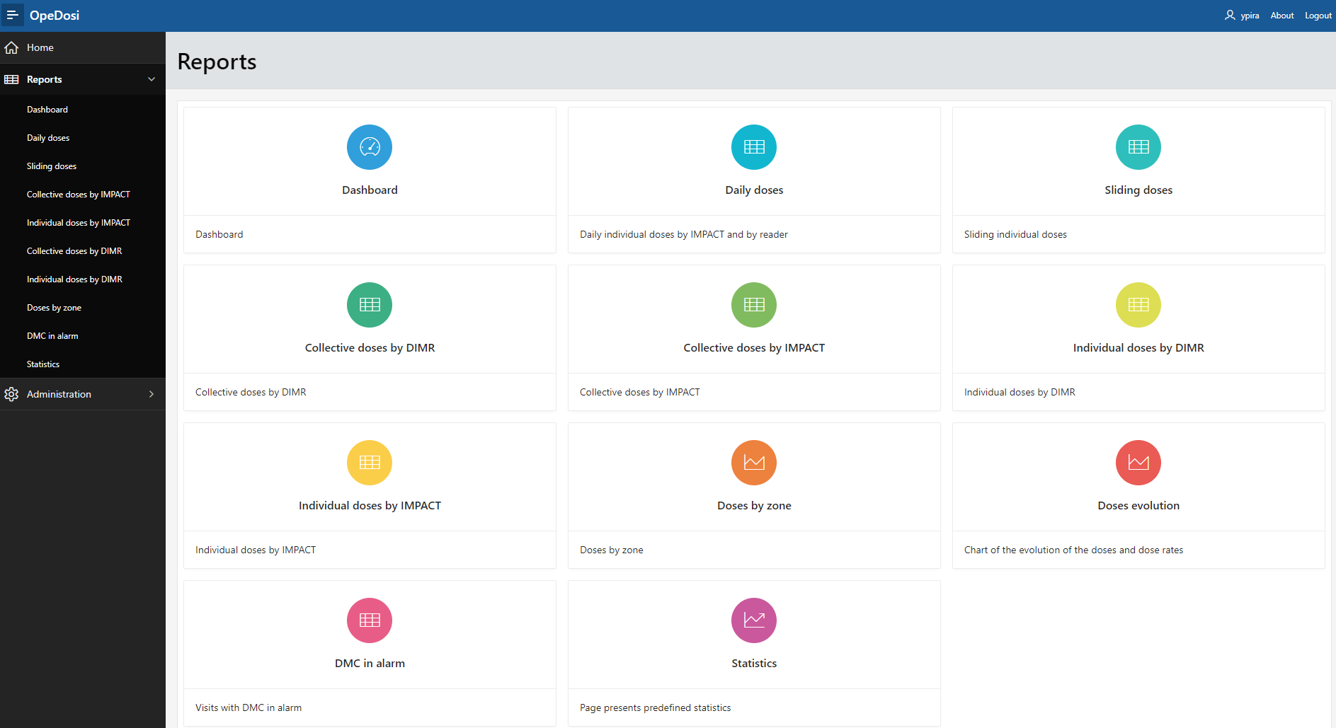
CERN Operational dosimetry system and computing tools
Based on the system provided by Mirion Technologies
All data is kept internally, in CERN’s Oracle Databases
Modified to fulfil CERN’s requirements
Dedicated website based on Oracle APEX, to perform dosimetric follow-up
Link between Operational Dosimetry system and IMPACT web-tool
OpeDosi website

Slide 18
Link between the operational dosimetry and IMPACT
IMPACT and the operational dosimetry system are synchronised every 6 minutes
New workers
New activities
Statuses of activities
Dose estimates in IMPACT are allowing to set dose limits in dosimeters
Allows parametrisation of dose limits and dose rate limits
When thresholds are exceeded, the worker cannot work on this activity anymore
If the worker gets to the yearly dose limit, he is not allowed to turn on operational dosimeter anymore

Slide 19
Follow-up of interventions
Internal Radiation Protection website allow the Radiation Protection Officers to perform dosimetric follow-up of interventions
IMPACT provides a “dose reporting tool” so that stakeholders could get informed about the intervention dosimetric situation
Dose visibility depends on users status
Department Heads / Group Leaders / Radiation Safety Officers / Radiation Support Safety Officers / Radiation Protection Experts have dedicated visibility
Blocking mechanisms ensures that estimates are respected

Slide 20
Follow-up of interventions

