Slide 1
Incident Management Procedure at CERN
PIVIDORI Carine
05-07-2022
EDMS 2753314

Slide 2
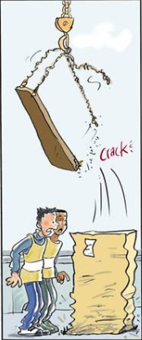
Incident Management Procedure at CERN
Serious or Major Injury
1
Minor Injury
10
Property Damage Accident
30
Near-miss
600
For © cf. http://www.seahealth.dk
Actions must be taken at this level
Near-misses are warnings

Slide 3
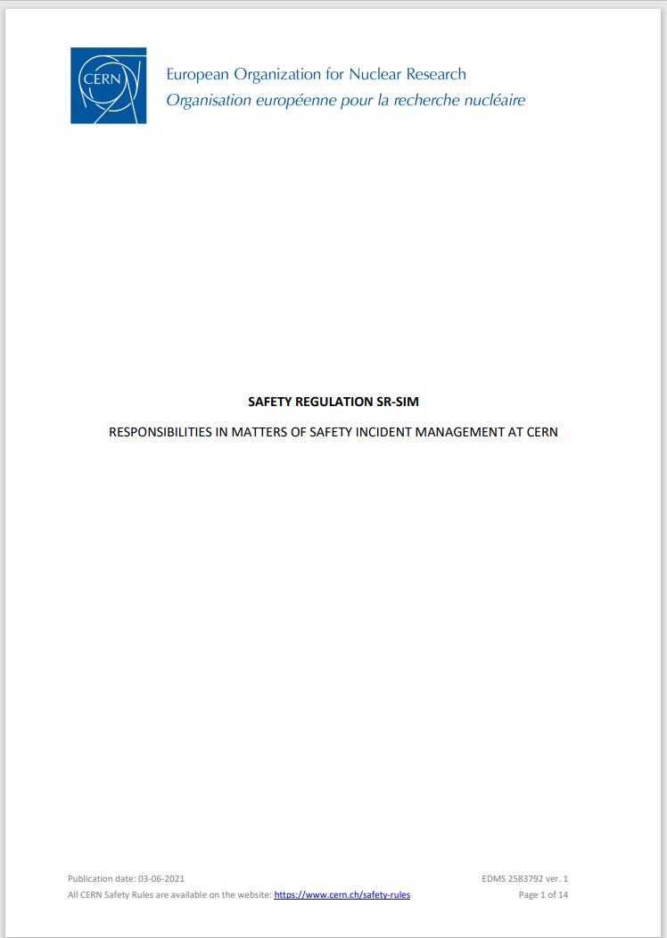
Incident Management Procedure at CERN
Safety Regulation SR-SIM “Responsibilities in matters of safety incident management at CERN”
Safety Incident: an unintended event or situation that has non-negligible, negative consequences or potential consequences from the point of view of Safety. The term Safety Incident covers Radiological Events, Deviations, Unsafe Situations, Near Misses
and Accidents, including Commuting Accidents.
Any safety Incident shall:
promptly be notified to the appropriate CERN services if immediate action is required, in particular the FRS +41 22 744 44
be reported

Slide 4
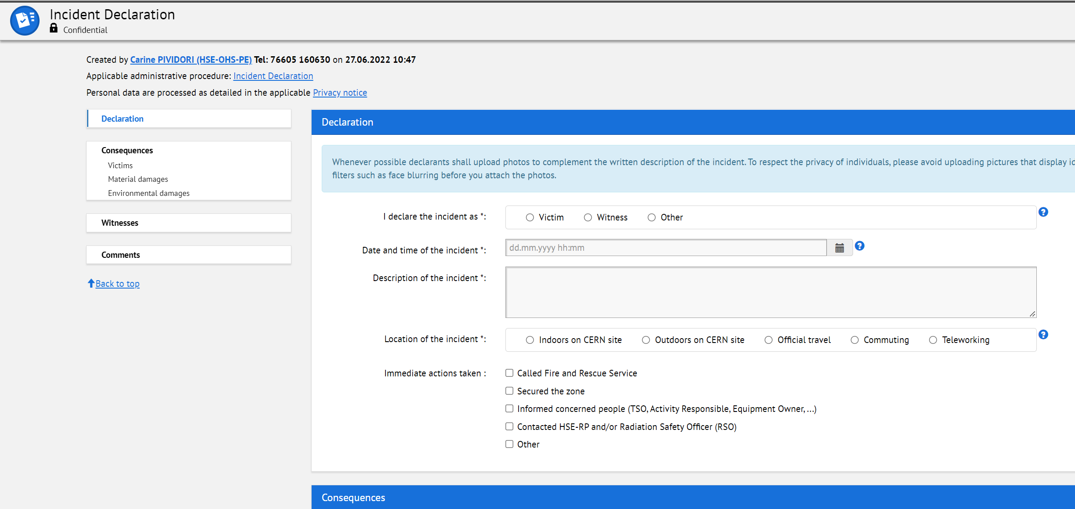
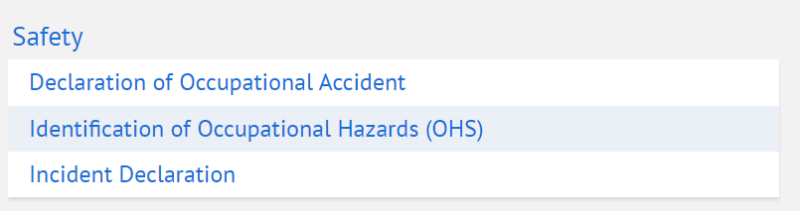

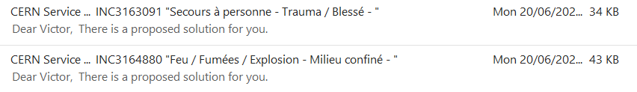
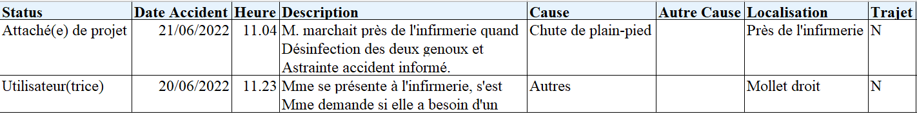
Reporting of safety incidents at CERN
Incident declaration form
Electronic form for the application of the SR-SIM – available for all persons with a CERN account
Call-out reports (Fire and Rescue & Medical Services

Slide 5
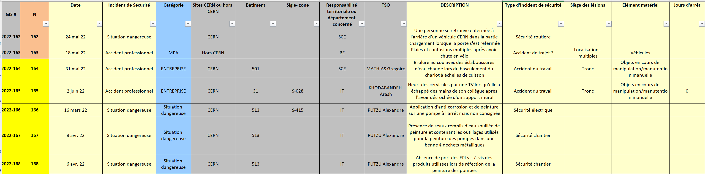
Reporting of safety incidents at CERN
Compilation of the safety incidents by the HSE Safety Incident Service in a spreadsheet
Distributed:
  - Weekly within Departments & Large Experiments (DSO / LEXGLIMOS) for action
  - Monthly to TSOs & EROs for information

Slide 6
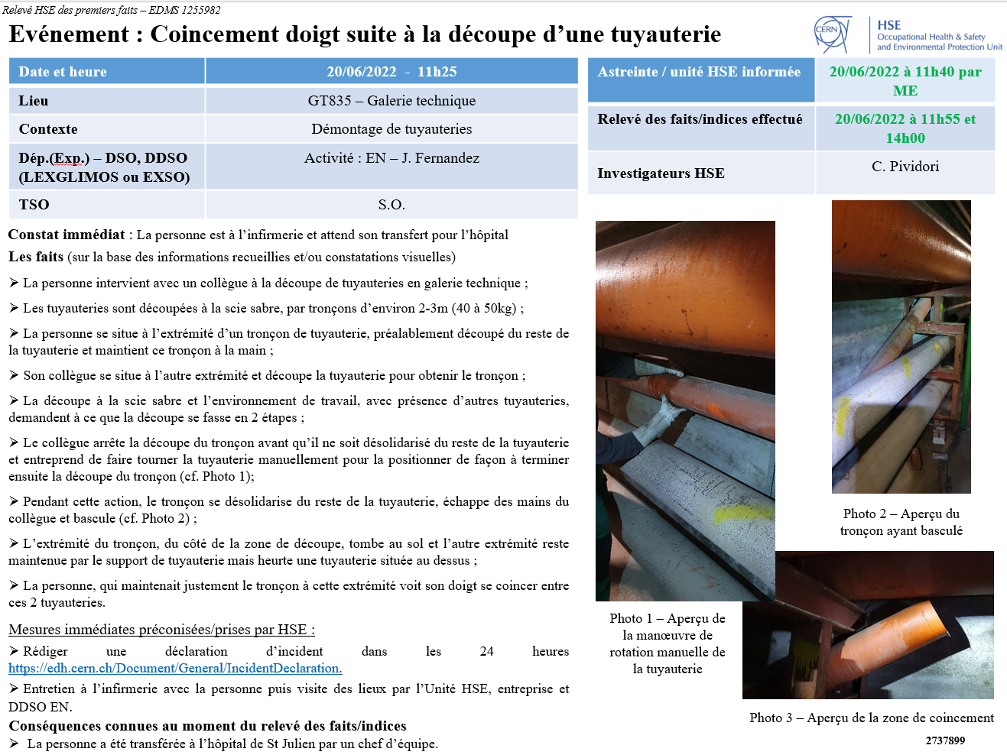
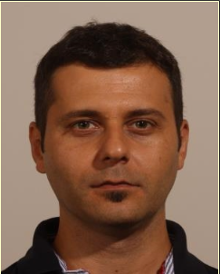
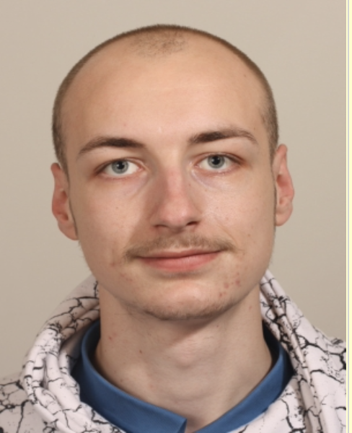
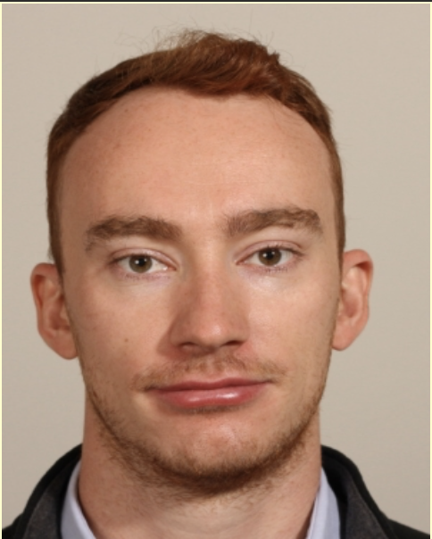
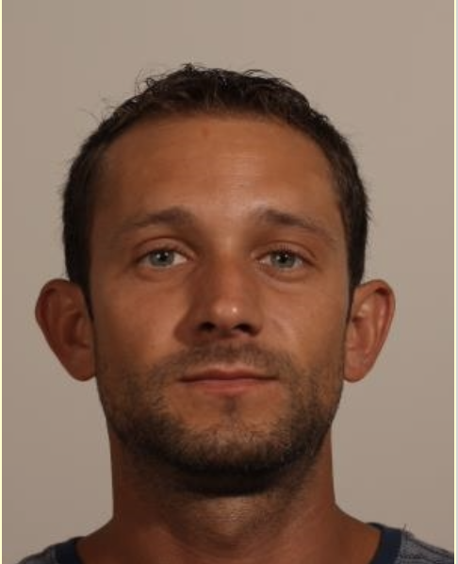
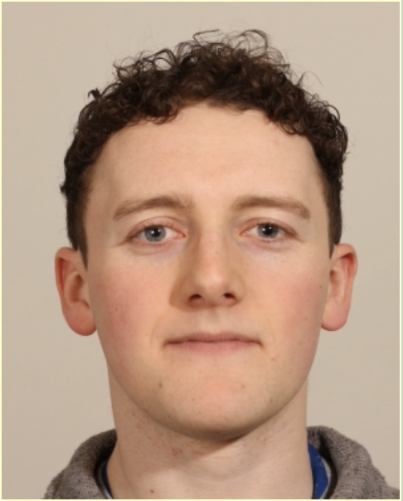

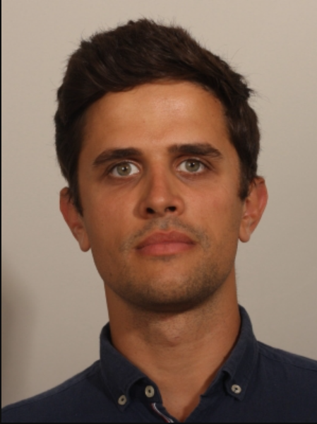

Analysis safety incidents at CERN
HSE On-Call accident service
Marco Andreini
Ludovic Dubois
Joshua Hope
Mathieu Lemetayer
James Loughlin
Igor Neuhold
Darko Perovic
Carine Pividori

Slide 7
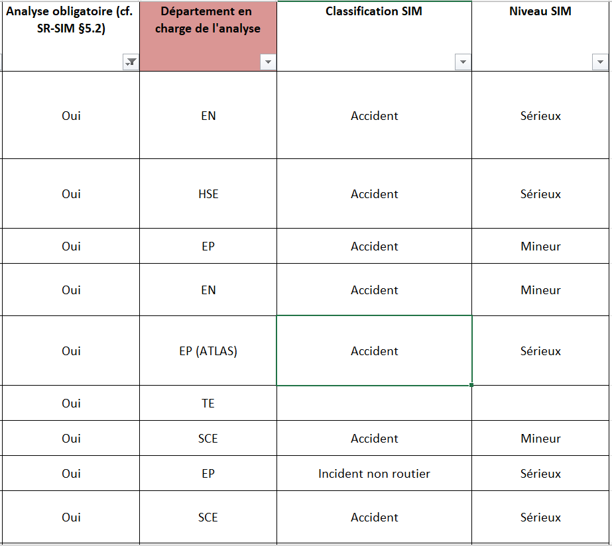
Analysis safety incidents at CERN
The analysis of a safety incident is the responsibility of the DSO in the Departments or the LEXGLIMOS in the Large Experiments
The safety regulation SR-SIM defines that incidents shall give rise to a more or less in-depth analysis, according to the level of classification of the incident concerned (Minor, Serious, Major).

Slide 8
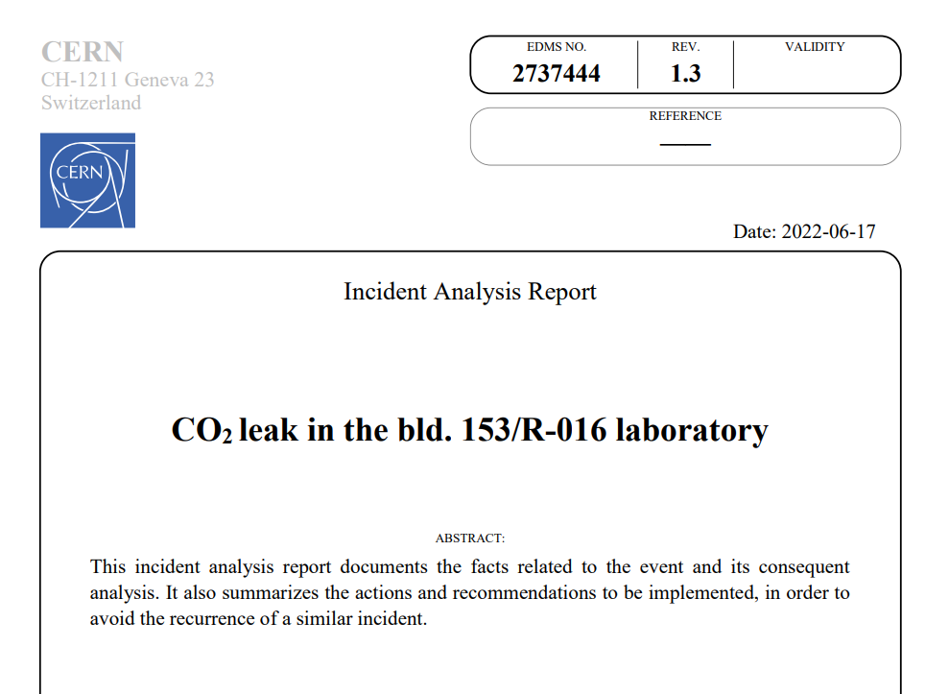
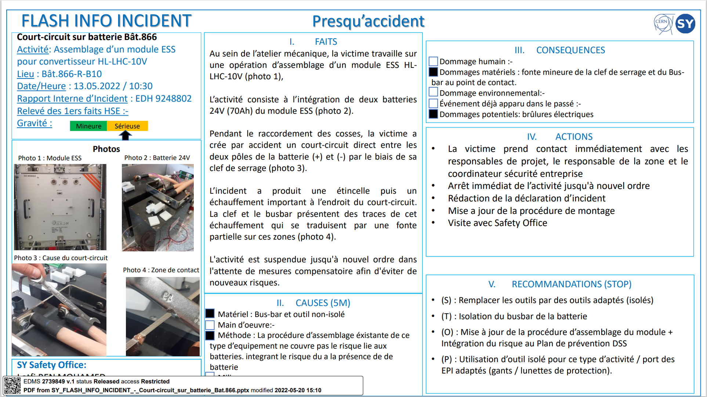
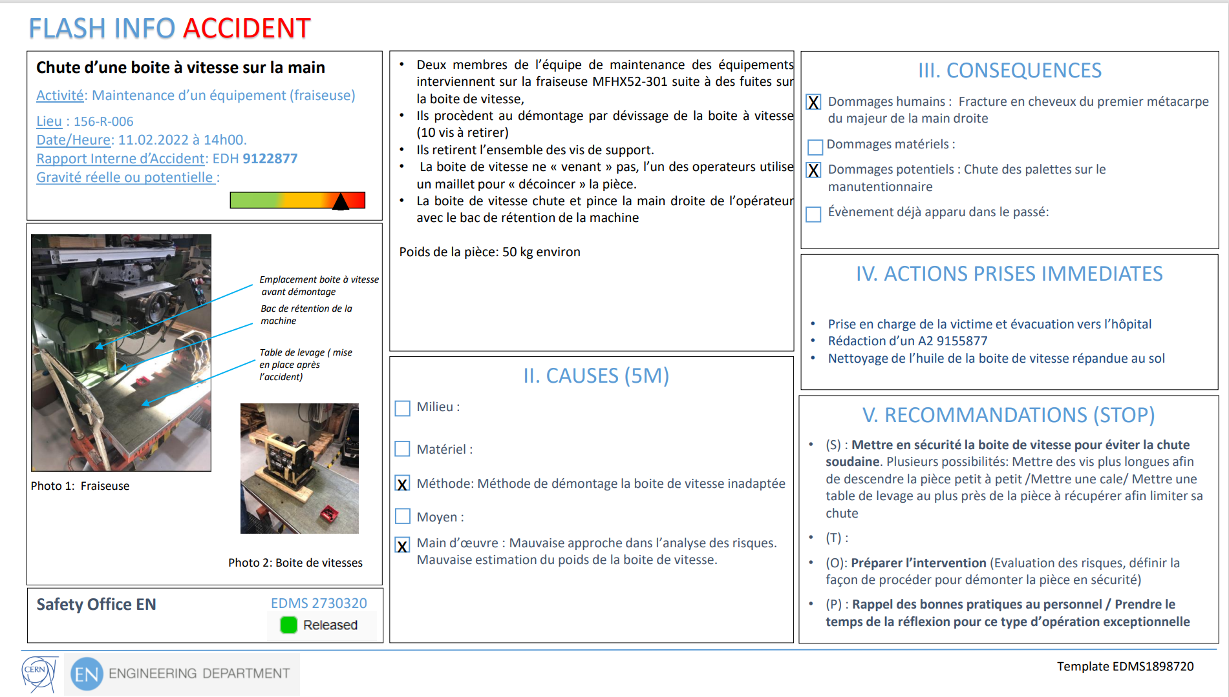
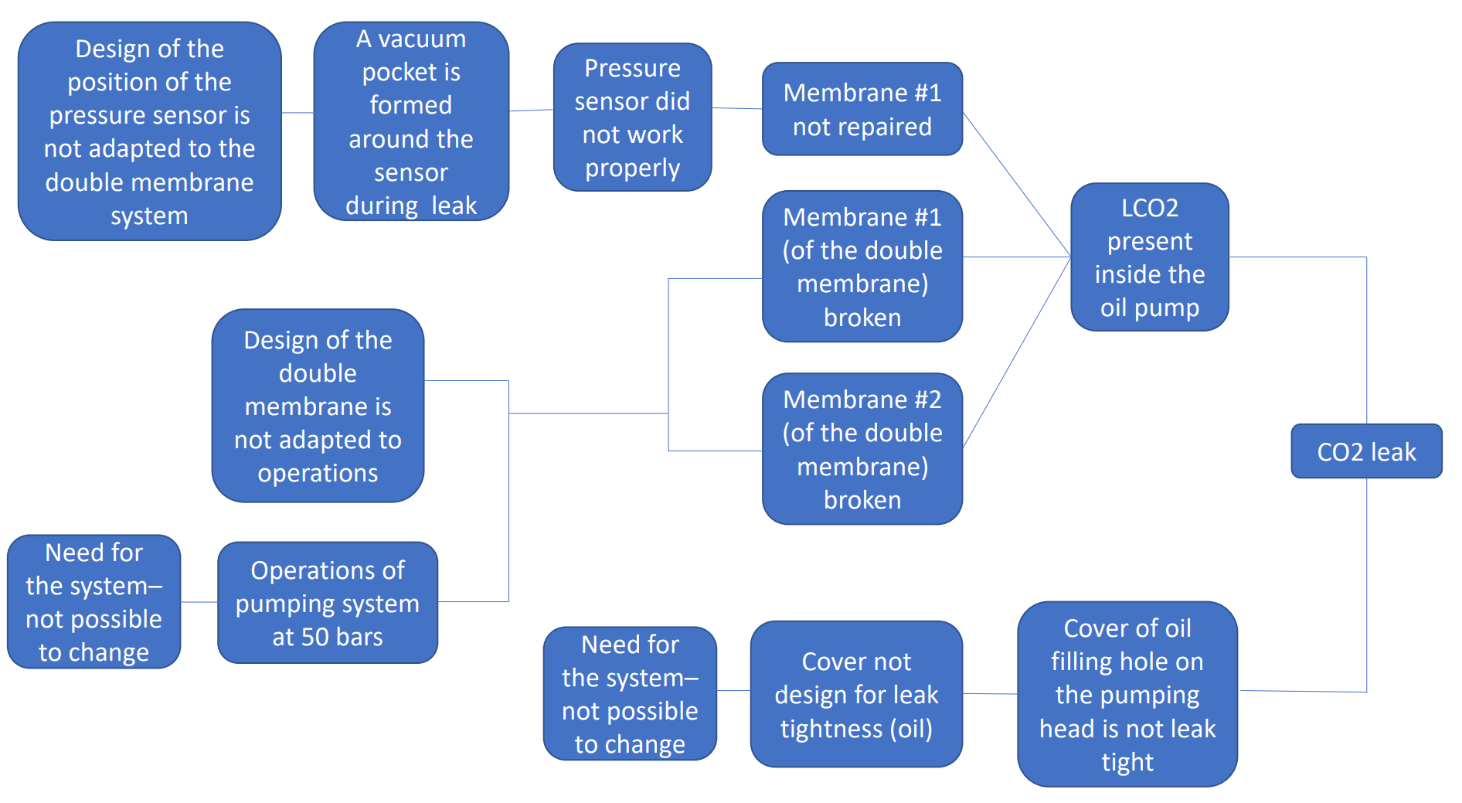
Analysis safety incidents at CERN
The competent DSO or LEXGLIMOS records in writing the analysis
3
1
2

Slide 9
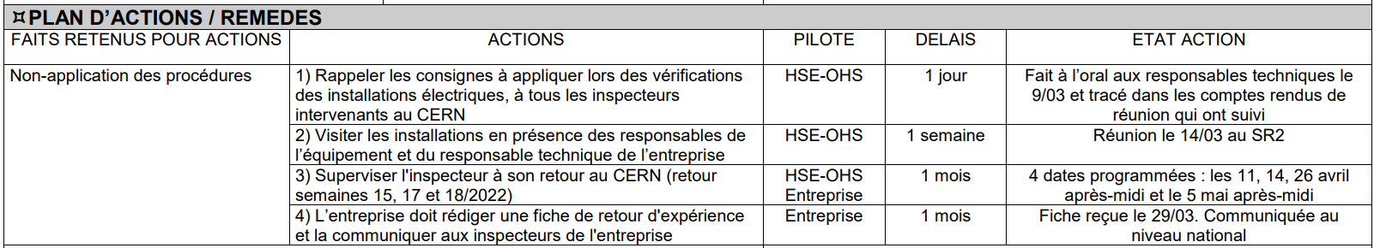
Analysis safety incidents at CERN
The action plan to be followed is defined in concertation with the people in charge of its implementation

Slide 10
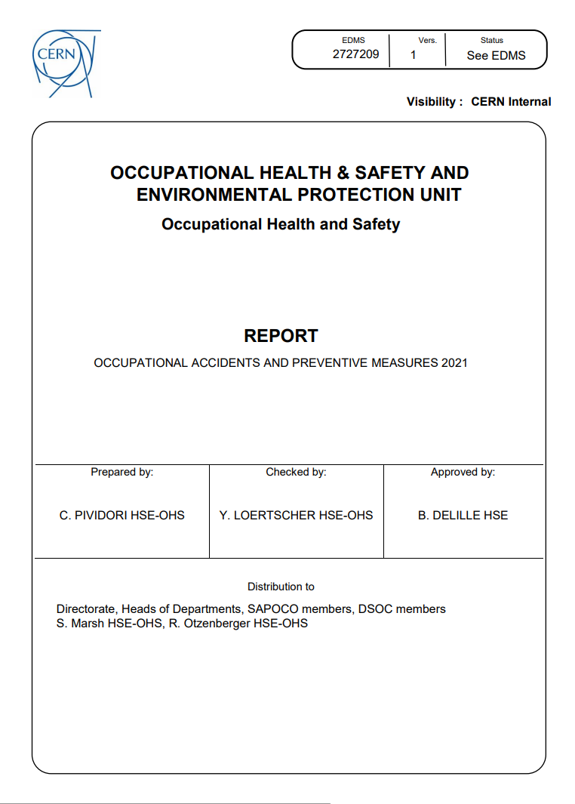
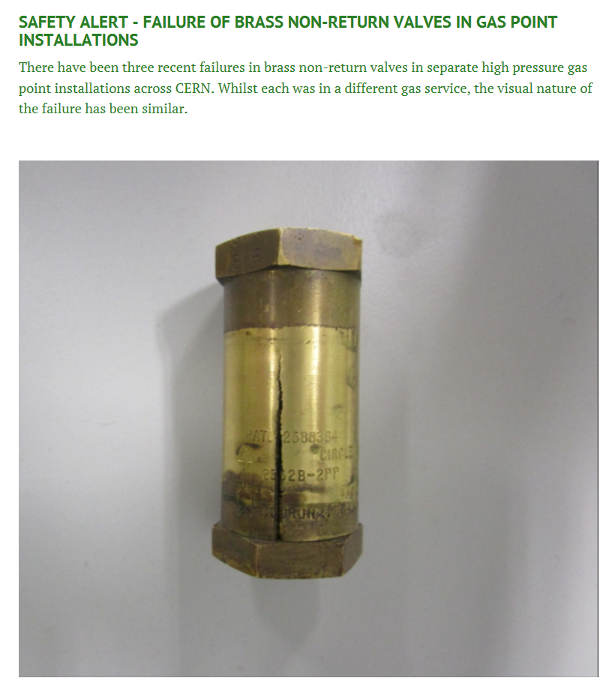
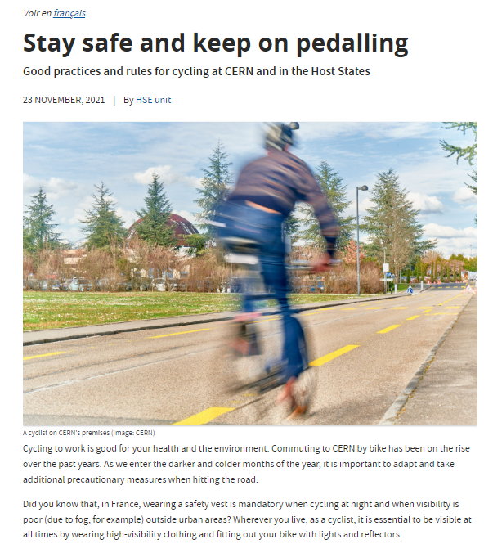
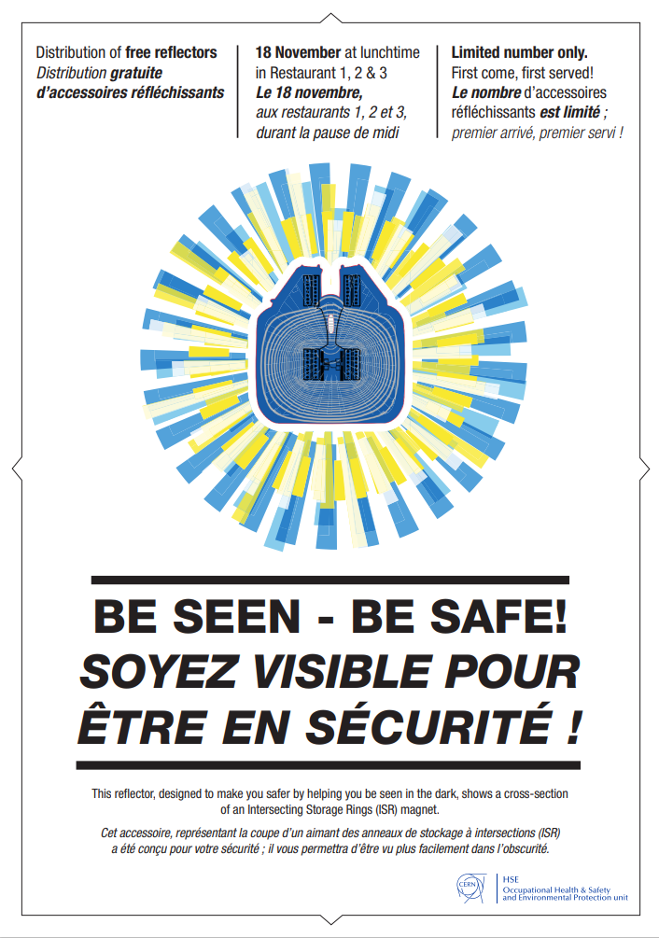
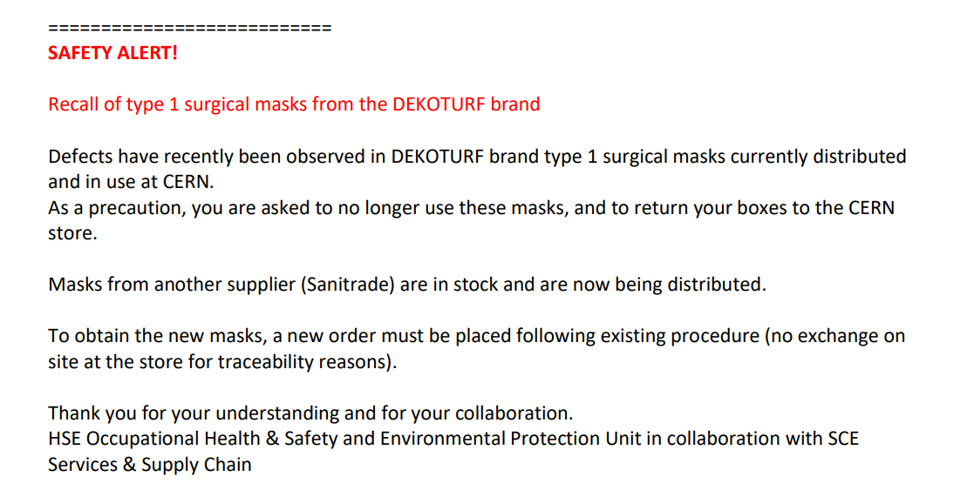
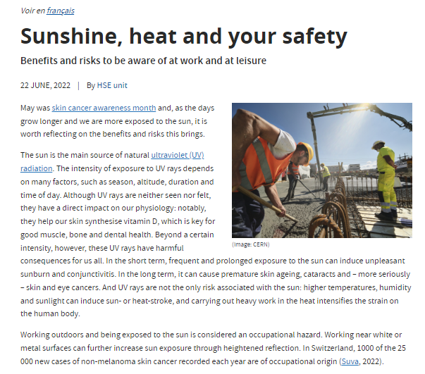

Follow-up / Lessons learned from safety incidents at CERN
Annual report
Safety Alerts
Safety Articles
Safety Campaigns
E-learning courses

Slide 11
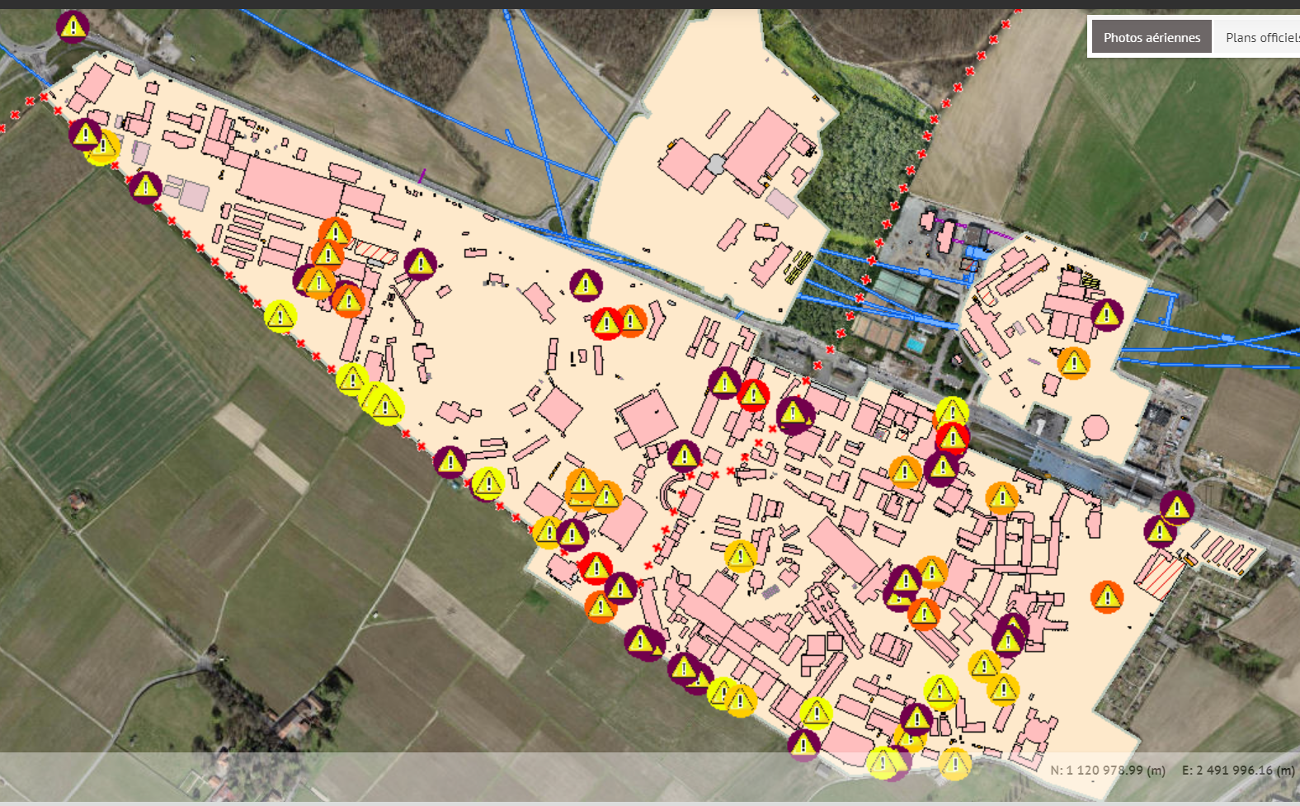
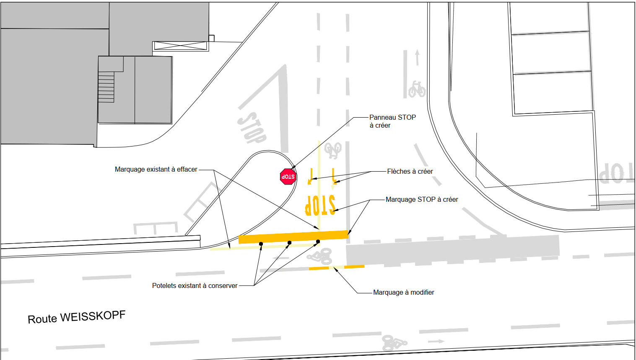
Follow-up / Lessons learned from safety incidents at CERN

Slide 12
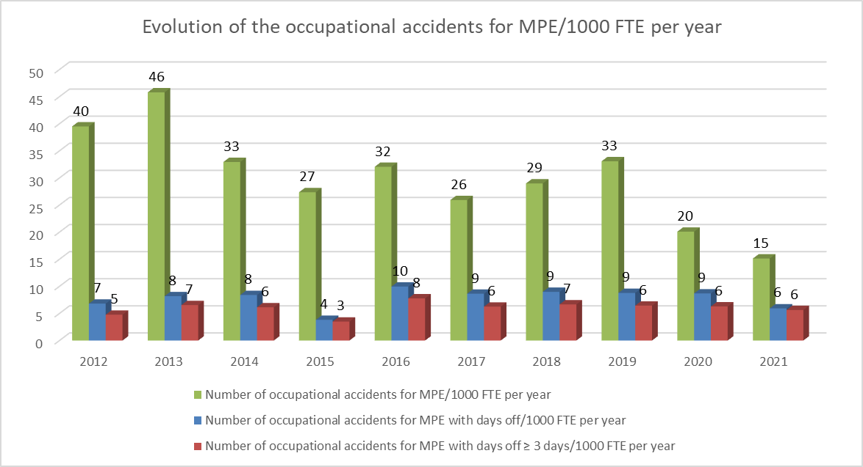
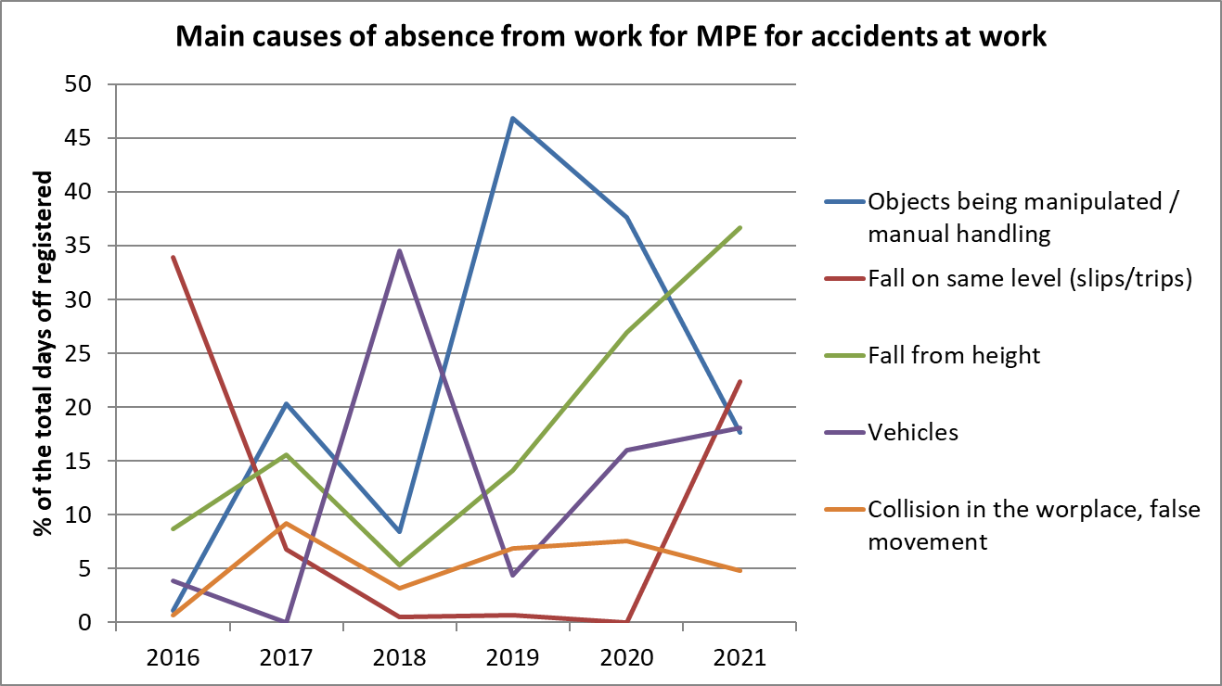
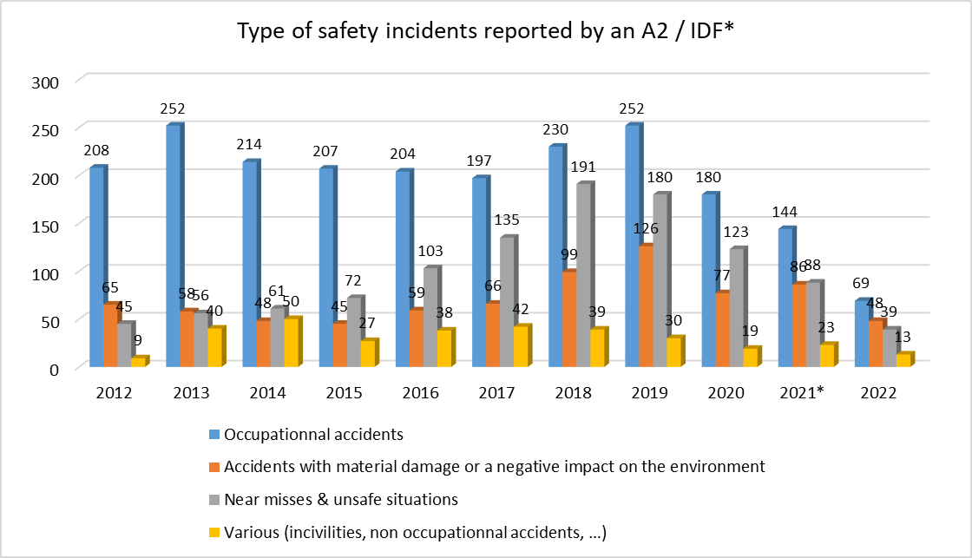
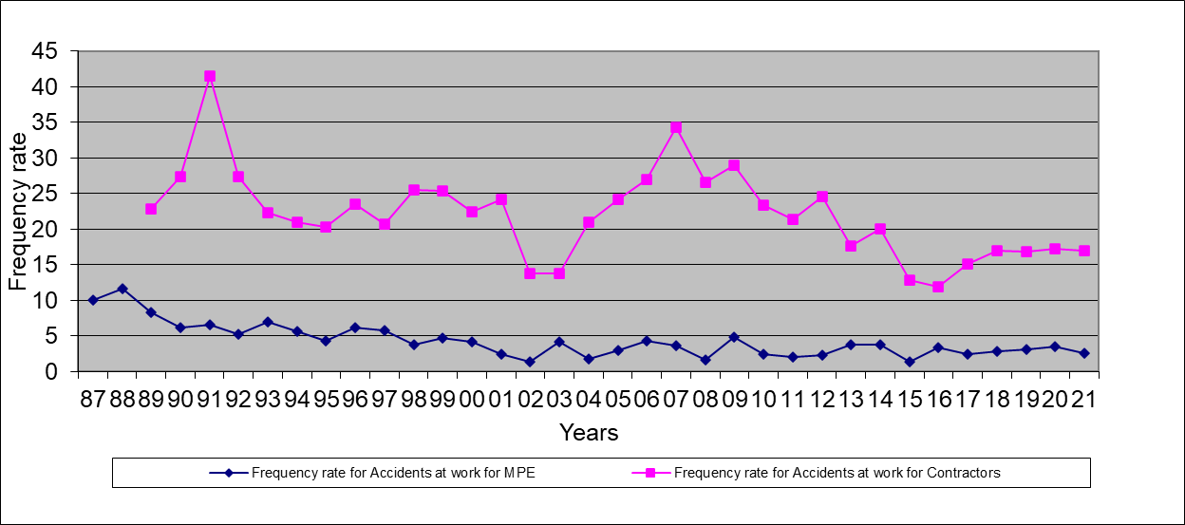
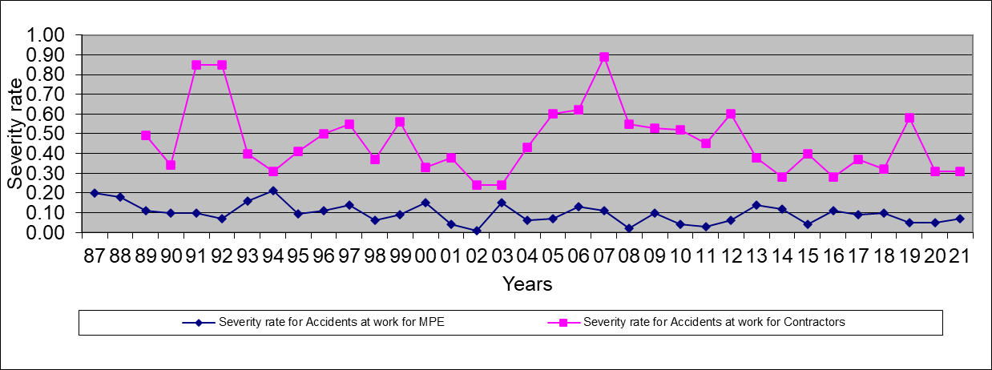
Follow-up / Lessons learned from safety incidents at CERN

