Slide 1
Algorithm-System-Hardware Co-Design for
Efficient Point Cloud Processing
Team at MIT: Zhijian Liu, Haotian Tang, Yujun Lin, Song Han
Achievements in the past month:
  Prepared the rebuttal of BEVFusion for NeurIPS 2022.
  Evaluated BEVFusion on more 3D benchmarks:
    Ranked 1st on nuScenes 3D object tracking benchmark.
    Ranked 1st on Waymo 3D object detection benchmark.
  Deployed BEVFusion-C on NVIDIA Jetson AGX Orin and Qualcomm S8G1.
    NVIDIA Jetson AGX Orin: 38FPS.
    Qualcomm S8G1: 24FPS.
Goal for the next month:
  Prepare for the code release of BEVFusion.

Slide 2
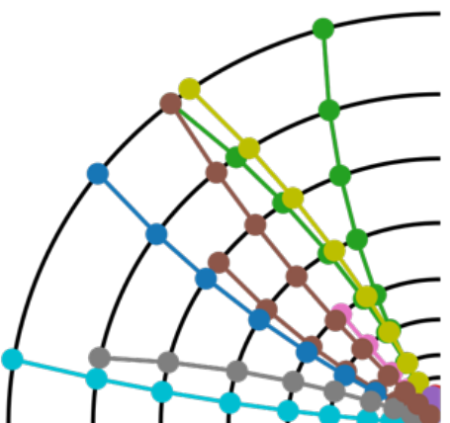
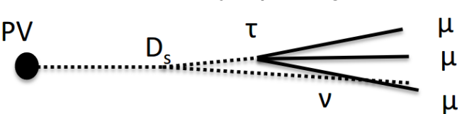
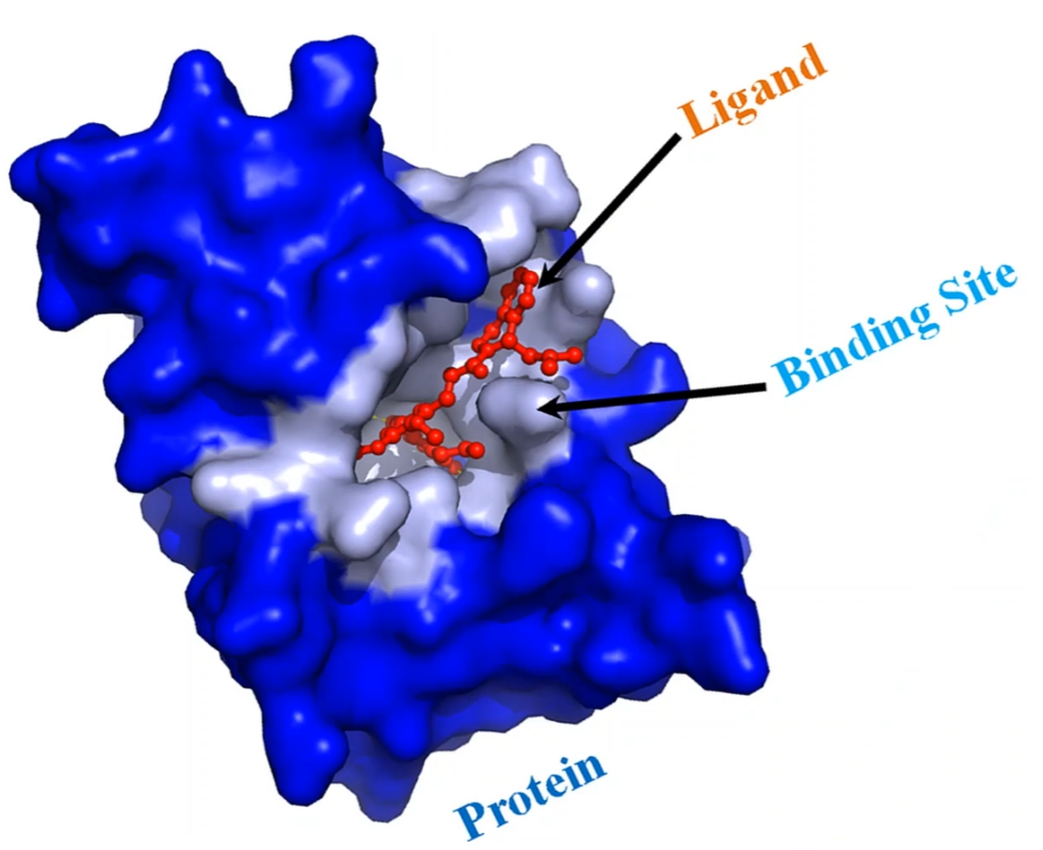
Interpretable Graph/Point Cloud ML
Team at Purdue: Siqi Miao, Miaoyuan Liu, Yunan Luo, Pan Li
Achievements in the past month:
Particle tracks to detect mu
  Adding multivariate Gaussian noise on coordinates provides finer-grained geometric interpretation
  Interpretation performance: 0.93 AUC, 0.90 prec@10, outperforms the Bernoulli version by 8.08%
Protein-ligand binding
  Perturbing relative distance between two atoms performs well on the dataset with synthetic binding logic
    0.80 AUC, 0.97 prec@10, outperforms Bern. by 2.27%
  On the PDBBind dataset, Gaussian and Bernoulli perturbation perform comparable: 0.58 AUC, 0.75 prec @10
Next month:
  Prepare the submission for ICLR 2023

Slide 3
Domain Adaptation on Graph Machine Learning
Team at Purdue: Shikun Liu, Tianchun Li, Miaoyuan Liu, Pan Li, and several external collaborators at Fermi Lab, UIUC, …
Achievements in the past month:
  Implemented the edge reweighting method to explicitly handle structure shifts
  Synthetic experiments conclusions compared to pure adversarial method:
    Marginal improvements around 1% on accuracy under moderate structure shift
    Greater than 5% improvements on accuracy under significant structure shift
Next month:
  Find suitable real datasets scenarios and conduct experiments
  Generalize the reweighting to multiclass classification and increase the dimensionality of node features in synthetic experiments
  Prepare the submission for ICLR 2023

