Slide 1


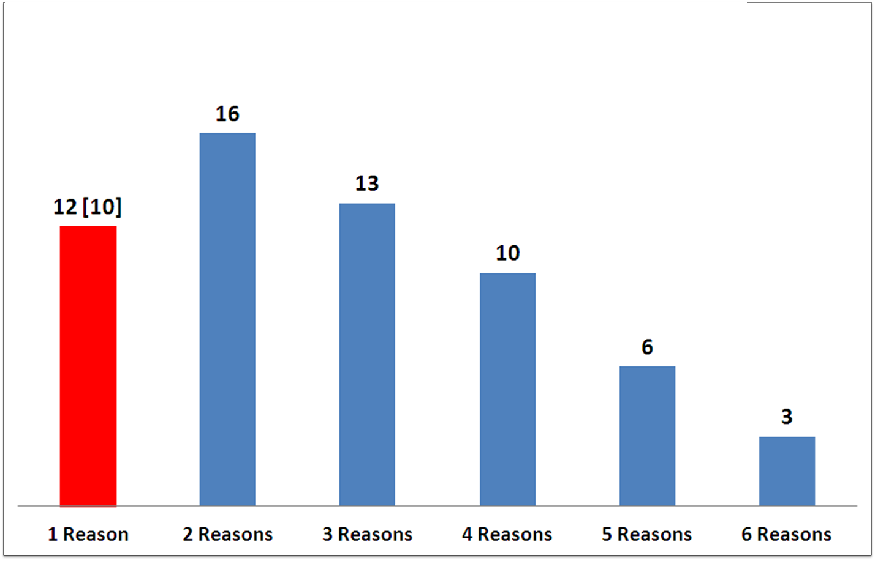
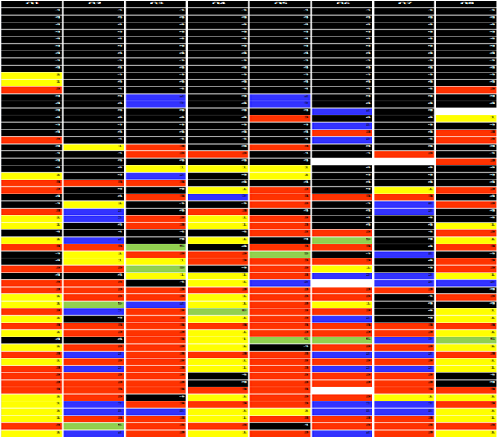
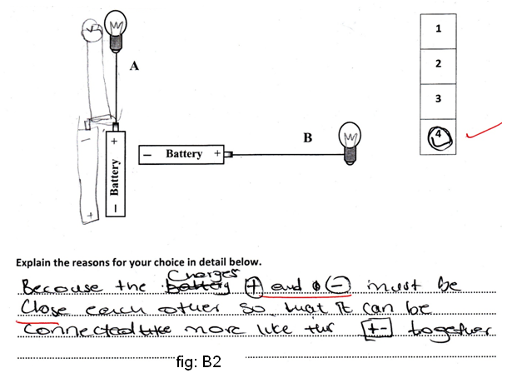
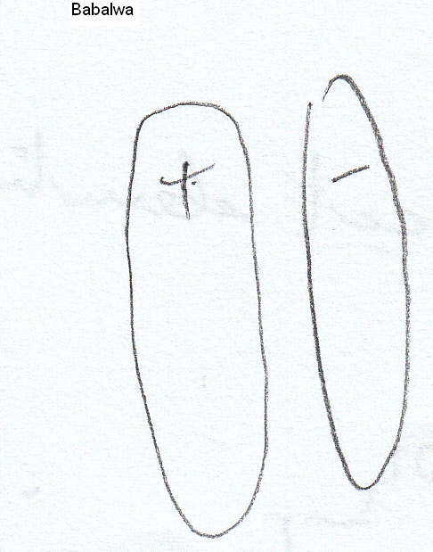
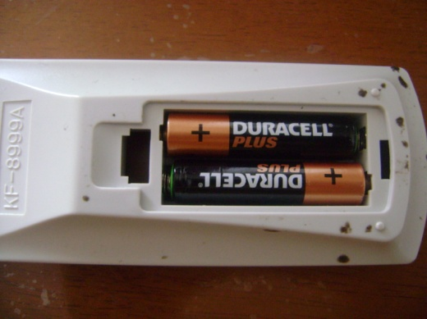
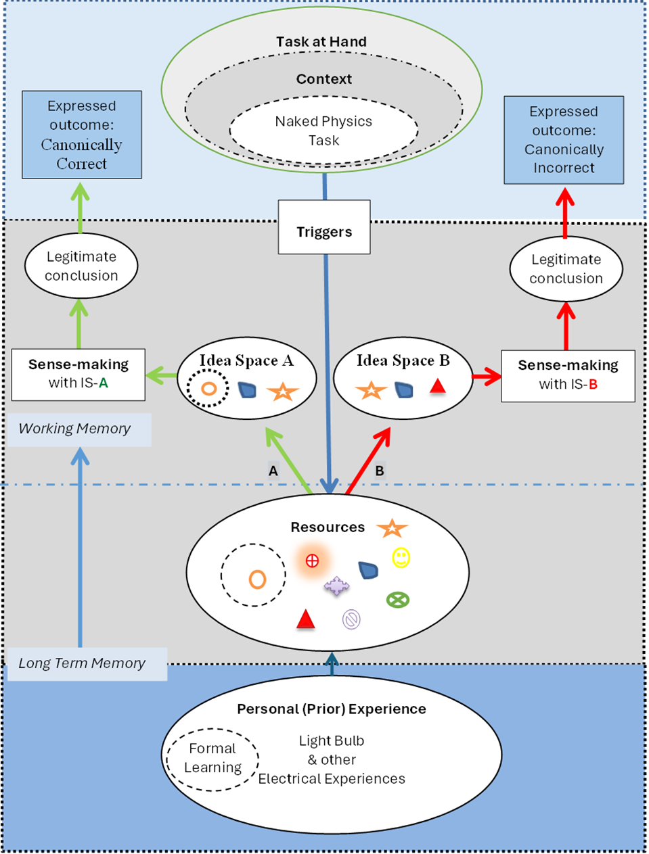
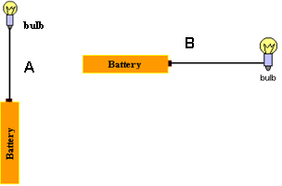





Student Model of Engagement in DC circuits
Ignatius John¹, Saalih Allie²
1 Department of Physics, Cape Peninsula University of Technology, Cape Town, johni@cput.ac.za
2 Department of Physics, University of Cape Town, South Africa, saalih.allie@uct.ac.za
Abstract
Result from composite sample
Number of students vs number of reasons/student
This is the culmination of a long and systematics study on contextual variation of student responses in the context of dc circuit. We published the contextual variation from their Forced Choice Responses of eight electrically identical questions with fine grained variations that are trivial to a physicist, the productive and unproductive foothold ideas, then narrated six micro-episodes from interviews that sketches the complex cognitive terrain of sense-making path that links complex everyday experience, mathematical reasoning and language connotations with the idealised physics model. We reflect on how the overall findings might be used in order to develop a student model which will help to develop a curriculum for simple DC circuits.
The summary of student answers obtained from the investigation is provided in table 2. The eight columns for the 8 answers. Each row represents eight answer of each student against 8 questions. The four Choices,(1) “only circuit A will activate”; (2)“only circuit B will activate”; (3) “both the circuits A & B will activate”; (4) “none will activate” (correct choice) are represented by different colours. BLACK cells represents the correct answer.
Students were grouped according to the number of reasons they used in 8 answers. 12 students used only one reason in all 8 answers , represented by RED bar. Others used more than one reason to explain different context.
Purpose of the study
Within the broader context of a DC circuit (open) we developed Aspects of Circuit Questionnaire (ACQ), to investigate the following:
  To what extent does the student response will affect by (i) changing a resistor for a light bulb or a heating element (ii) drawing the same circuit vertically or horizontally (iii) changing the phrase “charge flow” to “current”? Eur. J. Phys. 38 (2017) 015701
  Explores the reasons behind the contextual variations in student responses at a fine-grained level. Eur. J. Phys. 38 (2017) 015702
  Based on six micro-episodes from four follow-up interviews, sketches the complex cognitive terrain that students must negotiate in order to create a sense-making path that links complex everyday experience, mathematical reasoning and language connotations with the idealised physics model.
Foothold experiences and sense making from interviews
Student cohort
The cohort of students in this study is first time entering university students, 18+ years old, who were admitted to a special access program, who failed to obtain admission in main-stream due to poor grades in high school. High school students in South Africa study physical science which is a combination of physics and chemistry during grades 10, 11 and 12; electricity, in particular DC circuits, form part of a national curriculum.
Methodology
A series of questions based on an open circuit was developed in which three circuit elements were interchanged with each other, namely, a resistor, a light bulb and a heater. These circuit elements were connected with a single wire to one end of a battery in either a horizontal or vertical configuration. In addition the terms “charge flow”, “current” and “heat up” (or “light up”) were also interchanged in the text for identical circuits. For the purpose of this study we chose 8 questions. We studied the contextual variation of student response in three phases. First phase was analysis of numerical choices while the second phase was free response writing and lastly the personal interview. A Cognitive Medel is presented.
Battery
Battery
Simplified Cognitive Model
Sample Question (ACQ)
Table 2:
The Black cells represents the correct answer, “none of the circuits will activate”
Yellow: “Only Vertical circuit will activate”; Blue: “Only Horizontal circuit will activate”; Red: “Both the circuits will activate”
One student connects a light bulb to a battery as shown in figure A. Another student connects the light bulb to a battery as shown in the figure B. The following discussion takes place among the students.
Student 1 says “The bulb in figure A will light up but not the bulb in figure B!”
Student 2 says “No! The bulb in figure B will light up but not the bulb in figure A”
Student 3 says “I disagree! Both bulbs will light up!”
Student 4 says “No! None of the bulbs will light up!”
Student 5 says “I have another idea which I will explain!”
With whom do you most closely agree?
Circle only one of 1, 2, 3, 4 or 5.
Explain the reasons for your option in detail below.
………………………………….…………………………………………………………………………………
…………………………………………………………………………………………………………………….
Q1: Will the light bulb light up? Vertical bulb will light up because “it is connected to bottom of the bulb” | Q2: will charge flow in light bulb? Charge will not flow in horizontal bulb because “it is connected to side of the bulb” | Q3: will there be current in bulb? Vertical bulb will have current because “it is connected to bottom of bulb, where it gets energy”
Q4: Will the heater heat up? None of the heaters will heat up Because “battery should have two wires, one on each side” | Q5: will charge flow in heater? Charge will not flow in any heaters because “there is no positive and negative charges connected” | Q6: will there be current in heater? None of the heaters will have current because “heater has two points, positive and negative”
Reasons of student #142 RED elements are activated and BLACK elements are inactivated | Q7: will charge flow in resistor? Charge will flow in both resistors because “resistor make electricity travel from one place to other” | Q8: will there be current in resistor? There will be current in both resistors because “resistor makes current to flow to next object”
Examples of written explanation
1
2
3
4
5
Battery
Battery
Battery
Aspects of Circuit Questionnaire (ACQ)
Q1: Will the light bulb light up? A B | Q2: will charge flow in light bulb? A B | Q3: will there be current in bulb? A B
Q4: Will the heater heat up? A B | Q5: will charge flow in heater? A B | Q6: will there be current in heater? A B
 | Q7: will charge flow in resistor? | Q8: will there be current in resistor?
Q1: Will the light bulb light up? None of the bulbs will light up because “there is no proper connection” | Q2: will charge flow in light bulb? Did not answer | Q3: will there be current in bulb? None of the bulbs will have current because “circuit is not proper”
Q4: Will the heater heat up? None of the heaters will heat up because “of improper connection” | Q5: will charge flow in heater? Charge will not flow in any of the heaters because “of improper connection” | Q6: will there be current in heater? None of the heaters will have current because “of improper connection”
Reasons od student # 114 RED elements are activated and BLACK elements are inactivated | Q7: will charge flow in resistor? Charge will flow in both resistors because “resistor stores current” | Q8: will there be current in resistor? There will be current in both resistors because “resistor stops current”
Battery +
Battery +
Battery +
Cognitive Model of Task Engagement showing two pathways that could be followed by a particular student. Pathway A shows a sequence of events when the student has the resource of “loop continuity” available (circle enclosed within dotted circle), while Pathway B shows the sequence when the resource is absent. In both cases sense-making is applied.
References: 1. John, I., & Allie, S. (2017). DC circuits: I . Evidence for fine grained contextual dependence. European Journal of Physics, 38(38), 22., 2. John I & Allie, S. (2019). DC circuits: III. The complex terrain of sense-making. European Journal of Physics, 40(5), 1–13.
3. Allie, S., & Demaree, D. (2010). Toward Meaning and Scientific Thinking in the Traditional Freshman Laboratory : Opening the “ Idea Space .” American Institute Physics Conference Proceedings, 1289(1), 1–4.

