Slide 1
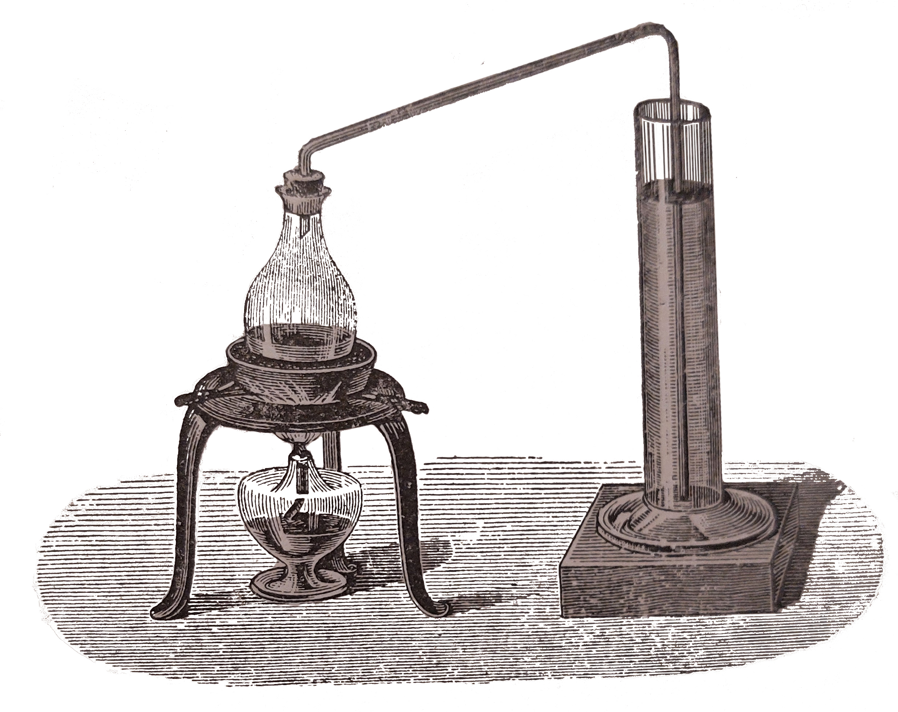
Towards Open Physics Education: Teaching with Jupyter (Note)Books
Freek Pols
c.f.j.pols@tudelft.nl

Slide 2
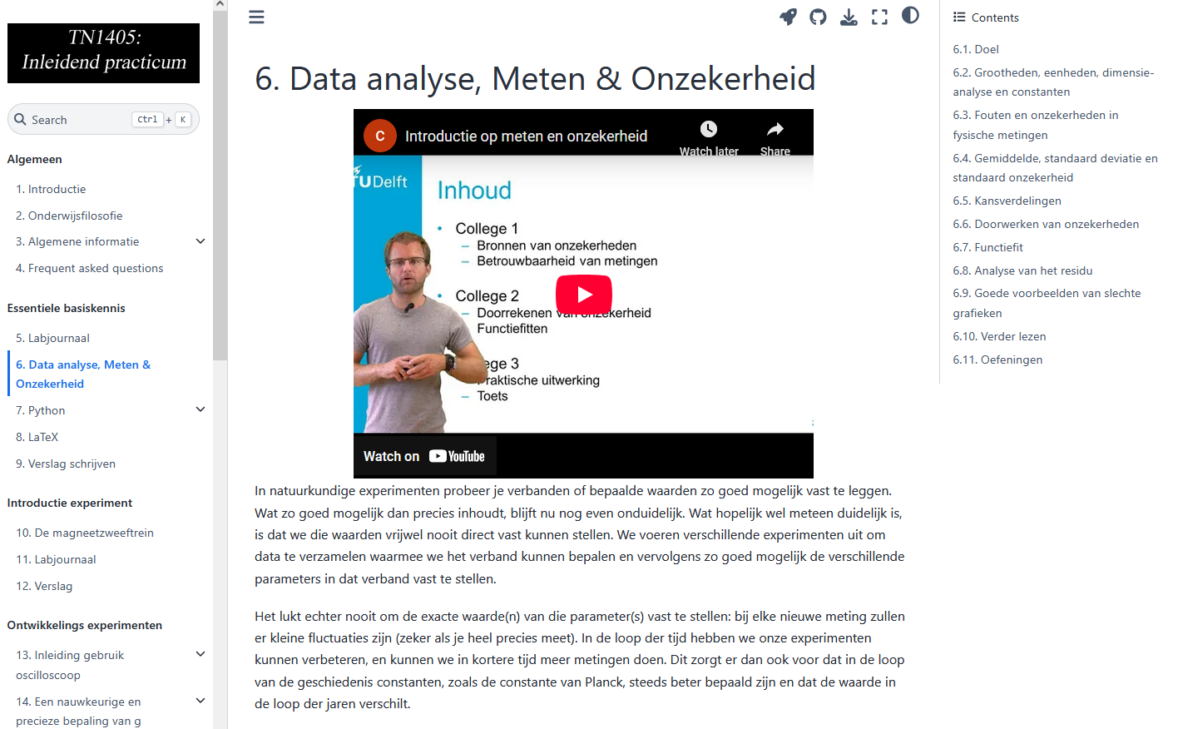
Jupyter (note)books
Jupyter Notebook:
Collection of text and code cells
Jupyter book:
Collection of Jupyter Notebooks (and markdownfiles) rendered as website, looking like a book
In browser python, downloadable, embed interactive elements

Slide 3



Open education

Slide 4
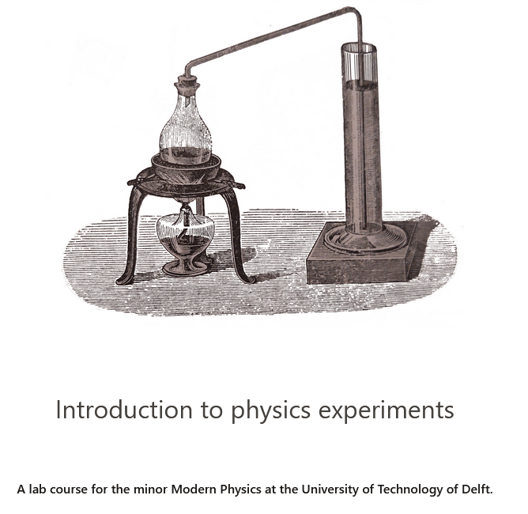
Lab courses
https://contemporary-physicslab.github.io/TN2985/

Slide 5
Lab courses

Slide 6
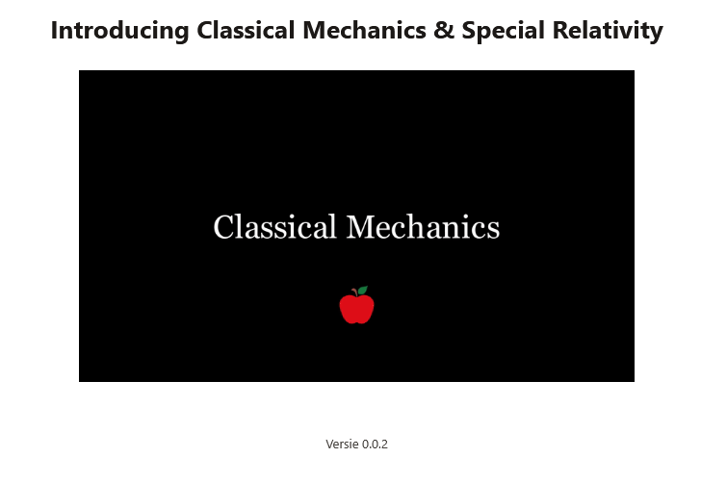
Theoretical courses
https://freekpols.github.io/Mechanica/

Slide 7

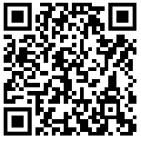
Teacher professionalization

Slide 8

Teachbooks

Slide 9
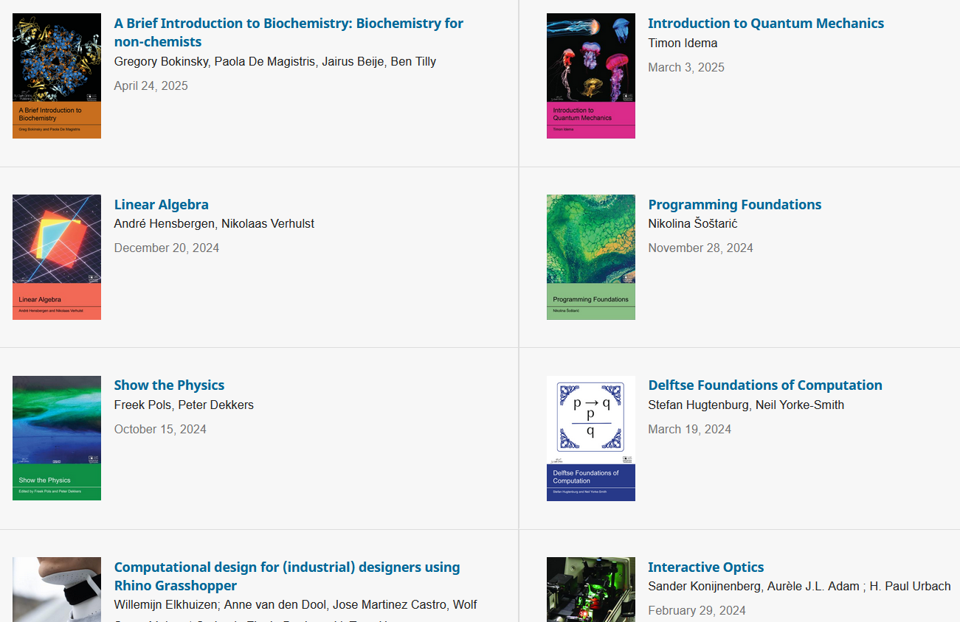
Open Education
https://interactivetextbooks.tudelft.nl/

Slide 10
Where to start?
https://teachbooks.io/
Join the Jupyter Book team at a JupyterHub Collaboration Cafe - Jupyter Book: Blog
c.f.j.pols@tudelft.nl

