Slide 1


Slide 2

Reflection
The conference is coming to a close. Now is a good time to reflect.
Notes:
Buienradar? Weeronline?

Slide 3

The Weather
Dutch weather combined with climate change..

Slide 4
Certificates & Invoices
Filling in this survey is necessary to receive your conference participation certificate!
Invoices via PayLogic.

Slide 5
Survey
Filling in this survey is necessary to receive your conference participation certificate!

Slide 6
World map

Slide 7
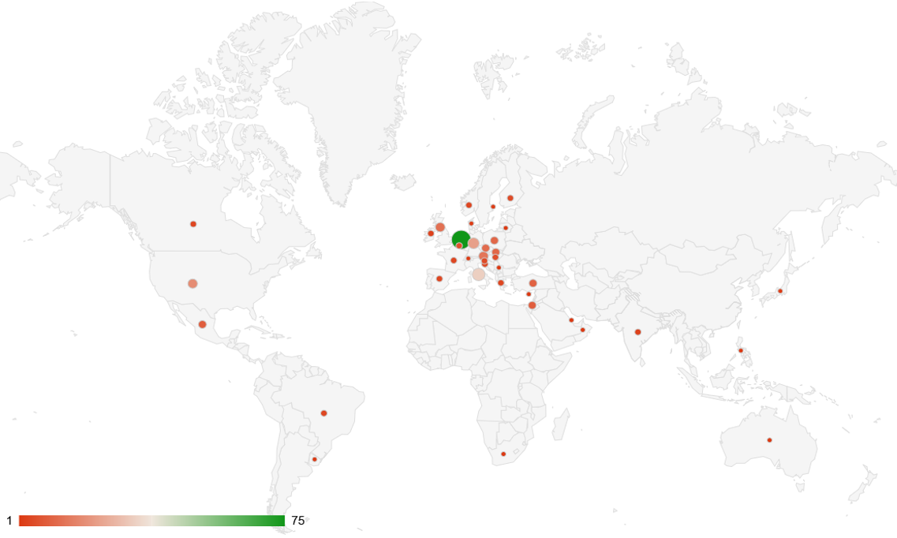

Slide 8
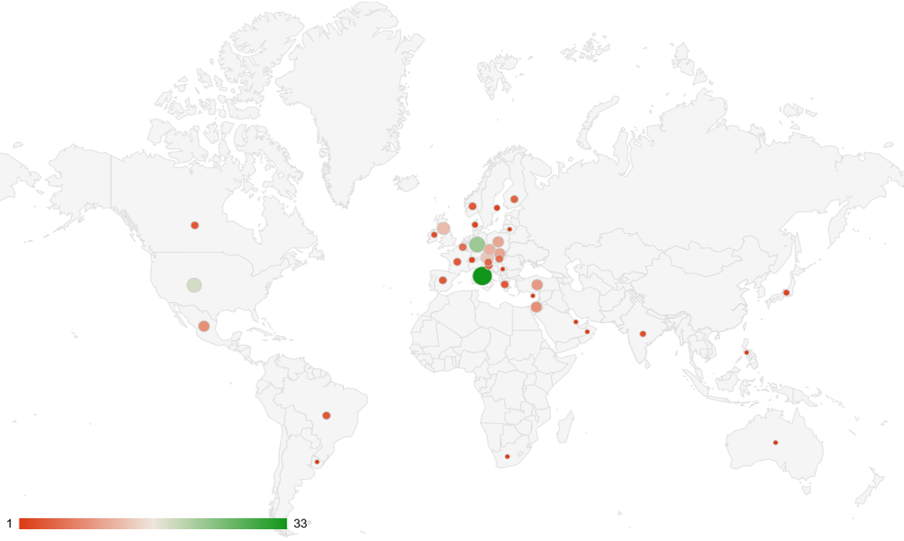

Slide 9
Country (38/313) | # |  | Country | # |  | Country | #
Netherlands | 75 |  | Hungary | 6 |  | Japan | 2
Italy | 33 |  | Croatia | 5 |  | Sweden | 2
Germany | 23 |  | Finland | 5 |  | Switzerland | 2
United States | 19 |  | Slovenia | 5 |  | Australia | 1
Austria | 14 |  | Brazil | 4 |  | Cyprus | 1
United Kingdom | 13 |  | Canada | 4 |  | Lithuania | 1
Czechia | 12 |  | France | 4 |  | Oman | 1
Poland | 11 |  | Greece | 4 |  | Philipines | 1
Slovakia | 11 |  | Norway | 4 |  | Qatar | 1
Türkiye | 10 |  | Spain | 4 |  | Serbia | 1
Israel | 9 |  | India | 3 |  | South Africa | 1
Mexico | 9 |  | Ireland | 3 |  | Uruguay | 1
Belgium | 6 |  | Denmark | 2

Slide 10
Type of contribution | #
Keynote speakers | 6
Symposia | 8
Panel discussions | 3
Workshops | 20
Oral presentations | 134
Posters | 62

Slide 11
Best poster
Out of 62 posters

Slide 12
Katarina Jelicic
Back to basics: reinventing a simple cart experiments for kinematics

Slide 13
Best presentation
Out of 134 presentations

Slide 14
Tobias Patrick Treczoks
… AI literacy assessment…

Slide 15
Postcards and stamps
Stamps got finished so we think it was a nice thought and we hope you have spread the word about GIREP-conferences!

Slide 16
Conference App
https://indico.cern.ch/event/1175859/page/38617-conference-app-hepcon

Slide 17
Excursions

Slide 18
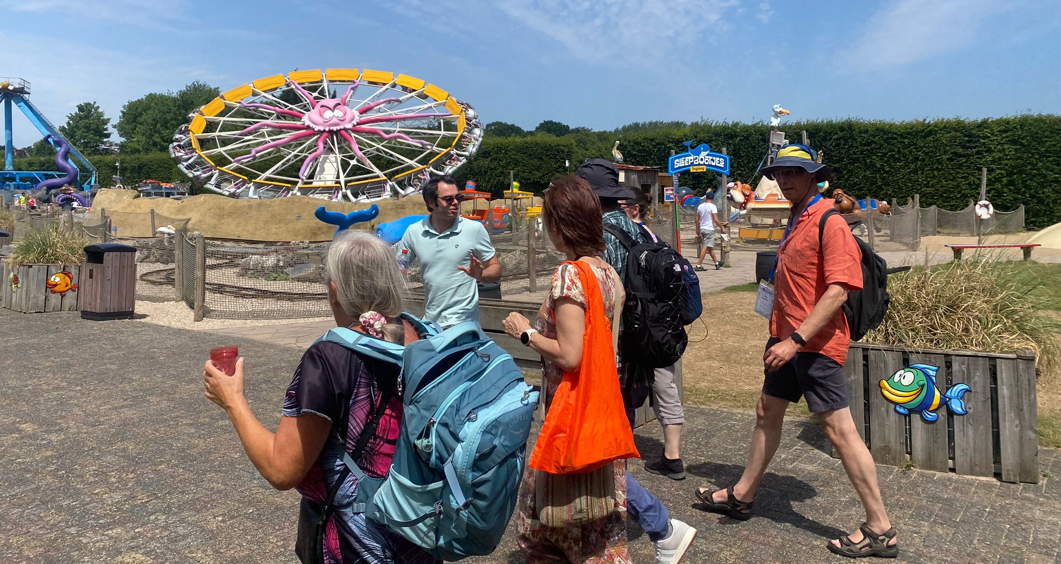
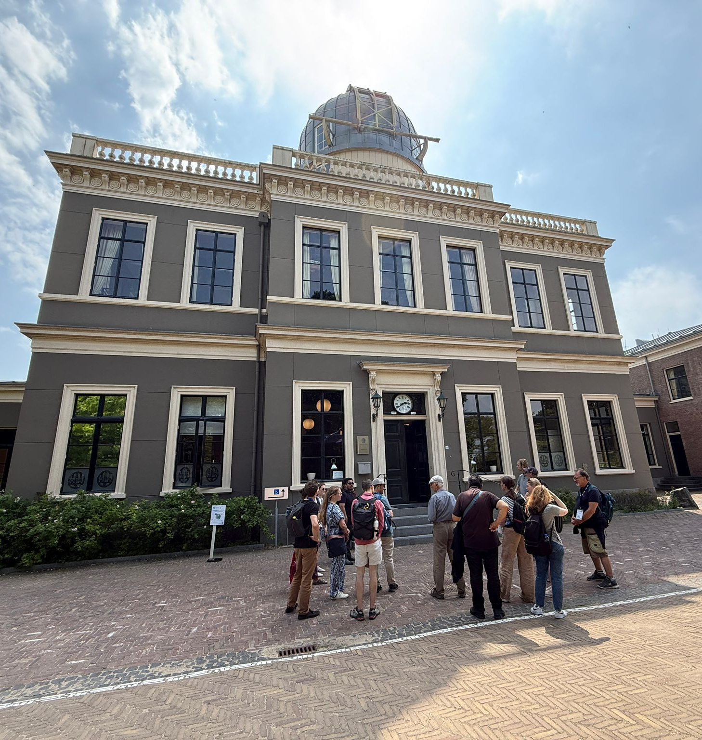
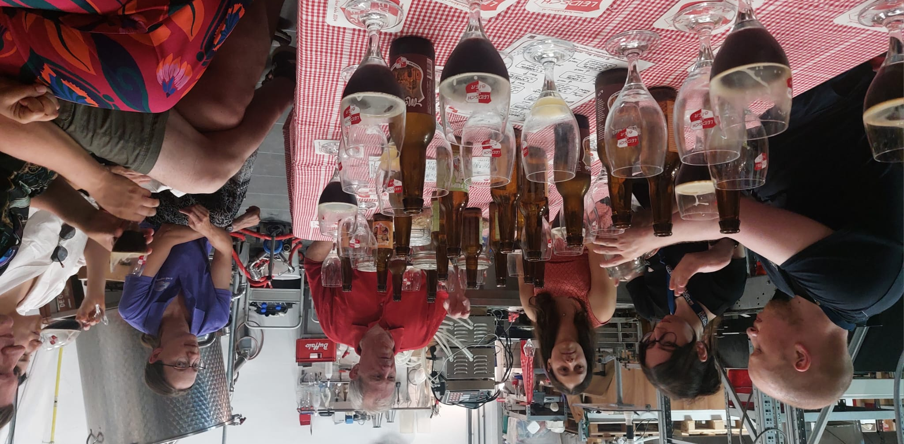

Slide 19
Group photo

Slide 20
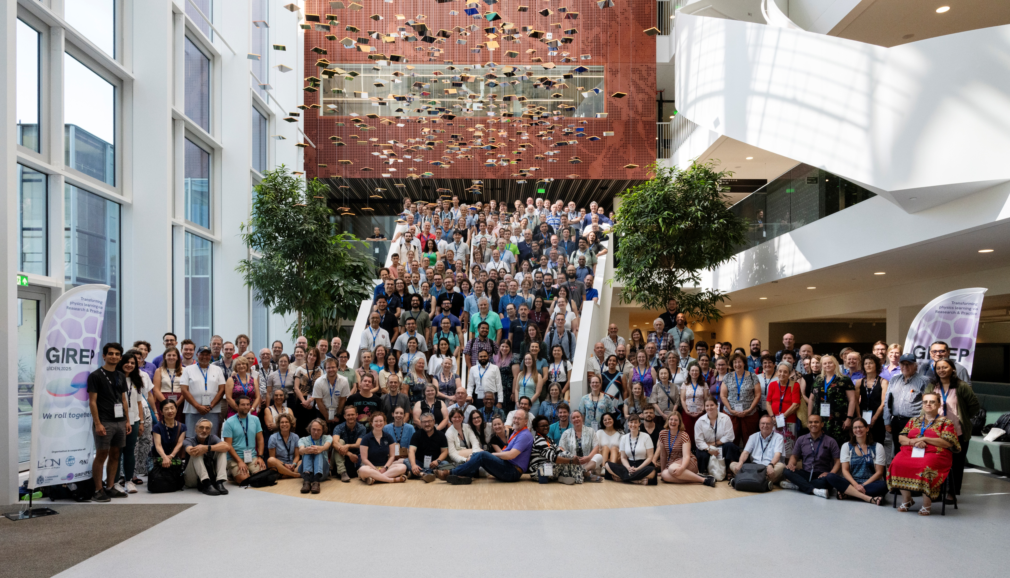

Slide 21
Conference dinner

Slide 22
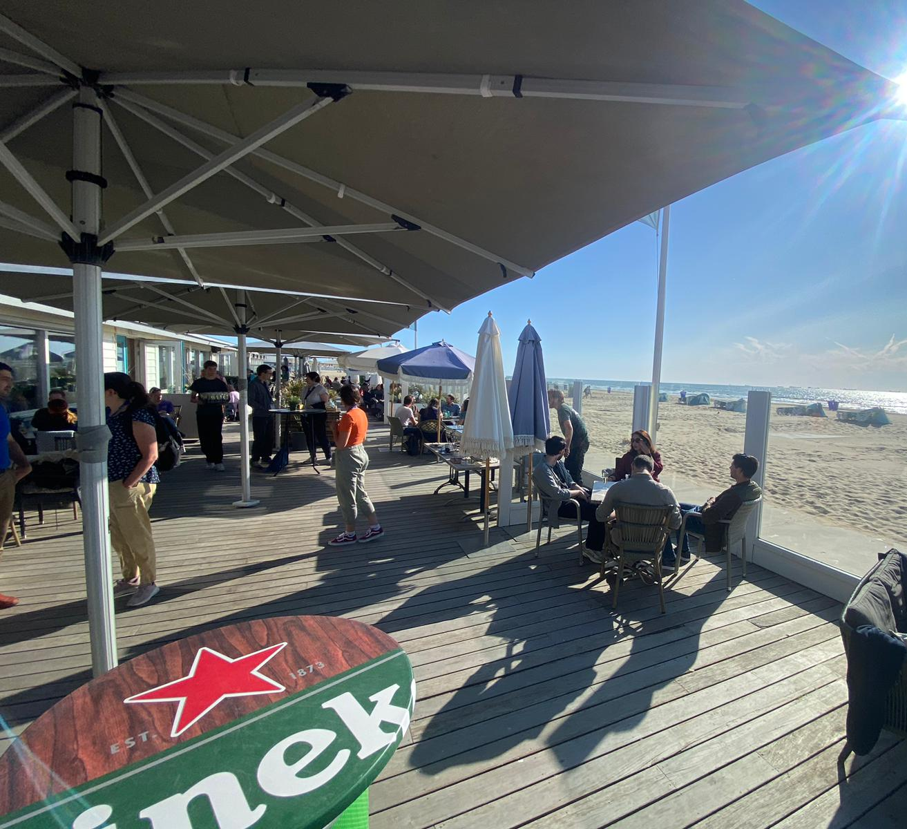
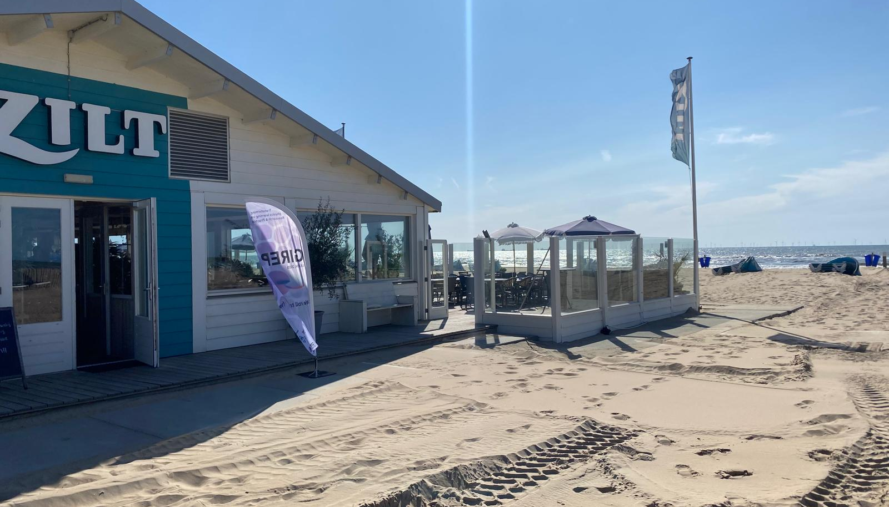
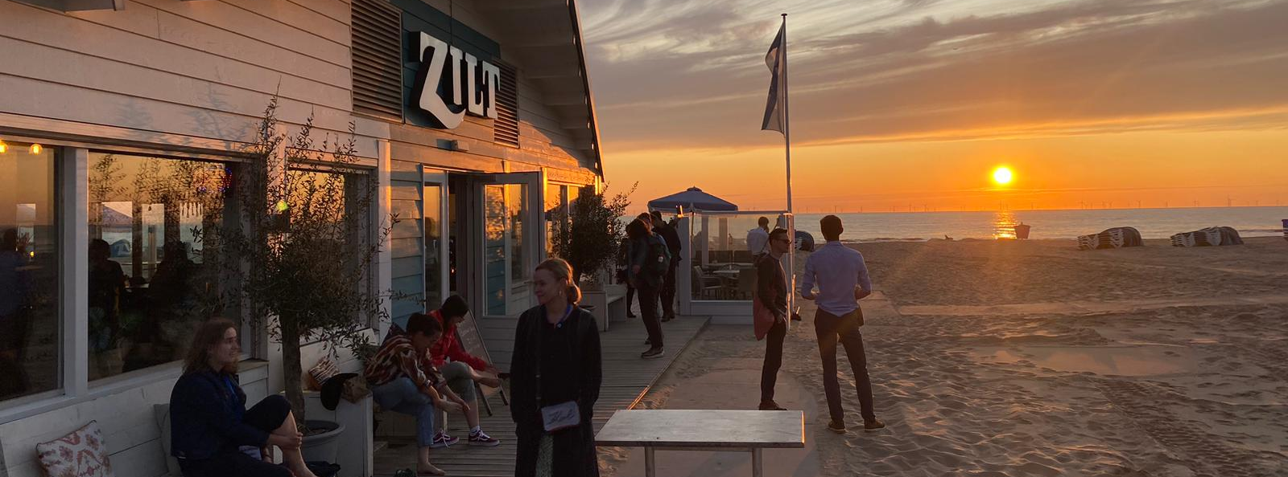

Slide 23
Team

Slide 24
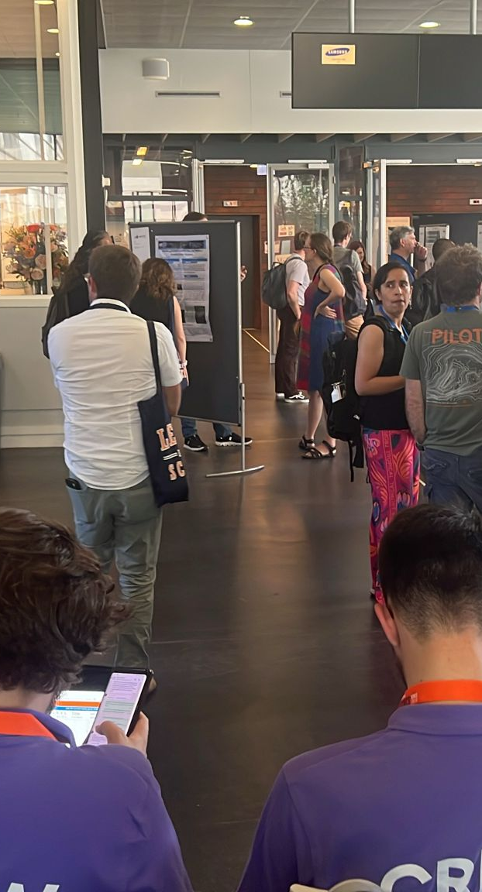
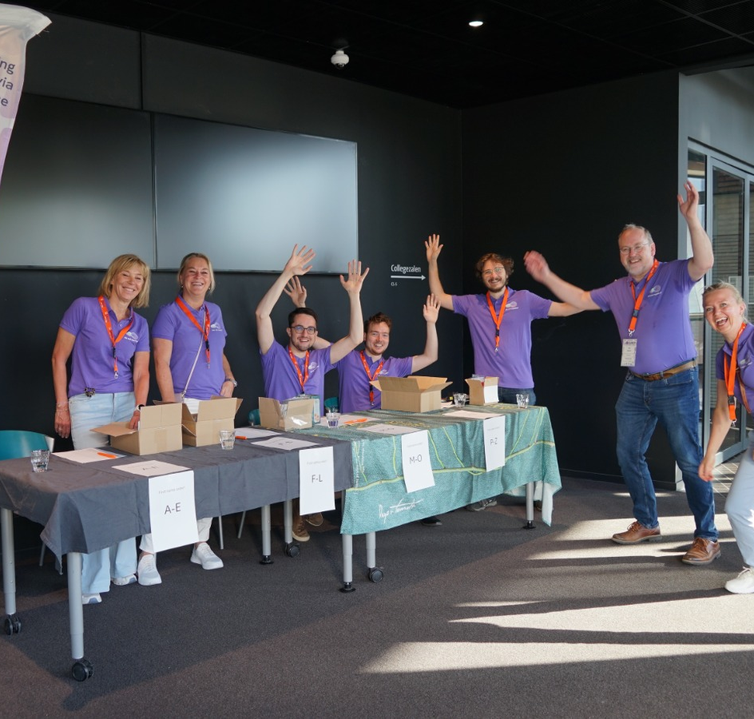
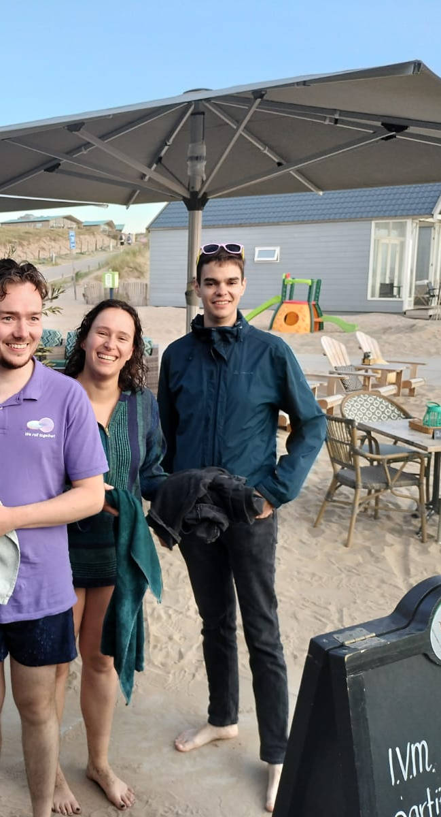

Slide 25
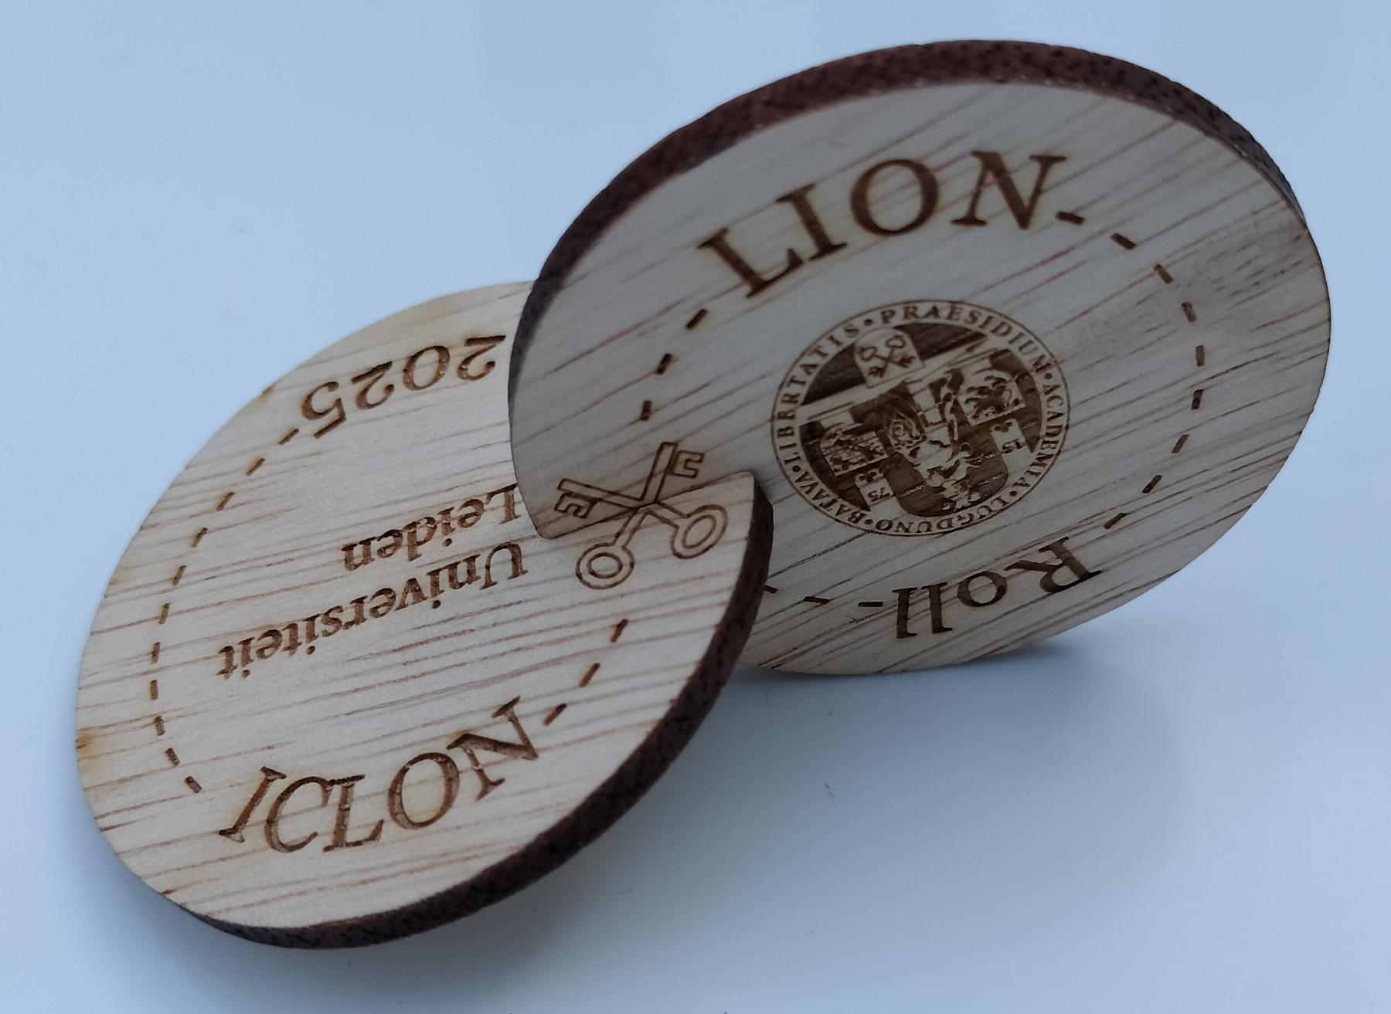
The conference is now officially over..
Please return us the chords (lanyards) for your badges!

Slide 26
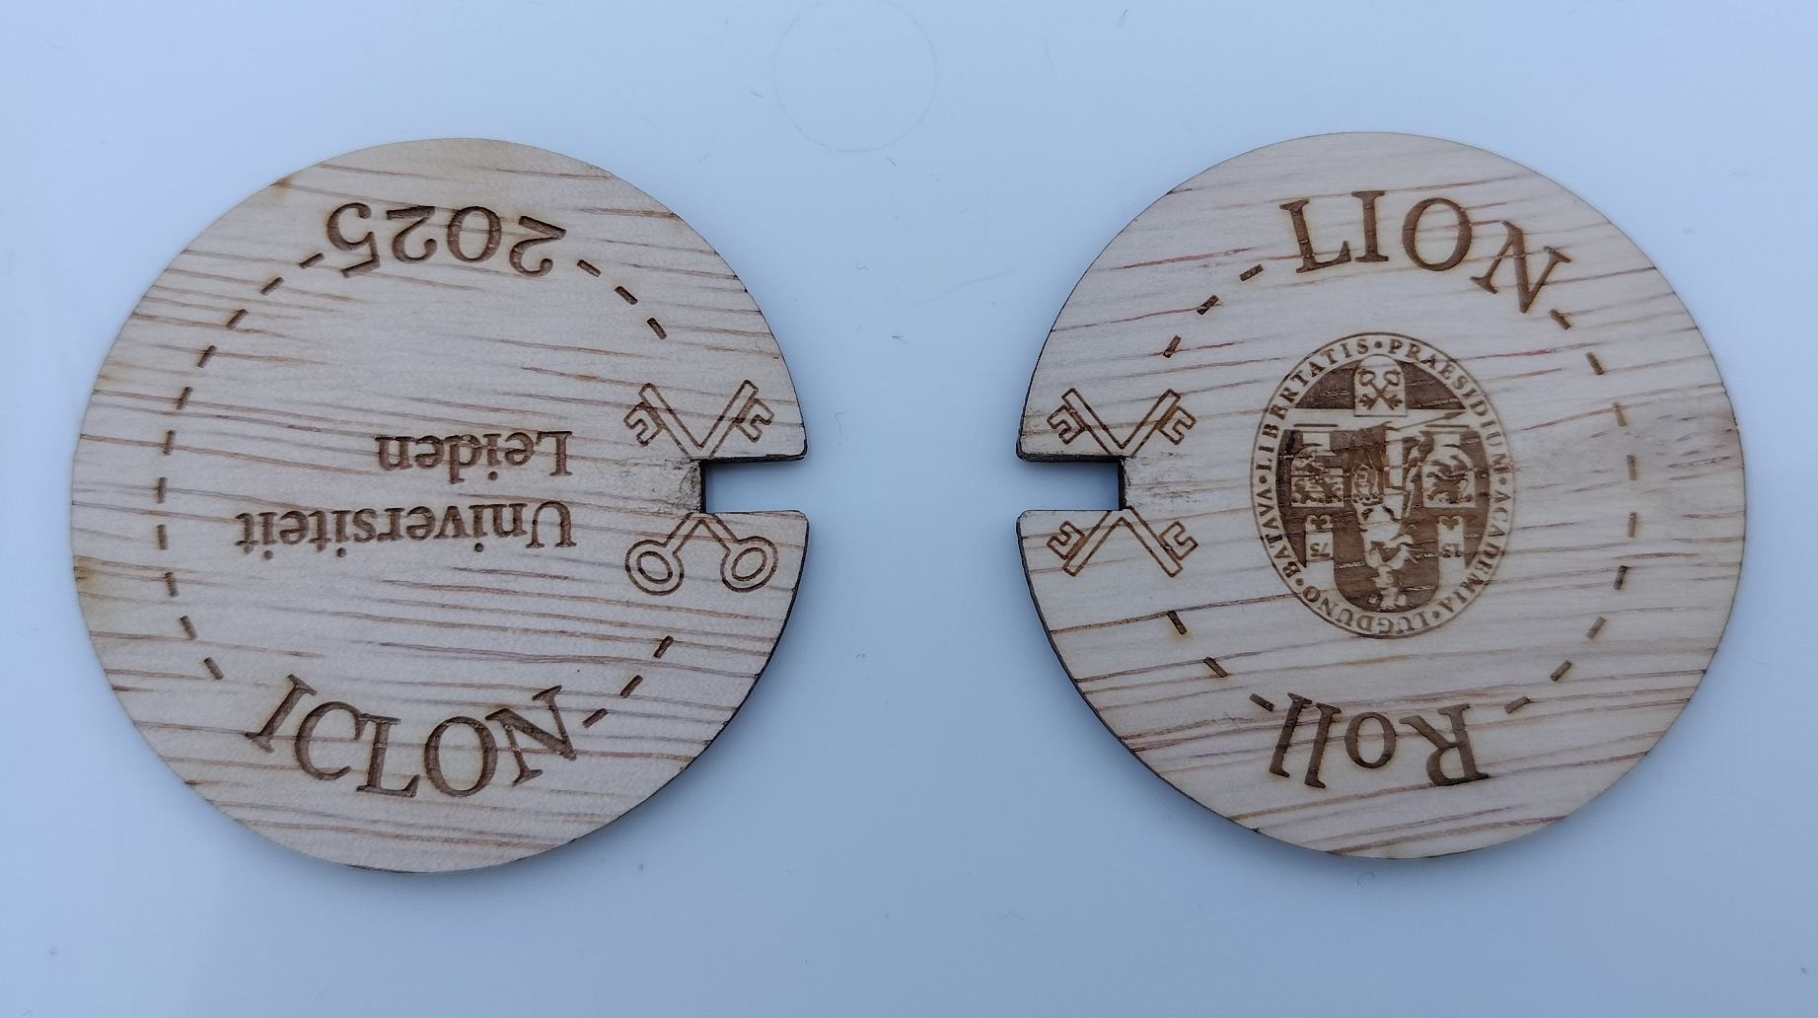
Please use the connections you have made here to keep on rolling!
Collaborate!

Slide 27

Next conference

Slide 28
Drinks!

