Slide 1
Software for
HL-LHC monitoring system
Vivien RUDE
2022-06-15
On behalf :
Mateusz SOSIN
Andreas HERTY

Slide 2
3 projects
June
2022
2023
2024
2025
2026
2027
2028
2029
Single component
String test
LS3
RUN 4
HL-LHC

Slide 3
Single component
June
2022
2023
2024
2025
2026
2027
2028
2029
Single component
String test
LS3
RUN 4
HL-LHC
Wire 1
WPS
Quadrupole or TAP
WPS
WPS
WPS
HLS
HLS
HLS
HLS
FSI
vert
FSI
long
FSI
vert
FSI
long
FSI
vert
FSI
Roll
FSI
Roll
HLS
HLS
HLS
HLS
Wire 2
WPS
WPS
WPS
WPS
5 motor assemblies (3 vertical and 2 radial) + Associated Load cell (3FSI channels)

Slide 4
String test
June
2022
2023
2024
2025
2026
2027
2028
2029
Single component
String test
LS3
RUN 4
HL-LHC
D1
CP
Q3
Q2b
Q2a
Q1

Slide 5
HL-LHC
June
2022
2023
2024
2025
2026
2027
2028
2029
Single component
String test
LS3
RUN 4
HL-LHC
UPS gallery
P1
P2
P3
P4
P5
P6
Alignment between Q1 and Q5 :
TDR limits : σ (1 sigma) < 0.1 mm
Alignment between Q5-left and Q5-right :
TDR limits : σ (1 sigma) < 0.15 mm
EXP.
Q5
Q4
CC2
CC1
D2
TCLX
TCTPH
TCTPV
TAXN
D1
CP
Q3
Q2b
Q2a
Q1
Q1
Q2a
Q2b
Q3
CP
D1
TAXN
TCTPV
TVTPH
TCLX
D2
CC1
CC2
Q4
Q5

Slide 6
Software
Frequency : 1 Hz
For Monitoring system
with more than 500 sensors
Compatible with FESA or Scada
Compatible with WinCCOA
C++
Universal software
INPUT
OUTPUT
Norm L2
Option : Detection of mistake : Norm L1
Option : Kinematic predictive model

Slide 7
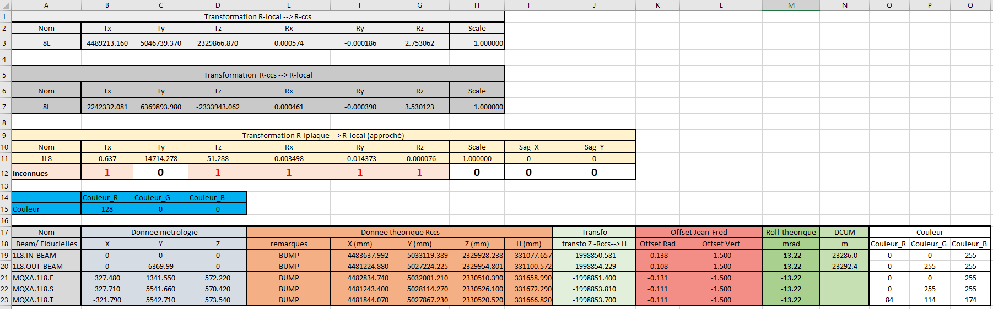
INPUT
Rccs
Rlocal
Y
X
Geode
Sensors

Slide 8
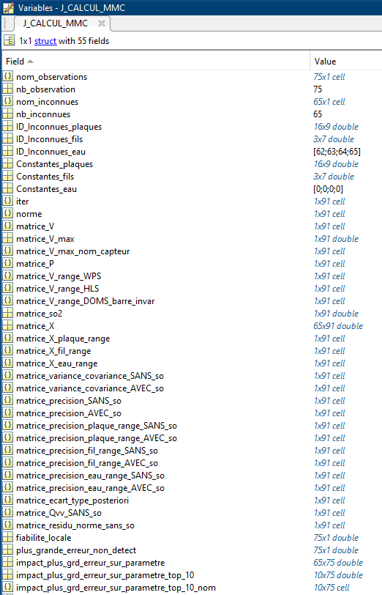
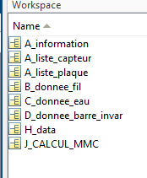
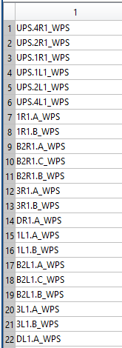
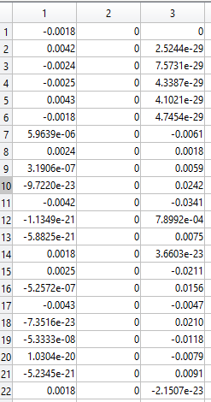
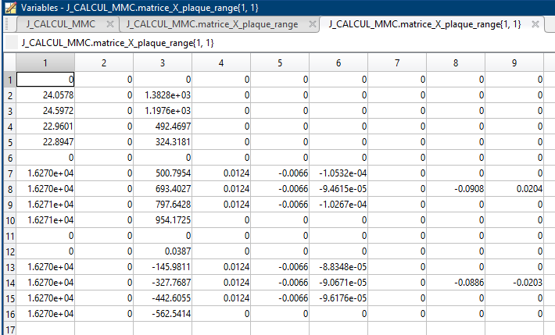


Slide 9
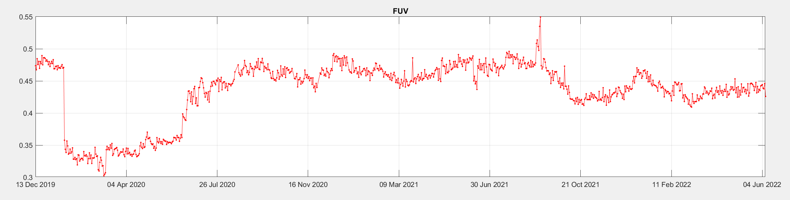
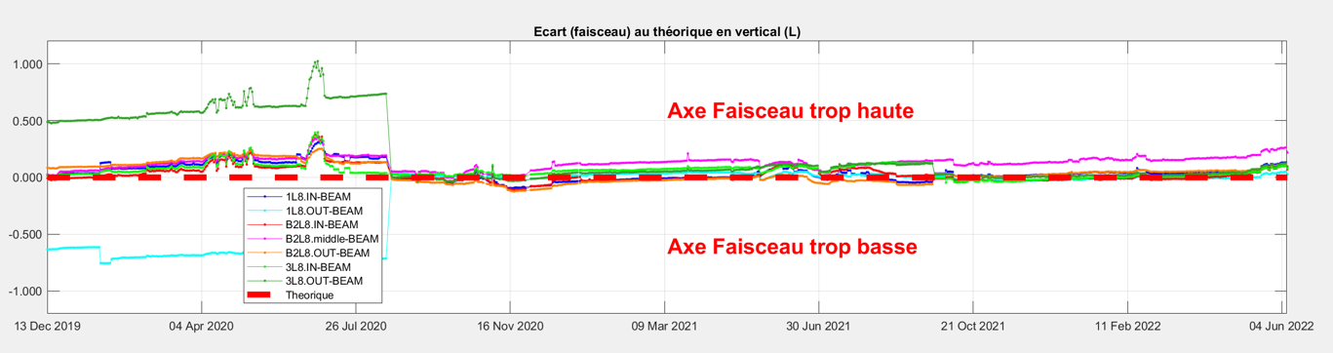

Slide 10
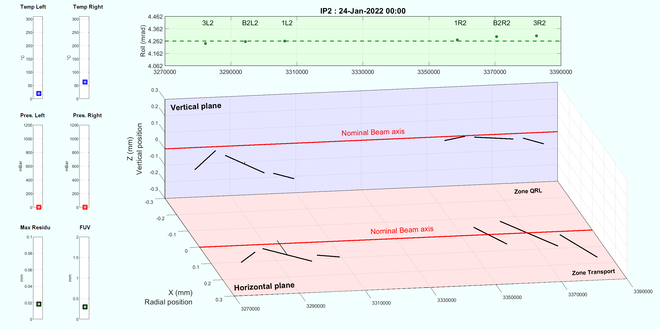
Frequency: 1 s
Q1R
Q2R
Q3R
Q3L
Q2L
Q1L
Q2R
Q1R
Q3L
Q2L
Q1L
Q3R

Slide 11
Thank you
for your attention

Slide 12
SPARE

Slide 13
Single component
FROM Andreas Herty
(CEM-GM-ICS FRAS meeting)
03.02.2022
The following component groups are identified
  Geodetic infrastructure
    location integration, sensor supports, external supports, main hydraulic network
  Sensor systems
    HLS (hydrostatic levelling system)
    WPS (wire positioning system)
    LON (longitudinal monitoring)
    INC (inclination sensor)
    INT (internal monitoring)
    FSI (frequency scanning interferometry) laser system
The following component groups are identified
  Adjustment systems
  jacks and motorized adaptors, load cells
  Software
  FESA (CEM-ICS), WinCC OA (ICS), algorithm (GM)
  Environmental measurements
  SamBuCa, temperature, humidity, pressure probes
  Hardware (of all kinds)

Slide 14
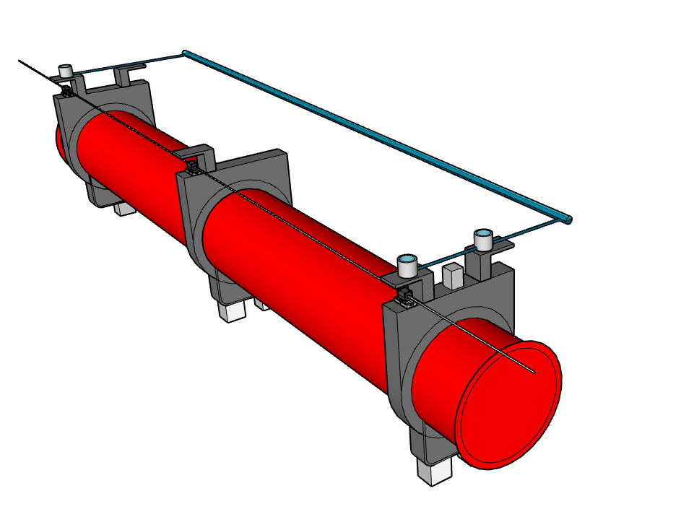
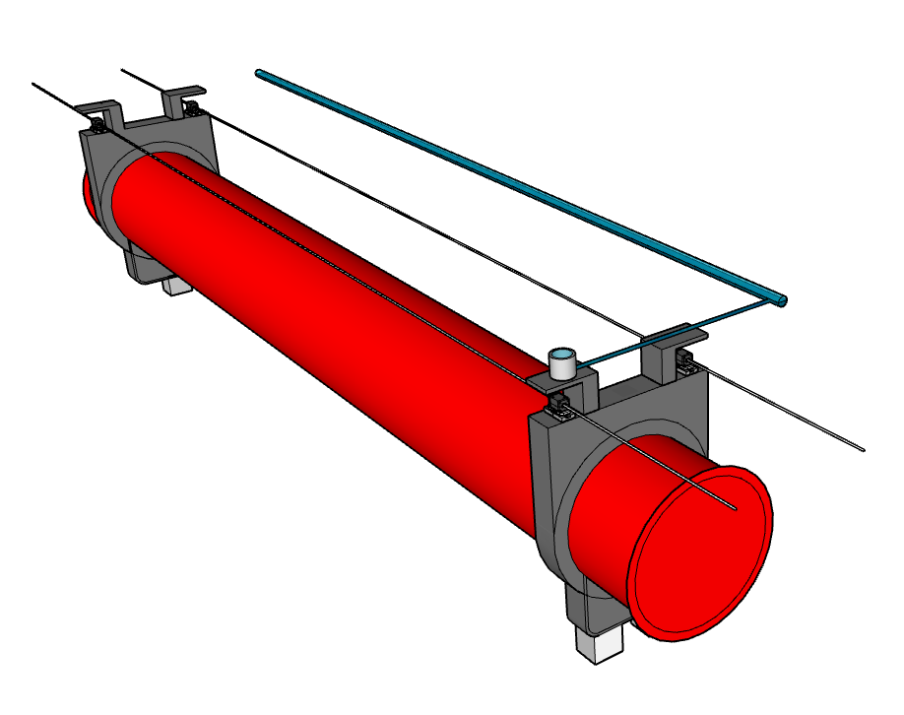
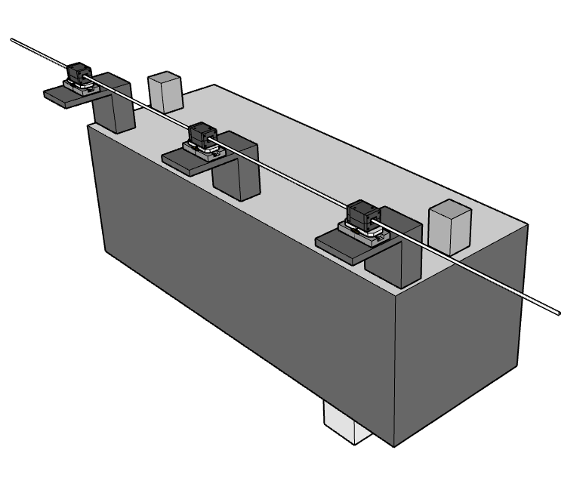
HL-LHC : Detail Configuration
1 wires → WPS sensor
Water networks → HLS sensors
Wire to wire → FSI sensors
Water networks → HLS sensors
P1
P2
P3
P4
P5
P6
Wire UPS
6 boreholes
HLS networks
Experiment
HLS networks
Wire Q1-D1
Wire Q1-D1
Wire 1 Left
Wire 1 Right
Q5L
Q4L
D2L
TCLXL
TAXNL
D1L
CPL
Q3L
Q2bL
Q2aL
Q1L
Q1R
Q2aR
Q2bR
Q3R
CPR
D1R
TAXNR
TCLXR
D2R
Q4R
Q5R
TCTPVL
TCTPHL
TCTPVR
TCLMCL
TCLMBL
CRAB1L
TCTPHR
TCLMBR
TCLMCR
CRAB2L
CRAB1R
CRAB2R
-220
-200
180
-160
-140
-120
-100
-80
-60
-40
-20
0
20
40
60
80
100
120
140
160
180
200
220
1 wire → WPS sensor
Water networks → HLS sensors
Longitudinal monitoring → FSI sensors
Roll → Inclinometer
2 wires → WPS sensor
Water networks → HLS sensors
Wire to wire → FSI sensors
Internal monitoring → FSI sensors
Longitudinal monitoring → FSI sensors
1 wire → WPS sensor
Longitudinal monitoring → FSI sensors
Roll → Inclinometer

Slide 15
FRAS - ongoing study
Defines main FRAS functionalities and reviews the impact of FRAS on components
Describes the scope of FRAS control system and defines its software functionalities
FRAS funtional specification (EDMS 2166298)
FRAS software functional specification (EDMS 2589302)
Towards FRAS engineering specification
FRAS safety assesment & proposed compensatory measures (EDMS 2592013)
FRAS Stakeholder meeting(s)
MPP reccomendations / approval
Study of FRAS failure modes
Proposition of FRAS control system safety measures
Presented on #8-2022 RASWG, to get initial comments
Gather feedback & comments from FRAS Stakeholders on the proposed safety measures

Slide 16
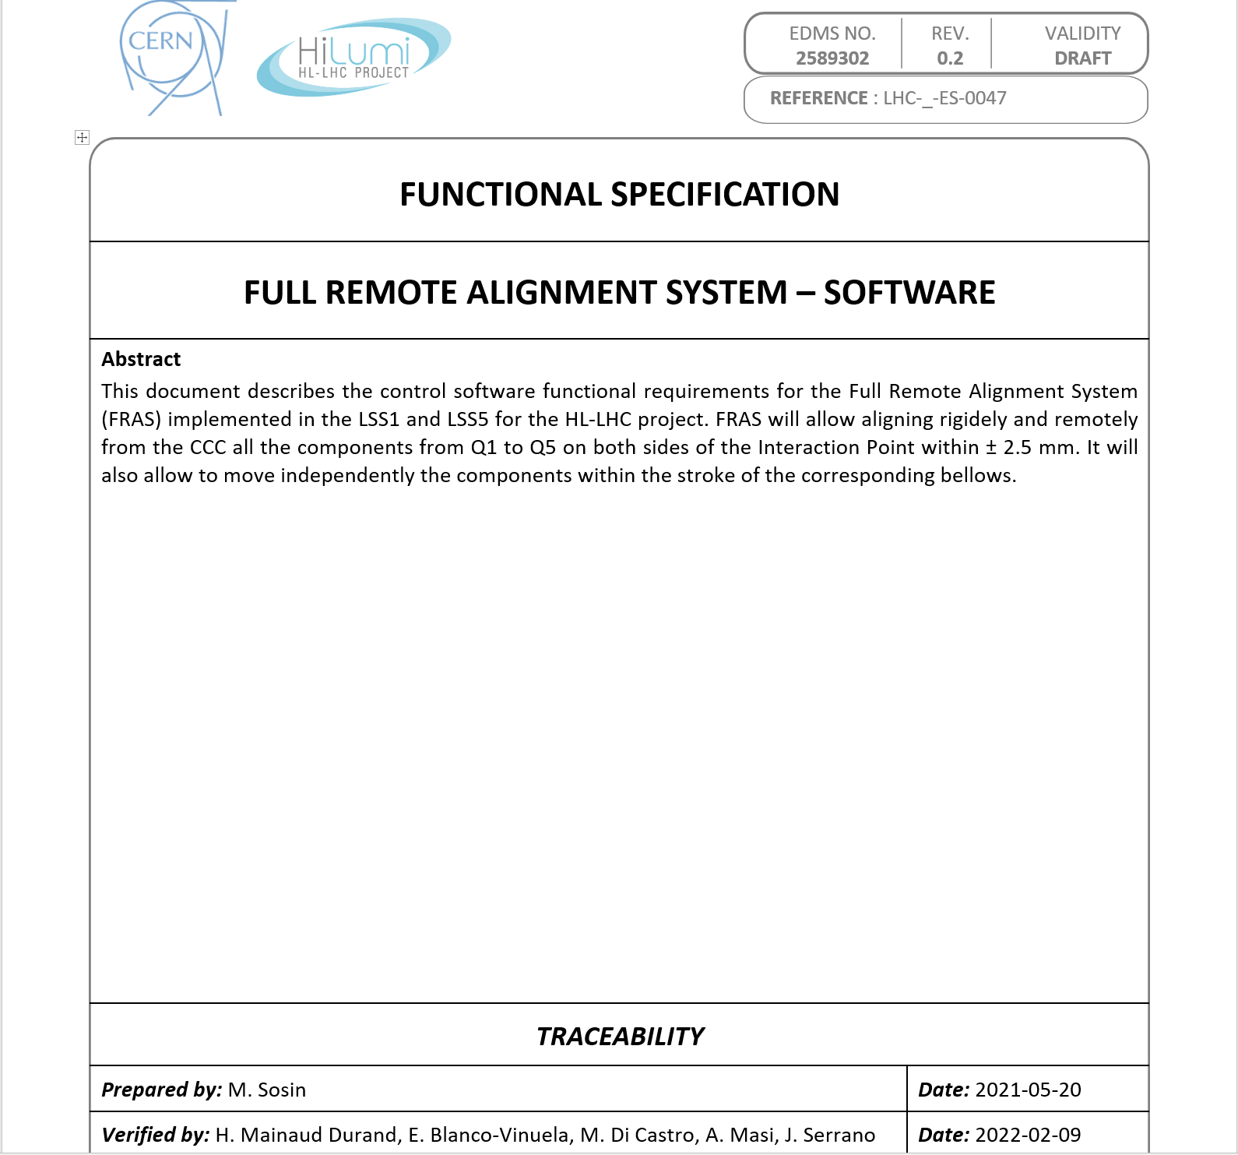
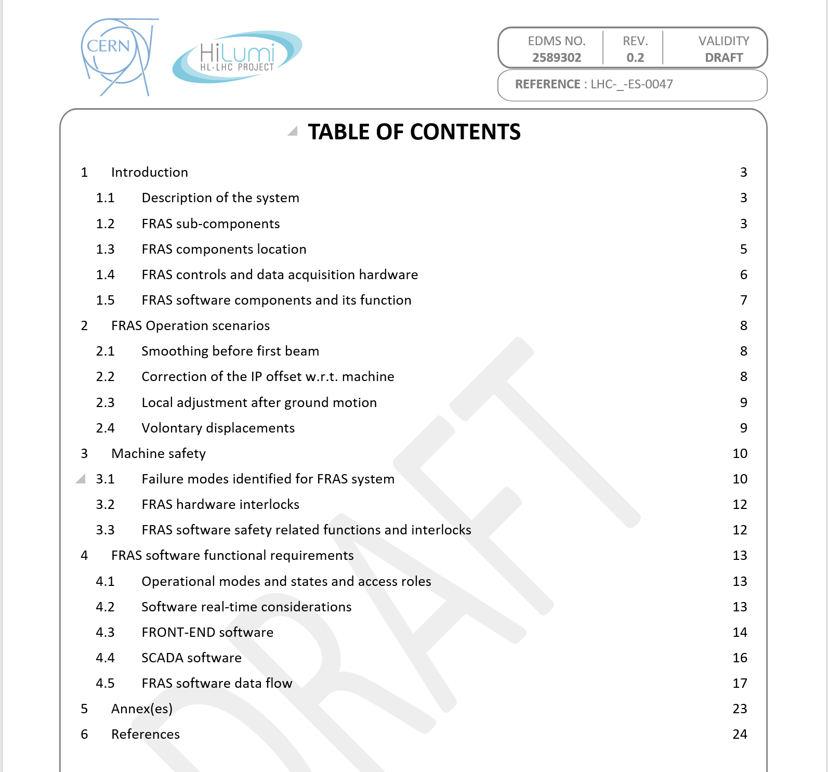
FRAS Software Functional Specification

Slide 17
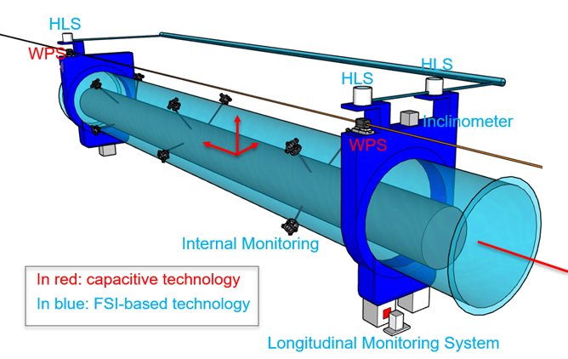
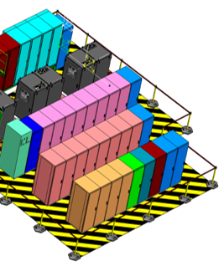
Full Remote Alignment System controls as colaborative project of BE-GM/CEM/ICS
Components:
Sensor systems
Motion control systems
Cables / optical fibers
Racks equipment
FRAS Hardware (BE-GM):
Motor assemblies;
Capacitive sensors: WPS
FSI based sensors: HLS, Inclinometers, longitudinal distance, internal monitoring, load cells
FSI patch panels
Environmental sensors: PT100, Humidity, Pressure
FRAS Hardware (BE-GM):
Cables for WPS sensors
Optical fibers for FSI based sensors
Cables for humidity, pressure sensors
FRAS Motion Control hardware (BE-CEM):
SAMbuCa control electronics
Motor drivers
FRAS Hardware (BE-CEM):
Cables for motors
Cables for PT100
FRAS acquisition hardware (BE-CEM):
FSI reading electronics (SAMBuCa/DI-OT)
FRAS Sensor electronics hardware (BE-GM):
WPS reading electronics (inside a rad-tol DI-OT crate)
Optical systems
FRAS Hardware (BE-CEM):
Motor patch panels
Connection cables between motors & patch panel

Slide 18
FRAS SYSTEM: Equipment/Software layers
FRAS Collaboration - controls HW/SW
layout and responsibilities
SCADA – UNICOS based (BE-ICS, BE-GM):
GUI, objects faceplates
Data logging
Sensors/FRAS disgnostics
Hi-level SU data analysis (Expert system)
WIN CC OA server
(SCADA)
Operators/CCC
Hi-Level Front-End Software (BE-ICS,BE-GM):
Abstraction of Q1-Q5 string, magnets, jacks, sensors, etc ...
3D motion control
Interlocks, RT-disgnostics
FRAS Control Software
Ethernet / TN
Low-Level Front-End Software (BE-CEM): drivers, single motor motion control algorithm
FEC (PXIe)
FEC
FEC (PXIe)
DI/OT FSI electronics
+ optics
WordFIP
Control
Electronics
Sambuca
DI/OT capacitive electronics
FRAS Sensor electronics hardware (GM-HPA, BE-CEM):
Rad-tol DI-OT
FSI reading electronics (SAMBuCa/DI-OT)+ gateware
WPS reading electronics
Optical delivery
Optical fibres
Capacitive sensors & cables
FRAS Motion Control hardware (BE-CEM):
SAMbuCa control electronics
Motor drivers
Motor cables, patchpanels
Delivery and reception of MACCON motors
PT100 cables
Motor drivers
FSI fibres
Capacitive sensors
cabling
Motors
cabling
FRAS Hardware (BE-GM):
Jacks, actuators (motion control);
Capacitive sensors (WPS network)
Optical FSI sensors (HLS, Inclinometers, distance), fibres
Environmantal sensors: PT100, Humidity, Pressure
Motors
FRAS - aligned components
Sensors (cap/FSI)

Slide 19


FRAS Software data flow
SCADA (WIN CC OA)
Q1-Q5
Adjusted object
GEODE, MTF, LOGGING
Adjusted object
Least square position computation
Aligned object
Diagnostic devices
Least square position computation
Aligned objects
Position computation
Diagnostic devices
Diagnostic devices
INTERLOCK
LOGIC
Motor commands
Data logging, Parametrization,
Calibration coef.
IT
CRABs
CMW communication
Hi-level Front-End Software
Internal monitoring
Internal monitoring
Internal monitoring
Internal monitoring
Internal monitoring
SURVEY
EXPERT
SYSTEM
Internal monitoring
Internal monitoring
Motors status,
Errors, HW interlock info
Sensors meas Errors
Sensors meas Errors
Software interlocks,
motor commands
Long term data analysis
Anomalies detection
Sensors validation
...
Inclino
HLS
Dist
Humi-Bragg
Load-Bragg
WPS
Pressure
Temp
Sensors
Inclino
HLS
Dist
Humi-Bragg
Load-Bragg
WPS
Pressure
Temp
Inclino
HLS
Dist
Humi-Bragg
Load-Bragg
WPS
Pressure
Temp
FRAS objects HMI, alarms
Raw meas, Parametrization diagnostics, Errors
Raw meas, Parametrization diagnostics, Errors
Raw meas Errors
Obj
Obj
Low-level
F-E S
FSI-ch[1]
WPS-ch[1]
MOT-ch[1]
PT100[1]
WPS-ch[2]
MOT-ch[2]
PT100/DI/AI/DO[n]
Obj
Obj
FSI-ch[2]
FSI-HW-CTRL
...
WPS –HW-CTRL
...
Obj
Obj
...
FSI-ch[n]
WPS-ch[n]
MOT-ch[n]
FSI channel meas.
WPS sensor meas.
SAMbuCa – motors control + temp. meas.

