Slide 1
Pulsed DC System
30th June 2022

Slide 2
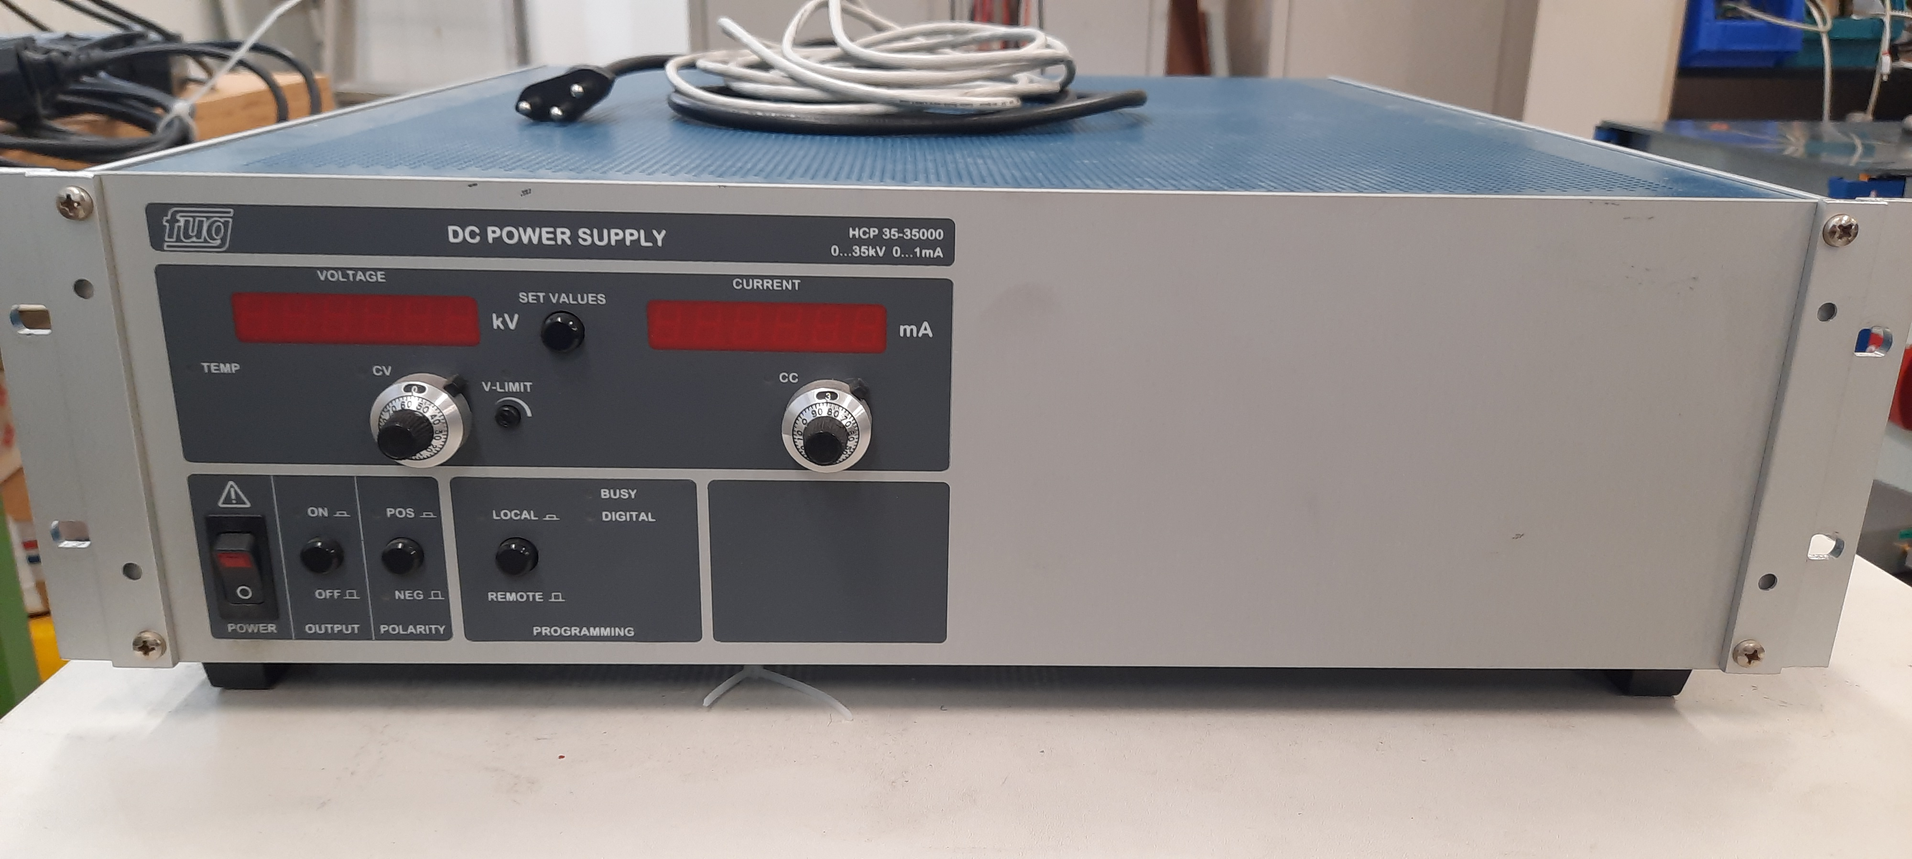
Limit 1mA

Slide 3
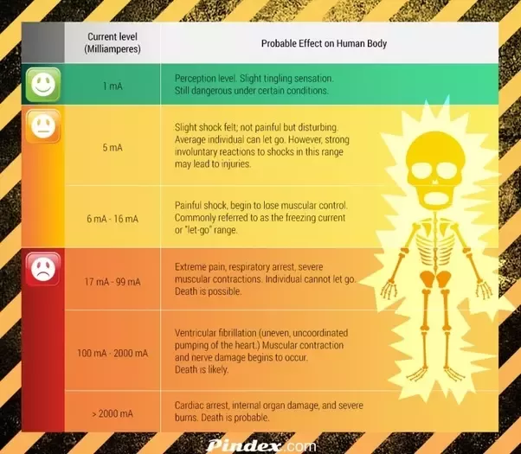
Maybe can’t kill you
I still don’t recommend touching

Slide 4
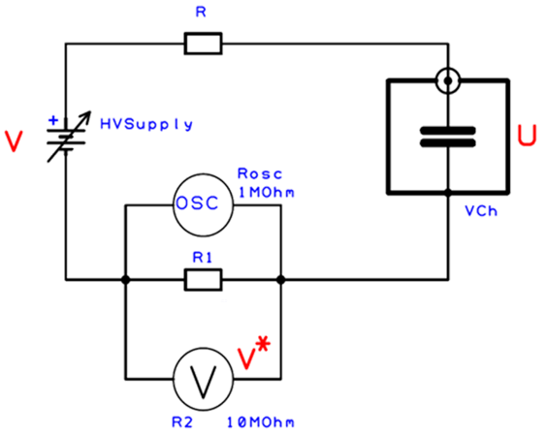
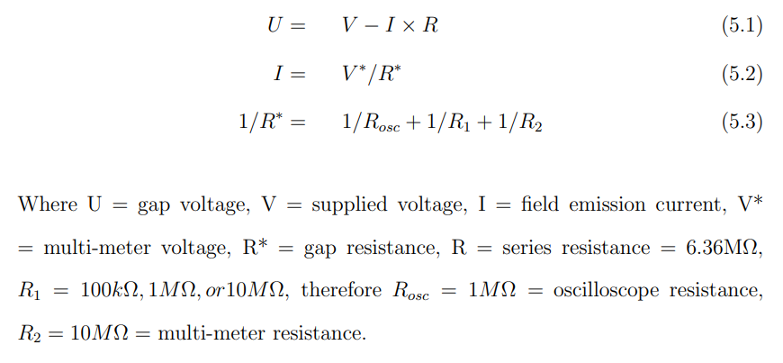
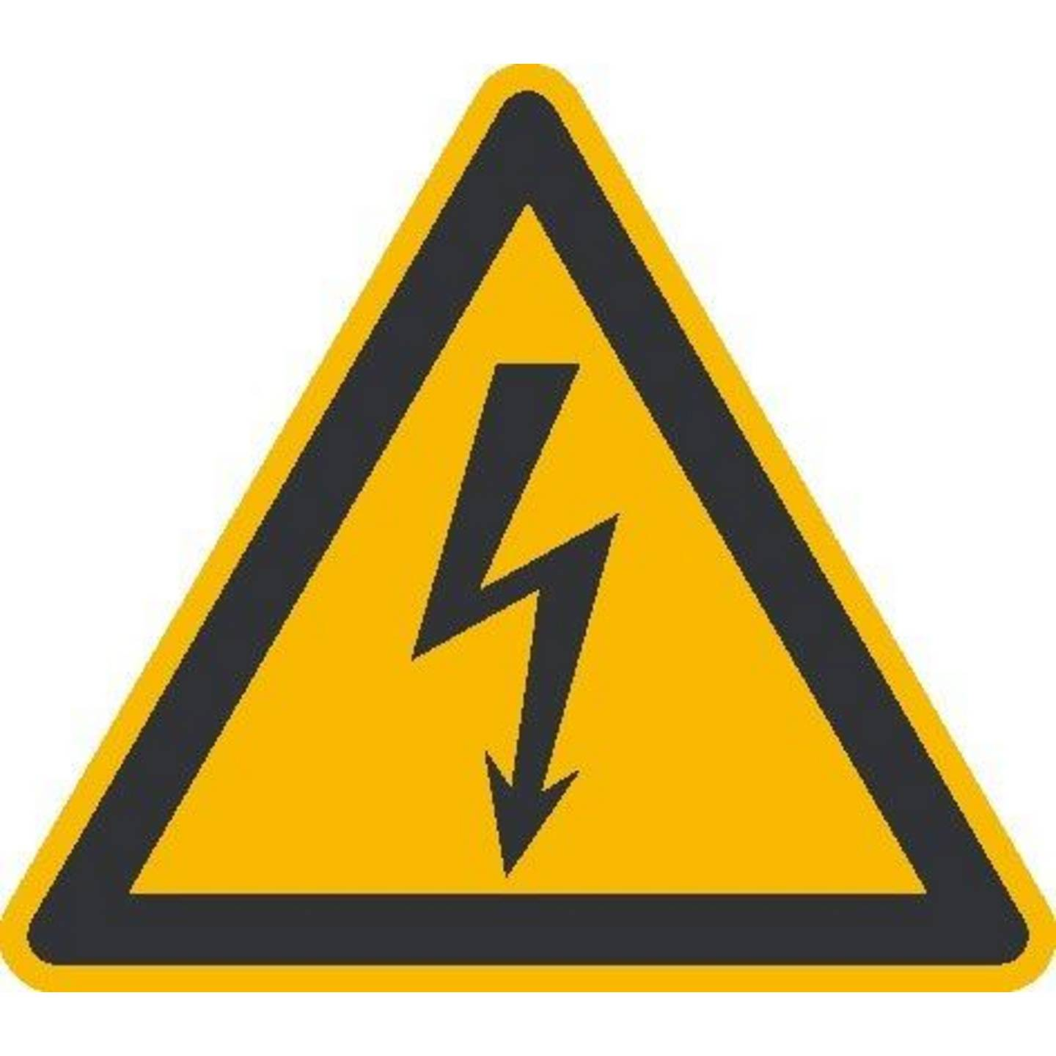
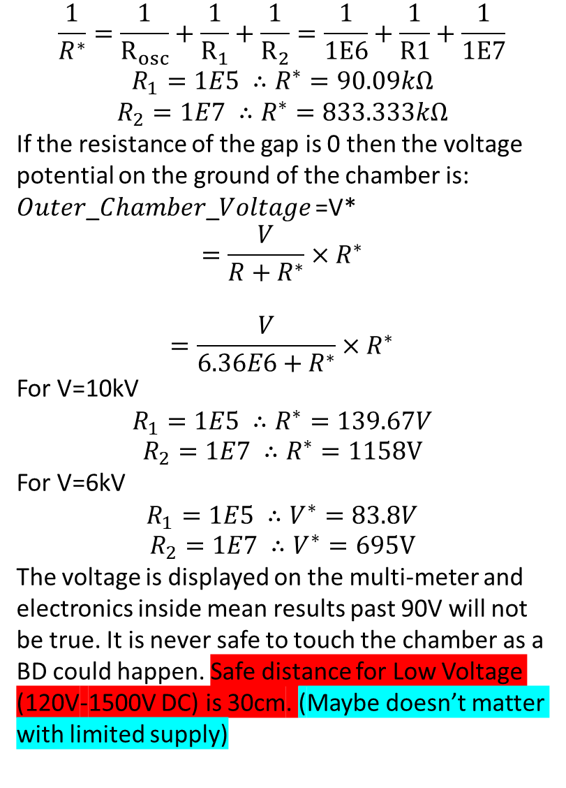
$$\frac{1}{R^{∗}}=\frac{1}{R_{osc}}+\frac{1}{R_{1}}+\frac{1}{R_{2}}=\frac{1}{1E6}+\frac{1}{R1}+\frac{1}{1E7}$$
$$R_{1}=1E5 ∴R^{∗}=90.09kΩ$$
$$R_{2}=1E7 ∴R^{∗}=833.333kΩ$$
If the resistance of the gap is 0 then the voltage potential on the ground of the chamber is:
𝑂𝑢𝑡𝑒𝑟_𝐶ℎ𝑎𝑚𝑏𝑒𝑟_𝑉𝑜𝑙𝑡𝑎𝑔𝑒 =V*
$$=\frac{V}{R+R^{∗}}×R^{∗}$$
$$=\frac{V}{6.36E6+R^{∗}}×R^{∗}$$
For V=10kV
$$R_{1}=1E5 ∴R^{∗}=139.67V$$
$$R_{2}=1E7 ∴R^{∗}=1158V$$
For V=6kV
$$R_{1}=1E5 ∴V^{∗}=83.8V$$
$$R_{2}=1E7 ∴V^{∗}=695V$$
The voltage is displayed on the multi-meter and electronics inside mean results past 90V will not be true. It is never safe to touch the chamber as a BD could happen. Safe distance for Low Voltage (120V-1500V DC) is 30cm. (Maybe doesn’t matter with limited supply)

Slide 5
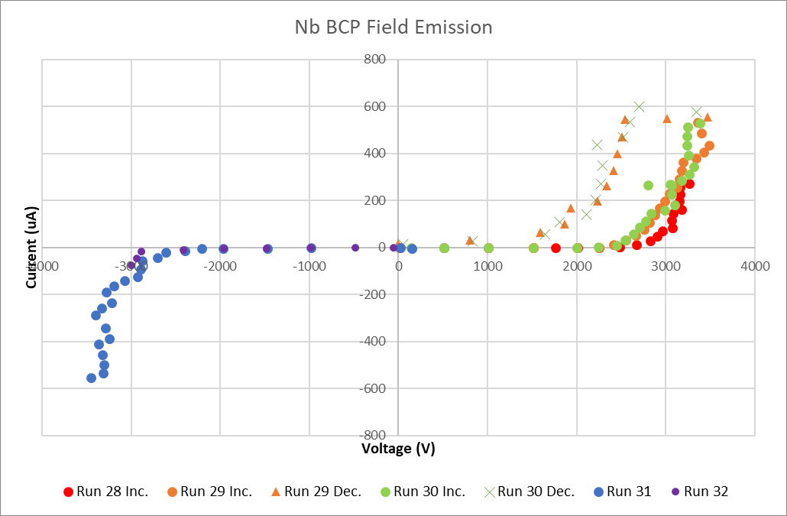
Niobium Field Emission

Slide 6
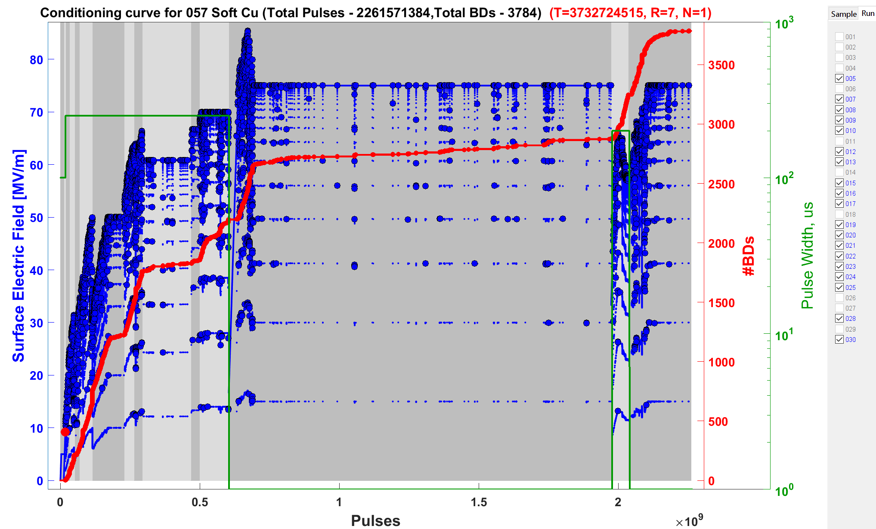
Soft Cu Conditioning

Slide 7
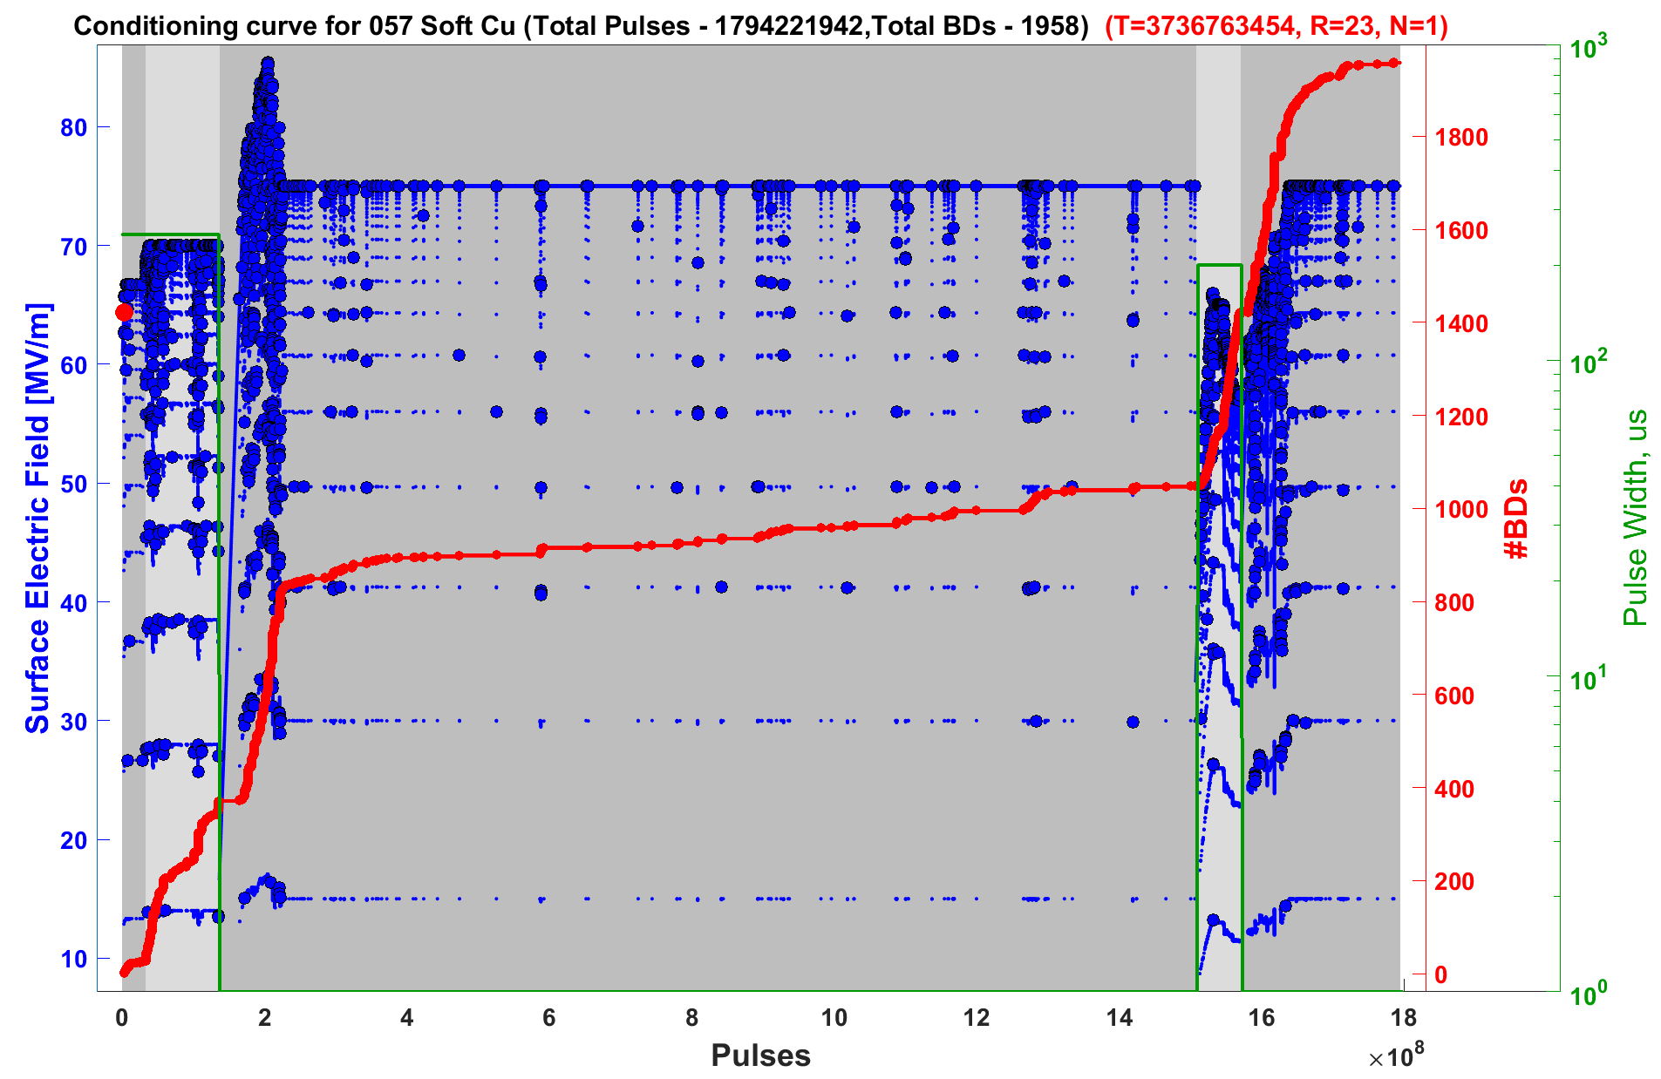
Soft Cu Conditioning

Slide 8
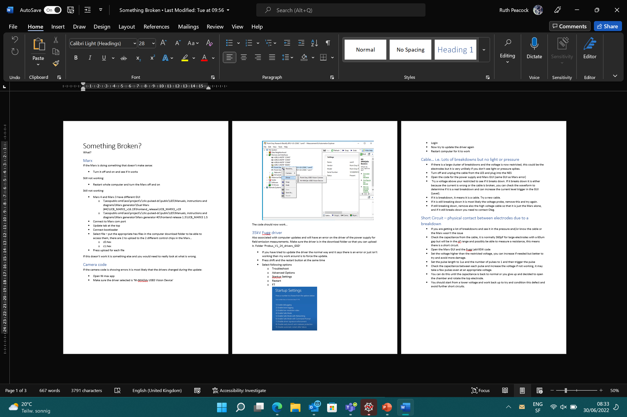
Cheat Sheet

