Slide 1
Evaluation of on-going IT Projects
Input from IT Project Managers
Marian Babik and Maria Alandes Pradillo on behalf of the PMO
5th July 2022

Slide 2
Overview
PMO Reminder
IT Project Catalogue
Project Evaluation Process
  Project Charters
  Project Evaluation Criteria
Practical Details
Projects Ending in 2022
Summary

Slide 3


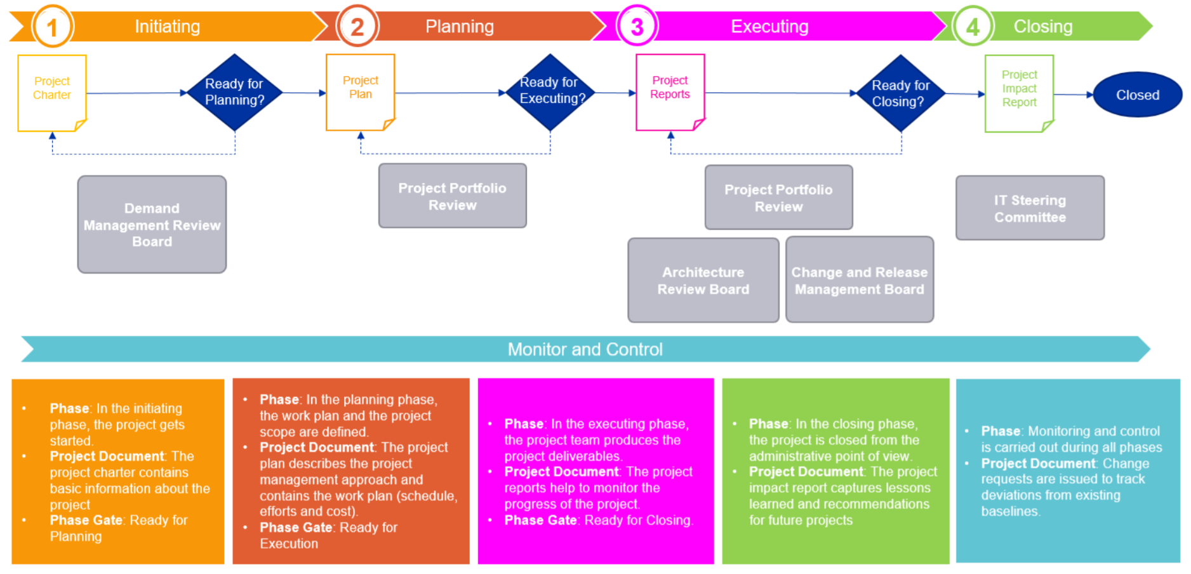


PMO Reminder
A Project Portfolio Management Office (PMO) sets and maintains standards for project management throughout an organization. It has a supporting role for decision making and for project managers.
Web Site: https://it-project-office.web.cern.ch/
  Up to date versions of project templates and lifecycle
Project Catalogue and Dashboards
Project Documentation Repository
Project Lifecycle and templates (on-going iterations to validate them)
Project portfolio Management Office
In production
Project Charter v5.10
Project Management Methodology
Support for Project Managers and Review Boards
Fore more information about the PMO, please check LIVE IT: https://indico.cern.ch/event/1157429/ (Recording available)
  An Informative PMO meeting is foreseen in Q4 2023 with all Project Managers with in-depth information about lifecycle and templates

Slide 4
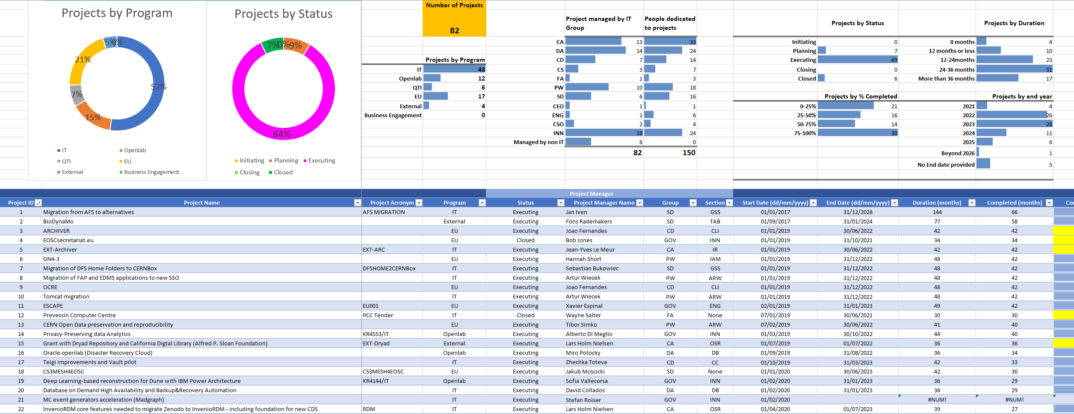
IT Project Catalogue
Collection of projects in the IT department with some basic information
  Project name, start and end date, project manager, status, etc
  There are three different catalogues:
    On-going, pending approval and closed projects
    https://cern.sharepoint.com/sites/it-project-office

Slide 5
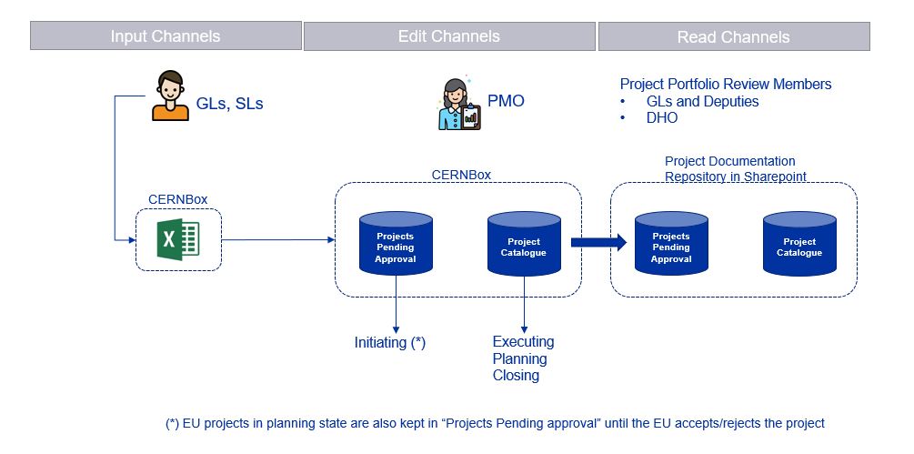
How project information has been collected
How the Project Catalogue has been built
GLs and SLs were requested to provide project information during May and June 2022
The collected information has been presented at the first Project Portfolio Review Meeting on 20th June 2022

Slide 6

Project Catalogue Validation
Next step is to validate the information in the Project Catalogue
  IT members have now access to the Project Catalogue
  We welcome feedback from everyone
    Is the information in the catalogue correct?
      Any typos? Any wrong data?
    Is there missing information for a project? Please, help us complete all the details:
      Start and End dates
      Effort
      Project Team members
    Are all the projects included?
This is a continuous process, so feel free to report any time
  Although we welcome feedback in the next weeks for a first validated version of the catalogue

Slide 7




Project Evaluation Process
Project Managers
New projects will follow the project lifecycle, but what happens with on-going projects?
  In the last PPR it was decided to evaluate on-going projects and decide whether they should be part of the portfolio or not
Which ones are affected by this exercise: “IT projects”
  EU, Openlab or QTI projects not included in this exercise
Who will do the evaluation: Project Portfolio Review
  Project Portfolio Review is DHO + GLs + EC program Lead
When: September 2022
How: Project Managers should provide Project Charters to give more details about their projects
  Project Charters will help PPR members to evaluate projects
  Project Charters contribute to transparency on the projects we run at the department
Project Charter
Project Documentation Repository (Sharepoint)
Project Evaluation Criteria
PPR members
Input for PPR

Slide 8
Project Charter and Evaluation Criteria
Project Charter
Project Summary
  Project acronym and full name
  Project Initiation Pathway (Not needed)
  Main Stakeholder
  Project Manager
  Abstract
  Estimated start and end dates and duration (Not needed)
Proposal Information
  Context (Need/Problem/Opportunity)
  Objectives
  Main Stakeholders
Strategic objectives Matrix
IT Personnel and resources
  Personnel (Not needed)
  Costs (Not needed)
  External funds (Not needed)
EU Projects section (Not needed)
Additional material
  Schedule/list of Milestones/Deliverables (optional)
Work in Progress
Evaluation Criteria
(Numerical values: 1 to 5)
Is this really a project?
Strategic area mapping (from IT Strategy)
Quality of the charter
  Quality of the contents
  Structure of the proposal
  Clear objectives
Resources
Urgency
Impact
Probability of success/risk
Value to the organization
Potential benefit to the department
Result → Project Score
PPR members
Project Managers
PPR members will assess projects based on:
Project Charter
Strategic objectives matrix
Schedule/List of Milestones (optional)
Their own experience
“Not needed” means PMO will extract this information from the Project Catalogue

Slide 9
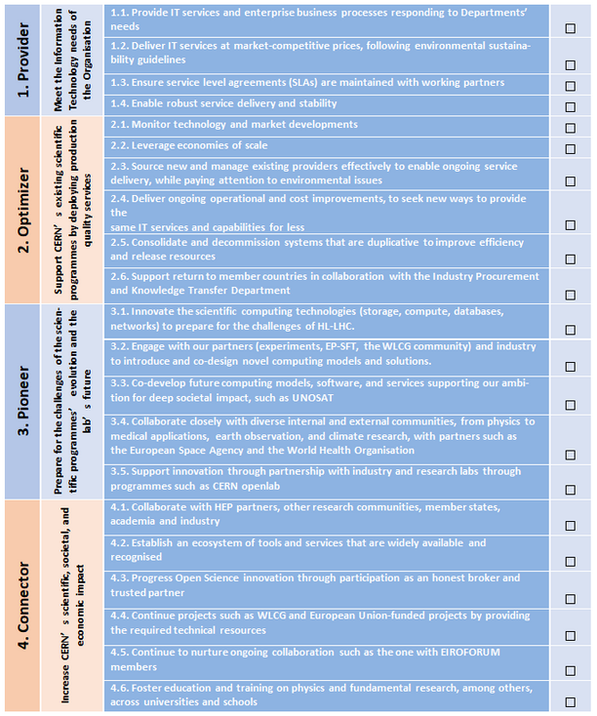
Strategic Objectives Matrix
The strategic objectives matrix contains a list of strategic objectives as described in the IT strategy document
  This information was partially provided by GLs
    See column “Relevance to IT Programme of Work and Strategy” in the Project Catalogue
  We would like to link projects to concrete strategic objectives
    The provided free text is difficult to analyse!

Slide 10
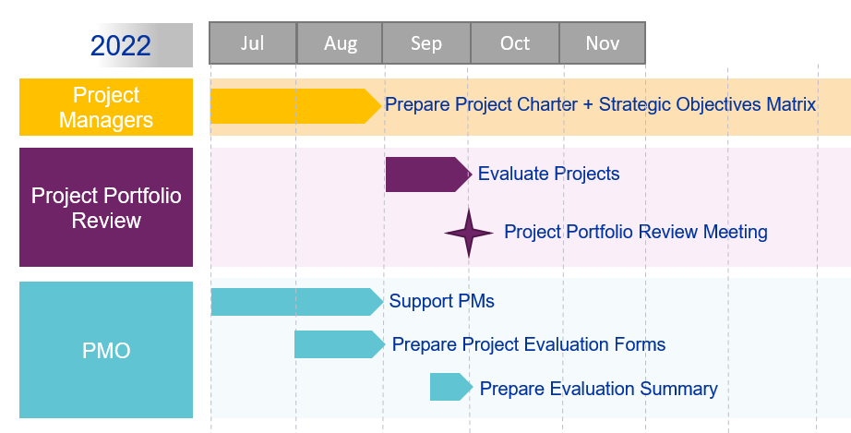


Practical Details
The Project Charter is available for download in:
  https://it-project-office.web.cern.ch/templates/
    You can check the PMO project charter example for inspiration
  Please send the charters by mail to it-pmo-team@cern.ch
  The charters will be uploaded in Sharepoint
Deadline: 26th August 2022
PMO is available for support, in particular:
Maria Alandes
Marian Babik
Keep us both in the loop during the summer in case one of us is on holidays!
CD
CA
SD
PW
GOV-CEO
CS
DA
GOV-ENG

Slide 11

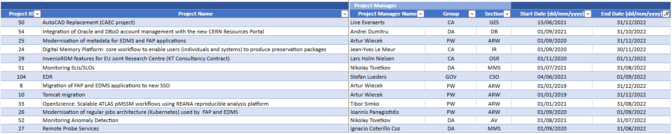
On-going projects ending in 2022
IF you are a project manager of a project ending in 2022
AND
You are sure the project will finish in 2022
THEN
No need to prepare a Project Charter
Your Project Resources will be released at the end of the project in 2022
You will have to write a Project Impact Report (more details after the summer)
ELSE
Prepare and submit your Project Charter

Slide 12
Summary
Review your project data in the Project Catalogue
  Report any errors to it-pmo-team@cern.ch
Download the Project Charter from the PMO web site
Fill in the Project Charter only for the “IT projects” (No EU, Openlab or QTI)
  In “Additional information”, you can include the project schedule/timeline/list of milestones ONLY IF this is already available for your project
Submit the project charter to it-pmo-team@cern.ch before 26th August 2022
  Do not hesitate to contact the PMO responsibles for support during the process
  The PMO will then:
    Include the missing Project Catalogue information in the charter
    Upload the charter to Sharepoint
    Notify you when this is done

