Slide 1

UPDATES FOR ITS3 PLENARY
Tuesday 28 June 2022
Aitor Amatriain Carballo

Slide 2
CONTENTS
BBM2: CFD AND MOTIVATION FOR IMPROVEMENTS
GLUE SELECTION
THERMAL SETUP
CFD SIMULATIONS FOR BBM3

Slide 3
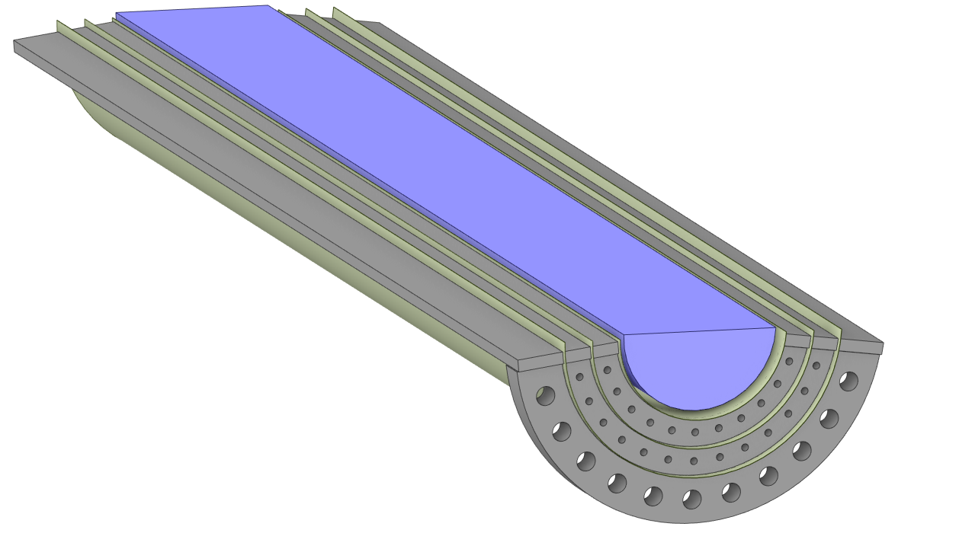
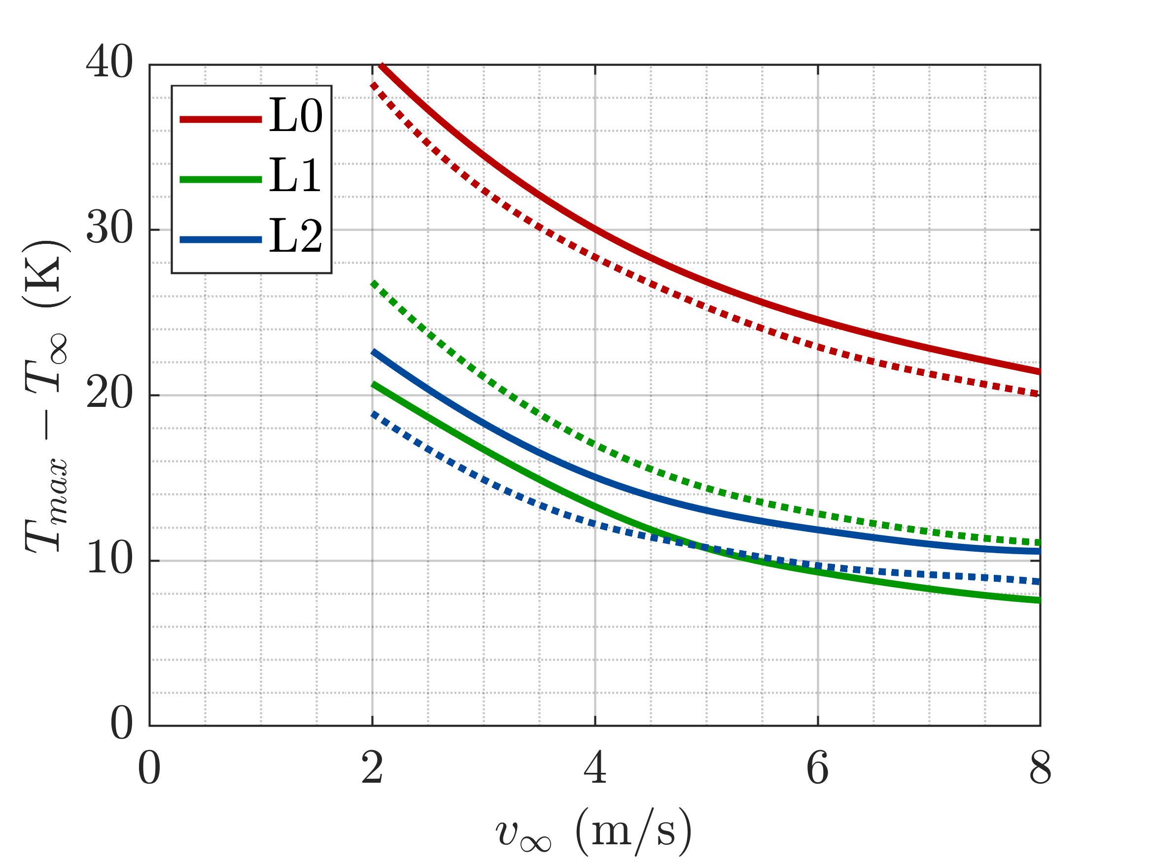
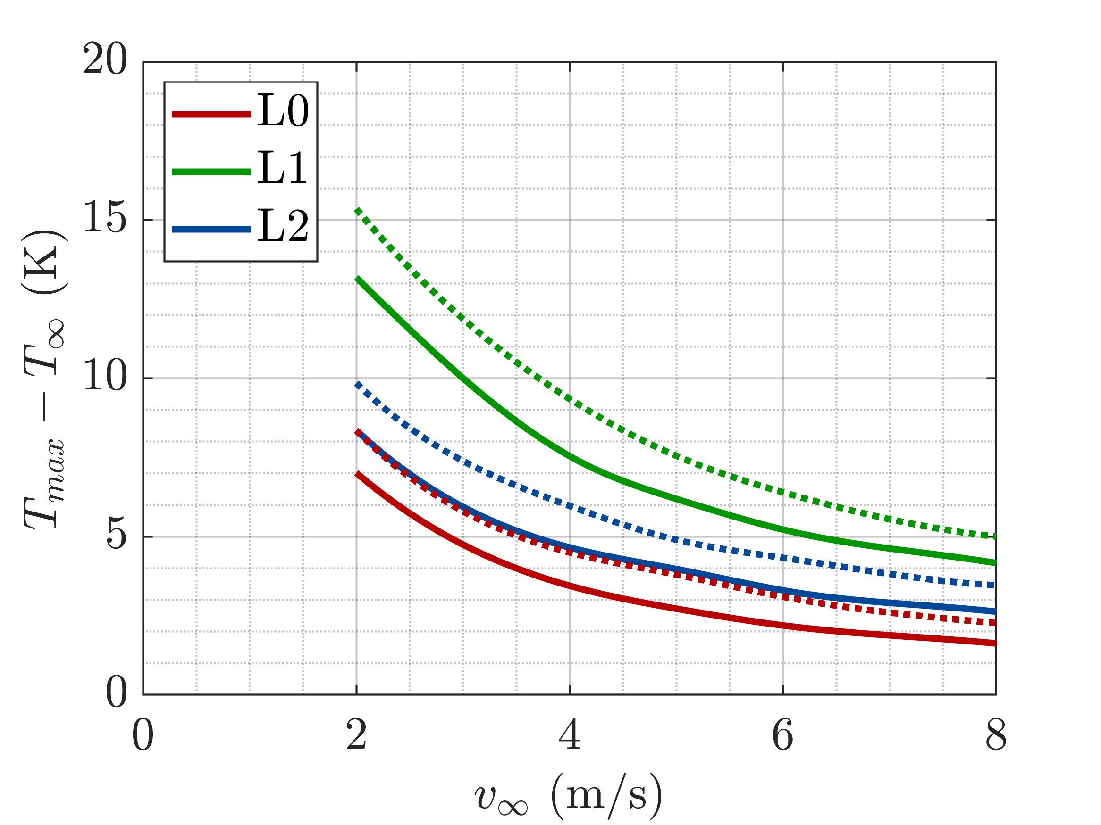
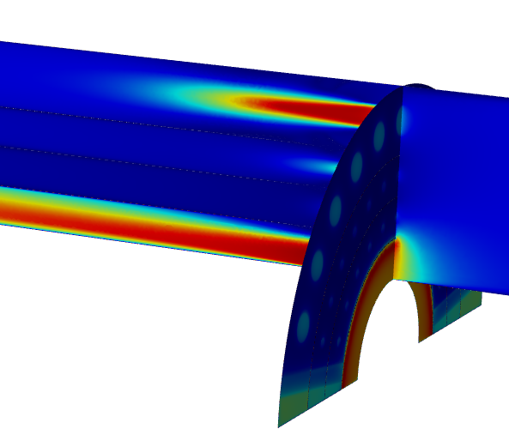
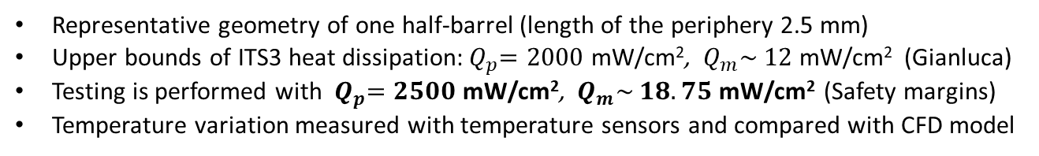
ALICE ITS3 COOLING: BBM2 - RESULTS
Representative geometry of one half-barrel (length of the periphery 2.5 mm)
Upper bounds of ITS3 heat dissipation:${ Q}_{p}=2000$ mW/cm², $Q_{m}\sim$ $12$ mW/cm² (Gianluca)
Testing is performed with ${ Q}_{p}=2500$ mW/cm², $Q_{m}\sim$ $18.75$ mW/cm² (Safety margins)
Temperature variation measured with temperature sensors and compared with CFD model
Air cooling
PERIPHERY
MATRIX
BBM2 geometry
Maximum temperature variation. Experiments (continuous lines) and simulations (dashed lines)
Velocity contour
Problem: High temperature differences, specially in the periphery of L0
Cause 1: 40 % of the flow rate in the BP-L0 layer and 42% in the L1-L2 layer -> Air flow not optimized
Cause 2: Many layers with thermally-insulative materials -> High thermal resistance, not present in ITS3
Carbon ring
Glue (Araldite2011)
Heater (Kapton+Ni)
Glue (Araldite2011)
Chip (FR4)
Glue (Araldite2011)
Carbon ring
Thermal interfaces in L1 and L2 peripheries

Slide 4
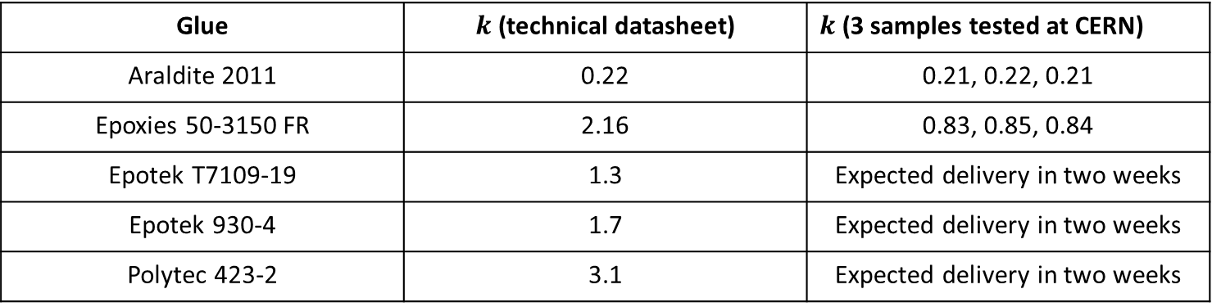
ALICE ITS3 COOLING: BBM2 – IMPROVEMENTS AREAS
GLUE
Currently used adhesive (Araldite 2011) has low thermal conductivity (0.22 W/(m*K))
Testing of thermally-conductive glues (>1 W/(m*K)) would be beneficial
Multiple candidates studied based on viscosity, thermal conductivity, electrical conductivity, curing temperature, moisture absorption, shear strength, CTE…
Four glues purchased. Araldite 2011 used to validate the measurement machine
Glue | $k$ (technical datasheet) | $k$ (3 samples tested at CERN)
Araldite 2011 | 0.22 | 0.21, 0.22, 0.21
Epoxies 50-3150 FR | 2.16 | 0.83, 0.85, 0.84
Epotek T7109-19 | 1.3 | Expected delivery in two weeks
Epotek 930-4 | 1.7 | Expected delivery in two weeks
Polytec 423-2 | 3.1 | Expected delivery in two weeks

Slide 5
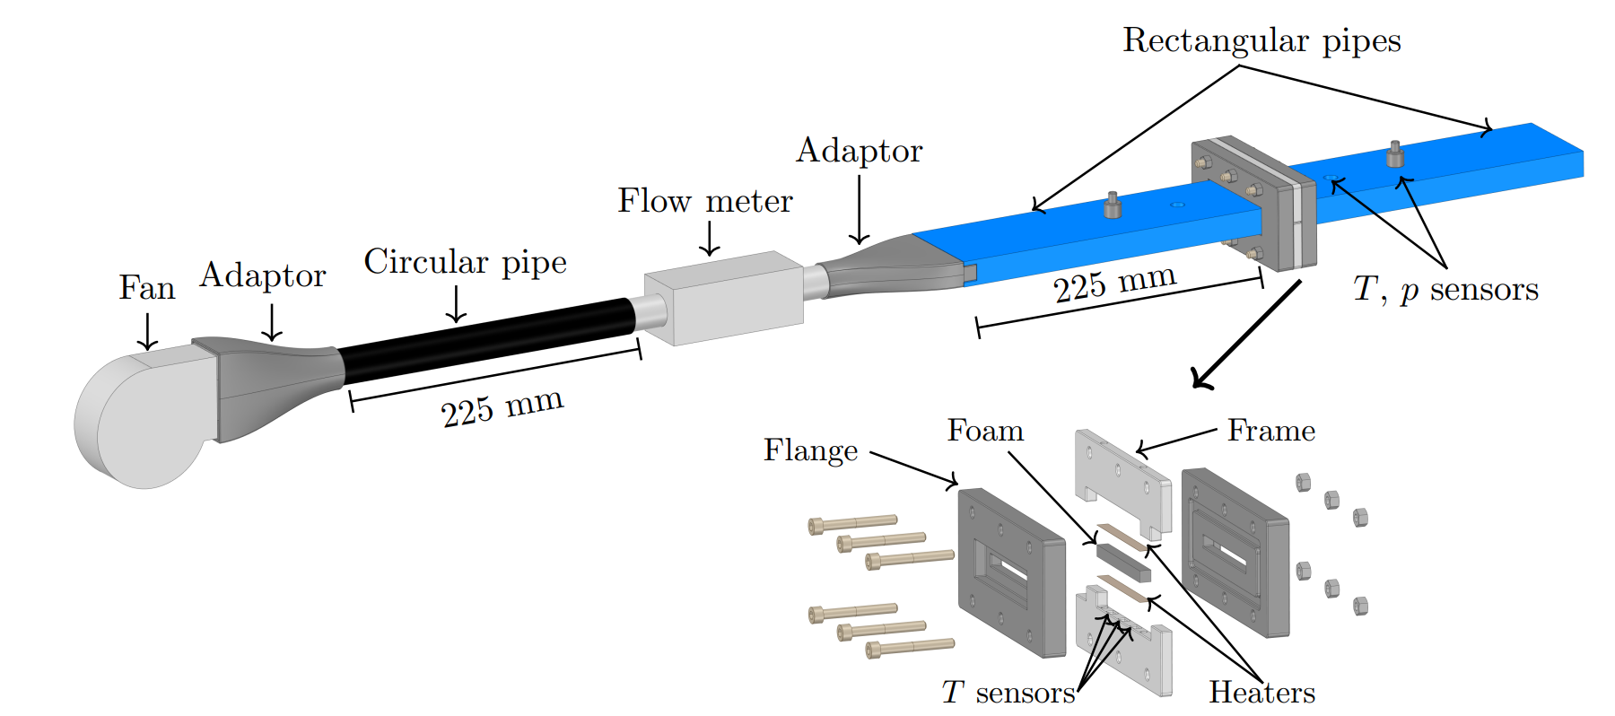
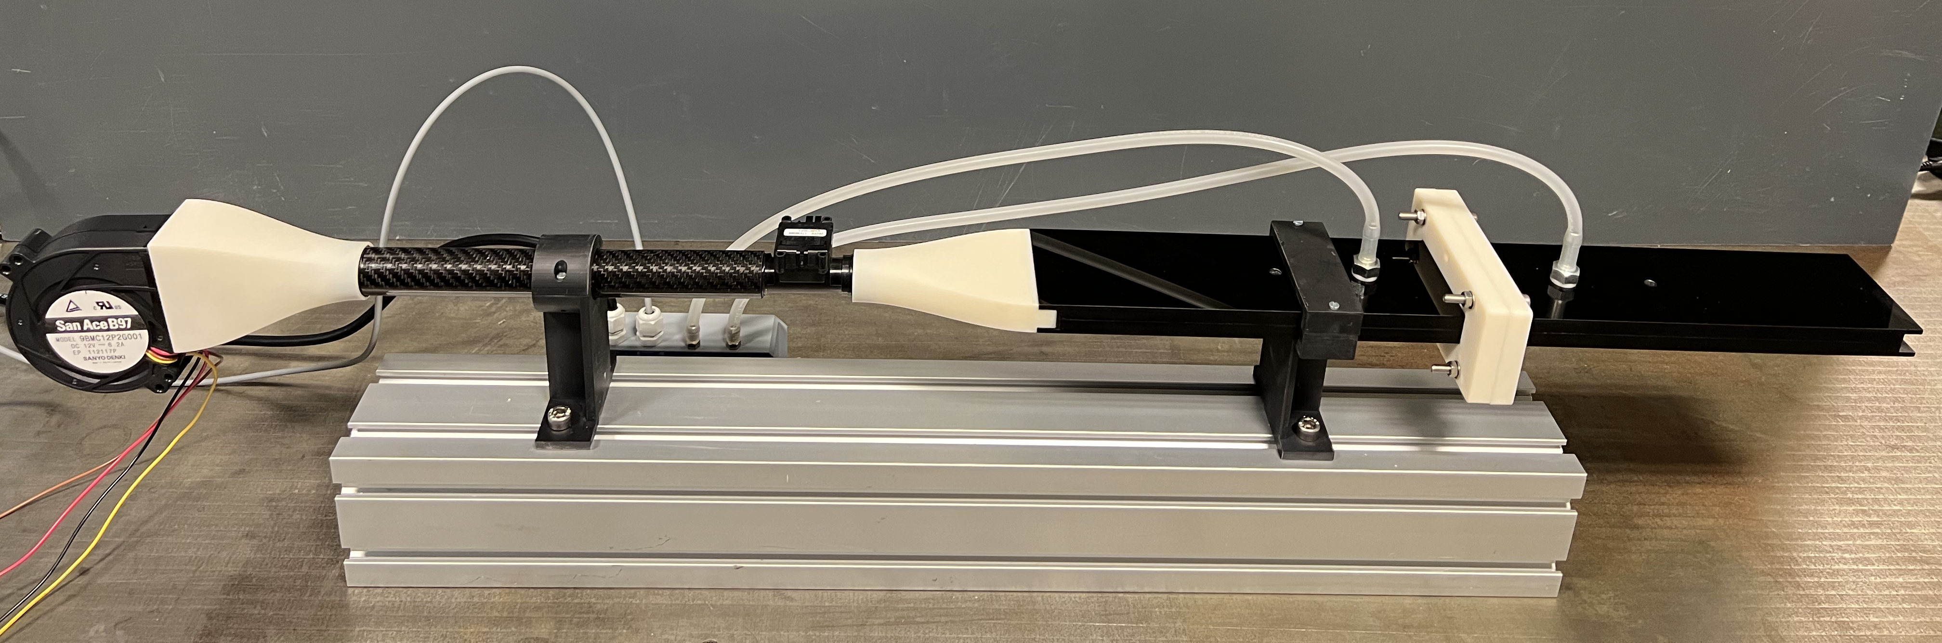
ALICE ITS3 COOLING: BBM2 – IMPROVEMENTS AREAS
CARBON FOAM
The optimum glue thickness of the foam-glue interface is unknown.
The pressure loss of the carbon foam is currently obtained from a CFD model that has been validated with other foams but not exactly the same of the rings
Thermal setup built for dedicated tests of foam samples of 6x6x60 mm
First measurements of pressure loss expected to be performed this week

Slide 6
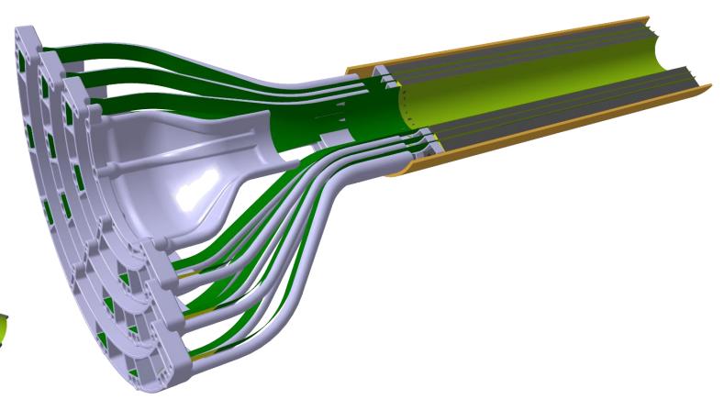
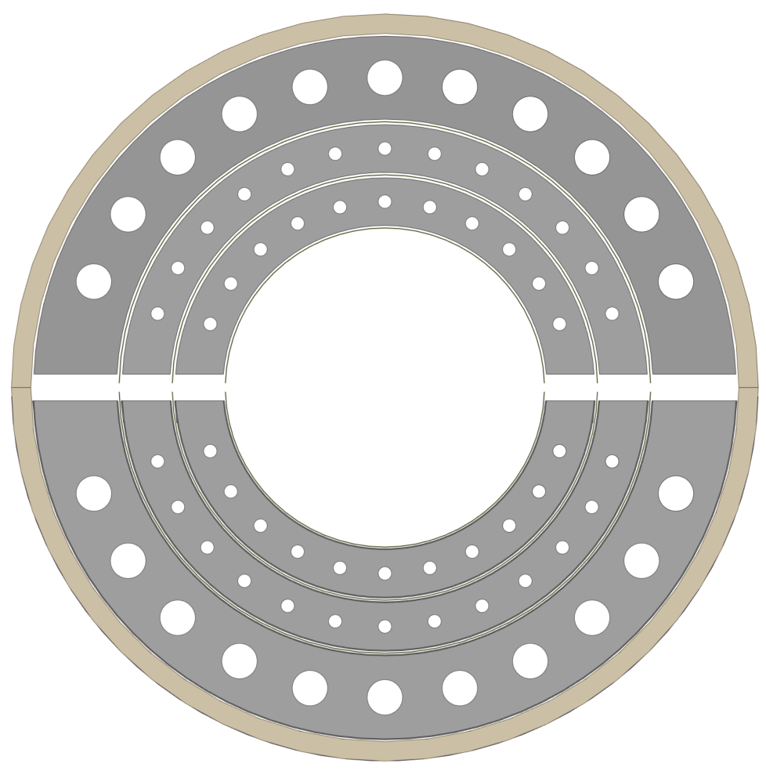

ALICE ITS3 COOLING: BBM2 – IMPROVEMENTS AREAS
INLET AIR FLOW DISTRIBUTION
The absence of a carbon ring in L0 drives the air to the BP-L0 layer where heat transfer is not effective
Apart from the channel between L0 and the beam pipe, the flow rate is strongly dependent on the diameter of the holes of the rings
Four separated flow lines will allow a better control of the flow distribution
AIR FLOW DISTRIBUTION IN EACH CHANNEL
In each layer there is a region of 3 mm of height where there is no foam -> Pressure loss of carbon foam should be minimized -> Optimization of hole size and distribution
Smaller holes provide heat transfer and higher velocities -> Aeroelastic analysis will be started in the following weeks
3 mm

Slide 7
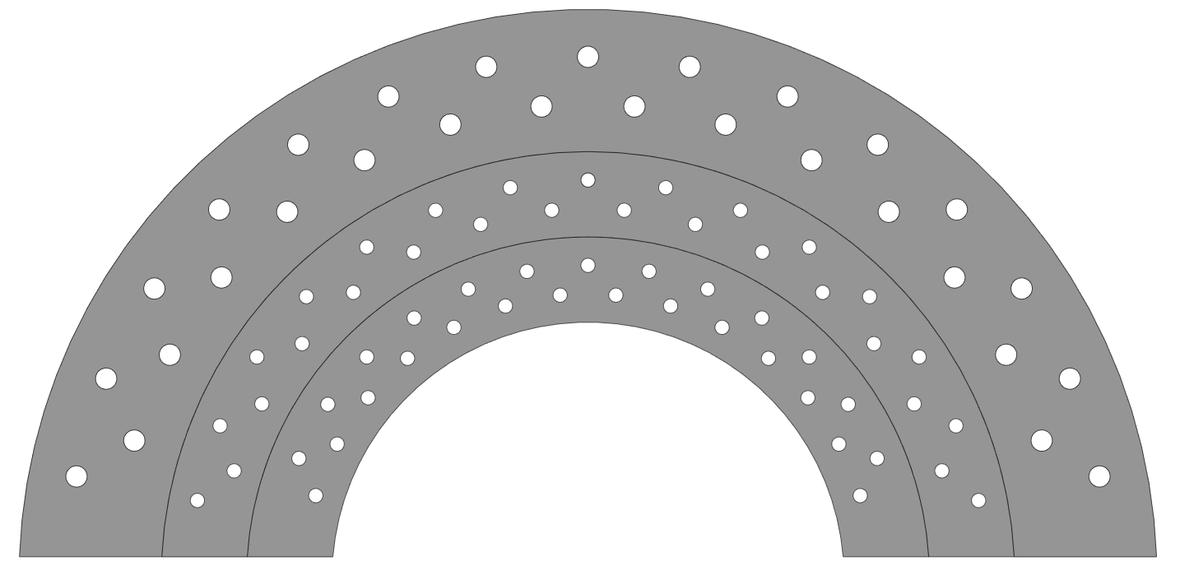
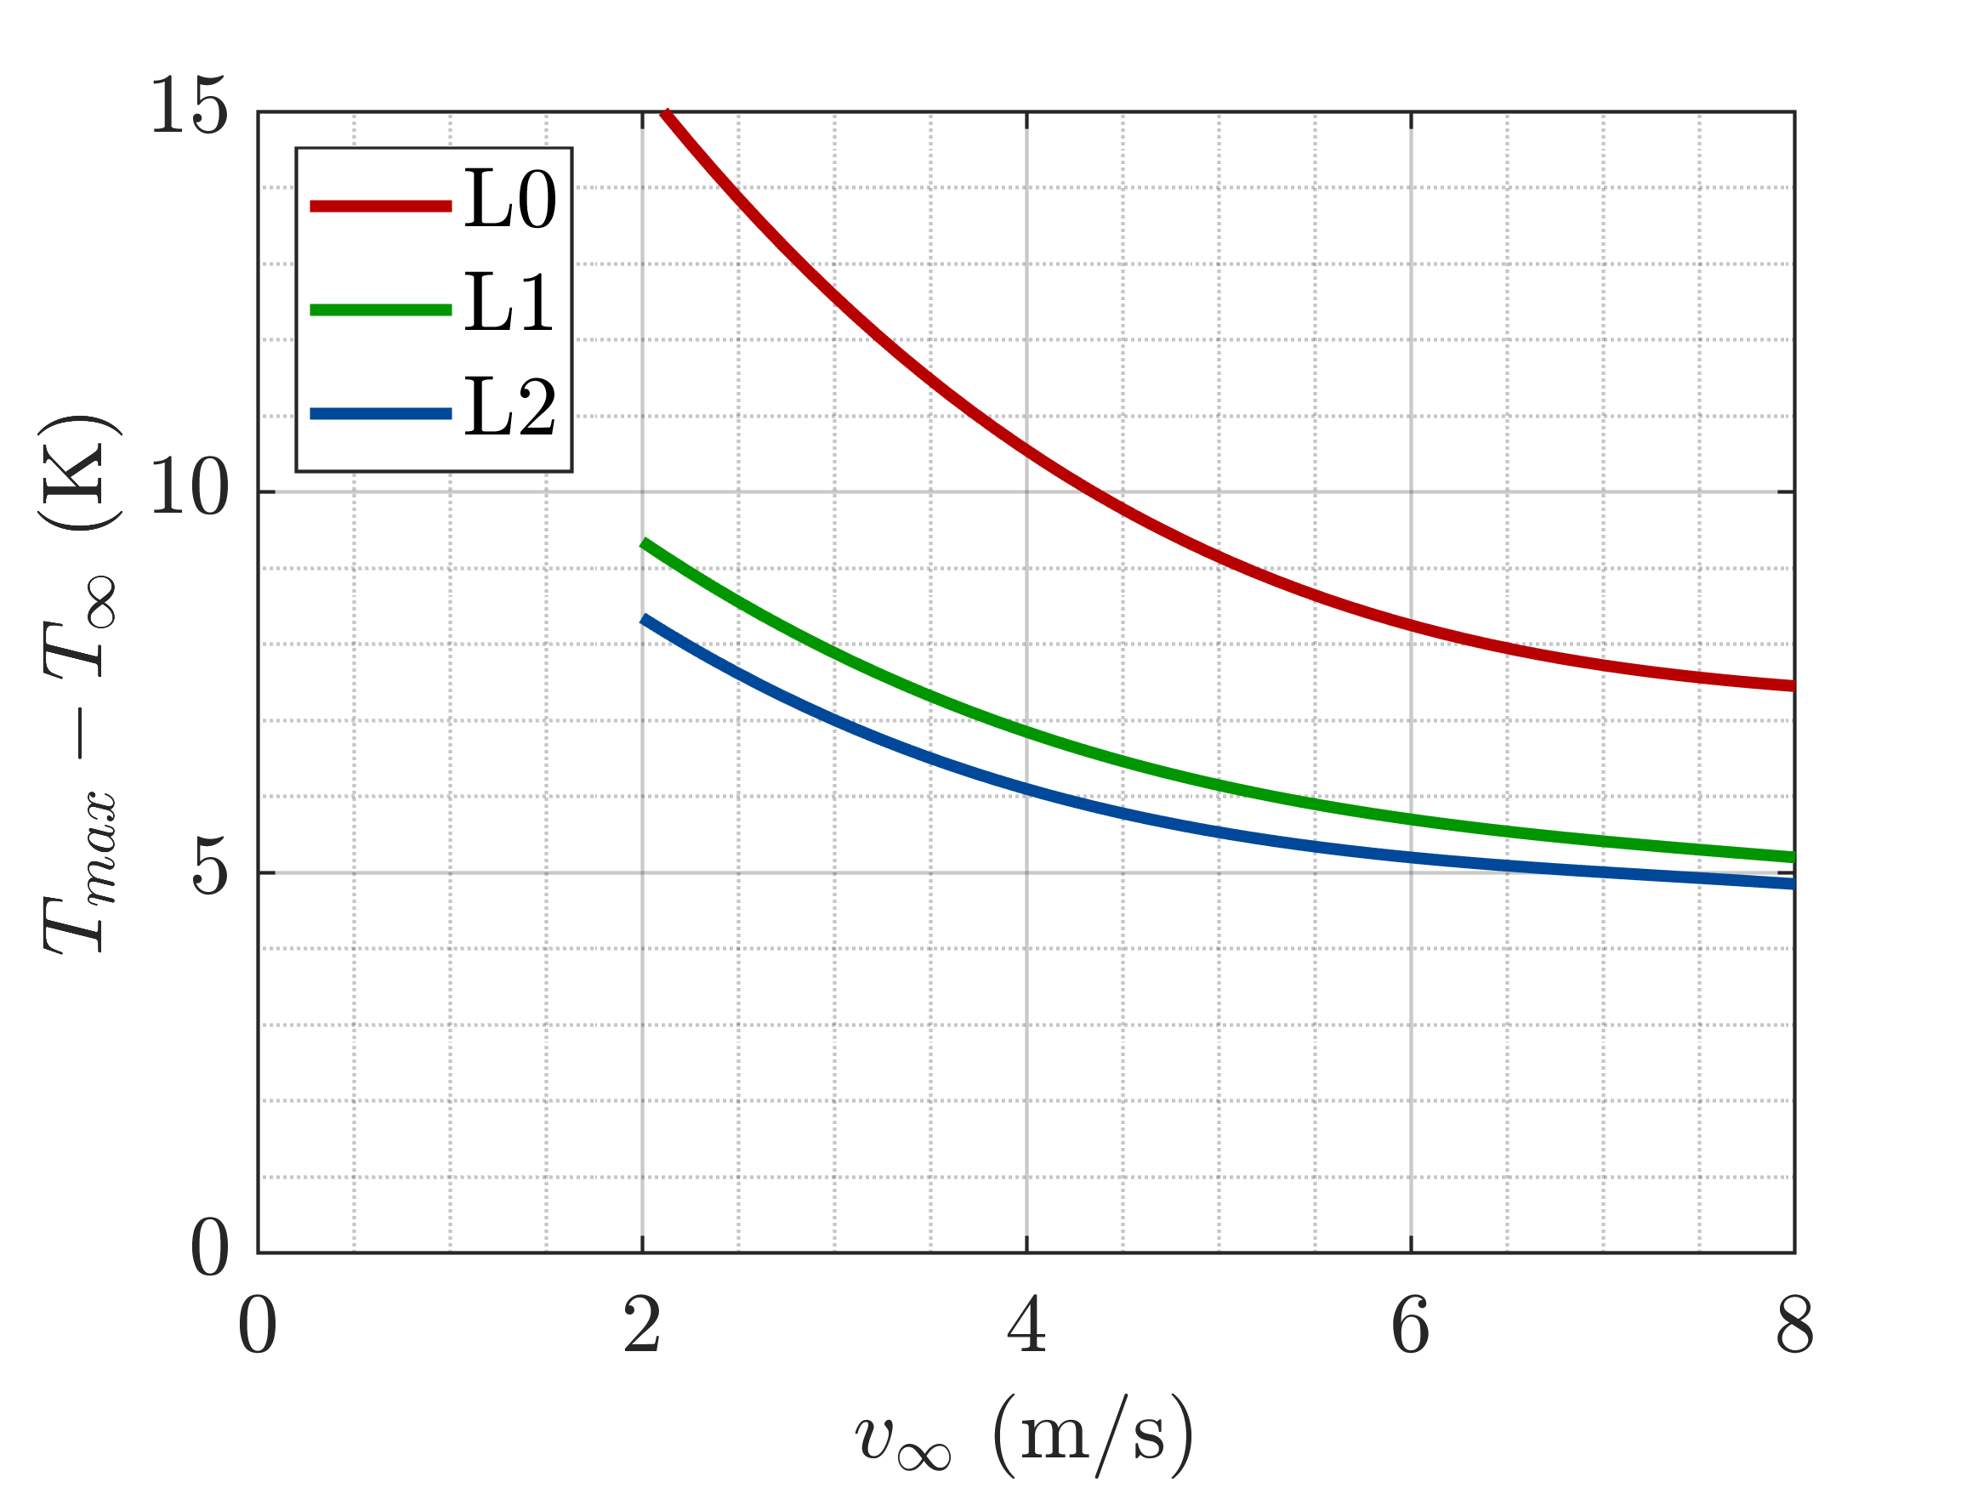
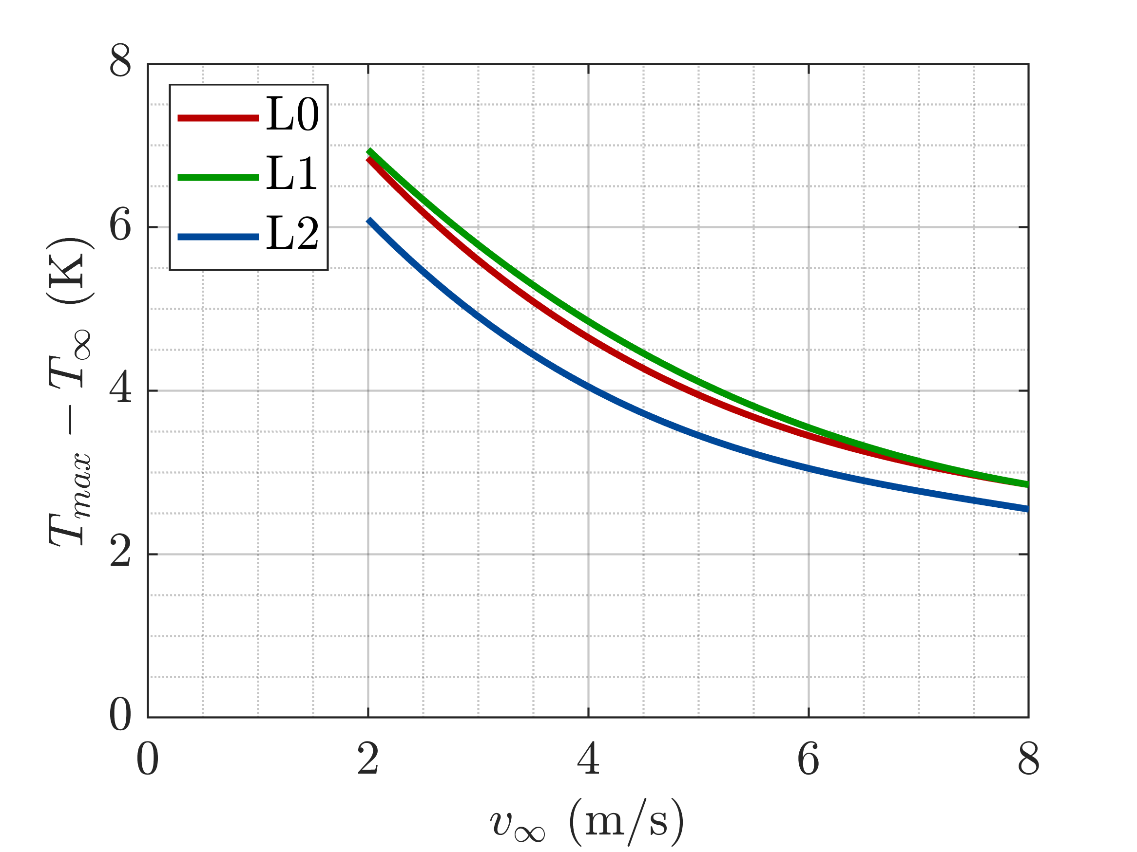
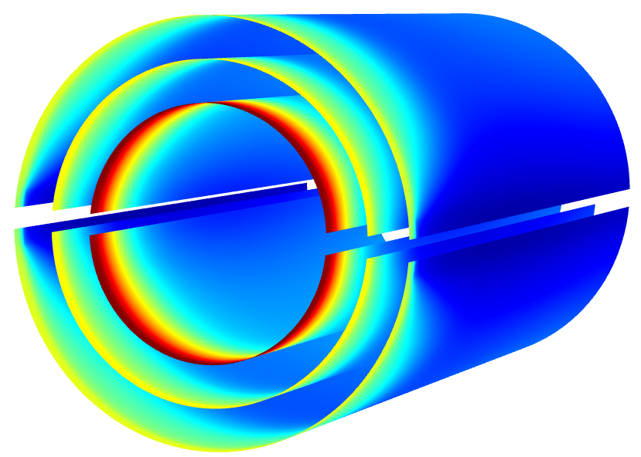
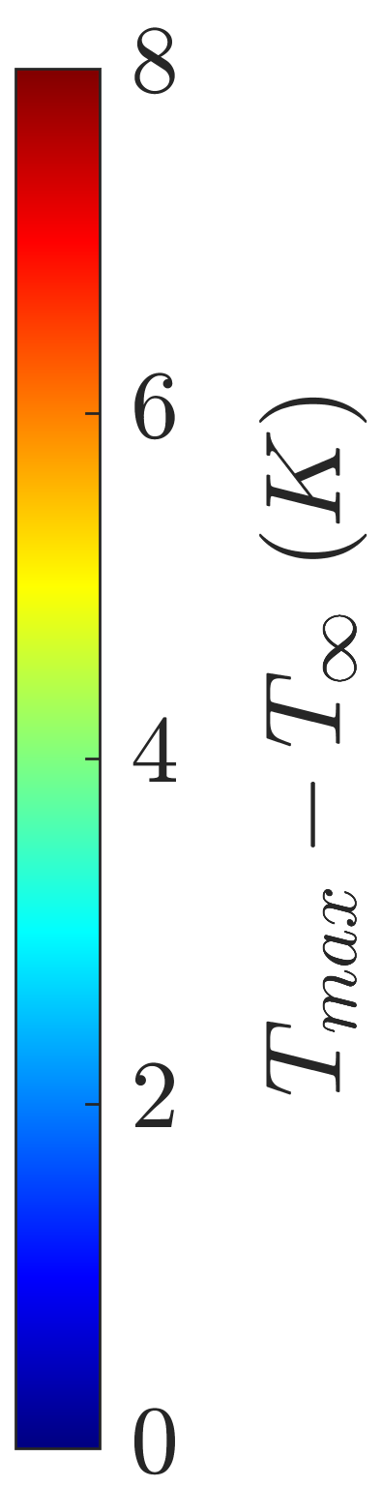
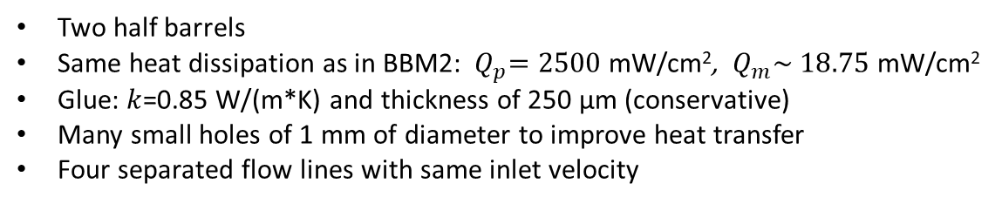
ALICE ITS3 COOLING: BBM3 – CFD SIMULATIONS
Two half barrels
Same heat dissipation as in BBM2: ${ Q}_{p}=2500$ mW/cm², $Q_{m}\sim$ $18.75$ mW/cm²
Glue: $k$=0.85 W/(m*K) and thickness of 250 µm (conservative)
Many small holes of 1 mm of diameter to improve heat transfer
Four separated flow lines with same inlet velocity
PERIPHERY
MATRIX
Maximum temperature variation
Temperature contours for $v_{∞}$= 6 m/s

