Slide 1
X-Band BOC Cavity
Design review
E.Berthomé – EN/MME
2022-06-30

Slide 2
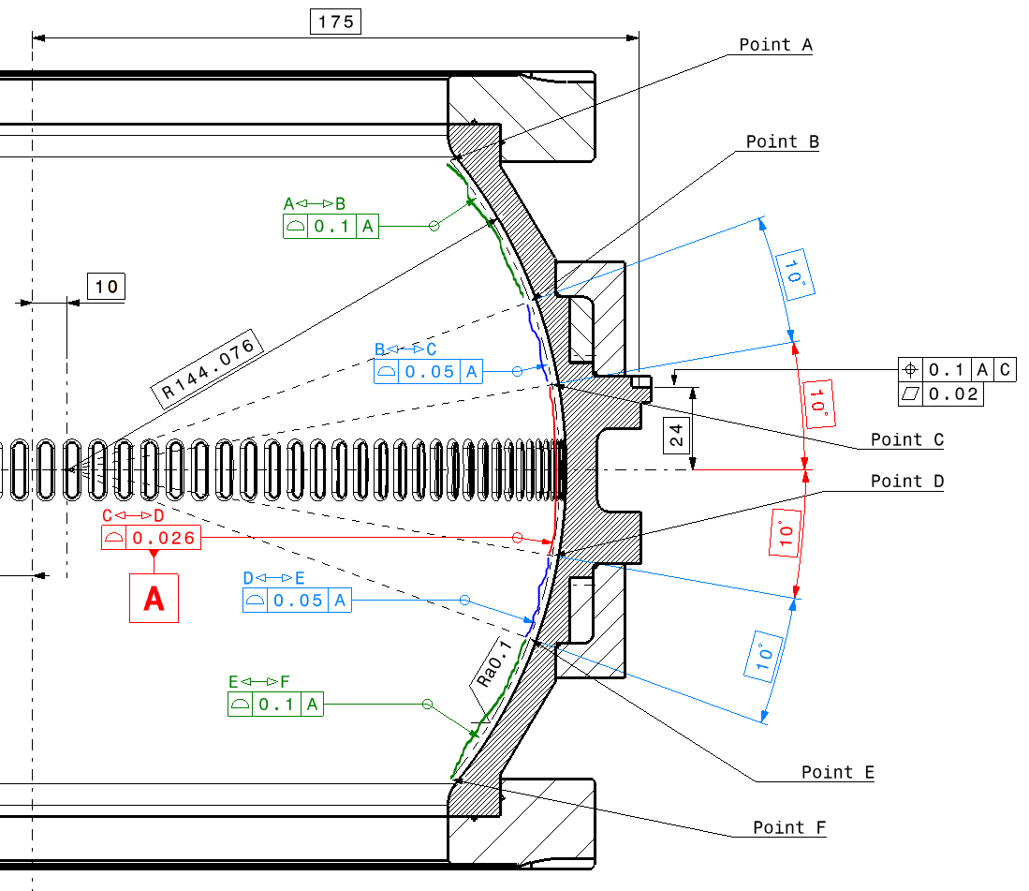
Inner shape cavity tolerance
2x Ø240 +/-0.1
2x R10 (+/-1)
E.Berthomé | X-band BOC cavity – Design review

