Slide 1
Heat Load Estimation and Dry Cooling Scheme Proposal for Sigrum
Torsten Koettig, Rob van Weelderen,
with inputs from Patricia Tavares Coutinho Borges De Sousa and Aleksandra Onufrena (CERN)

Slide 2
Content
Heat load estimation, updated
Dry cooling scheme
R&D options
Open points to address

Slide 3
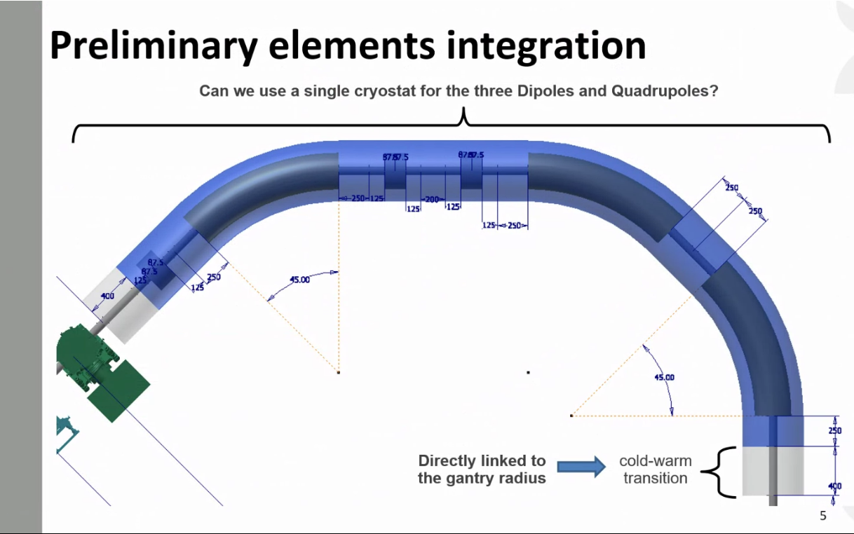
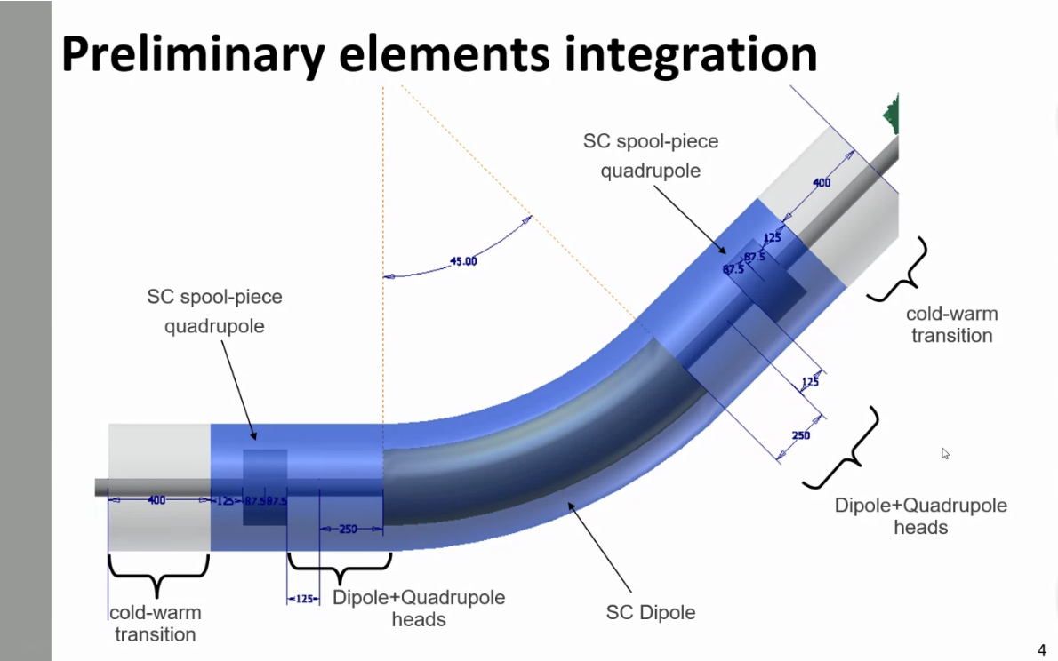
Heat loads at 4.7 K and 60 K
Parameters:
1 Dipole + 1 pair CL 2.5 kA (Dry + HTS)
2 Quadrupoles + 2 pairs CL 350 A (Dry + HTS)
Supports in G10, 30 cm, 15 cm heat intercept @ 60 K
60 K thermal shield and CL intercept
30 layer MLI @ 60 K
10 layer MLI at 4.7 K
5 W heat load on cold mass (Mikko)

Slide 4
Heat loads at 4.7 K and 60 K
Parameters:
1 Dipole + 1 pair CL 2.5 kA (Dry + HTS)
2 Quadrupoles + 2 pairs CL 350 A (Dry + HTS)
Supports in G10, 30 cm, 15 cm heat intercept @ 60 K
60 K thermal shield and CL intercept
30 layer MLI @ 60 K
10 layer MLI at 4.7 K
5 W heat load on cold mass (Mikko)

Slide 5
Heat loads at 4.7 K and 60 K
Parameters:
One common cryostat
3 Dipoles + 1 pair CL 2.5 kA (Dry + HTS)
3 Quadrupoles + 3 pairs CL 350 A (Dry + HTS)
Supports in G10, 30 cm, 15 cm heat intercept @ 60 K
60 K thermal shield and CL intercept
30 layer MLI @ 60 K
10 layer MLI at 4.7 K
5 W heat load on cold mass per dipole (Mikko)

Slide 6
Heat loads at 4.7 K and 60 K
Parameters:
One common cryostat
3 Dipoles + 1 pair CL 2.5 kA (Dry + HTS)
3 Quadrupoles + 3 pairs CL 350 A (Dry + HTS)
Supports in G10, 30 cm, 15 cm heat intercept @ 60 K
60 K thermal shield and CL intercept
30 layer MLI @ 60 K
10 layer MLI at 4.7 K
5 W heat load on cold mass per dipole (Mikko)

Slide 7
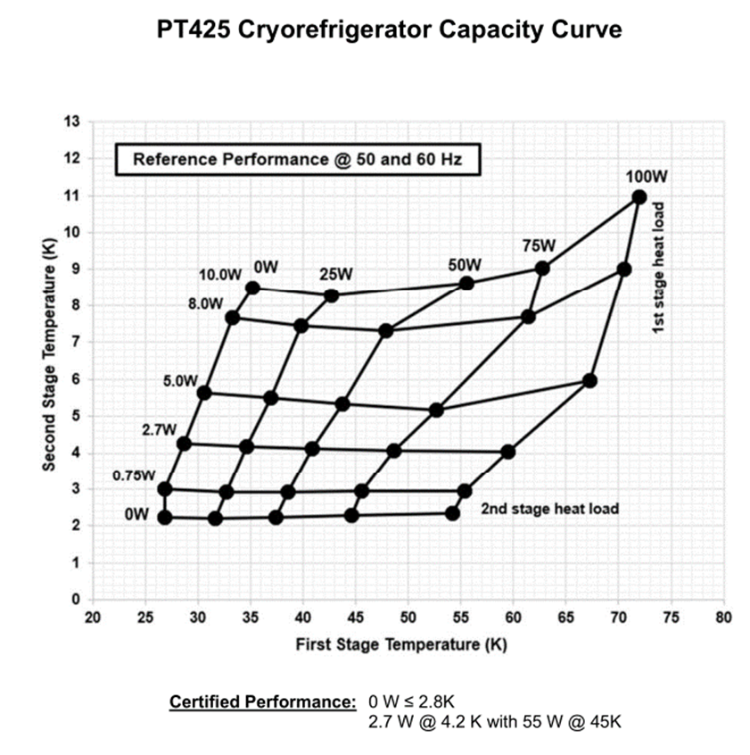
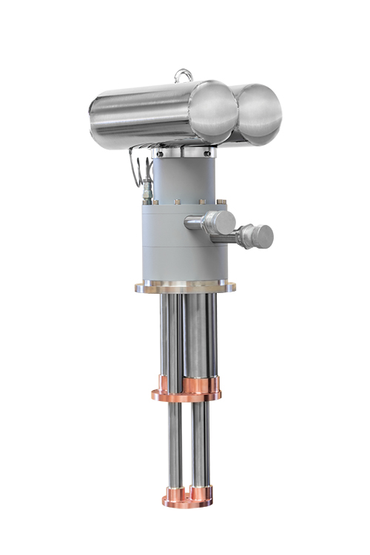
Cooling comparison
Two-stage Pulse Tube Refrigerators vs. He cryoplant
Summary |  |  |  | 2 stage |  |  |  |  |  |  | He refrigerator
 |  |  |  | PT 425
Cryostats | 1 | 2 to 4 | Total Q | # |  | Cost | Q_el in kW | kCHF/a |  |  | Total Q | Green 2008 | 2022 | Q_el in kW | kCHF/a
 | Q in W | Q in W | in W |  |  | kCHF |  |  |  |  | in W | kCHF | kCHF
T= 4.7 K | 9.008 | 24.18 | 33.2 | 13 |  | 845 | 143 | 125 |  |  | 33.188 | 304.2 | 760.6
T= 60 K | 322.78 | 439.52 | 762.3 | 9 |  |  |  |  |  |  | 50 | 393.8 | 984.6
 |  |  |  |  |  |  |  |  |  |  | 100 | 609.5 | 1523.7 | 50 | 65.7
It needs:
a dedicated cryocooler- satellite box (incl. 2 add. PTR) + distribution system
electrical insulators for the CL!

Slide 8
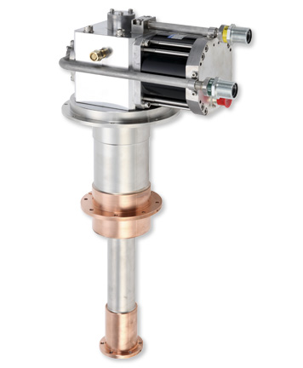
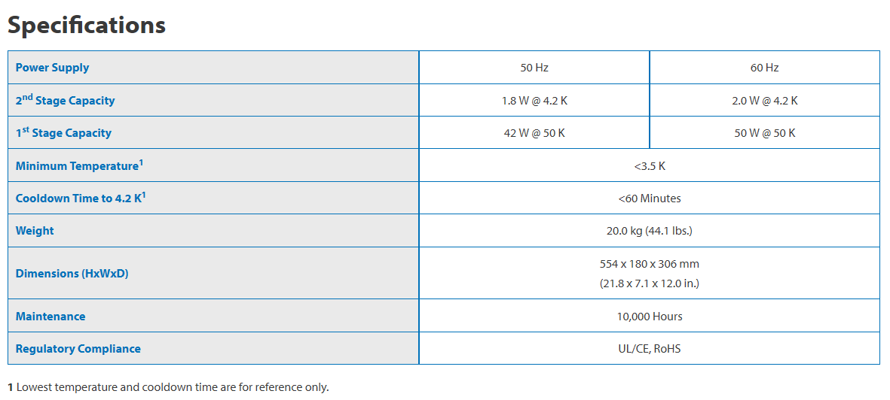
Cooling comparison
Two-stage GM Cryocooler vs. He cryoplant
Summary |  |  |  | 2 stage |  |  |  |  |  |  | He refrigerator
 |  |  |  | PT 425
Cryostats | 1 | 2 to 4 | Total Q | # |  | Cost | Q_el in kW | kCHF/a |  |  | Total Q | Green 2008 | 2022 | Q_el in kW | kCHF/a
 | Q in W | Q in W | in W |  |  | kCHF |  |  |  |  | in W | kCHF | kCHF
T= 4.7 K | 9.008 | 24.18 | 33.2 | 19.0 |  | 855 | 152.0 | 133 |  |  | 33.188 | 304.2 | 760.6
T= 60 K | 322.78 | 439.52 | 762.3 | 16 |  |  |  |  |  |  | 50 | 393.8 | 984.6
 |  |  |  |  |  |  |  |  |  |  | 100 | 609.5 | 1523.7 | 50 | 65.7
Sumitomo GM RDE-418D4 4K Cryocooler
Is there an option to reduce the number of PTC?

Slide 9
Remote cooling circuit R&D at the Cryolab at CERN
PhD thesis of A. Onufrena at the University of Twente

Slide 10
Remote cooling arrangements
Pump
Compressor
Pump
Compressor
Pump
Compressor
1 bar
(LP)
4-5 bar
(HP)
1 bar
(LP)
4-5 bar
(HP)
1 bar
(LP)
4-5 bar
(HP)
T~ 55 K
T~ 55 K
Parameters:
Boost cooling performance
Separation of PTC and CIF
SC/Sub-cooled Liquid
PTC orientation OK, if
Separate cryocooler box
T gradients in single phase flow
T~ 55 K
Very effective heat exchangers !!!
8 K
8 K
4.5 K
~1 bar
~1 bar
~4-5 bar
Cooling interface
Cooling interface
Cooling interface
T~ 4.5 K
T~ 4.5 K
T~ 4.3 => 4.7 K

Slide 11
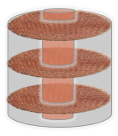
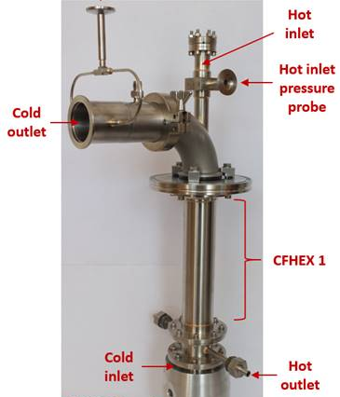


Critical components: compact CFHEXs
Hot flow
Outlet flow:
$T_{lp}$, $p_{lp}$, ${\dot{m}}_{out}$
Inlet flow:
$T_{hp}$, $p_{hp}$, ${\dot{m}}_{in}$
2-stage GM cryocooler
Main design features:
Concentric tube-in-tube CFHEX with stacked copper mesh as fins
Large “wetted” area + compactness
High radial & low axial thermal conductivity (due to wire-wire interfaces)
Scalable, demonstrates an ease of manufacturing, and adaptable to many applications
CFHEX 1
1st stage
Cold flow
Cold flow
CFHEX 2
2nd
stage
Cryocooler envelope
CFHEX 3
Radiation shields
Great candidate for a high-effectiveness compact heat exchanger!
0.1 m
Joule-Thomson expansion
Experimental
cooling interface (CIF)
Remote envelope

Slide 12
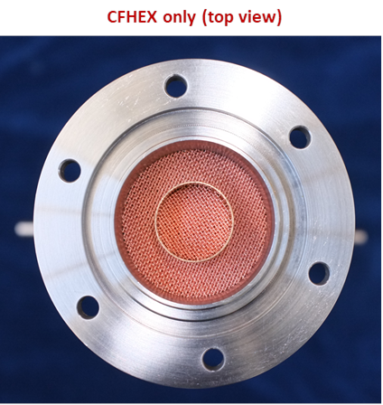
Critical components: compact CFHEXs
Inner tube-mesh interface
Axial conduction
CFHEX numerical model was built and correlated with experimental data [1]
Test results have shown that inner tube-to-mesh interface conductance and axial conduction have a strong influence on effectiveness
Novel CFHEX design proposed (patenting in progress)
[1] A. Onufrena, et al. “Cryogenic Performance of a Compact High-Effectiveness Mesh-Based Counter-Flow Heat Exchanger”, Cryogenics, 2022

Slide 13
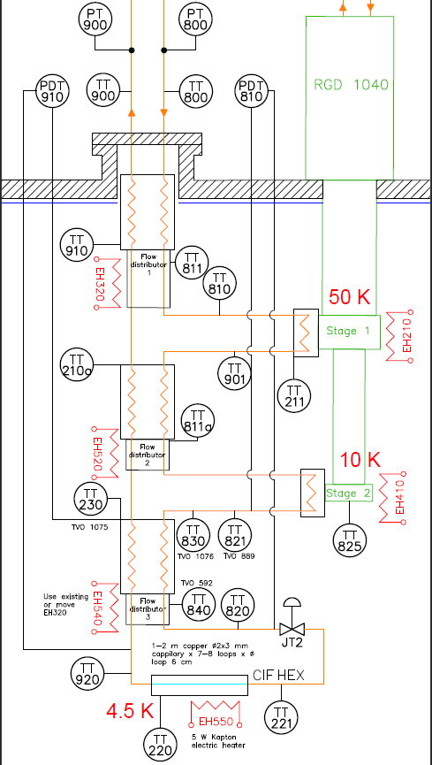
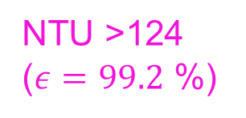
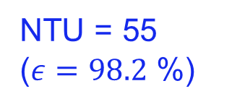
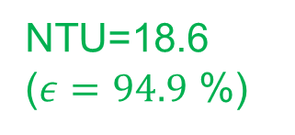
Critical components: compact CFHEXs
Very high experimental performance achieved with the novel mesh-based CFHEX design
NTU=18.6 ($ε=94.9$ %)
NTU = 55 ($ε=98.2$ %)
NTU >124 ($ε=99.2$ %)

Slide 14





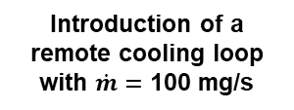
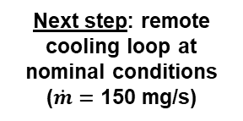




System performance results
$p_{lp,out}=$ 1.3 bar
$p_{hp,in}=$ 3.7 bar
Cryocooler envelope
$p_{lp,out}=$ 1.0 bar
$p_{hp,in}=$ 5.3 bar
2-stage
GM
cryocooler
Cryocooler envelope
CFHEX 1
2-stage
GM
cryocooler
CFHEX 1
2-stage
GM
cryocooler
$≈$ 50 K
$≈$ 50 K
CFHEX 2
$≈$ 40 K
CFHEX 2
Introduction of a remote cooling loop with $\dot{m}=$ 100 mg/s
$≈$ 10 K
Next step: remote cooling loop at nominal conditions
($\dot{m}=$ 150 mg/s)
$≈$ 10 K
Remote envelope
8.8 K
Remote envelope
0.4 W at 8.8 K at the 2nd stage
CFHEX 3
CFHEX 3
Boost: 1.3 W at 4.5 K at 0.7 m distance from the 2nd stage
Boost: 0.4 W at 4.6 K at 0.7 m distance from the 2nd stage (demonstrated already) !
0.4 W @ 4.6 K
Experimentally demonstrated
1.3 W @ 4.5 K

Slide 15
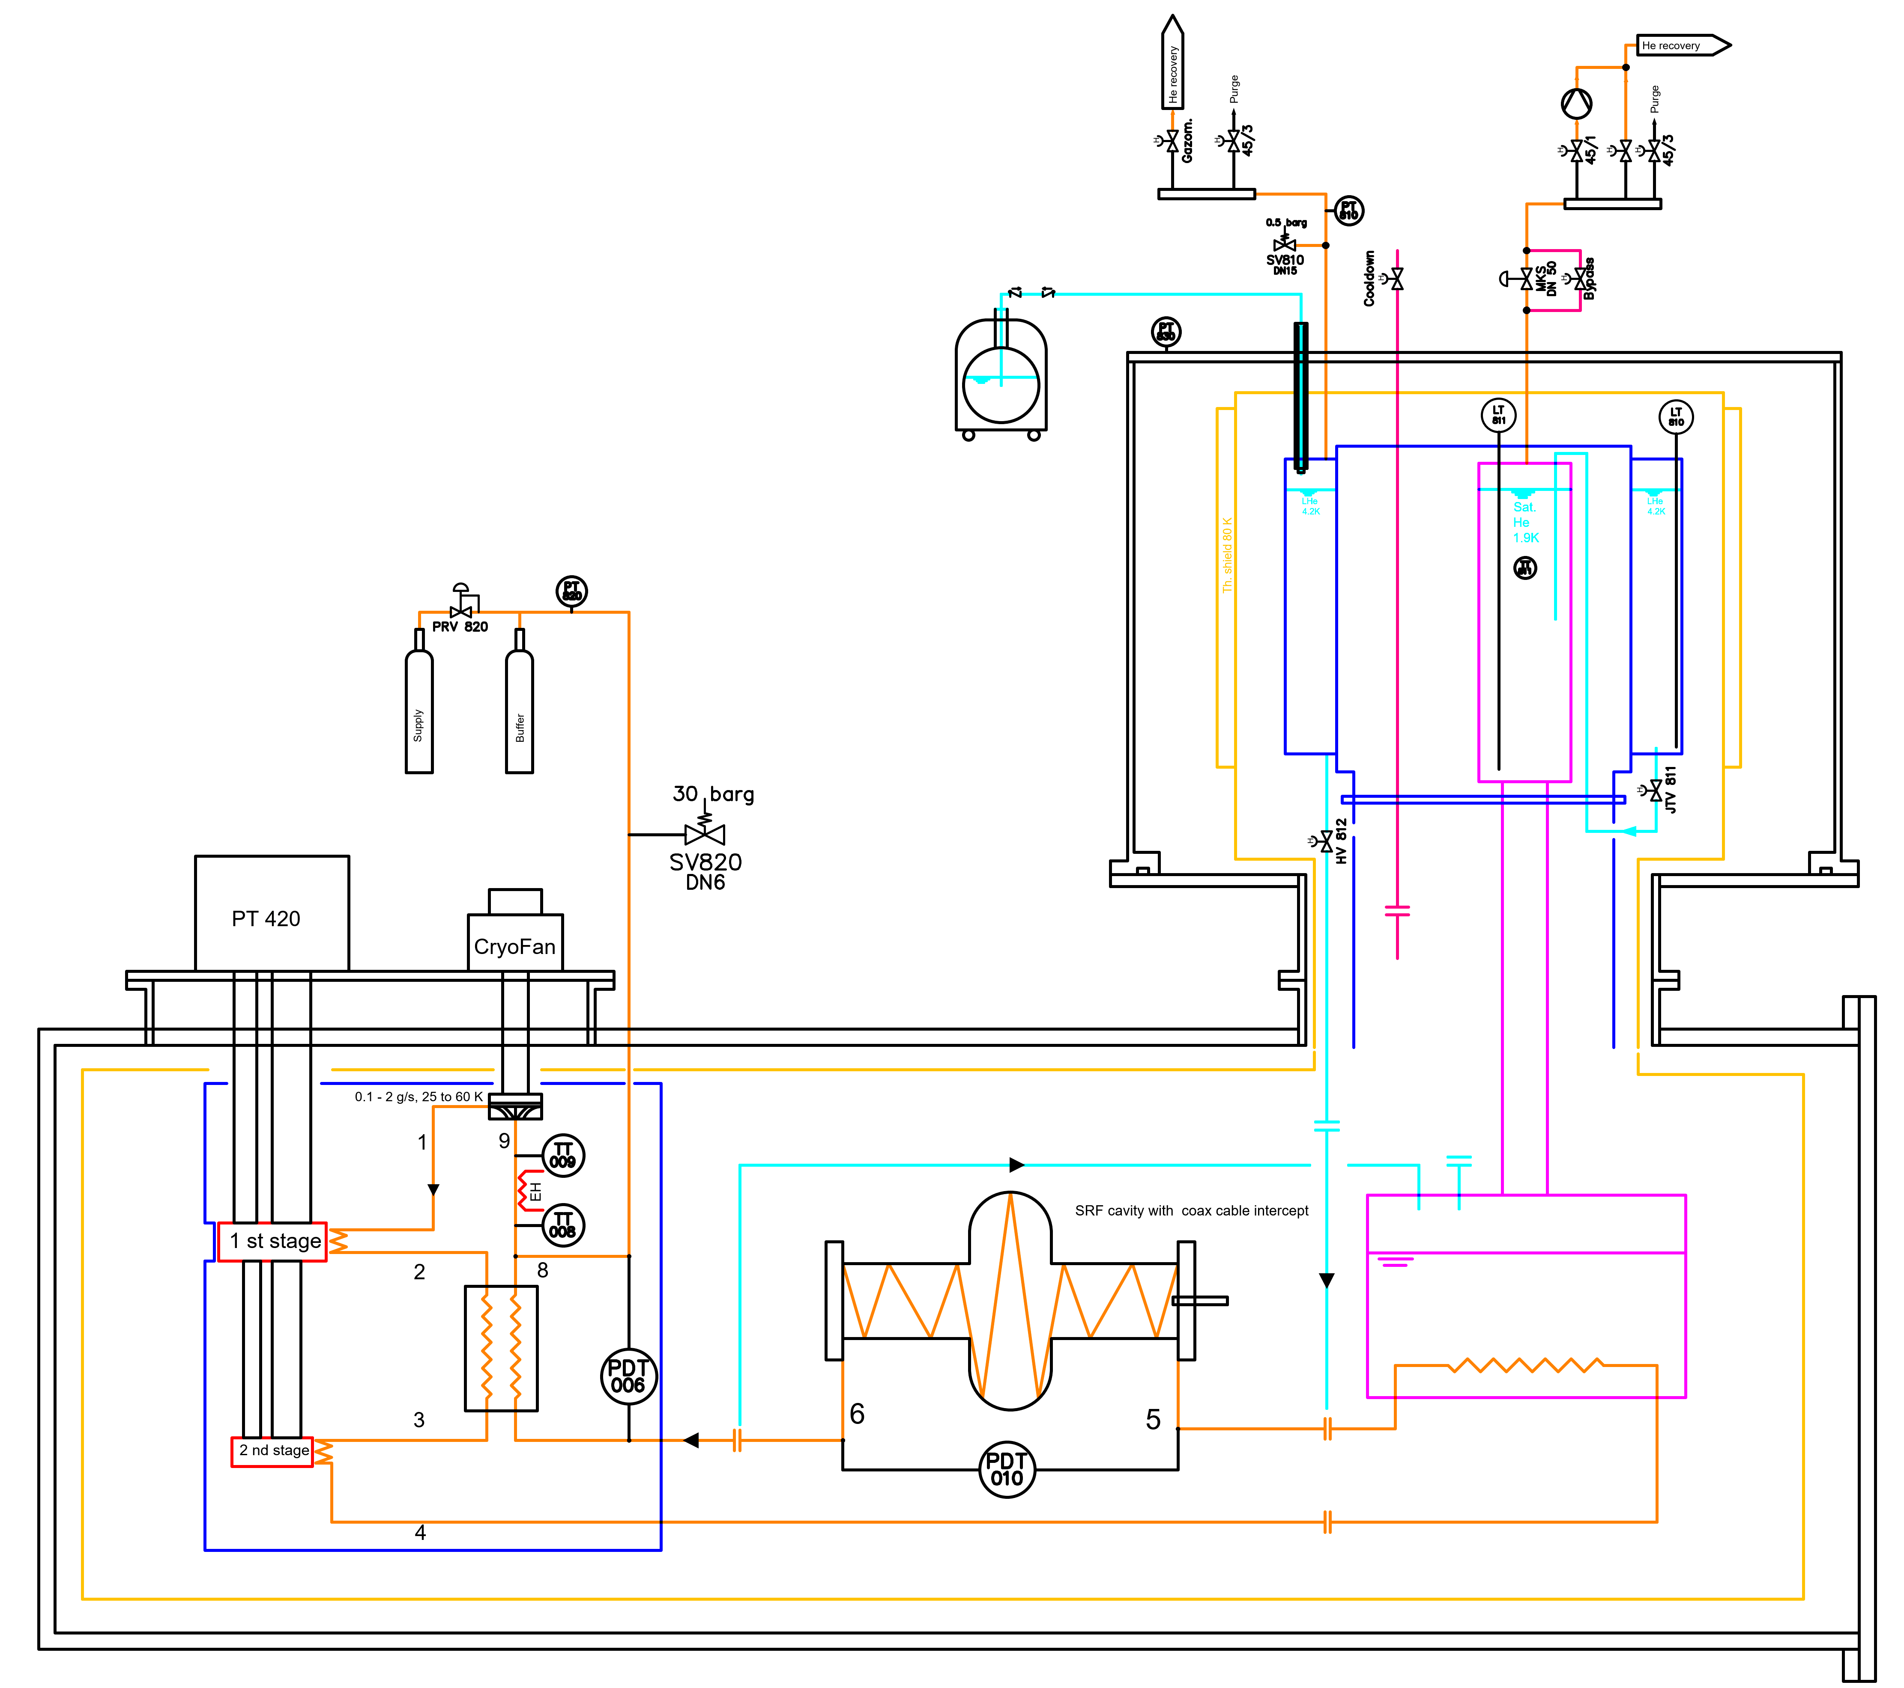
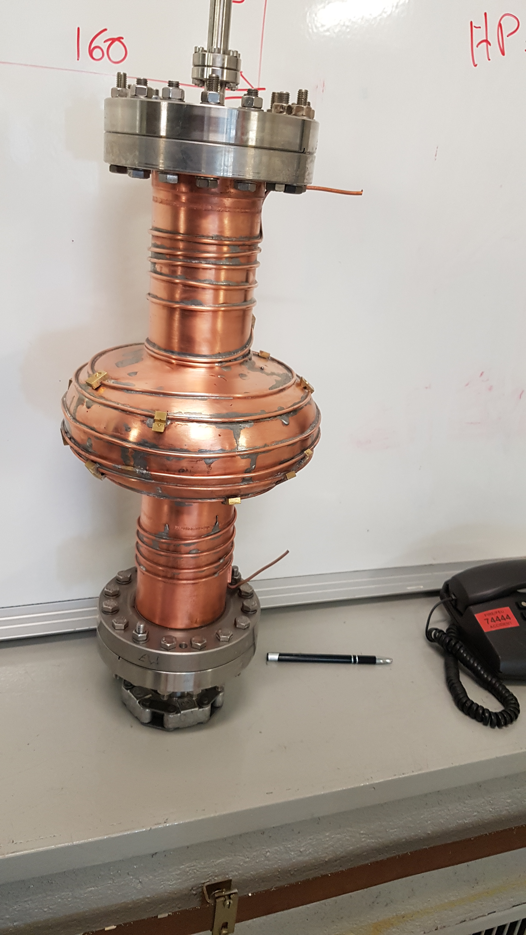
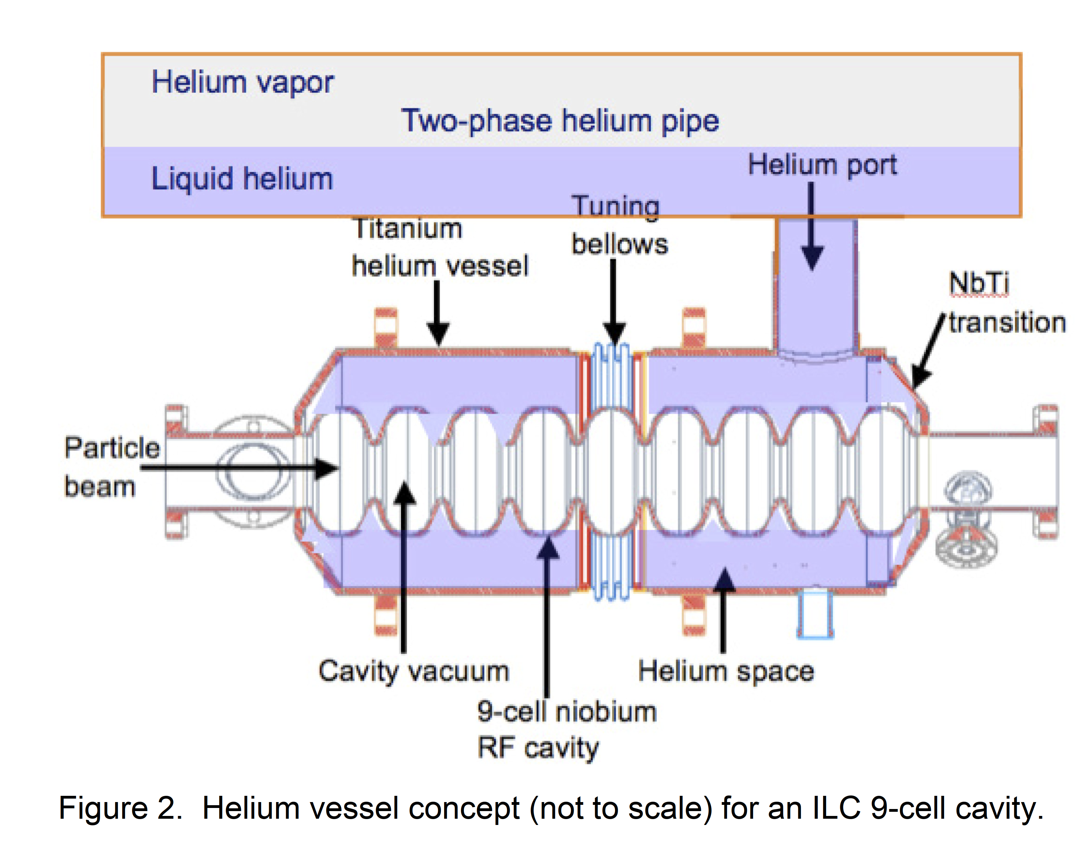
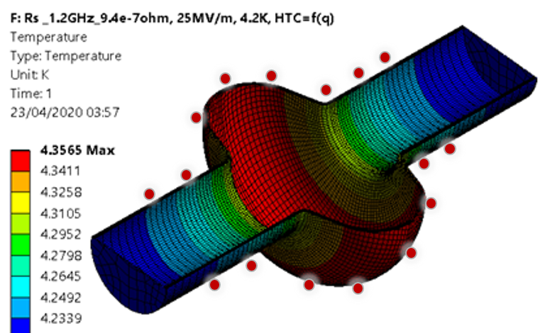
Applications: dry SRF cavity cooling
Dry cooling principle
Test setup to study dry colling (system performance, flow in the capillary)

Slide 16
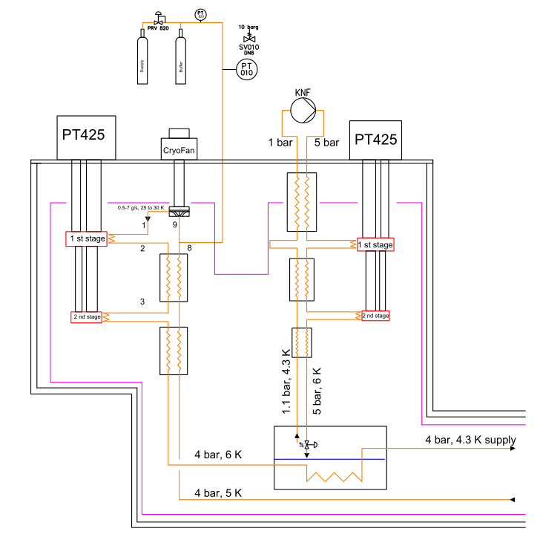
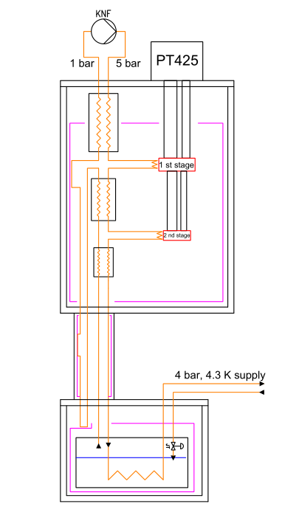
Application to Sigrum
Subcooled 4 bar cooling loop – high Q
Subcooled 4 bar cooling loop
Pushing the limits is one of our current R&D topics in the Cryolab
3-4 x

Slide 17
Summary
Can we refine the heat loads?
Study of the thermal interface to the cold mass at T< 4.7 K
Thermal gradients along the cooling channel and perpendicular
Quadrupoles, heat load and more
Rotation angle of the gantry => feedthroughs, which are rotating, cold and leak-tight?
Options to cool the prototype, in LHe and then dry (incl. the cooling tube already)
Remote cooling R&D will proceed in the Cryolab

