Slide 1
Vertex2022 2nd IAC 30.6.2022
LOC: same members as for Vertex2020
Local Organising Committee
Kazuhiko Hara (Uni of Tsukuba, chair)
Toru Tsuboyama (KEK, co-chair)
Koji Hara (KEK)
Akimasa Ishikawa (KEK)
Tsutomo Mibe (KEK)
Toshinobu Miyoshi (KEK)
Koji Nakamura (KEK)
Yoshiyuki Onuki (Uni Tokyo)
As KH is retiring end March 2023,
Koji Nakamura is to take KH’s place for Vertex
ATLAS ITk pixel
LGAD

Slide 2
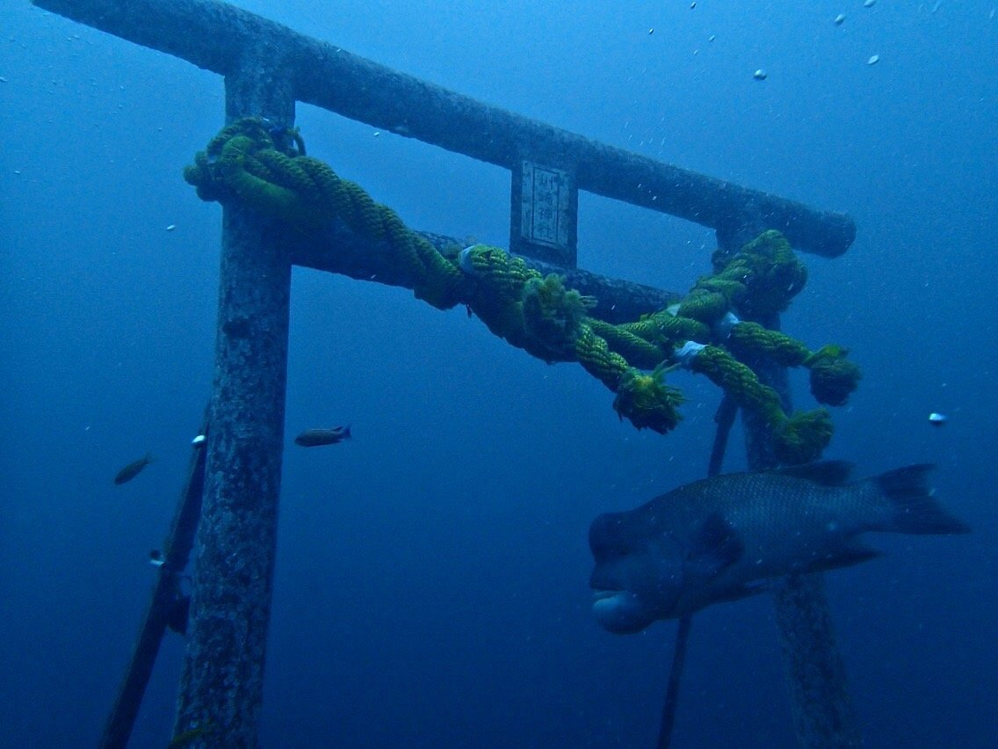
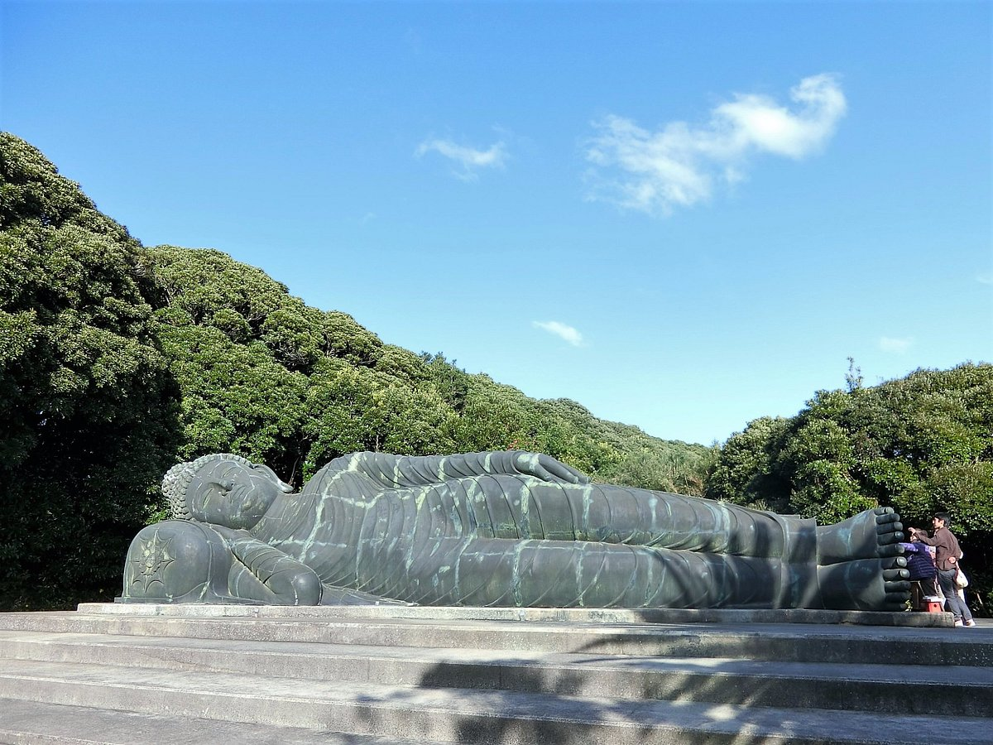
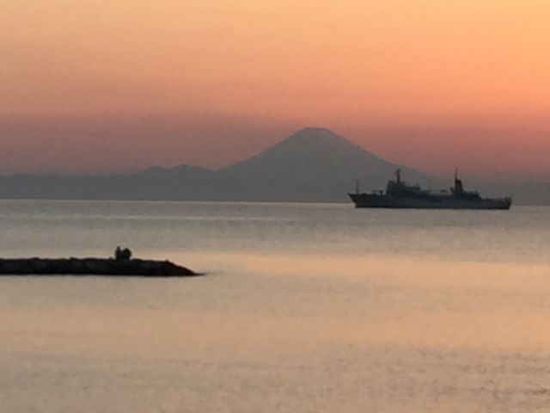
Tateyama City & Resort Hotel location
Narita
Haneda
Tateyama
Kamogawa Sea World
(excursion)
Resort Hotel
Public route to Tateyama Station:
3.5hr from Narita airport by trains
95min from Haneda (direct bus:time table)
Station⇔Hotel:
Hotel shuttle (need reservation)
1km

Slide 3
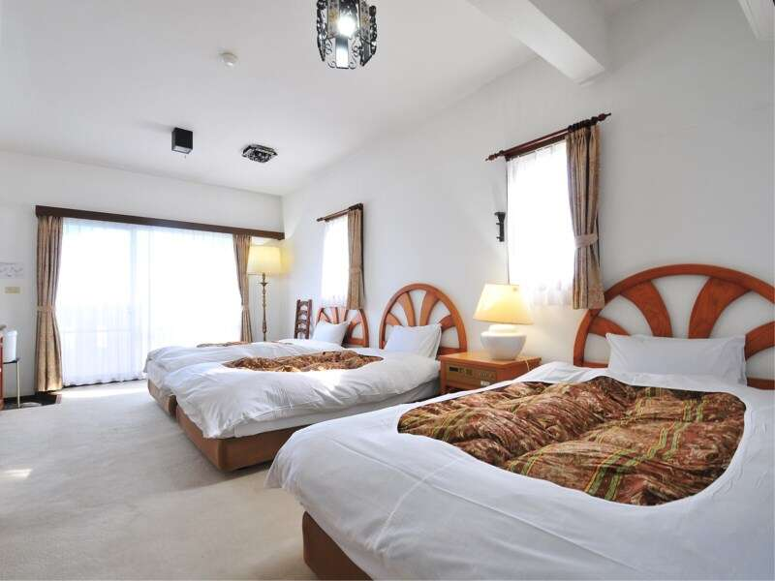
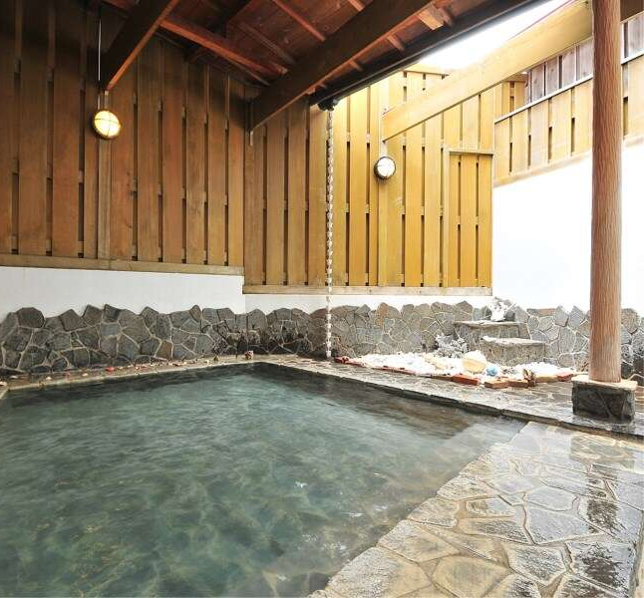
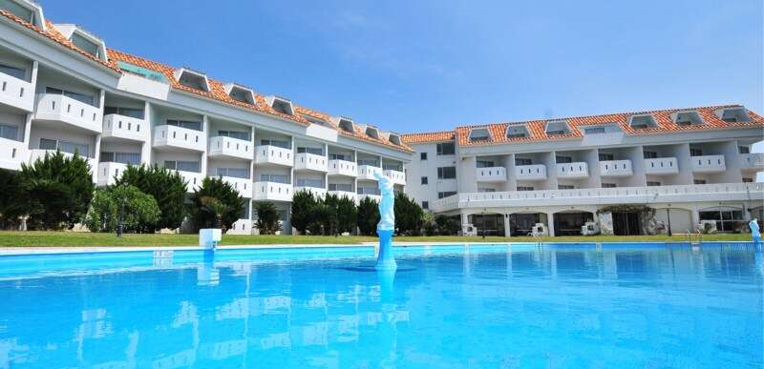
Tetayama Resort Hotel
12000/day/person
18000/day/2persons
including breakfast
Viking style dinner(3000)
Light lunch(1500)

Slide 4
Convention Hall
13mx20m (desks+chairs)x40~ ?
White wall for screen

Slide 5
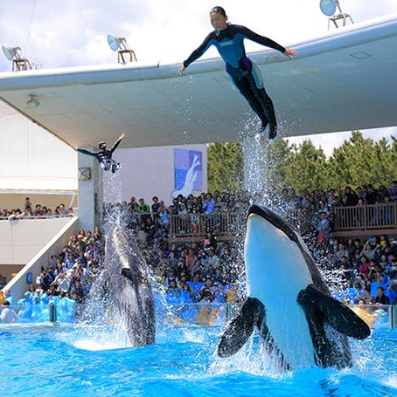
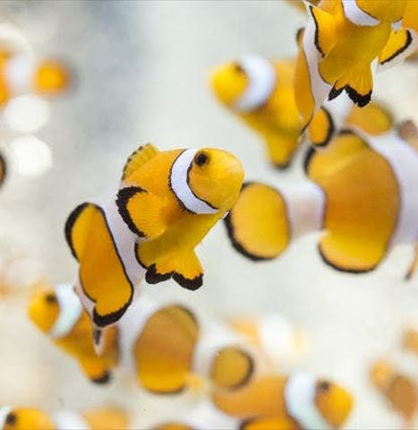
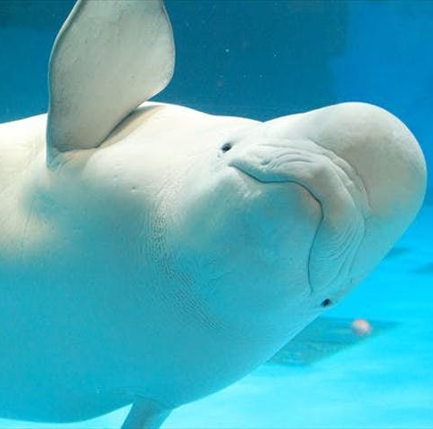

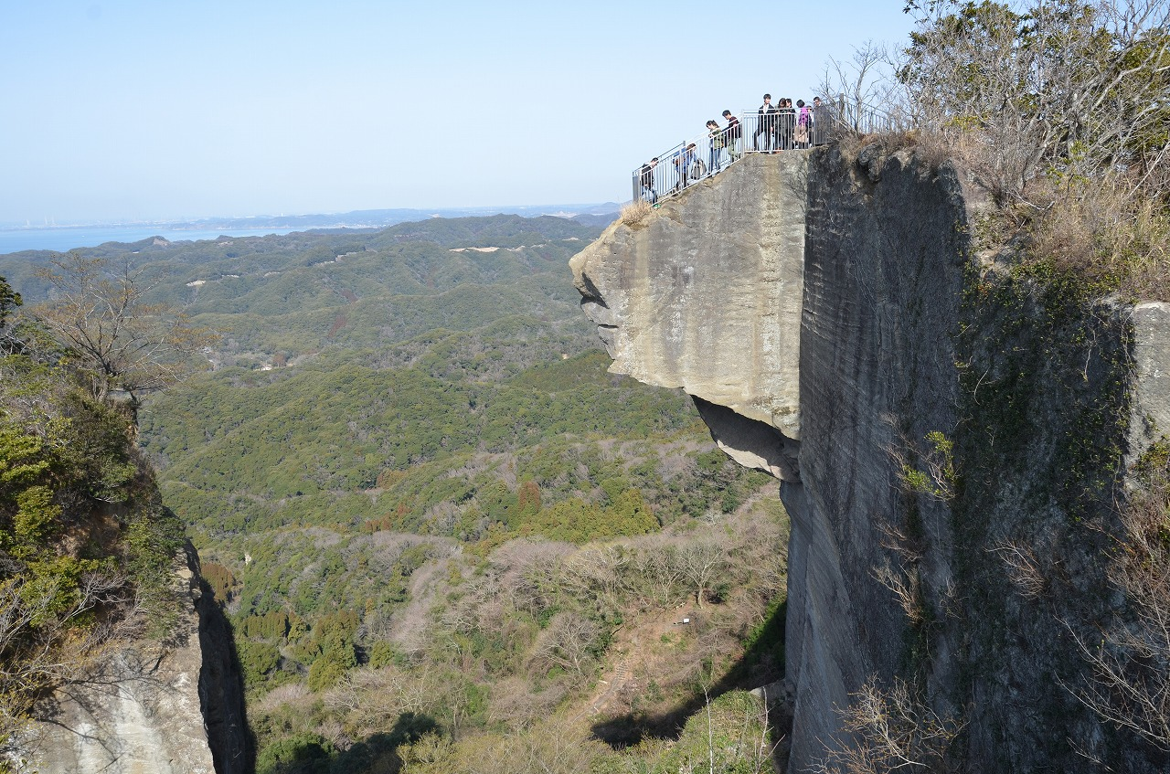
Excursion: Kamogawa Sea World
Nokogiri-yama (mountain) area is interesting but weather condition matters…

Slide 6
workshop
12,000/person
18,000/2person including breakfast
X 5days Hotel=60,000/person
meal: 25,000/person
excursion: 11,000/person
workshop 336,600/
Transportation 510,000/
96,000/person
Hotel room
~20,000/person
meal
X 15%(tax+agency)
transportation
Individual adjustment of stay duration is possible
Dinner (Viking style)
Lunch (sandwich/bento – where to eat? )
Transportation from/to Tateyama station
（hotel can provide – fixed time schedule/ need reservation）
Money flow –registration(system/Credit: extra cost）
Visa – when to start (valid for 3 months：after August)ERFS
excursion
KNT: cancellation be made 20 days before
For 40 participants

