Slide 1
AOB: Status and >next steps< of the BBCW commissioning in Run 3
G. Sterbini on behalf of the wire team
A. Poyet, K. Skoufaris, A. Rossi, S. Kostoglou, S. Fartoukh, Y. Papaphilippou, H. Bartosik, P. Belanger, O. Kester, D. Kaltchev, M. Marchetto, A. Bertarelli, L. Gentini, J. Wenninger, M. Solfaroli, D. Jaquet, Collimaiton team
1 July 2022

Slide 2
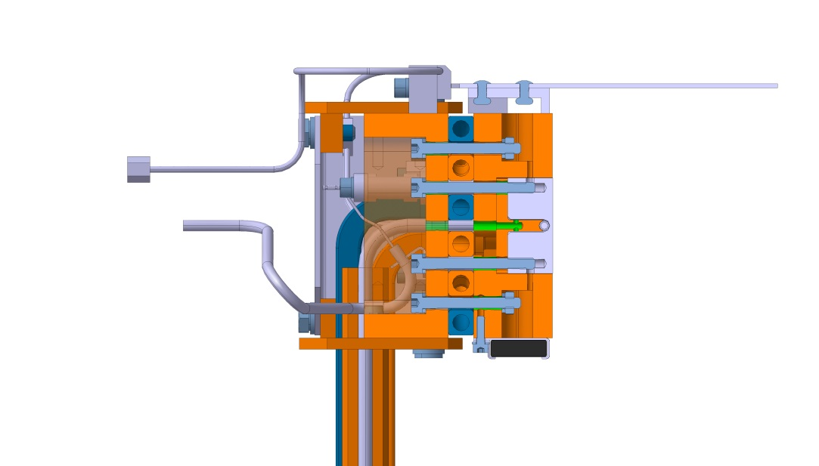
Present status in LHC: B1 got wires!
After Run 2, it was proposed
  to use the wires (2-jaws powered) during the Run 3 operation
  AIM: best use of the demonstrators hardware to acquire operational experience (integration of the wire in the cycle) and (moderate) reduction of beam losses.
  Wires ON after the EoL (Iw = 350 A).
Notes:
2

Slide 3
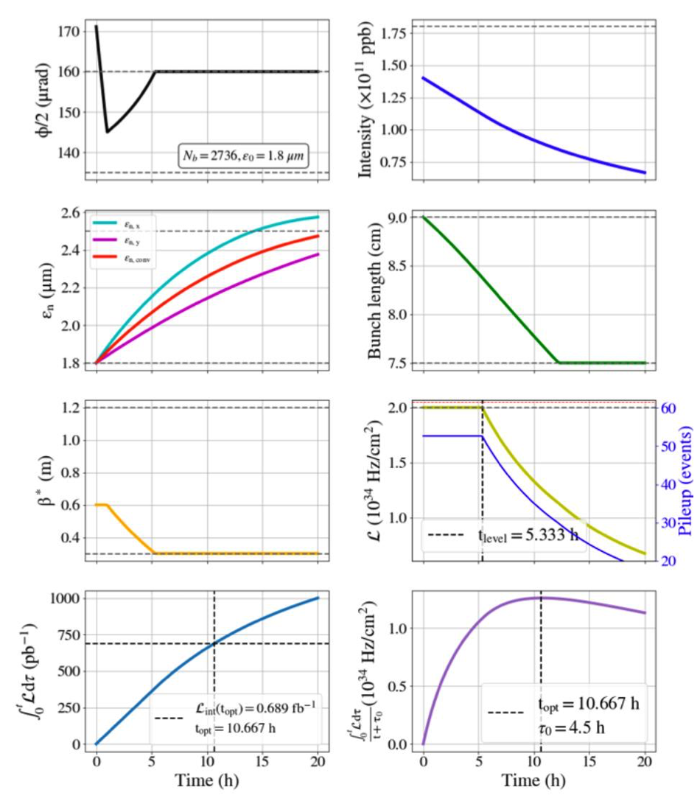
RUN 3 2022: BBCW ON after the EoL
S. Kostoglou, Evian 21
BBWC ON
BBWC ON
EoL ~5 h from the start of stable beams→ Nb ~ 1.15e11 ppb
E = 6.8 TeV, β* = 30 cm (tele-index 2)
φ_{c}/2 = 160 μrad (IP1 vertical, IP5 horizontal)
TCT at 8.5 σ@3.5 μm (for β∗= 30 cm)
Wires (V in IR1 and H in IR5) at
  9.2 mm in IR1 for B1 (tctpv.4l1.b1) and B2 (tctpv.4r1.b2)
  12.4 mm in IR5 for B1 (tctph.4l1.b1) and B2 (tctph.4r1.b2)
BBWC ON
BBWC ON
BBWC ON
BBWC ON
BBWC ON
BBWC ON
3

Slide 4
RUN 3: BBWC interlocks (EDMS 2384198)
WIC to protect the wire overheating (one WIC per TCT wire)
  Trigger BIS (B1/2) and PC OFF in external fault (~1.2 s delay).
Internal faults of the 4 wires PCs to protect the machine
  Trigger BIS (B1/2) (~1 ms delay).
(FGC settings: allows only -350 A < I < 350 A on the wires)
MPP April 29th, 2022
All wires WICs successfully tested during HW commissioning (April 8th, 2022)
4

Slide 5
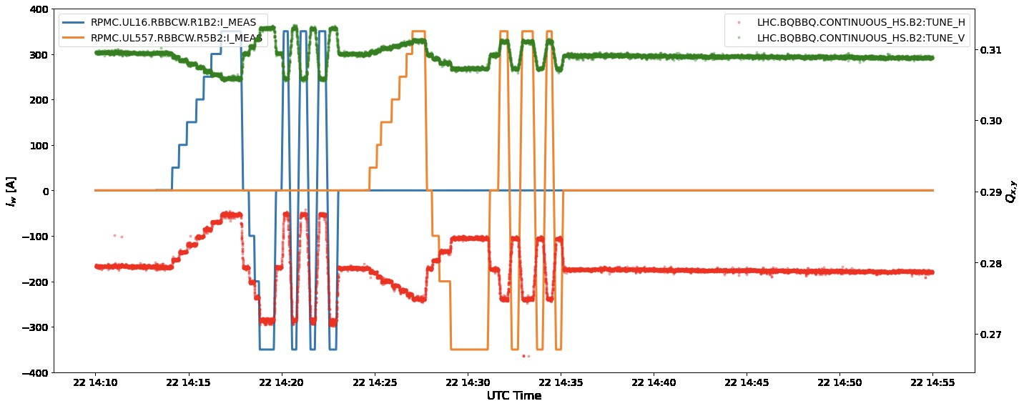
RUN 3: commissioning with the beam
Beam Commissioning BBWC@450 GeV
May 22nd 2022
A. Poyet
  All 4-wire polarities were checked successful with beam at injection (B2 shown in the picture).
5

Slide 6
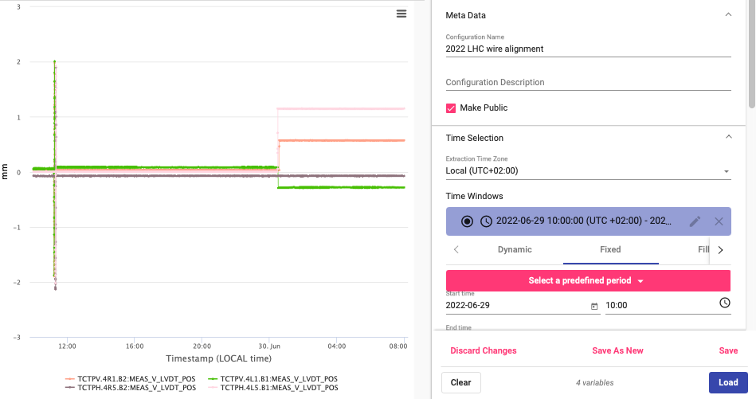
5th-axis alignments
Collimation Team, June 22nd, 2022
https://timber.cern.ch/query?tab=Visualization&configuration=33223&autoLoad=true

Slide 7
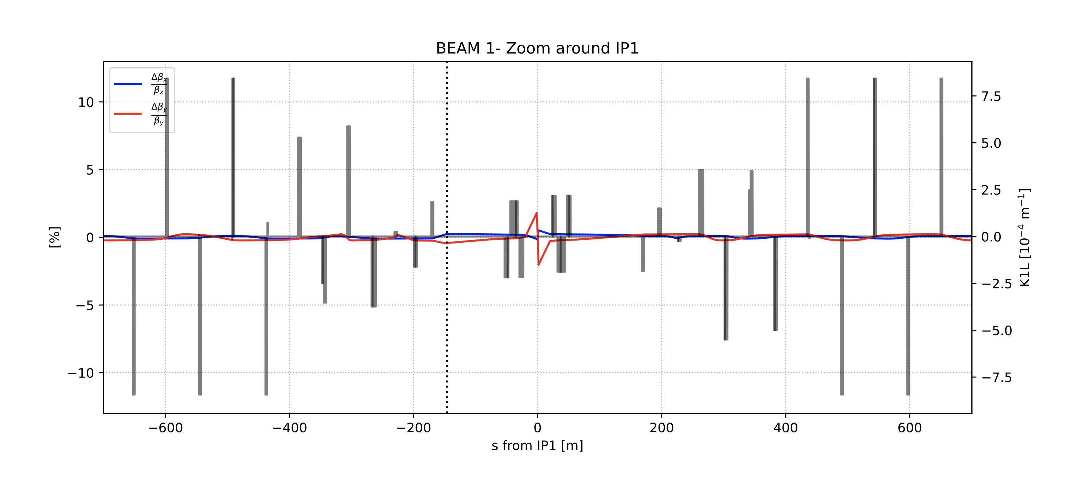
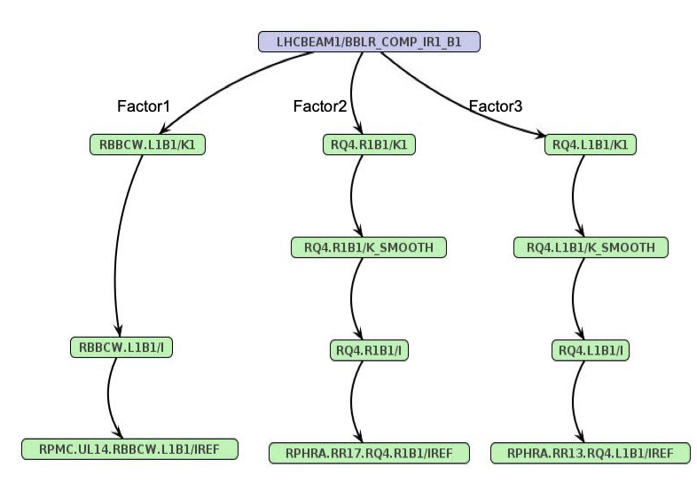
RUN 3: SIS and BBLR
LBOC March 1st, 2022
SIS: window of 0-350 A for the wire current when the wire is used
SIS: PCInterlock system to be open on quads ref to allow the Q-feedforward trim
D. Jacquet, LBOC #135
Using the Q4L/R correct the tune but not (fully) the induced beta-beating:
minor effect on luminosity (<0.1%)
Impact on Forward Physics (<2% effect on the transfer matrices elements)
7

Slide 8
Next steps (to discuss)
Test the Q-feedforward (for each single wire, β*=30 cm a Iw=350 A)
OMC optics measurement (β*=30 cm and all wires at Iw=350 A)
Loss maps (β*=30 cm and all wires at Iw=350 A)
Are other tests required from MPP?
Can we accomodate these tests before the intensity ramp-up?
Thank you.

Slide 9
BACK-UP SLIDES

Slide 10
What we expect with BBCW during R3?
To reproduce Run 2 MD reduction of losses and of crossing-angle at constant loss rate.
  Run 2: B2 → Run 3: B1+B2
  Run 2: MD → Run 3: operational configuration: beam-wire distance defined by TCT settings!

Slide 11
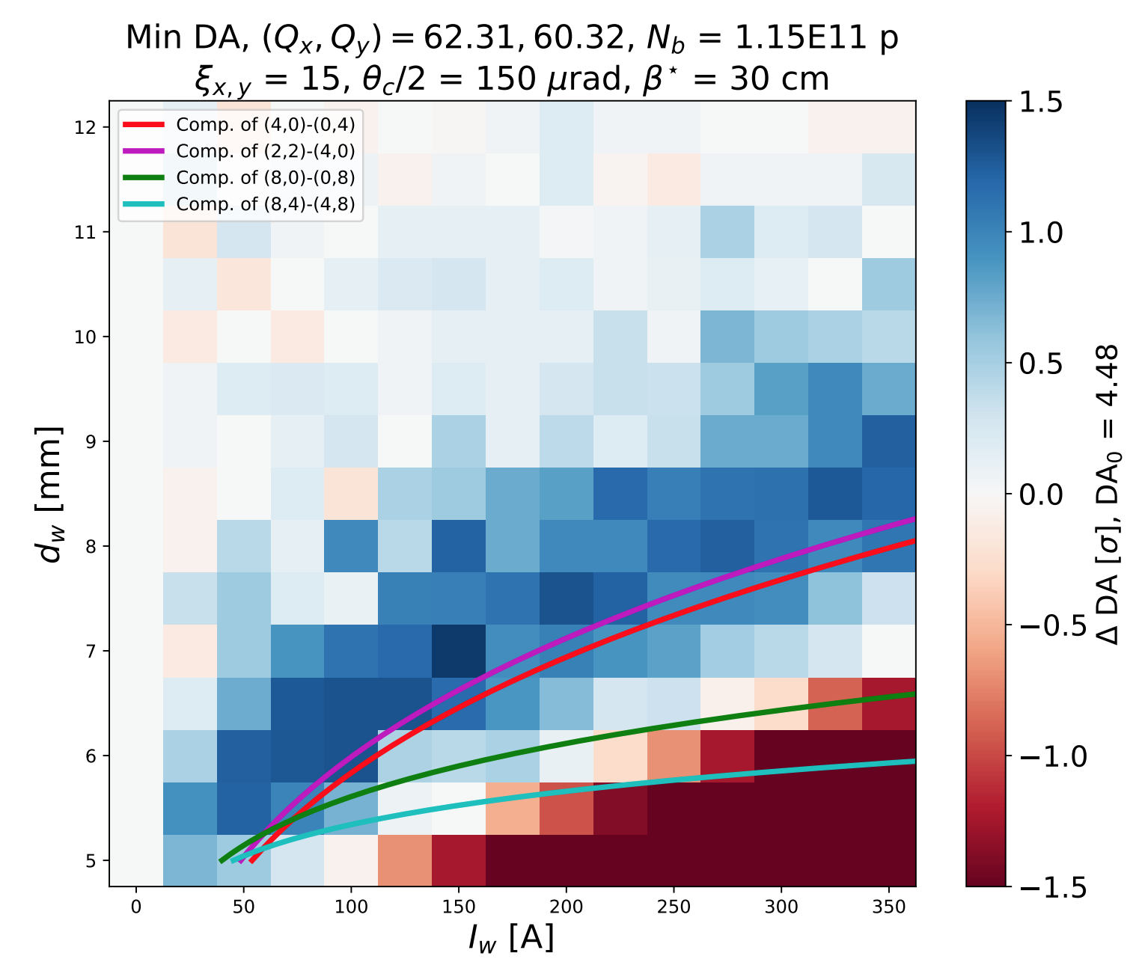
Optimal wire distance/current settings
References to define the wires settings (s-position, wire current and wire distance):
[1] J.-P. Koutchouk, 2000
[2] S. Fartoukh, 2015 → approach followed for the LHC MDs and for space reservation in HL-LHC
[3] D. Kaltchev, 2019
A. Poyet IPAC19
Numerical simulations and experimental results for round optics in RUN 2 show that there not single sweet points but a "sweet regions” for compensation (octupolar contribution).

Slide 12
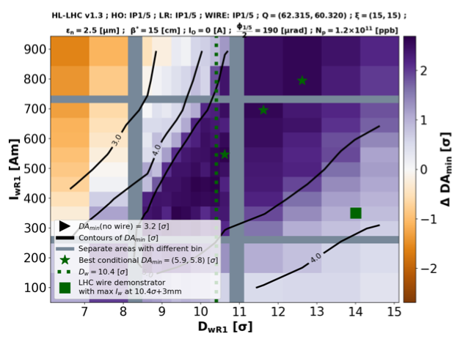
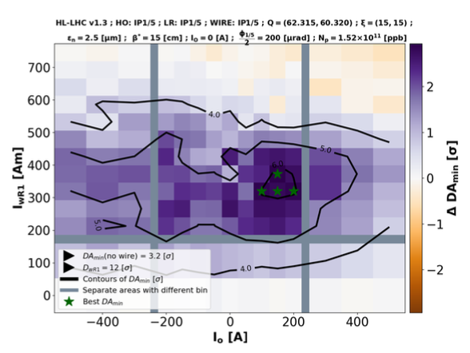
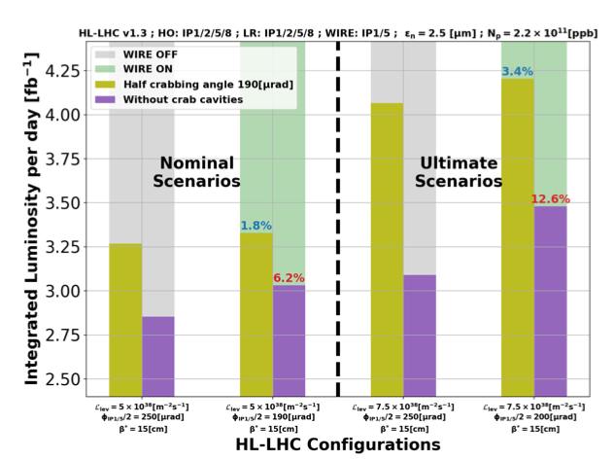
HL-LHC wire compensation
K. Skoufaris, 2021
This was confirmed by Kyriacos’s studies for HL-LHC round optics, opening the way to a technical implementation of the wire in the HL
In the meantime:
  TRIUMF is exploring an in-kind contribution to the HL wire
  Satellite workshop at HL CM as preparation for a technical review if confirmed with the management.

Slide 13
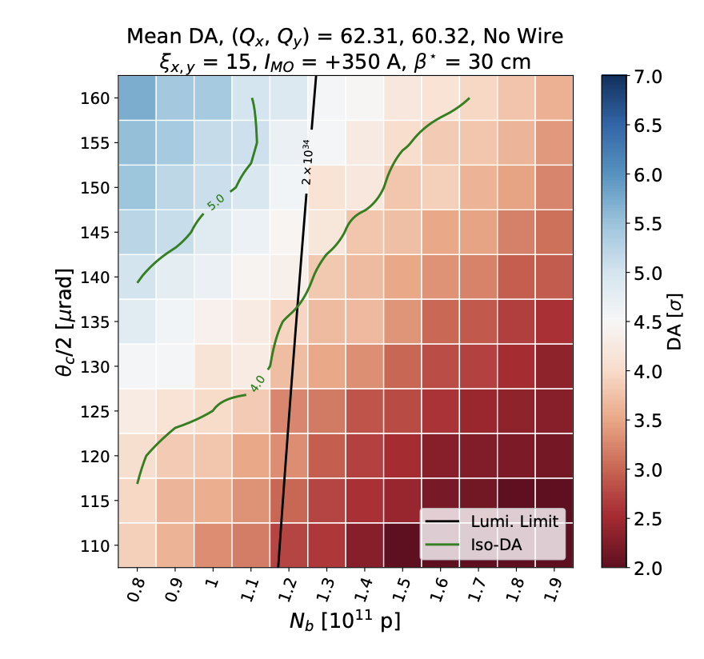
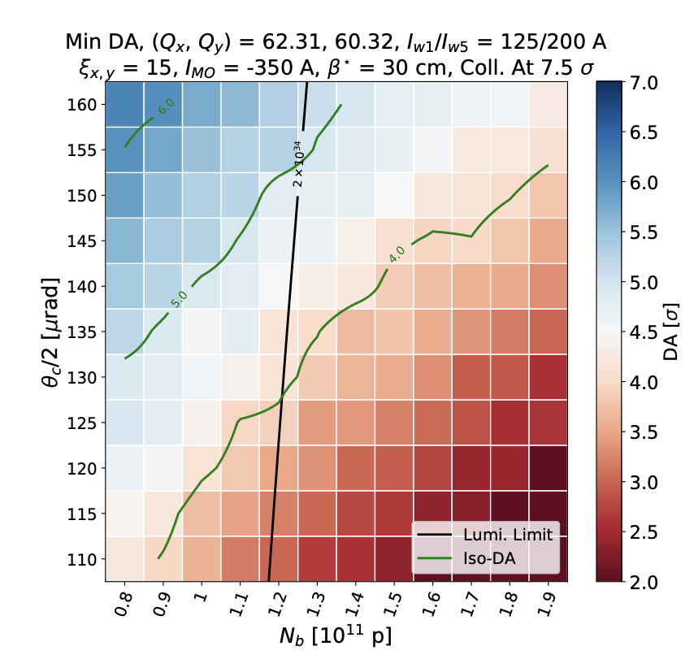
Run 3 numerical simulation
A. Poyet IPAC21
BBWC OFF
BBWC ON
Simulations (and B2 observations in the 2018 MD) show that it will be difficult to gain more than ~10 μrad in the crossing angle at the EoL in Run3 (we focused on the 2022 Run).

Slide 14
LHC wire-in-collimator
Present status for Run 3
14

Slide 15
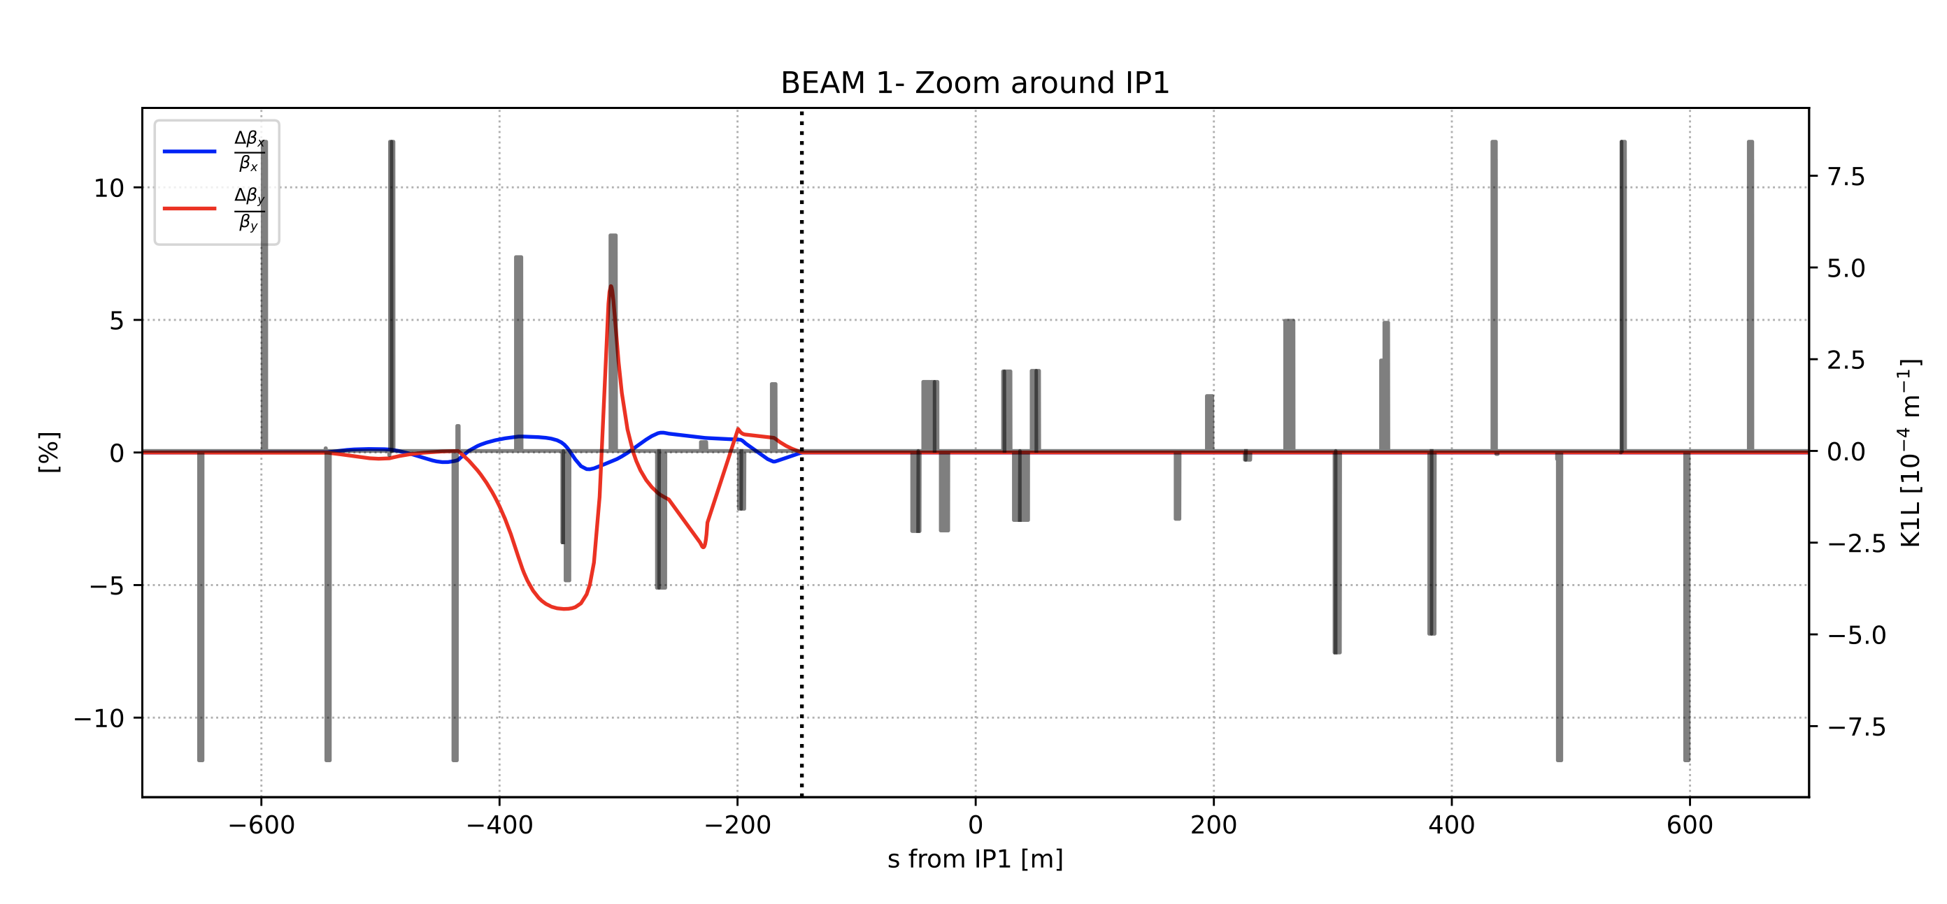
RUN 3: SIS and BBLR
LHC Run3 meeting, 8 April 2022
A Q13-Q4 correction was studied (Q6-7 not included) to rematch properly the IP optics.
Solution is available and can be tested during MD in 2022 and deployed later stage
15

Slide 16
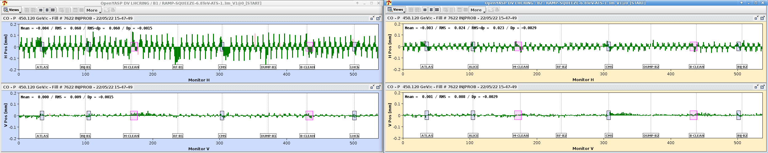
RUN 3: commissioning with the beam
Beam Commissioning BBWC@450 GeV
May 22nd 2022
CO effects with IR1 BBWC in B1 ON
  When switching ON the BBCW wires in B1 we observed a CO effect on B2 (and vice versa). It needs further investigation (Philippe will help on this front). If the CO feedback is on the effect is fully compensated.
16

Slide 17
HL-related outstanding aspects
We would like still to address the following points by the September workshop:
Quantify the impact of wire compensation on the core-diffusion and update the evolution of the Run 4/5 configurations
Check the impedance of the device and also the beam induced heating of the wire (→ IWG)
Verify if the design (see WP2 Feb 22nd, 2022) is vacuum compliant (outgassing and SEY/ecloud of AlO ceramic, UFO, radiation?) and define a strategy for the vacuum sectorization
Verify beam-impact limit and background noise contribution for the experiment (→ FLUKA, dose on the device/handling, forward physics FP/RP)
Check forward physics requirments/conflicts (→ TREX).
The configuration of Run 4 with relaxed collimator configuration (TCT @ 13.2 σ) imposes severe limitations on the beam-wire distance.

Slide 18
Conclusions
In Run 3 we will see for the first time BBWC in B1 and deployment of the BB compensation in operation
Despite the marginal improvement of the performance, this will give additional feedback on the operational aspect of the BBWC
The compesation will be at the end-of-leveling in 2022. With the TCT moving during the leveling (>2022) we can explore compensation scenarios during the leveling.
Next steps for Run3: after the collision orbits at β*=30 are established → 5th axis alignment of the TCT and Q-knobs checks.
A word of caution: the Run 4 relaxed TCT settings are challenging for possible new BBWC design and applicatiion in HL-LHC…
Thank you for your attention.

Slide 19
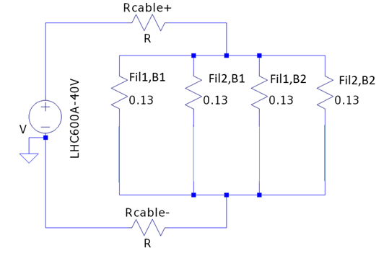
Can we reuse the PCs?
LHC600A-40V can operate (for one year, 2024) at 600A in DC operation, without issue to fear, in theory. They were designed for, even if not operating at that level in the LHC (max 550A).
A quick calculation gives
  Assuming the 45 meters to be added are in 2x400 mm2
  250 meters (500 meters in total, go and return) of 2x 400 mm2 represents (25°C) 10.6 mOhms, which would, at 600A represents 6.4 Volts.
It is better (reliability) to limit the voltage across the total load (cables + wires) in order to limit the overall power the converter needs to provide. Current calculation gives (20 V - 0.13 Ohms x 150 A - across a wire at 150A + 7 V for DC cables, 2x 400 mm²), then 27V, which is correct at first glance (40V max).
https://indico.cern.ch/event/1099813/

Slide 20
HL-type functional specification
Present HL proposal (iterations are on-going):
8 assemblies (2x beams x2 IPs x2 sides) containing DC wires at room temperature (demineralized water cooling needed).
The slots are between HL Q4 and Q5, starting at 186 m ending at 195 m from IP (9 m).
450 Am per beam/side/IP
Each tanks contains 3 modules of 1 m pre-aligned on a common girder.
1 mm wire diameter carrying max 150 A
Motion of the 1 (or 2) principal axis (parallel to crossing): from 0 to 15 mm (garage position, TODO: verify aperture).
Motion of the 3rd axis (perpendicular to the crossing): -10 to +10 mm
Possibility to rotate the V wires tanks when the V-crossing polarity is switched
(2xH and 2xV BPMs per wire assembly, ~ 1 BLM per wire assembly)
LHC wire-in-collimator
20

Slide 21
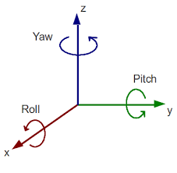
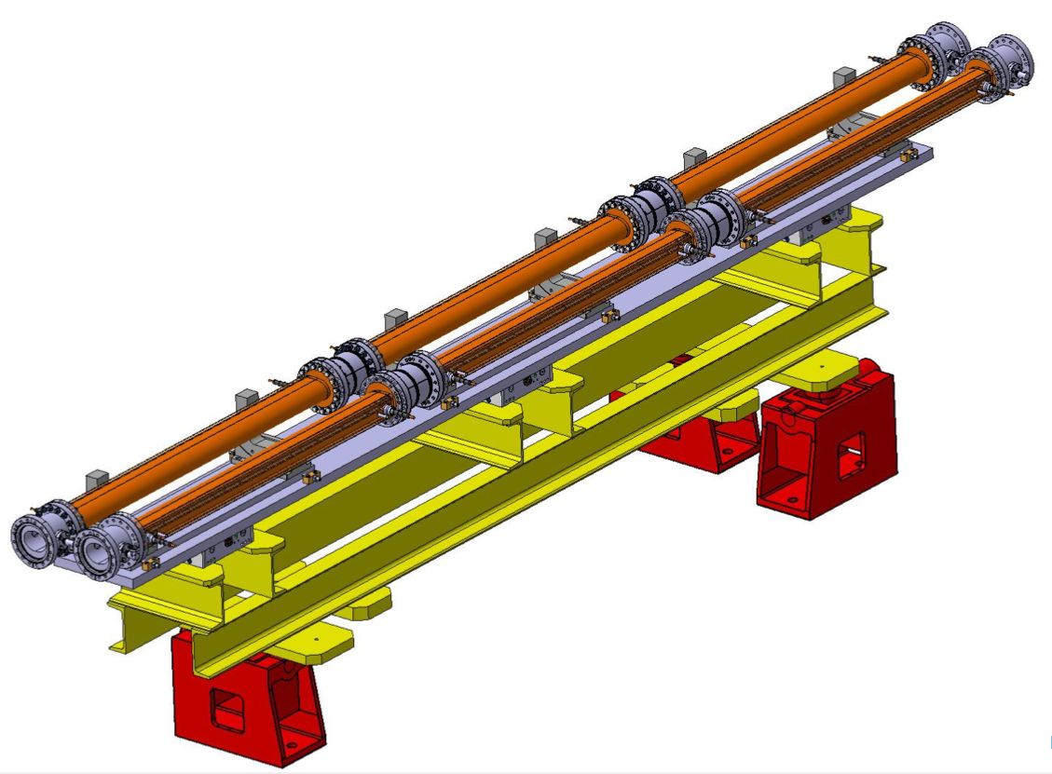
2 wire tanks (each with 3x 1m modules)
LHC wire-in-collimator
Courtesy EN-MME
(A. Bertarelli and team)
21

Slide 22
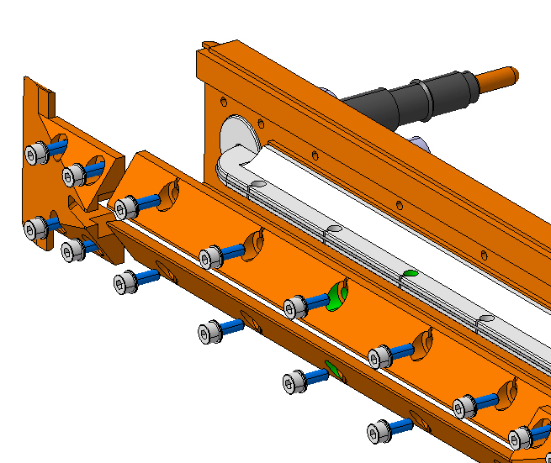
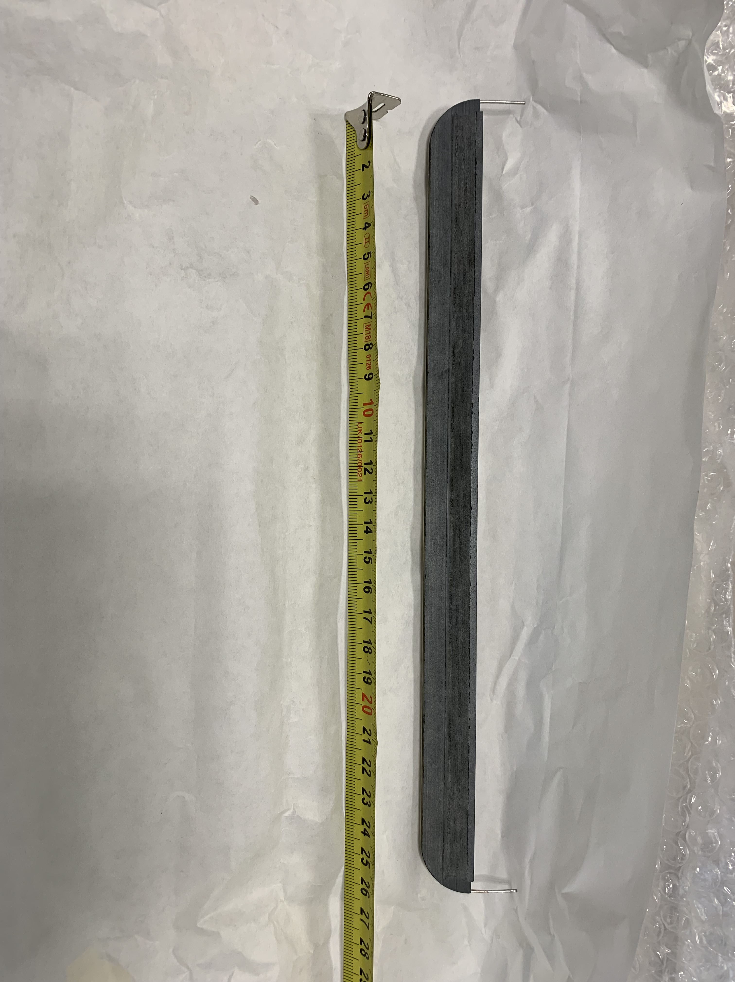
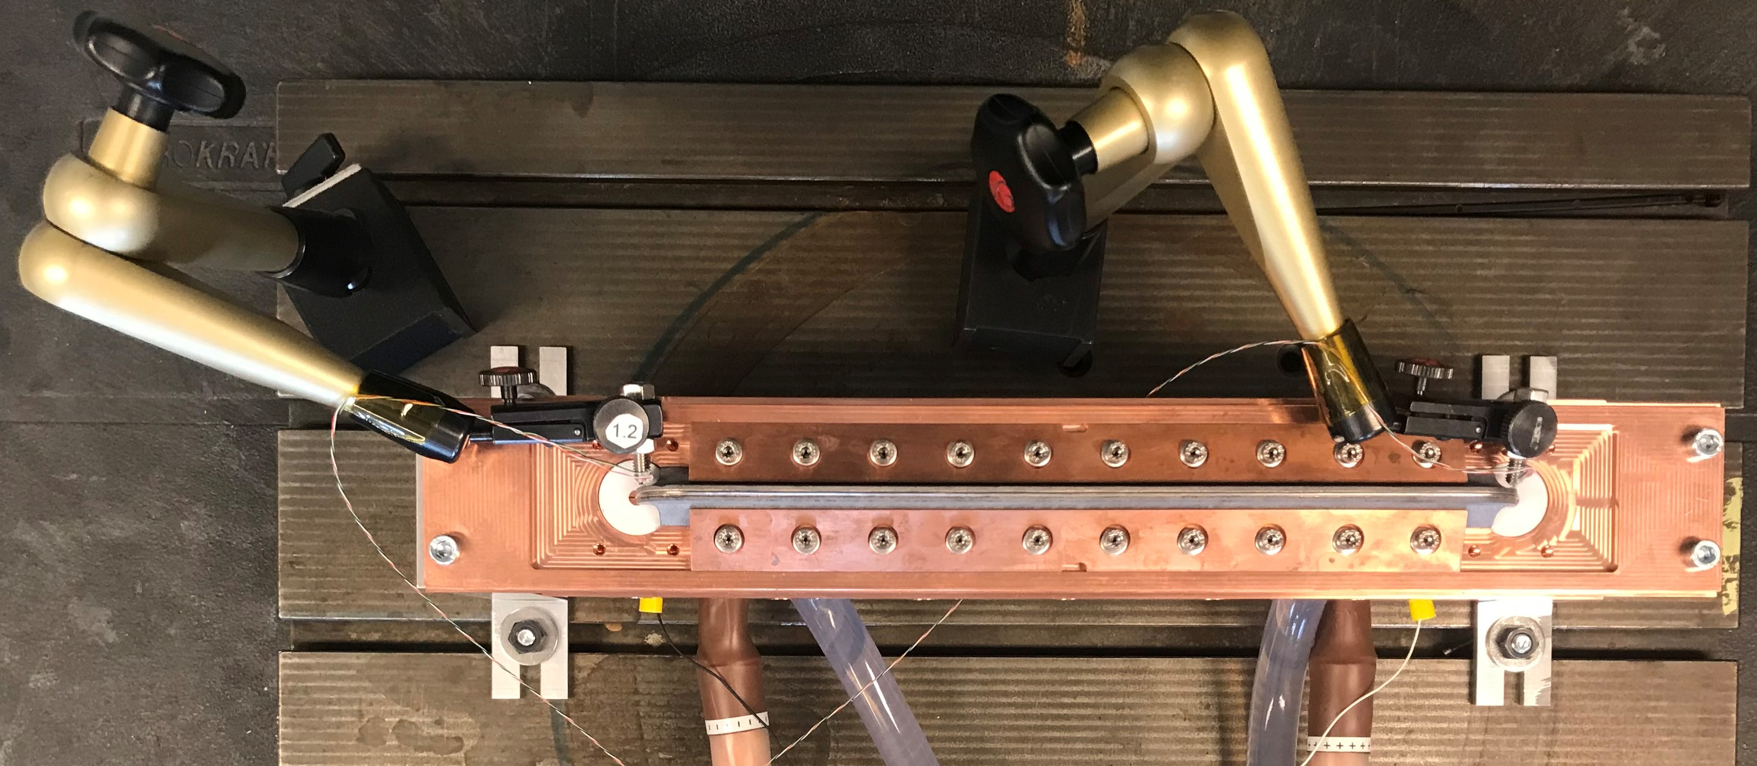
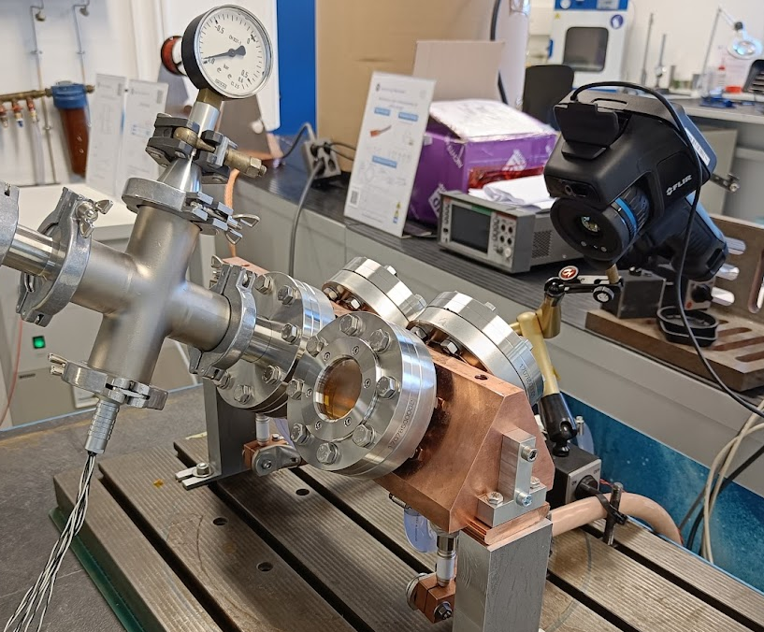
HL-type wire test
There was an extensive testing campaign by EN-MME on a short HL-type wire.
Courtesy EN-MME
(A. Bertarelli and team)
Results (out/in vacuum) are not yet circulated (EDMS 2432228): the tests were done with 1 mm and 0.8 mm radius molybdenum wires.
Courtesy EN-MME
(A. Bertarelli and team)
22

