Slide 1

MQXFB(P3) test results at CERN
Tests ongoing
F. Mangiarotti, G. Ninet, V. Desbiolles, S. Juberg, L. Fiscarelli, G. Willering,
P. Rogacki, R. Keijzer, V. Di Capua, S. Russenschuck
on behalf of the test & measurements team
2022.09.28, Follow-up on MQXFB actions

Slide 2
Quench performance

Slide 3
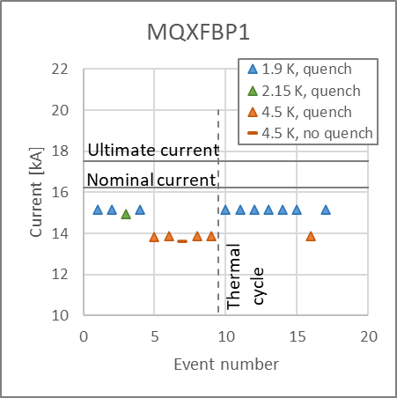
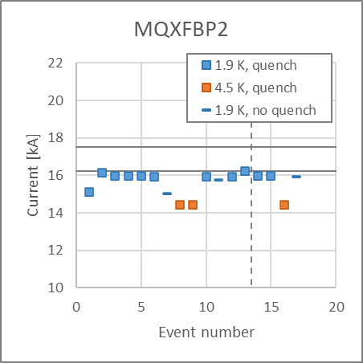
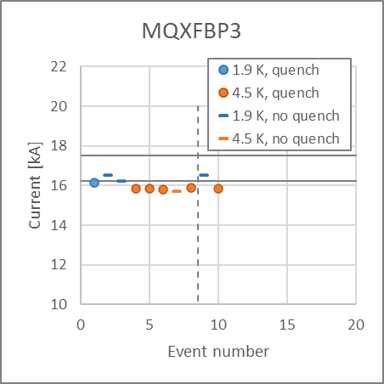
Quenches at nominal ramp rate
At 1.9 K: MQXFBP1 and BP2 were limited below nominal current (~15 and ~16 kA respectively). BP3 reached the target current (nominal + 300 A)
At 4.5 K: the three magnets are limited below nominal current: 13.8, 14.2 and 15.8 kA respectively.
All magnets kept perfect training memory after thermal cycle.

Slide 4
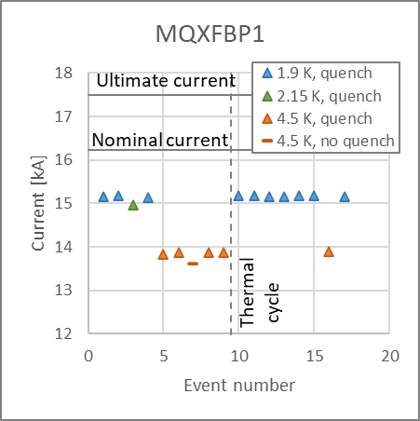
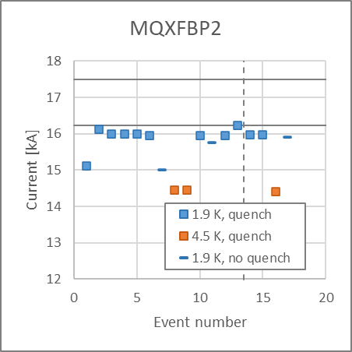
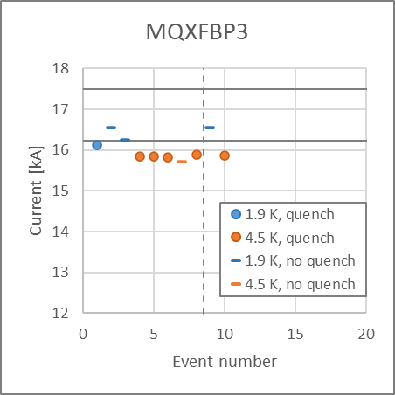
Quenches at nominal ramp rate
At 1.9 K: MQXFBP1 and BP2 were limited below nominal current (~15 and ~16 kA respectively). BP3 reached the target current (nominal + 300 A)
At 4.5 K: the three magnets are limited below nominal current: 13.8, 14.2 and 15.8 kA respectively.
All magnets kept perfect training memory after thermal cycle.

Slide 5
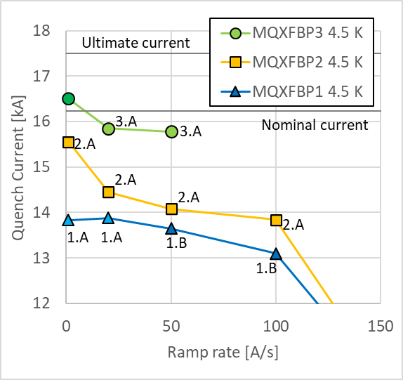
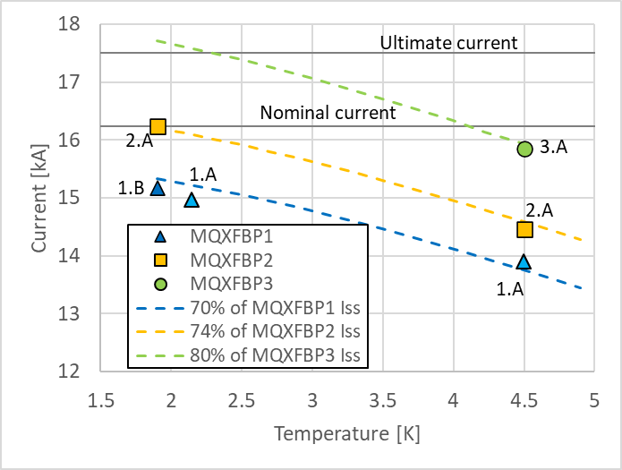
Ramp rate and temperature dependency
Point labels indicate quench location.
Ramp rate and temperature dependency very similar between the three magnets.
Quench level extrapolation for BP3 at 1.9 K: above ultimate current.

Slide 6
Quench localization

Slide 7
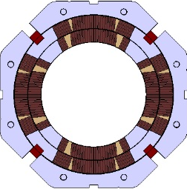
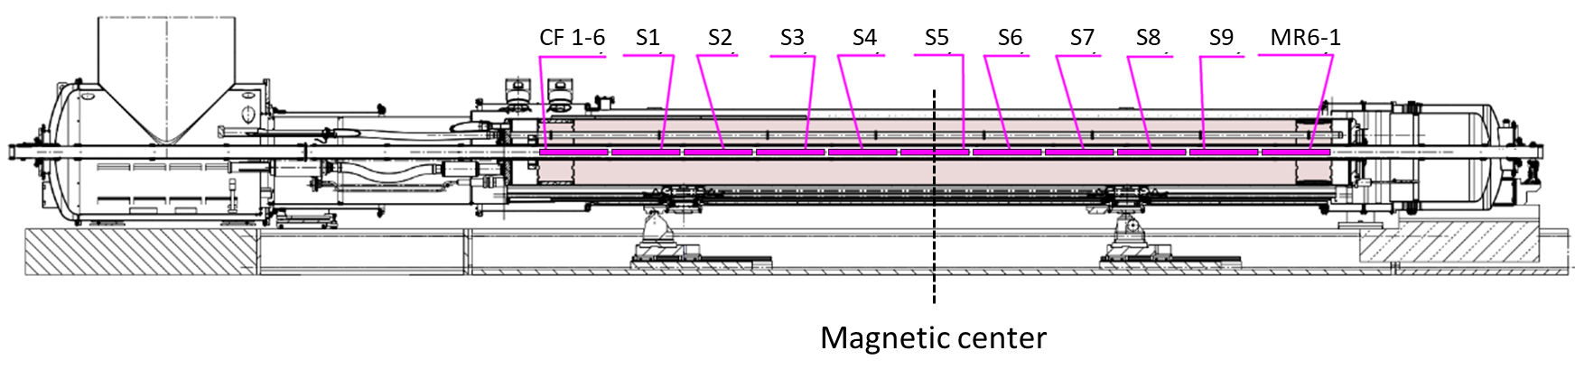
Recurring quenches as of BP3.CD2
MQXF… |  | 1 A/s | 20 A/s (VI) | 20 A/s | 50 A/s | 100 A/s
BP1 | 1.9 K |  | 1.A | 1.B
 | 2.15 K |  | 1.A
 | 4.5 K | 1.A | 1.A | 1.A | 1.B | 1.B
BP2 | 1.9 K | Not recurring | 2.A | 2.A | 2.A | 2.A
 | 1.9 K trim | No quench |  | 2.C
 | 4.5 K | 2.A |  | 2.A | 2.A | 2.A
 | 4.5 K trim | 2.B |  | 2.C
BP3 | 4.5 K | Not recurring |  | 3.A
P2
P1
CS
NCS
CS view
P3
P4
Side view
Notes:
20-100 A/s quenches were in coil P1 in the same location that is limiting the performance.
150-200 A/s quenches were in a different coil, and they were caused by a too large heating power that heats up the coil faster than it can be cooled – the quench location is not related to damage or degradation in the conductors, but just to cooling and heating of the impregnated coil.

Slide 8
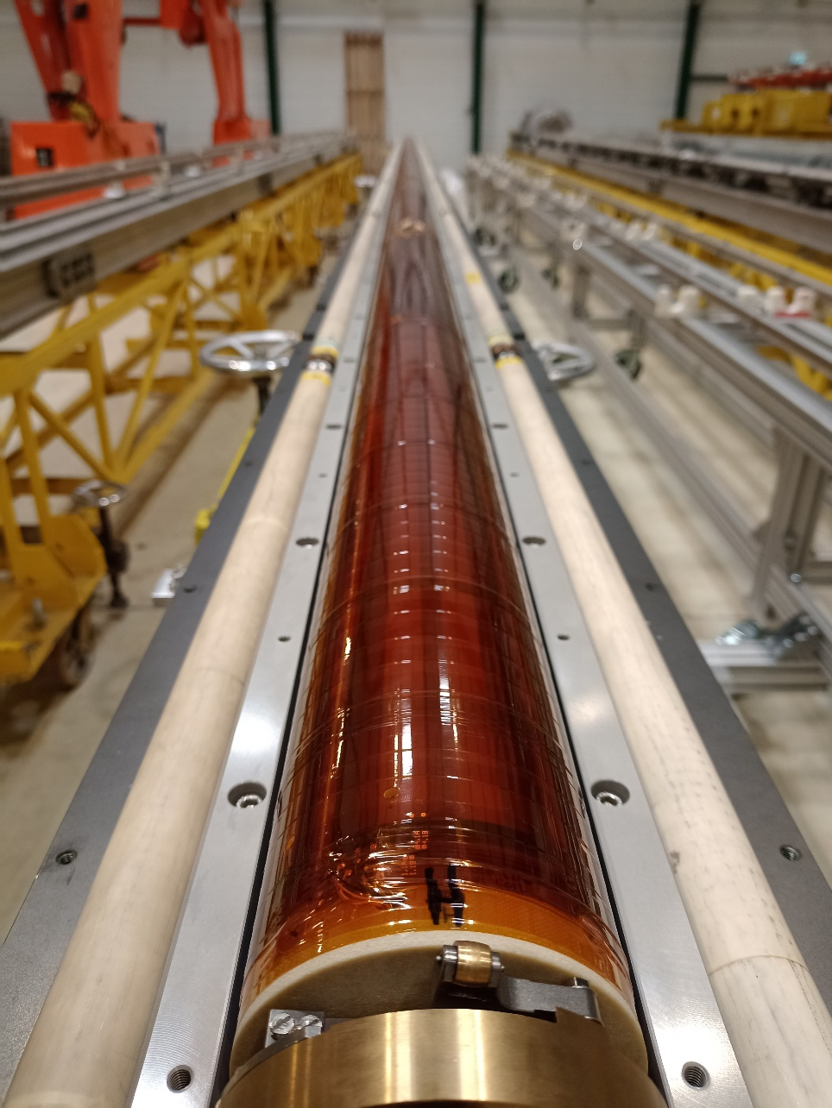
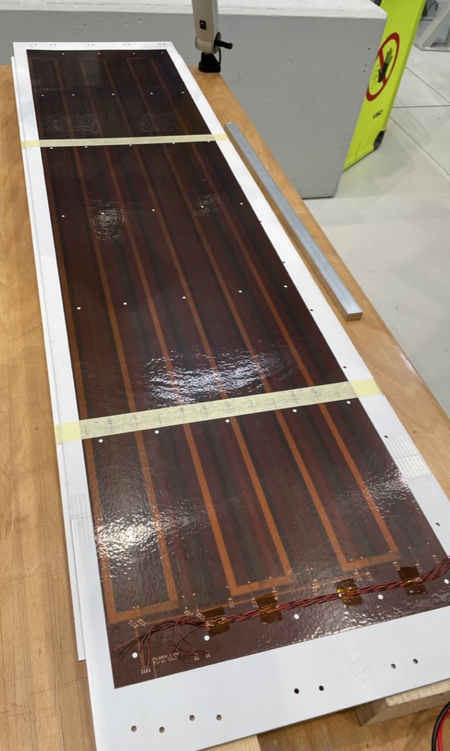
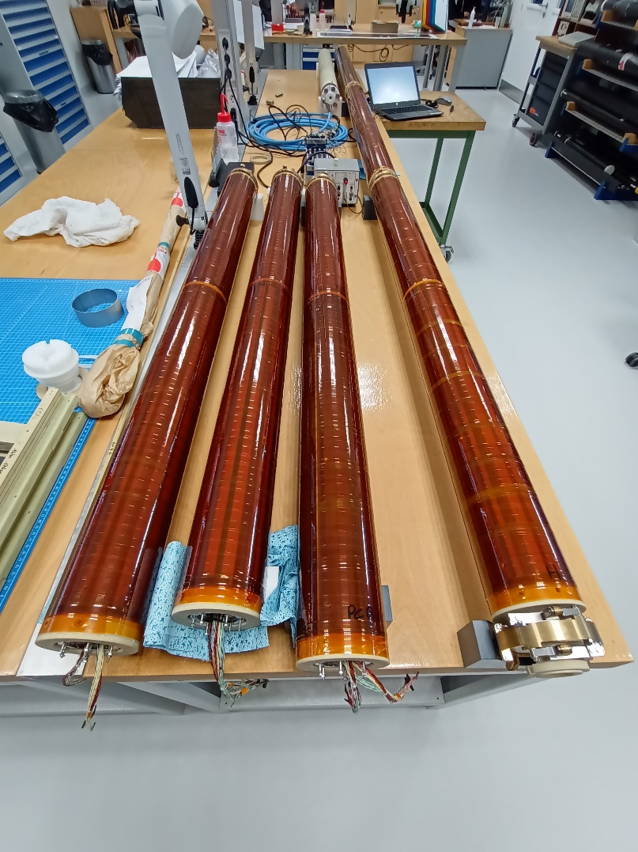
Multipole Sensitive Quench-Antenna
Sensitivity mostly to B3, A3, B4, A4 through coil design (analogue bucking and use of Flex PCBs)
Compromise between noise (PC, vibrations, etc), resolution in radial direction, and signal strength.

Slide 9
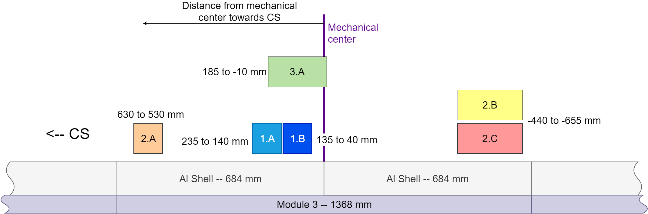
Longitudinal quench localization
On repetitive quenches we can narrow down the longitudinal position of the quench by shifting the quench antenna position.
Higher precision (±50 mm) with the standard quench antenna due to higher density of coils.
CF4
CF3
The limiting locations in all three magnets are at the central 1.5 m of the magnet.
No quench, no limiting location found at any of the coil heads.

Slide 10
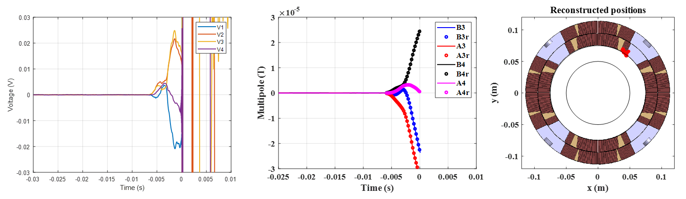
Cross-section quench localization
QA voltage signals
Reconstructed multipoles
Reconstructed quench position
P2
P1
In MQXFBP1 and BP2 we relied on voltage taps for quench localization in the cross section.
In MQXFBP3 we use the multipole quench antenna. A first prototype was validated in MQXFBP2 (see above) and implemented as main QA in MQXFBP3. Quench location can be identified within a few turns.
In all cases, the performance limiting location is in the inner layer pole turn (BP1 and BP2) or pole turn block (BP3).
CS view
P3
P4

Slide 11
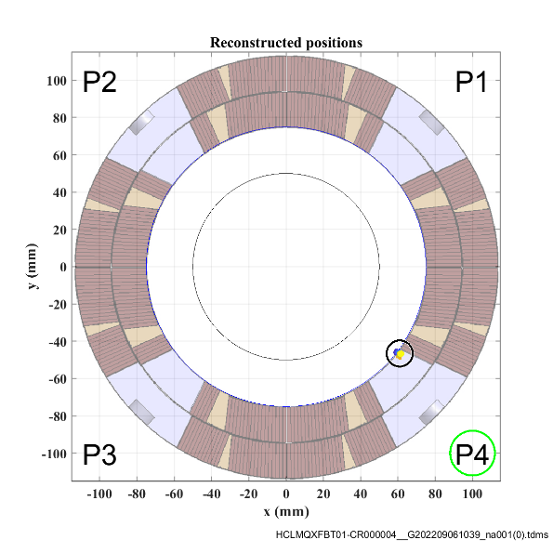
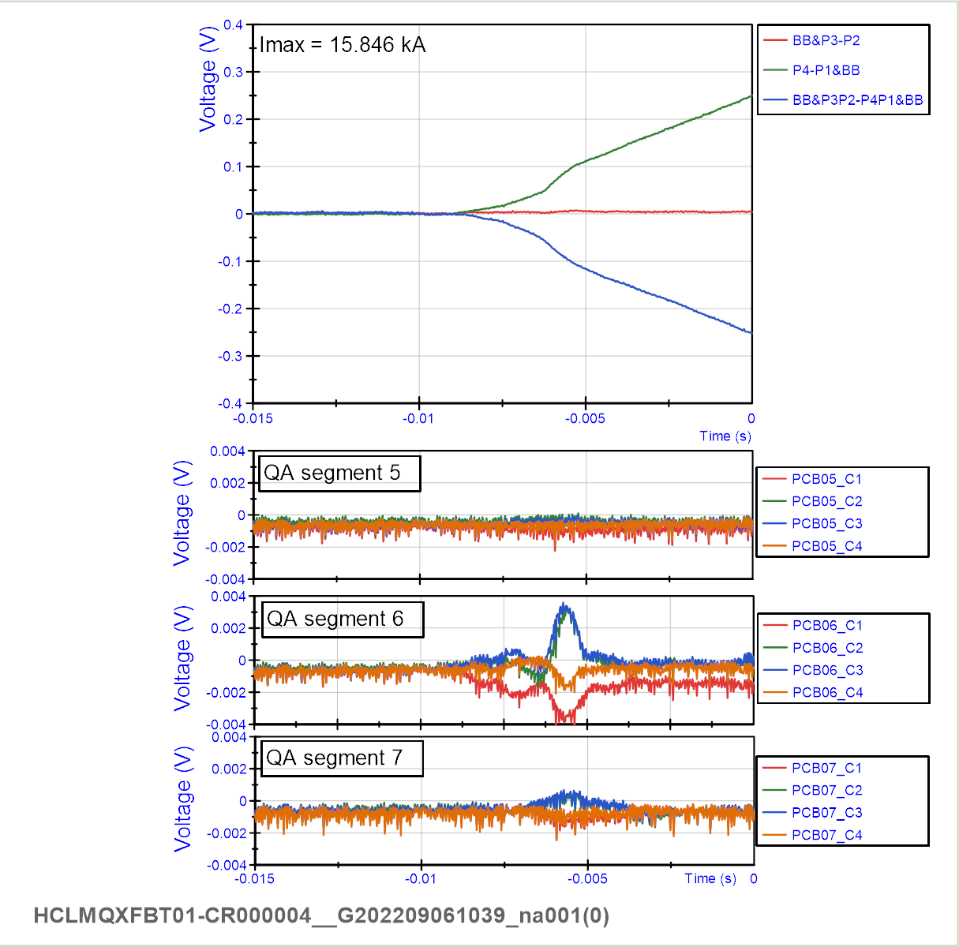

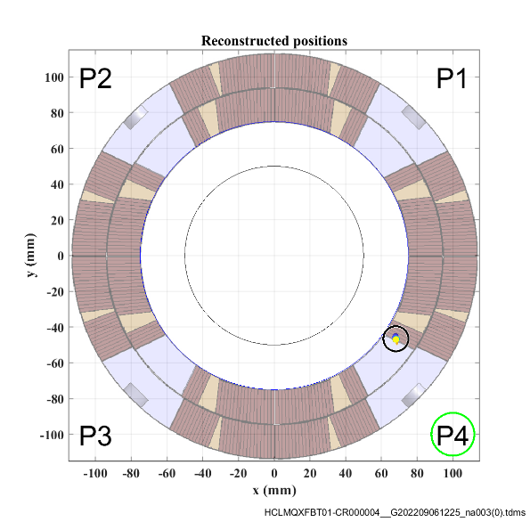


MQXFBP3: location 3.A
CD1
Q1
4.5 K
20-50 A/s
Very consistent behavior
CD2
Q1
CD1
Q2
CD2
Q2
CS
NCS
CD1
Q3

Slide 12
Voltage buildup during quench
Shown: quenches in short models and prototypes BP2 and BP3 around 16 kA, at 20 A/s, inner pole turn or pole turn block
Voltage buildup in both prototypes is similar to that of short models, hinting towards local limitation in the prototypes

Slide 13
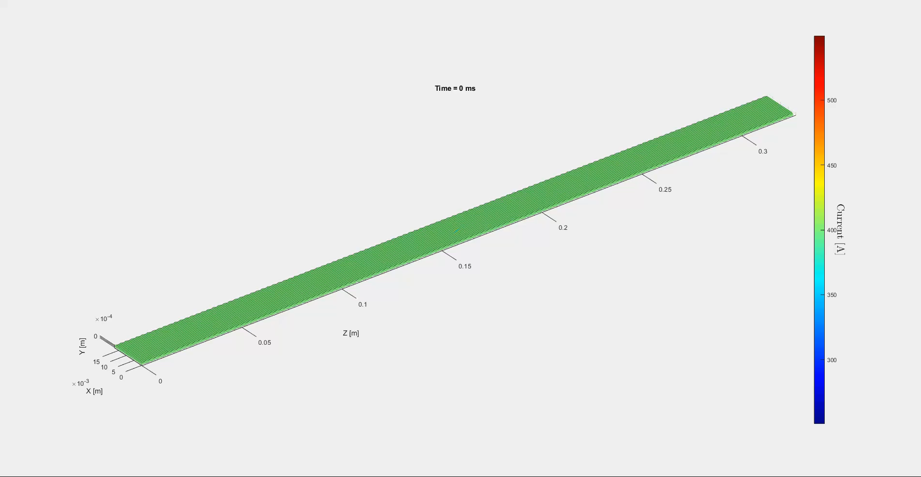
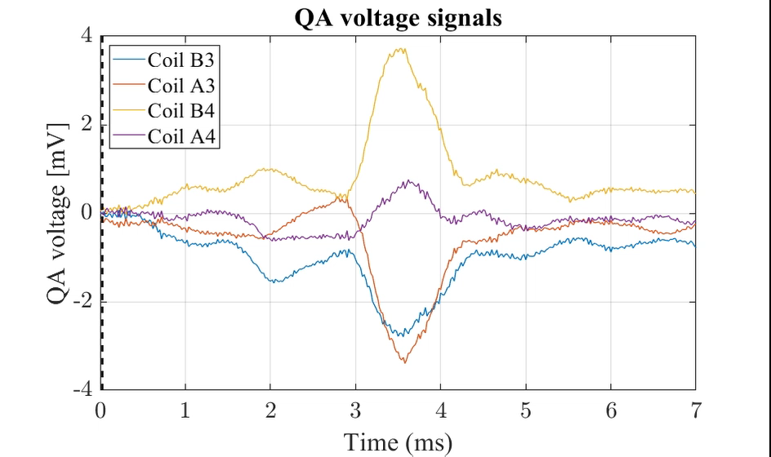
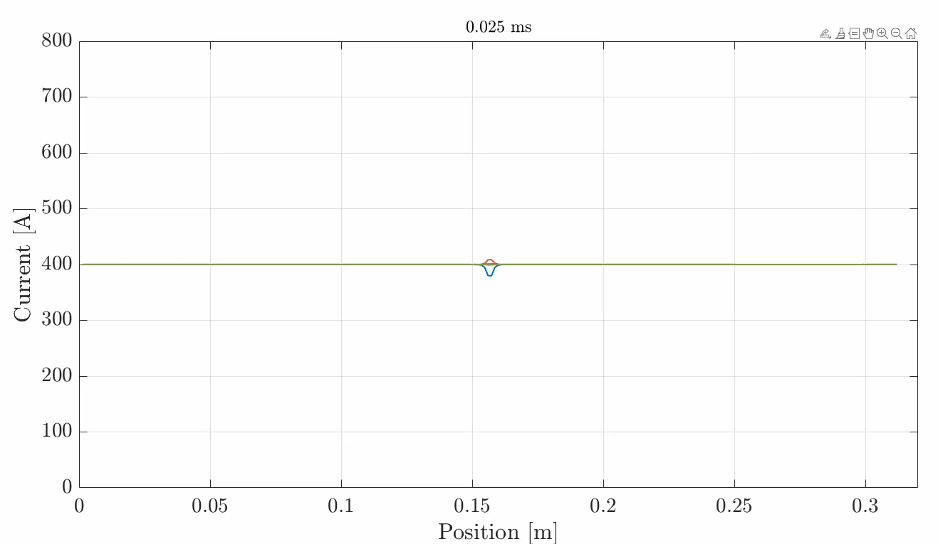
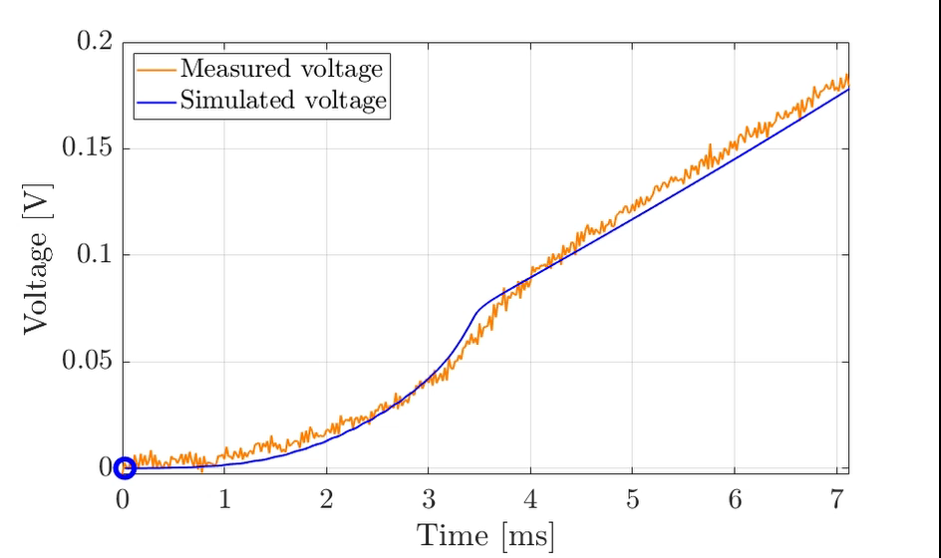
Quench simulation with 3D network model by Ruben Keijzer, PhD student, TE-MSC-TM
2022-09-26 Gerard Willering – Feedback and confidence Superconducing Magnet Tests
On behalf and with thanks to the entire magnet test team

Slide 14
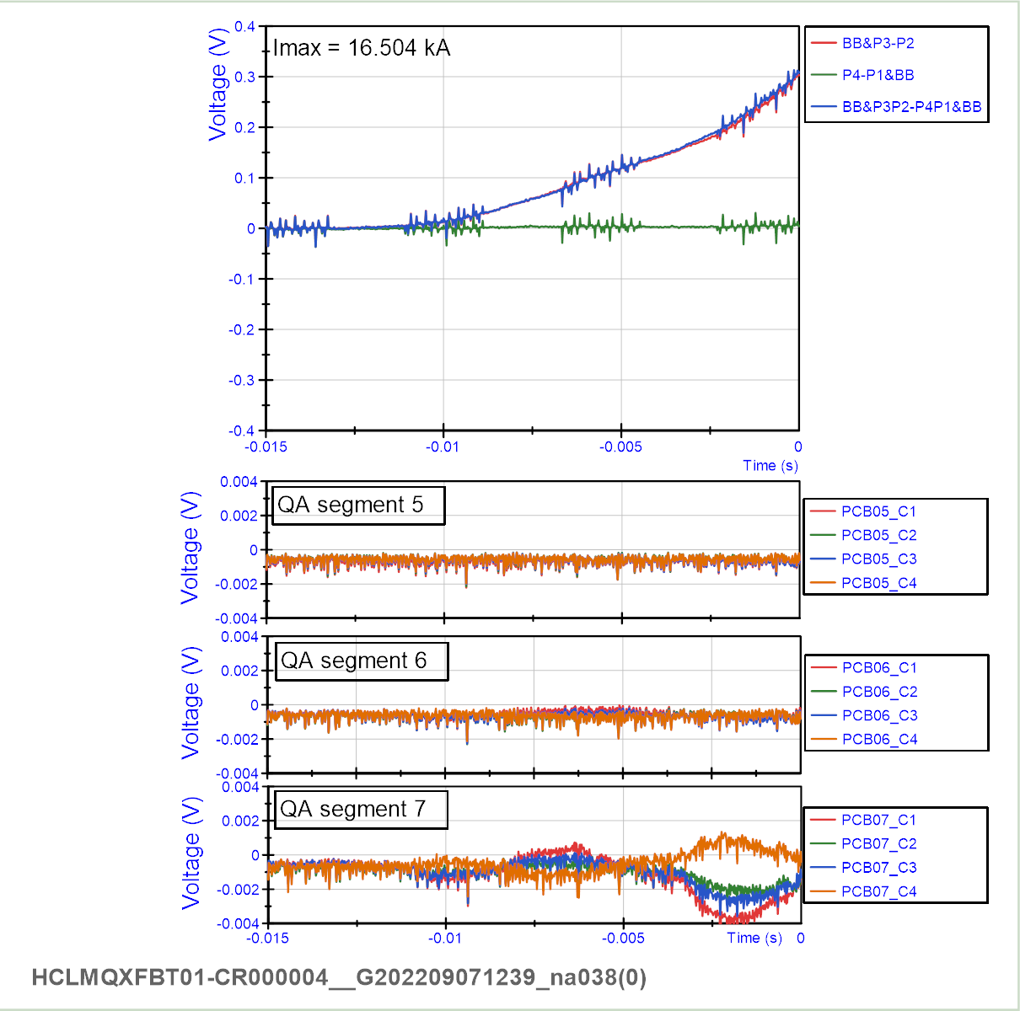
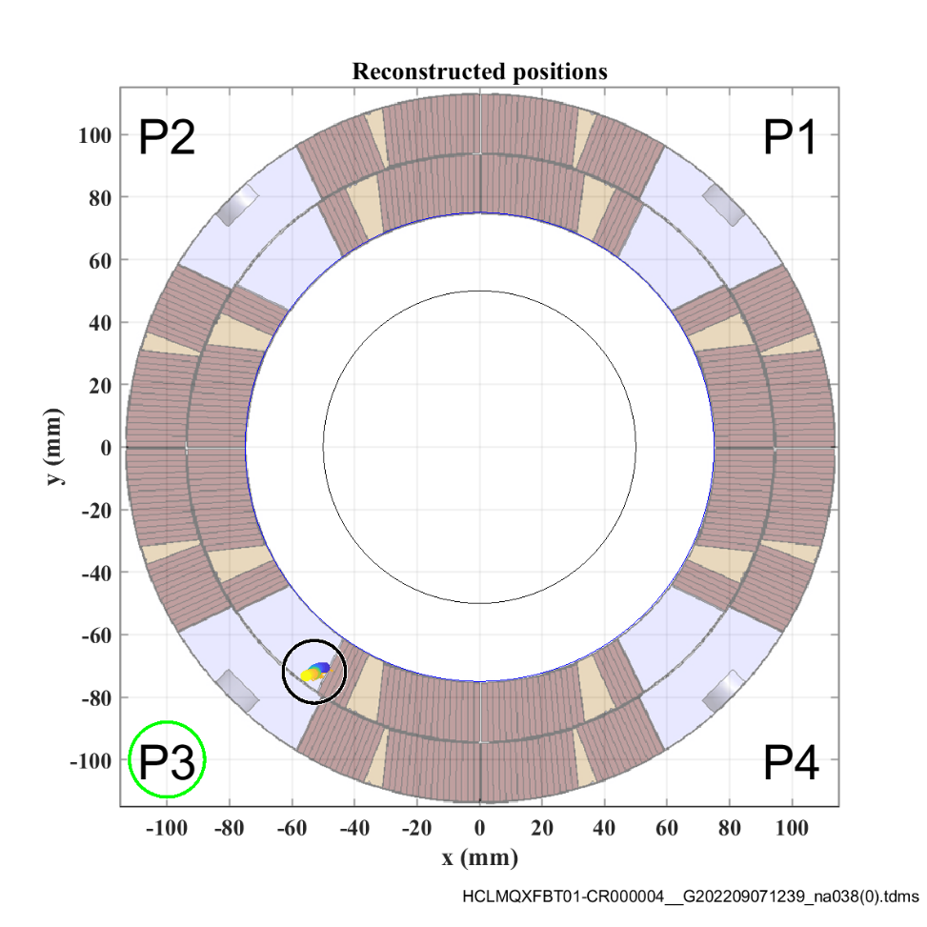
MQXFBP3:
4.5 K, VI cycle, CD1
Quench current in CD1: 16.5 kA
CS
NCS

Slide 15
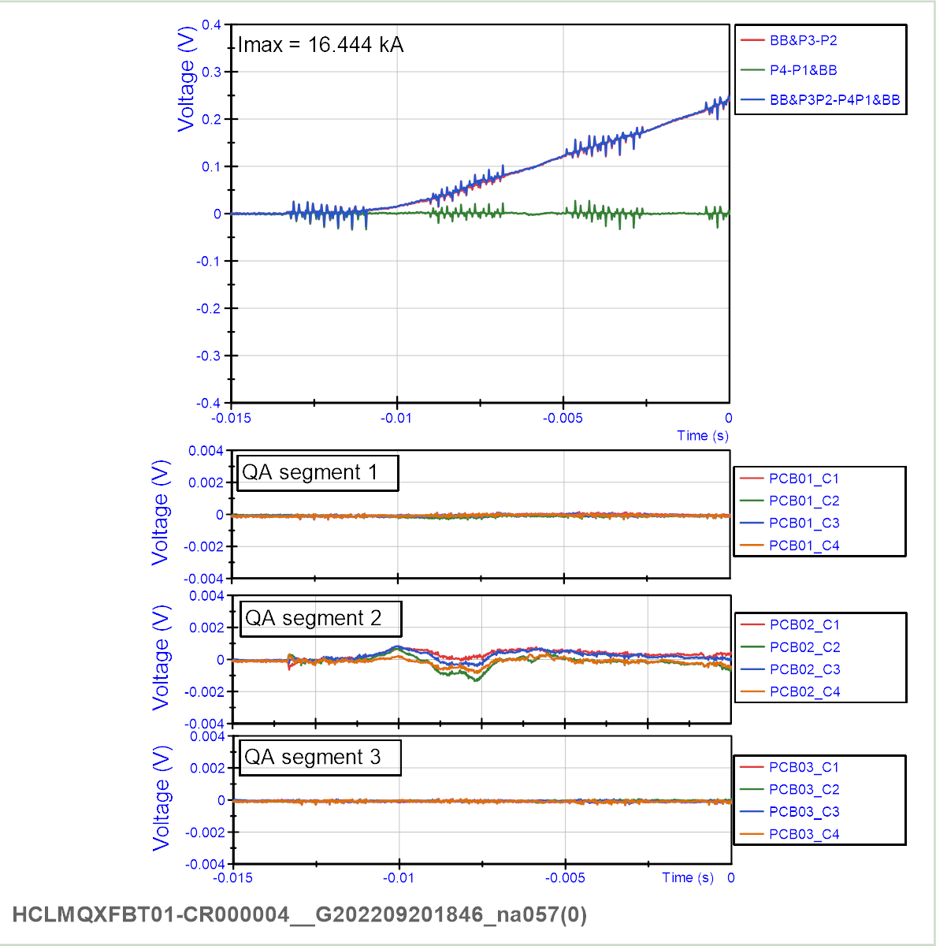
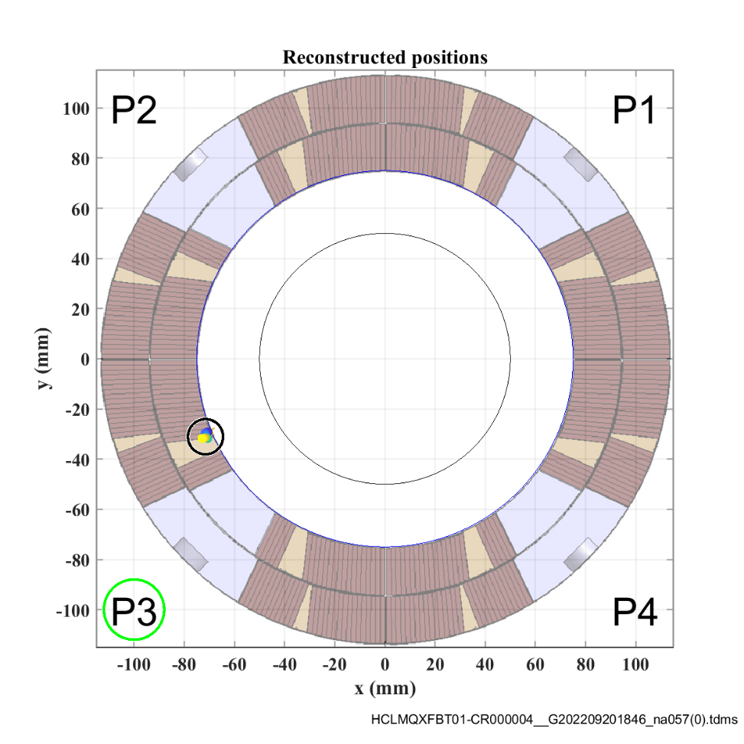
MQXFBP3:
4.5 K, VI cycle, CD2
Quench current in CD1: 16.4 kA
CS
NCS

Slide 16
V-I measurements

Slide 17
MQXFBP2 vs BP3 VI measurements
MQXFBP2
MQXFBP3
Tests done at 4.5K
Shown: coil voltage – average coil voltage. Offset corrected at the first plateau.
In MQXFBP2 the coil voltage mirrors the single segment voltage (1127-1212).
In MQXFBP3 no early superconducting transition was observed.
We are working on reducing the measurement noise level.

Slide 18
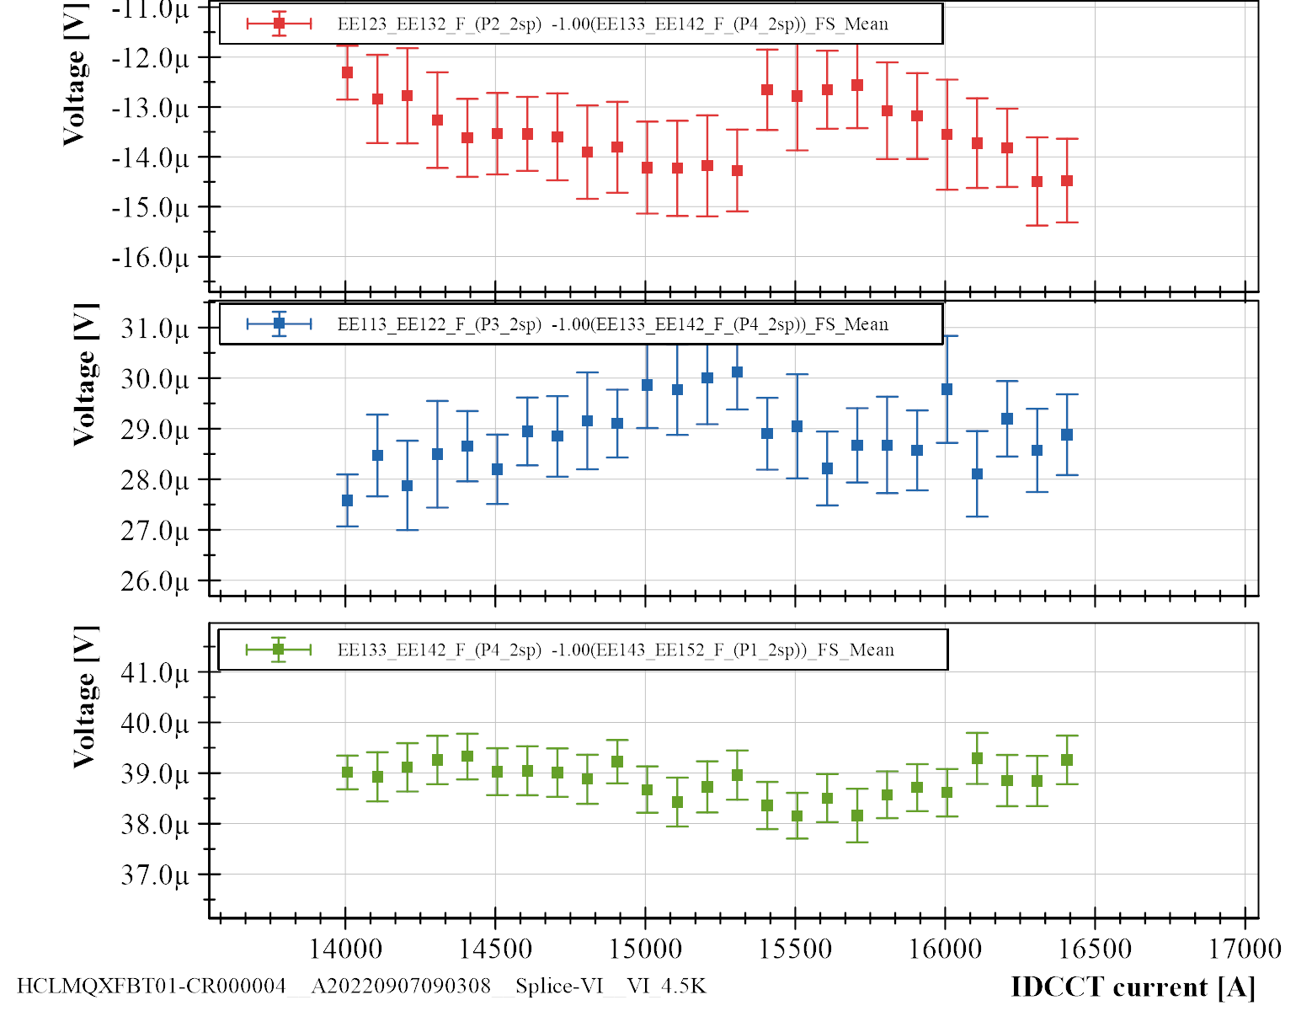
VI at 4.5 K
CD1
P2-P4
Unexplained drift around 15.3 kA, also visible in the splices.
All coils seem to be OK within 1 uV measurement error
P3-P4
P4-P1
Nominal
current

Slide 19
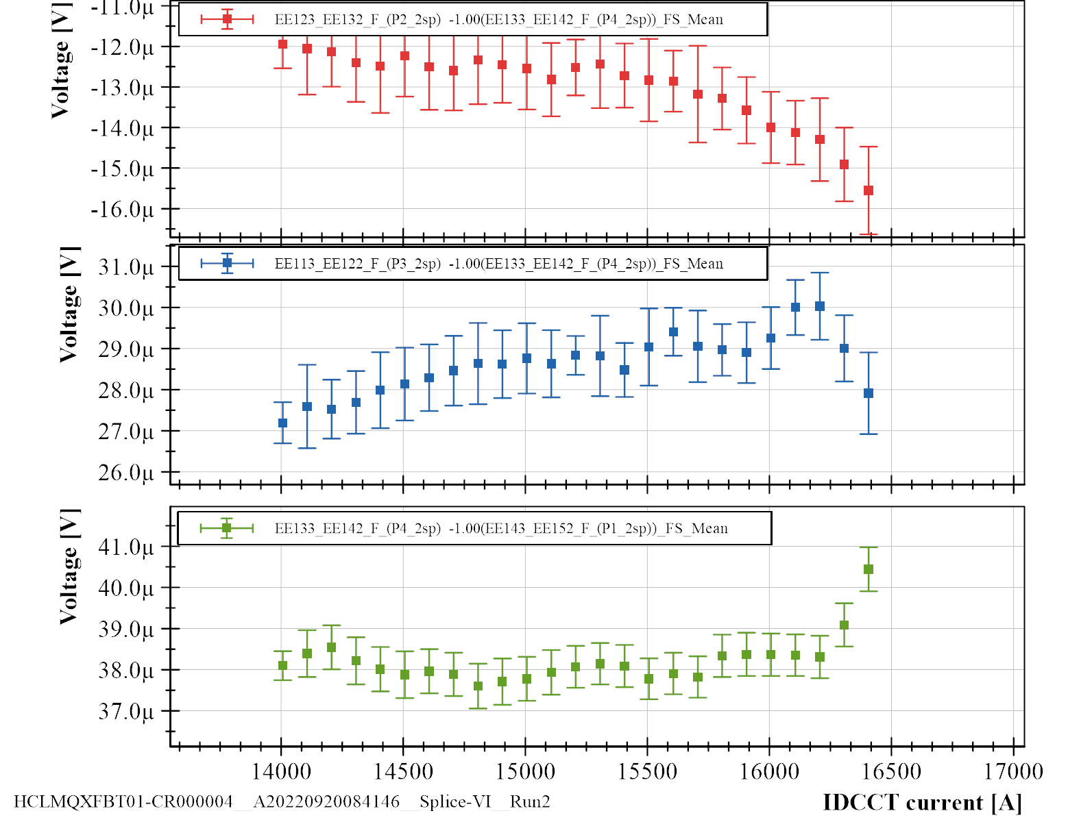
VI at 4.5 K
CD2, 1st
P2-P4
Slight and gradual drift in signals (also in splices)
In two of the three compensation methods, the last two points (16.3, 16.4 kA) show a small increase in P4 voltage
All coils seem to be OK within 1 uV measurement error, at least up to nominal current
P3-P4
P4-P1
Nominal
current

Slide 20
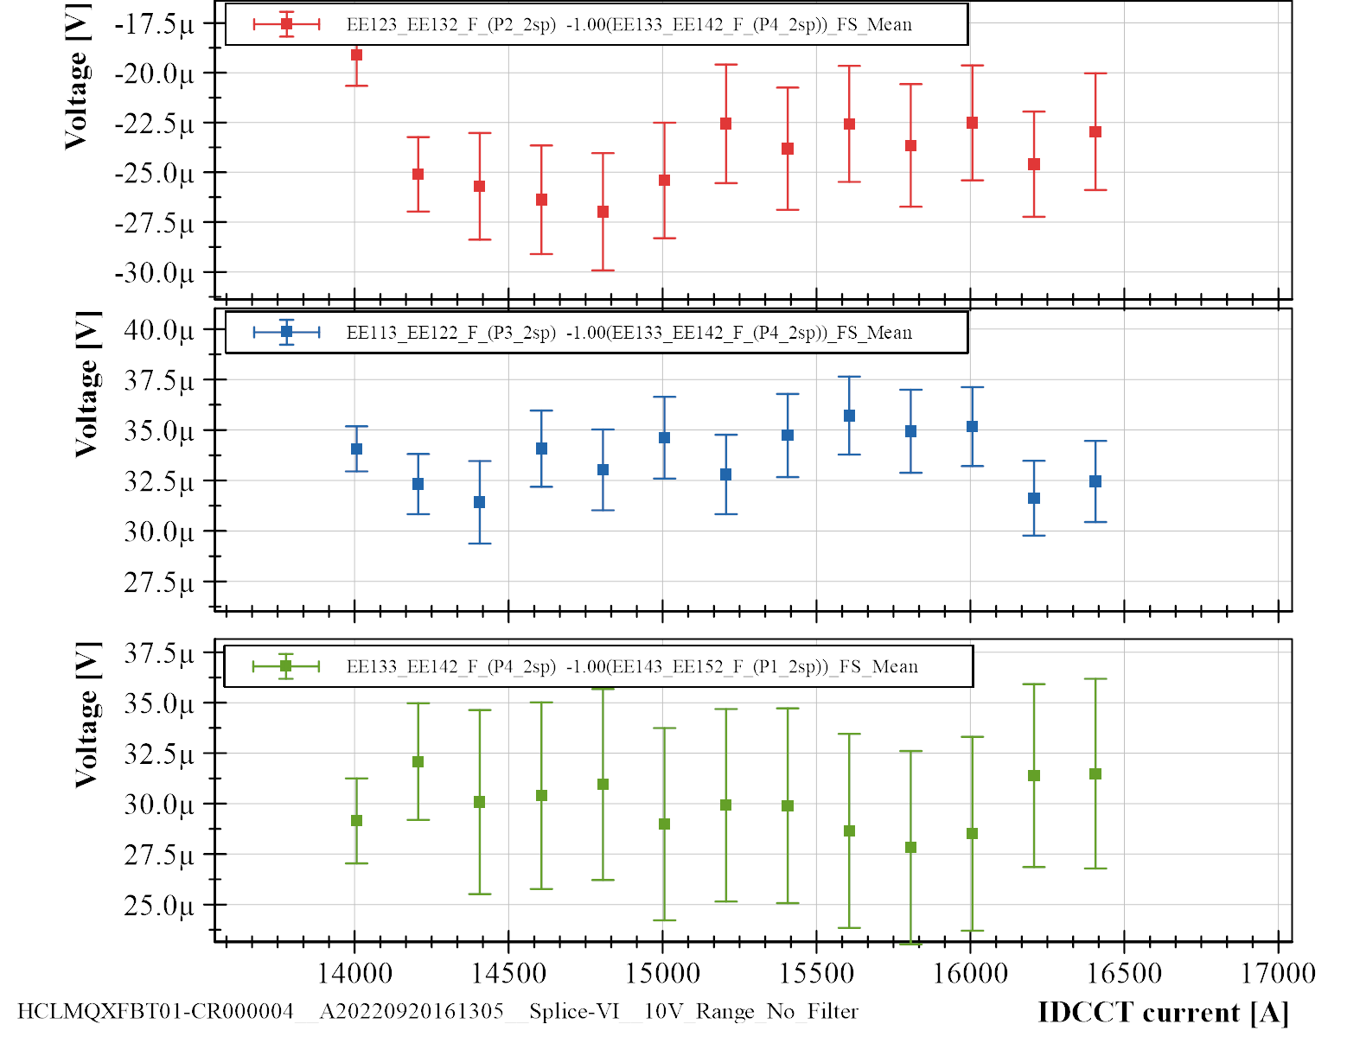
VI at 4.5 K
CD2, 2nd
P2-P4
Note different scale (2.5 uV per division)
Second test during CD2 with different settings, to see if the drift was reduced. New settings noisier…
P3-P4
P4-P1
Nominal
current

Slide 21
Conclusions

Slide 22
Conclusions
Multipole quench antenna allows to localize quenches in the cross section
MQXFBP3 has similar quench behaviour as BP1 and BP2 – but at significantly higher current
VI measurements in BP3 show no transition up to nominal current at 4.5 K
  In previous magnets we profited from local voltage taps – not the case for BP3
  Drift during measurements make the measurements difficult to analyze

