Slide 1

Improvement in cold mass assembly
(since April 22)
H. Prin
T. Bampton, N. Bourcey, S. Straarup
Follow-up on MQXFB actions 07/09/2022
https://indico.cern.ch/event/1177429/

Slide 2
Outline
Fixed point implementation on:
  Traction tests at cold
  MQXFBP3 in LMQXFBT04
  MQXFBP2 in LMQXFB01
  MQXFB02 in LMQXFBT05
Welding quality improvements
Shell production quality improvements
Magnet to Cold Mass Interference

Slide 3
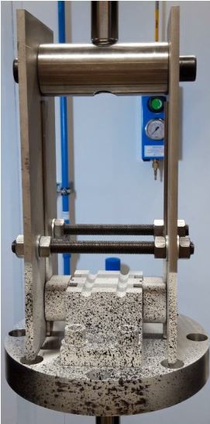
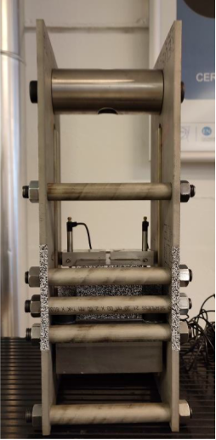
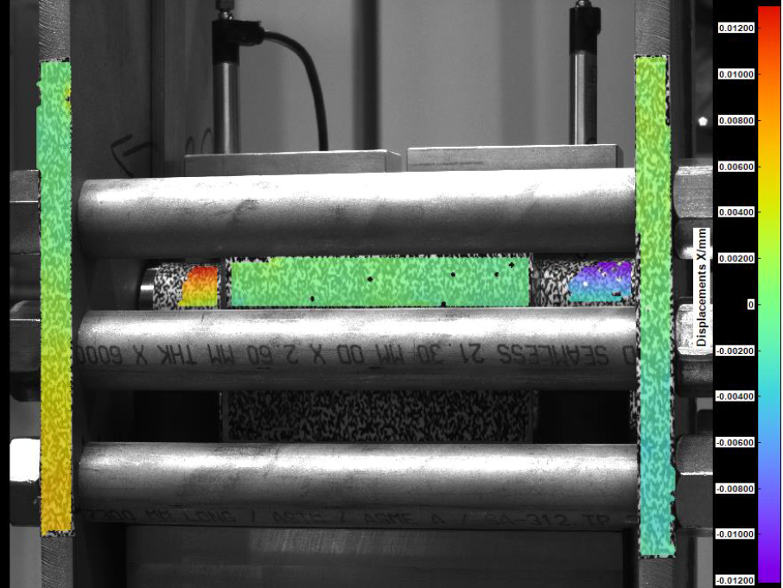
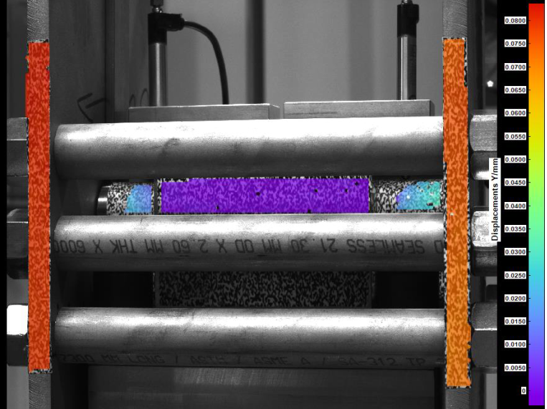
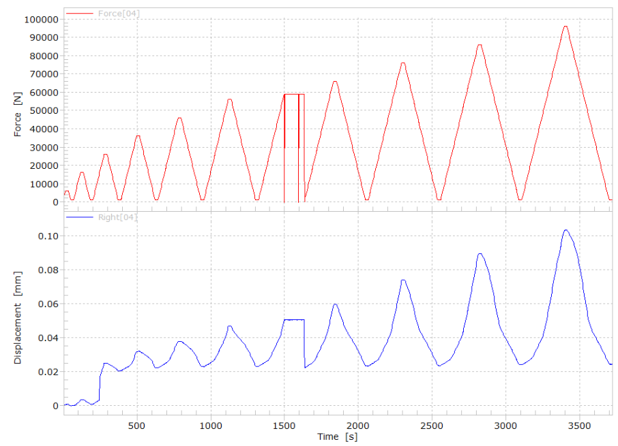
Fixed point tests at warm and 77K in the MME mechanical measurement lab
https://edms.cern.ch/document/2711705/ by O. Sacristan de Frutos
Horizontal displacement RBMR colormap at 55 kN.
Vertical displacement RBMR in the second ramp of test-protocol 2
Assembly #1 demonstrated an important flexibility of the lateral plates. This excessive flexibility was judged not representative of the actual mechanical behavior of the system in service.
Assembly #2 was produces as a modification of assembly #1. Stiffeners were included in the design. The tests performed both at room temperature and 77K depict small relative displacements consistent with local adjustment of the different parts, but no hints of permanent and significant deformation of the materials.
load-unload cycles from 1 to 96 kN (load rate of 55 kN/min)

Slide 4
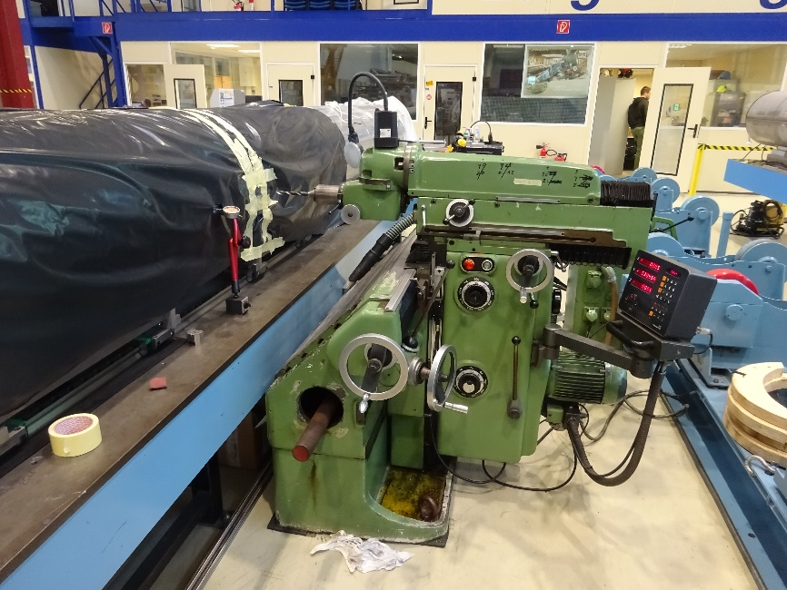
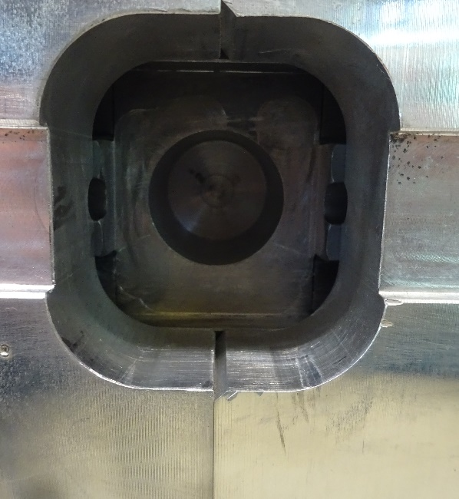
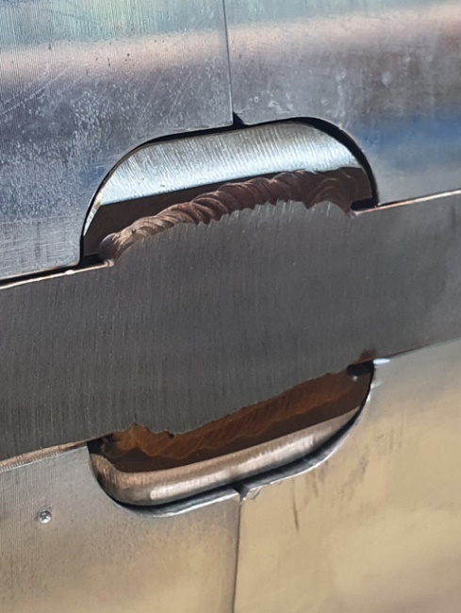
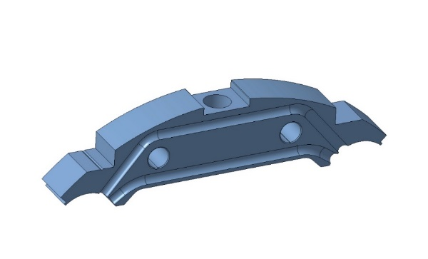
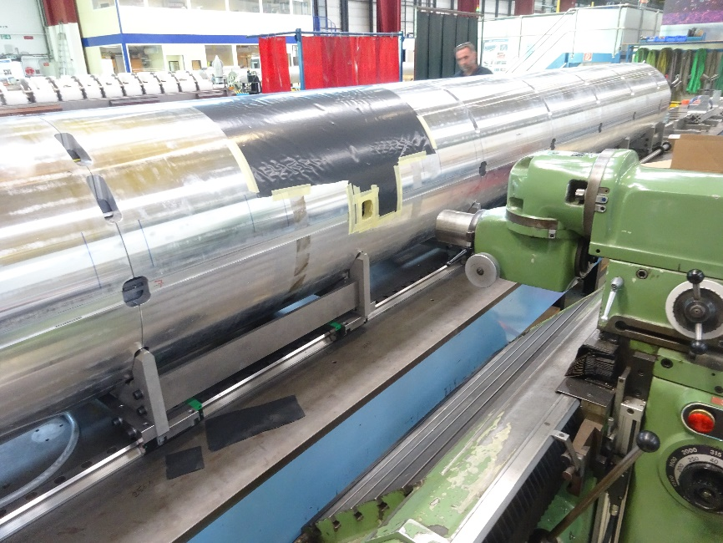
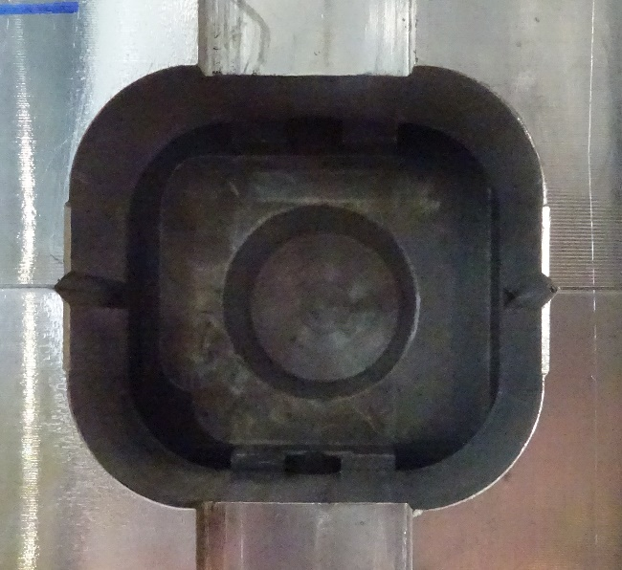
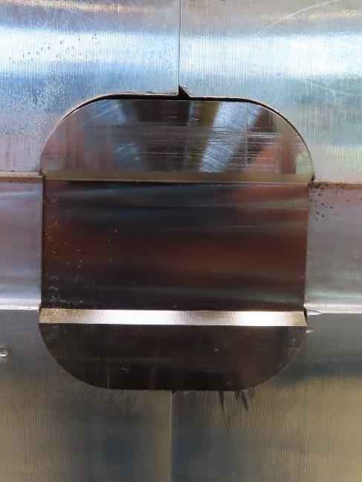
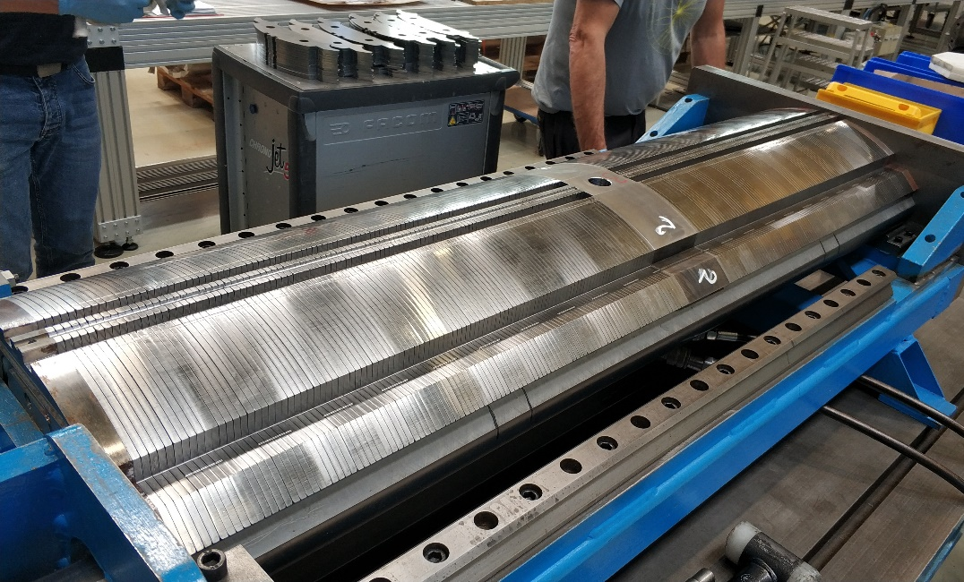
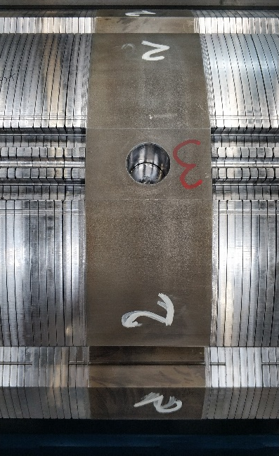
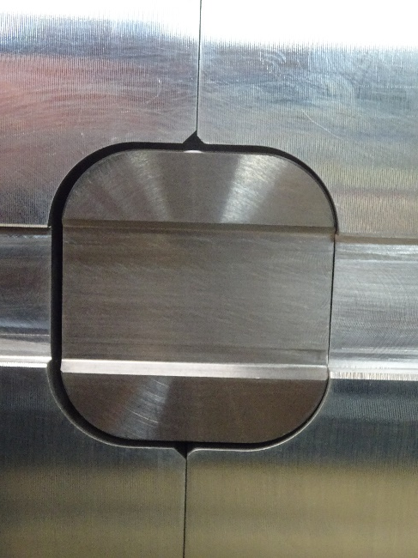
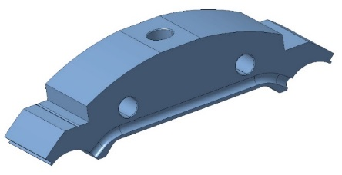
Fixed point implementation
MQXFBP3 machined inside LMQXFBT04
Middle yoke plate machined for MQXBP2 and 3 (45mm)
MQXFBP2 machined inside LMQXFB01
Middle yoke plate enlarged design for the series (91.4mm)
MQXFB02
Assembled in LMQXFBT05

Slide 5
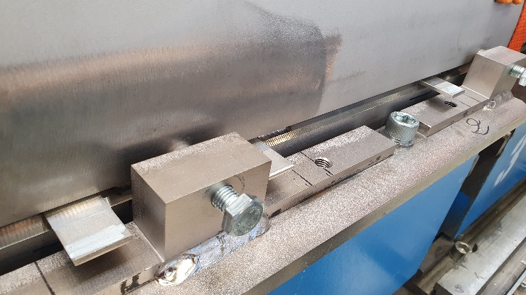
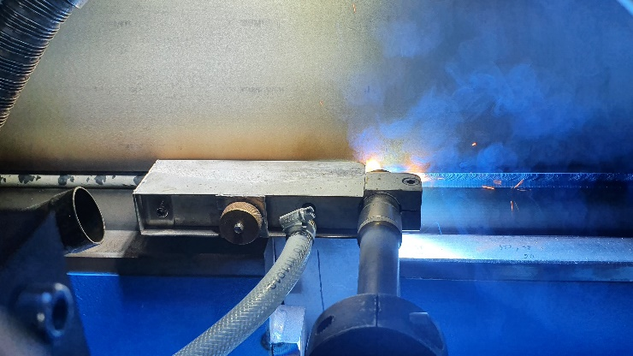
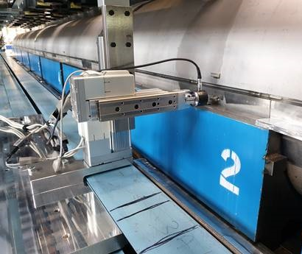
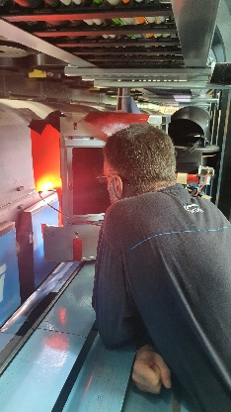
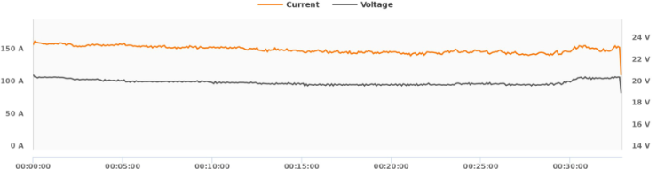
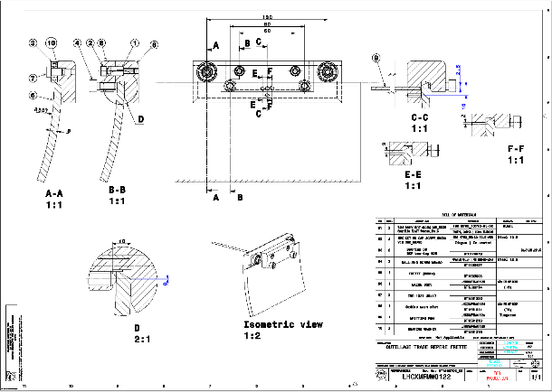
Welding quality improvements
Implemented
Parameter refinements within the WPS range to improve weld profile and repeatability
Tooling to eliminate the gap between the upper shell and the backing strip (0.5mm max)
Pre-tack shims to maintain root gap consistency along the weld
Modification of the program for the root pass to reduce the heat input and thus the weld contraction
Trials conducted to validate tack up without filler material (to eliminate variables between technicians)
Gaseous protection trailers serviced and gas flow optimized
Ongoing
Measuring probe automation
Protection boxes around the TIG welding torches for welders' safety, they will be replicated on the MIG torches.
Weldeye software to monitor continuously the welding parameters (Amperage, Voltage, heat input, estimated speed) implement on the MIG sources, TIG system integration to follow
Proposed
System to mark the shells for torch and welding alignment

Slide 6
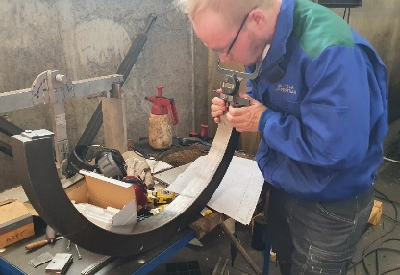
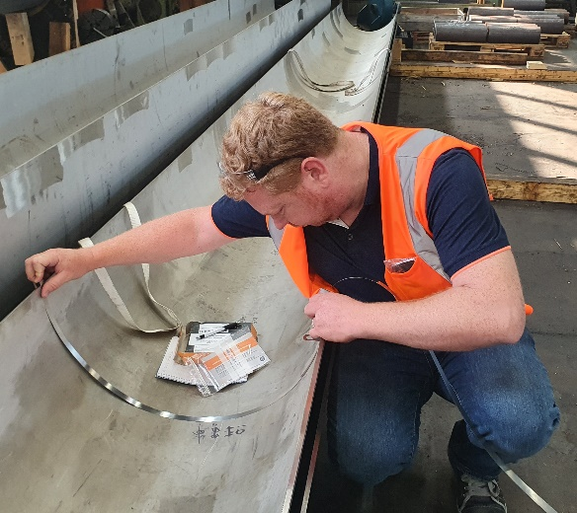
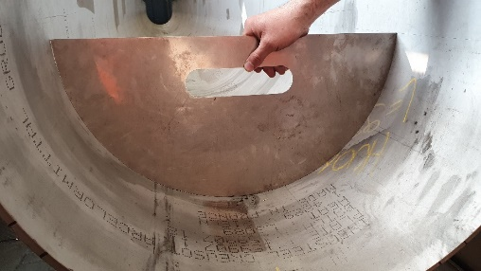
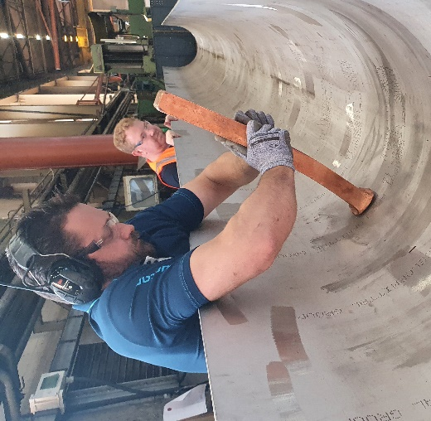
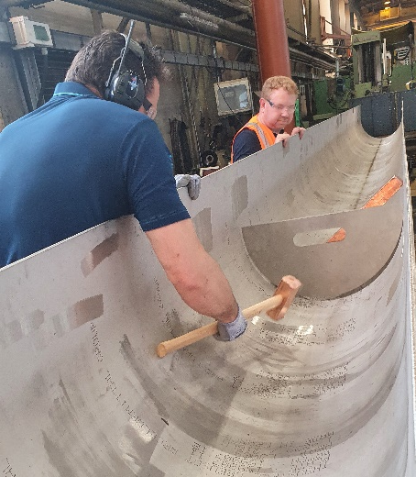
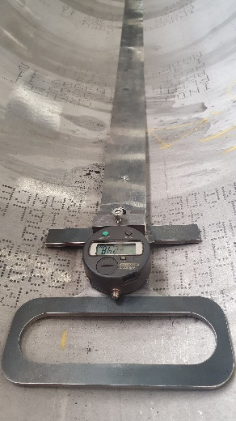
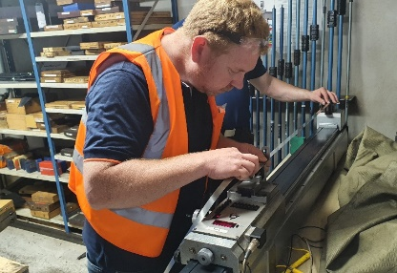
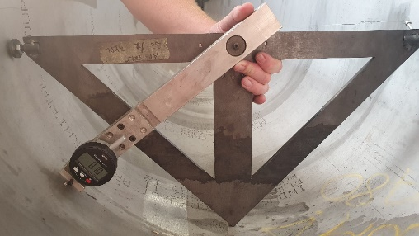
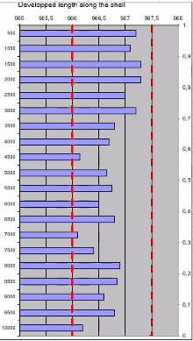
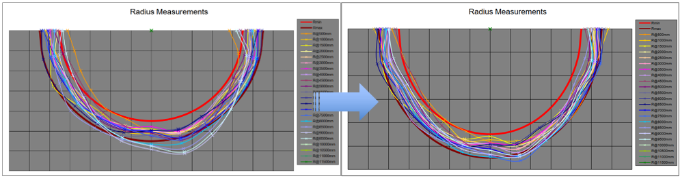
Shells production quality improvements
Weekly meeting via Zoom since November 2021
Visit in AP-Tela in June the 30th
  Aim of the visit: review of the preformed shells in stock, review the measuring devices and techniques, assess the dimensional effect of the local ground marks on the shell profile after shaping and agree a production schedule.
  Visit report: https://edms.cern.ch/document/2766233/
  Agenda of the visit:
  Review of the preformed shells in stock,
  Review of tooling,
  Review of the measuring devices and techniques,
  Assessment of the dimensional effect of the local ground marks on the shell profile after shaping,
  Agree a production schedule,
Developed length measurement tool and calibration checks
Shell developed length measurements
Shell shape template and measurement tool
Manual re-“calibration”

Slide 7
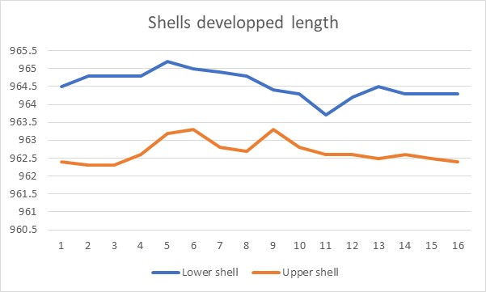
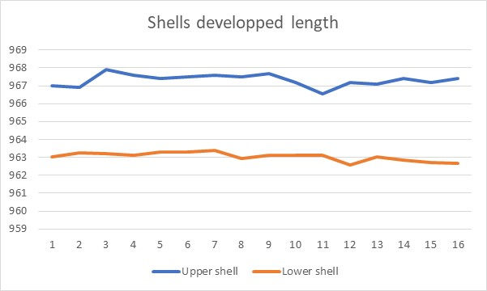
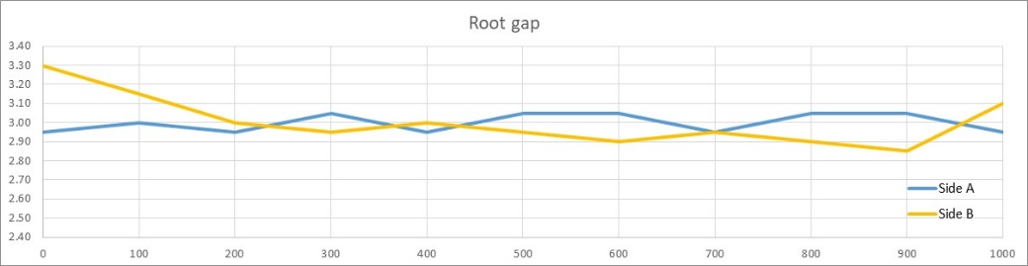
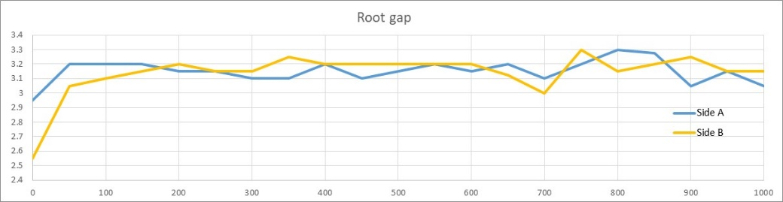
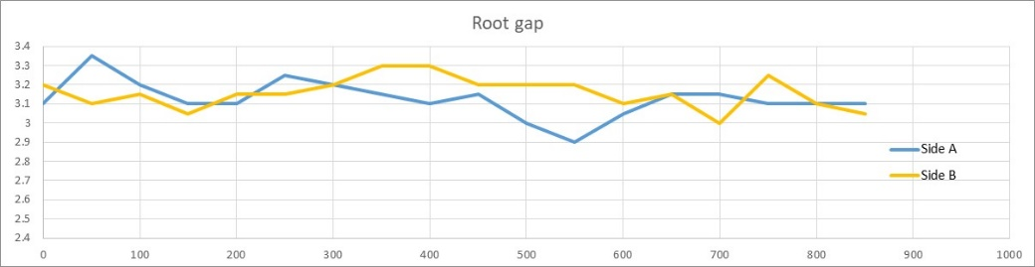
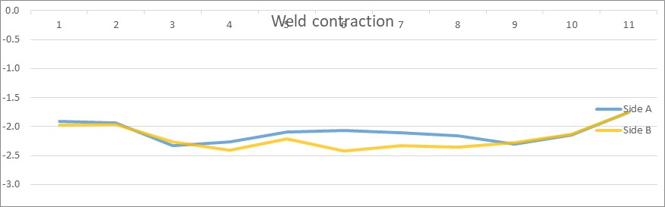
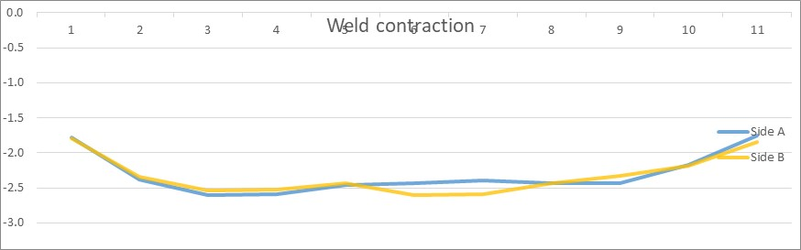
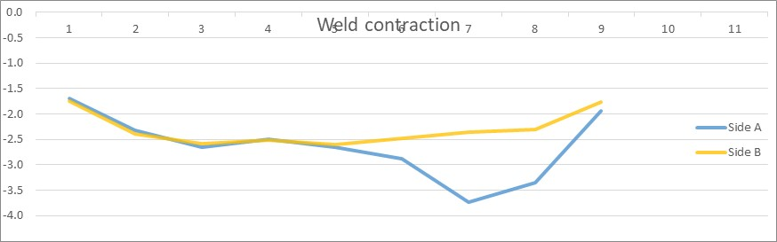
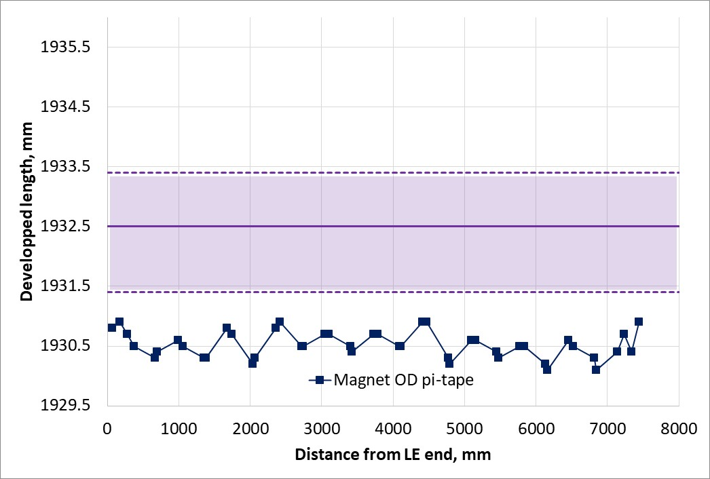
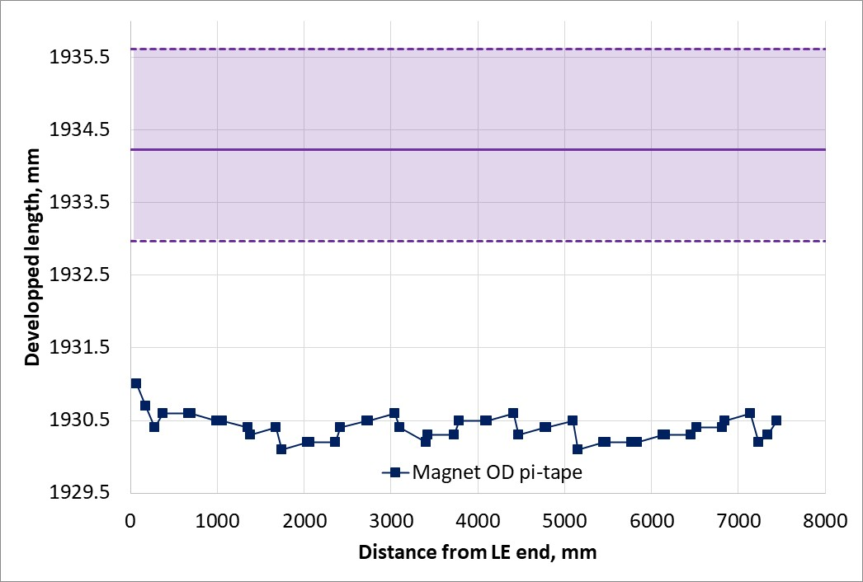
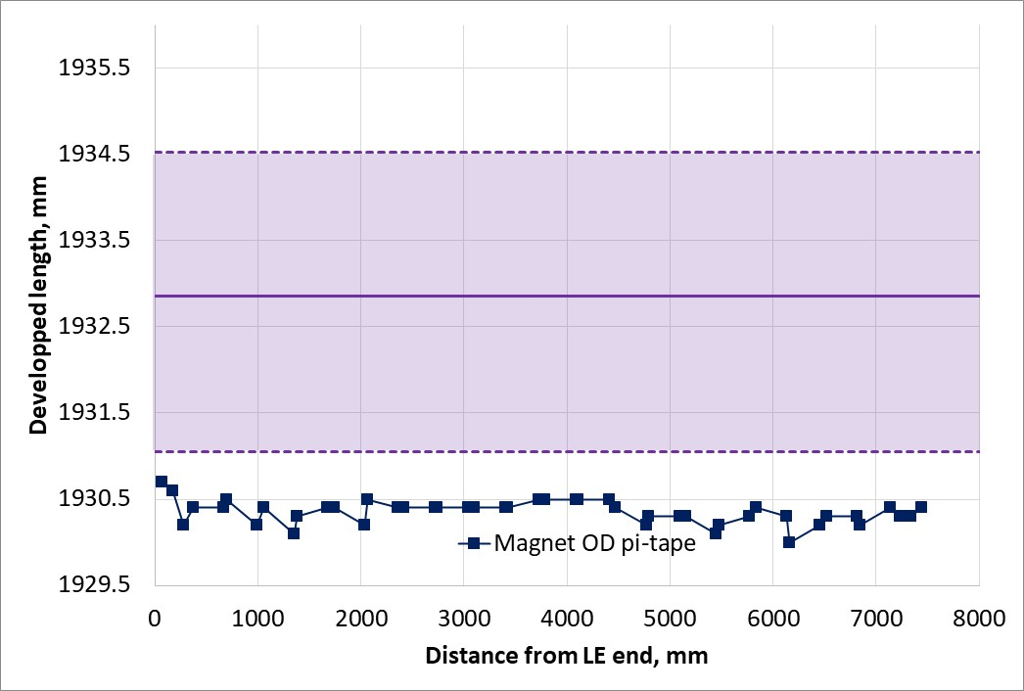
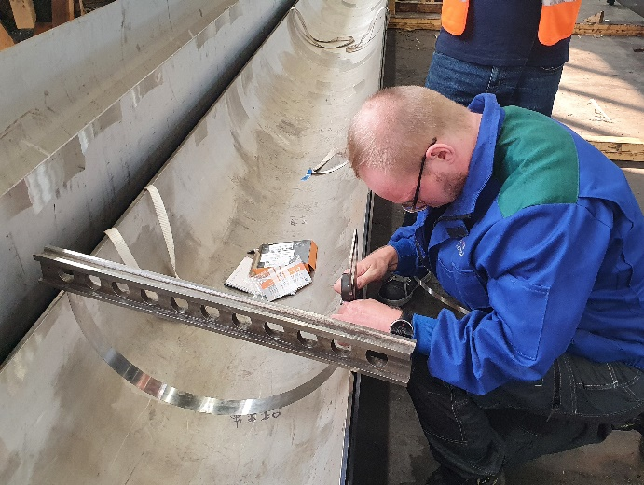
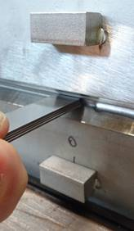
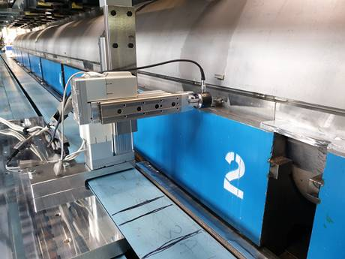
Magnet to Cold Mass Interference
LMQXFBT04
LMQXFB01
LMQXFBT05
Shell dev length
Root gap
Weld contraction
Ldev_{Cold mass}= Ldev_{Shells1} + Ldev_{Shells2} + Root gap_{A} + Root gap_{B} - Shrinkage_{A} - Shrinkage_{B}
Magnet/Vessel
Interference

