Slide 1

Assessing Resin and insulation limits and improving electrical robustness
Helene Felice, Roland Piccin, Davide Tommasini, Bharti Verma, Christian Scheuerlein, Juan Carlos Perez, Susana Izquierdo Bermudez, Ezio Todesco
Sept 7th 2022 – Follow-up Report on Ongoing actions for MQXFB

Slide 2
Timeline for improvements presented on 29/04/2022
Quench Heater reliability
Implementation in
MQXFS 115/116
Assembly in MQXFS8
Adhesion
Interim report 1 on adhesion studies
Interim report 2 on adhesion studies
In case of convincing results, compatible with HL-LHC timescale
Interlayer
Report on HT coil interlayer
Q2 2022
Q3 2022
Q4 2022
Q1 2023
Q2 2023
HFM
Cable insulation
Report on HT impregnated braid
Resin development
Interim report 1 on tougher resin
Prelim report on irradiation of impregnation system in air
Interim report 2 on tougher resin
Start of irradiation campaign at cold

Slide 3
Timeline for improvements presented on 29/04/2022
Quench Heater reliability
Implementation in
MQXFS 115/116
Assembly in MQXFS8
Adhesion
Interim report 1 on adhesion studies
Interim report 2 on adhesion studies
In case of convincing results, compatible with HL-LHC timescale
Interlayer
Report on HT coil interlayer
Q2 2022
Q3 2022
Q4 2022
Q1 2023
Q2 2023
HFM
Cable insulation
Report on HT impregnated braid
Resin development
Interim report 1 on tougher resin
Prelim report on irradiation of impregnation system in air
Interim report 2 on tougher resin
Start of irradiation campaign at cold

Slide 4
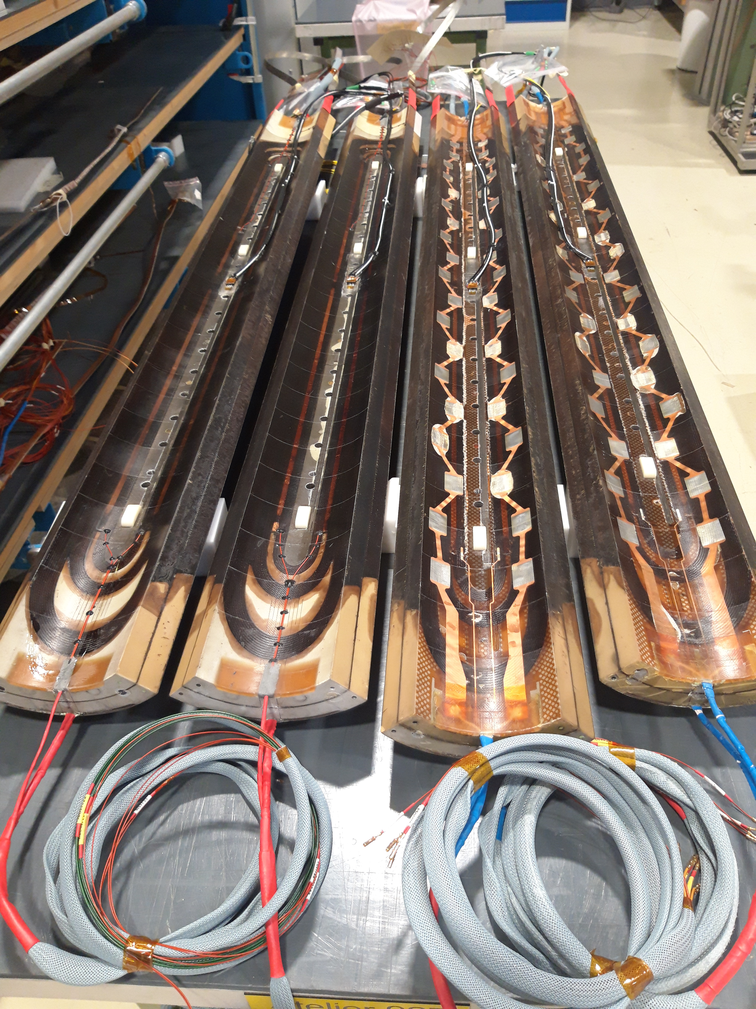
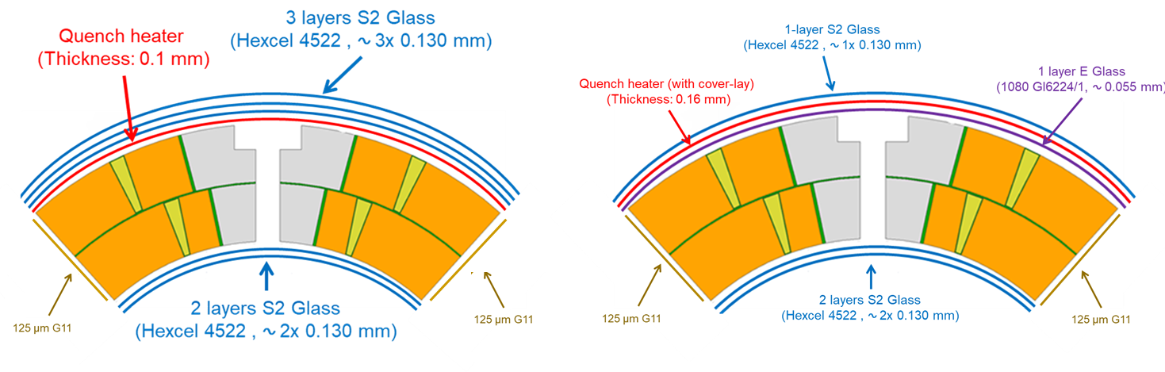
Improvements in QH robustness
To improve the reliability of the Quench heaters:
Sandwich construction: addition of a Polyimide coverlay to improve the mechanical robustness of the QH (heaters circuit on the neutral axis)
0.055 mm E-glass (EDMS 2519642 (v.1)) added after reaction between heater and coil to :
  Facilitate resin impregnation
  Provide additional dielectric insulation heater to coil
HV qualification tests on QH before installation from
3.7 kV to 5 kV
Initial Design
New Design
Implemented in coils 115/116 for MQXFS8 to be assembled in Sept 2022
Implemented in MQXFB from coil 126
Already implemented in 2 MQXFB Cu coils 004 and 005
MQXF QH Technical Meeting
https://indico.cern.ch/event/1077589/

Slide 5
Timeline for improvements presented on 29/04/2022
Quench Heater reliability
Implementation in
MQXFS 115/116
Assembly in MQXFS8
Adhesion
Interim report 1 on adhesion studies
Interim report 2 on adhesion studies
In case of convincing results, compatible with HL-LHC timescale
Interlayer
Report on HT coil interlayer
Q2 2022
Q3 2022
Q4 2022
Q1 2023
Q2 2023
HFM
Cable insulation
Report on HT impregnated braid
Resin development
Interim report 1 on tougher resin
Prelim report on irradiation of impregnation system in air
Interim report 2 on tougher resin
Start of irradiation campaign at cold

Slide 6
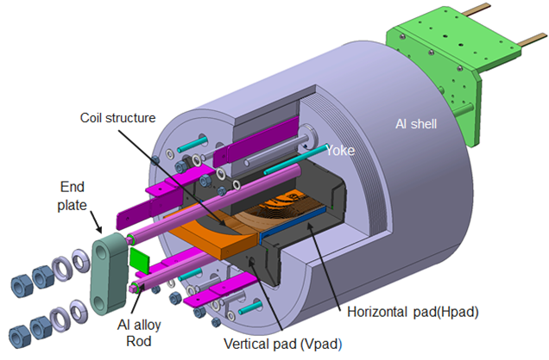
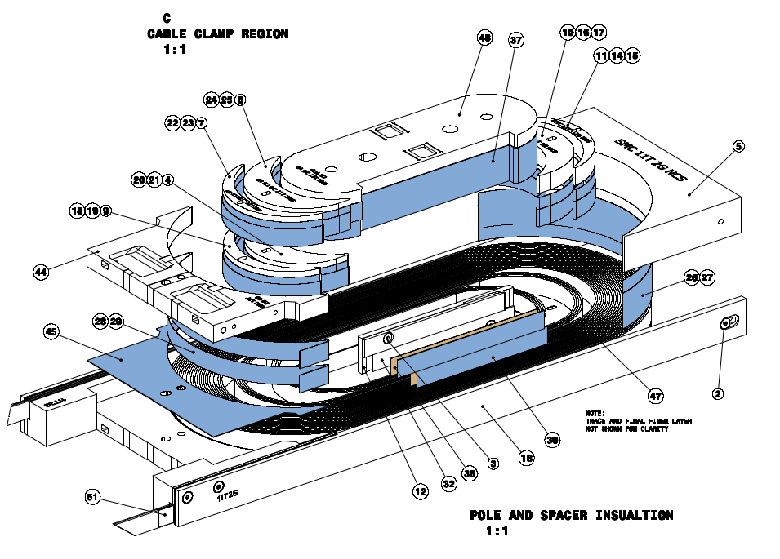
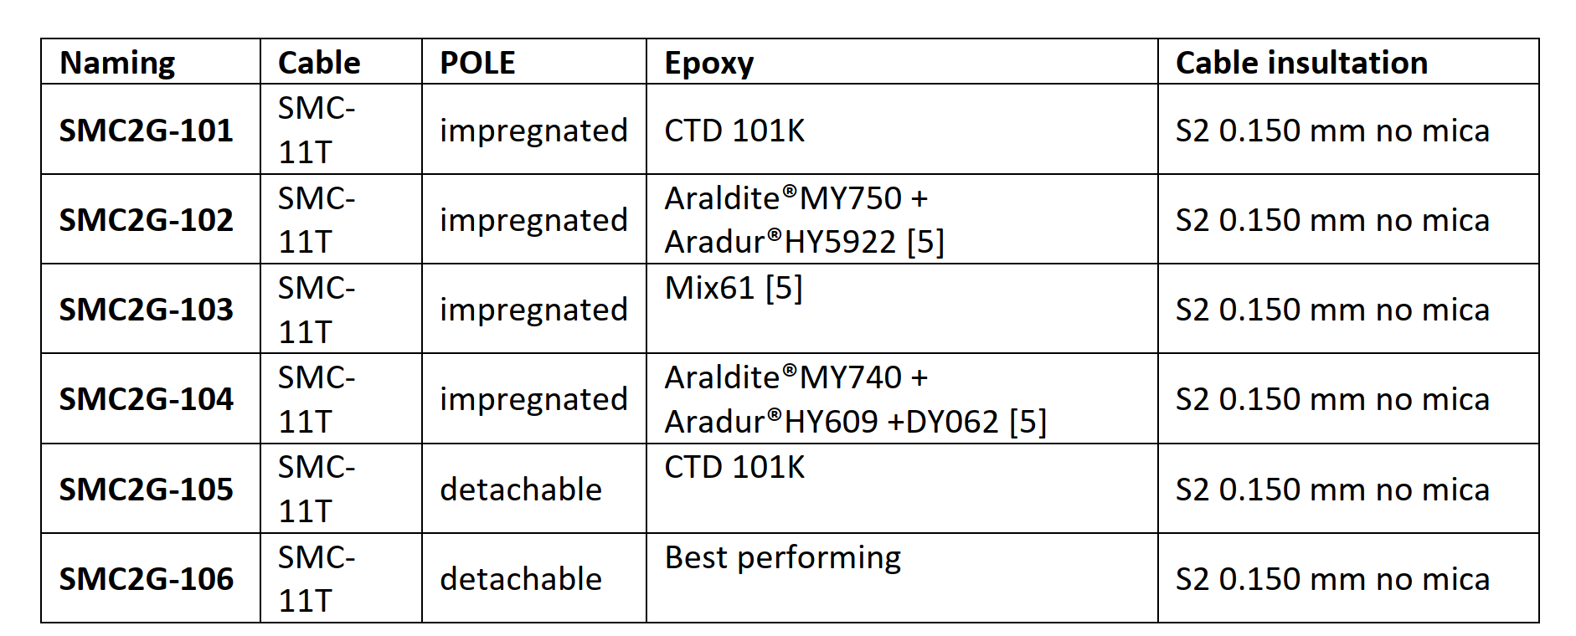
Resin Fracture Toughness
Role in magnet performance
In parallel with the characterization of each resin (see later slides), the challenge is to understand the role of the fracture thoughness in the magnet performance
SMC program
Completed and ready for assembly in October 2022
Major NC – coil 103b in fabrication
Completed and ready for assembly after 101 and 102
SMC Models - 1st series - MSC HFM Program | Document 2682457 (v.3) (cern.ch)
Several SMC coils ready for tests

Slide 7
Timeline for improvements presented on 29/04/2022
Quench Heater reliability
Implementation in
MQXFS 115/116
Assembly in MQXFS8
Adhesion
Interim report 1 on adhesion studies
Interim report 2 on adhesion studies
In case of convincing results, compatible with HL-LHC timescale
Interlayer
Report on HT coil interlayer
Q2 2022
Q3 2022
Q4 2022
Q1 2023
Q2 2023
HFM
Cable insulation
Report on HT impregnated braid
Resin development
Interim report 1 on tougher resin
Prelim report on irradiation of impregnation system in air
Interim report 2 on tougher resin
Start of irradiation campaign at cold

Slide 8
Snapshot of activities on robust electrical insulation
The R&D activities on the electrical insulation are focused to determine the factors that have an impact on the magnet performance and reliability
Impact of the physical parameters of the insulation on the magnet performance
Adhesion strength
Resin fracture thoughness
Thermal conductivity / specific heat
Viscosity / potting life
Impact of reaction heat treatment on the insulating materials
Interlayer
Conductor braid
The role of the binder
Impact of radiation sources and enviromental conditions (temperature, O₂-free)
Development of enhanced coil insulation system
Resin development
Conductor insulation
In-coil characterization
The R&D is in the frame of HFM but it may have an impact on the HL-LHC project

Slide 9
Timeline for the next 12 months
Interim report 1 on adhesion studies
Adhesion
Interim report 2 on adhesion studies
Interlayer
Report on HT coil interlayer
Prelim report on irradiation of impregnation system in air
Start of irradiation campaign at cold
Irradiation
Q3 2022
Q4 2022
Q1 2023
Q2 2023
Q3 2023
Cable insulation
Report on HT impregnated braid
Resin development
Interim report 1 on tougher resin

Slide 10
Impact of reaction heat treatment on the insulating materials
Interlayer
Conductor braid
The role of the binder
Impact of the physical parameters of the insulation on the magnet performance
Adhesion strength
Resin fracture thoughness
Thermal conductivity / specific heat
Viscosity / potting life
Impact of radiation sources and enviromental conditions (temperature, O₂-free)
Development of enhanced coil insulation system
Resin development
Conductor insulation
In-coil characterization

Slide 11
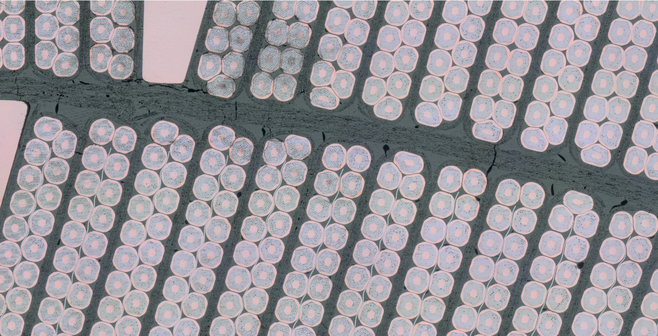
The impact of heat treatment – the interlayer and binder
The manufacturing process (EDMS 1726069)
Main materials
2x 250 µm S2 glass layer
1x 175 µm S2 glass layer
Binder CTD1202 Part A + B
The process
1h 80℃ + 2h 150℃ (heat treatment)
Afterward goes through coil reaction 650 ℃ in Ar
Impregnated with CTD101K
Metallographic examination of MQXFB coil - Courtesy of M. Crouvizier
Observations
Several cracks in the interlayer region
Debonding of resin from components
Questions
Q1: What are the mechanical and dielectric properties of MQXFB interlayer as it is (with binder CTD1202)?
Q2: What is the chemical process of the system glass-binder during coil reaction at 650 ℃ ?
Goal
Propose improvements to reduce the appearance of cracks between layers

Slide 12
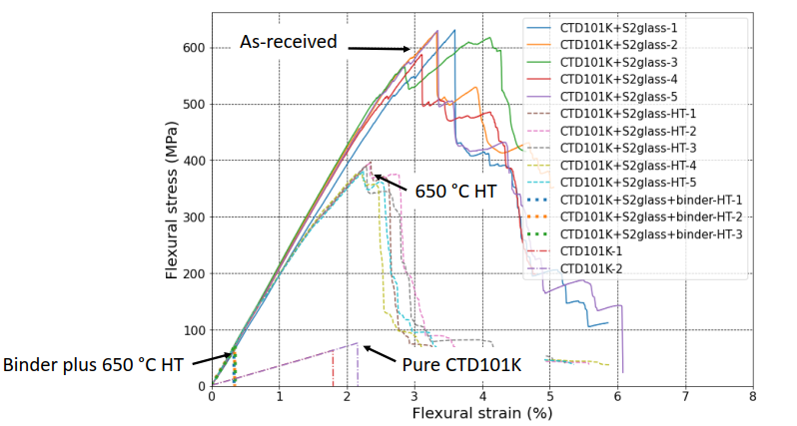
Q1 - Mechanical strength of the MQXFB interlayer
Courtesy of C. Scheuerlein / A. Gaarud
The HT at 650 ℃ degrades the fibers (loss of almost half flexural strength)
Dramatic drop of mechanical strength after the HT at 650 ℃ in Ar with the CTD 1202 binder
Report https://edms.cern.ch/document/2744986/1

Slide 13
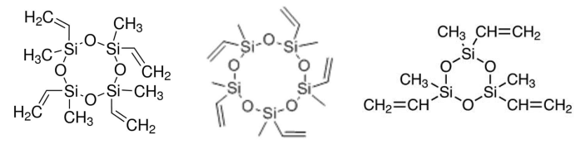
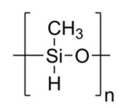
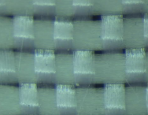
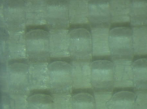
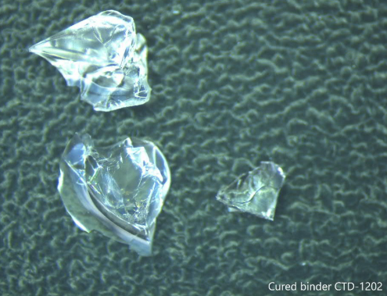
Q2 – Chemical process: formation of the Siloxane 3D network
CTD 1202 binder
=
+
Cyclosiloxanes (Part A)
Polymethyl Hydrosiloxane (Part B)
Hydrosilylation reaction
(150 ℃ in Air for 4 hours)
Fibers before hydrosilylation
Fibers after hydrosilylation
Pure CTD1202 cured
Report of D. Ternova - EMDS 2732657

Slide 14
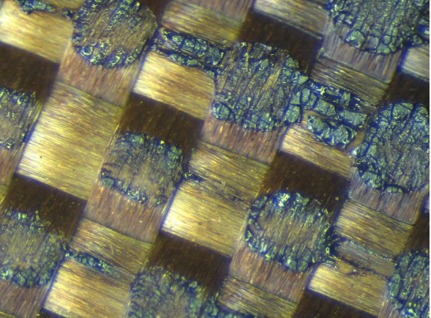
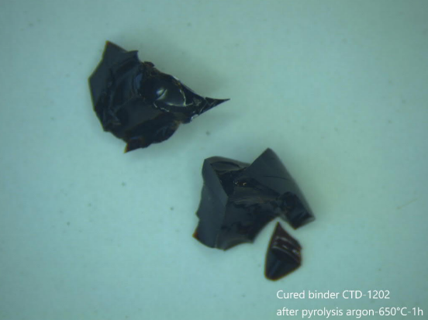
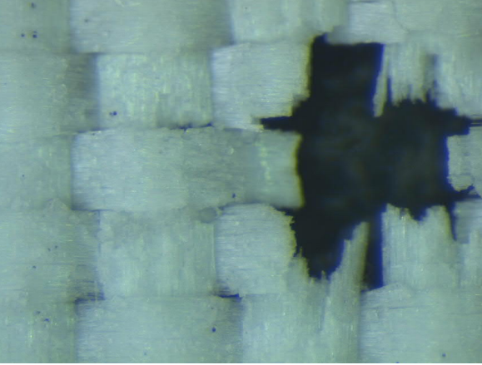
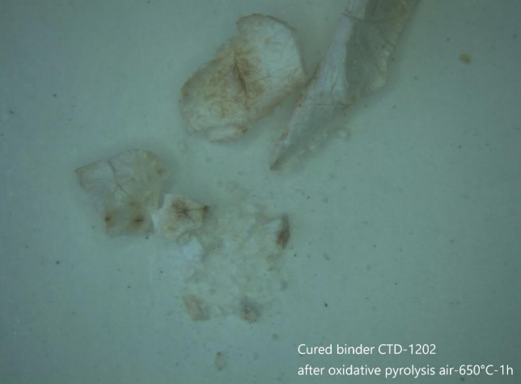
Q2 – Chemical process: Pyrolysis during coil reaction
Pyrolysis 650 ℃ in Argon
The binder turns into a ceramic structure called silicon oxicarbide (dark glass)
TGA measures 12.4% mass loss
Oxidative Pyrolysis 650 ℃ in Air
The binder turns into a white crumble structure and fibers gets extremely fragile
TGA measures 15.6% mass loss. Organic part volatilize and it does not constitute the ceramic structure
Report of D. Ternova - EMDS 2732657

Slide 15
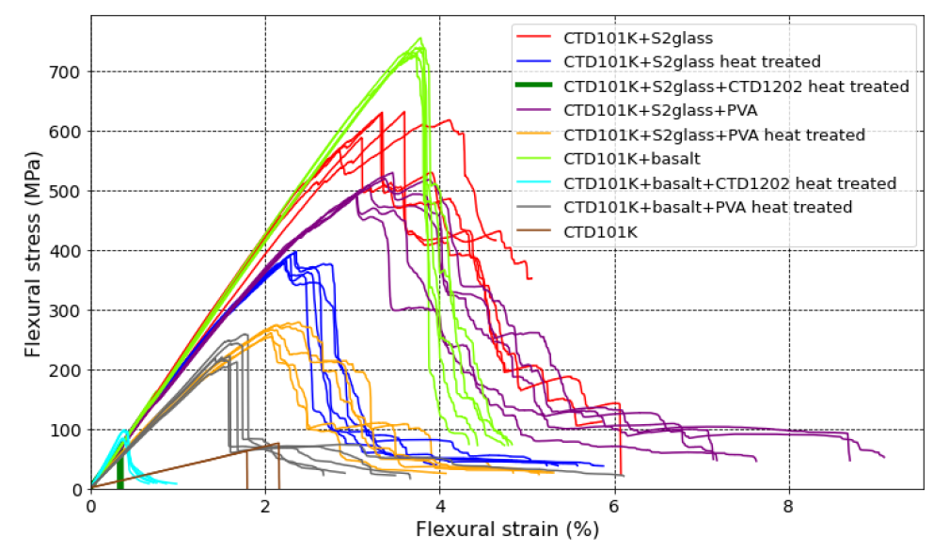
Exploring alternatives and improvements
From past studies it appears that grade 28-99 of Polyvinyl Alcohol (PVA) could be a potential candidate as binder material.
Other fibers such basalt shows better endurance to thermal cycle temperatures
M.G. Lopes - Glass Fiber / Binder Characterization, EDMS 1405346
S2 glass/PVA
S2 glass/CTD1202
Next actions for Q4 2022
- Process optimization aqueous concentration %PVA, wettability
- Physical characterization of CTD1202 or PVA/S2glass and CTD1202 or PVA/basalt (mechanical, electrical, chemical)
- Alternative weaving
- Impact of binder on conductor braid

Slide 16
Impact of reaction heat treatment on the insulating materials
Interlayer
Conductor braid
The role of the binder
Impact of the physical parameters of the insulation on the magnet performance
Adhesion strength
Resin fracture thoughness
Thermal conductivity / specific heat
Viscosity / potting life
Impact of radiation sources and enviromental conditions (temperature, O₂-free)
Development of enhanced coil insulation system
Resin development
Conductor insulation
In-coil characterization

Slide 17
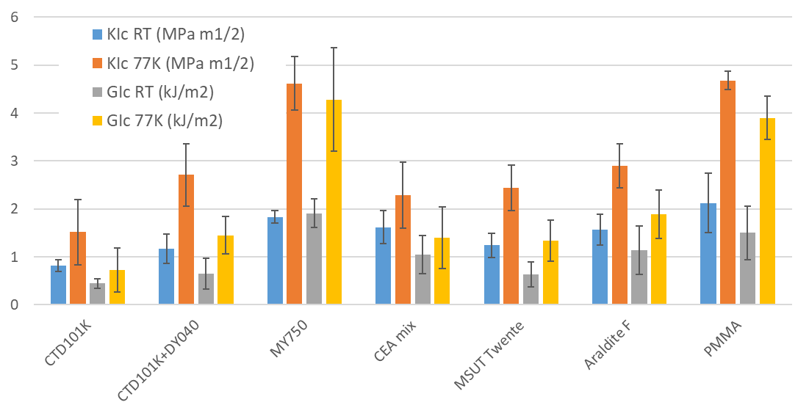
Progresses on resin systems
A. Garuud, Fracture toughness for the selected resin at RT and LN2, EDMS 2728875
Resin toughness
MY750 is the toughest resin. A new formulation based on MY750 has been investigated with ETHZ to extend the potting life (A. Garuud, EDMS 2774004)
CTD 101K is the least tough. However, its fracture toughness increases of 77% at 77K introducing the flexibilisator DY040 (A. Garuud, EDMS 2747910)
Next actions
Dielectric characterization of CTD 101K + DY040, verify radiation resistance

Slide 18
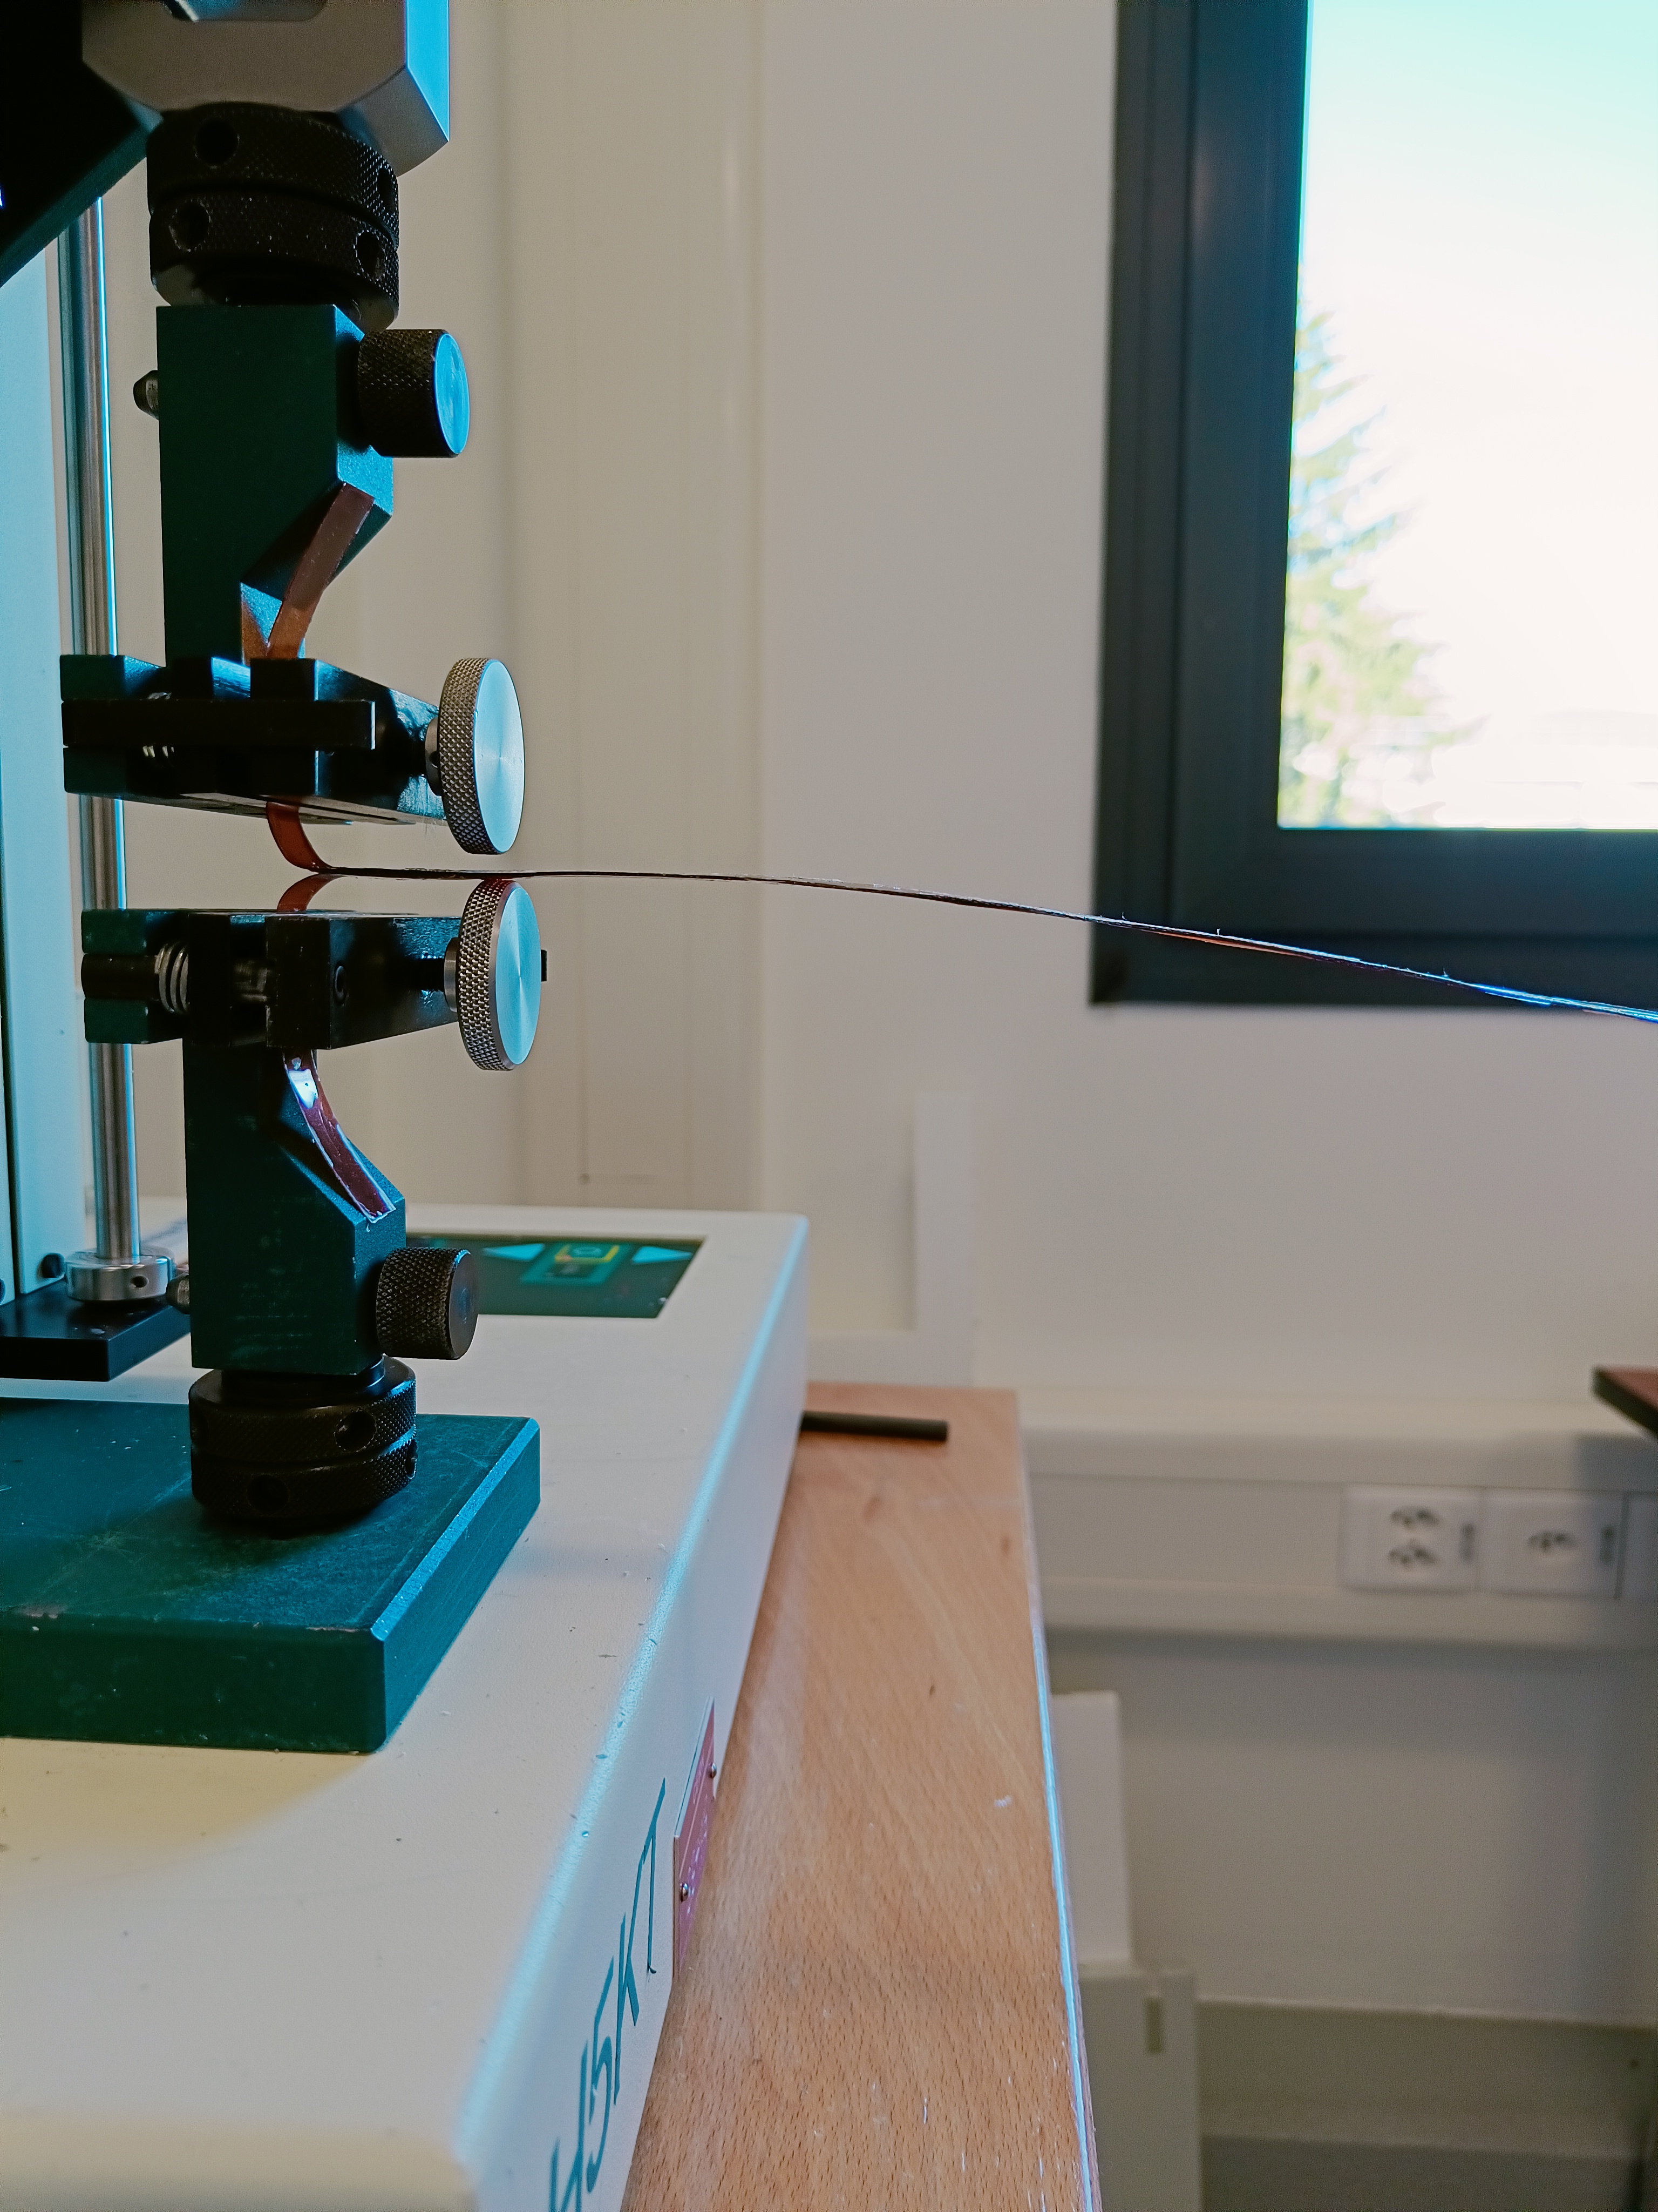
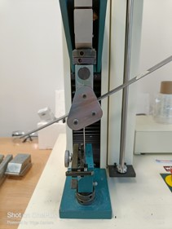
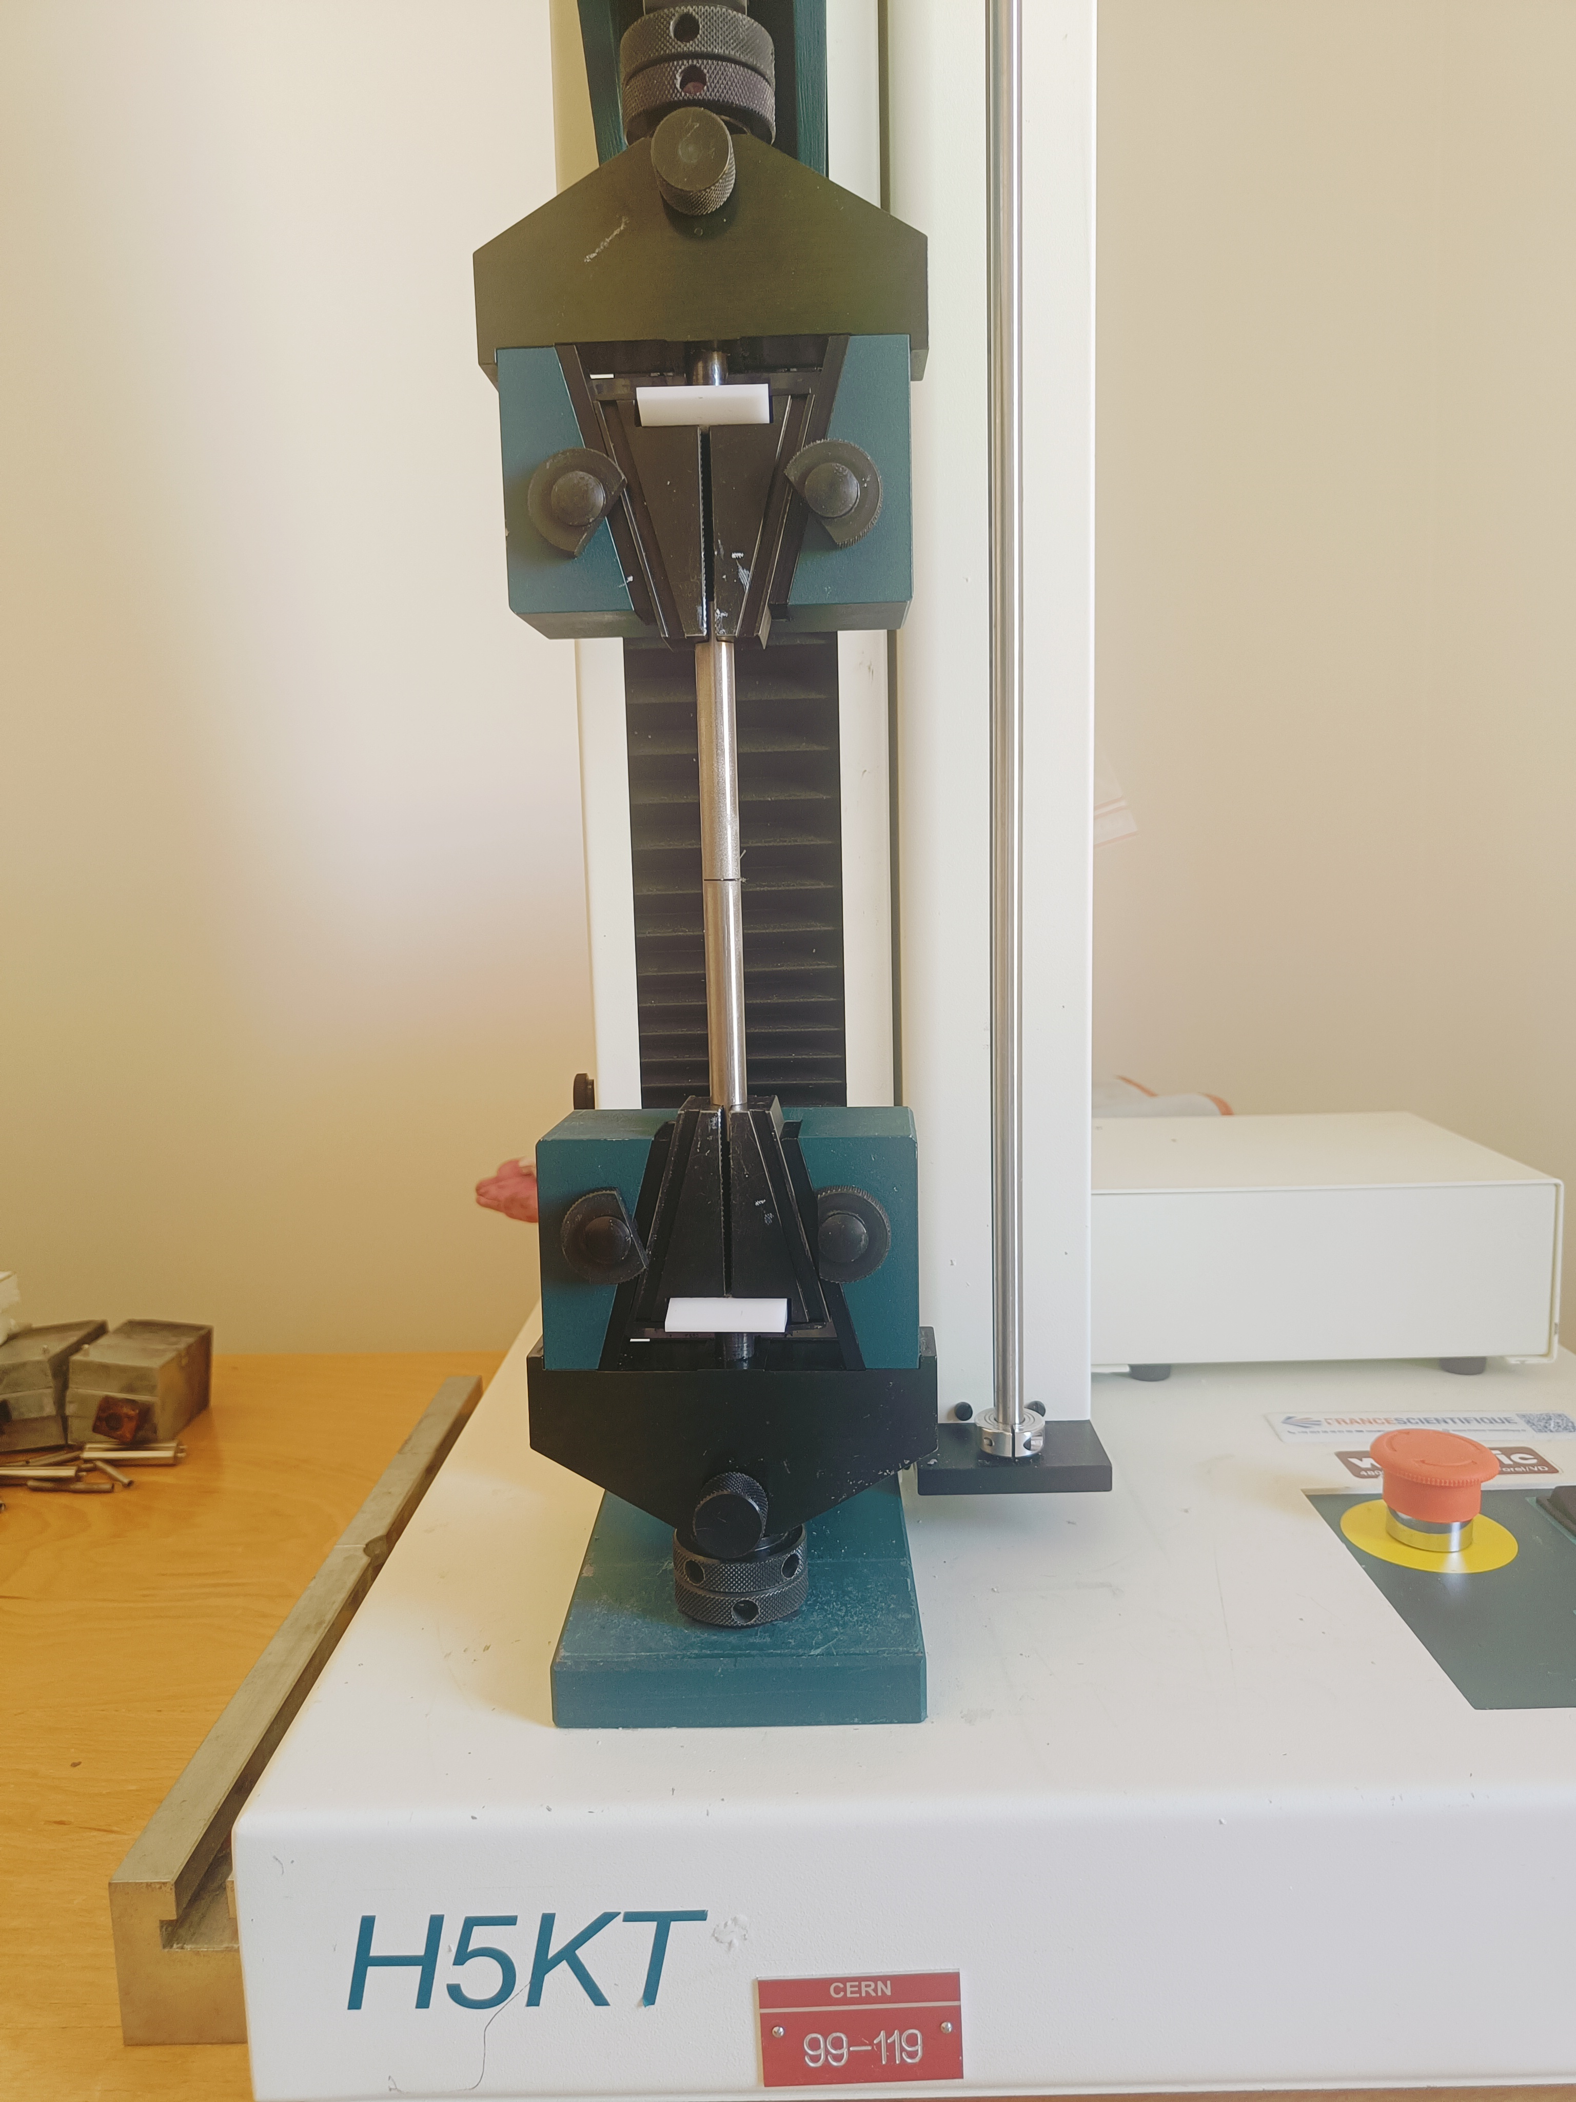
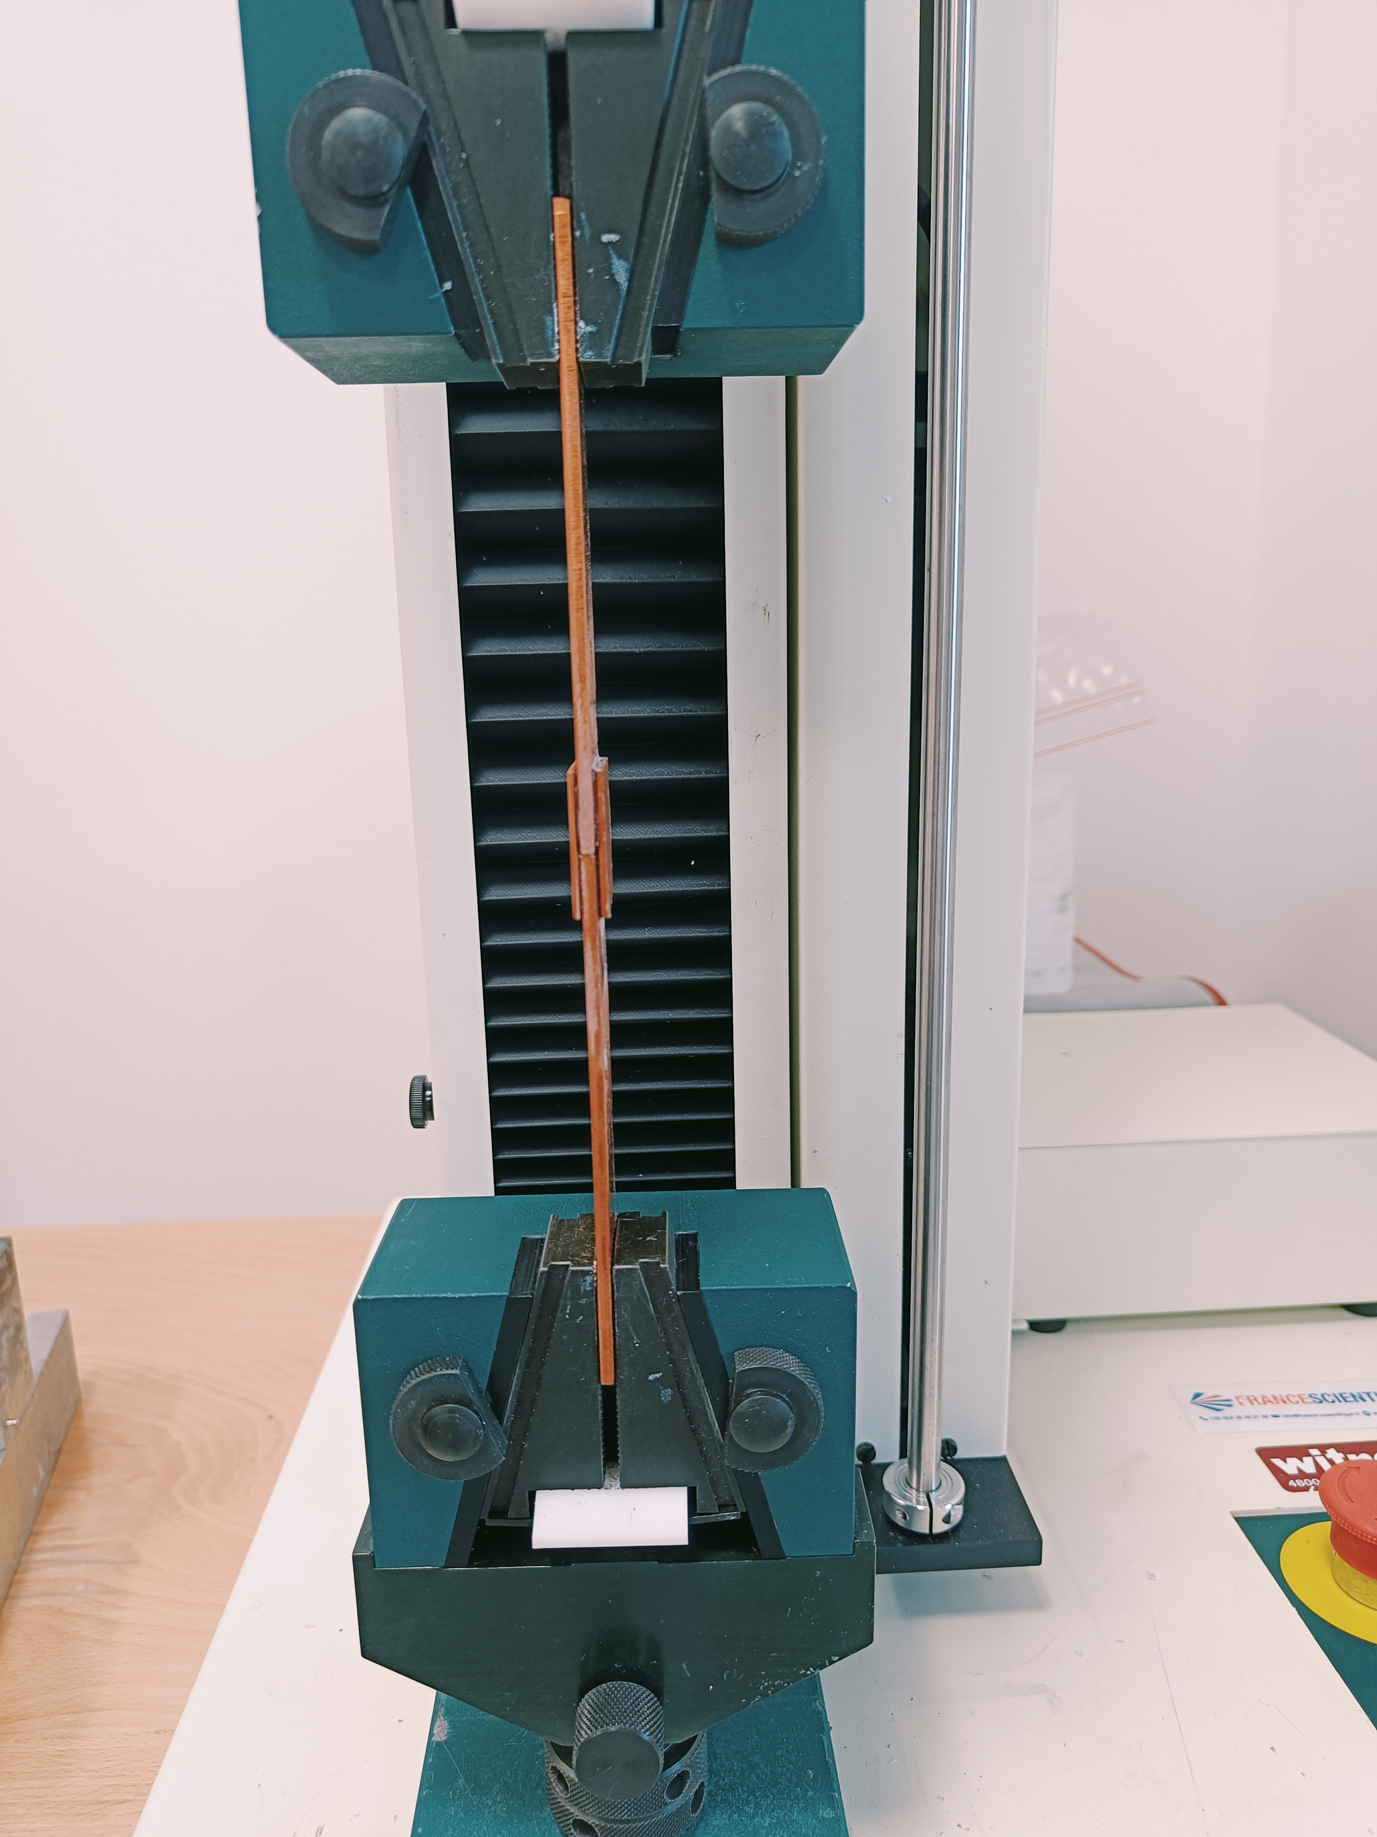
Progresses on resin systems
Adhesion
Methods
Characterization of adhesion based on several test principles:
peel-off strength
shear strength
pull-off strength
T-Peel
Roller-Peel
The program consists of the characterization of the adhesion strength towards copper, stainless steel, glass tissue, polyimide, virgin and heat treated cable insulation
Next action
Issue preliminary report on methods definition and results on the resin CTD101K, Mix61, MY750 and MSUT
Butt joint
Double lap shear joint
Courtesy of B. Verma
Thermal properties
Next actions
Expected to kick-off thermal characterization for CTD101K, Mix61, MY750 and MSUT within the current month in collaboration with the Cryolaboratory:
  Thermal expansion
  Thermal conductivity, diffusivity and specific heat
  Superfluid He permeability

Slide 19
Impact of reaction heat treatment on the insulating materials
Interlayer
Conductor braid
The role of the binder
Impact of the physical parameters of the insulation on the magnet performance
Adhesion strength
Resin fracture thoughness
Thermal conductivity / specific heat
Viscosity / potting life
Impact of radiation sources and enviromental conditions (temperature, O₂-free)
Development of enhanced coil insulation system
Resin development
Conductor insulation
In-coil characterization

Slide 20
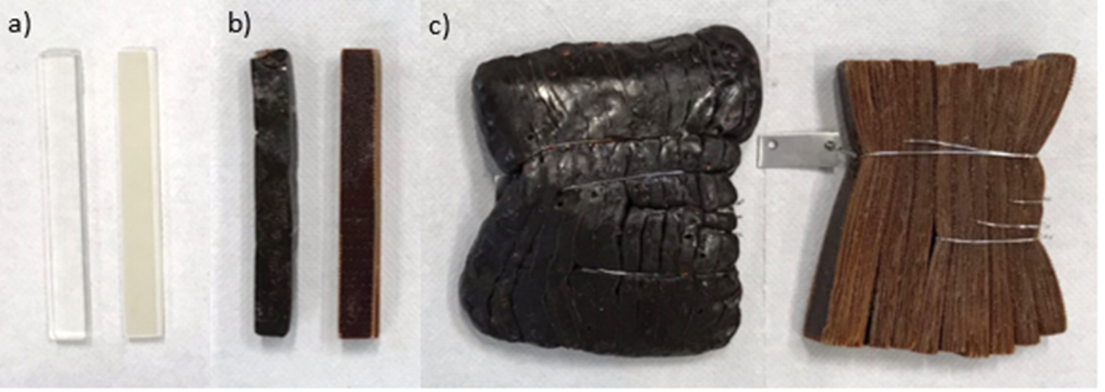
Radiation hardness campaigns
Irradiation at ambient conditions may be particularly harsh for resin with a low Tg like MY750.
Irradiation in non-representative operating conditions may rule out resins which are potentially promising.
MY750, gamma irradiation in ambient conditions at (a) 0 MGy, (b) 10 MGy, (c) 20 MGy
Status
Ongoing radiation hardness campaign in ambient conditions for LHC correctors MCBC/Y/X
Ongoing irradiation gamma and protons in ambient conditions for LHC-HC and new resins
Next actions
To launch collaboration with TU Wien for neutron irradiation in Q3 2022
Preliminary report on equivalence of radiation sources in air in Q4 2022

Slide 21
Impact of reaction heat treatment on the insulating materials
Interlayer
Conductor braid
The role of the binder
Impact of the physical parameters of the insulation on the magnet performance
Adhesion strength
Resin fracture thoughness
Thermal conductivity / specific heat
Viscosity / potting life
Impact of radiation sources and enviromental conditions (temperature, O₂-free)
Development of enhanced coil insulation system
Resin development
Conductor insulation
In-coil characterization
It is planned to implement the meaningful results on the SMC coils

Slide 22
In Summary
The implementation of new QH scheme is ongoing: no issue during fabrication
The characterization of the interlayer has shown an important degradation of the glass fibers after the heat treatment. An alternative binder is under study and it could be implemented in HL-LHC MQXFB coil production if proven suitable.
Electrical, mechanical and thermal characterization of resin systems is progressing with implementation in small-scale coils.
Irradiation tests under various radiation sources have been initiated. Results on MCBC/Y/X samples will support decision making on remplacement strategy.
Irradiation tests under different temperature and atmospheres are starting in Q2 2023.

