Slide 1
The CUORE EXPERIMENT: A search for neutrinoless double beta decay
2nd International Conference on Particle Physics
in Memoriam Engin Arık and Her Colleagues
Istanbul, Turkey
20 - 25 June 2011
Marco Andrea Carrettoni on behalf of the CUORE collaboration

Slide 2

Outline
Theoretical and experimental context:
  Neutrinoless Double Beta Decay (0ν−DBD)
  Sensitivity
  Bolometric Approach
The CUORE experiment
  Set-up and properties
CUORICINO: the demonstrator
On the road to CUORE: CUORE-0
Conclusions

Slide 3
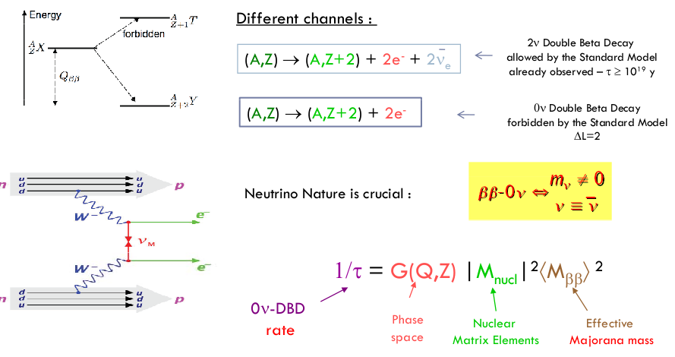
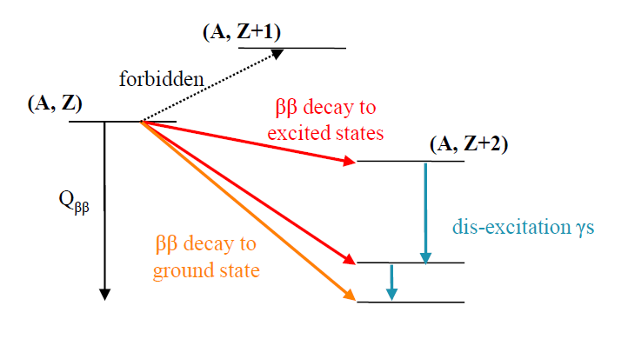
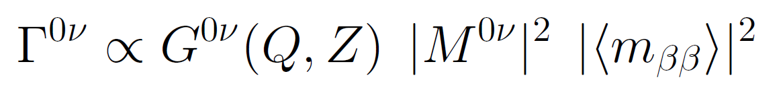
Why Neutrinoless Double Beta Decay?
Effective
Majorana
Mass
DBD rate
Phase space
Nuclear matrix element

Slide 4
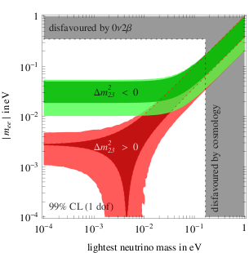
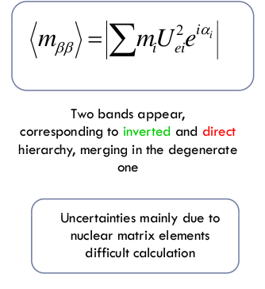
Probing the neutrino mass
Strumia&Vissani hep-ph/0503243

Slide 5
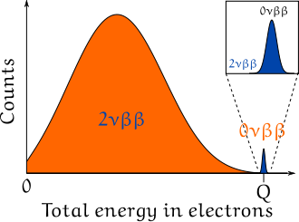
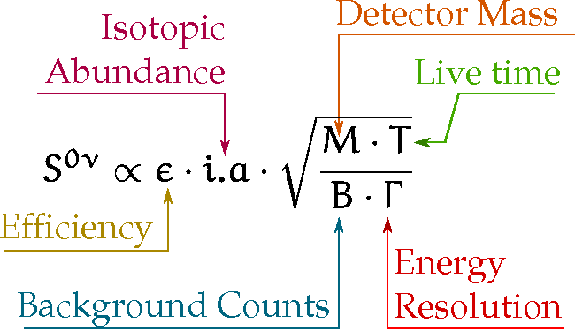
Signature and sensitivity
dN/dE
In a source=detector approach we expect a peak at the q-value Q of the transition (energy sum of the two electrons)
Q
Electrons energy
Sensitivity: Defined as the decay time corresponding to the minimum number of detectable events above a background (B) at a given C.L.

Slide 6
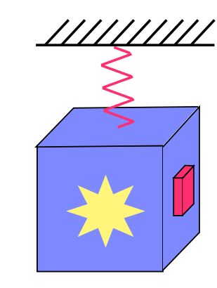
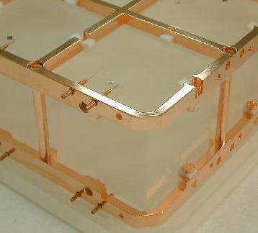
Bolometric approach
6
Ideal Calorimeter: Energy to phonons conversion
Thermal bath (copper)
@ 10mK
Weak thermal coupling
(Teflon)
NTD Ge thermistor
R≅100 MΩ
TeO₂ Crystal Absorber
C ≅ 10⁻⁹ J/K
Pros:
High resolutions
Wide choice of materials
Cons:
Slow signals
No particle distinction
Operating principle:
Dielectric and diamagnetic crystals: low thermal capacity @ low temperature
Notes:
CUORICINO MODULE !!!!

Slide 7
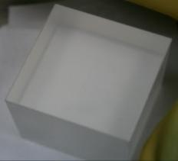
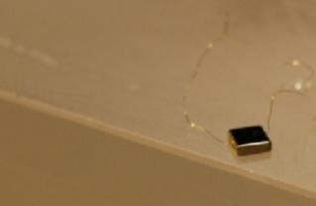
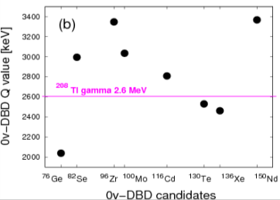
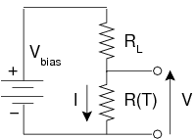
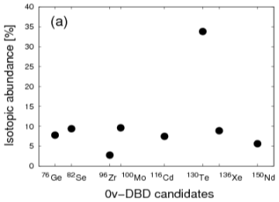
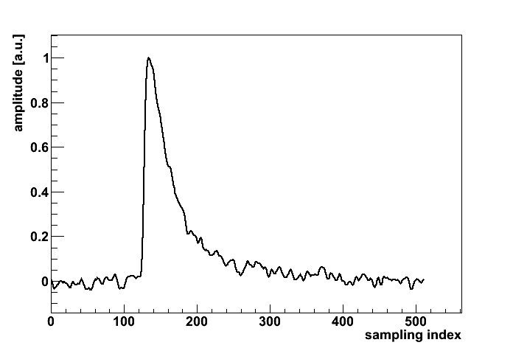
Energy absorber & temperature sensor
TeO₂ cubic crystal
NTD-Ge thermistor
5x5x5 cm³
- The choice of the material is driven by the choice of the candidate nuclide
3x3x1 mm³
- Ge doped by Neutron Transmutation Doping
¹³⁰Te
TeO₂
1.
~2527 keV
A. Dielectric with T_{D}=232 K:
C minimized
B. Easy to grow large crystals with good radio-purity
C. Resistance to series of thermal cycles at very low temperatures
2.
A typical acquired particle signal

Slide 8
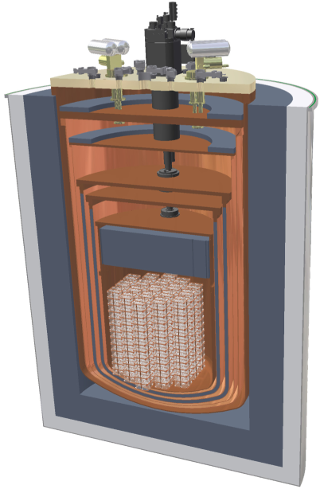
CUORE (Cryogenic Underground Experiment for Rare Events)
Pulse Tube
(L He-free cryostat)
  988 TeO₂ crystals 5x5x5cm³ (750g), arranged in 19 towers;
  741 kg of TeO₂ -> 206 kg of ¹³⁰Te
  Resolution 5 keV @ 2615 keV (FWHM)
  Background aim: 0.01-0.001 c/keV/kg/y
  Main concepts:
  Stringent controls on radioactivity
  Heavy shielded (Roman lead)
  High efficiency in bkg rejection thanks to close packet geometry
Polyethilene
(Neutrons Shieldings)
Copper Shielding
External Lead
Shieldings
(²¹⁰ Po<14 mBq/kg)
Roman Lead Shieldings
(²¹⁰ Po<4 mBq/kg)
Detector

Slide 9
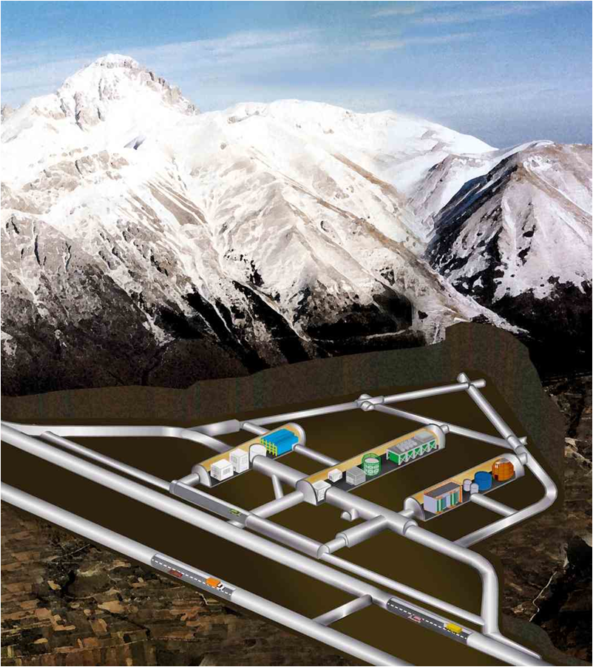
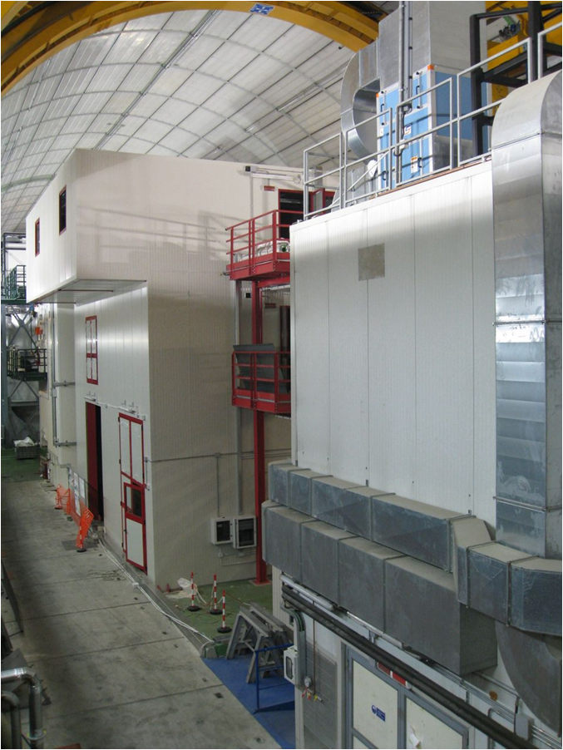
LNGS
CUORE will be located in the Hall A of the Gran
Sasso national laboratories (L’Aquila – Italy)
Depth: 3650 m.w.e.
Muon flux: (2.58±0.3)x10⁻⁸ μ/s/cm²
Neutron flux ≅ 4x10⁻⁶ n/s/cm²
Gamma flux: 0.73 γ/s/cm²
Cosmic rays are not a problem!

Slide 10
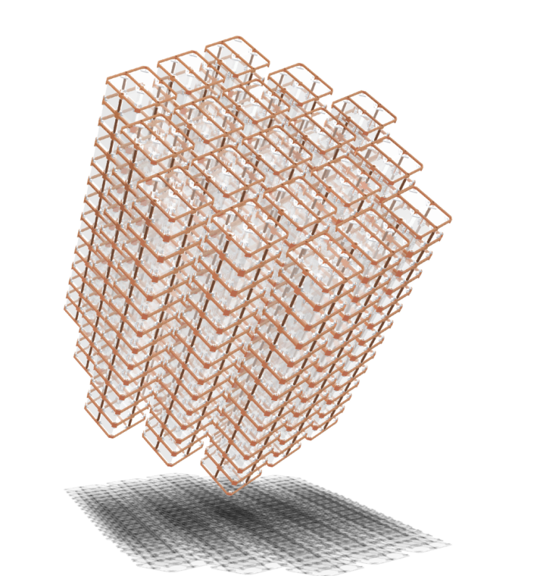
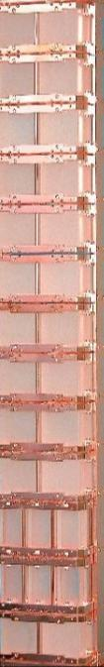
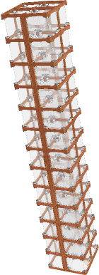
The CUORE program
CUORICINO
2003-2008
CUORE – 0
2011 - 2014
CUORE
2014-2019
1 Tower
62 crystals
M ≅11 kg of ¹³⁰Te
Bkg ≅ 0.15 c/keV/kg/yr
1 Tower
52 crystals
M≅11 kg of ¹³⁰Te
Bkg 0.05 ÷ 0.1 c/keV/kg/yr
19 Tower
998 crystals
M≅ 206 kg of ¹³⁰Te
Bkg 0.01 ÷ 0.001 c/keV/kg/yr

Slide 11
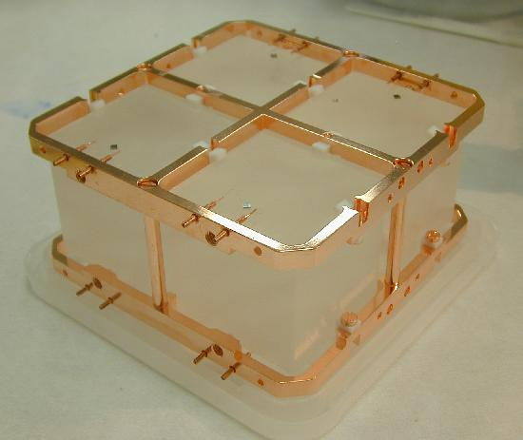
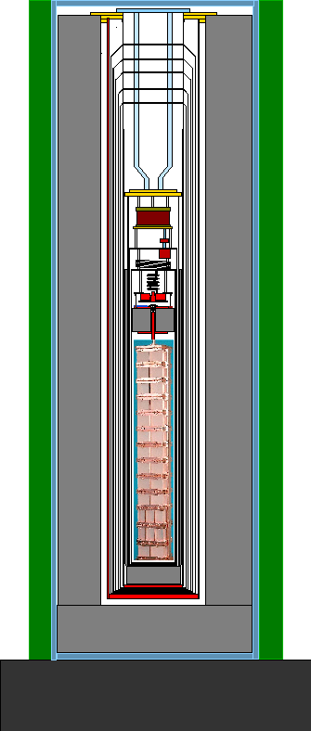
Cuoricino: the demonstrator
The bolometric technique has been applied to the search of the following 0v-DBD:
¹³⁰Te  ¹³⁰Xe + 2e⁻ Q_{ββ}^{0v}~2527 keV
The Cuoricino experiment (LNGS, 2003-2008) is the result of years of research on bolometers containing ¹³⁰Te, by using TeO₂ energy absorbers
Cryostat
Lead Shield (20 cm)
Neutron shield of borated
Polyethilene
Roman Lead Shield
(²¹⁰Po < 4mBq/kg)
Mass
40.7 kg TeO₂
(11.3 kg ¹³⁰Te)
Total exposure
19.75 kg y [¹³⁰Te]] y

Slide 12
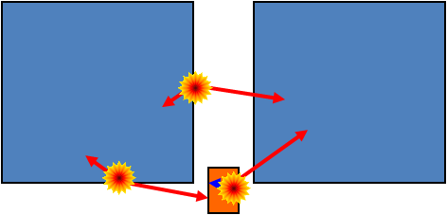
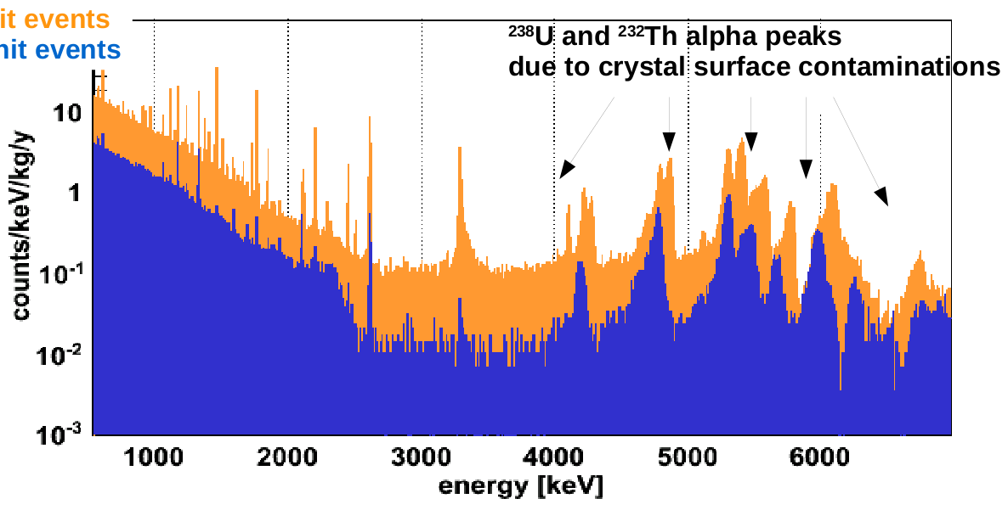

Cuoricino main operating principle
The analysis is carried out on anti-coicinidence spectra in order to reduce:
  Contribution from crystal surfaces
  Compton or multi-compton events
Accidental coincidences 0.7%
Bkg reduction : 15%
TeO₂
TeO₂
Single Hit Events
Double Hit Events
TeO₂

Slide 13
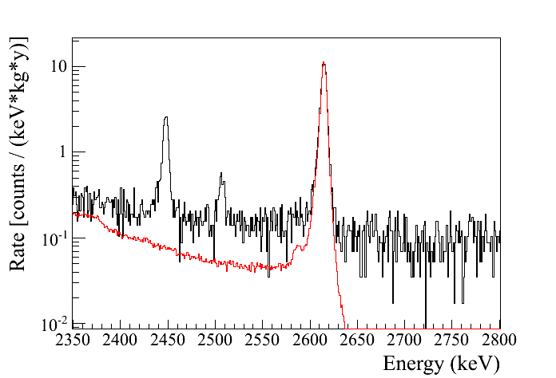
0ν-DBD region of interest
The anti-coincidence spectrum in the region of interest shows three main peaks:
  ²⁰⁸Tl : (probably in the cryostat)
  ⁶⁰Co: cosmogenic origin
  ²¹⁴Bi: Rn contamination
The main background contributions are:
  Multicompton events of ²⁰⁸Tl (30%)
  Flat background coming from degraded alphas on the surface of materials facing the crystals
  (70%)
²¹⁴Bi
R.O.I.
²⁰⁸Tl
⁶⁰Co (γ+γ)
Flat continuum
0νDBD
Normalized calibration
escaped Te X-ray

Slide 14
A flowchart to Γ_{0ν}
First level Analysis:
Second level Analysis:
Raw pulses
Pulse shape analysis
Filtering:
(noise reduction)
Coincidence analysis
Quality checks
and data reduction
P(Γ_{0ν}| cuoricino)
Background modelization
Thermal instability correction
Systematics
Calibration

Slide 15
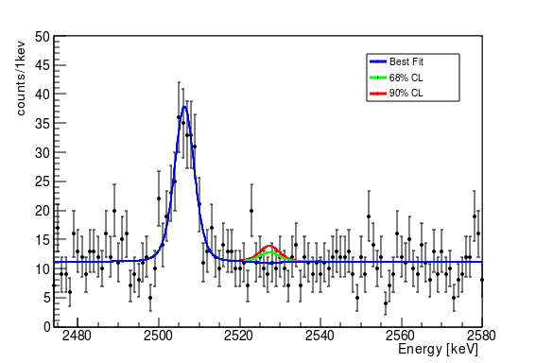
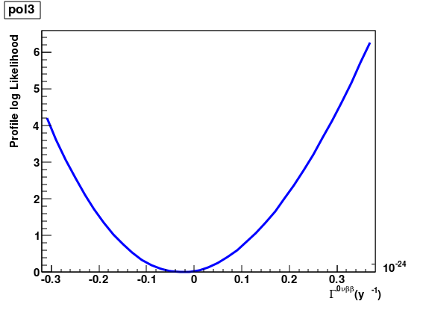
Cuoricino Result
Astropart. Phys. (2011), doi:10.1016/j.astropartphys.2011.02.002
m_{ee}<300-701 meV*
τ^{0νββ}_{1/2} > 2.8x10²⁴ y
@ 90% CL
UUnphysical
region
Method:
Best fit: maximum likelihood-chisquare
Limit: bayesian (flat prior on Γ_{0ν})
Avg Background in the region of interest:
0.169±0.006 c/keV/kg/y
Avg resolutio: ∆E≅7 keV FWHM
* Spread introduced by NME
⁶⁰Co

Slide 16
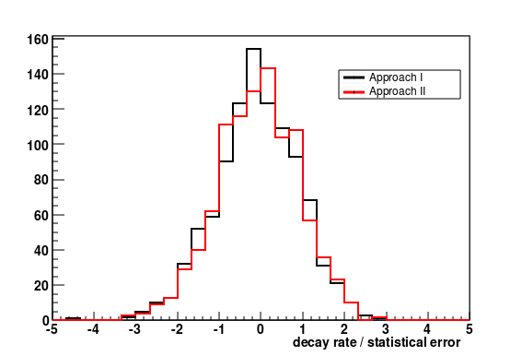
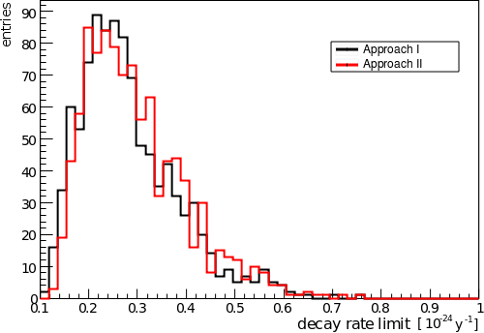
Two parallel analysis: validation on Monte Carlo
Two indepentent analysis were carried out on data and simulation with an exeptional agreement
Both the methods proved to be unbiased and robust.
On the simulations (1000 Cuoricino-like experiments) they show a wide distribution of possible outcomes.
The median outcome of these experiments corresponds to a limit on the half life of 2.6x10²⁴ y comparable to the experimental limit

Slide 17
From Cuoricino to CUORE
Extensive study of the background sources
Design of the experiment
Cryostat and shieldings
Radioactivity control
Electronics
DAQ
Crystals
Software
Calibration system
Tower assembly
…
Challenging effort on
every crucial aspects of
the experiments

Slide 18
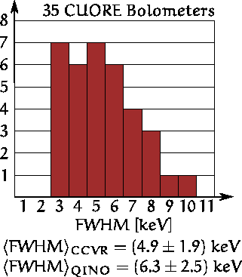
CUORE Crystals
The 1000 CUORE crystals are produced by SICCAS
(Shanghai, China):
- 560 crystals ordered by INFN (now @LNGS);
- 500 crystal ordered by DoE (91 already in
@LNGS, end in Sept. 2012)
For each production batch 2 or more crystals are
tested in the Hall C R&D Cryostat:
- Same single module as CUORE;
- New Data Acquisition and online as CUORE;
- All material cleaned CUORE-like;
6 CCVR measurements were analyzed (preliminary results):
Surface : < nBq/cm²
Resolution : avg ∆E = (4.9 ± 1.9) keV FWHM
preliminary
Bulk:
< 6 · 10−14 g/g in ²³⁸U
< 8 · 10−14 g/g in ²³²Th
Production requirements
perfectly fulfilled!

Slide 19
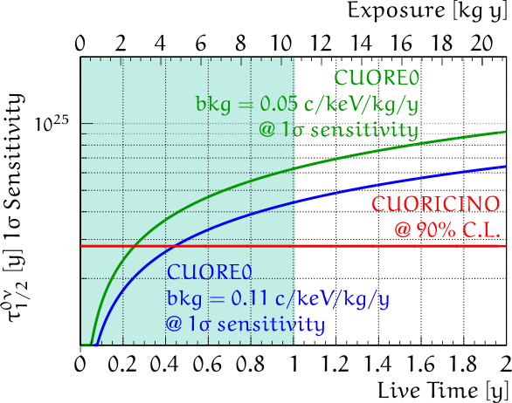
The answer to CUORE-0
The full assembly of a CUORE-like tower: data taking starts this fall
High statistic test of the background achievements: crucial importance
for surface background studies
Two irreducible background predicted (realistic and optimistic case)
CUORE-0 will be a competitive 0nDBD experiment itself!

Slide 20
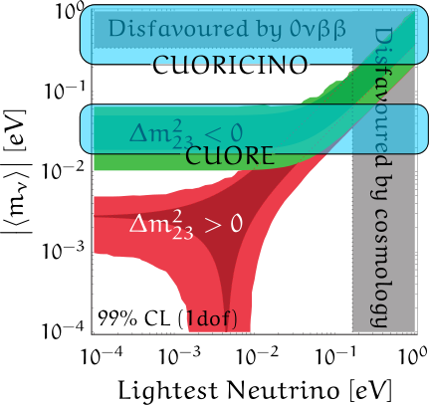
CUORE scientific goal
In 5 years of live time, CUORE has a 1σ sensitivity of τ^{DBD}_{1/2} = 2.1x10²⁶ y
⇒ effective Majorana neutrino mass down to 35 ÷ 82 meV
With the foreseen aim of
0.01 c/keV/kg/y
CUORE will be able to probe
the inverted scale

Slide 21
Conclusions
Te0₂ bolometers proved to be a competitive tool for the DBD search
Cuoricino proved to be not only an important experiment, but also a great prototype, showing that an experiment like CUORE is feasible
CUORE-0 will be the first test of a CUORE-like tower from the assembly to data taking and a competitive experiment itself
CUORE data taking is foreseen for 2014

Slide 22
Conclusions
Thank you for you attention

