Slide 1
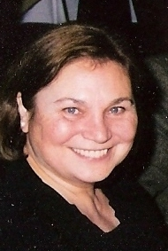
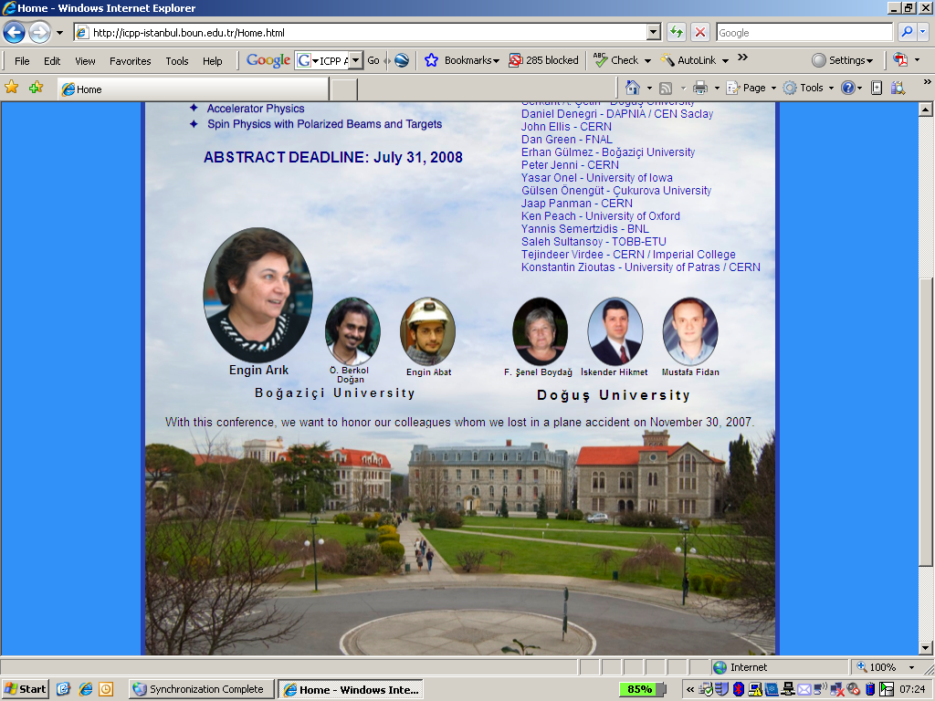
The Status of CLIC the Compact Linear Collider
2nd International Conference on Particle Physics in memoriam of Engin Arik and colleagues
Doğuş University, Istanbul
23rd June 2011
Engin Arik
Ken Peach
(JAI, University of Oxford)

Slide 2
Contents
Introduction
  (Why) do we need a linear collider
The technology challenges
  Cold, warm or incandescent
The Compact Linear Collider – CLIC
  What is it
  Status
Summary

Slide 3
Introduction
Why do we need a linear collider?

Slide 4
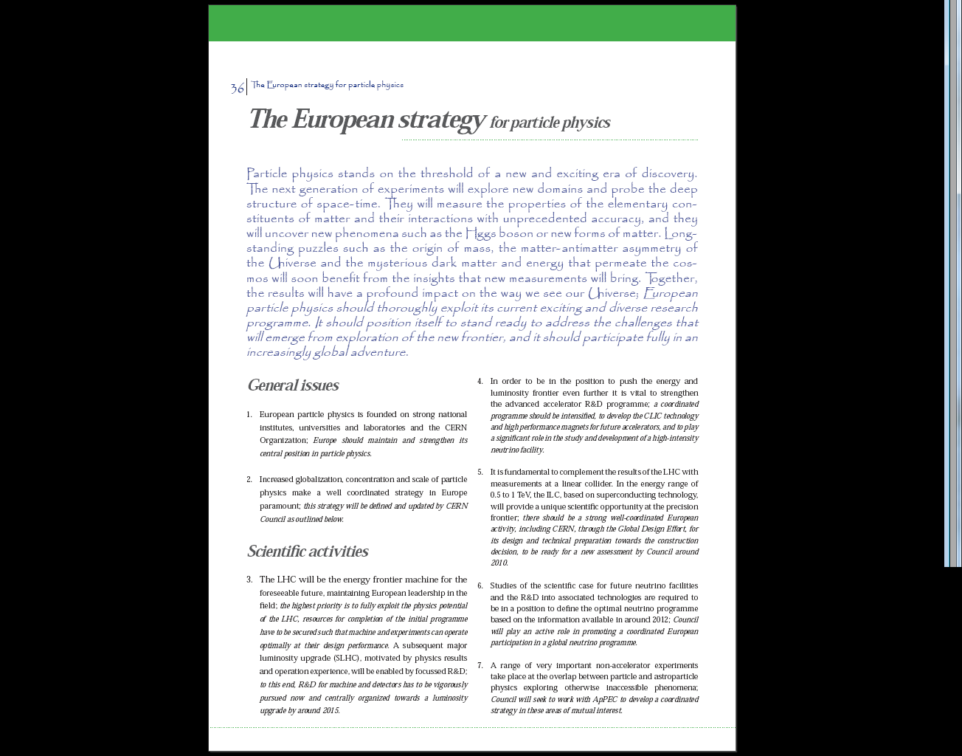

The European Strategy for Particle Physics

Slide 5
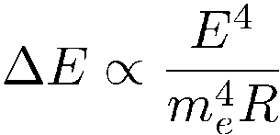

Why a linear collider?
Ring colliders more efficient
  Re-use the particles
    Cost: RF ∝ E⁴/R ; Ring ∝ R
      Combined ∝ E² (+c_{R})
Linear collider
  Single pass
    Cost: RF ∝ E (+c_{L})
so there must be a crossover
  Breakpoint √s~200 GeV
                LEP2
Ring
cost
Linear
Energy
After Mark Thomson

Slide 6
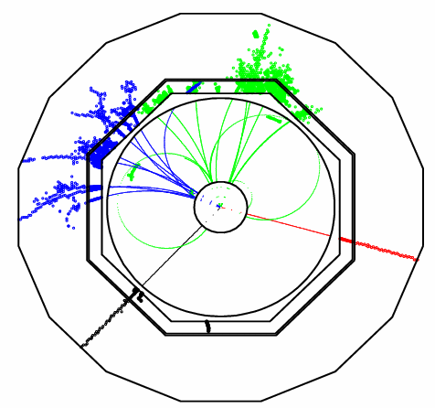
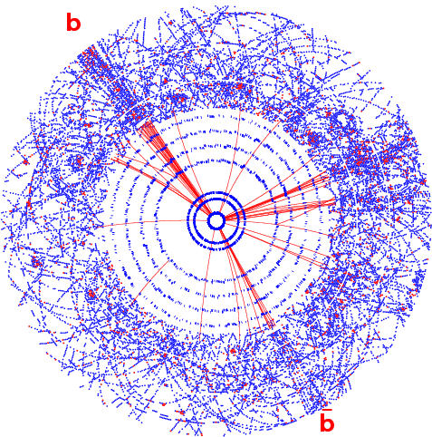
e⁺e⁻ cleaner than LHC - precision
e⁺e⁻→ HZ ; Z→μμ
pp → H +X ; H→bb

Slide 7
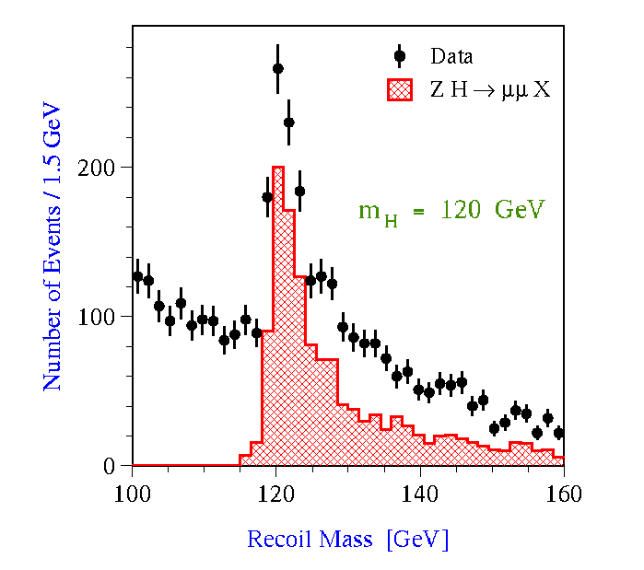
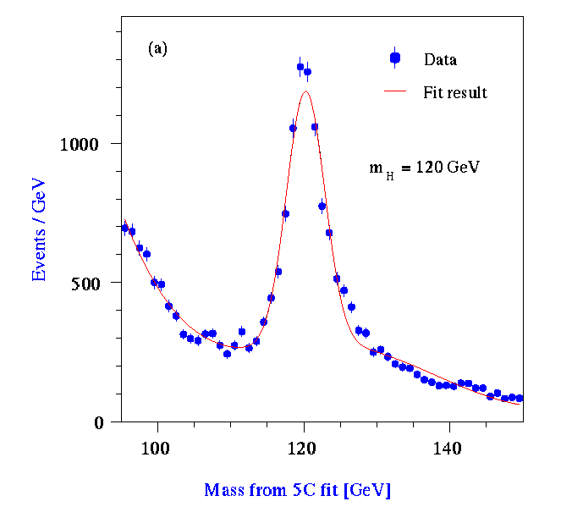
A LC is a Precision Instrument
Clean initial state (e⁺e⁻)
  Polarization, tunable √s hard scattering
Detailed study of the higgs sector
  Mass 0.03% Couplings 1-3%
  Spin & CP structure Total width 6%
  Model-independent measurements
Precision SUSY measurements
  If it exists
  Masses to 1% (if within reach)
  SUSY space-time properties
Precision top, W, TGC’s etc
New Physics (W_{L}W_{L} scattering etc …)
After Mark Thomson

Slide 8
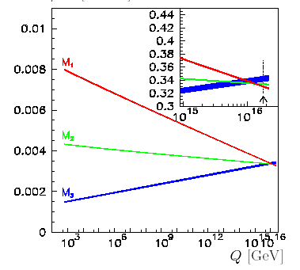
Physics goals
SUSY
  precision mass measurements
Dark Matter
  m_{χ} & couplings
    Input to cosmology [ΩDMh²~ 3%]
      Mismatch to WMAP/Planck – more DM
Quantum level consistency
  e.g. direct & indirect m_{h}
G. Blair et al
‘WMAP’ | 7 %
LHC | ~15 %
‘Planck’ | ~2 %
LC | ~3 %
F. Richard/SPS1a
After Mark Thomson

Slide 9
What Energy? Light Higgs (120 GeV)
}
× 4
> 400k Higgs per year

Slide 10
Physics case: SUSY measurements
LC/LHC complementarity: precision measurements at ILC/CLIC
e.g. 1150 GeV smuon mass to O(1%)
Will a 0.5-1 TeV collider be enough?
De Roeck et al, hep-ph/0508198

Slide 11
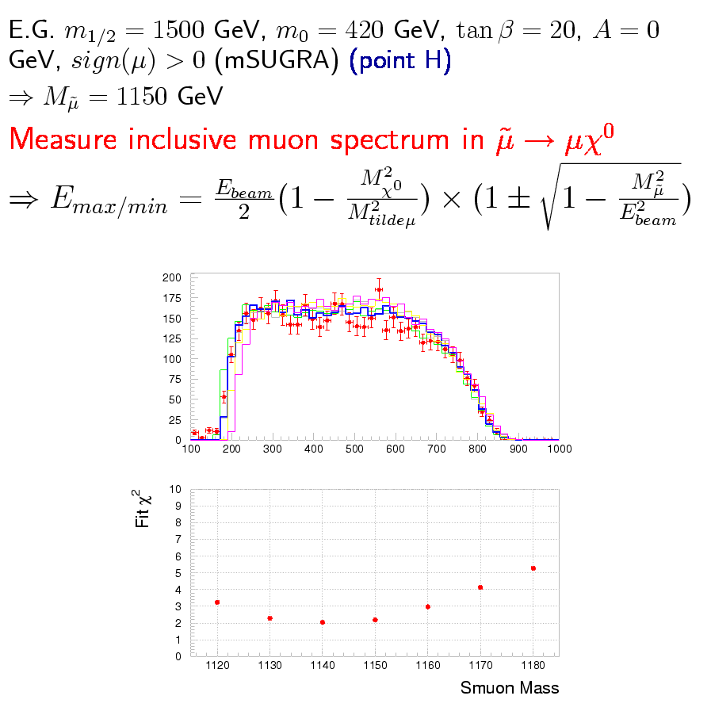
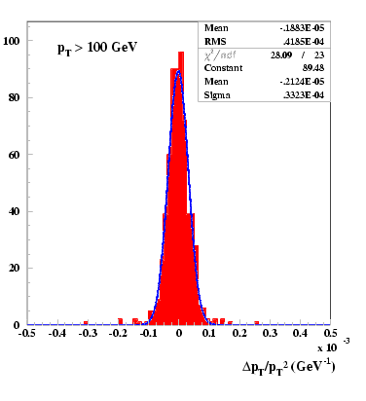
SUSY Mass Measurements
Momentum resolution
δp_{t}/p_{t}² ~ 10⁻⁴ GeV⁻¹
Mass measurements to O(1%)
After Mark Thomson

Slide 12
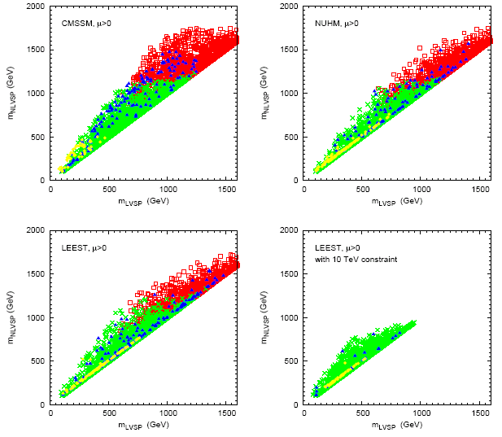
Sparticle Detection
Full
Model
samples
← Second lightest visible sparticle
Detectable
@ LHC
Provide
Dark Matter
Dark Matter
Detectable
Directly
Lightest visible sparticle →
J. Ellis et al.

Slide 13
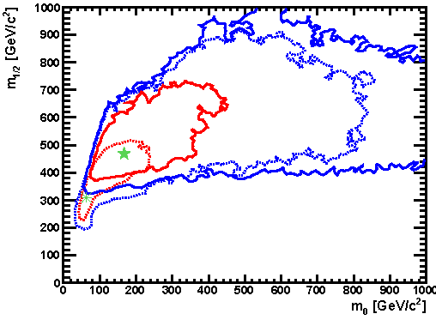
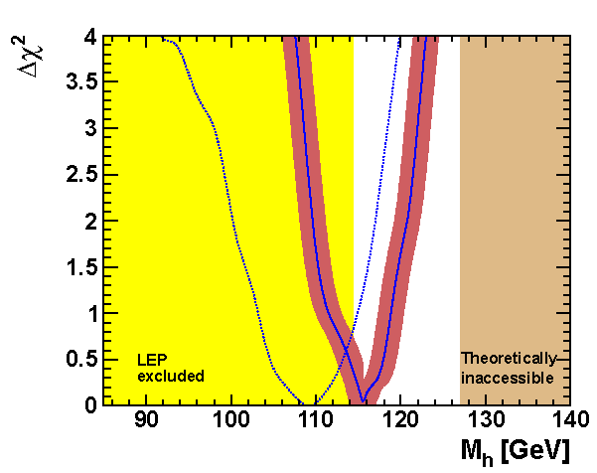
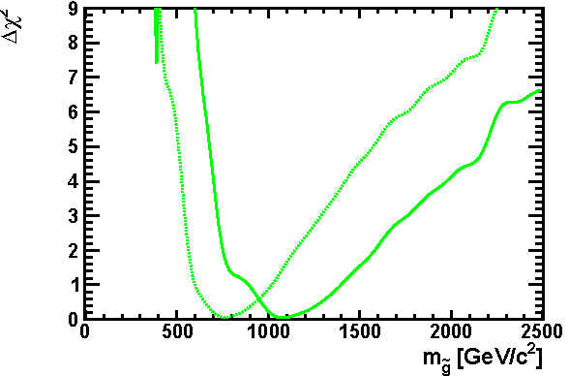
Implications of the LHC data 2010
Pre-LHC
Post-LHC & Xenon
CMSSM
Buchmueller et al
hep-ph/1106.2529v1

Slide 14
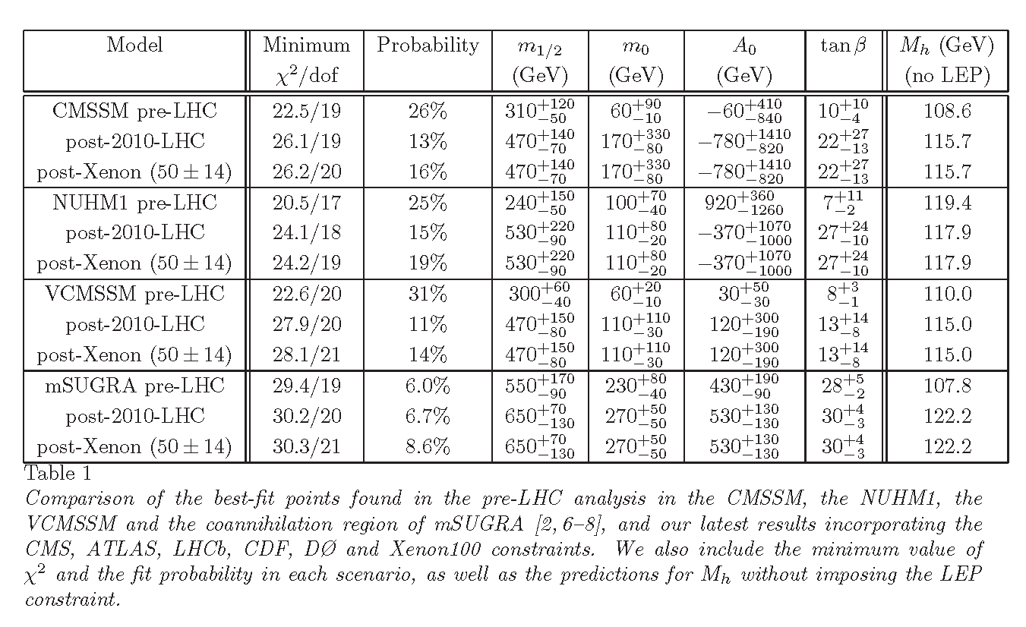
Latest parameters for 4 SUSY models
Buchmueller et al
hep-ph/1106.2529v1

Slide 15
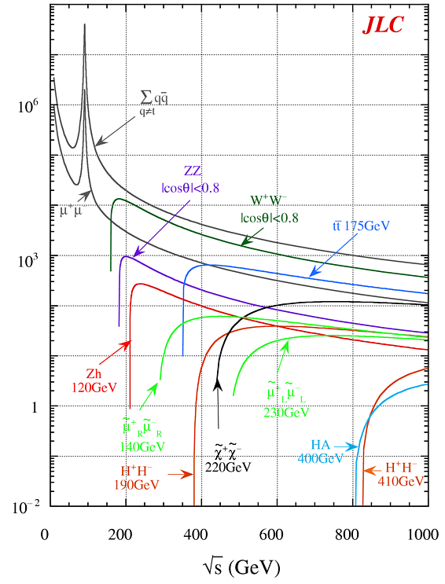

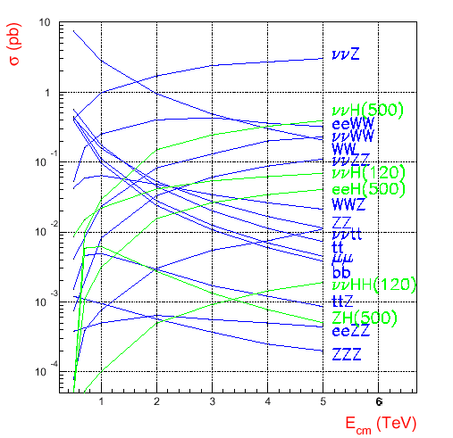
ILC & CLIC

Slide 16
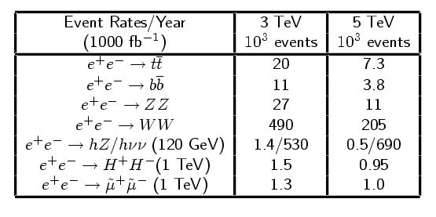
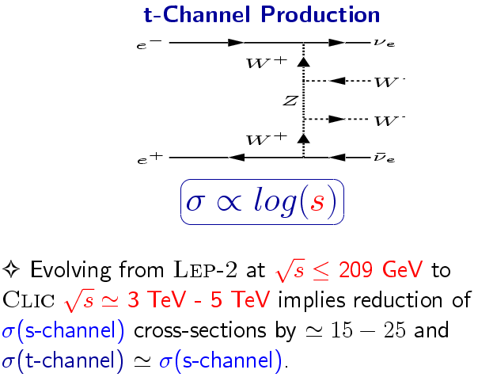
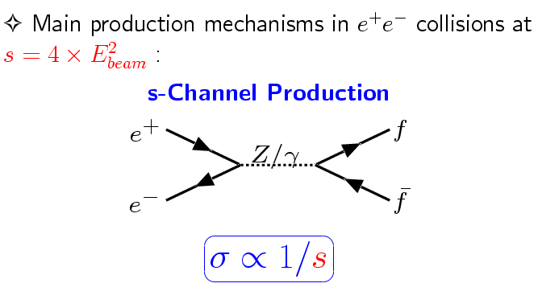
Cross Sections at CLIC

Slide 17
Technology Challenges
Cold, warm or incandescent?

Slide 18
Three challenges
Energy
  Need to be well above LEP (200 GeV)
  Preferably > 1TeV
    Based on latest LHC results
Luminosity
  Falling s-channel cross-sections (∝ 1/s)
  Increasing luminosity
    Initial State Radiation broadens the peak
Reliability
  RF
  Stability

Slide 19
Energy

Slide 20
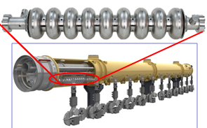
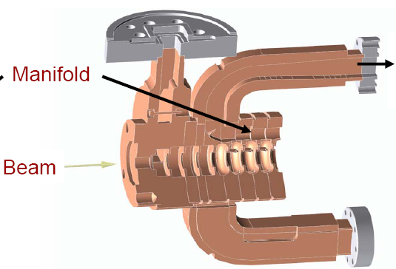
Conventional technologies
Superconducting cavities – ILC
  35 MV/m
    (limit ~55MV/m)
X-band
  65MV/m
    (loaded)
Others (C-band, S-band)

Slide 21
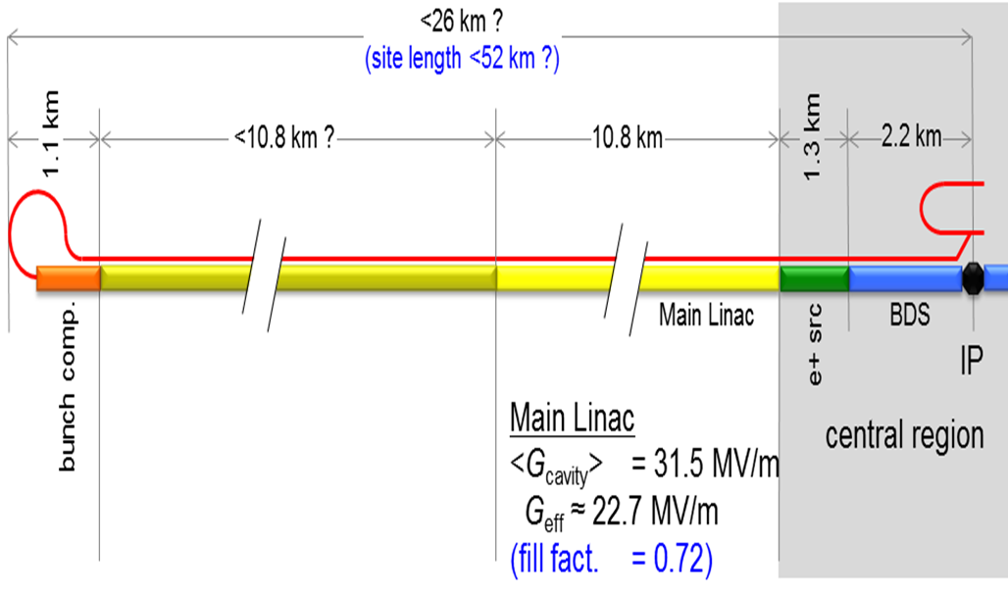
The ILC @ 1 TeV [new-ish]
1 TeV, 2.7 × 10³⁴ cm²s⁻¹
  Length <52km
  Gradient 31.5 Mv/m (>50?)
  AC power 352 MW
Nick Walker, ALCPG11

Slide 22
Production Yield - Progress
Only contains: 2 vendors + 2 infrastructure (DESY, JLAB)
Next update:
Additional Japan vendor + 2 infrastructure (KEK, FNAL/ANL)

Slide 23
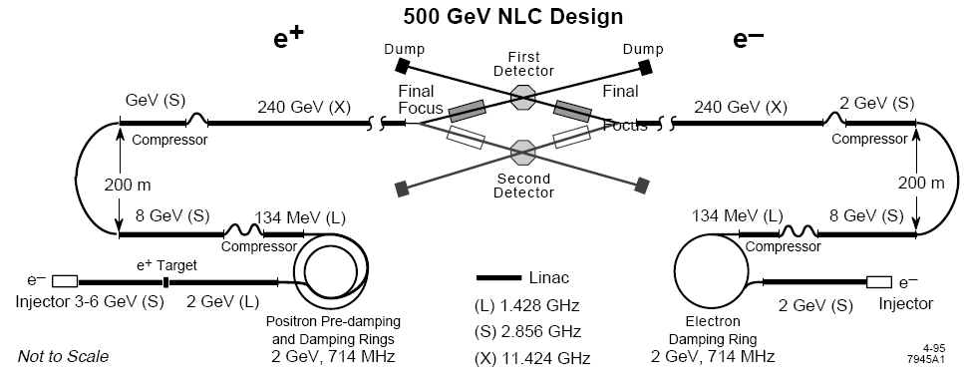
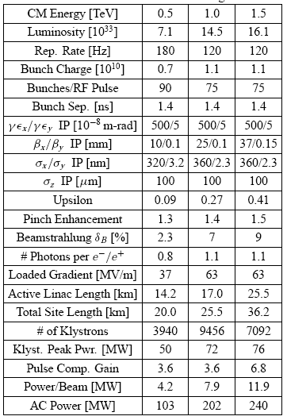
An example of an X-band design
1 TeV, 1.45 × 10³⁴ cm²s⁻¹
  25.5km
  9456 klystrons
  Klystron power 72 MW
  AC power 202 MW
Raubenheimer et al, PAC 95

Slide 24
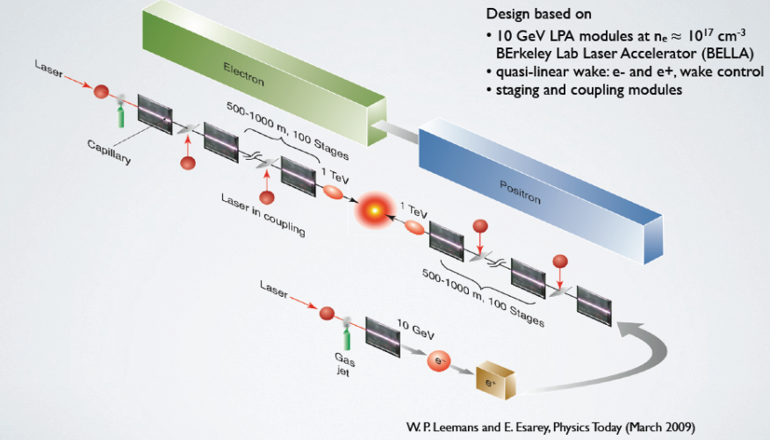
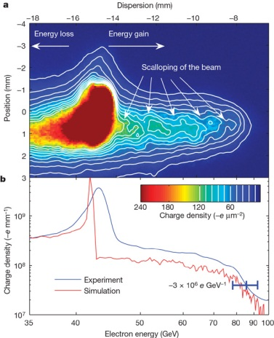
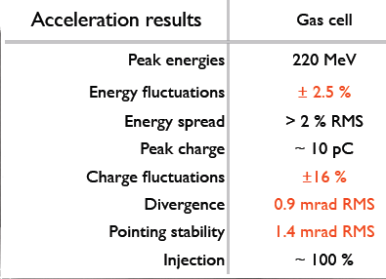
Incandescent – plasma acceleration
Laser-driven plasma
Achievement (2008)
Beam driven plasma
42 GeV electron beam
0.85m plasma
42 GeV energy gain
Nature 445, 741-744 (2007)
In 15mm of plasma

Slide 25
Luminosity

Slide 26
Luminosity
Beamstrahlung parameter
Efficiency
Disruption parameter
Trade-off between
Luminosity
beam energy precision (beamstrahlung δ)
backgrounds (related to H_{D})
running cost
After Blair

Slide 27
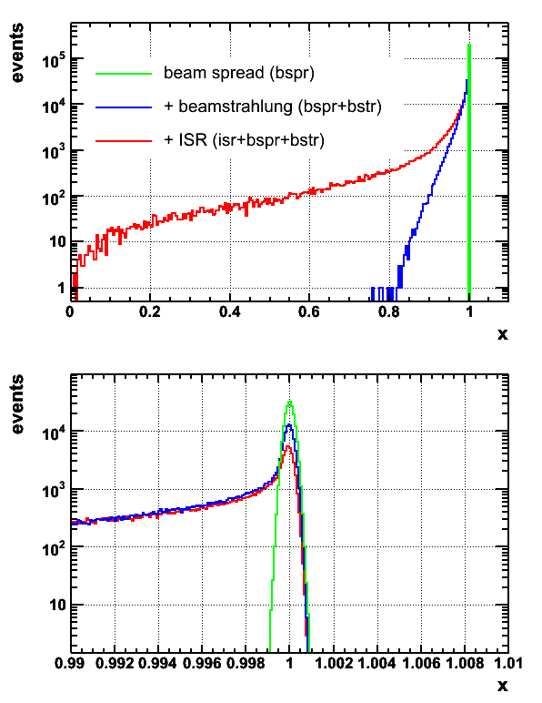
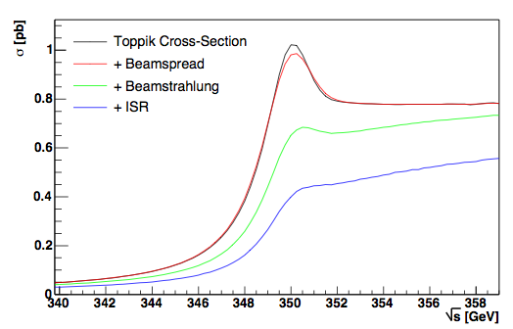
ILC energy spectrum
Need for:
  Energy measurement accuracy 10⁻⁴
  Stability and ease of operation
  Minimal impact on physics data taking
After Blair

Slide 28
DR Challenges
Electron cloud: suppression with
clearing electrodes?
Fast ion effects in electron DR:
    feedback, vacuum design (1nTorr), train gaps?
Long-range wake fields can drive multi-bunch instabilities,
Short-range wake fields can drive single-bunch instabilities
Requires: Fast kicker: 5ns rise time, 30 ns fall time…
(one train of 2625×369ns →290 km !)
“The DR have more accelerator physics than the rest of the accelerator…”
After Blair

Slide 29
Reliability

Slide 30
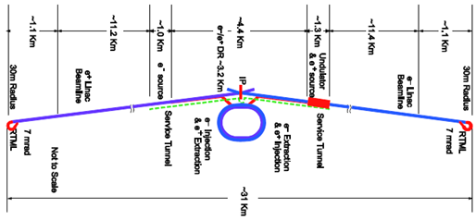
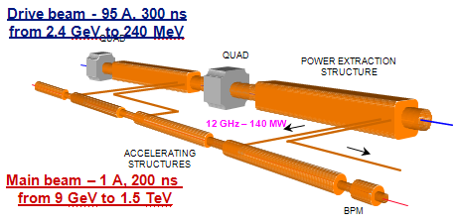
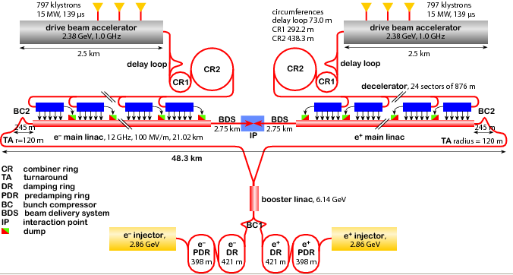
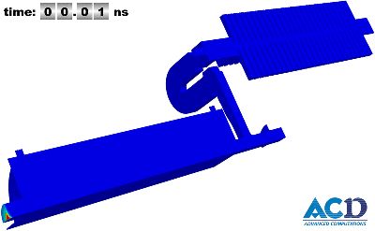
Linear Collider layouts http://www.linearcollider.org/cms http://clic-study.web.cern.ch/CLIC-Study/
ILC 0.5 TeV – 30 km
ILC 1 TeV – 50 km
CLIC 3 TeV: 48 km
CLIC 0.5 TeV: 13 km
Delahaye, ICHEP10

Slide 31
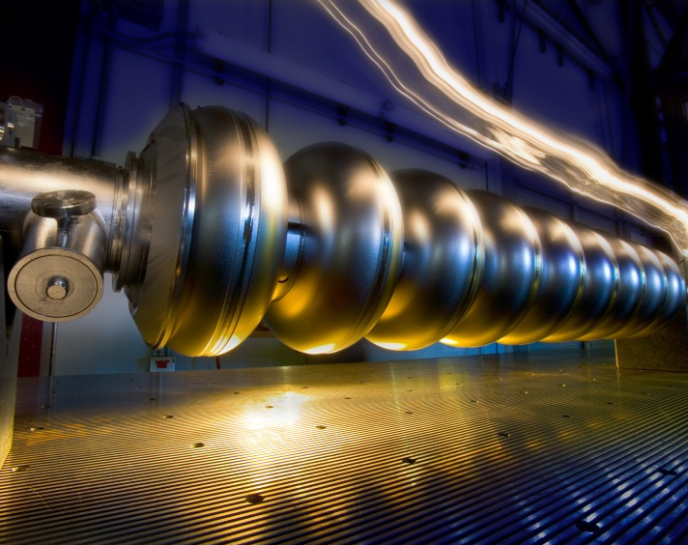
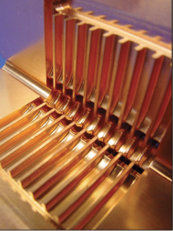
Today: ILC & CLIC
ILC
CLIC
Based on SC RF Cavities
Gradient: 32 MV/m
Energy 500 GeV (upgradable to 1 TeV)
Detector studies mostly 500 GeV
Based on 2 beam acceleration scheme
Gradient: 100 MV/m
Energy 3 TeV (staging likely)
Detector studies mostly 3 TeV
Renewed impetus on CERN Compact Linear Collider:
  CLIC CDR due late Summer 2011: Accelerator + Detector/Physics
  could be the long term future of CERN
  but very challenging accelerator (R&D at least 5 years behind ILC)
  also very challenging detector environment

Slide 32
Compact Linear Collider
CLIC
What is it?

Slide 33

























The CLIC Collaboration
4 institutes, 21 countries & growing
Delahaye
ACAS (Australia)
Aarhus University (Denmark)
Ankara University (Turkey)
Argonne National Laboratory (USA)
Athens University (Greece)
BINP (Russia)
CERN
CIEMAT (Spain)
Cockcroft Institute (UK)
ETHZurich (Switzerland)
Gazi Universities (Turkey)
Fermilab
Helsinki Institute of Physics (Finland)
IAP (Russia)
IAP NASU (Ukraine)
IHEP (China)
INFN / LNF (Italy)
Instituto de Fisica Corpuscular (Spain)
IRFU / Saclay (France)
Jefferson Lab (USA)
John Adams Institute/Oxford (UK)
John Adams Institute/RHUL (UK)
JINR (Russia)
Karlsruhe University (Germany)
KEK (Japan)
LAL / Orsay (France)
LAPP / ESIA (France)
NIKHEF/Amsterdam (Netherland)
NCP (Pakistan)
North-West. Univ. Illinois (USA)
Patras University (Greece)
Polytech. University of Catalonia (Spain)
PSI (Switzerland)
RAL (UK)
RRCAT / Indore (India)
SLAC (USA)
Thrace University (Greece)
Tsinghua University (China)
University of Oslo (Norway)
Uppsala University (Sweden)
UCSC SCIPP (USA)
Notes:
33
33

Slide 34
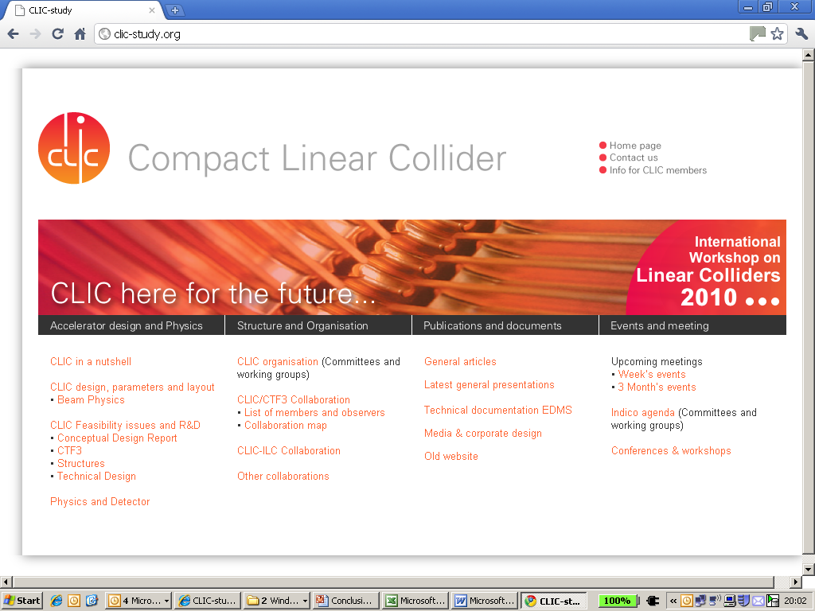
CLIC website: http://clic-study.org/

Slide 35
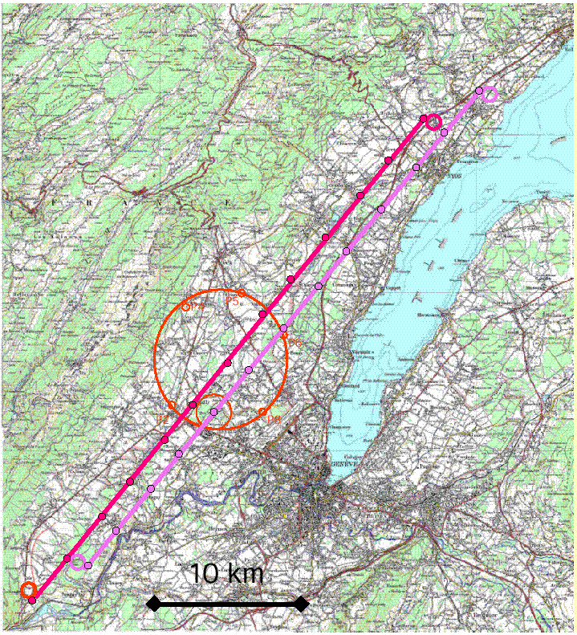
Building CLIC at CERN?
40 km continuous available
Good geology
Parallel to Jura & lake
  also ILC?

Slide 36
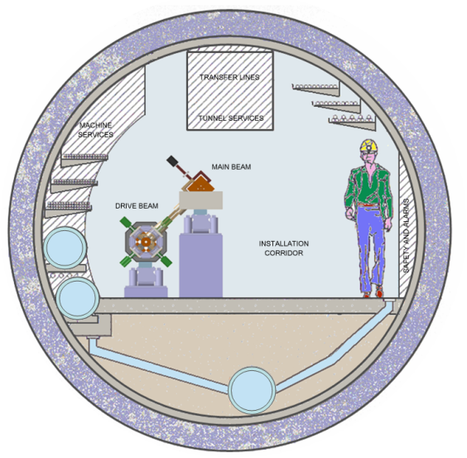
it won’t be easy…
QUAD
QUAD
POWER EXTRACTION
STRUCTURE
ACCELERATING
STRUCTURES
BPM
Drive Beam
Generation
Complex
Main Beam
Generation
Complex

Slide 37
Compact Linear Collider
CLIC
Status

Slide 38
Main CLIC parameters
Centre-of-mass energy | CLIC 500 GeV |  |  | CLIC 3 TeV
Beam parameters | Relaxed | Nominal |  | Relaxed | Nominal
Accelerating structure | 502 |  |  | G
Total (Peak 1%) luminosity | 8.8(5.8)·10³³ | 2.3(1.4)·10³⁴ |  | 7.3(3.5)·10³³ | 5.9(2.0)·10³⁴
Repetition rate (Hz) | 50
Loaded accel. gradient MV/m | 80 |  |  | 100
Main linac RF frequency GHz | 12
Bunch charge10⁹ | 6.8 |  | 3.72
Bunch separation (ns) | 0.5
Beam pulse duration (ns) | 177 |  | 156
Beam power/beam MWatts | 4.9 |  | 14
Hor./vert. norm. emitt (10⁻⁶/10⁻⁹) | 7.5/40 | 4.8/25 | 7.5/40 |  | 0.66/20
Hor/Vert FF focusing (mm) | 4/0.4 | 4 / 0.1 4/0.4 |  |  | 4 / 0.1
Hor./vert. IP beam size (nm) | 248 / 5.7 | 202 / 2.3 | 101/3.3 |  | 40 / 1
Hadronic events/crossing at IP | 0.07 | 0.19 | 0.28 |  | 2.7
Coherent pairs at IP | 10 | 100 | 2.5 10⁷ |  | 3.8 10⁸
BDS length (km) | 1.87 |  | 2.75
Total site length km | 13.0 |  | 48.3
Wall plug to beam transfert eff | 7.5% |  | 6.8%
Total power consumption MW | 129.4 |  | 415

Slide 39
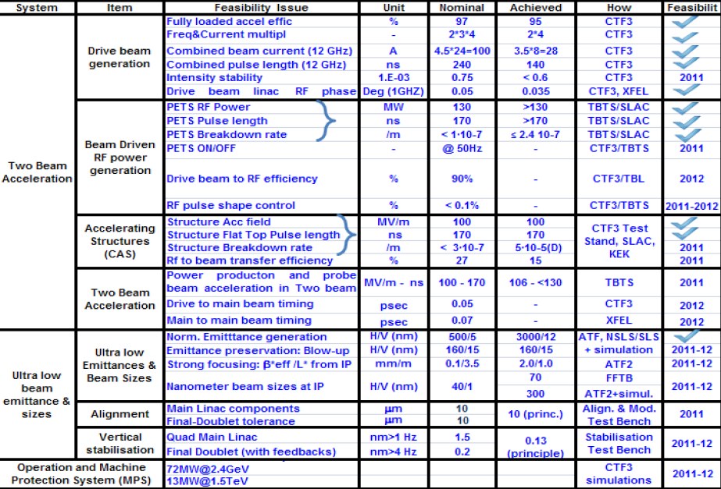
CLIC Feasibility status
Delahaye

Slide 40
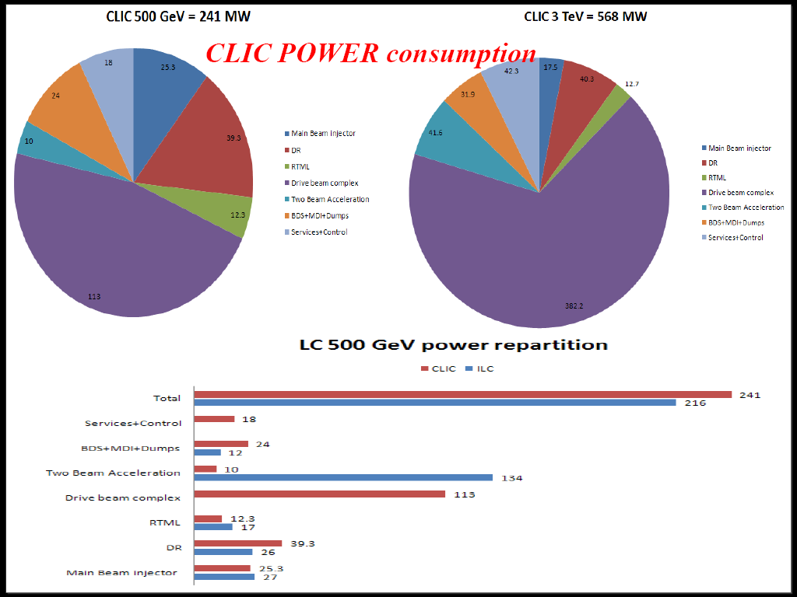
CLIC Power Consumption
Delahaye

Slide 41
Drive Beam Generation
Ring isochronicity α_{p} < 10⁻⁴
Transverse rms emittance
100 π mm mrad (end of linac)
Bunch length control
< 1 mm rms (end of linac)
Factor 2 combination
in Delay Loop
(from 3.5 to 7 A)
Control of ring length to better than 0.5 mm
Beam current stability
~ 0.1 % end-of-linac,
~ 0.2 % combiner ring
~ 0.06 % end-of-linac !
Bunch train recombination factor 4 in Combiner Ring (from 3 to 12 A)
Full beam loading (95% transfer)
high current acceleration (up to 5 A)
Bunch train recombination 2 x 4 in DL and CR (from 3.5 to 28 A)
Transverse rms emittance
< 150 π mm mrad (combined beam)
Bunch length control
< 1 mm rms (combined beam)
Beam current stability
~ 0.1 % for combined beam
Sub-Harmonic bunching with
fast (< 6ns) 180° phase switch
(8.5% satellites)
Corsini

Slide 42
CTF3 Achievements
8 PETS + spectrometer installed to verify transport of a 28 A beam with up to 30% of energy extracted.
Nominal probe beam to end of line (no accelerating structure)
Probe beam acceleration to 100 MV/m.
(55 MV/m measured)
Beam-powered test of a PETS to nominal parameters (135 MW, 240 ns) with external recirculation (10 A) and without (20 A) – including probe beam
Improved power & drive beam energy loss measurements
(Break-down kick measurement).
Beam-powered test of a PETS with external recirculation to 170 MW, <200 ns - ~10 A beam current
Power & drive beam energy loss measurements.
Corsini

Slide 43
Progress-1: Energy scanning
The issue
  Small (10%) scans can always be done
    Tune magnets, detune RF
  Optimise the machine for one energy
    Running at much lower (or higher) energy
      Compromised luminosity
      Needs a machine reconfiguration
      Cannot be done quickly (within a few hours)
        Can it be done at all?

Slide 44
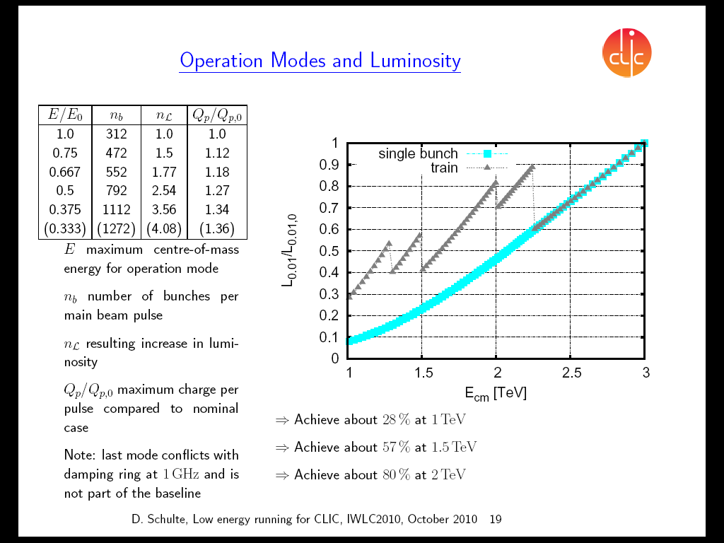
Progress-1: Energy scanning-2
Compensate partially for loss of (useful) luminosity from decreasing the RF gradient by increasing the pulse length
Schulte

Slide 45
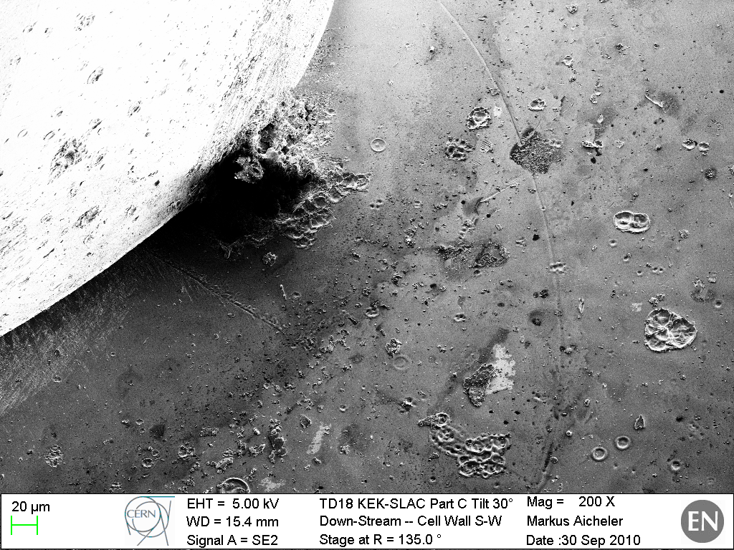
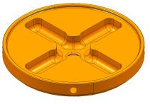
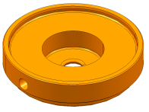
Progress-2: Accelerating Structures
with
damping
without
damping
CLIC Goal
Wuensch
Delahaye

Slide 46
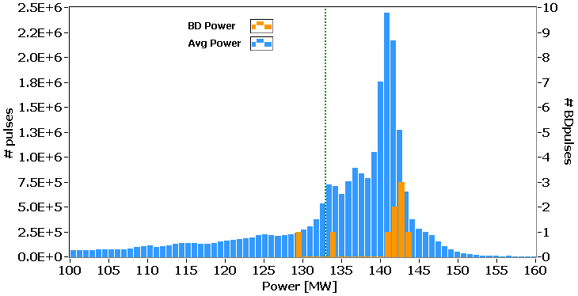
Progress-2: PETS
1.55x10⁷ pulses
8 PETS breakdown events in 1.55 ×10⁷ pulses (125 hours)
  Breakdown rate 5.3 ×10⁻⁷/pulse [CLIC Goal <2 ×10⁻⁷/pulse]
    (excluding the 8 in the cluster – 1.3 ×10⁻⁷/pulse)
  In 80 hours no breakdowns were registered
    BDR <1.2x10⁻⁷/pulse
Wuensch

Slide 47
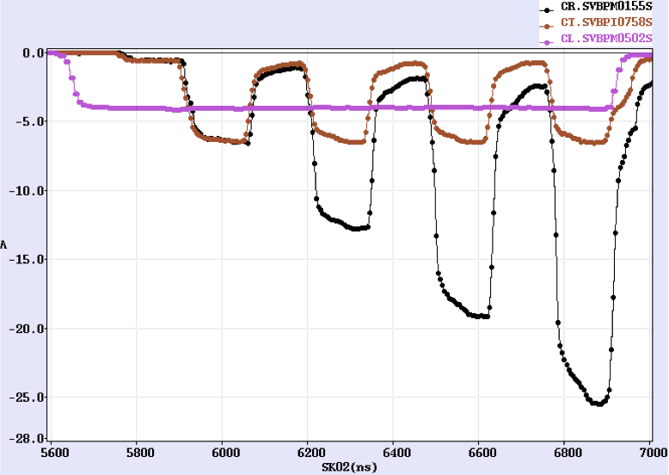
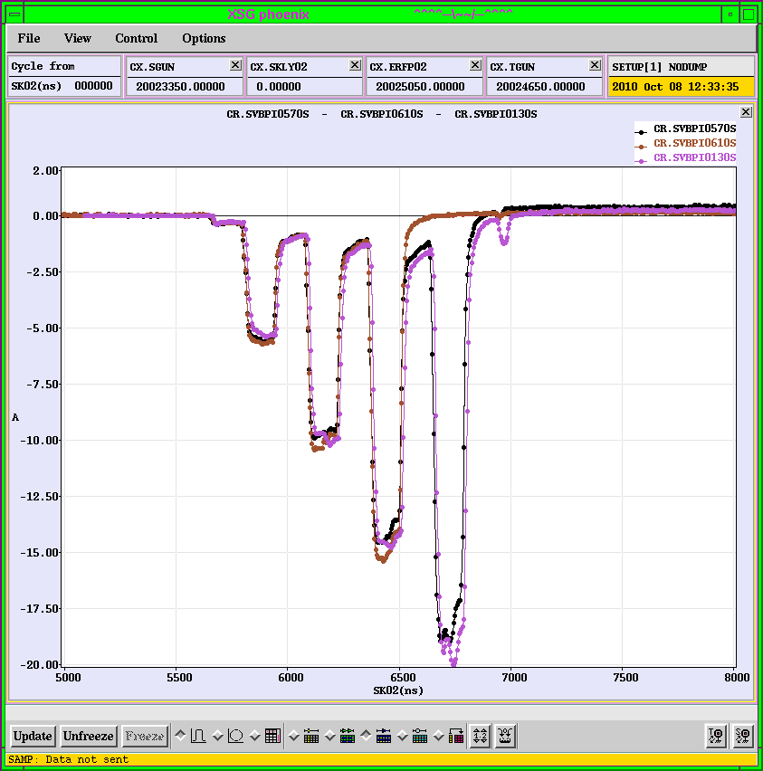
CTF3
4 x combination
  Lower current ←→ Missing klystron
  But back in operation – continue work
2009
2010
Current from
Linac
Current after
Delay Loop
Current in the ring
20 A
26 A
Tecker

Slide 48
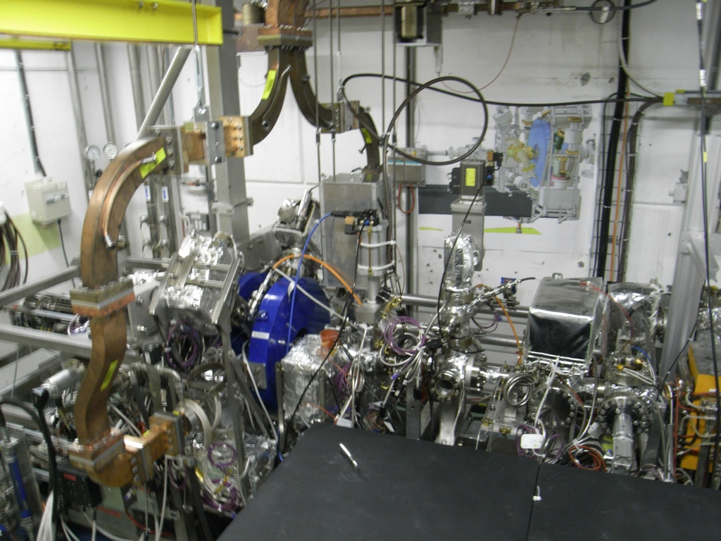


PHIN
See Oznur Mete, Friday 17:00
specifications successfully demonstrated during the June run
measurements along pulse train
⎫
✓
✓
✓
✓
✓
✓
✓
⎦
✓
✓
✓
✓
✓
✓
Emittance
(03 March 2010)
Emittance Measurement along the Pulse Train of 1.2µs
Tecker

Slide 49


High charge & cathode tests - PHIN
Marta Csatari
New green responsive cathode tested in UV Cs3Sb
Cathode lifetime measurements
Maximum charge extracted with 75 bunches
333ps switch
8.1nC/bunch
999ps switch
HIGHEST charge extracted from PHIN to date

Slide 50



Beam Stability
Beam current along TL2, TL2’ and TBTS
21 Aug

Slide 51


Two-beam acceleration in CTF3
maximum probe beam acceleration of 11 MeV measured
=> gradient ~55 MV/m
RF calibrations to be verified
Drive beam OFF
Drive beam ON

Slide 52




RF Power Production - PETS
>200 MW peak RF power
  ~ 3x10⁵ pulses (rapid)
  Record level
reliable pulses
  ~100 MW in accelerating structure
  ~ twice power neded for 100 MV/m
    two beam experiment
    TD24_vg1.8_disk structure.
Roger Ruber

Slide 53
Detectors

Slide 54

CLIC Detector Concepts
Modified ILC detector concepts
  Vertex detector further out (r_{min} = 30 mm)
  Thicker HCAL (8 λ_{I})
    HCAL inside solenoid – need to keep “thin” (Tungsten?) Full Geant4 simulations of ILD and SiD for CLIC

Slide 55

Reconstructed CLIC event with “pile-up”
1.4 TeV of background !

Slide 56

After timing cuts at cluster level
0.1 TeV of background

Slide 57
Next Steps

Slide 58
“Lehman” impact
Increase in resources for CLIC
  Materials 11.9→19.0MCHF
  Personnel 12.8→10.9MCHF
    Overall increase ~60%
  but
    Shortage of manpower
    Collaboration

Slide 59
“Lehman” impact
Increase in resources for CLIC
  Materials 11.9→19.0MCHF
  Personnel 12.8→10.9MCHF
    Overall increase ~60%
  but
    Shortage of manpower
    Collaboration

Slide 60

Planning 2011
3 GHz beam setup to CR
initial beam to CLEX
CALIFES setup
1
CR x 4 combination
emittance studies
combined beam to CLEX
CLEX closed
2
PHIN run
2a
1.5 GHz beam setup
x 8 combination
(if TWT is available – only 1 operational)
Smoke in MKS02
One month stop
2
2a
3
100 MV/m acceleration
breakdown kicks
TBL deceleration
(1-2 days for DB beam studies)
3
1
  ε < 150 mm mrad
  longitudinal studies
  stability x 8 combination
  (night running for BDR)
INSTALLATION
TBL PETS
&
PETS on-off
?
4
4
5
>
today
5
    breakdown rate measurements
    PETS / ACS
>
Test of new PETS on-off scheme
TBL deceleration up to 8 PETS
Beam phase CSR
rep. rate / losses night supervision

Slide 61
CLIC Feasibility status
Delahaye

Slide 62
CLIC Tentative Schedule
After Delsahaye
Final CLIC CDR and
proposal next phase
@ CERN Council
European Strategy
for Particle Physics
@ CERN Council
Draft Conceptual
Design Report
(CDR)
Project Implementation
Plan (PIP) and
proposal for next phase

Slide 63




CLIC CDR: P&D Editorial Team
Stanitski

Slide 64
Do we need CLIC0? (Project after 2016?)
10% of a CLIC decelerator sector
CALIFES type injector
0.2 GeV, 1.2 A
TBA
6.5 GeV, 1.2 A
0.2 GeV, 101 A
DB Turn around
0.48 GeV, 101 A
DBA
0.48 GeV, 4.2 A
DL
CR1
CR2
Compression
2 x 3 x 4
100 m
20% of CLIC DB energy
Corsini

Slide 65

CLIC-ILC WG on General Issues
2010

Slide 66
CLIC-ILC WG on General Issues
Membership:
  CLIC: Ph. Lebrun (co-chair), K. Peach, D. Schulte
  ILC: E. Elsen, M. Harrison (co-chair), K. Yokoya
Mandate
    Promoting the Linear Collider
    Identifying synergies
    Discussing detailed plans for the ILC and CLIC effort & project planning.
    Discussing issues that will be part of each project implementation plan
    Identifying points of comparison between the two approaches
Reporting line
  Creported to the ILCSC and CLIC Collaboration Board
  Amin to produce a joint document.
Working method
  Approximately monthly meetings by teleconference
  Four face-to-face meetings

Slide 67

A tentative roadmap
Not Officially Approved!

Slide 68
Accelerator Inspired Working Groups
Current technical working groups are
  Beam delivery system & machine-detector interface
  Civil engineering and conventional facilities
  Positron generation
  Damping rings
  Beam dynamics
  Cost & schedule
    Opportunities for further work
      Conventional RF?
      Surface science?
      …

Slide 69
Decision point for the LC
2½ key facts are needed
  Is there a light (<200 GeV/c²) Higgs?
  Is there New Physics (below 1 TeV)?
    If yes, what is the energy range?
Note:
  It does not matter much from the point of view of defining the decision point what the answers to these questions are – only that we know them!
  The 1st question may be answered by end 2012
  The 2nd question may be answered by end 2011
    The ½ question may not be clear for some time
  We need to define criteria for making a “fact”
    Is 3σ enough for evidence?
    Is 98% enough to exclude?
Reach of LC wrt HE-LHC or HL-LHC?

Slide 70
Comments and proposals
Do we need the answers to both to proceed?
  (KJP) yes (politically)
Is the European Strategy update a constraint?
  (KJP) yes
    If either is question are answered before Strategy workshop
      Encourage the Americas & Asia to update their strategies
      Organise input to these discussions
    If there is no reliable information by March 2012
      Be prepared to organise a quick workshop between March and the Strategy update workshop if evidence emerges
      Plan for a “community workshop” in 2013 to review the situation
      [this will either define the LC parameters or address the crisis]

Slide 71
Summary
Excellent technical progress to the CDR
  Delayed ~6 months by the fire
  Address remaining feasibility issues
  On track for CDR by end 2011
Plans developed for the post-CDR phase
  Disrupted by the financial crisis
    But a revised plan emerging
Opportunities for greater collaboration
  Prepare for the post 2012 landscape
    New connections ILC⬅➔CLIC?
    New organisational structures?
Wait for “good news” from the LHC

Slide 72
Thank you

