Slide 1
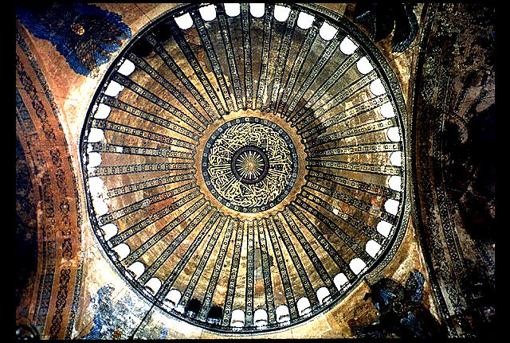
The Large Hadron Collider
Mike Lamont
for the LHC team

Slide 2
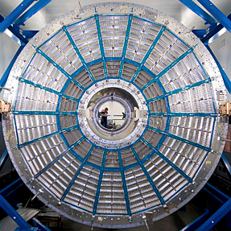
Overview
Introduction
Performance in 2010
Progress in 2011
Looking ahead
Conclusions

Slide 3
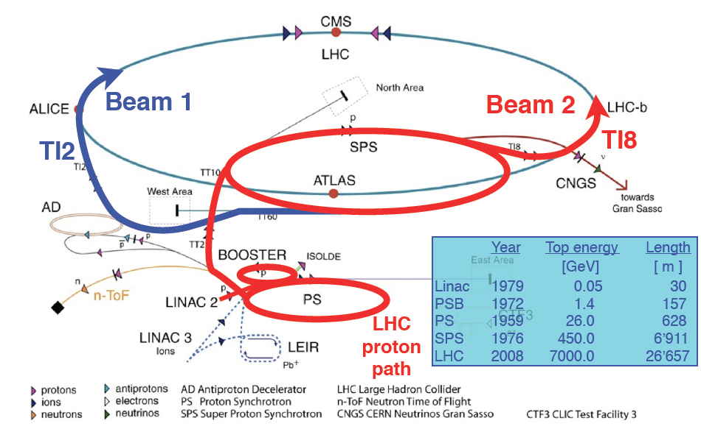
CERN’s injector complex

Slide 4
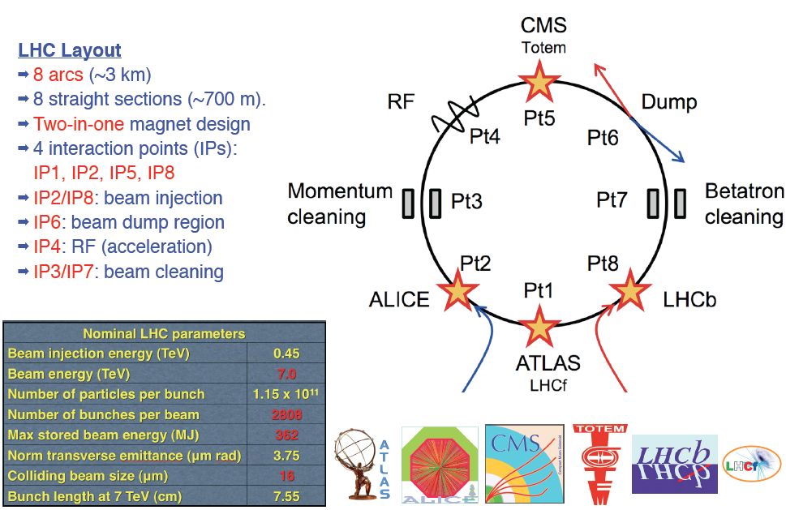
LHC layout and accelerator systems

Slide 5



Luminosity - reminder
N | Number of particles per bunch
K_{b} | Number of bunches
f | Revolution frequency
 | Beam size at interaction point
F | Reduction factor due to crossing angle
 | Emittance – area in phase space occupied by beam
 | Energy normalized emittance
 | Beta function at IP – defines beam envelope

Slide 6
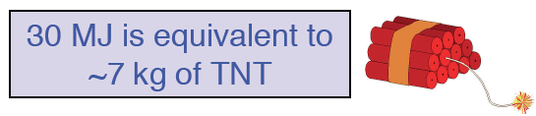
2010 – main aims
Lay the foundations for 2011 and the delivery of 1 fb⁻¹. Peak luminosity target 1x10³² cm⁻²s⁻¹
Gain solid operational experience of injecting, ramping, squeezing and establishing stable beams
Steady running at or around 1 MJ for an extended period
Perform a safe, phased increase in intensity up to around 30 MJ per beam

Slide 7
2010 parameters
 | 2010 | Nominal
Energy [TeV] | 3.5 | 7
beta* [m] | 3.5, 3.5, 3.5, 3.5 m | 0.55, 10, 0.55, 10
Emittance [mm.mrad] | 2.0 – 3.5 start of fill | 3.75
Transverse beam size at IP [microns] | ~60 | 16.7
Bunch intensity | 1.2e11 | 1.15e11
Number of bunches | 368 348 collisions/IP | 2808
Stored energy [MJ] | 28 | 360
Peak luminosity [cm⁻²s⁻¹] | 2e32 | 1e34

Slide 8
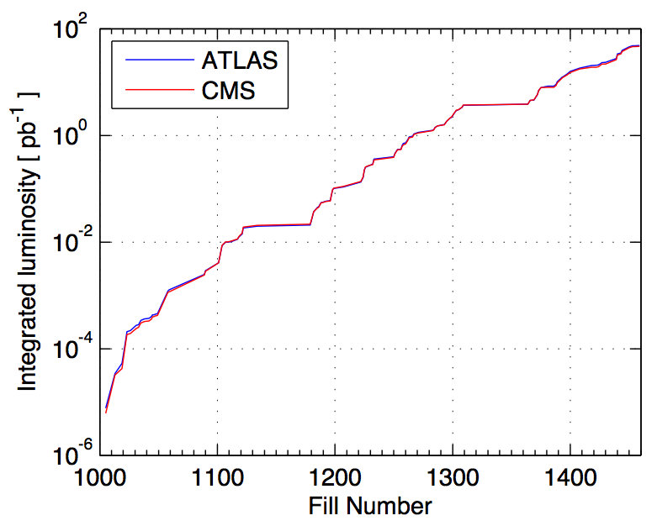
Luminosity: 3 running periods
Performance ramp-up
(368 bunches)
Nominal bunch operation
(up to 48)
Bunch trains
Performance ramp-up made possible by a safe, staged commissioning.
Meticulous preparation for unsafe beams!
Initial luminosity run
Nominal bunch commissioning

Slide 9
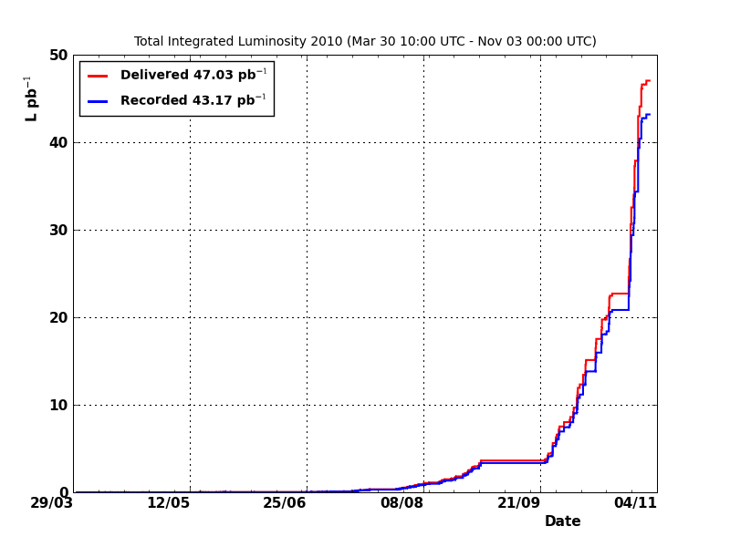
Luminosity 2010
CMS

Slide 10
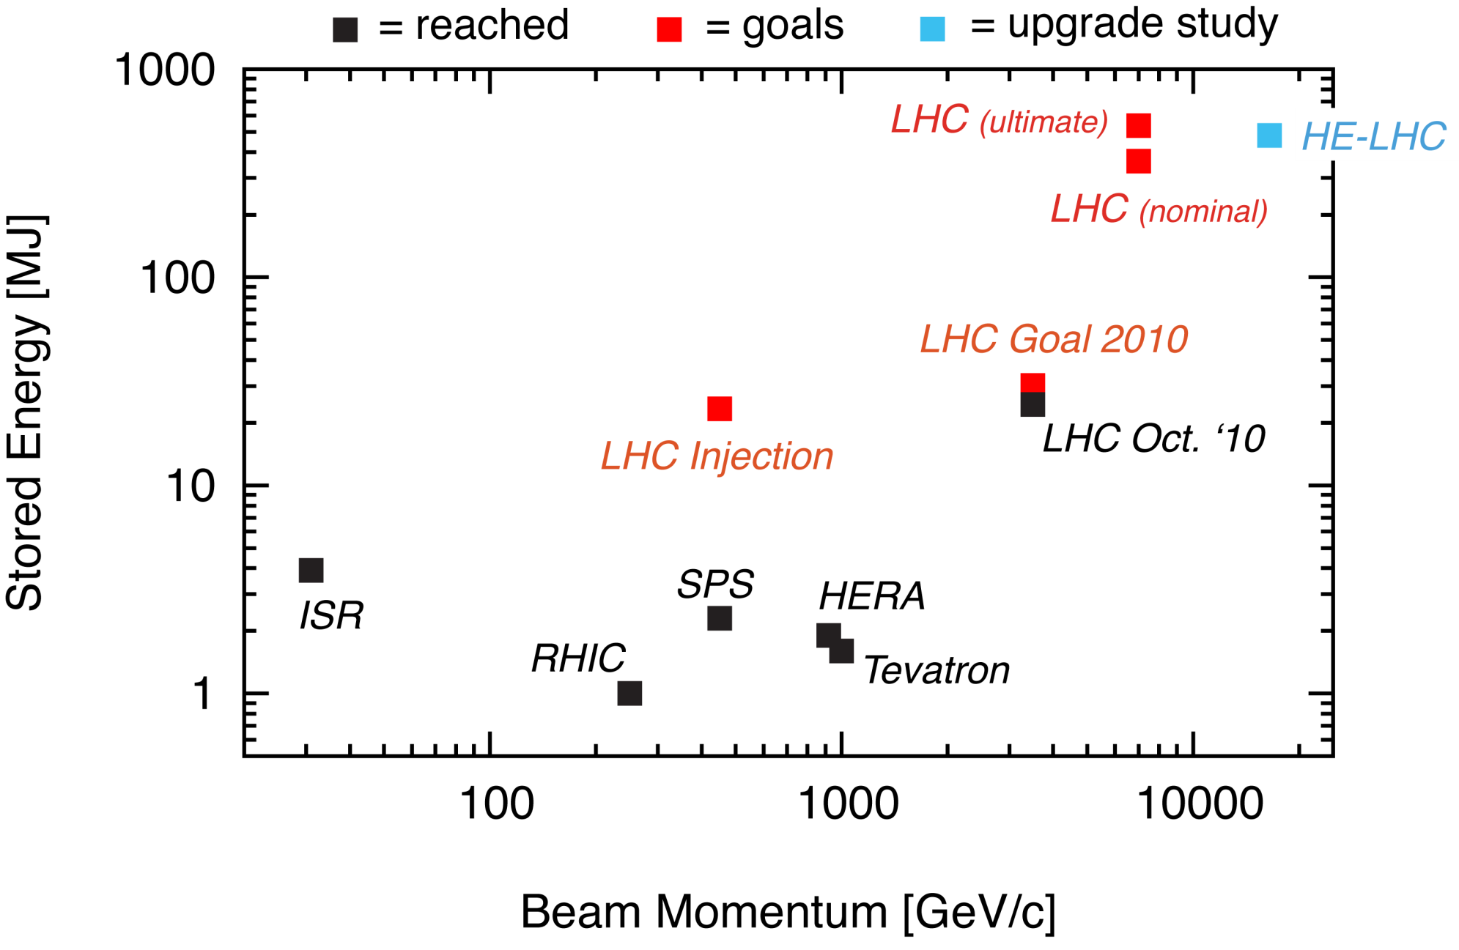
Status LHC Stored Energy
Stored energy reached at 3.5 TeV: 28.0 MJ
80 kg TNT
Ralph Assmann

Slide 11
Lifetimes
Excellent single beam before collisions - over 300 hours
Luminosity lifetime 15- 20 hours, better in 2011
  Reasonably well given by emittance growth and intensity decay
  Minimal drifts in overlap – beams very stable
Intensity lifetime ~90 hours
  Luminosity burn, losses on collimators
Emittance growth (hor. ~ 30 hours, vert. ~ 20 to 40 hours)
  Intra Beam Scattering
  and something else – at least sometimes “the hump”

Slide 12
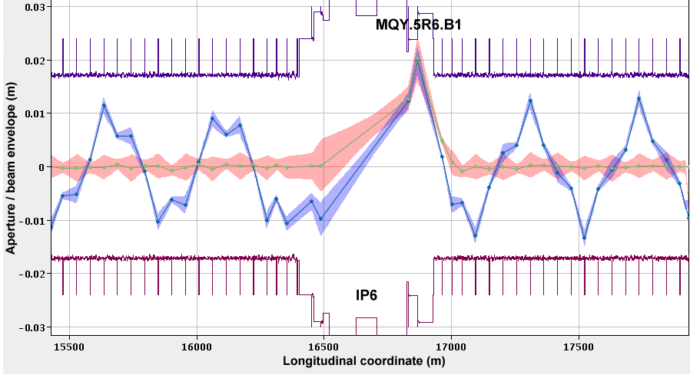
Aperture looks good

Slide 13
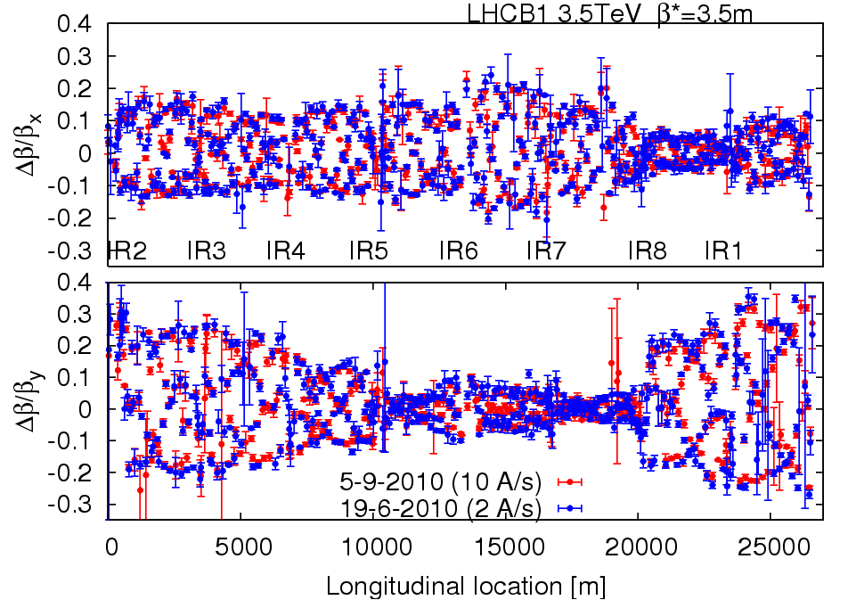
Optics & magnetic machine
Optics stunningly stable
Machine magnetically and optically well understood
  Excellent agreement with model and machine
Magnetically reproducible
  Important because set-up remains valid from fill to fill

Slide 14
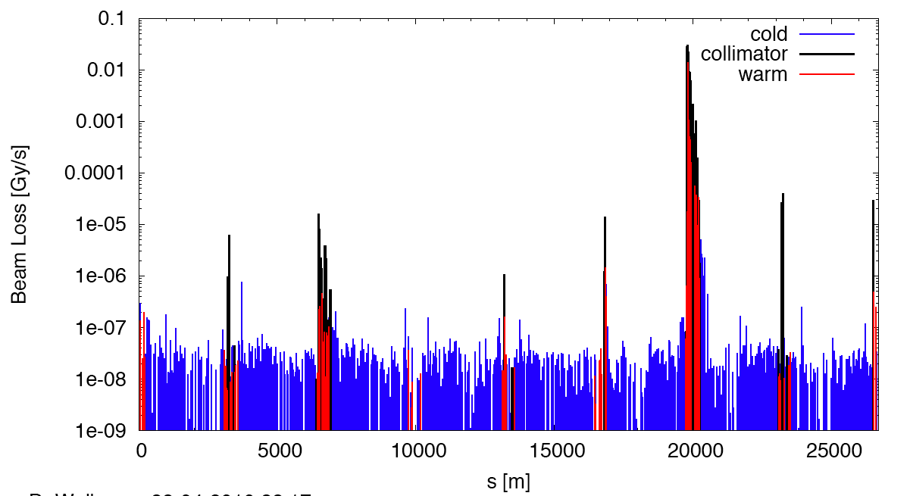
Measured Cleaning at 3.5 TeV
Making sure the hierarchy is respected
(beam1, vertical beam loss, intermediate settings)
Dump Protection Col.
Momentum Cleaning
IR1
IR8
IR2
IR5
Beam cleaning efficiencies ≥ 99.98% ~ as designed

Slide 15
LHC 2010 - summary
Excellent single beam lifetime
Ramp & squeeze essentially without loss
  No quenches with beam above 450 GeV
  Excellent performance of Machine Protection
Optics close to model (and correctable)
Excellent reproducibility
Aperture as expected
Better than nominal from injectors
  Emittances, bunch intensity
Beam-beam: can collide nominal bunch currents
  With smaller that nominal emittances – surprise!
And surprisingly good availability…

Slide 16
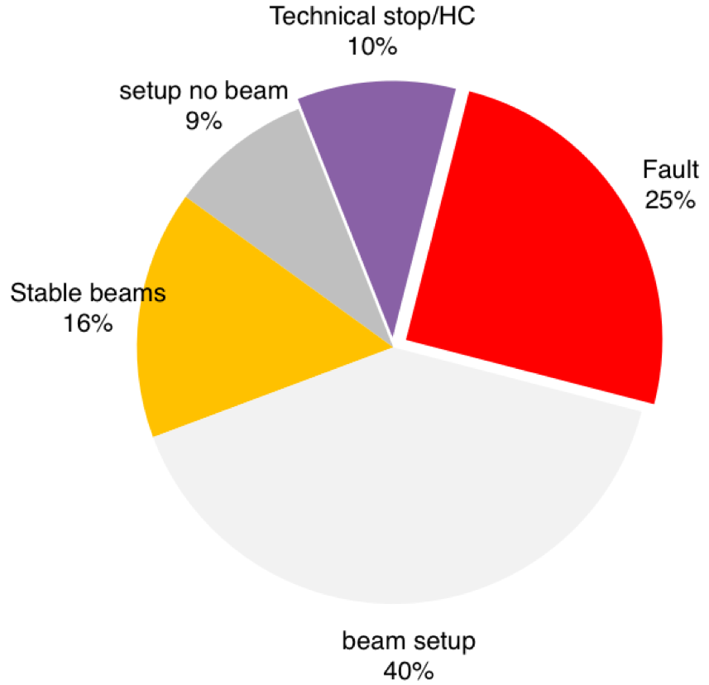
Overall LHC efficiency in 2010
65%
availability
Not bad for the first year of operation!
W. Venturini

Slide 17
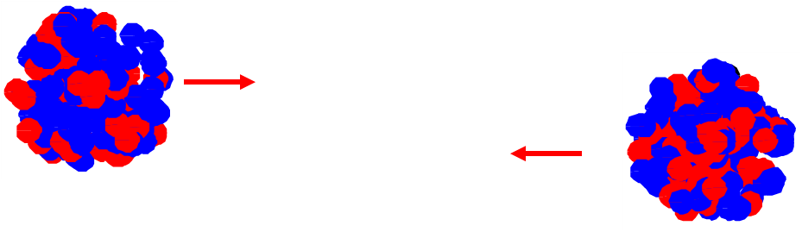
Pb run 2010
Very fast commissioning plan worked:
  Collisions within 50 hours of first injection
  Profited of the experience of the proton run
  Stable beams within 4 days (… and physics)
  Rapid progression in number of bunches
The LHC worked with Pb beams
  No rapidly decaying, invisible beams
  No quenches
  Some new losses and radiation problems

Slide 18
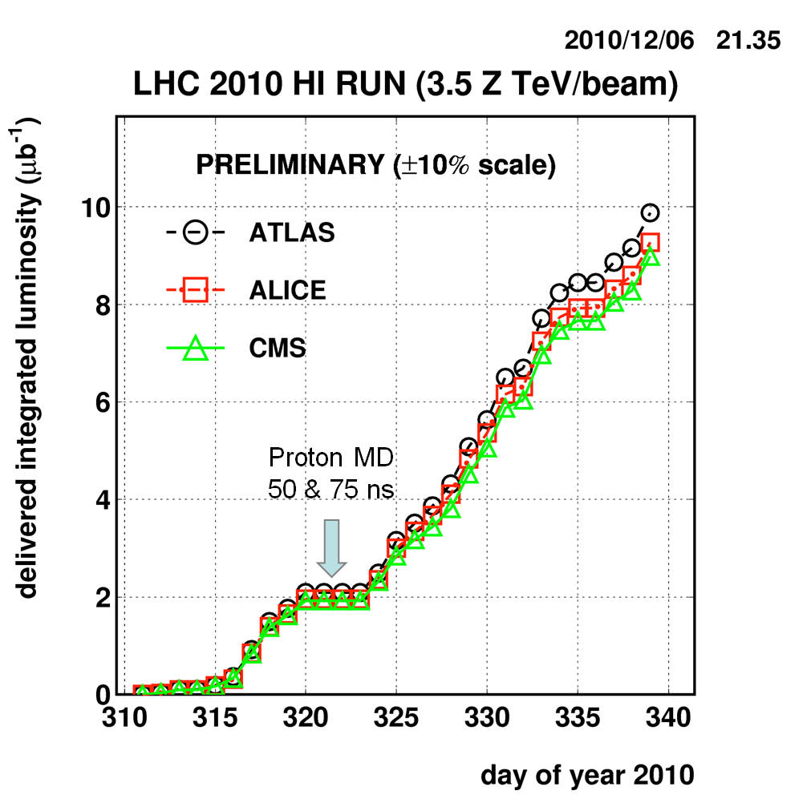
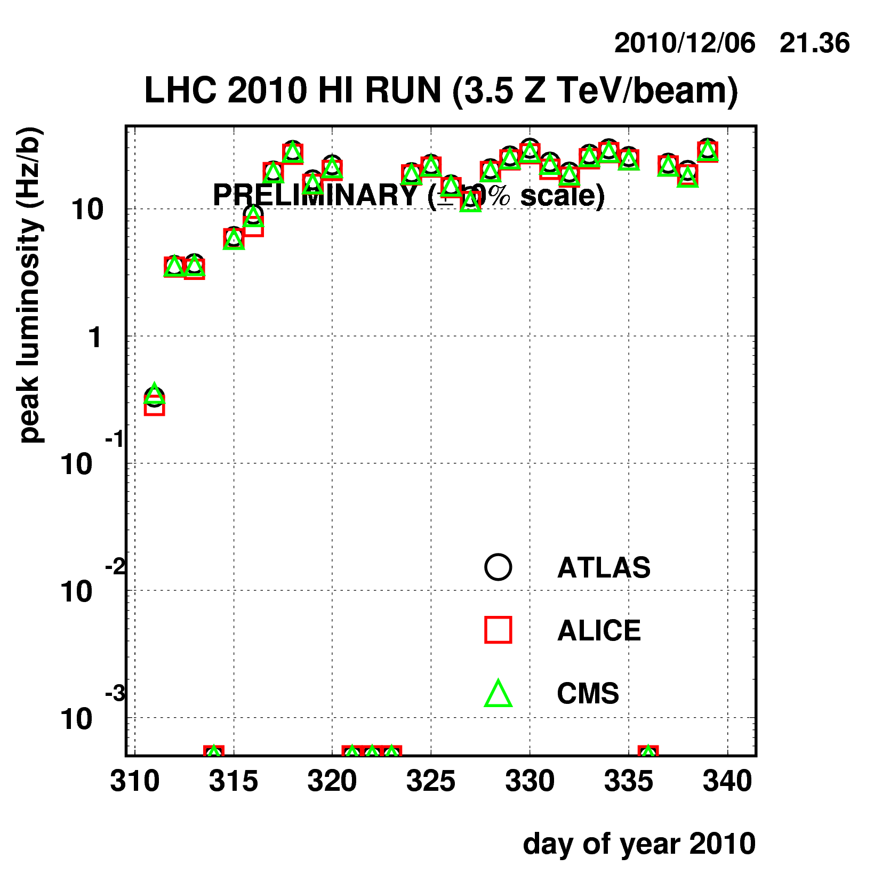
Pb run 2010 - Achievements
Integrated Luminosity | 10 μb⁻¹
Peak Stable Luminosity Delivered | 3.04x10²⁵ cm⁻²s⁻¹
Maximum number of bunches in collision | 137
Average bunch population | 1.2x10⁸ ions (>60% above nominal)
Notes:
7x10^7 ions is the nominal population

Slide 19
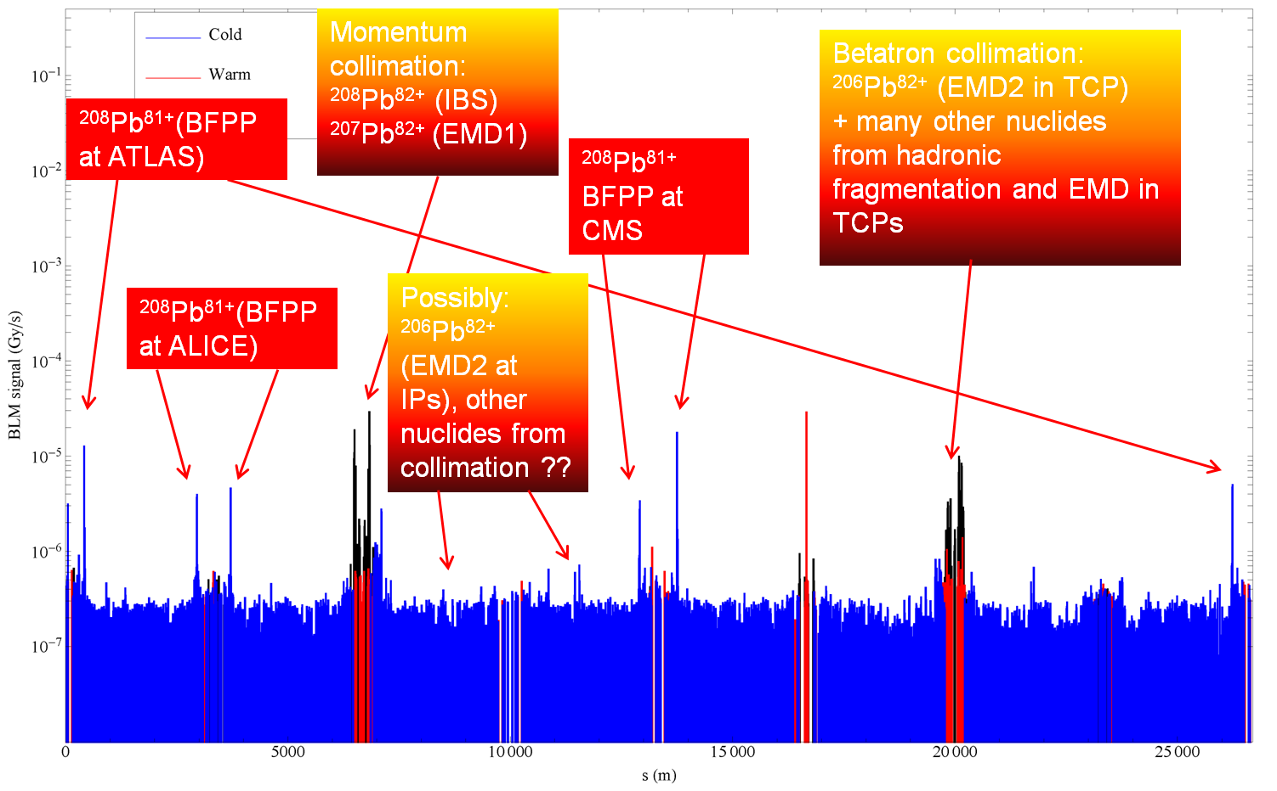
Pb run 2010: Collimation
  Generally according to predictions (i.e. efficiency is a factor 100-500 worse than p).
J. Jowett

Slide 20
PROBLEMS – TWO OF them

Slide 21
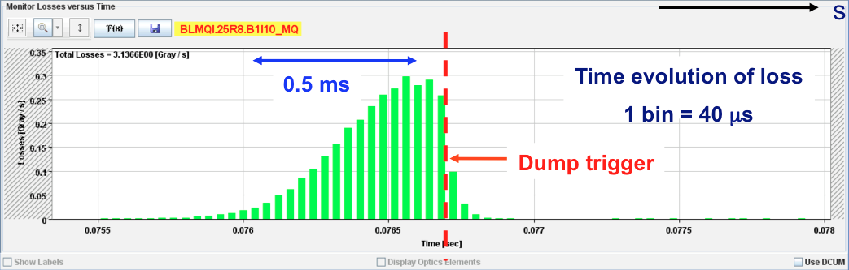
UFOs – unidentified falling objects
Many sudden local losses have been recorded.
No quench, but preventive dumps
Rise time around of the order 1 ms.
Potential explanation: dust particles falling into beam creating scatter losses and showers propagating downstream
Distributed around the ring – arcs, inner triplets, IRs

Slide 22
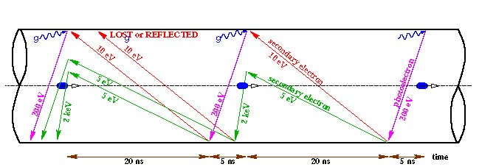
Electron cloud
Reflection
Schematic of electron cloud build up in LHC arc beam pipe due to photoemission and secondary emission [F. Ruggiero]
Secondary emission yield [SEY]
Vacuum pressure rise (background in experiments)
Single-bunch instability
Multi-bunch instability
Incoherent emittance growth
Heat load in cold arcs (quenches in the limit)

Slide 23
Experience in 2010
Vacuum activity started off in regions with common beam pipe at 450 GeV as we pushed up the number of bunches with 150 ns spacing
  Test solenoids cured problem – electron cloud
Tried 50 ns bunch spacing
  Things really kicked off
  High vacuum activity in warm regions
  Significant heat load in cold regions
  Instabilities and beam size growth observed
  Surface conditioning (‘scrubbing’) observed
    Gas desorption rates and SEY drop
    Time constant < 1 day
Situation a lot cleaner with 75 ns
  incoherent effects seen – emittance blow-up
  800+ bunches injected into both beams

Slide 24
Scrubbing strategy for 2011
2010 observations are certainly due to ~ 2 < SEY < 2.5, whereas 1.7 was usually the max value studied in the past
Scrubbing with large emittance, high intensity 50 ns beam
Time around 10 days including preparation and validation
Lots of wire wrapped around warm bits during the technical stop (solenoids)

Slide 25
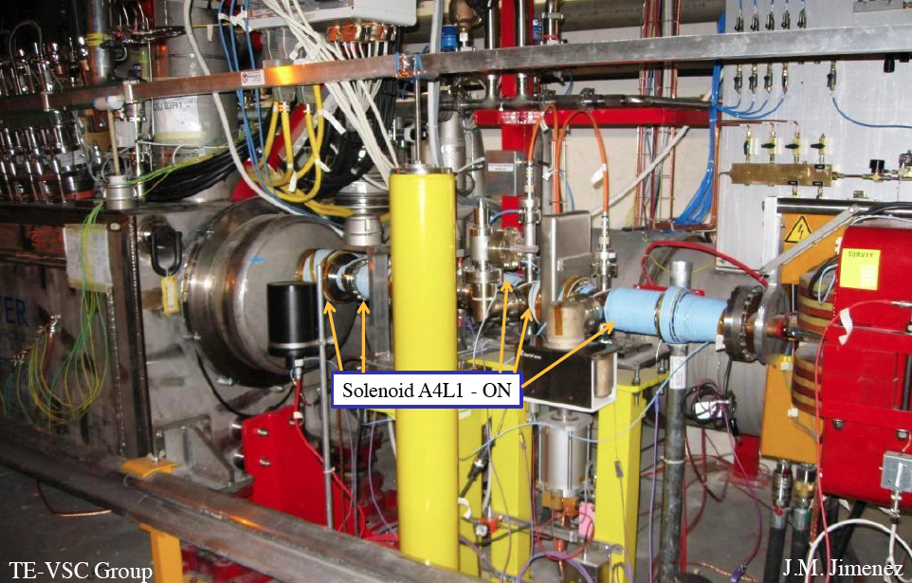
Solenoids between DFBX and D1 in IR1R

Slide 26

2011: main goals
Motivation is clear!
1 fb⁻¹ delivered to each of IP1, IP5 and IP8 at 3.5 TeV
Challenge to deliver 1 fb⁻¹ to IP8
  Maximum luminosity : from 2e32 to 3e32 cm⁻² s⁻¹
  Luminosity leveling via separation required to get close
Alice
  pp run: 5e29 < L < 5e30 cm⁻² s⁻¹, µ < 0.05
fast, secure and far-reaching
Decided on beta* = 1.5 m in Atlas, CMS; 3 m in LHCb; 10 m in Alice

Slide 27
Baseline scenario for 2011
Beam commissioning: 3 weeks
  Exit - stable beams with low number of bunches
Ramp-up to ~200 bunches (75 ns): 2 weeks
  Multi-bunch injection commissioning continued
  Stable beams
Technical Stop: 4+1 days
Scrubbing run: 10 days including 50 ns injection comm.
Intermediate energy run – 5 days
Resume 75 ns operation and increase no. bunches: 3 weeks
  300 – 400 – 600 – 800 – 930 - MPS and OP qualification
Physics operation 75 ns: ~930 bunches
50 ns remains an option if things look good
We are here!

Slide 28
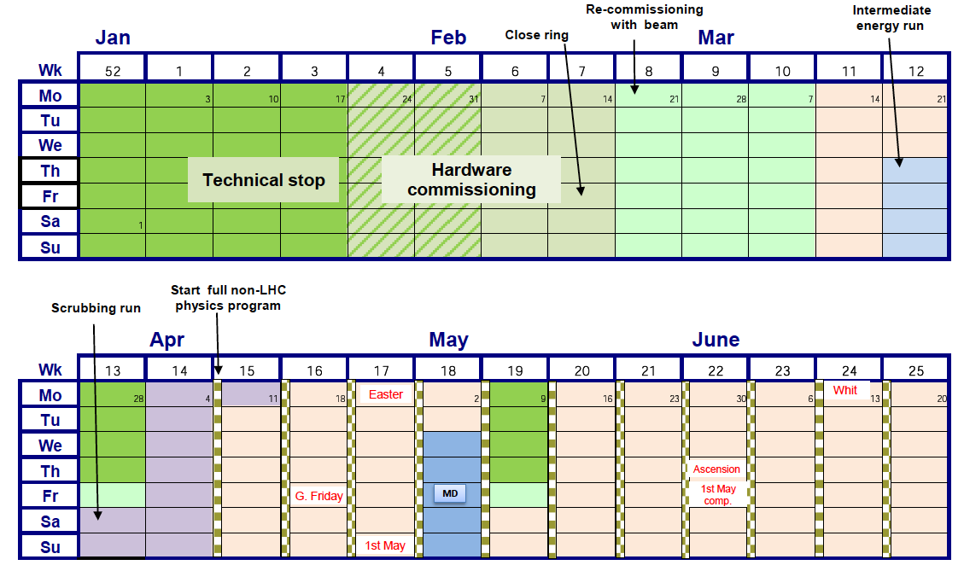
2011 LHC schedule Q1/Q2

Slide 29
2011 – recommissioning
19th February | First beam, circulating beams established.
3rd March | First collisions at 3.5 TeV, beta*=1.5 m with pilot beams
5th March | Nominal bunches at 3.5 TeV, start collimator set-up, injection and beam dump set-up & validation
13th March | First stable beams, 3 bunches per beam, initial luminosity 1.6e30 cm-2s-1
18th March | 32 bunches per beam, initial luminosity ~3e31 cm⁻²s⁻¹
19th March | 64 bunches per beam, initial luminosity ~6e31 cm⁻²s⁻¹
20th March | 1.45e32 cm⁻²s⁻¹ with 75 ns
Fast re-commissioning, improvements across the board.
Operation cycle now well optimized: faster ramp & squeeze, much fewer manual actions required by shift crews

Slide 30
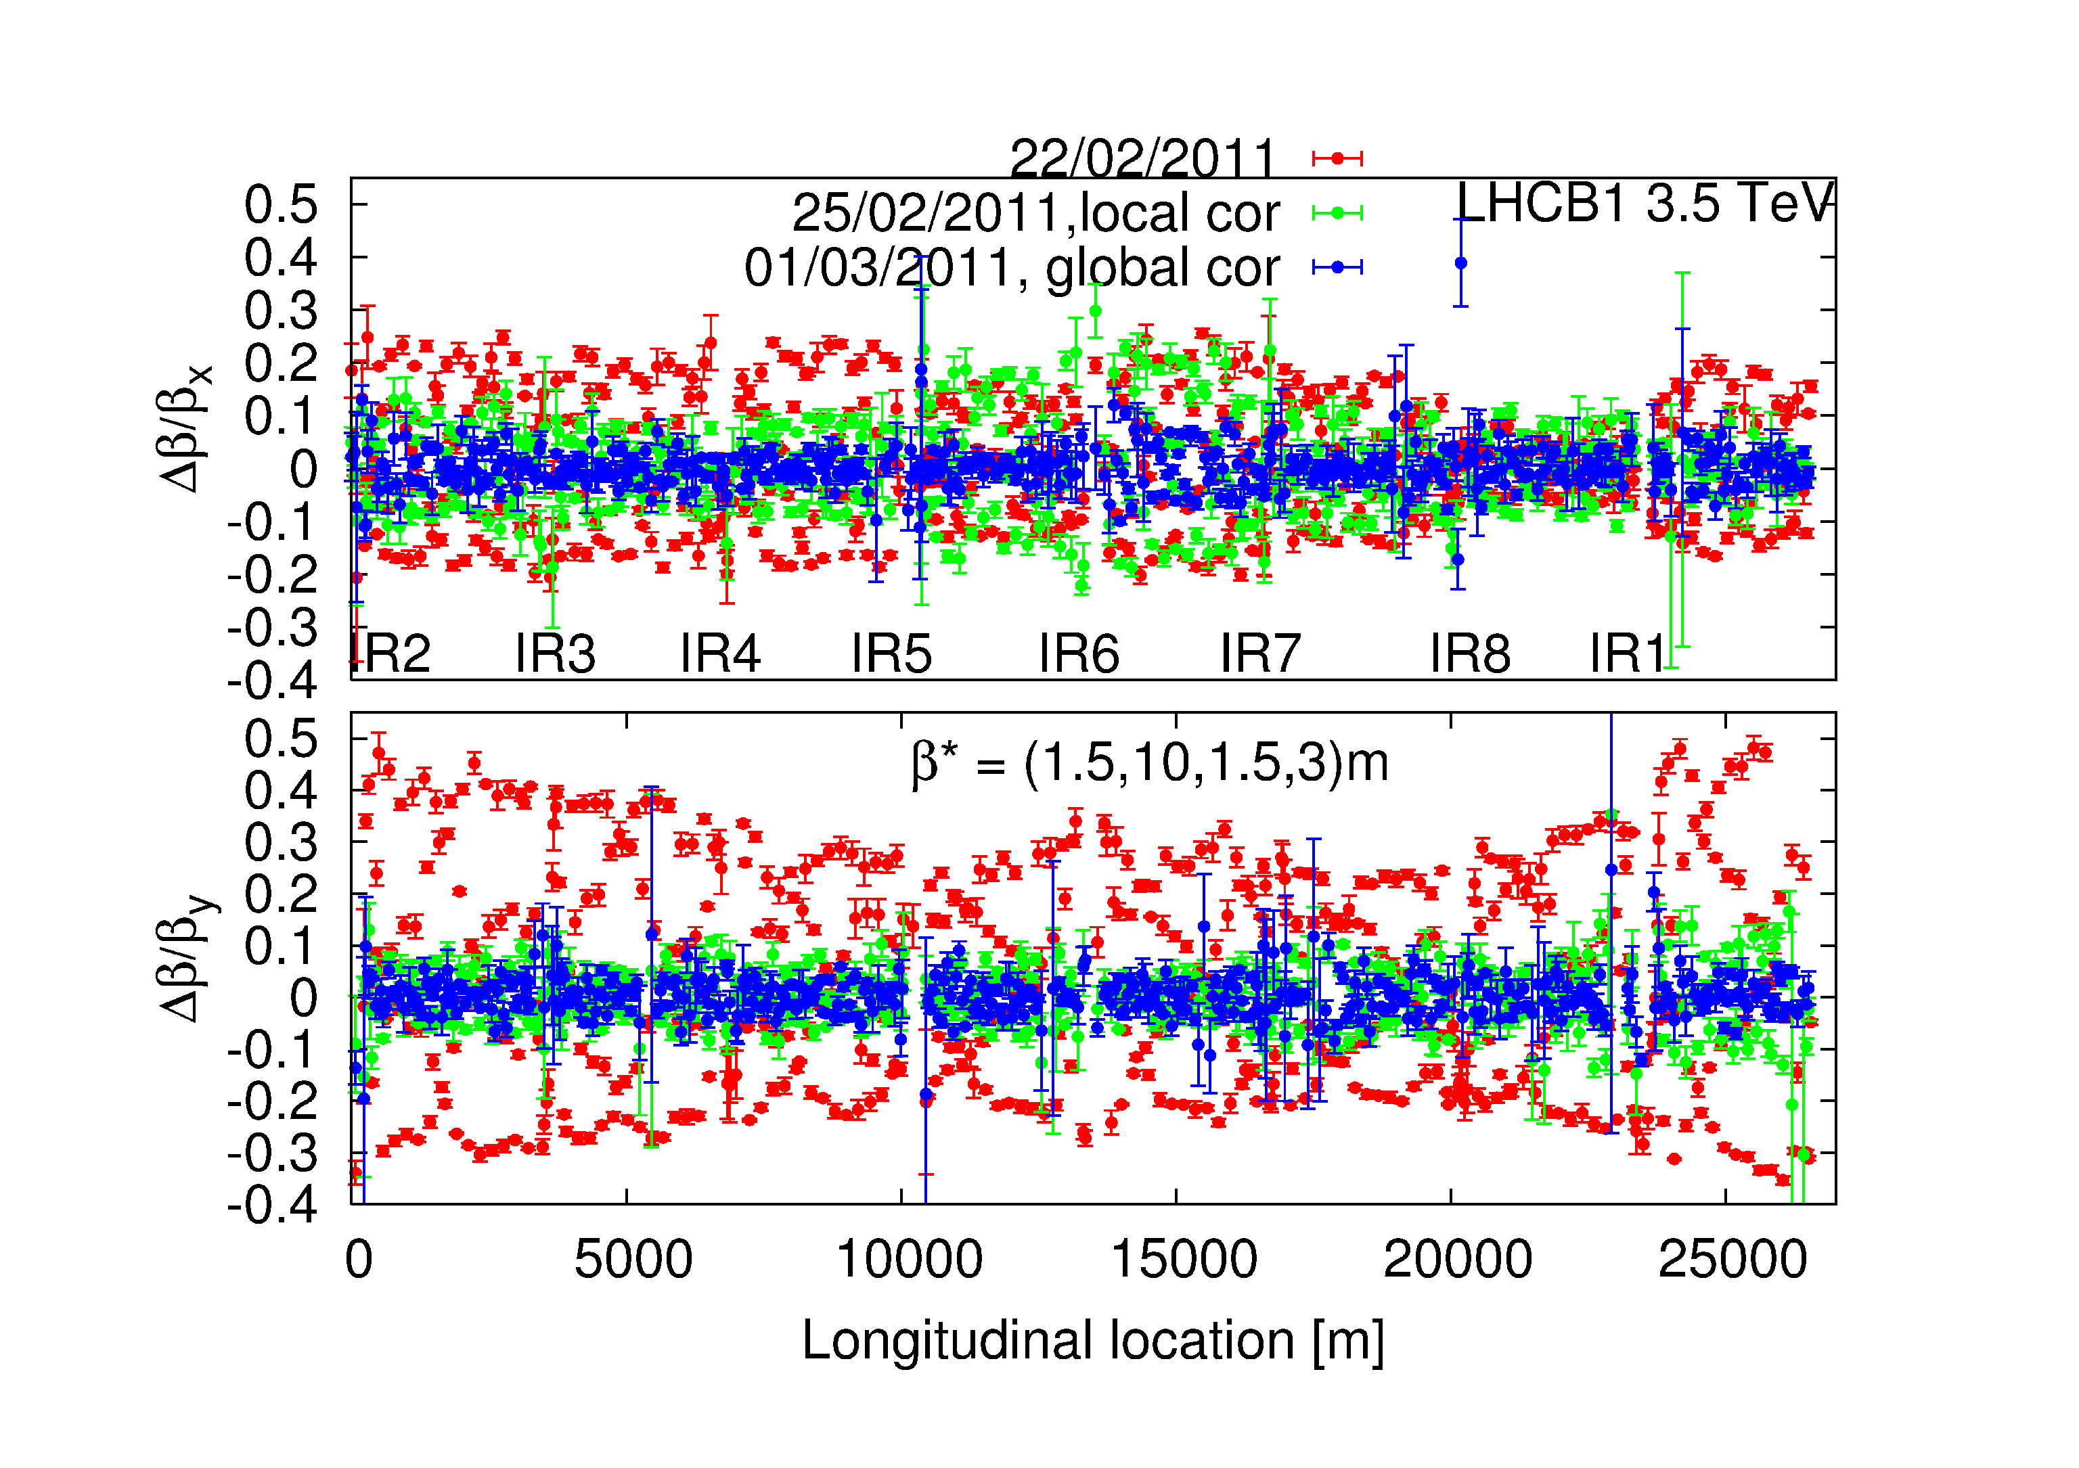
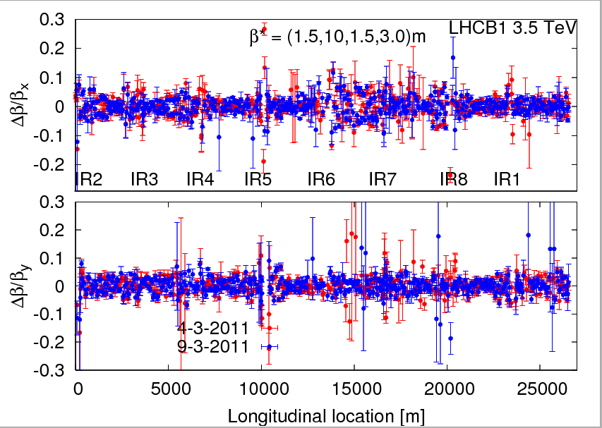
Machine still beautiful
Beta beating corrected down to 5-10%!!
Confirmed stability of the optics
‘Final’ β* values from K-modulation:
Errors around 4-10%
Aperture: global > 12 σ, triplet > 14.5 σ
Beam/plane | IR5 | IR1
B1H | 1.50 | 1.53
B2H | 1.48 | 1.57
B1V | 1.52 | 1.50
B2V | 1.52 | 1.57

Slide 31
Scrubbing run
Impressive progression in spite of several technical problems not related to the scrubbing (> 3 days lost).
5 days of scrubbing
All solenoid off (experiments and vacuum solenoids at warm sections)
Date | Bunches B1+B2
Tue 5th April | 300+300
Wed 6th April | 408+336
Sat 8th April | 588+588
Sun 9th April | 804+804
Mon 10th April | 1020+1020
Careful increase in intensity (in steps of 200 bunches) monitoring cryogenics, vacuum, machine protection and particularly RF
Limited to 72 bunches/train by injection performance
Reached 1020 bunches per beam at the end of the scrubbing run ➔ more than 10¹⁴ protons per ring

Slide 32
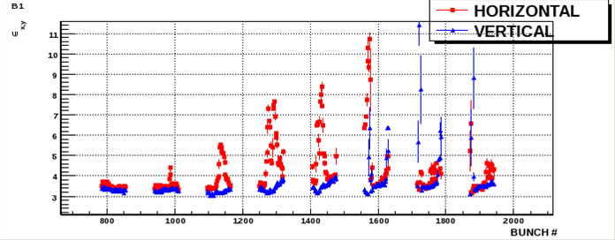
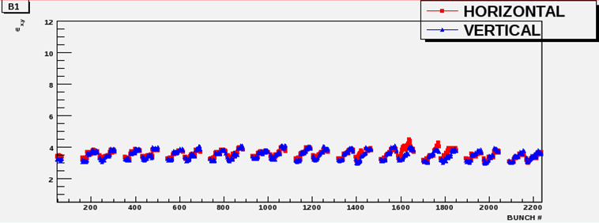
Scrubbing: effect on beam
Started like this – 300 bunches
804 bunches some hours of scrubbing

Slide 33
Scrubbing: Heat-loads in the arcs
Impressive reduction of the heat load in few hours: results consistent with SEY reduction from 2.5 to <1.8
L. Tavian
Decision taken to go with 50 ns bunch spacing after encouraging scrubbing run

Slide 34
Next step – increasing the number of bunches
Issues include:
Running with higher total beam intensity requires much finer control of the beam parameters plus…
More UFOs
More SEUs
RF Power Couplers (present limitation)
RF wave-guide flashover (linked to UFOs)
HOM heating of Injection kickers, cryo, collimators.. (total intensity and bunch length dependence)

Slide 35
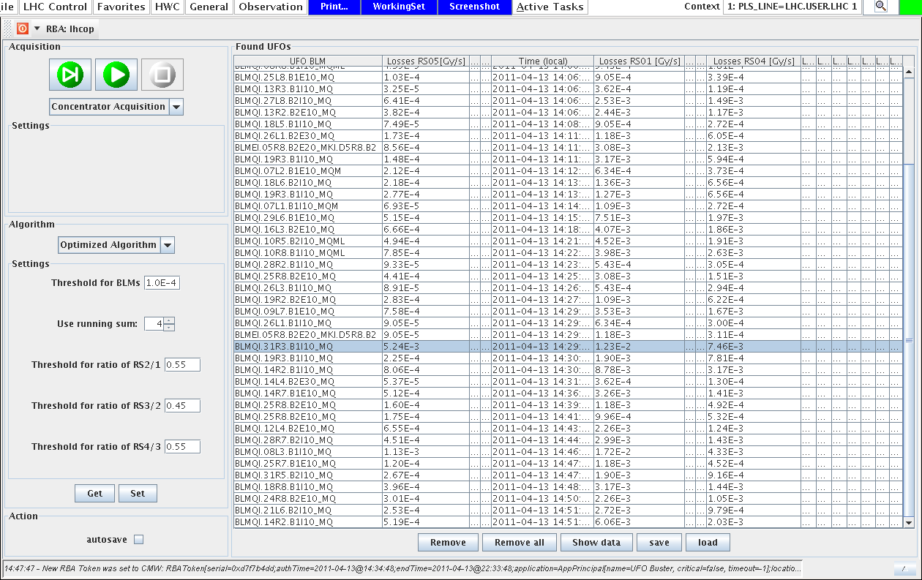
UFO’s: coming thick and fast
~90 in 90 minutes – happily most below threshold

Slide 36
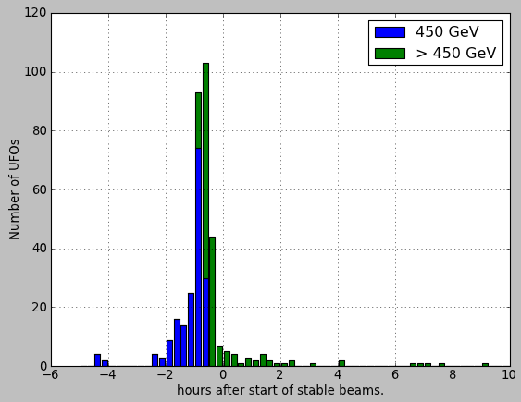
UFO around injection region
679 UFOs around the injection kickers
caused 9 beam dumps.
Most of the UFOs around the
kickers occur before going to
stable beams.

Slide 37
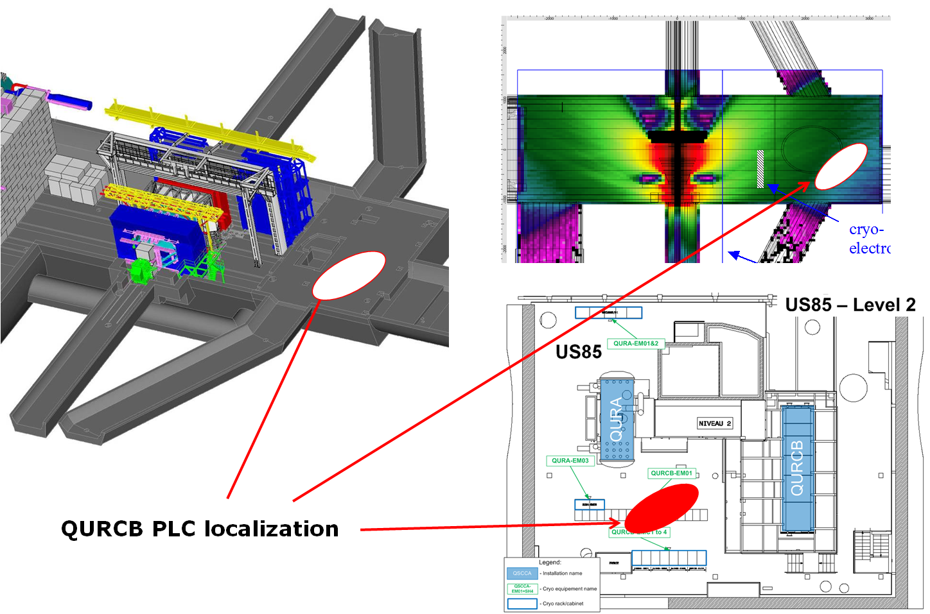
Radiation to electronics (SEUs etc.)
US85
Cryogenics controls implicated (among others)

Slide 38
Increasing intensity – machine protection
Collimation loss of hierarchy at 450 GeV
  Orbit. Regular loss maps performed
72 (108/144) bunches from SPS
  Beam quality from injector very important
  144 bunches per injection from SPS > 1 MJ down the lines
High temperature superconducting current lead quenched (7th April)
  Invoked quench of 11 magnets
Injection Kicker Flashover (18th April)
  Not pretty, heavy beam loss
However…

Slide 39
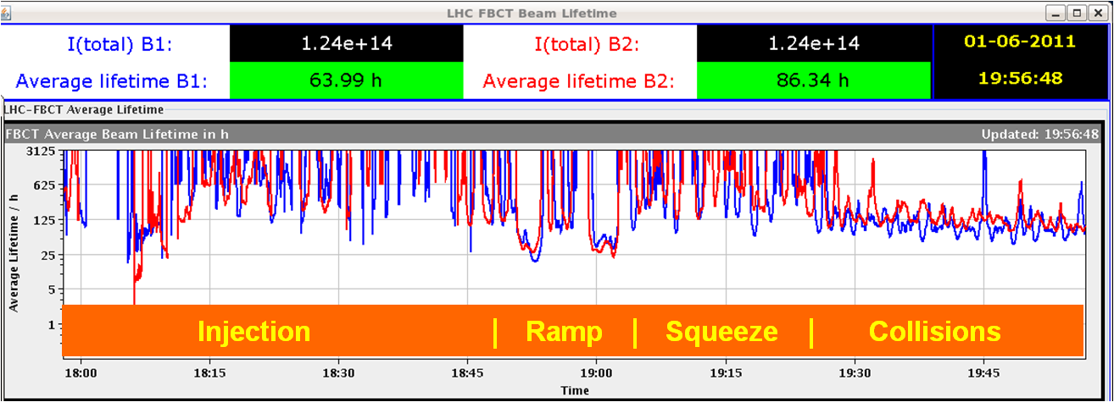
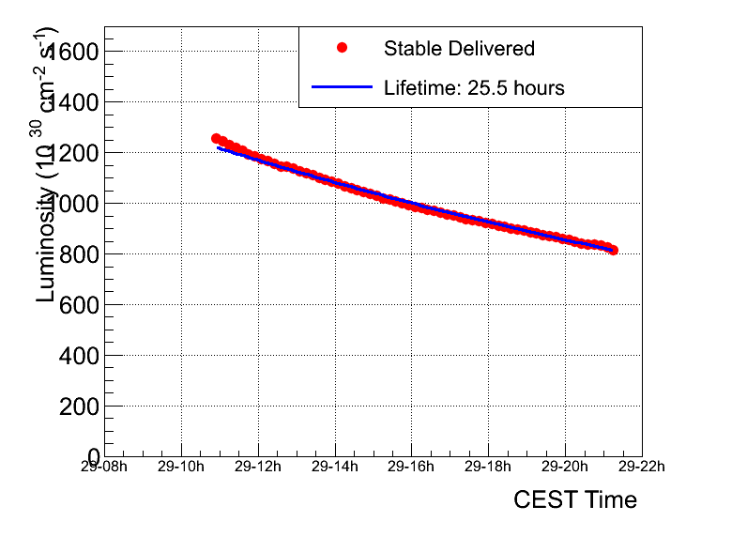
Lifetimes during a fill (1092 bunches)
Very good lifetime during the whole process
Hardly visible when we go in collision
Luminosity lifetime > 20 hours
c/o ATLAS

Slide 40
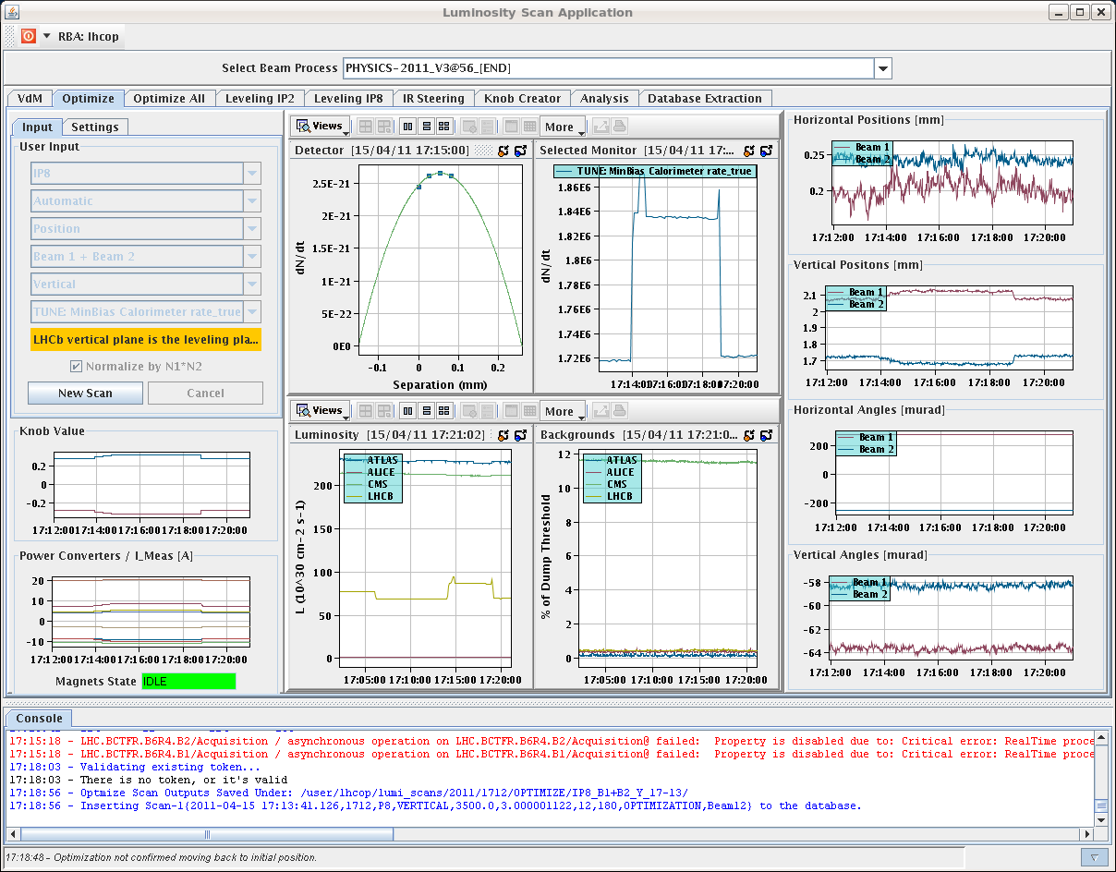
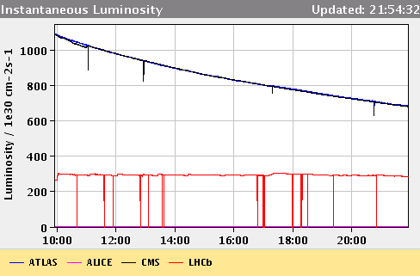
IP8 Luminosity leveling operational
Needed to get to 1 fb⁻¹ in LHCb given the limit in peak luminosity

Slide 41
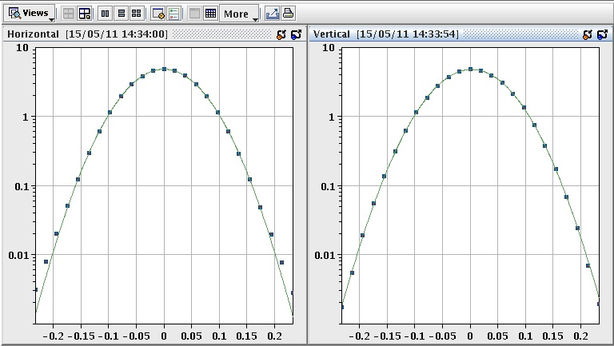
LHC precision front
absolute luminosity normalization
low, well understood backgrounds
precision optics for ATLAS-ALFA and TOTEM
VdM scan
IP1 H
IP1 V
precise measurement of the luminous region +
beam intensity --> absolute luminosity and
cross section calibration
currently ~ 5 % level,

Slide 42
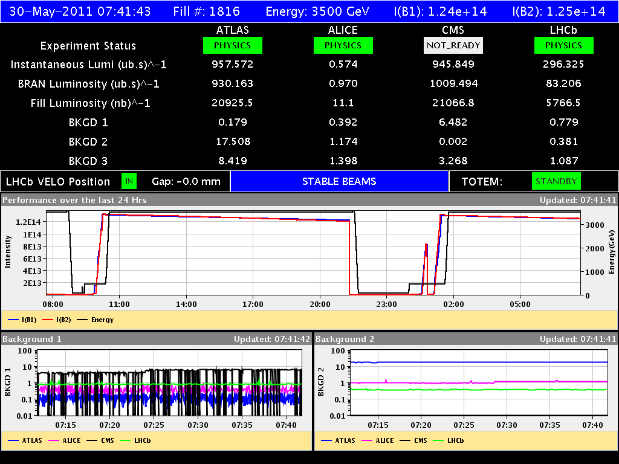
And we’ve been producing some luminosity
Back to back fills with 1092 bunches
Luminosity 1.2-1.3 x10³³cm⁻²s⁻¹

Slide 43
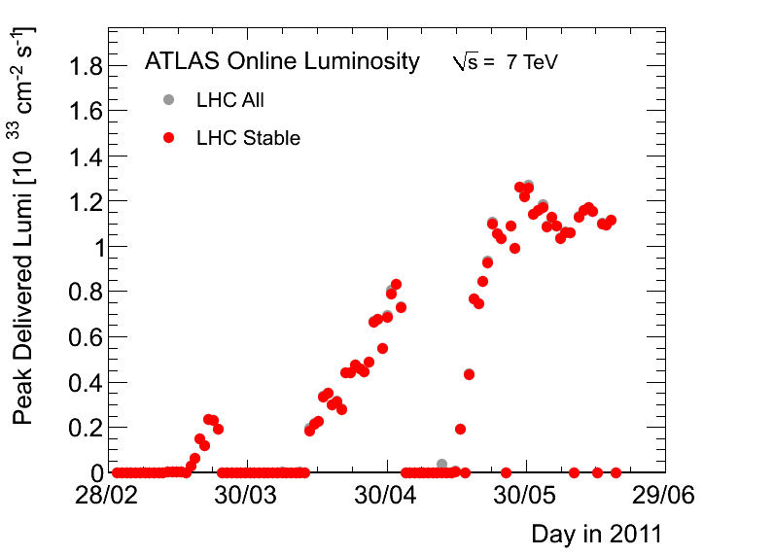
Peak Luminosity

Slide 44
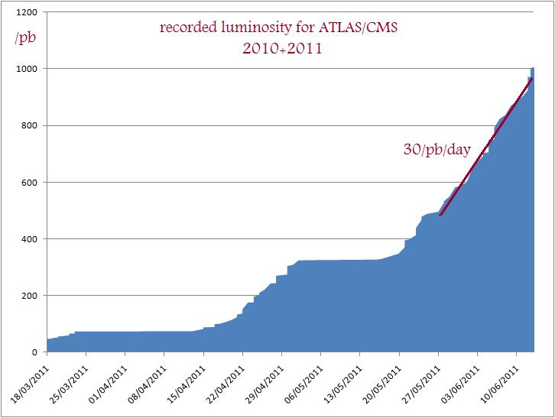

Slide 45
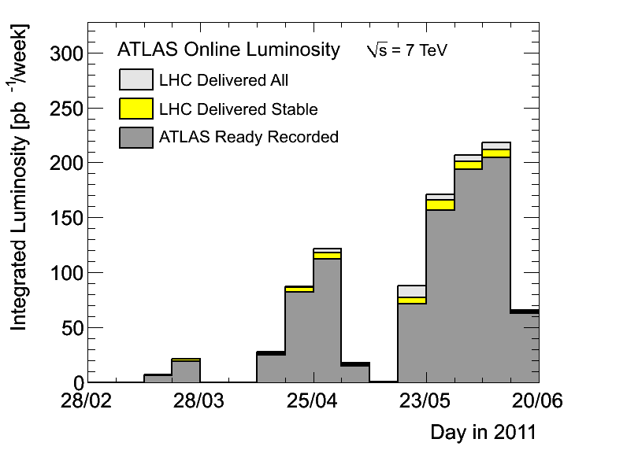
Weekly

Slide 46
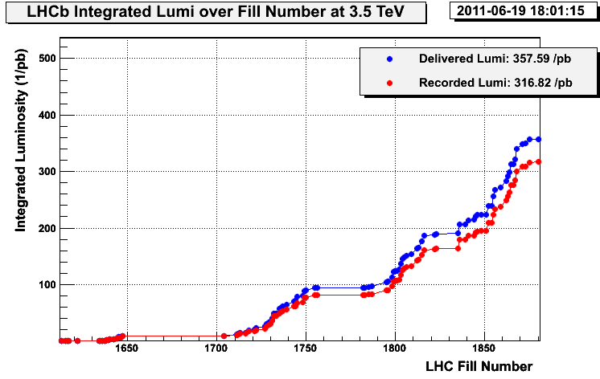
LHCb

Slide 47
Status
Integrated Luminosity to date (IR1-5/IR8) | 1.06 fb⁻¹/0.36 fb⁻¹
Peak Stable Luminosity Delivered | 1.26x10³³ cm⁻²s⁻¹
Maximum number of bunches at 450 GeV/c | 1308
Maximum number of bunches in collision | 1092
Maximum intensity in collision | 1.3x10¹⁴ p/beam
Maximum stored energy | 73 MJ/beam
Average bunch population | 1.2x10¹¹ p
Emittance in collision | ~2.5 μm
Maximum Luminosity Delivered in one day | 56 pb⁻¹
Maximum Luminosity Delivered in one week | 239 pb⁻¹

Slide 48
Week 23 – the week before last!
Date | Fill number | Time in stable beams | Int. lumi [pb⁻¹] | Cause of dump
Mon 6th | 1854 | 9m | .59 | trip of RQ6.L2
Mon-Tues | 1855 | 14h21m | 41.3 | RTQX2.R1 - FGC
Tue-Wed | 1856 | 10h50m | 31.0 | Alice dipole trip
Wed | 1858 | 0 |  | Big UFO IP2
Wed-Thu | 1859 | 3h56m | 13.4 | Electrical glitch
Thu | 1862 | 11h12m | 32.4 | Trip RSQSX 400 V PS
Thu - Sat | 1863 | 9h43 | 30.8 | PLC DFB-cryo MS L1
Sat - Sun | 1864 | 6h48 | 23.1 | D2.L1 bus bar quench
Sun - Mon | 1865 | 13h36m | 42.6 | Collimator controls
Mon | 1866 | 20m | 1.3 | RF Total Voltage Intlk B1
Mon 14th | 1867 | 8h14m | 28.8 | RF module trip

Slide 49
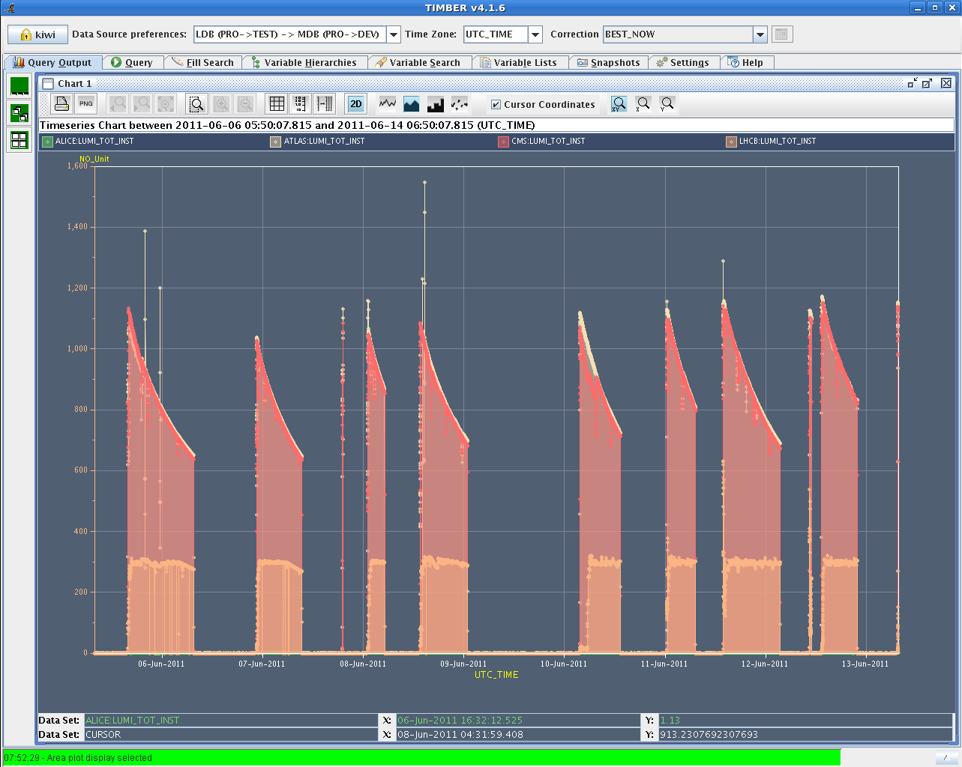
Week 23

Slide 50
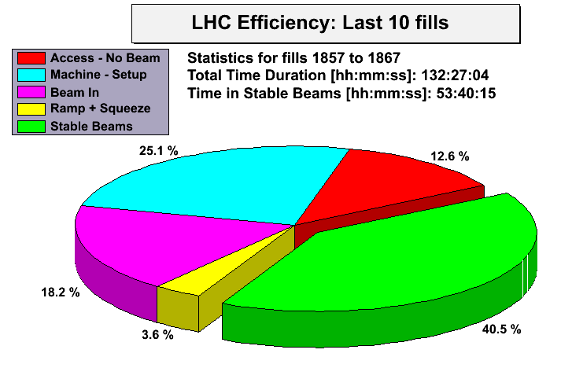
Week 23

Slide 51
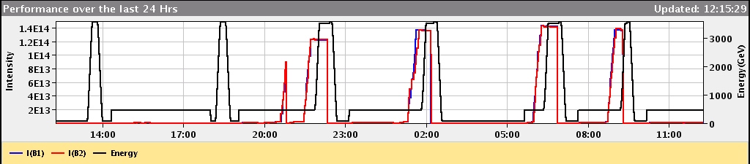
It is not always easy! A day in June.
Injection preparation for 144b
Collimator temperature
QPS noise → quench
Cryo S56
Cryo S34
UFO IR2
RF arc
And let’s not mention last week.

Slide 52
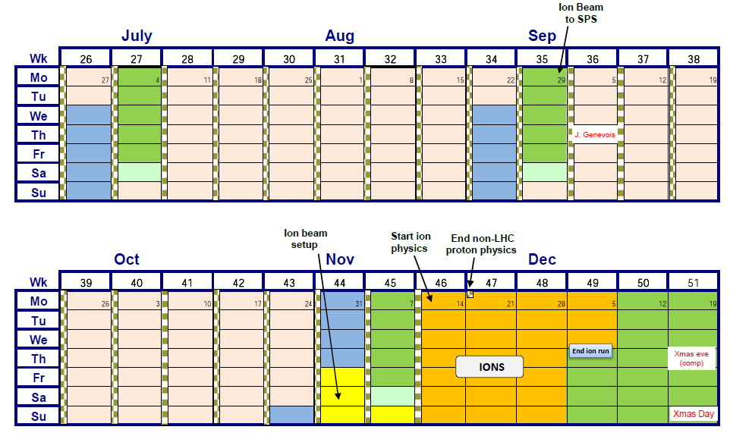
Outlook for 2011 (protons)
110 more days at >10³³ cm⁻²s⁻¹ and an efficiency for physics (Hubner factor) of 0.2 gives another 2 to 3 fb⁻¹
Main known unknowns: UFOs and SEU
25 ns studies to come during MDs (to sort out injection and beam stability issues) and possibly an operational development period to validate scrubbing and future operation

Slide 53
Outlook for 2011 (Pb)
Number of bunches vs. bunch population
  Possibility to reach 540 bunches but likely limited to nominal bunch population
Optics
  Take over ATLAS and CMS β* from protons
  Squeeze ALICE to same value β*= 1.5 m - 2 days setup
Could reach peak luminosities in the range of 1 to 1.4×10²⁶ cm⁻²s⁻¹ and integrate 30 to 50 μb⁻¹
Short run more sensitive to any prolonged machine problems

Slide 54
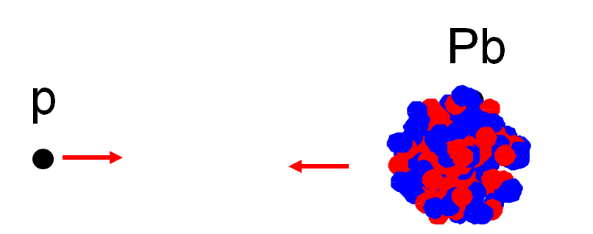
Testing p-Pb in 2011
Important to resolve uncertainties regarding feasibility, Pb intensity limit from unequal revolution frequencies at injection, ramp
  Modulation of long-range beam-beam, transverse feedback, tune-control …
Crucial questions are related to injection and ramping
  Effects of protons (say 10% of nominal) on one Pb bunch
  Inject few Pb bunches against some convenient p filling scheme
  Possible in 2011 (OK in 2012)
  Detailed planning of MD being worked out

Slide 55
2012
Physics data-taking until end of 2012
Following measurements of the copper stabilizers resistances during the Christmas stop, we will re-evaluate the maximum energy for 2012 (Chamonix 2012)
Baseline is probably 50 ns
  Better emittances from injectors with potential to push lower, better performance for a given total beam intensity
  Possible to push up bunch intensity
  But first see what 25 ns brings…
Given up making predictions of integrated luminosity!

Slide 56
Conclusions
The LHC is a beautiful machine (although some times temperamental) – a real testament to those that built it.
High intensity was known to require more careful control of the machine parameters and to potentially bring a host of other issues into play
  Work very much in progress
50 ns has proven to be a good choice - more potential
> 1 fb-1 delivered to ATLAS and CMS
~0.36 fb-1 delivered to LHCb
How much higher in peak luminosity we can go for ATLAS and CMS will depend on extent of UFOs, SEUs etc.
  Aiming for 1380 bunches…

