Slide 1

2nd International Conference on Particle Physics
in Memoriam Engin Arık and Her Colleagues
Doğuş University, İstanbul, Turkey
20 - 25 June 2011
Phenomenological study of
Fragmentation Functions in
Hadronization processes
Maryam Soleymaninia
With Collaboration
Ali Khorramian
Mohamad Musavinejad
Semnan University, Semnan,Iran
and
School of Particles and Accelerators, Institute for Studies in
Theoretical Physics and Mathematics (IPM),Tehran,Iran

Slide 2
Outline
1- Motivation
2- Take electron positron annihilation into hadrons
3- Hadronization
4- Fragmentation Functions
5- QCD Framework
6- Results and conclusion
M. Soleymaninia (IPM & Semnan university) ICPP 2011

Slide 3
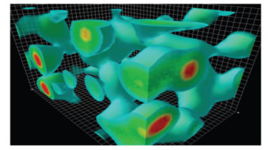


Motivation: Understand the hadronization process
Hadrons
Quark
Quarks and gluons produced in a short distance process
from themselves into hadrons.
M. Soleymaninia (IPM & Semnan university) ICPP 2011

Slide 4
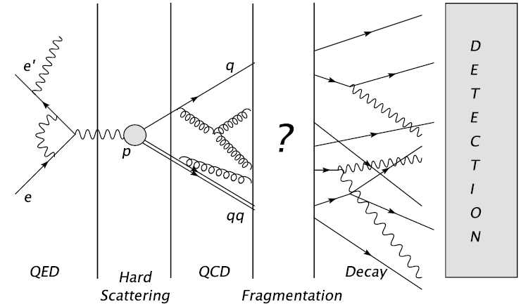
Motivation: Fragmentation functions’s role in Hadronization
We learn hadronization by fragmentation.
M. Soleymaninia (IPM & Semnan university) ICPP 2011

Slide 5
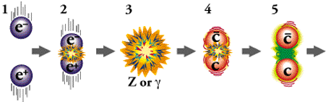
Take electron positron annihilation into hadrons
Frame 1: The electron and positron zoom towards their certain doom.
Frame 2: They collide and annihilate, releasing tremendous amounts of energy.
Frame 3: The electron and positron have annihilated into a photon, or a Z particle, both of which may be virtual force carrier particles.
Frame 4: A charm quark and a charm anti quark emerge from the virtual force carrier particle.
Frame 5: They begin moving apart, stretching the color force field (gluon field) between them.
M. Soleymaninia (IPM & Semnan university) ICPP 2011

Slide 6
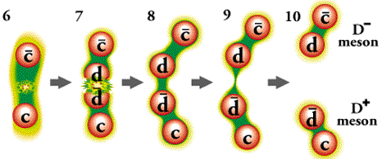
Take electron positron annihilation into hadrons
Frame 6: The quarks move apart, further spreading their force field.
Frame 7: The energy in the force field increases with the separation between the quarks. When there is sufficient energy in the force field, the energy is converted into a quark and an anti-quark (
Frames 8-10: The quarks separate into distinct, color-neutral
particles: the D+ (a charm and anti-down quark) and D- (an anti-charm and down quark) mesons.
M. Soleymaninia (IPM & Semnan university) ICPP 2011

Slide 7
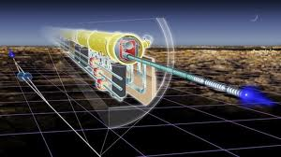
Experimental events
collisions between electrons and positrons are much simpler to analyze than collisions in which the energy is distributed among the constituent quarks, antiquarks and gluons of baryonic particles
measurements could be made more
accurately at the ILC.
Electron positron events clean,
interesting final-state particles only.
In electron-positron collision leptons
annihilate completely.
In fact, energies at the LEP were limited to
209GeV by energy loss via synchrotron radiation.
One of the roles of the ILC would be making precision measurements of the properties of particles discovered at the LHC.
M. Soleymaninia (IPM & Semnan university) ICPP 2011

Slide 8
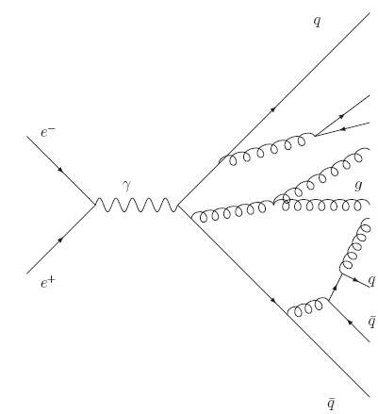
Parton shower in
e+ e−
Experimentally the original quark and antiquark can not be
directly detected.
What is detected is multitude of outgoing hadrons whose
energies sum to give Q.
e⁻
By examining and studing these outgoing hadrons we learn
about the quark and antiquark that initiated the process.
Z⁰/γ
Hadrons
e⁺
M. Soleymaninia (IPM & Semnan university) ICPP 2011

Slide 9
Electron positron event generator
jet
Jet
e⁻
Z⁰/γ
colorless states - hadrons
e⁺
Fragmentation process
outgoing parton
jet
Hard scatter
The hadrons in a jet have small transverse momentum relative to the parent parton’s direction and the sum of their longitudinal momenta is roughly the parent parton momentum
Jets are the experimental signatures of quarks and gluons and manifest themselves as localized clusters of energy
Fragmentation function: probability that a parton at a short distance 1/Q fragments into a hadron with fraction z of the parent momentum x
M. Soleymaninia (IPM & Semnan university) ICPP 2011

Slide 10
Hadronization
FFs
σ Hard
Scattering
Hadronization
PDFs
M. Soleymaninia (IPM & Semnan university) ICPP 2011

Slide 11
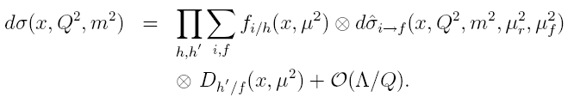


Formalism
Hadronization can be described in terms of hard scattering cross sections
and non-perturbative but universal functions.
For single-inclusive hadron production processes:
The cross section can be decomposed into convolutions of two parts.
Perturbatively calculable partonic hard-scattering cross sections.
Certain combinations of nonperturbative parton distribution and fragmentation functions.
M. Hirai, S. Kumano, arXiv:1008.3814v1 [hep-ph] 23 Aug 2010
M. Soleymaninia (IPM & Semnan university) ICPP 2011

Slide 12


Formalism
Right side: total cross section
αs: running coupling constant
z = 2 EH/Q, with Q/2 = beam energy
Cijs: Coefficient functions:
probability of creating a parton i with momentum fraction x of beam energy µ (0 for gluons at lowest order)
M. Hirai, S. Kumano, T.-H. Nagai, K. Sudoh; Phys. Rev. D 75, 114010 (2007)
D. de Florian, R. Sassot, M. Stratmann; Phys. Rev. D 75, 114010 (2007)
M. Soleymaninia (IPM & Semnan university) ICPP 2011

Slide 13



Subprocesses and coeficient functions
The cross section of inclusive pion production in annihilation
To NLO in the modified minimal subtraction scheme, the cross sections
of the relevant subprocesses are given by
B. A. Kniehl, G. Kramer and B. Potter, Nucl. Phys B 582-514 (2000)
J. Binnewies, B. A. Kniehl and G. Kramer, Phys. Rev. D, 4947 (1995)
M. Soleymaninia (IPM & Semnan university) ICPP 2011

Slide 14



S.~Kretzer,
S.~Kretzer,
S.~Kretzer,
Parametrization
The fragmentation functions are expressed in term of a number of parameters at initial
scale in the same way as the PDF analysis.
A simple polynomial form is taken:
Use fragmentation function at different cms energies Evolution with increasing energy scale: DGLAP Evolution equation
Splitting functions: control the rate of change of parton distribution probability. Pij is the probability of finding a Particle B from a particle A with a fraction z of the longitudinal parent momentum.
S. Kretzer, Phys. Rev. D 62, 054001 (2000).
Ali N. Khorramian, S. Atashbar Tehrani, S. Taheri Monfared, F. Arbabifar, F. I. Olness , Phys. Rev. D 83, 054017 (2011),
arXiv:1011.4873 [hep-ph]
Ali N. Khorramian, H. Khanpour, S. Atashbar Tehrani, Phys. Rev. D 81, 014013 (2010)
M. Soleymaninia (IPM & Semnan university) ICPP 2011

Slide 15



Pion Parametrization
Considering the constituent quark composition , we take the same favored fragmentation
functions for from quarks:
The pion productions from and are disfavored processes, and they are considered
The same at the initial scale:
A fragmentation function from gluon is given by
M. Soleymaninia (IPM & Semnan university) ICPP 2011

Slide 16
Different values for initial scale
Different functions are assigned for productions from heavy quarks because
of mass differences:
We use three different values for
For u,d,s&g
For c
For b
M. Soleymaninia (IPM & Semnan university) ICPP 2011

Slide 17

Theresholds
Thresholds for heavy quarks are in calculating
evolutions and the running coupling constant.
The thresholds for the cross section are taken
M. Hirai, S. Kumano, T.-H. Nagai, K. Sudoh; Phys. Rev. D 75, 114010 (2007)
S. Kretzer, Phys. Rev. D 62, 054001 (2000).
M. Soleymaninia (IPM & Semnan university) ICPP 2011

Slide 18
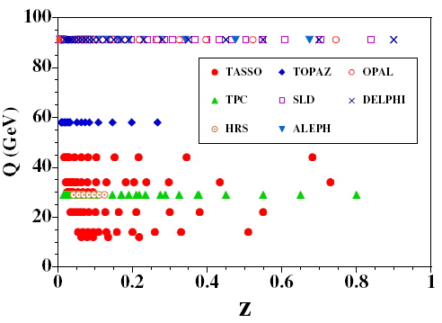
Experimental data range
FIG. 1 Kinematical range is shown by z and Q values for pion data.
M. Soleymaninia (IPM & Semnan university) ICPP 2011

Slide 19
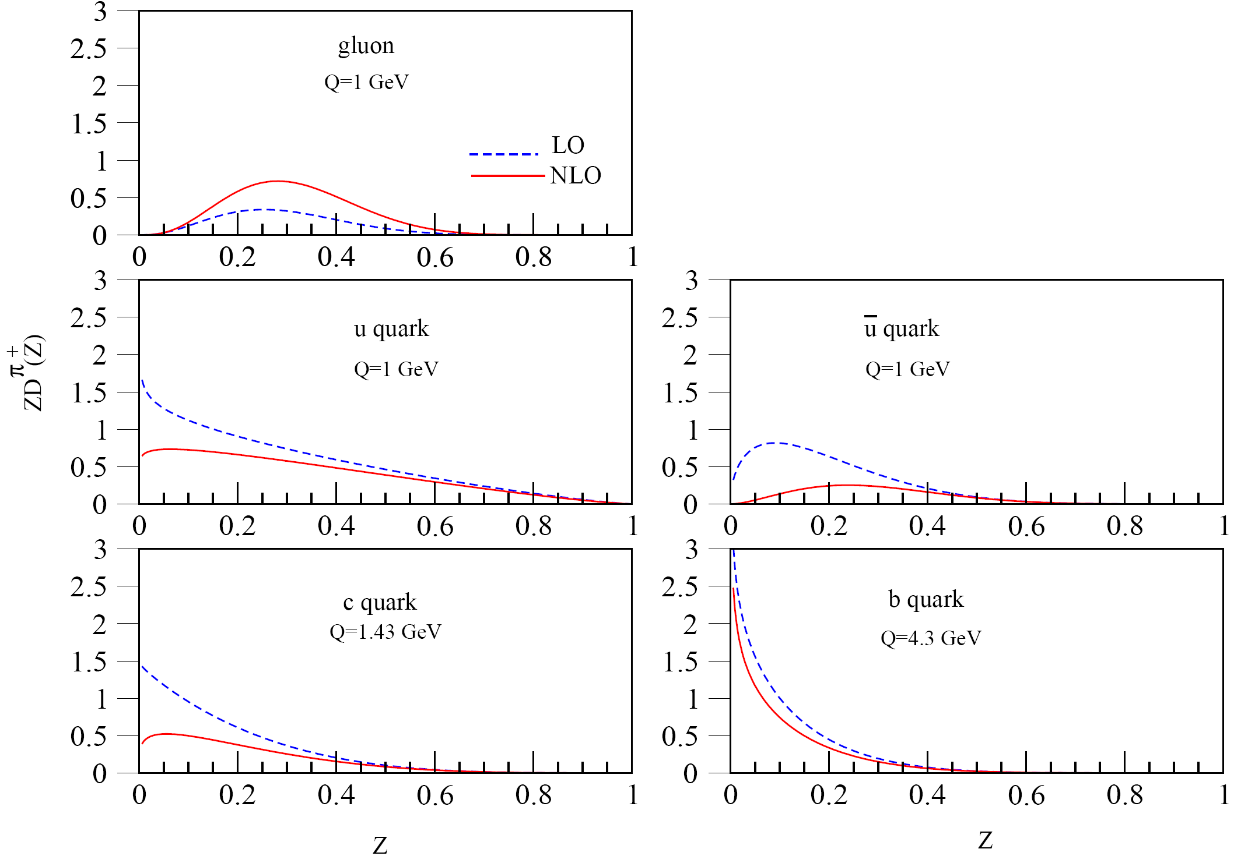
QCD fit results
FIG. 2 Fragmentation functions for pion at initial scales.
M. Soleymaninia (IPM & Semnan university) ICPP 2011

Slide 20
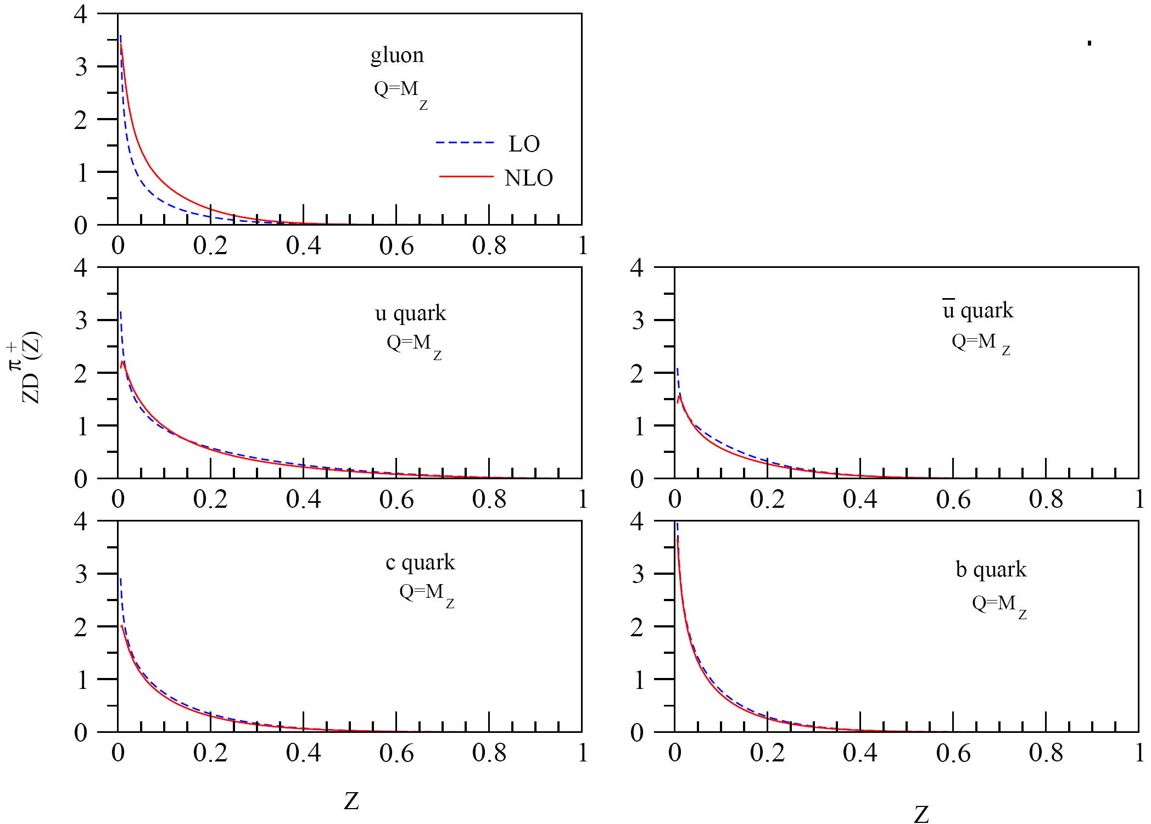
QCD fit results
FIG. 3 Fragmentation functions for pion at .
M. Soleymaninia (IPM & Semnan university) ICPP 2011

Slide 21
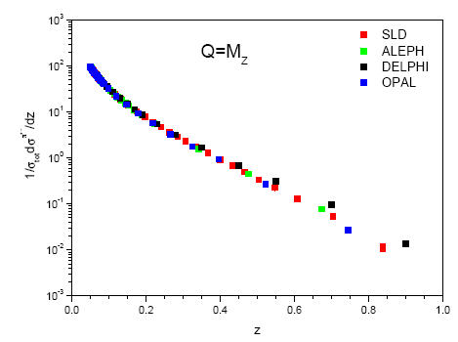
Experimental data
FIG 5. pion production data.
M. Soleymaninia (IPM & Semnan university) ICPP 2011

Slide 22
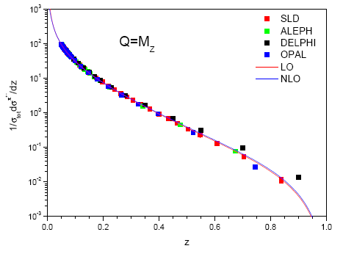
Fit results
FIG 5. Compression of our LO and NLO results with pion production data.
M. Soleymaninia (IPM & Semnan university) ICPP 2011

Slide 23
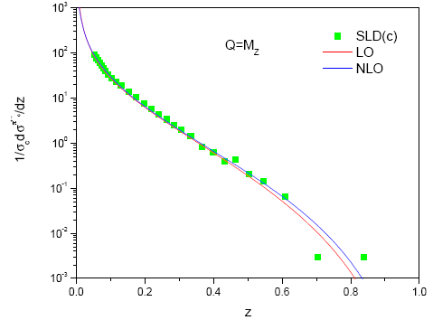
Fit results
FIG 5. Compression of our LO and NLO results with c quark pion production data.
M. Soleymaninia (IPM & Semnan university) ICPP 2011

Slide 24
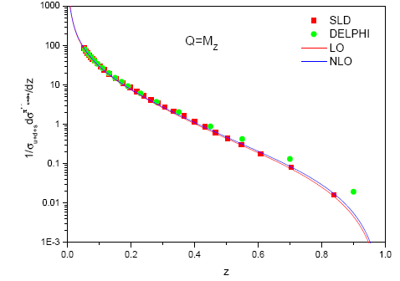
Fit results
FIG 5. Compression of our LO and NLO results with light quarks pion production data.
M. Soleymaninia (IPM & Semnan university) ICPP 2011

Slide 25
Summary
Overview of understanding of how quarks become hadrons.
Why electron-positron annihilation as a hadronization processes is
better than the other hadronizations.
Fragmentation model is used in high energy reaction processes with hadron production.
Like the PDFs also the FFs are universal in the sense that they are process independent.
M. Soleymaninia (IPM & Semnan university) ICPP 2011

Slide 26

Thanks for your paying attention

