Slide 1

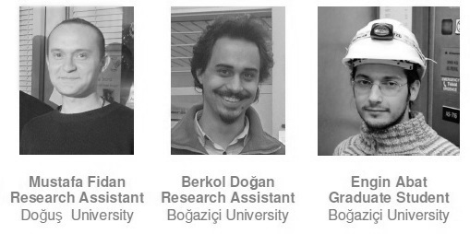



2nd International Conference on Particle Physics in Memoriam Engin Arık and Her Colleagues Doğuş University, İstanbul, Turkey 20 - 25 June 2011
Collective behavior of partons could be a source of energetic hadrons
Dr.Sc. Mais Suleymanov

Slide 2
Outline
Definition
2. Collective behavior at relativistic hadron-nuclear interactions
2.1 JINR Cumulative effect
2.2 CERN EMC effect
Collective behavior at ultrarelativistic heavy ion collisions
3.1 Scaling behavior of v₂ at RHIC energies
3.2 Scaling behavior of v₂ at LHC energies
4. A source of energetic cosmic rays

Slide 3
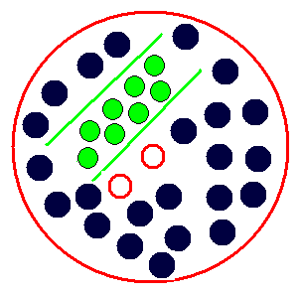
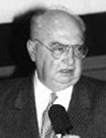
Definition: energetic /cumulative hadrons – hadrons which are formed as a result of the hadronization of parton/partons which could get the energy of collective partons in the high density/temperature system.
collective hadrons /partons
energetic/cumulative hadrons/partons
Academician Baldin A.M.
JINR Dubna

Slide 4
Collective behavior at relativistic hadron-nuclear interactions
JINR Cumulative effect - Baldin’s prediction
cumulative hadron
Limiting fragmentation of nuclei
A.M. Baldin et al. Sov.J. Nucl.Phys.18,41 (1973); A.M. Baldin. Journal of PEPAN, v.8 (1977), p.429- 477
A.M
V.S . Stavinski. Journal of PEPAN, v.10 (1979), p.949-995
The energy dependence E for the invariant cross
section σ of protons (with momentum in the range
0.4-1.0 GeV/c and with angles: 160⁰-164⁰ in
lab system) produced on different targets by pions
and protons (blacked points). The σ_{in} is total cross
section for inelastic πp and pp interactions.

Slide 5

Cumulative processes : production the particles with energies behind the kinematic limit of free nucleon collisions at relativistic energies. Ones could be produced on the system of collected (groped) nucleons.
inverse of slope
≅ 0.15
π¹²C at 40 GeV/c
pA at 8.9 GeV
The effect as a result of
nucleon collective phenomena
M.I. Stricman, L.L. Francfurt PEPAN, v.11, p.571 (1980);
A.V. Efremov PEPAN, v.13, p.613 (1982).

Slide 6
Coherent Tube Model" (CTM) [G. Berlad, A. Dar, and G. Eilam, Phys. Rev. D 13, 161 (1976);Y. Afek, G. Berlad, G. Eilam, and A. Dar, Technion Report No. PH-76-12] the interaction of a hadron with a target nucleus results from its simultaneous collision with the tube of nucleons of cross section σ that lie along its path in the target nucleus
cumulative square of the center-of-mass energy, ~ s_{i} ≅ 2imp _{lab}
i – a number of nucleons ;m - the nucleon mass; p _{lab} - lab. momentum of the incident hadron.
p _{lab}
Y. Afek, t G. Berlad, and G. Eilam and A. Darf. PHYS. REV. LET. 37, 14(1976)
pp.947-951.Cumulative Enhancement of J/Ψ Production in Hadron-Nucleus Collisions.
Inclusive J/Ψ production from nuclear targets for particles produced in hA collisions at incident energies below 30 GeV; Cumulative effects (via energy rescaling) led to an A dependence of the cross section for p+ A - J/Ψ+X that was much stronger than the commonly assumed A or A^{2/3} dependence of this cross section.
In this model /Afek et al. , 1978/ , a substitution has been proposed replacing interaction of n₁ nucleons of the incident nucleus with n₂ nucleons of the target nucleus belonging to “colliding tubes” by interaction of two fictious “nucleons” with the momentum n₁p₁ and n₂p₂ , respectively. Then the corresponding relativistic invariant
S=(n₁p₁+n₂p₂)²
i.e. the interaction proceeds in such a way as if the energies were higher but number of “interaction centers” is reduced.

Slide 7
CERN EMC-effect
European Muon Collaboration (CERN) : deep-inelastic muon-nucleus scattering [J.J. Aubert et al., Phys. Lett. 123B, 275 (1983) ] - the structure function F₂ and hence the quark and gluon distributions of a nucleon bound in a nucleus differ from those of a free nucleon.
The ratios of structure functions for different nuclei [A. V. Efremov, Phys. Lett. 174B, 219-223 (1986)] - none of the popular models suggested to explain the EMC effect seems satisfactory and presents a new point of view on the effect as a simple relativistic phenomenon.

Slide 8
Collective behavior at ultrarelativistic heavy ion collisions
Scaling behavior of v₂ at ultrarelativistic energies
azimuthal anisotropy at RHIC, LHC show a collective behavior, which is likely to be formed at an early, parton, stage of the spacetime evolution of product hot and dense matter [. V. A. Okorokov. Physics of Atomic Nuclei, 2009, Vol. 72, No. 1, pp. 147–160.; J.Adamset al., Phys.Rev.Lett. 95, 122301 (2005);A.Adareet al., Phys.Rev.Lett. 98, 162301 (2007)].
anisotropy indicate that matter under extreme conditions behaves as a nearly ideal liquid rather than an ideal gas of quarks and gluons.

Slide 9
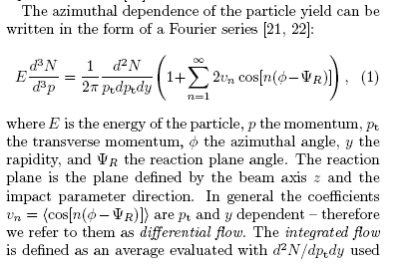
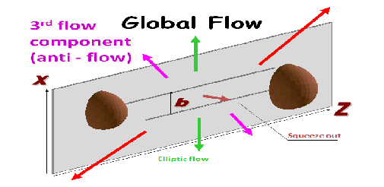

K. Aamodt et al. arXiv: 1011.3914v1 [nucl-ex] 17 Nov 2010
The azimuthal dependence of the particle yield (in the form of Fourier series)
[S. Voloshin and Y. Zhang, Z. Phys. C 70 (1996) 665; A. M. Poskanzer and S. A. Voloshin Phys. Rev. C 58 (1998) 1671]
E- energy; p-momentum ;p_{t}-transverse momentum; ϕ - azimuthal angle; y-rapidity; ψ_{R} –reaction plane angle . The reaction plane – the plane defined by the beam axis z and the impact parameter b direction.
in general the coefficients v_{n}=<cos[n(ϕ-ΨR)]> are p_{t} and y dependent - differential flow. The integrated flow - an average evalution with d²N/dp_{t}dy used as a weight. v₁ – direct flow ( is zero at midrapidity due to the symmetry of the collision); v₂ – elliptic flow
Directed
Transverse
flow
Laszlo Csernai : Multi module modelling of heavy ion collisions Collective flow and QGP properties a RIKEN-BNL workshop November 17-19, 2003

Slide 10
scaling behavior of v₂ [J.Adamset al., Phys.Rev.Lett. 95, 122301 (2005); A.Adareet al., Phys.Rev.Lett. 98, 162301 (2007)] gives possibility to assume that the collective behavior of the partons defines the dynamic of the expansion in the longitudinal plane namely; evolution of the collective flow occurs on the parton state namely.
pA 8.9 GeV
number of quark (n_{q}) scaled v₂ as a function of scaled p_{T} for Ξ⁻+bar Ξ⁺ (filled circles) and Ω⁻ +bar Ω⁺ (filled squares). Same distributions also shown for π⁺+π⁻ (open diamonds), p+bar p (open triangles) [S. S. Adler et al. (PHENIX Collaboration), Phys. Rev. Lett. 91, 182301 (2003)], K₀^{S} (open circles), Λ+barΛ (open squares) [J. Adams et al. (STAR Collaboration), Phys. Rev. Lett. 92, 05230 (2004)]. All data are from 200 GeV Au+Au minimum bias collisions. The dot-dashed-line is the scaled result of the fit to K₀^{S} and Λ [X. Dong, S. Esumi, P. Sorensen, N. Xu , Z. Xu, Phys. Lett. B597, 328 (2004)].

Slide 11
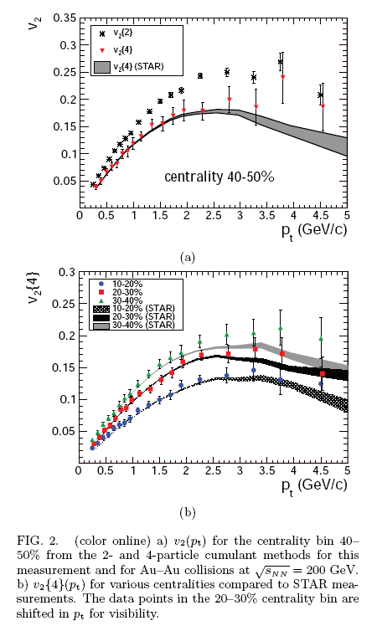
K. Aamodt et al. arXiv:1011.3914v1 [nucl-ex] 17 Nov 2010
The first measurement of elliptic flow of charged particles in Pb-Pb collisions at the center of mass energy per nucleon pair ,with the ALICE detector
V₂ (p_{t}) for the central bin 40-50% from the 2- and 4-particle cumulant methods for the measurement and for the Au-Au collisions (STAR RHIC) at
v₂(p_{t}) does not change within uncertainties from
200 GeV to
2.76 TeV

Slide 12
main
relativistic&ultrararelativistic hadron-nuclear and nucleaer-nuclear interactions show the collective behavior which is likely to be formed at an early, parton, stage of the spacetime evolution of product hot and dense matter;
through the coherent interaction of the grouped partons the energetic hadrons could be produced and their energies could be limited by values of the total energy of the collected partons system only;
the hadrons could be a signal
for the extreme states of the
strongly interacting matter /QGP
S_{i} = 2imp

Slide 13
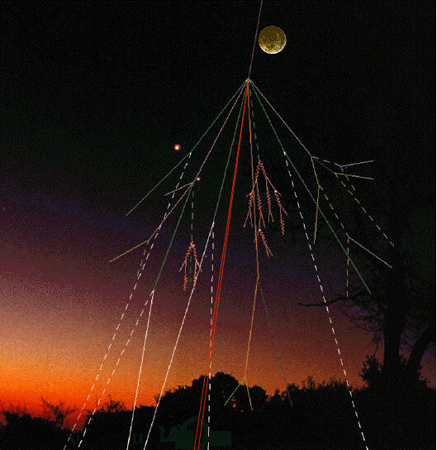
A source of energetic cosmic rays
cosmic rays are a main component of the Universe ; they could solve an important information on appearance and evaluation of the Universe
a course of cosmic rays with super high energies (10¹⁵eV) stays unknown [V.L. Ginzburg "The origin of cosmic rays (Forty years later)“ Phys. Usp. 36 (7) 587–591 (1993) ] , even whether galactic or extragalactic origin of the super cosmic rays is not clean steel
the flux of cosmic ray particles as a function of their energy. The flux for the lowest energies (yellow zone) are mainly attributed to solar cosmic rays, intermediate energies (blue) to galactic cosmic rays, and highest energies (purple) to extragalactic cosmic rays [S. Swordy, The energy spectra and anisotropies of cosmic rays, 2001, Space Science Reviews 99, pp.85–94]

Slide 14
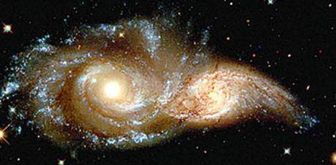
some massive stars could be sources of the super high energy cosmic rays
huge magnetic field generated by these stars could be a reason of acceleration of cosmic particles to super high energies [K.V. Ptitsina,S.V.Troitsky. Phys. Usp. 187 (7) 587–591 (2010)]
the generated energy of the magnetic field by the massive stars is not enough to get the energies great than 10¹⁵eV

Slide 15

the super high energy cosmic rays could be produced by the massive stars without any acceleration
high temperature and high density states of matter could be formed in the center of some massive starts (neutron stars) and the deconfinement (and parton structure) could appear there
the energetic parton (or partons) could be formed in the system as a results of the coherent interactions of grouped partons and to transform to super high energy cosmic particles
the maximum energy of cosmic particles might be limited only by the values of
the total energy of the system [Mais Suleymanov et al. PoS EPS-HEP2009:406,2009]

Slide 16
Summary
experimental results on relativistic and ultrarelativistic hadron – nucler and nuclear-nuclear collisions point out the collective behavior of the partons ;
energetic partons could be produced as a results of coherent interactions of the grouped quarks/partons;
in the center of some massive starts where the critical conditions for the deconfinement are reached the produced energetic partons could transform to super high energy cosmic rays

Slide 17
Thank You

