Slide 1
A multi-channel, multi-audience communications and outreach campaign
Ana Godinho (CERN Education, Communications and Outreach)
Partner meeting at EPPCN Autumn Meeting| 09.06.2022

Slide 2
Components of the campaign
Events
Products
Channels
Higgs symposium
Run3 first physics Live
Local public events
home.cern
CERN Bulletin
voisins.cern
CERN Courier
Visual identity kit
Videos and animations
home.cern Higgs portal
Education resources
Digital communication kits
Exhibition
Social media
Globe event
4 July 2022
5 July 2022
June - July
3 July 2022
Education programmes
Media relations
Media briefing
30 June 2022

Slide 3
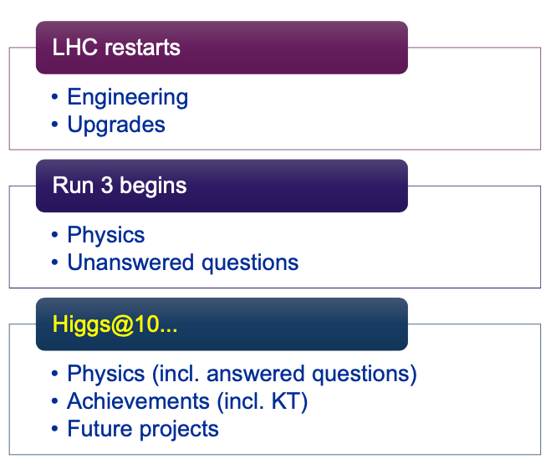
Media plan - built on 3 milestones
Celebration
10 years on
Preparing the future
(22 April)
Media update on 22 April including LS2 Backgrounders and LS2 video highlights (see back-up slides for media metrics)
30 June, 15:00 (CET):
Media briefing on both Higgs10 and Run 3, in person and webcast
Panel with DG, spokespersons of the four LHC experiments, Joachim Mnich (Director Research and Computing), Mike Lamont (Director Accelerators and Technology)
Media invitation sent out on 3 June. Already expressed an interest: BBC, Keystone-ATS (Swiss press agency), The Economist
Press release will be shared with journalists in advance, under embargo for 4 July. Text undergoing final approval by DG, then will circulate to partners.
4 July, a.m.
Press release on Higgs10 + media update on Run3
Media update text going through approvals, then will circulate to partners.
Also: Nature special issue on Higgs with media update.
5 July, p.m.
Media update on the restart - has happened!
Include a VNR from the Run3 live event.
(5 July)
(4 July)

Slide 4

Social Media - three campaigns
Celebration
10 years on
Preparing the future
The goal is to build interest towards the tenth anniversary of the discovery of the Higgs boson.
How:
  Promote the events around the three milestones to our key audiences
  Engage our community in positive conversations tailored to each campaign
Hashtags to aggregate campaign content
Can be combined and used with other topic-specific hashtags
Partners are invited to use these hashtags in their posts
LHC restarts (see back-up slides for metrics)
Run 3 begins
10th anniversary of the Higgs discovery
Engineering
Upgrades
Physics programme at CERN
Physics (incl. answered questions)
Bulletin
Courier
#restartingLHC
#LHCRun3 #Higgs10
3 video announcing the LIVE
Symposium
#LHCRun3
Quiz on Twitter and IG
Final upgrades
home.cern Quick facts
Notes:
Key messages:
A reminder of what we have planned for the semester
We have fully planned the three campaigns, but left some flexibility to welcome content suggestions
At the end of each campaign, we thought to do a quiz, could be an opportunity for partnership

Slide 5
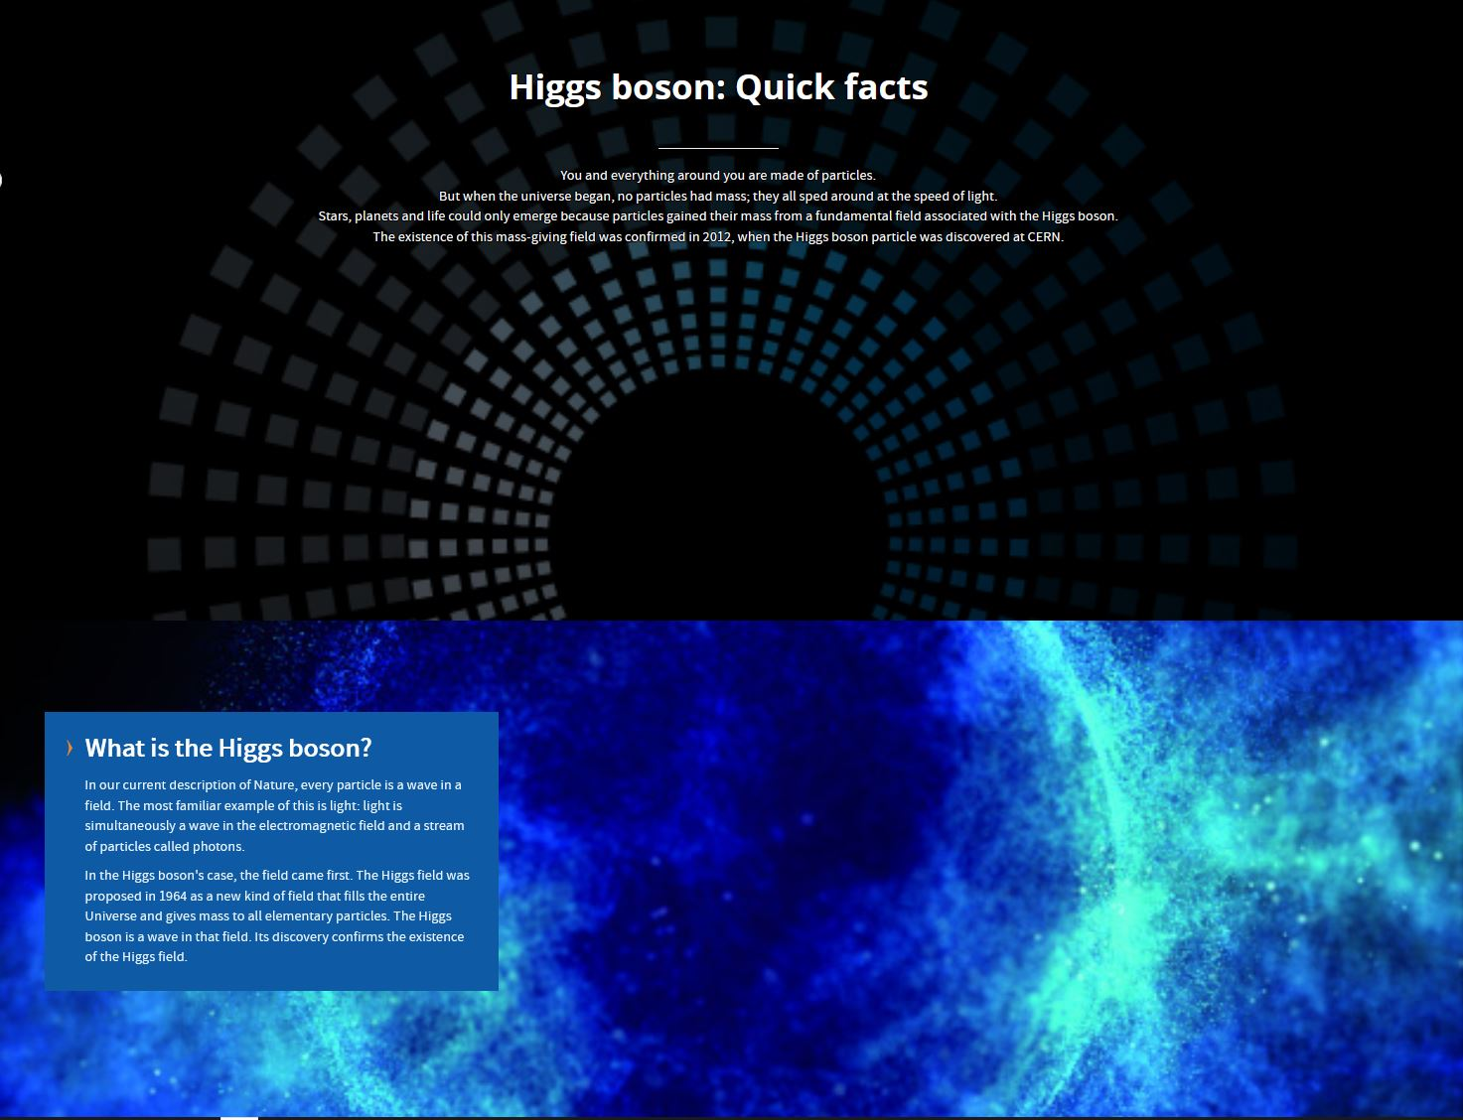
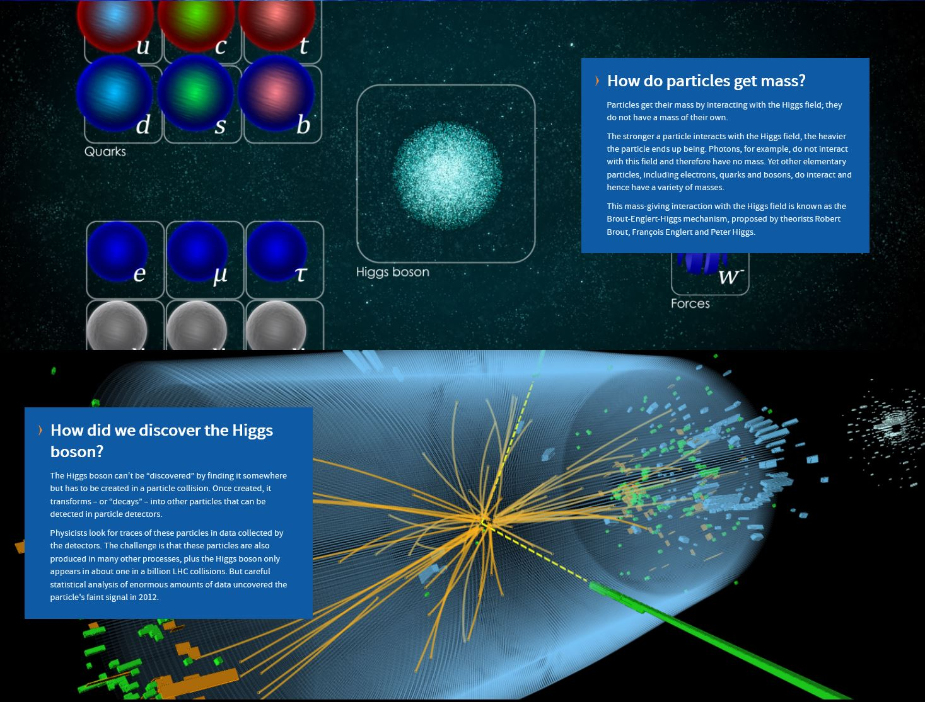
Higgs@10 content on home.cern
Celebration
10 years on
Preparing the future
Seven quick facts planned:
What is the Higgs boson? [ready to share with partners]
How do particles get mass? [ready to share with partners]
How did we discover the Higgs boson?
How did we know it was the Higgs?
What have we learned in the last 10 years?
What are we going to look for next?
How does the Higgs boson impact everyday life?
DRAFT
DRAFT

Slide 6
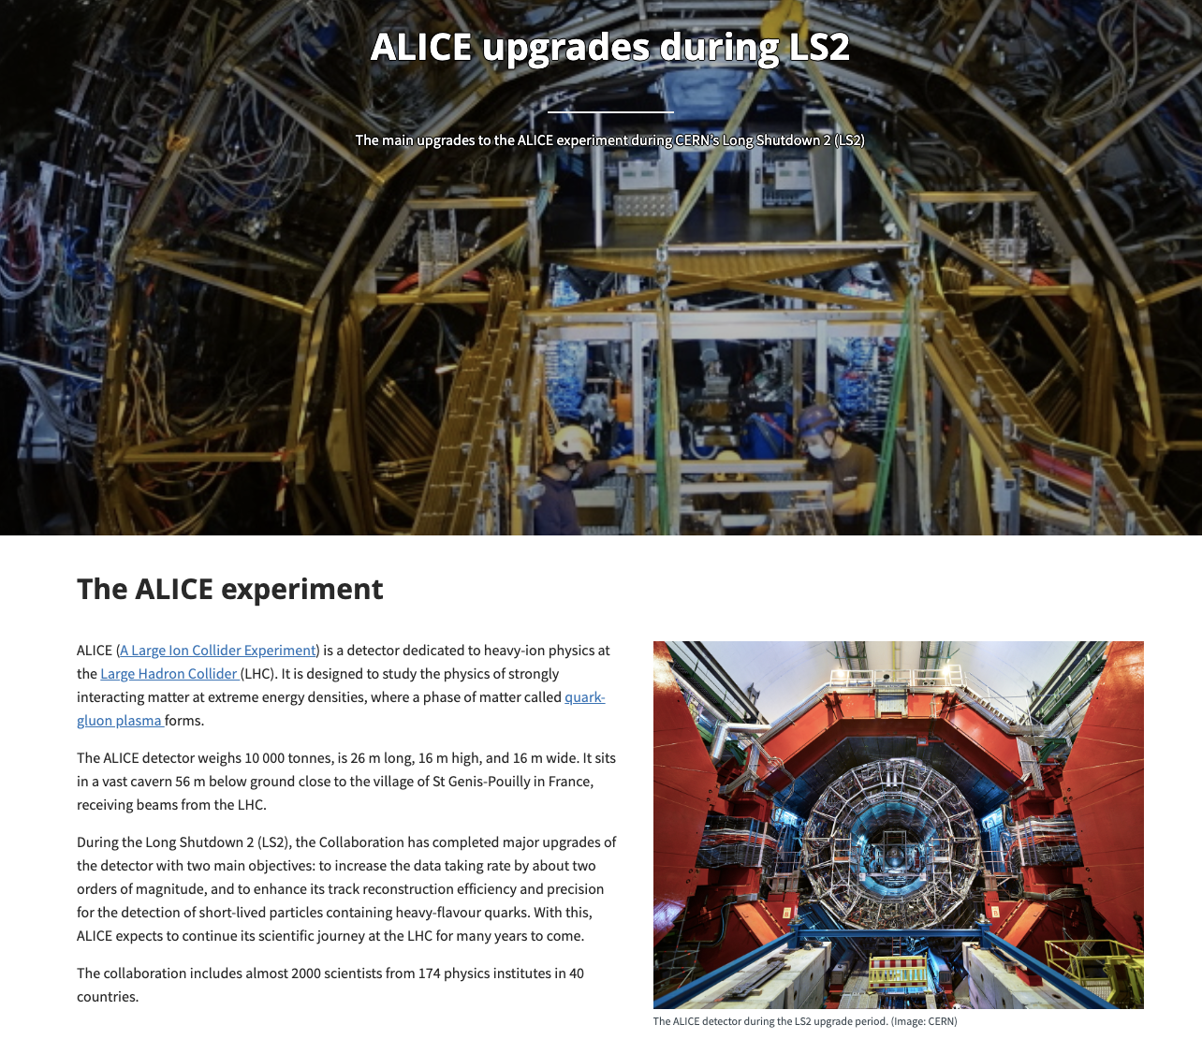
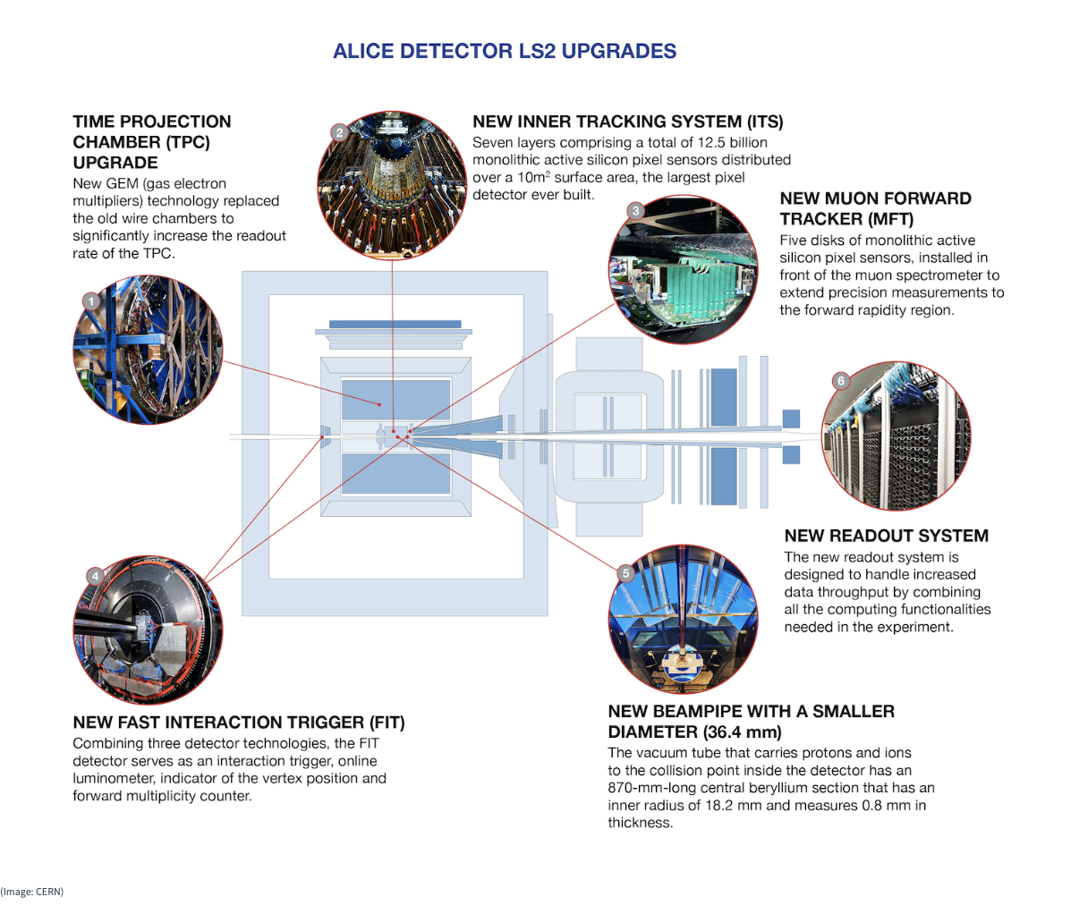
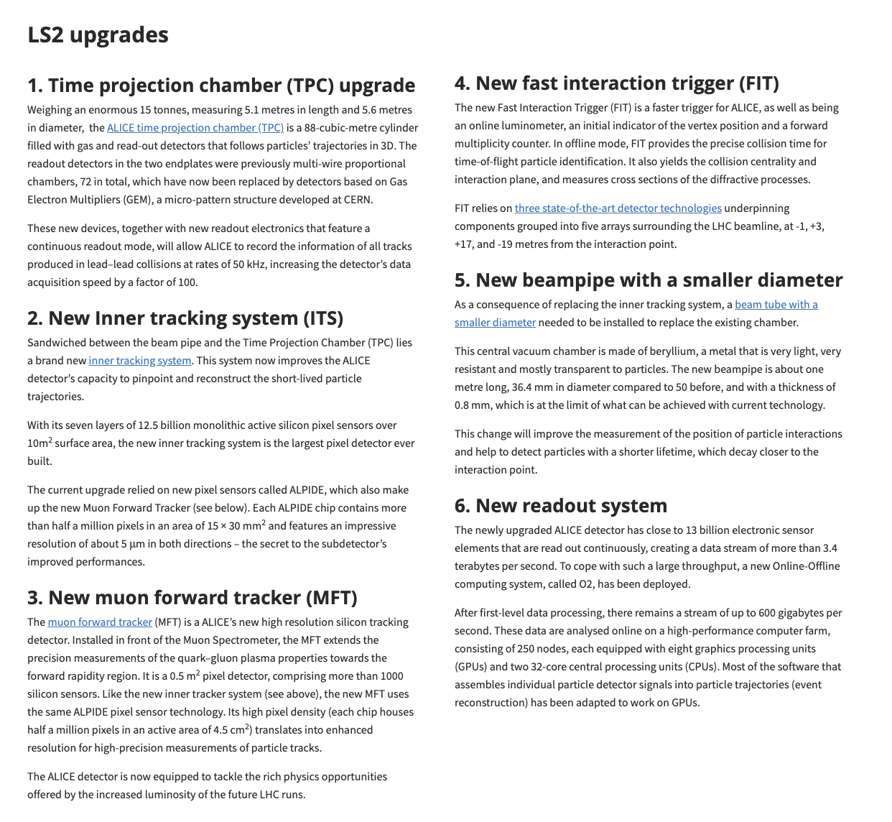
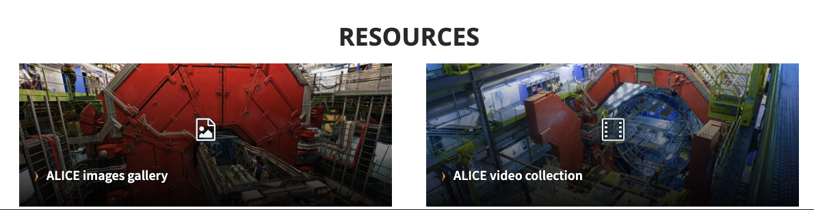
Online media kits - #RestartingLHC example
Celebration
10 years on
Preparing the future

Slide 7
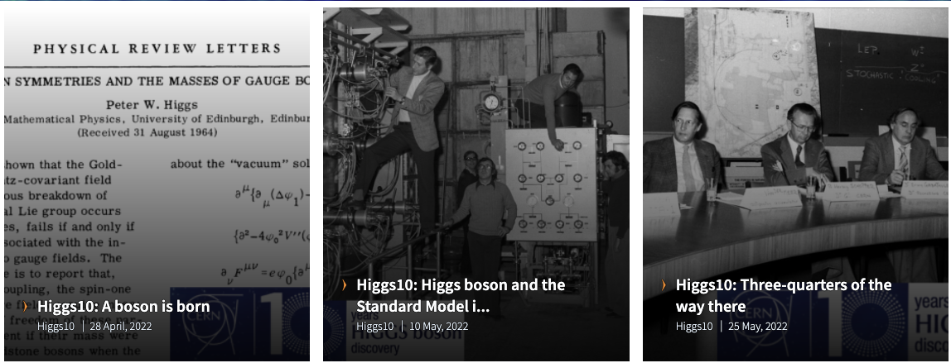
CERN Bulletin
A century of discovery: CERN’s past, present and future relations with the Higgs
Celebration
10 years on
Preparing the future
“A boson is born” (Matthew Chalmers, CERN Courier editor)
On the 1964 Higgs origins (first paper rejected by CERN-TH’s Prentki)
“The Higgs boson and the rise of the Standard Model of Particle Physics in the 1970s” (John Ellis, CERN TH)
On Neutral currents and Higgs phenomenology in the 1970s
“Three quarters of the Higgs discovered” (Matthew Chalmers)
On the W&Z discoveries in 1983
“LEP at the limits” (Roger Cashmore and Luciano Maiani)
On LEP and the Higgs (decision to close the LEP despite reluctance in the community
“Big Bang day” or “Just another day at the office”
On the 2008 LHC start up
“I think we have it”
On the 2012 discovery announcement
“10 years of interrogation”
On the 10 years of Higgs research since 2012
The Higgs and the universe (Matthew McCullough)
On the Future of Higgs research (HL-LHC / FCC)
8 articles
April - August
Covering period 1960s to 2040s
https://home.cern/news/series/higgs10

Slide 8
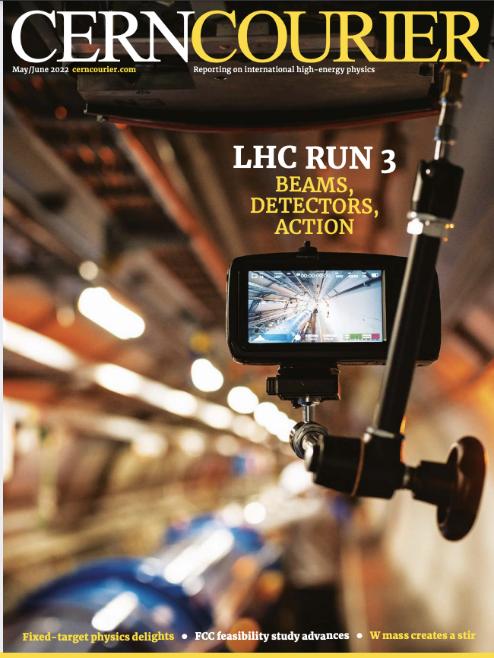
CERN Courier – Two special issues
May / June – “A new chapter for the LHC” - Run 3
Jul / Aug – the Higgs boson
Notes:
Working subject headings:
Higgs and the Nobel prize
The renormalisation revolution
Precursors to discovery
Machine machinations
Precision Higgs measurements
EWSB & baryogenesis
The Higgs & vacuum stability
Naturalness after the Higgs
The Higgs portal
Yukawa force
Viewpoint: Why we need a Higgs factory
Interview: Mary K Gaillard

Slide 9
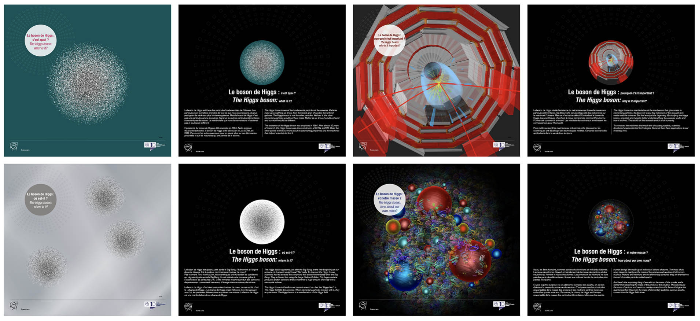
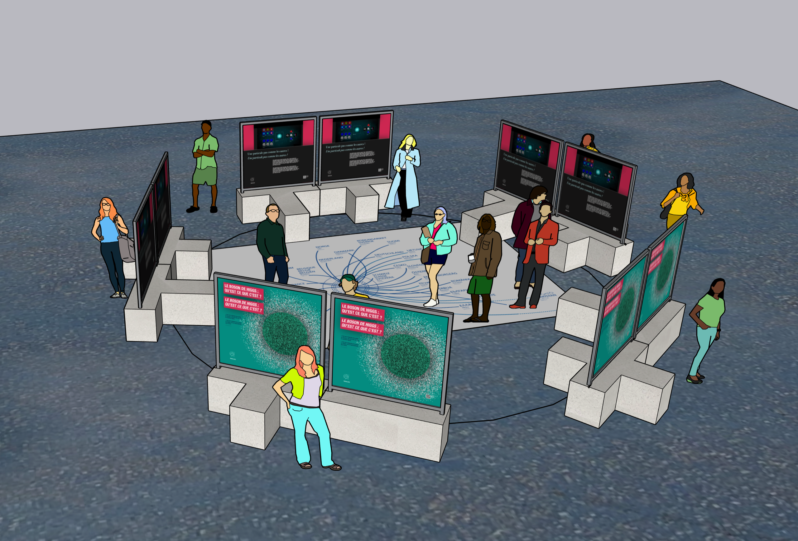
Exhibition
Celebration
10 years on
Preparing the future
On Esplanade des Particules + Content available to MS, partner labs, etc
  In French and English
10 panels in total
  5 Higgs-related
  5 about current and future technologies (HL-LHC)
Installed on Esplanade des Particules by 1 July
  Panels are on the visual identity website, for download and translation (please contact Fabienne)

Slide 10
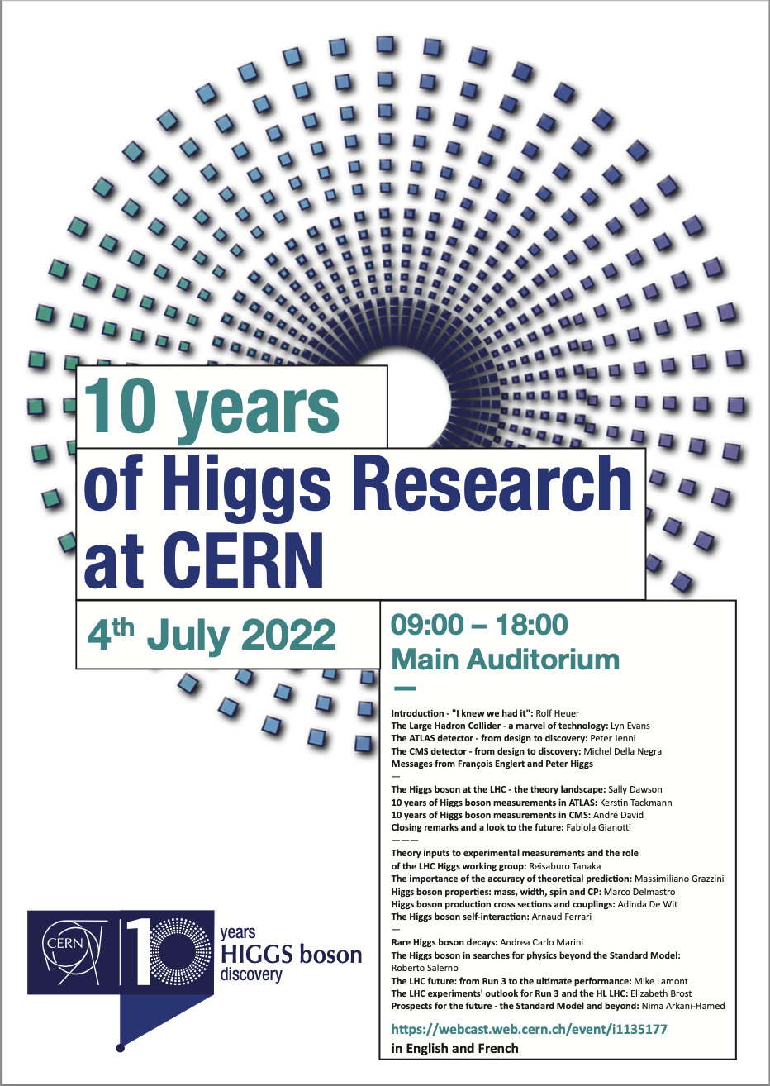
Higgs scientific symposium - 4 July
Celebration
10 years on
Preparing the future
In CERN Main Auditorium + EN and FR webcast
Indico page - https://indico.cern.ch/event/1135177/timetable/
Webcast link - https://webcast.web.cern.ch/event/i1135177
Poster will be available on identity pack page
Please use the poster for communication, directing people to the webcast. Auditorium capacity is limited (and almost complete).
Partners invited to organise “viewing parties”
Selected talks on social media
Target audiences:
Particle physics community | CERN community | Media | Teachers and students

Slide 11

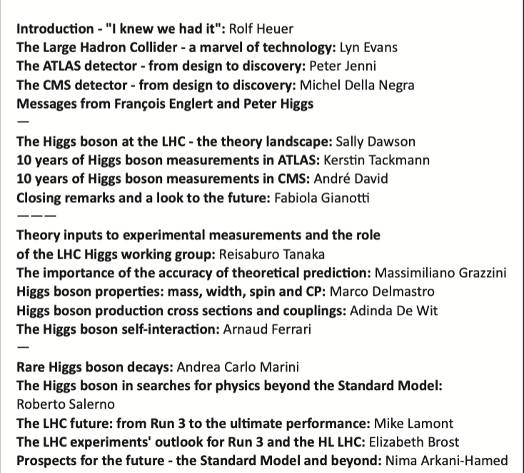
Higgs scientific symposium - 4 July
Celebration
10 years on
Preparing the future
Plenary-type talks on on past, present and future of Higgs research
Current and future Higgs research, including theory and machine

Slide 12
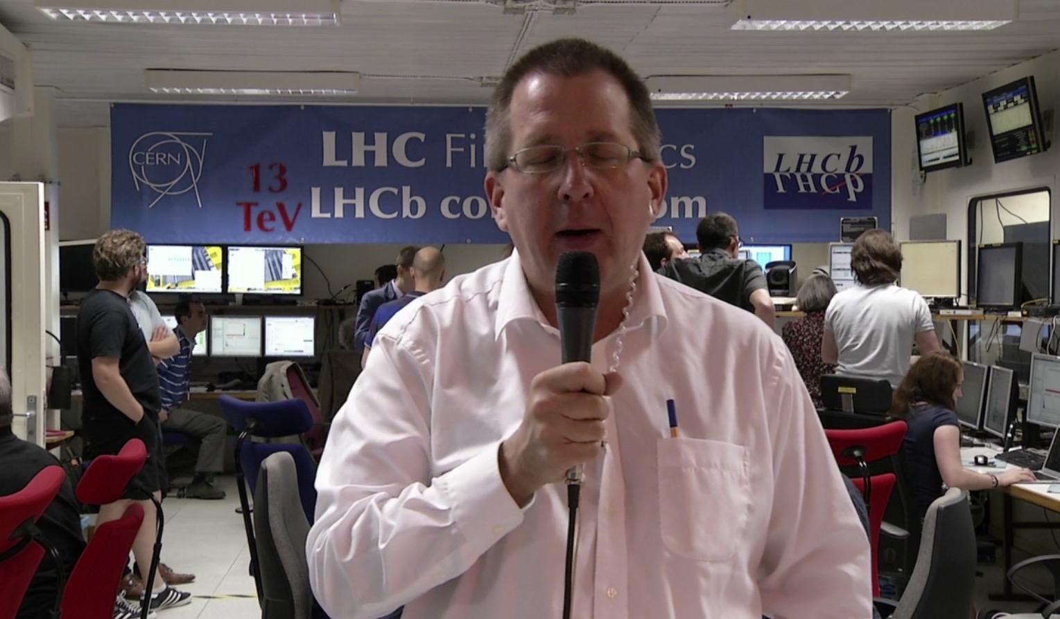
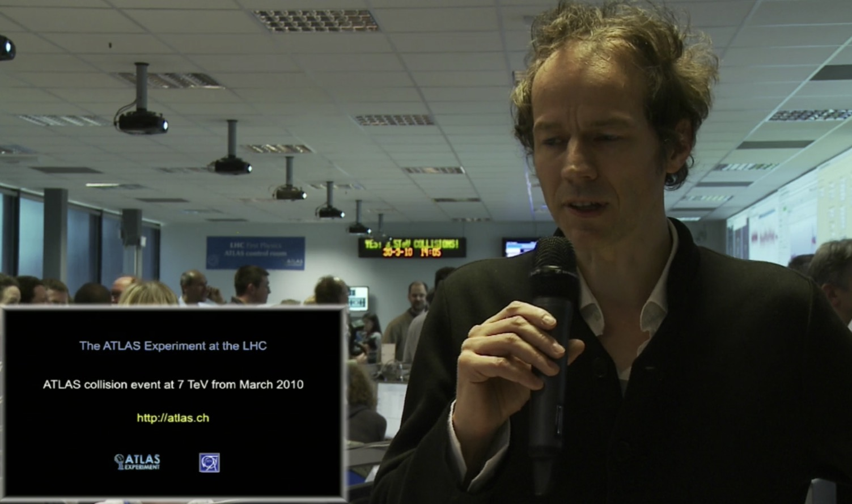
Live of Run3 first physics – 5 July 2022
10 years on
Preparing the future
Live with running commentary from 4 LHC experiments + CCC (main hub) + data centre
Streamed on CERN and experiments’ social media channels (Facebook, YouTube, Twitter) + CERN webcast + high quality Eurovision satellite
Commentary in 5 languages
Social media: 3 videos planned for the promotion; Events on Facebook and LinkedIn (next week) + teaser
Potential for collaboration: livestream on multiple platforms (RTMP key) + moderation + promotion
  Supporting products will be shared with partners in advance
  Teaser for Run3
  Illustrations and animations (accelerator complex, protons accelerating in LHC)
  Pre-recorded interviews with LHC experiment spokes, deputy-spokes, theorists, ATS Director, Deputy-Director
  CERN Council delegates that confirm attending the symposium will be invited to stay for the Run3 live
  Media update on the day + VNR (Video News Release) aired via satellite to EBU

Slide 13
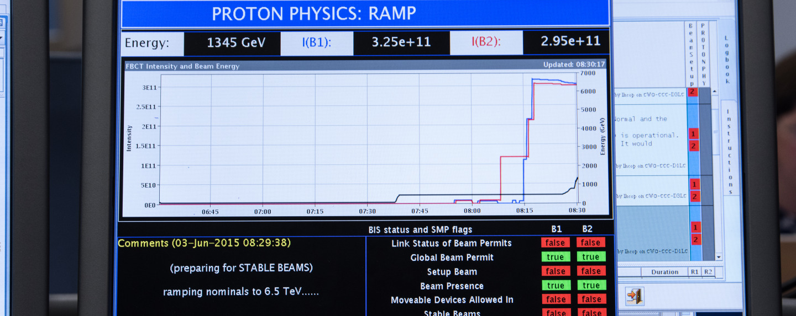
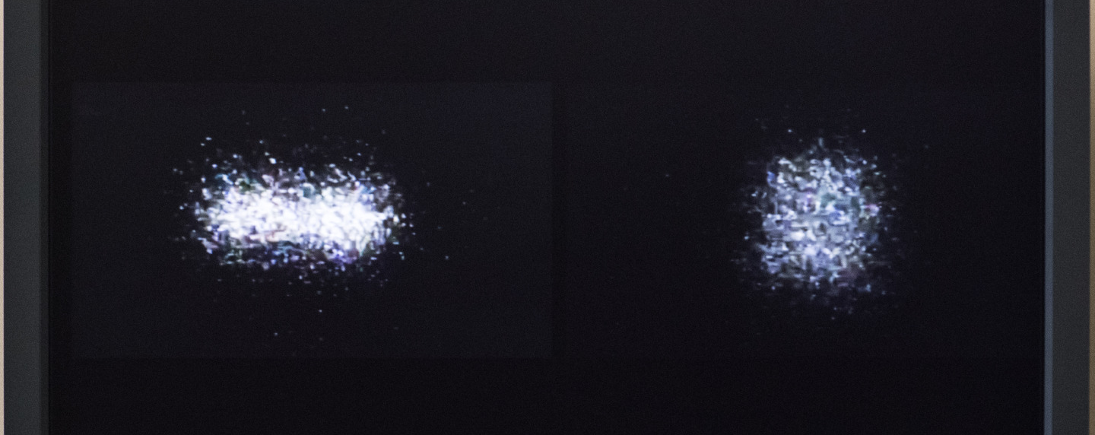
LHC Run3 live sequence
(Agreed with LHC OPS)
12:00-14:00 PRE-RECORDED Start of injection, ramp from injection energy to 6.8 per beam - flat top – squeeze (pre –recorded to allow for potential cryo- problems, time to recover and time to rehearse)
16:00 LIVE streaming starts
  Play back pre-recorded highlights with live commentary
  LIVE
    ADJUST
    declare STABLE BEAMS AND COLLIDE
    Clip to recover real event display
    DG interview + Management
    Q&A (English only; not on EBU
      In the CCC: DG, ATS Director, Research Director (TBC), ATLAS Deputy-spokesperson, CMS future spokesperson, LHCb deputy spokesperson, ALICE TBC, KT Group Leader, OPS lead
      From LHC experiments’ control rooms – spokesperson/deputy-spokesperson/physics coordinator/technical coordinator
-

Slide 14

Events for the general public
Screenings of Particle Fever + Q&A
In CERN local communities [1, 11, 23 June]
  10 CERN speakers, with connections to local area
At Globe as part of Cineglobe Festival [3 July]
  Webcast of the film in VOSTFR, introduction and panel in both EN and the FR simultaneous interpretation
    Webcast link available on Indico page
  Panel: Fabiola Gianotti, Mike Lamont, Nima Arkani-Hamed (TBC), Monica Dunford
  Partners invited to organise “viewing parties
Nuit de la Science in Geneva [9-10 July]
Include educational activity

Slide 15
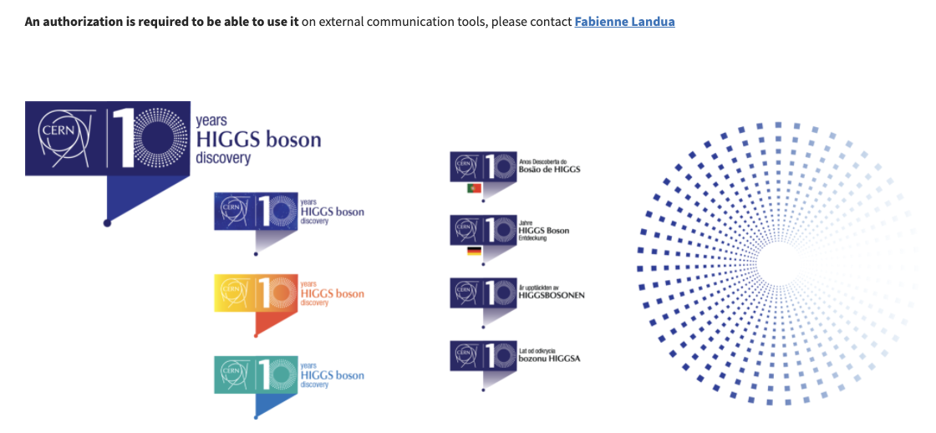
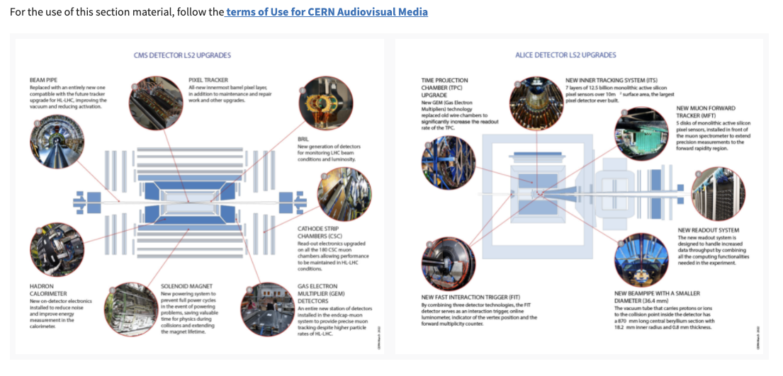
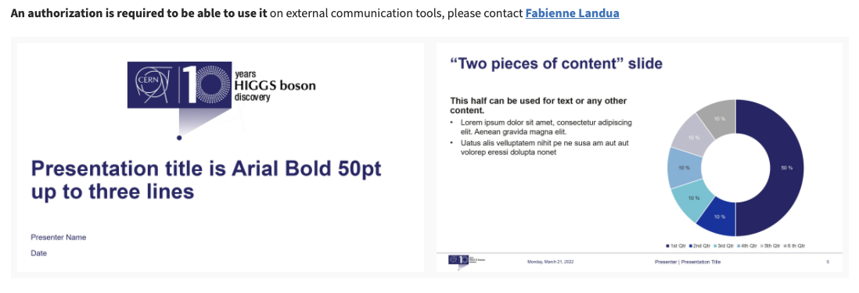
Visual identity pack and guidelines are online
Includes
Logo in colour and language palette
PPT templates
Illustrations
Email signature
Exhibition panels
Backgrounders
Symposium poster

Slide 16
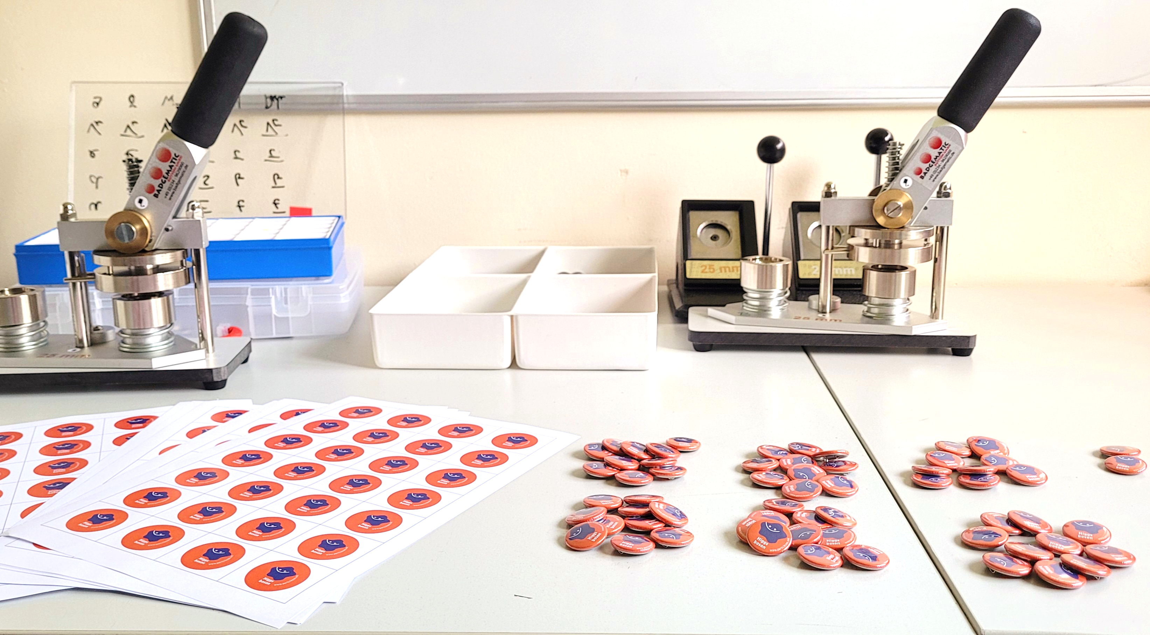
Education resources / activities
Celebration
10 years on
Preparing the future
Articles/papers in journals
1000 Higgs badges to distribute during public events
Hands-on activity (also for Nuit de la science & social media content)
10-min Science Show excerpt for "Science Me!" competition and Nuit de la Science
Higgs-themed geocache – containers have information on Higgs discovery milestones
Teacher event – 43 teachers will join morning of Higgs symposium + dedicated Q&A later
Event for high-school student alumni - special online Q&A session complementing public webcast

Slide 17
Thank you for partnering with us!
Over to you for your updates
ana.godinho@cern.ch

Slide 18
Back-up slides

Slide 19
LHC restart clippings across all countries
> 1500 clippings within a few days

Slide 20




















LHC restart - summary of international and national media outlets

Slide 21
LHC restart across CERN Member States

Slide 22
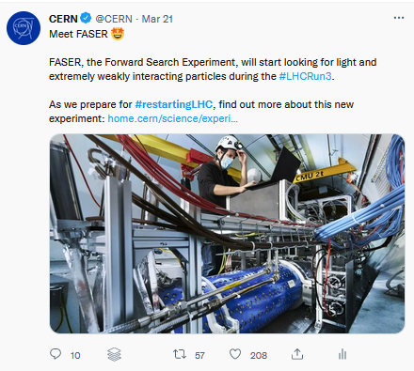
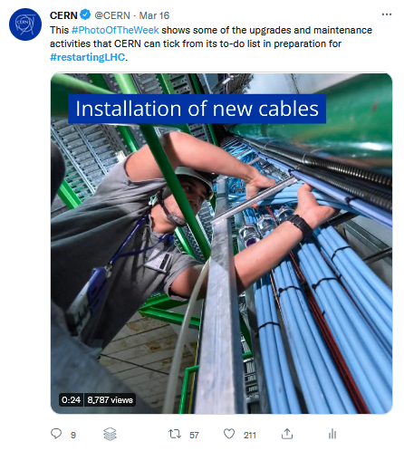
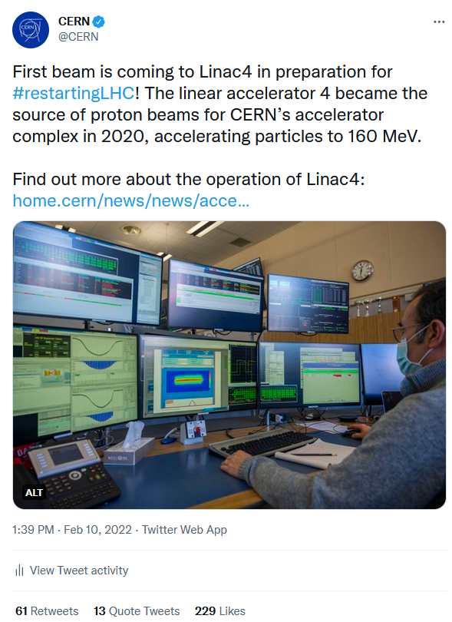
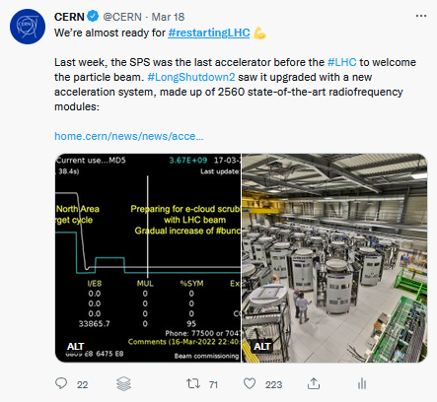
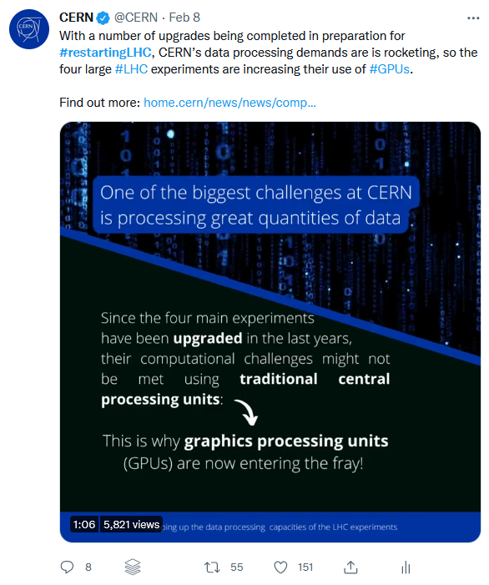
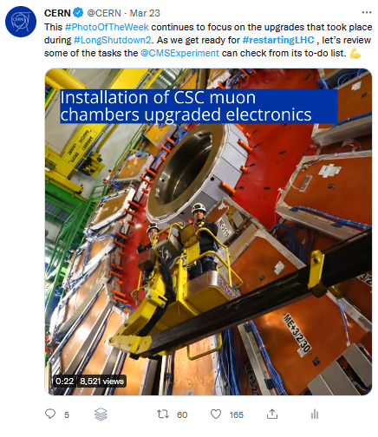
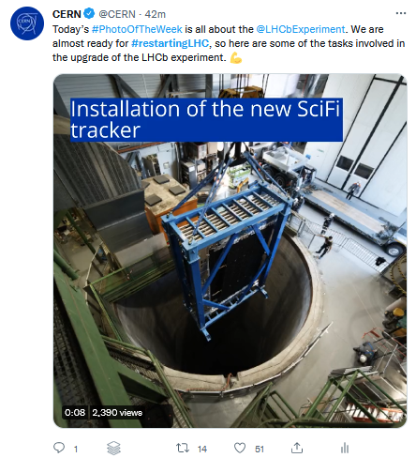
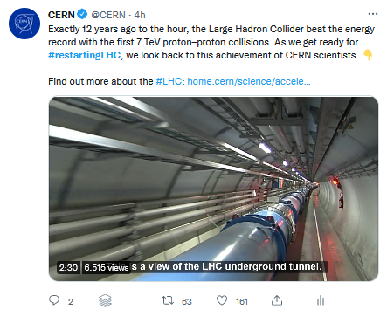
#restartingLHC update 31.03.2022
#NeverSeenBefore
+ ATLAS last live visit
+ CMS closure video
+ Magnet article from CMS
Mentions
+ Big Wheels photo
from ATLAS
1 February to 30 March 2022
Notes:
Key messages:
We evaluate the performance of our posts and adapt the strategy to answer the results we’ve seen (e.g., IG stories)
We are gaining momentum, as seen by the peaks at the end of the period featured here.
Conversation driven not just by CERN accounts but also by the constellation of associated accounts and partners (e.g., experiments, STFC)
We are in contact with the experiments and will soon also start activities with EPPCN working group

Slide 23
#restartingLHC at a glance
6 122 453 total impressions
128 214 total reactions
An overall sentiment more positive than usual:

Slide 24
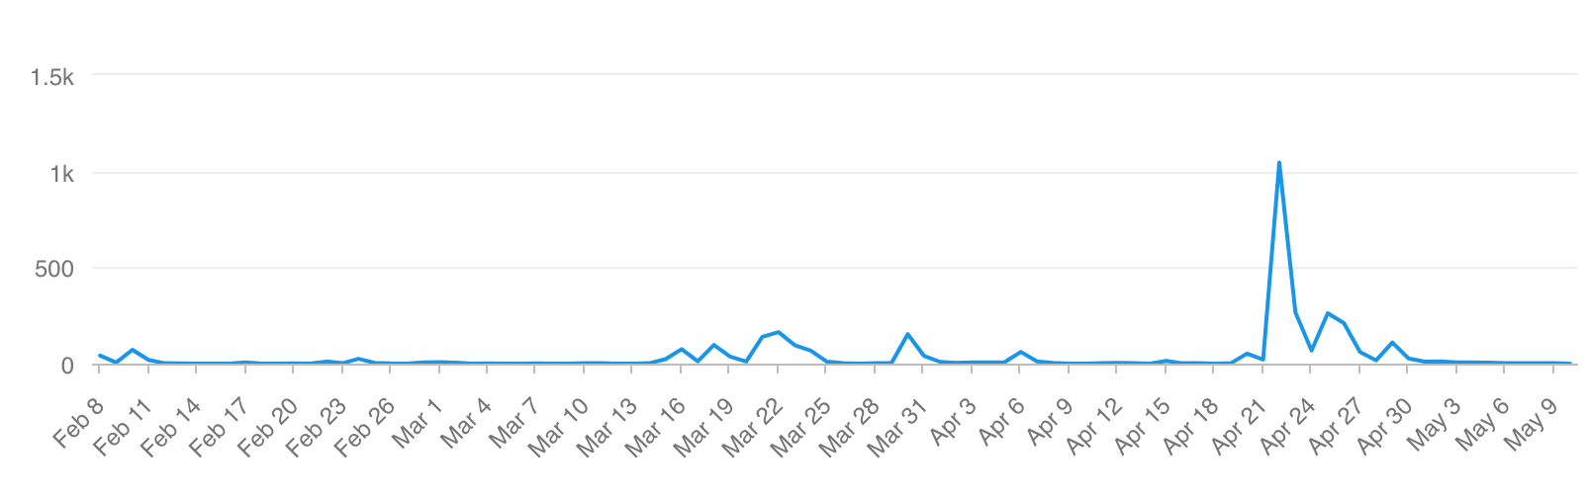
Key figures and insights
3461 uses of the hashtag
4057 mentions related to the upgrades and restart
6882 total mentions of CERN on the 22 April
(avg. 2022 = 1085 mentions per day)
Evolution of the use of the hashtag #restartingLHC
  Identify opportunities to push our content.
  Regular content, key moments for press.
  Create content guiding the audience through the unique work at CERN.
  ”News-like” videos + technologies
  Share enthusiasm as the audience is willing to be excited with us.
  Engaged fans = an opportunity?
Timing
Content
Audience

Slide 25
Other opportunities for collaboration…
!! Use country hashtags
INFN, Italy | CNRS, France | Nikhef, The Netherlands
Series of lives from LHC restart + experiments Web page for Higgs10 with all the events INFN divisions and labs are organising CMS and ATLAS Italy launched a contest for University students, winners will be announced in July Live event for 4 July During ICHEP (Bologna, Italy), there will be a big event about the Higgs | Article on the physics of Higgs Series of articles on LS2 and Run3 detailing FR contribution (four in total, every Friday) Public events, such as live streams. Internal event on 6 July. IG stories testimonials, lab in Grenoble doing the same from tech side. Local events, e.g. Annecy 5 July, also Science fest in October. History of Higgs thread on Twitter. | Public event 3 July, will live tweet about this. We start with a main story about Higgs (focus: science) on 27 June From 28 June until 4 July, we share two personal stories per day. Stories and personal stories all in English.

Slide 26
And more opportunities for collaboration…
!! Use country hashtags
KEK, Japan
Timeline reconstruction leading up to the discovery.
CHIPP, Switzerland
Geneva – card game
STFC, UK
Bern – waiting for OK
Channel: Twitter.
Online public lecture through Talking Science.
Science festival stand in government ministry on 4 July.
LIP, Portugal
Portuguese ATLAS and CMS teams stories on social media
LIP magazine
Public session with public
Possibly the screening of Particle Fever and Q&A.

