Slide 1

Higgs10 Bulletin article series
Thomas Hortala

Slide 2
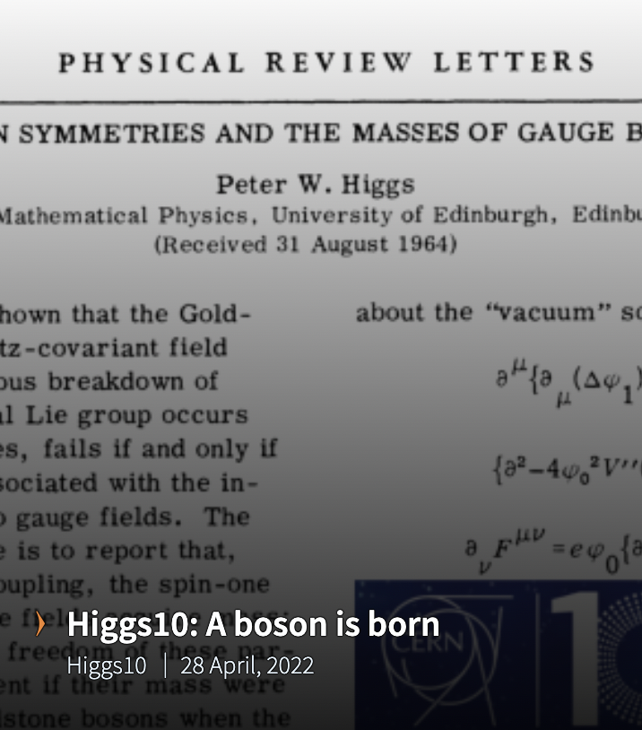
What?
Article series originally targeted for the internal community (CERN Bulletin)
Decision to share it with the general public
Articles then transformed into featured pages
The first piece, authored by Matthew Chalmers, was published in April 2022. It covers the theorisation of the Higgs boson in the 1960s.

Slide 3
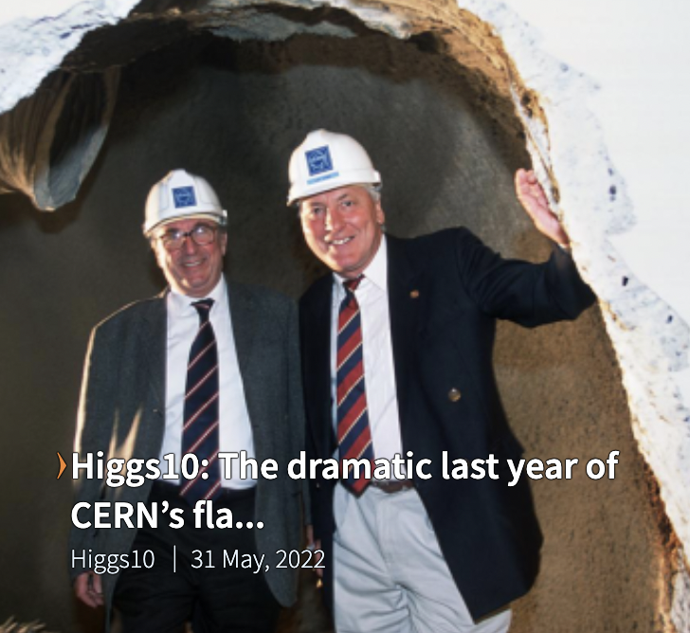
Why?
Anecdotes such as those surrounding the decision to discontinue the LEP in 2000 peppered the series.
Historical perspective complements approaches adopted by other ECO sections (Higgs nuggets, etc.)
Rare opportunity to revisit CERN’s role in the history of the Higgs before and beyond the 2012 discover.

Slide 4
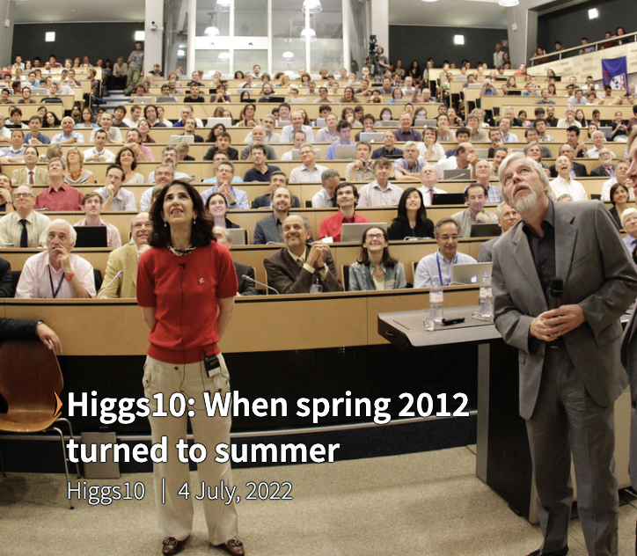
Who?
Fabiola Gianotti and Joe Incadela reminisced about the day the discovery of the Higgs was announced in an article published on 4 July.
External contributors, senior guest writers: John Ellis, Luciano Maiani and Roger Cashmore, Lyn Evans, Fabiola Gianotti and Joe Incandela, Monica Dunford and Andre David, Matthew McCullough…
ECO-wide effort: Bulletin team, but also Courier, PRD…

Slide 5
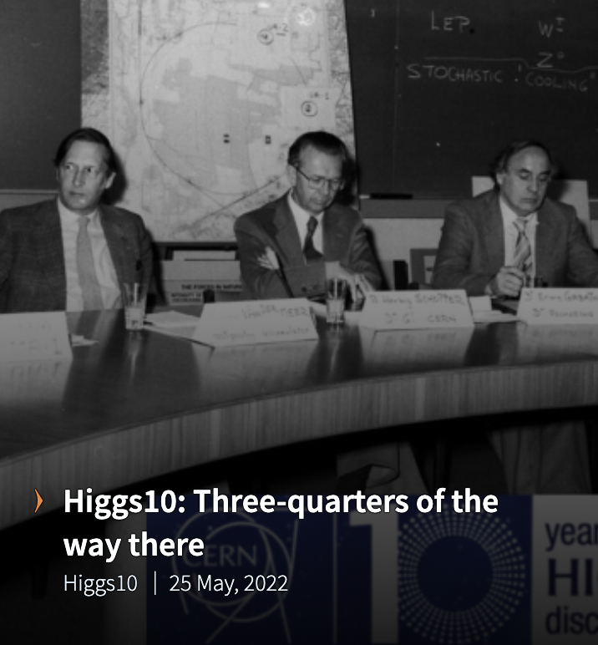
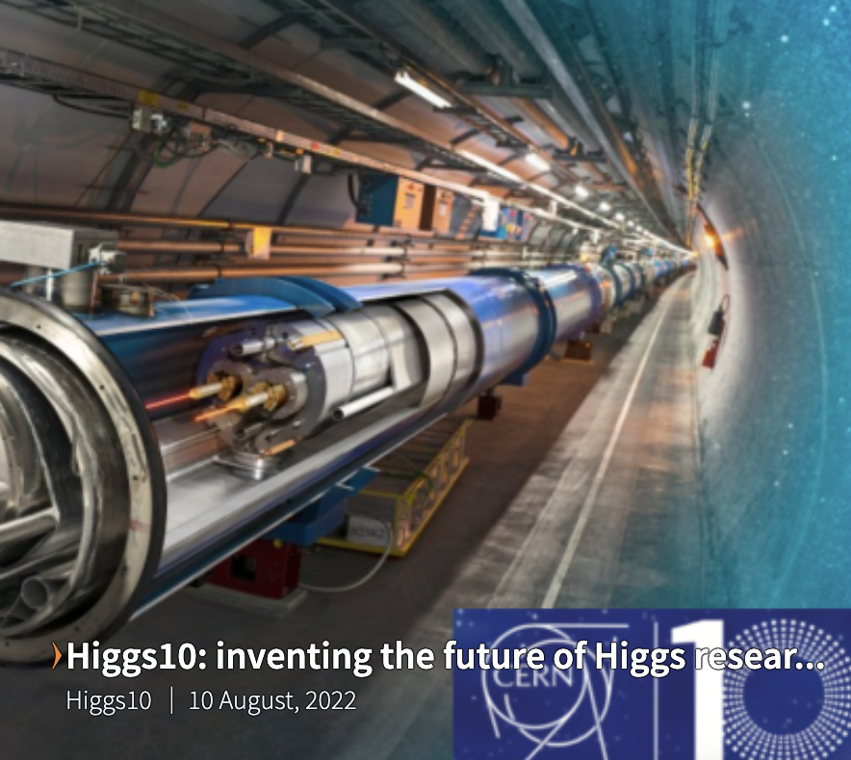
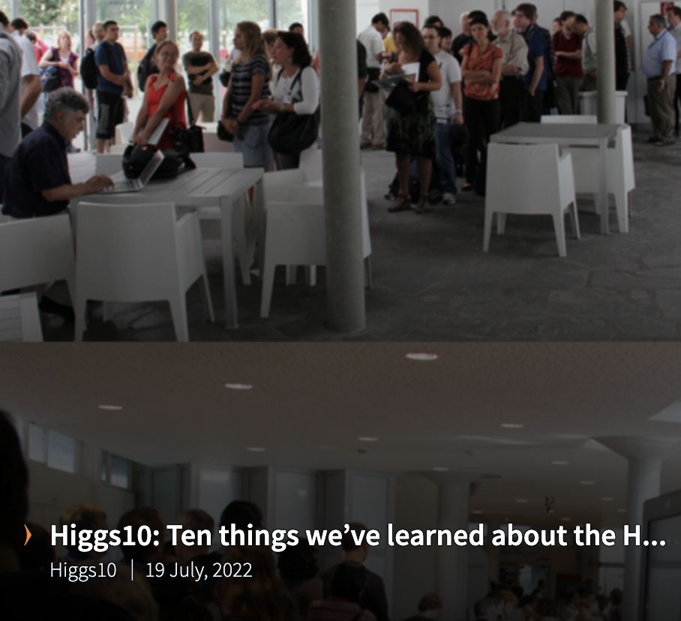
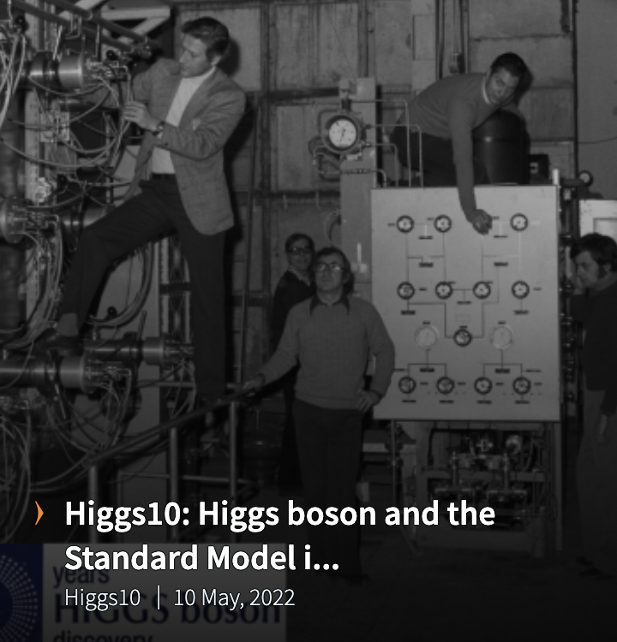
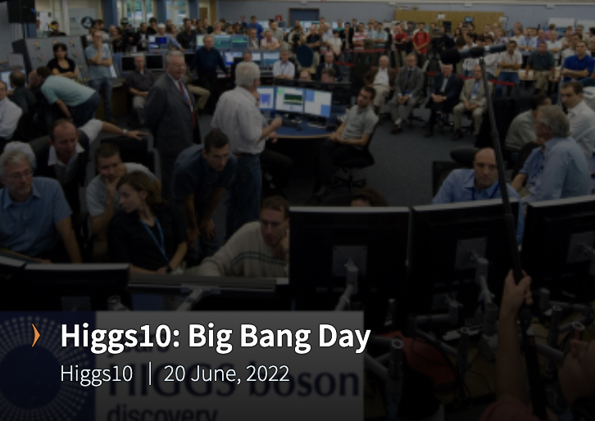
The outcomes
Eight riveting articles turned featured pages on home.cern.
Potential resources for future products.

Slide 6
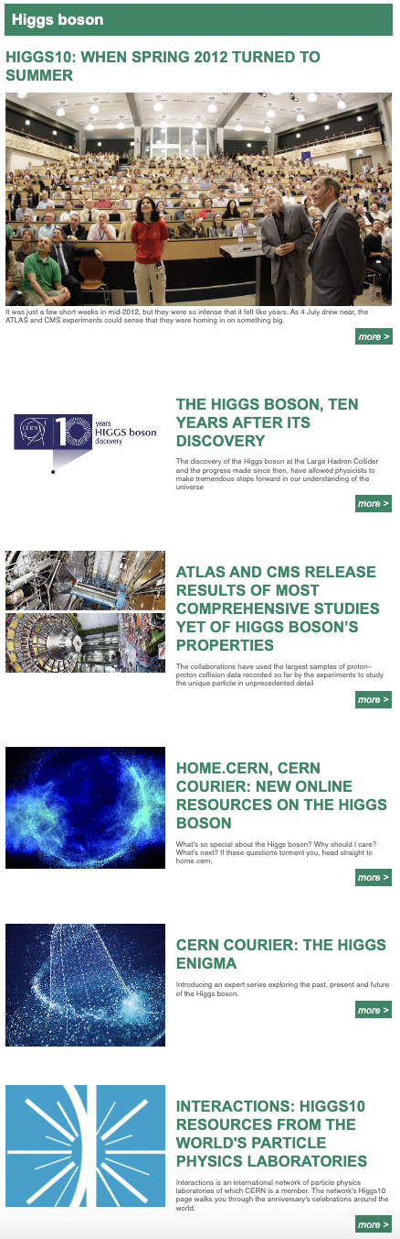
The outcomes
Special Bulletin issue on 4 July:
New banner designed by the graphic design team
Fabiola and Joe’s piece as featured article
Exclusively Higgs10 content + Run3 announcement

Slide 7
The outcomes
2400 views

Slide 8
Pieces covering landmark events (LHC start and Higgs Boson discovery) – popular with the general public
Pieces covering history of Higgs boson research in the 20th century – more taylored for an internal audience

Slide 9
Higgs10 pieces generally topped or were on par with regular home.cern pieces published over the period.
But not the same visibility as press releases on major July events (some of which have been viewed more than 34 000 as of mid-August).

Slide 10
Lessons learned
Positive
+ Broad interest for “throwback” content exists both in and outside of the community;
+ Cooperation between various ECO teams leads to quality content (thanks Matthew!)
+ We now have a collection of unique collection of articles that we can draw upon in the future.
Negative
Conversation was sparked on the level of difficulty in physics content that is appropriate for a Bulletin audience.

