Slide 1
Higgs@10
WP8 – Public event(s)
Loraine Massarotti, Andrea Perez Fernandez

Slide 2
WP8 Public events – Local film screenings
What?
  Screenings of film Particle fever followed by a ~40 min panel discussion / Q&A on «And now, what’s next?»
  Well received by the locals who were happy with CERN coming to them
  Good questions during the discussions (Big questions, Future of CERN, Environmental issues, FCC)
  The event in Saint Genis triggered a collaboration with the Médiathèque for the Fête de la Science 2022
Date | Location | N° attendees | Speakers | Moderator | Town Hall Representative
Wed. 1 June 2022 | Meyrin Ecole des Vergers | 55 | Mar Capeans, Chef du Département SCE Etiennette Auffray, Physicienne Sonja Kleiner, Chef du Groupe Environnement | Aurélie Coulon, Jounaliste, Le Temps | Adrien Fohrer Responsable de service communication et affaires économiques
Sat.11 June 2022 | Saint-Genis-Pouilly Théatre Le Bordeau | 110 | Frédérick Bordry Alain Blondel, Physicien Sabrina Schadegg, Ingénieur Environnement Sarah Portaboeuf, Physicienne | Jérémie Lanche, Correspondent for Radio France / RFI / RTL / Radio Canada | Hubert Bertrand Maire de Saint Genis Pouilly
Thu. 23 June | Saint-Julien-en-Genevois Cinéma Rouge & Noir | 72 (Most attended film in the Theater after the pandemics) | Bertrand Nicquevert, Ingénieur projet Martin Aleksa, Coordinateur Technique Adjoint ATLAS Luisa Ulrici, Chef de groupe adjoint, environnement | Jérémie Lanche, Correspondent for Radio France / RFI / RTL / Radio Canada | Sabine Loyau, Maire adjointe à la culture

Slide 3
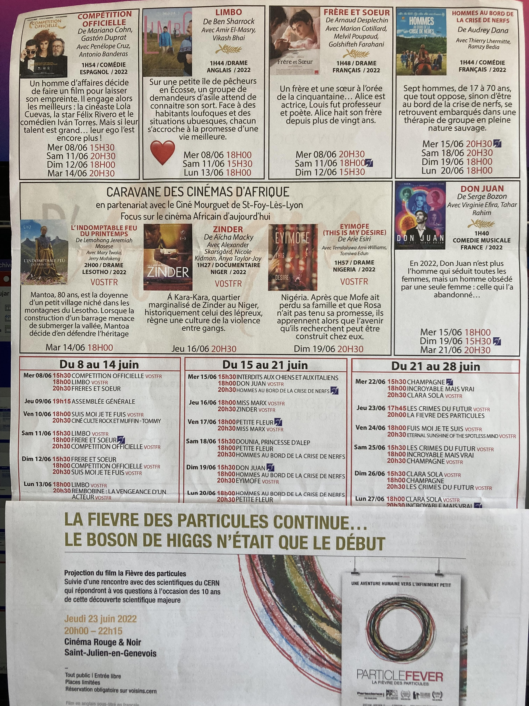
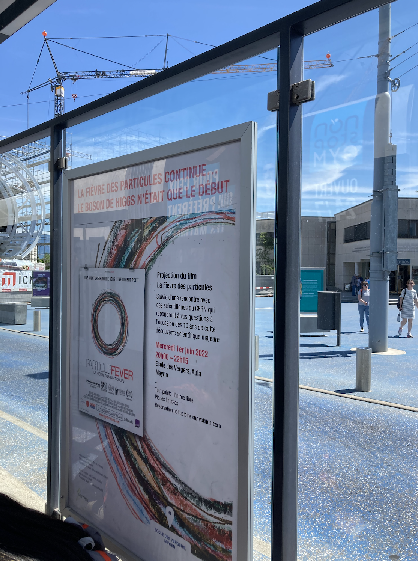
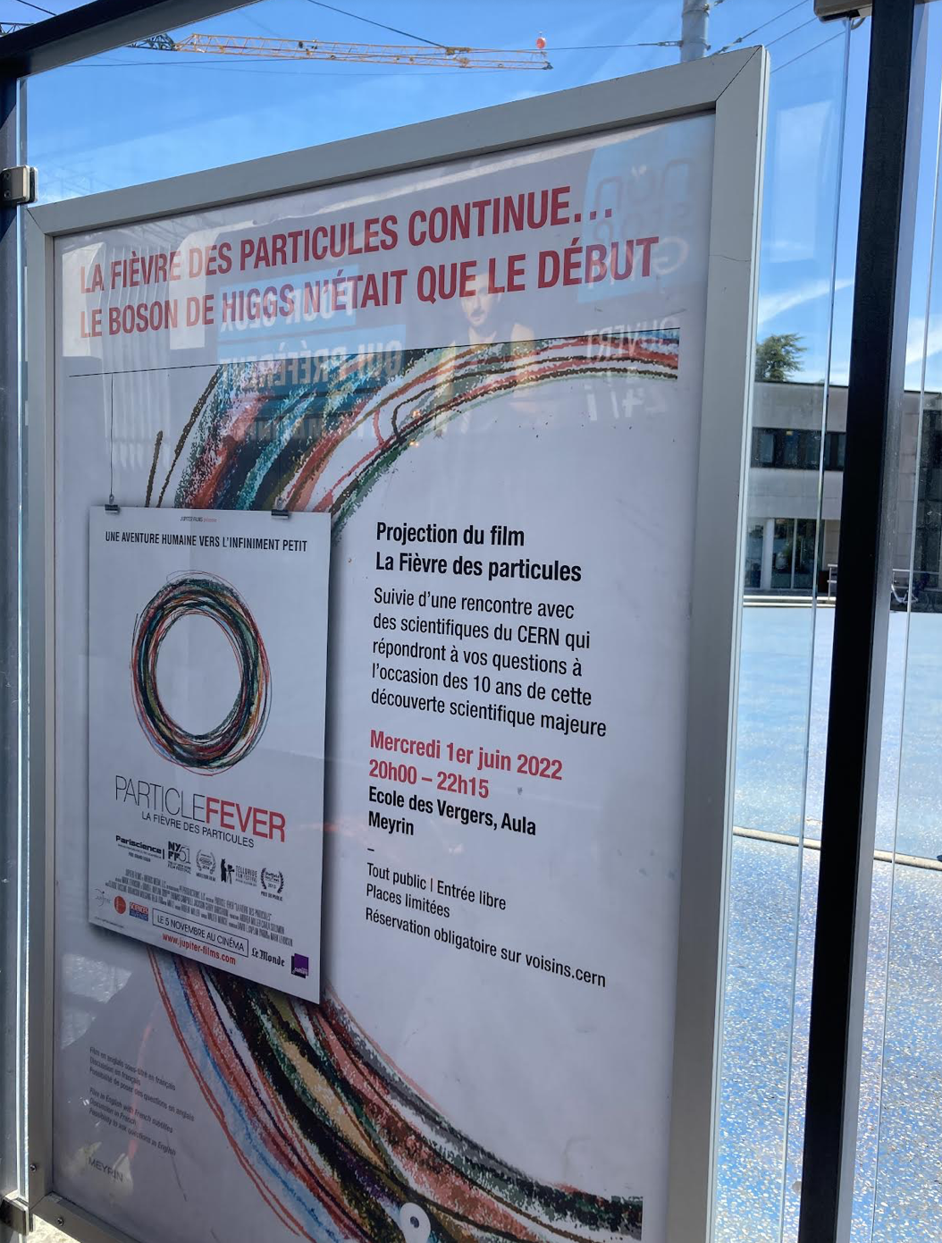
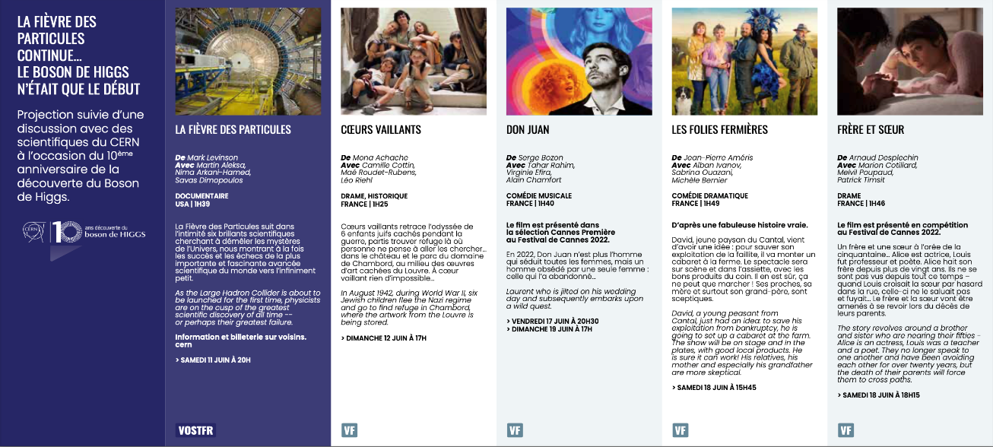
WP8 Public events – Local film screenings
Meyrin
Tram stops
Program: Cinema Rouge et Noir – Saint Julien en Genevois
Program: Theatre cinema le Bordeau – Saint Genis Pouilly

Slide 4
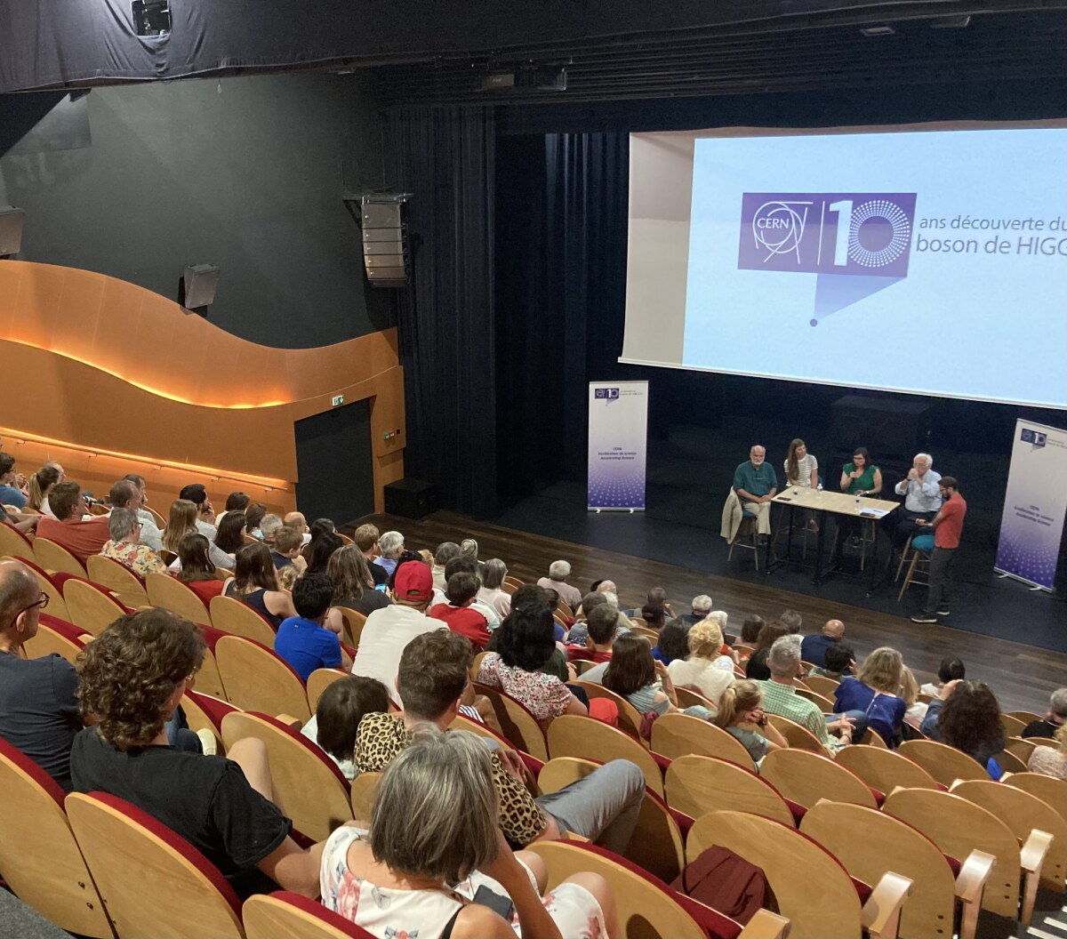
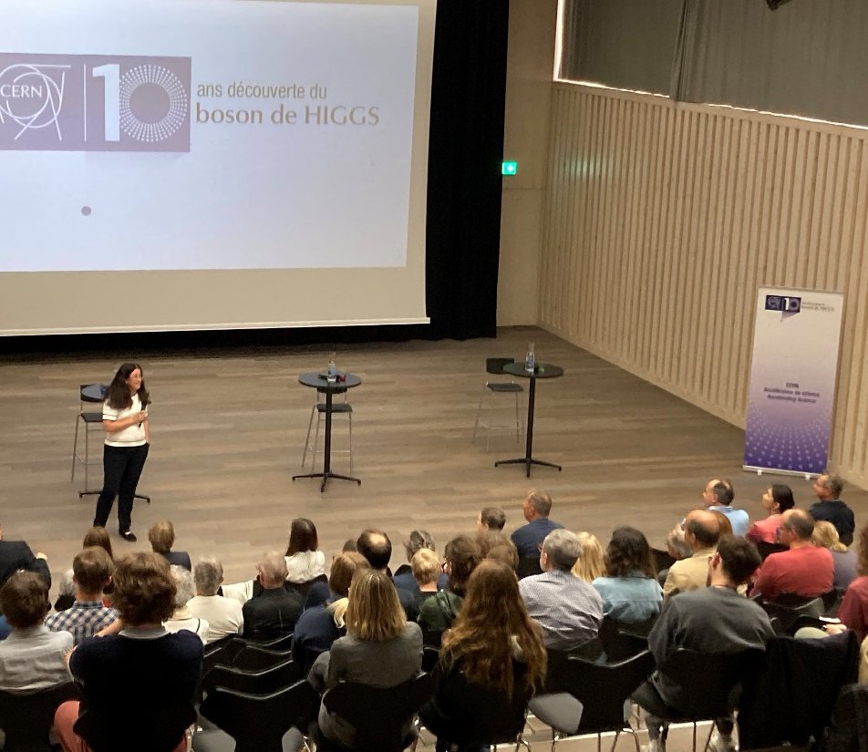
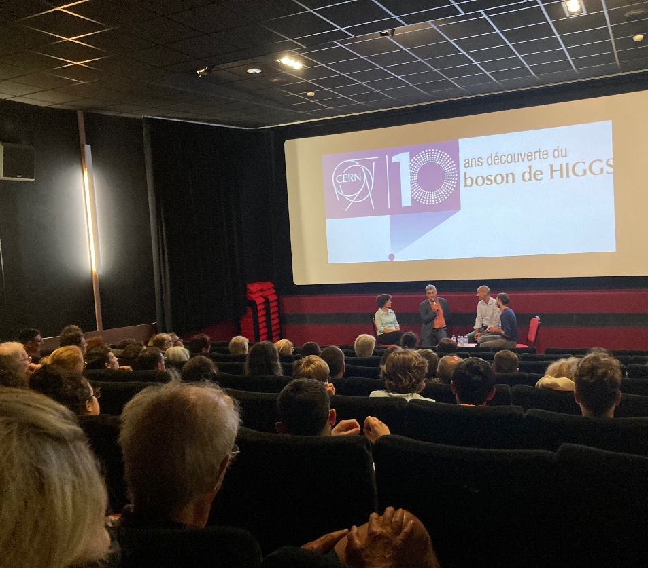
WP8 Public events – Local film screenings
Saint Julien en Genevois
Saint Genis Pouilly
Meyrin

Slide 5
WP8 Public events – Globe event
What?
  Globe event: Particle Fever followed by a panel discussion / Q&A with the public.
  Great event overall. The fact that the speakers knew each other gave a nice dynamic to the conversation
  Disappointment with the moderator (lack of preparation, poor English)
Date | Location | N° attendees | N° connections to webcast | Speakers | Moderator
Sun. 3 July 2022 | Globe of Science and Innovation | 186 | 53 | Nima Arkani-Hamed, Theoretical Physicist, Institute for Advanced Study Monica Dunford - Professor of Physics, Kirchhoff-Institute for Physics, Heidelberg University Fabiola Gianotti - Director-General, CERN Mike Lamont - Director for Accelerators and Technology, CERN | Sarah Sermondadaz Head of Science and Editorial Projects, Heidi Media SA

Slide 6
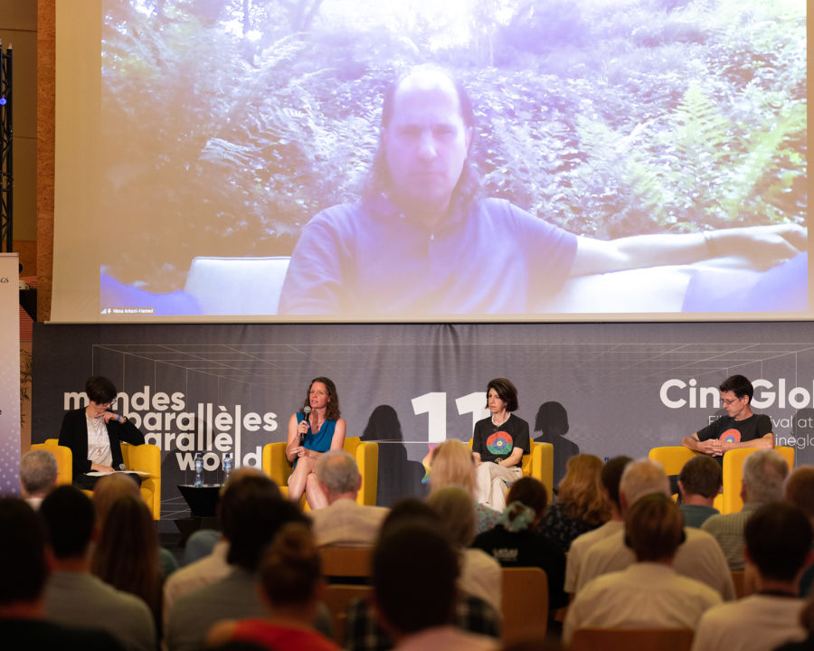
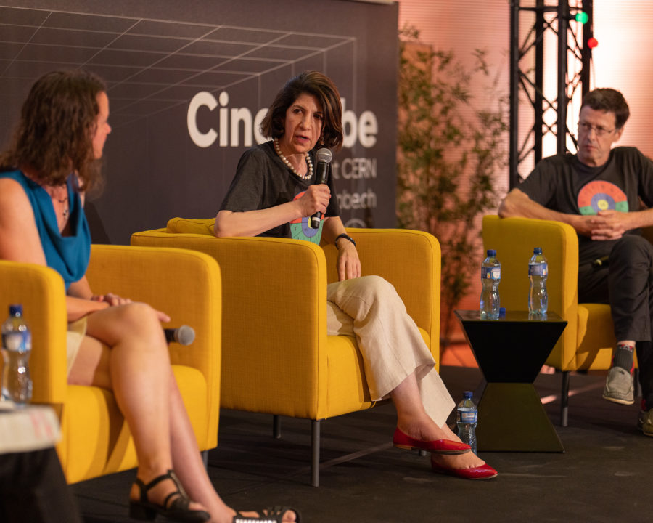
WP8 Public events – Globe event

Slide 7
WP8 Public events – Nuit de la science
What?
  Two dedicated activities : Iron filling + particle zoo, vortex canon + DIY canon
  Rally for children with one question on the Higgs boson
Lessons learned
  Vortex canon: worked well but not useful to explain the Higgs but great for seeing the invisible, collisions, etc.
  DIY canon: people didn’t take instructions but used as an intro
  Particle identities: worked great to engage on the Higgs and particules in general. People love takeaways!
  Particle zoo: great to explain the Higgs field
Outcomes
    People understood well thanks to very basic material
    Our visitors smiled!
Date | Location | N° attendees | Volunteers | Attendees
Sat. 9 & Sun. 10 July 2022 | Parc de la Perle du Lac, Geneva | Hard to say… | 19 CERN volunteers over 2 days | Families coming on purpose or walking by, locals, tourists. Attendees to the Science me competition
Notes:
Great local event. Comfortable for CERN since all logistics is handled by the Museum
Reaching out to an audience which doesn’t know CERN but leaves curious to visiting more
CERN volunteers are great ambassadors!

Slide 8
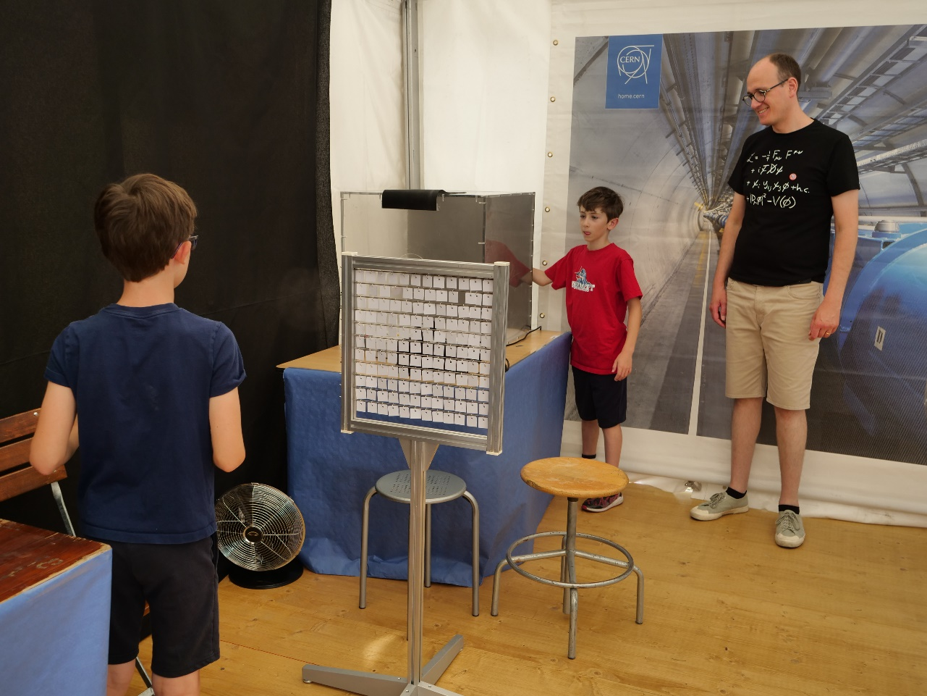
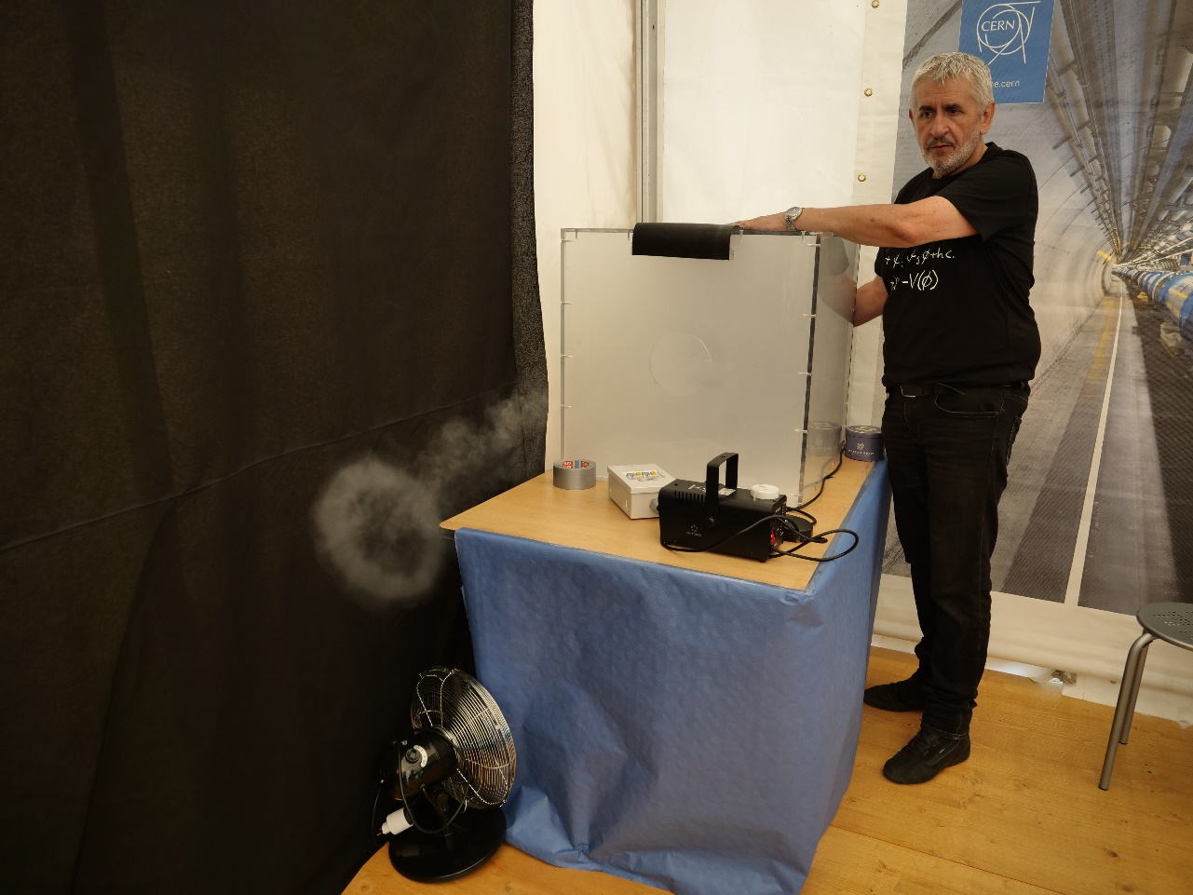
WP8 Public events – Nuit de la science

