Slide 1
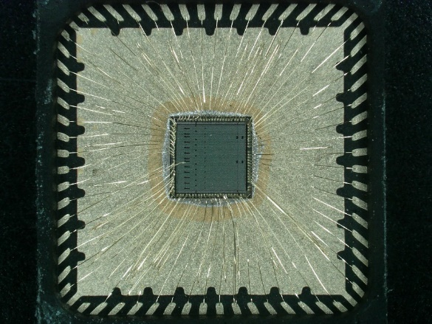
The FastIC project: From the FastIC ASIC to FastIC+ and FastRICH
R. Ballabriga on behalf of the CERN-ICCUB collaboration
EP-ESE-ME, CERN
Esplanade des particules 1
1217 Meyrin, Suisse
rafael.ballabriga@cern.ch

Slide 2
Outline
FastIC project context
Architecture
Readout
Measurements (Linearity, Energy resolution, SPTR, CTR)
Derivatives of FastIC (FastIC+, FastRICH)
Summary

Slide 3


The FastIC project: context

Slide 4
The FastIC project: motivation
Fast Timing
detectors
Front-End
Multi Channel
ASIC
Time-to-
Digital-
Conversion
SiPMs, MCPs, PMTs
FastIC (65nm, 2020)
FastIC addresses limitations from NINO (2004, 0.25μm): mainly non-linearity of the energy measurement and power consumption
Highly configurable:
Singled ended, differential and summation of 4 single-ended channels to explore benefits of segmentation of detector areas
Positive and negative polarity
Large range of input capacitances
Large dynamic range (with positive and negative polarity readout)
~30 ps r.m.s. Jitter (electronics) (Hamamatsu S13360-3050CS, 3600x50μm microcells, 4.5V_{OV}, wirebonded) + Linear energy measurement (~2.5 % error) up to 20 mA peak (12mW single ended channel)
Collaboration between CERN (KT funded) and University of Barcelona (ICCUB)

Slide 5
The FastIC project: Architecture

Slide 6
Single Ended (Positive Polarity) configuration
Notes:
Front-End
Current mirror with double feedback loop
Low Frequency loop: Controls the DC voltage of the input node. Enabling the adjustment of the voltage of the SiPM individually to equalize the SiPM performance to compensate non-uniformities in gain or PDE.
High Frequency loop: Common gate regulated cascode configuration to keep low input impedance at signal bandwidth.
Design strategy:
Dominant pole is set at the input node. This means that the stability is not compromised when connecting a high capacitance SiPM.
Current copy generation.
Time And Trigger measurement
Time path:
Leading edge discriminator. Information on ToA in rising edge
Produces non-linear ToT response
Low level Trigger: Same architecture as the Fast time path. A trigger pulse is provided by performing an OR between the trigger signals of all channels. The trigger level is adjustable and usually set above the Dark Count Rate (DCR) noise, i.e. to a few photoelectrons to filter these events. Thought for pixelated crystals
Cluster Level Trigger: A trigger pulse is obtained as a discriminated sum of a fraction of the input signal. For monolithic crystals where light (signal is spread)
Time Signal as Trigger: The Time signal can also be used as Trigger in cases where high sensitivity is required and the events are close to the single photoelectron level.
Energy path:
- Transimpedance amplifier ~5ns peaking time
- Shaper (nominal peaking time 30 to 50ns
(can be made faster at the expense of decrease in linearity)
- Peak detector and hold
Ramp generator and voltage comparator. The slope of the ramp can be adjusted.
The Ramp can be triggered by the two flavours of trigger, by the time signal and also by an external signal (external trigger) used for the calibration of the pedestals.

Slide 7
Single Ended (Negative Polarity) configuration

Slide 8
Differential configuration

Slide 9

Implementation: combination of signals
Large area SiPM → Large Cdet
Front-End
TDC
Large area SiPMs can have an equivalent detector capacitance higher than 1 nF
This high input capacitance degrades the slew-rate $SR∝\frac{Q_{det}}{C_{det}}$

Slide 10
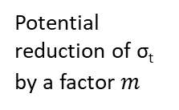
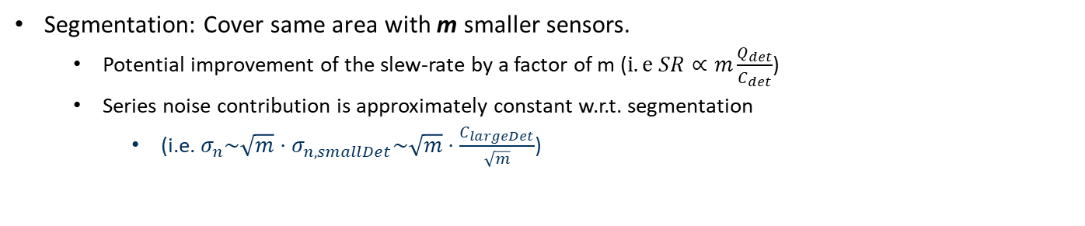
Strategy to cope with large detectors
Segment SiPMs to cover same area → Cdet/4
Front-End
TDC
+
m: physical channels = 4
Segmentation: Cover same area with m smaller sensors.
  Potential improvement of the slew-rate by a factor of m ($i.e SR∝m\frac{Q_{det}}{C_{det}}$)
  Series noise contribution is approximately constant w.r.t. segmentation
    (i.e. $σ_{n}\sim \sqrt{m}⋅σ_{n,smallDet}\sim \sqrt{m}⋅\frac{C_{largeDet}}{\sqrt{m}}$)
Potential reduction of σ_{t} by a factor $m$
Sum of m uncorrelated contributions
The series noise is proportional to the detector capacitance, which reduces a factor sqrt(m)

Slide 11
SUM4 (Positive Polarity) configuration

Slide 12
SUM4 (Negative Polarity) configuration

Slide 13
The FastIC project: readout system

Slide 14
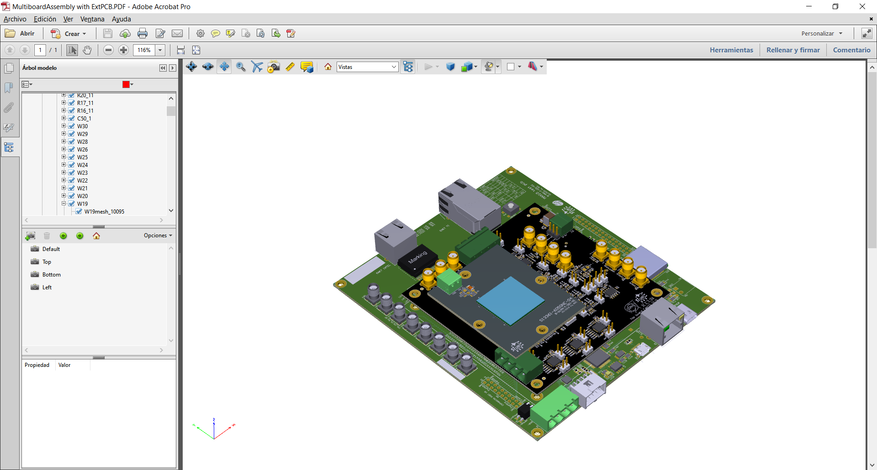
Evaluation system
Aims of the evaluation system:
  Basic operational test & debug ASIC functionalities
  Initial electrical characterization and linearity analysis.
  Initial benchmark i.e. evaluate the FastIC chip by comparison
    With respect previous designs (NINO, HRFlexTOT)
    Using reference SiPM sensor:
      Hamamatsu S13360-3050CS
      FBK NUV-HD
  Interface with other sensor based on adaptor board
  Signal acquisition:
    FPGA-based TDC (45ps time bin)
    Differential sLVS link to external system

Slide 15
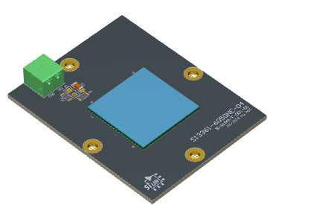
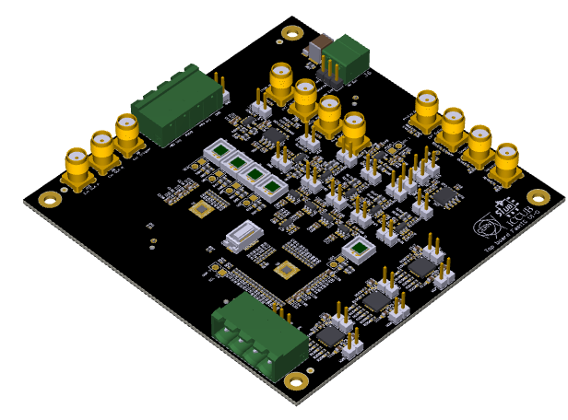
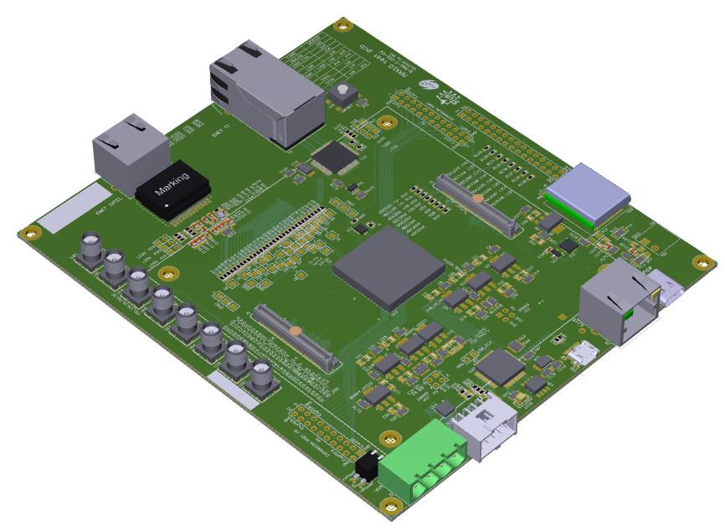
Evaluation system
Custom sensor board
FastIC generic board
  2 FastICs on QFN64 (16 channels)
  Reference SiPM sensors included
  The board can be used stand alone
FPGA board
  FPGA board for slow control, acquisition and additional biasing.
  Multichannel TDC is implemented in the FPGA (45ps time bin)

Slide 16
The FastIC project: measurements

Slide 17
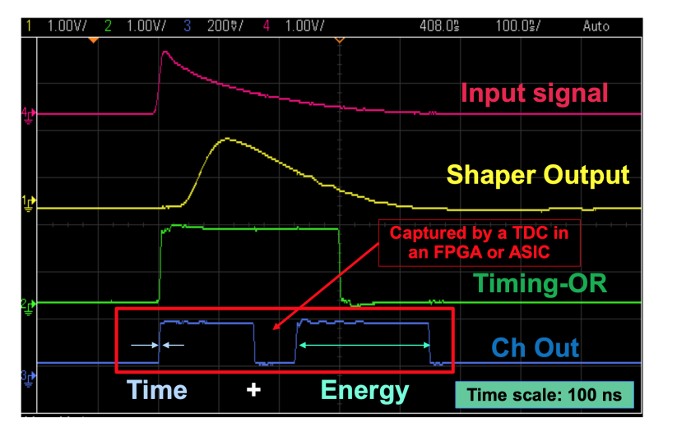
Time waveforms
FastIC provides a measurement of time and energy per channel in two consecutive pulses
Time is encoded in the rising edge of the first pulse
Energy is encoded on the width of the second pulse. The readout is based on HRFlexToT architecture*
*D. Sanchez, S. Gomez, et. al. "HRFlexToT: A High Dynamic Range ASIC for Time-of-Flight Positron Emission Tomography" 2021, IEEE TRPMS, https://doi.org/10.1109/TRPMS.2021.3066426

Slide 18
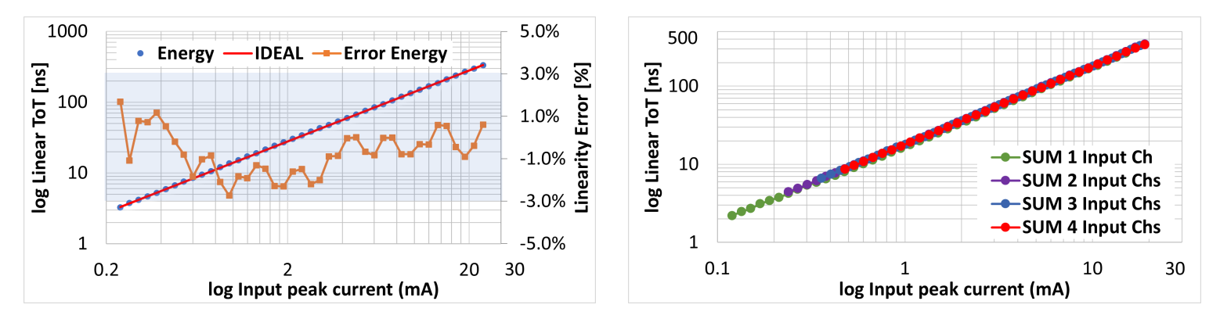
Linearity of the energy measurement
An electrical SiPM-like signal is injected into the FastIC for energy evaluation using an AWG
Linearity error is below 3% over the whole dynamic range
Saturation is reached at 25 mA input current (positive polarity) and 20 mA (negative polarity)
Summation in the energy is linear, independently of the channels added
This makes FastIC very versatile and suitable for LYSO/LSO, BGO, Cherenkov, Monolithic, etc.
S. Gomez

Slide 19
The FastIC project: measurements with sensors

Slide 20
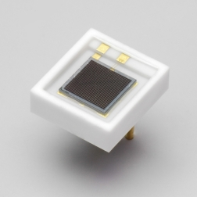
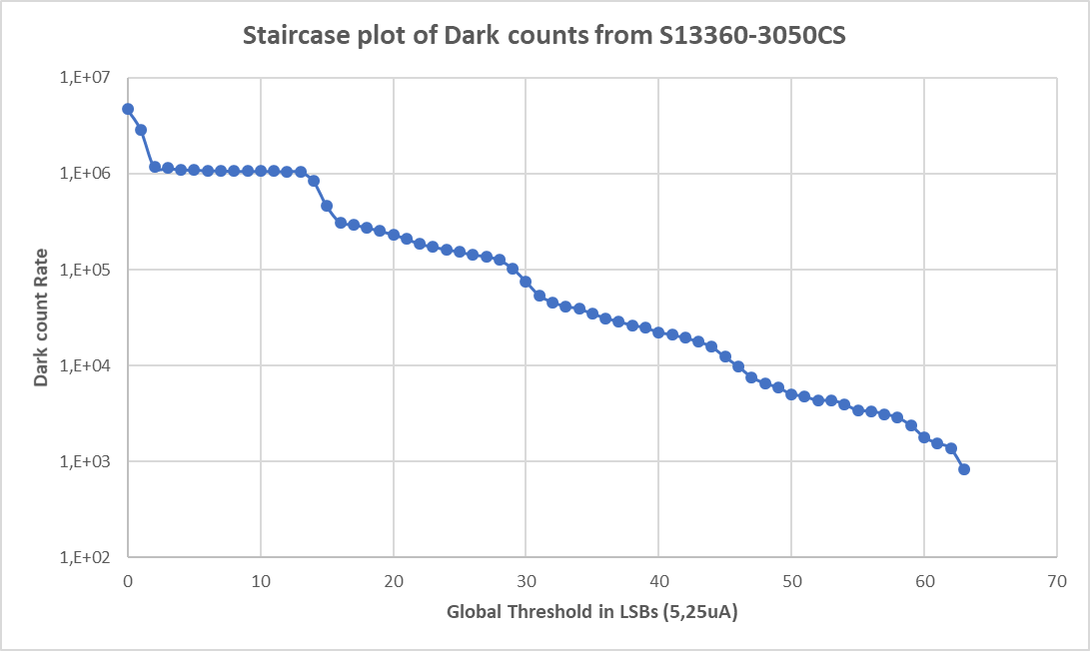
SiPM measurements
3mm
Positive Input stage
SiPM S13360-3050CS operated at 60V of HV (Over-voltage ~7.6V)
3mm
SiPM Hamamatsu
S13360-3050CS
1PE,2PE,3PE,...
2PE,3PE,...
3PE, 4PE,...
4PE,5PE,...
S. Gomez, D. Sanchez
Notes:
Note:
1. Uncorrelated noise: the main source of noise on a SiPM came from "false" avalanche
pulses, triggered by thermally generated carriers on the active junction. Each of those
pulses are the result of a thermally generated electron that initiates an avalanche in
the high ﬁeld region, for this reason, the uncorrelated noise depends on the Vov applied
to the SiPM. This signal is generated even at dark conditions and are identical to
the "real" signals from a light source, that noise is called Dark Count Rate (DCR).
The number of dark pulses is typically given in units of kHz/mm2. Furthermore, it
depends on the microcell ﬁll-factor and the depleted region width. Importantly, the
DCR is reduced a 50% factor every time the temperature decreases 10 degrees [39].
Nevertheless, this reduction reaches a limit where the DCR is not reduced that much
anymore, due to other phenomena like tunneling generation.
2. Correlated noise: this type of pulses are mainly due to (1) at the same microcell by
afterpulsing or (2) caused by optical light coming from an adjacent cell, where in this
case it is called optical crosstalk.
a) Afterpulsing: on every avalanche process during the photoconversion, there is
a probability that some carriers become trapped in defects in the silicon. After
a certain delay, the trapped carriers are released, leading to a possible second
avalanche (typically exponential distribution from the release times) after some
nanoseconds from the original one. If the release time is smaller than the recharge
time of the cell, the charge contained in this afterpulse will be smaller compared
with a normal cell signal. Moreover, the afterpulse can be induce optically by the
secondary photons generated during the avalanche process, that can be reabsorbed
in the neutral region and the carriers will be diﬀused to the depleted region and
trigger a second avalanche.
b) Crosstalk: as mentioned above, several secondary optical photons are emitted
during the carriers avalanche process. Typically 2 to 3 · 10−5 NIR photons are
emitted in isotropic directions for a single avalanche. Those photons can reach
neighboring cells and trigger a second instantaneous avalanche, resulting in a
signal output of amplitude and charge N times the single cell signal, with N the
number of optical crosstalk photons absorbed. There are three main transport
paths used by the optical photons to reach a neighboring cell (ﬁgure 2.9): (1)
direct crosstalk, where an adjacent cell triggers and avalanche right after the
primary one is detected, the NIR photons travels directly in straight line. (2) The
NIR photons escape from the cell and is being reﬂected in the window cover and
bounces back to a next by cell, or (3) reﬂected from the bottom of the substrate.
2 and 3 are also called delayed crosstalk. An extensive study on the crosstalk
characterization can be found in[40, 41].

Slide 21
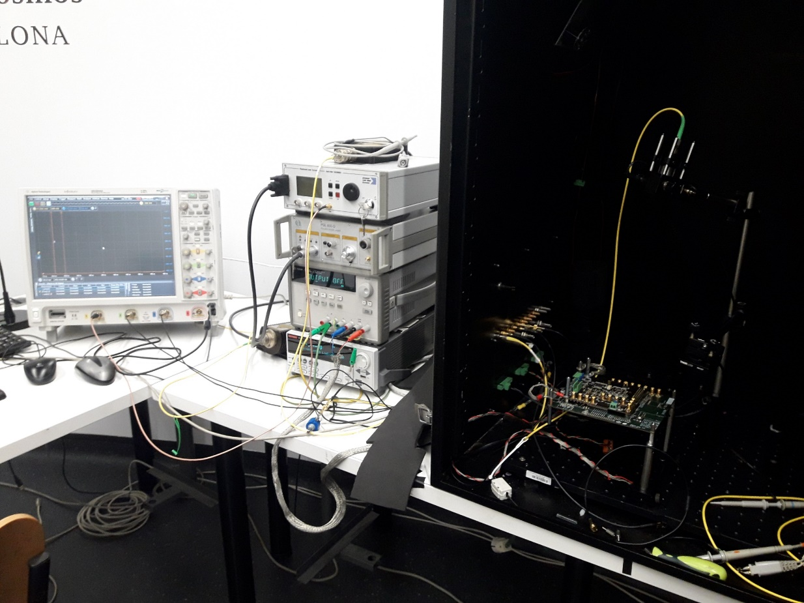
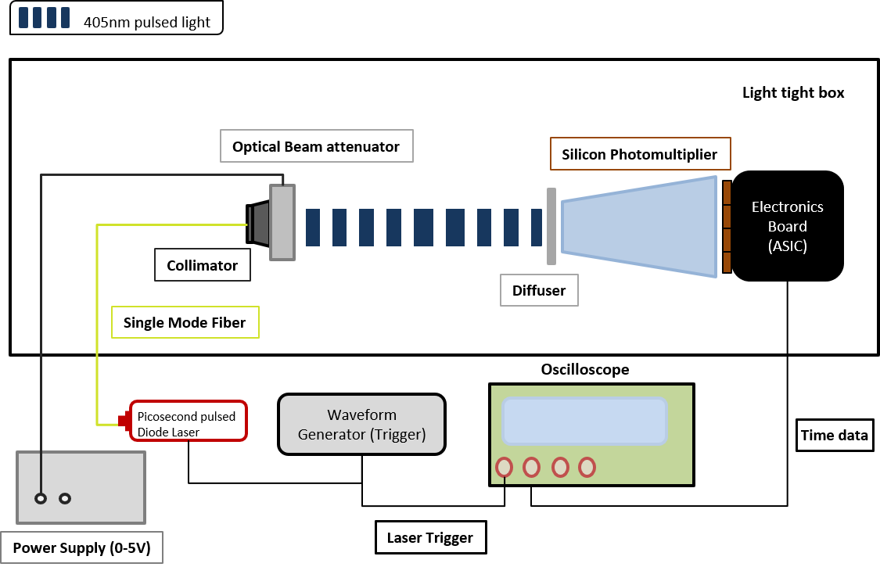
Setup for SPTR measurement
Laser (405 nm) – 40 ps FWHM pulse width
S. Gomez

Slide 22
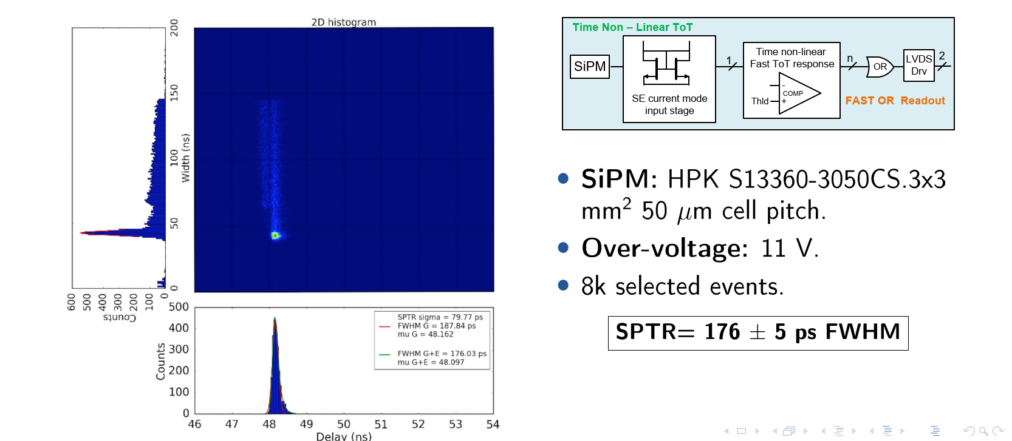
SPTR measurement
Hamamatsu S13360-3050CS (3x3 mm² 50μm cell pitch, V_{OV}=11V)
SPTR= 176 ± 5 ps FWHM
FBK NUV-HD Low Field V2 (3.12x3.2 mm² 40μm cell pitch, V_{OV}=10.5V)
SPTR= 151 ± 5 ps FWHM
S. Gómez

Slide 23
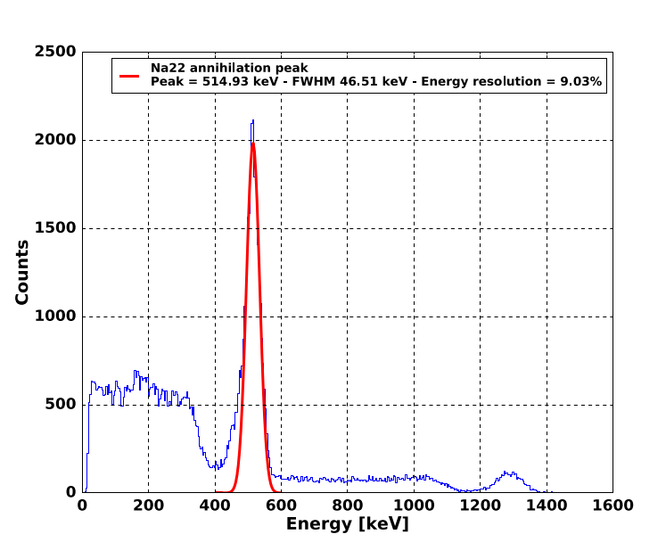
Energy resolution measurement
The Energy Resolution was measured with a ²²Na source
The TDC implemented in the FPGA was used to digitize the data
Crystal: LYSO:Ce:0.2%Ca 3.13x3.13x20mm³
SiPM: Hamamatsu S13360-3050CS (3x3 mm² 50μm cell pitch, V_{OV}=3V)
Compton edges and gamma peaks are used to calibrate the nonlinearities of the SiPM*
Energy resolution expressed in FWHM/μ [%].
Energy resolution of 511 keV ²²Na ~9%
S. Gómez
*D. Sanchez, S. Gomez, et. al. "HRFlexToT: A High Dynamic Range ASIC for Time-of-Flight Positron Emission Tomography" 2021, IEEE TRPMS, https://doi.org/10.1109/TRPMS.2021.3066426

Slide 24
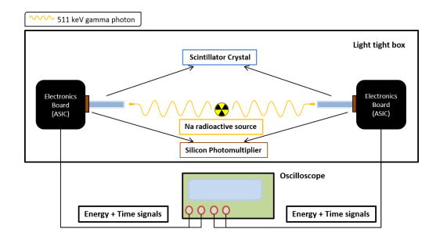
Coincidence Time Resolution
S. Gómez

Slide 25
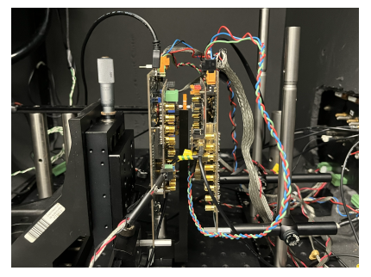
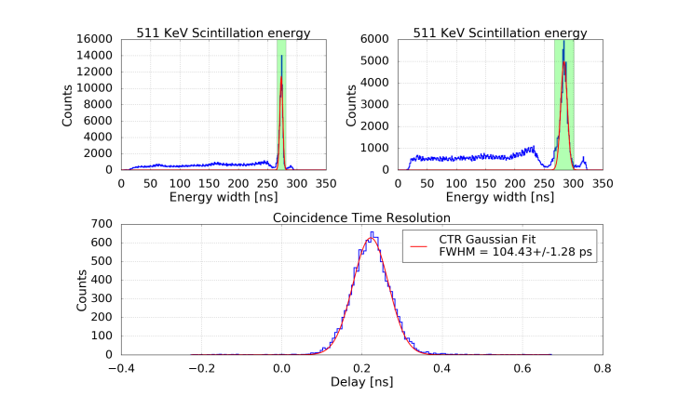
Coincidence Time Resolution
Crystal: LSO:Ce:0.2%Ca 2x2x5 mm², LY=39.2 ph/keV, τ_{d}=~32ns
SiPM: Hamamatsu S13360-3050CS (3x3 mm² 50μm cell pitch, V_{OV}=8V)
CTR= 104 ± 3 ps FWHM
S. Gómez

Slide 26
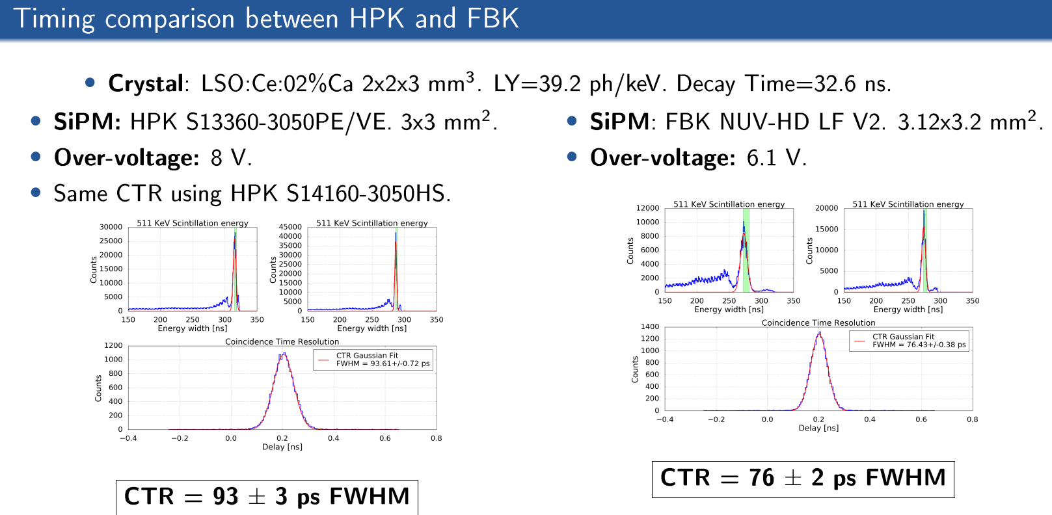
Coincidence Time Resolution
Crystal: LSO:Ce:0.2%Ca 2x2x3 mm², LY=39.2 ph/keV, τ_{d}=~32ns
SiPM: Hamamatsu S13360-3050CS (3x3 mm² 50μm cell pitch, V_{OV}=8V)
CTR= 93 ± 3 ps FWHM
Crystal: LSO:Ce:0.2%Ca 2x2x3 mm², LY=39.2 ph/keV, τ_{d}=~32ns
SiPM: NUV-HD LF V2 (3.12x32 mm², 40μm cell pitch, V_{OV}=6.1V)
CTR= 76 ± 2 ps FWHM
S. Gómez

Slide 27
Design completed (CERN-UB)
FastIC Analog:
Analog chip
Generic
Wide range C_{DET}
Large dynamic range
Signal summing
Used with external TDC
Not radiation hard
FastIC Analog
8 channels
FAST TIME
DEVELOPMENTS
EP-ESE-ME

Slide 28
Design completed (CERN-UB)
FastIC Analog:
Analog chip
Generic
Wide range C_{DET}
Large dynamic range
Signal summing
Used with external TDC
Not radiation hard
Design ongoing (CERN-UB)
FastIC+:
Analog and Digital chip
Generic
Wide range C_{DET}
Large dynamic range
Signal summing
Used with internal ~25ps bin TDC
Not radiation hard
FastIC Analog
8 channels
FastIC+
8 channels
Medical
Applications
FAST TIME
DEVELOPMENTS
EP-ESE-ME

Slide 29
Design completed (CERN-UB)
FastIC Analog:
Analog chip
Generic
Wide range C_{DET}
Large dynamic range
Signal summing
Used with external TDC
Not radiation hard
Design ongoing (CERN-UB)
FastIC+:
Analog and Digital chip
Generic
Wide range C_{DET}
Large dynamic range
Signal summing
Used with internal ~25ps bin TDC
Not radiation hard
FastIC Analog
8 channels
FastIC+
8 channels
Medical
Applications
FAST TIME
DEVELOPMENTS
EP-ESE-ME
Design ongoing (CERN-UB)
FastRICH:
Analog And Digital chip
Application specific
Smaller range C_{DET} (PMTs/Small SiPMs)
Small dynamic range (single photon operation)
No signal summing
Internal TDC (~25ps bin TDC)
~2ns Gate (duration/phase programmable)
CFD
Radiation hard
FastRICH
LHCb
16 channels

Slide 30
Towards FastRICH
FastRICH is based on the experience from the CERN-UB team on the design of FastIC for the readout of fast detectors
The design involves major changes in the analog part, the implementation of a TDC and a full digital readout
The chip provides a radiation hard (TID and SEE), low power and compact system for the LHCb RICH detector for interfacing with the detector on one side and on the other with lpGBT/optical links
The chip aims at reducing the amount of data generated
  With Zero Suppressed Readout
  A programmable ~2ns Shutter signal
  A Constant Fraction Discriminator (CFD)
And also a configurable number of output links (1/2/4) to adapt to the occupancy of the different regions of the experiment

Slide 31
Design completed (CERN-UB)
FastIC Analog:
Analog chip
Generic
Wide range C_{DET}
Large dynamic range
Signal summing
Used with external TDC
Not radiation hard
Design ongoing (CERN-UB)
FastIC+:
Analog and Digital chip
Generic
Wide range C_{DET}
Large dynamic range
Signal summing
Used with internal ~25ps bin TDC
Not radiation hard
FastIC Analog
8 channels
FastIC+
8 channels
Medical
Applications
FAST TIME
DEVELOPMENTS
EP-ESE-ME
Design ongoing (CERN-UB)
FastRICH:
Analog And Digital chip
Application specific
Smaller range C_{DET} (PMTs/Small SiPMs)
Small dynamic range (single photon operation)
No signal summing
Internal TDC (~25ps bin TDC)
~2ns Gate (duration/phase programmable)
CFD
Radiation hard
Future Roadmap
Emphasis on module
Analog and Digital chip
Pixelized, Sensor co-design, hybrid integration
More channels
Smaller range C_{DET}
Large dynamic range
No signal summing
Used with internal TDC
Future
developments
FastRICH
LHCb
16 channels

Slide 32
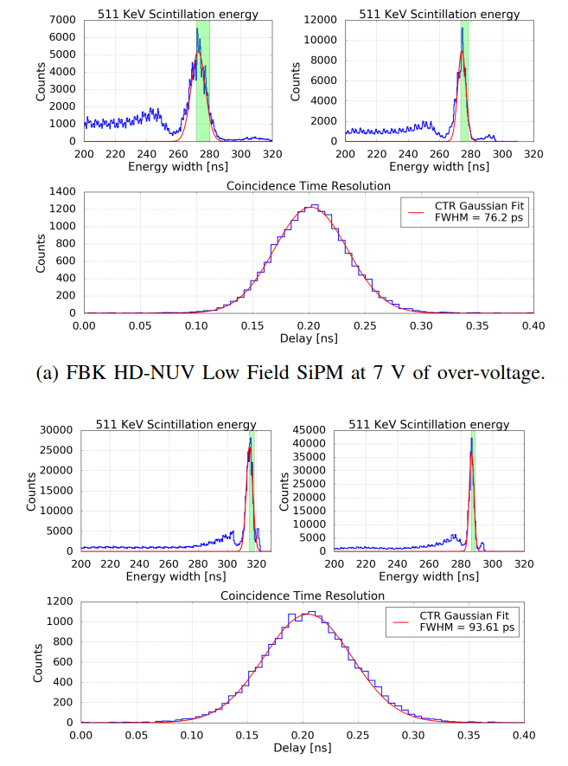
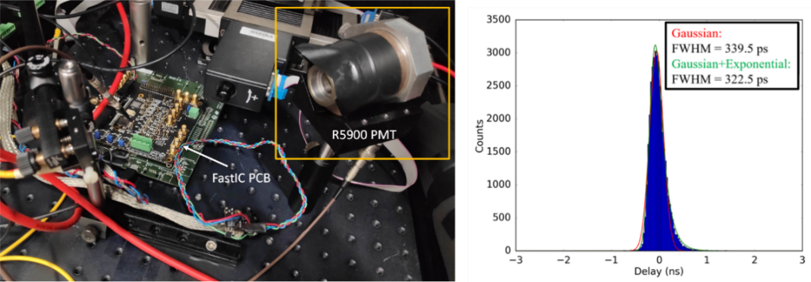
Summary of results with FastIC
CTR measurement with 2 × 2 × 3 mm³ LSO:Ce0.2%Ca crystals
coupled to FBK (a) and HPK (b) devices in coincidence (20 K events used).
Single Photon Time Resolution (SPTR) measurements
  Blue light laser (PiL040X, 405nm, jitter <3ps, pulse width<45ps)
  Agilent MSO 9404A, 4GHz, 20GS/s
  18ºC Temperature
  176 ±3ps FWHM (HPK SiPM S13360-3050CS, 3x3mm² V_{OV}=10.6V)
  151 ±3ps FWHM (FBK HD-NUV Low Field SiPM, 40μm cell, 3.12x3.12mm² V_{OV}=10.6V)
  Fits with the initial spec ~30ps_{rms} contribution from electronics with large SiPM
Coincidence Time Resolution (CTR) measurements
  LSO:Ce:0.2%Ca 2x2x3mm³
  93 ±3ps FWHM (HPK SiPM S13360-3050CS, 3x3mm² V_{OV}=8V)
  76 ±2ps FWHM (FBK HD-NUV Low Field SiPM, 40μm cell, 3.12x3.12mm² V_{OV}=6.1V)
Linearity error <3% up to 25mA (+ polarity stage) or up to 20mA (- stage)
9% energy resolution for 511keV (LYSO:Ce:0.2%Ca 3.13x3.13x20mm³)
R5900 Hamamatsu PMT, 800V.
  Jitter of ~340 ps FWHM, which corresponds to the intrinsic PMT time uncertainty when detecting tens of photons.
Two spin-off projects: FastIC+ and FastRICH
FBK HD-NUV Low Field SiPM at 6.1 V of over-voltage.
HPK S13360-3050PE SiPM at 8 V of over-voltage.

