Slide 1

FBK LGAD Technology for fast timing
1st MONOLITH Workshop on silicon sensors for timing and their applications
Genève, 5-6 Sept. 2022
FBK LGAD group: A. Bisht, G. Borghi, M. Boscardin, M. Centis Vignali, F. Ficorella, O. Hammad Ali, G. Paternoster
UFSD group
INFN Torino, Univ. of Turin, Univ. of Piemonte Orient, Univ. of Trento, FBK Trento, Univ. of California at Santa Cruz.
paternoster@fbk.eu

Slide 2




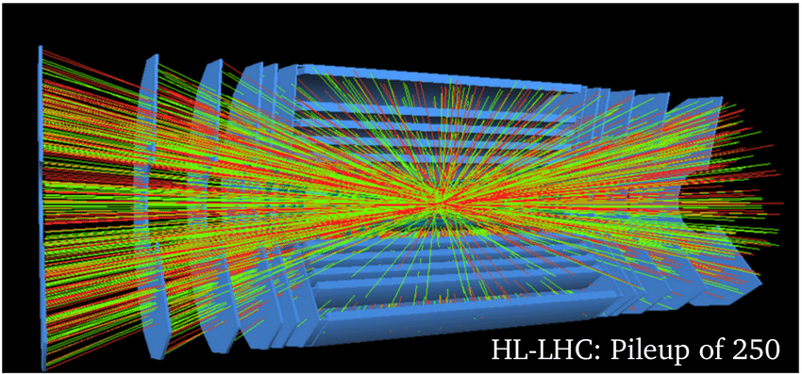
Introduction and Motivation
LGAD Technology developed at FBK since 2015
Developed together with INFN Turin and University Trento for 4d-tracking
More than 15 batches produced since 2015
Motivation
High Luminosity LHC (HL-LHC, operational in 2026):
  Luminosity: ×5 compared to LHC → 150-200 events per bunch crossing
  Timing and spatial resolution of standard silicon tracking sensors not sufficient: 10-15% of vertexes composed of 2 events
Requirements for silicon timing detectors in HL-LHC:
  Timing resolution: 30 ps (rms)
  Low spatial granularity: ~1 mm (timing information assigned to the track)
  High radiation hardness: > 1·10¹⁵ n_{eq}·cm⁻²

Slide 3
LGAD Technology
metal
metal
oxide
n+
n+
p-
p
p
p
20 - 100 µm
p++
E Field
Technological features
Main functionalities
Silicon detectors with internal charge multiplication
Gain: 10-20
Gain layer provides high-field region
Depleted thickness: 20 - 100 µm (epi or Si-Si wafers)
Time resolution 30 ps with thin 50 µm sensor
Improve SNR of the system (when the sensor shot noise is not dominating)
Low Noise and power consumption

Slide 4
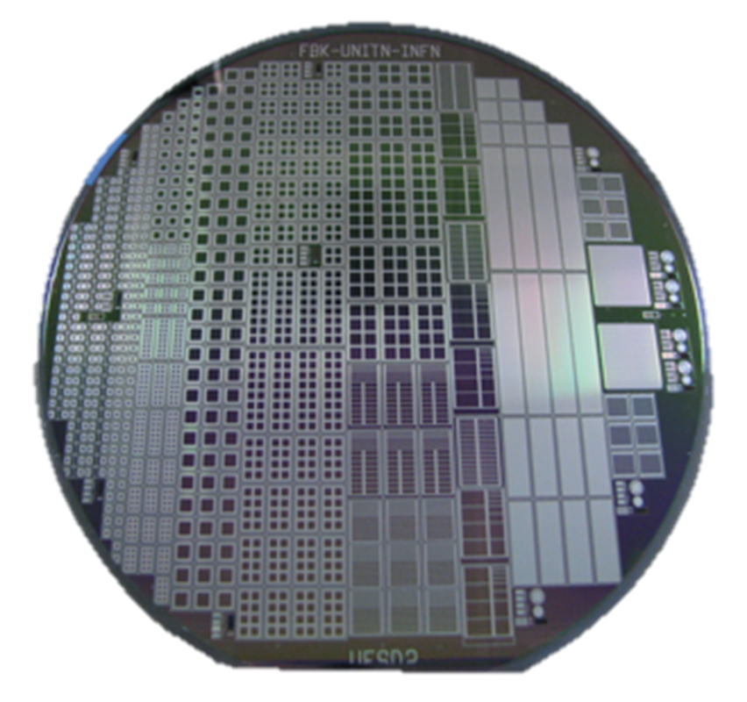
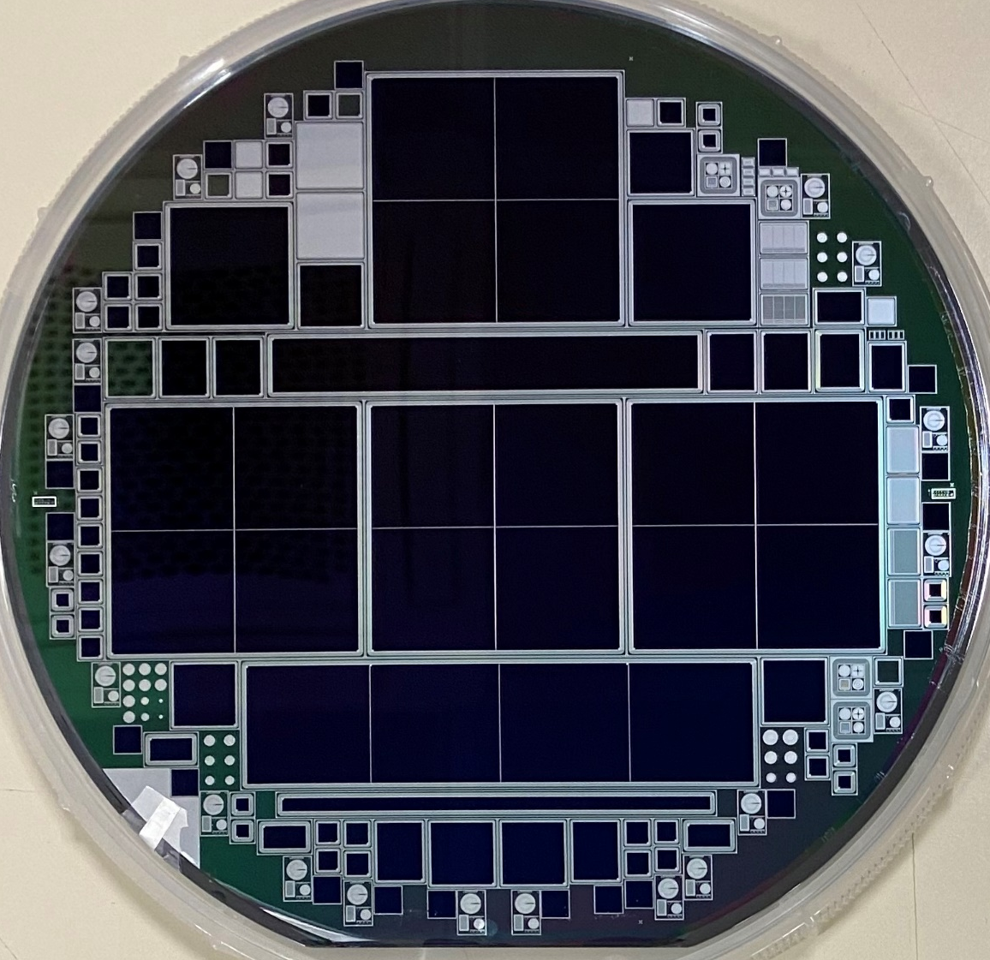
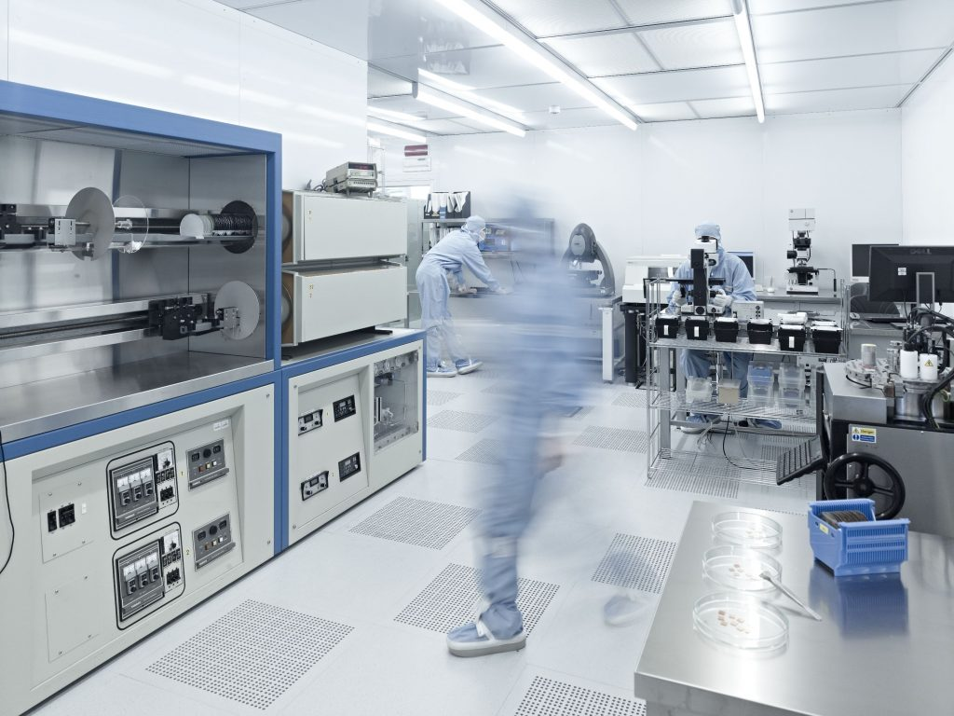
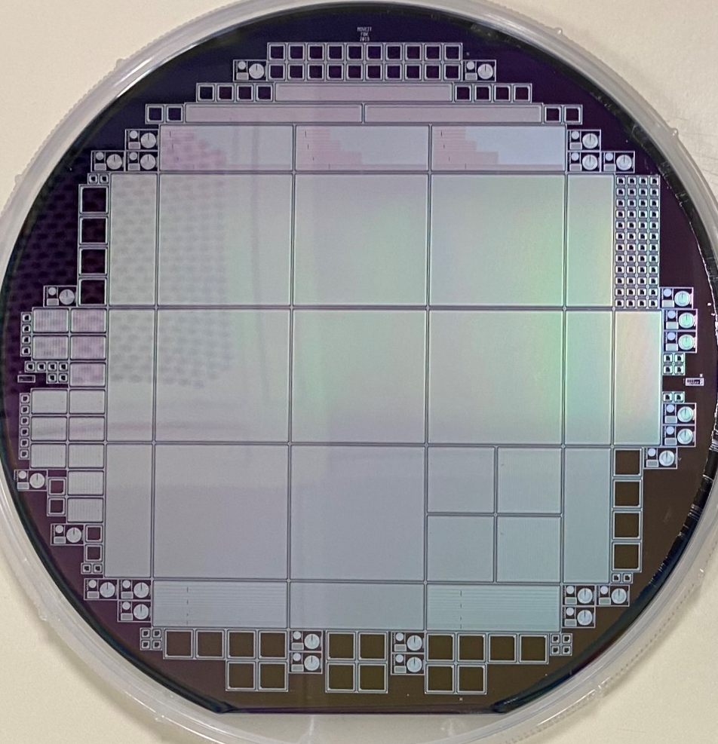
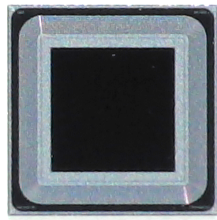
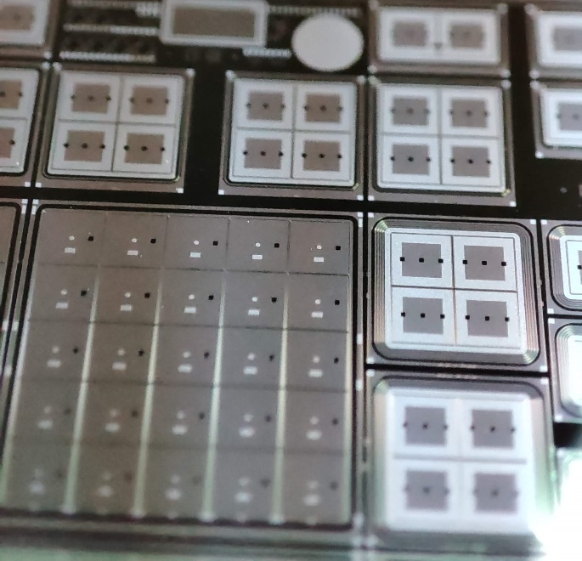
LGAD Fabrication Technology
Single pads,
Pad arrays;
Strips;
Other pixelated detectors….
Fabricated on 6 inches Wafers
Custom CMOS-like Technology
Fabricated in the FBK internal facility (ISO 9001:2015 certified)
Large area detectors
Up to ~ 3x3 cm2

Slide 5
FBK LGAD Technology Roadmap
Different designs, optimized for different applications
UFSD
Fast timing and radiation resistance
4D-tracking at HL-LHC
iLGAD
(double-sided)
Fine-segmentation, Thin-Entrance window
Soft x-ray detection
TI-LGAD
(trench-isolated)
Fine segmentation, fast-timing, radiation resistance
4D-tracking, soft x-ray
RSD (Resistive
Silicon Detectors)
New red-out paradigm: high temporal- and space-resolution with reduced # of channels
4D-tracking

Slide 6
UFSD: Recipe for fast timing
Key factors governing time resolution of LGADs.
Both design & technology
metal
metal
Thickness
Gain
Drift velocity of e⁻ in the bulk
Pad geometry (weighing field)
oxide
n+
n+
HR p-type
p
Gain layer
Gain layer
LR p-type

Slide 7


Recipe for fast timing
$$slew rate$$
$$\frac{dV}{dt}∝\frac{G}{d}$$
Gain
Gain depends on GL dose and Bias Voltage
High Gain reduces the jitter
At too high gain the time resolution is dominated by Landau noise
timing
Landau floor
jitter
Rule: use the minimum gain that allows
reaching the minimum value in time resolution
Bulk E_{field}
Working point
Target gain should be reached at a Bias where the e- velocity in the bulk is saturated (E > 3e4 V/cm)
For 50 µm the target is G~10 at V > 200 Volts
Sadrozinski et al 2018 Rep. Prog. Phys. 81 026101

Slide 8

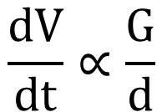
Recipe for fast timing
$$slew rate$$
$$\frac{dV}{dt}∝\frac{G}{d}$$
Thickness
Reducing Thickness ->
Higher slew-rate
Lower Landau and Time-walk
High capacitance
Less radiation resistance (SEB)
Trade off ~ 50 um
Sadrozinski et al 2018 Rep. Prog. Phys. 81 026101

Slide 9
Recipe for fast timing
Latest test with ultra-thin LGADs
35 μm and 25 μm
Wafers from eXFlu0 production
Thickness
Ultra-thin sensors produced at FBK (EXFLU project)
Characterized at INFN Bologna, INFN Turin and CERN
35µm thick LGADs approach 20ps time resolution (mainly thanks to Landau noise reduction)
No further improvement moving to 25 µm. Possible causes:
  higher substrate doping (not saturated electrons velocity in the bulk)
  Higher noise of the sample
F. Carnesecchi, arXiv:2208.05717

Slide 10
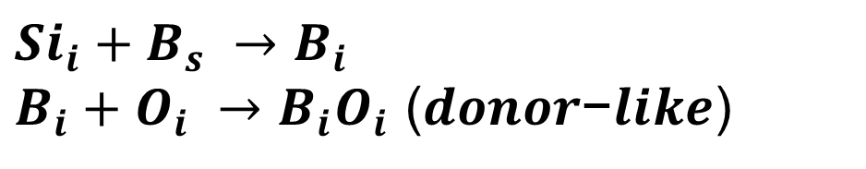
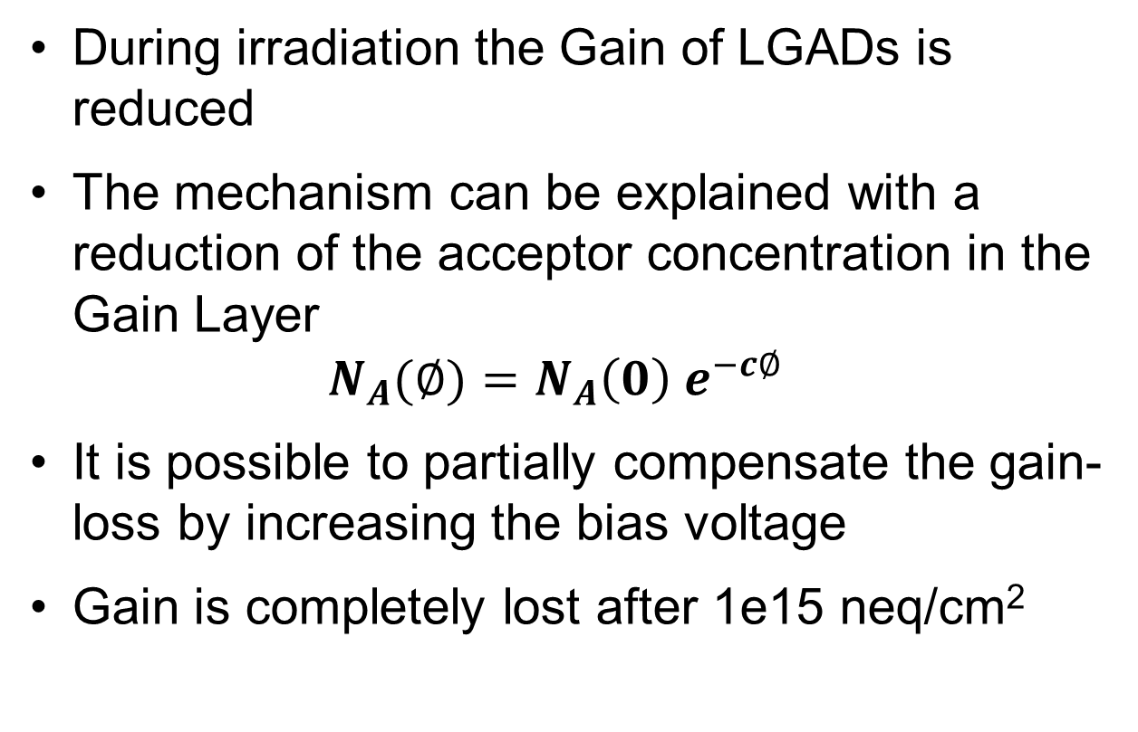
Radiation Hardening
Initial Acceptor removal
During irradiation the Gain of LGADs is reduced
The mechanism can be explained with a reduction of the acceptor concentration in the Gain Layer
$N_{A}(∅)=N_{A}\left(0\right) e^{−c∅}$
It is possible to partially compensate the gain-loss by increasing the bias voltage
Gain is completely lost after 1e15 neq/cm²
Increasing Fluence
Possible microscopic mechanism:
Boron de-activation due to Si interstitial
$$Si_{i}+B_{s} →B_{i}$$
$B_{i}+O_{i} →B_{i}O_{i}$ (𝒅𝒐𝒏𝒐𝒓−𝒍𝒊𝒌𝒆)

Slide 11
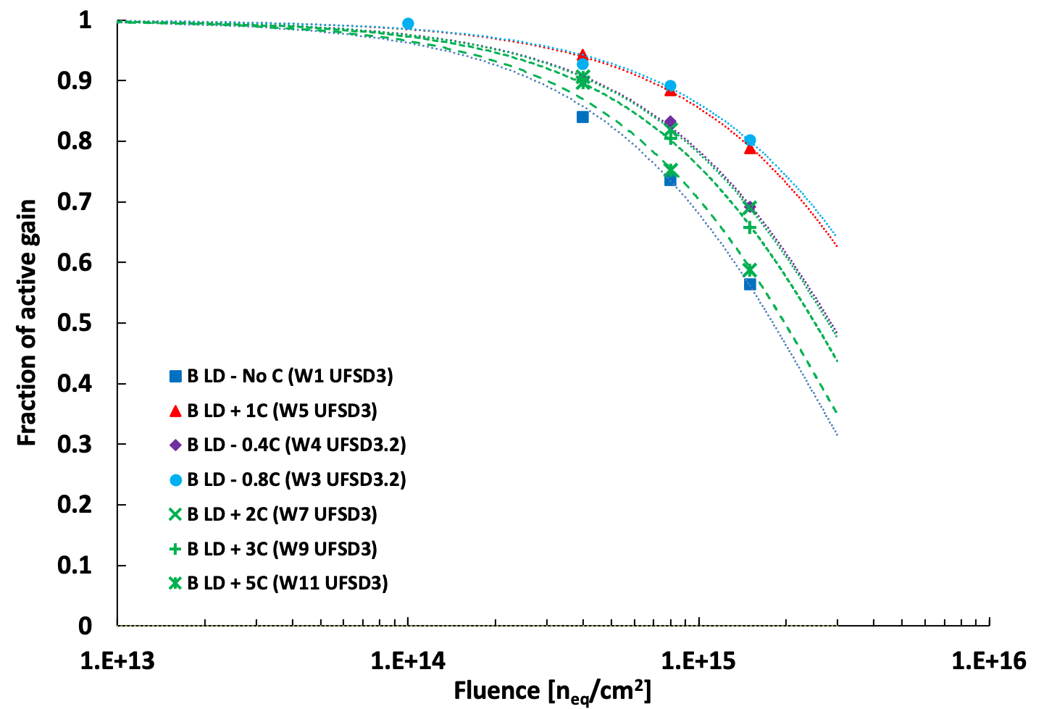
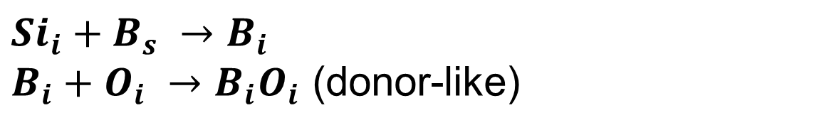
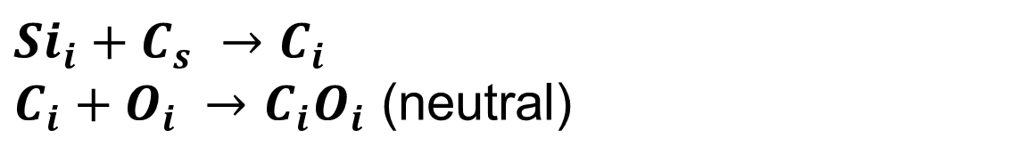
Radiation Hardening
Carbon Co-implantation for acceptor removal mitigation
Boron removal
Carbon
co-implantation
Carbon Enables competing mechanism
$$Si_{i}+B_{s} →B_{i}$$
$B_{i}+O_{i} →B_{i}O_{i}$ (donor-like)
$$Si_{i}+C_{s} →C_{i}$$
$C_{i}+O_{i} →C_{i}O_{i}$ (neutral)
+ Carbon (optimal dose)
Carbon implanted only in the Gain Layer at the same depth (overlapping to Boron)
Carbon
Boron
Many split on C dose
Carbon co-implantation Optimization
Carbon Dose
Carbon implantation depth
Thermal load Boron/Carbon for activation and diffusion
No Carbon

Slide 12
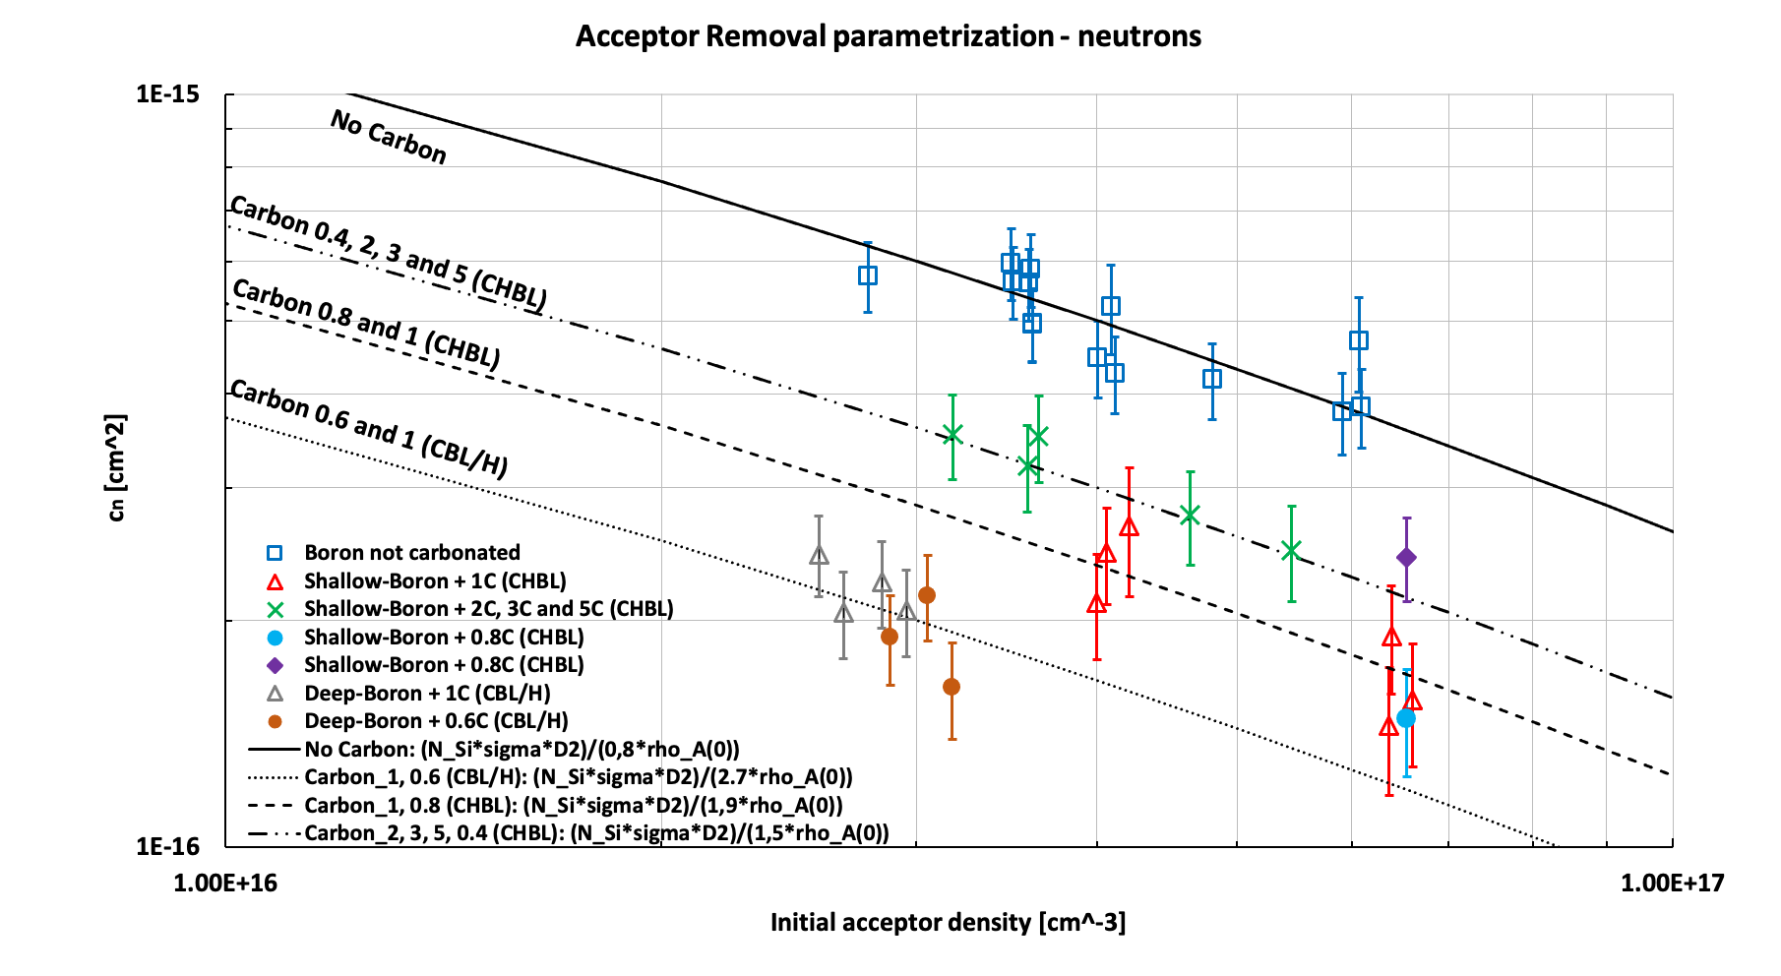


Radiation Hardening
Carbon co-implantation for acceptor removal mitigation
$$N_{A}(∅)=N_{A}\left(0\right) e^{−c∅}$$
$$c={c(N}_{A}\left(0\right))$$
Different carbon doses and Thermal Load
[M. Ferero, INFN To, 37th RD50 Workshop ]
Recipe for high radiation resistance
Acceptor removal coefficient
Radiation resistance improving
Using optimized Carbon dose
Increase boron density (w/o increasing the gain too much)
Higher initial boron Density

Slide 13
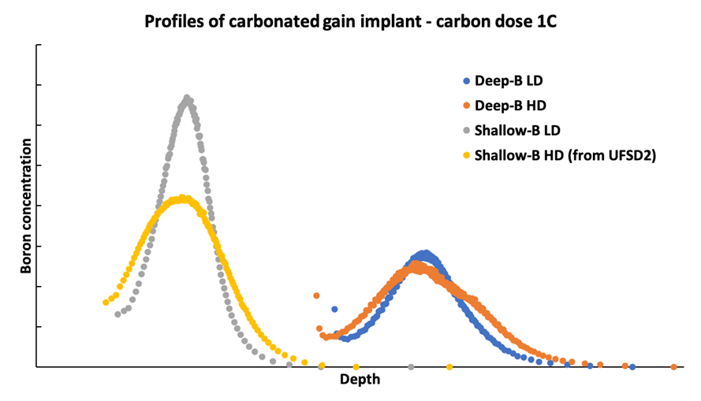
Radiation Hardening
Gain layer optimization
Boron depth: Shallow (~1um) or Deep
Thermal diffusion (low or high)
Low thermal budget
Higher initial boron Density
Higher Boron concentration -> lower c factor
Shallow B implant
(more dose for the same gain)
Narrower (low diffused) B profiles
Disadvantages of a Shallow gain layer:
• Worst gain recovery than deep-gain implant, using external bias
Shallow GL
Deep GL

Slide 14
Radiation Hardening
Carbon Co-implantation for acceptor removal mitigation
i) No Carbon
ii) Carbon in the Gain Layer (GLC)
Shifting (or adding) an additional Carbon implant deeper than the Gain Layer (Carbon shield)
More tests are ongoing…
Carbon
Boron
Boron
iii) Carbon shield (CS)
iv) GLC + CS
First tests on GLC + CS show a further decreasing of the c factor of ~ 20%.
Carbon
Boron
Boron
Carbon
Carbon
(the right place to add Carbon has still to be understood…)

Slide 15
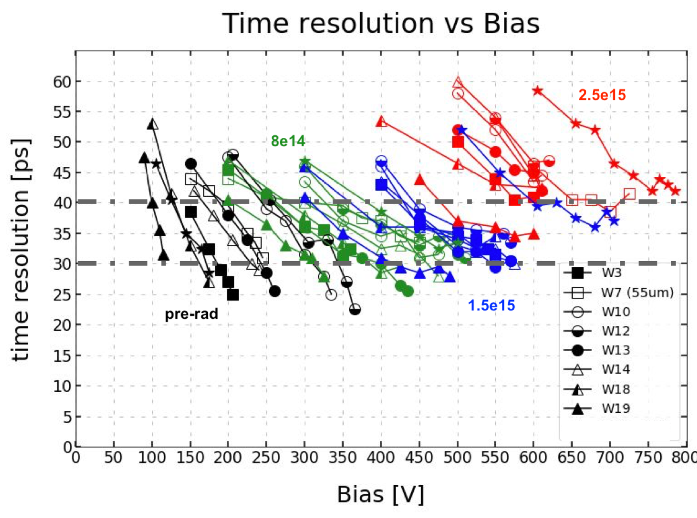
Recipe for fast timing
Time resolution
< 30 ps up to 1e15 neq/cm²
< 40 ps up to 2.5e15 neq/cm²
Demonstrated radiation resistance and time resolution for HL-LHC

Slide 16
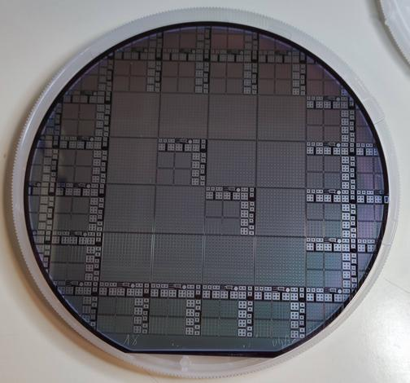
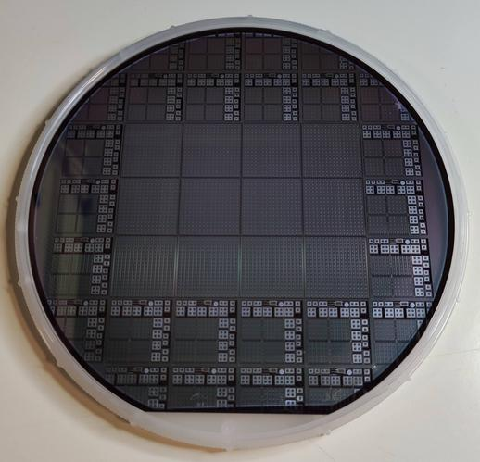
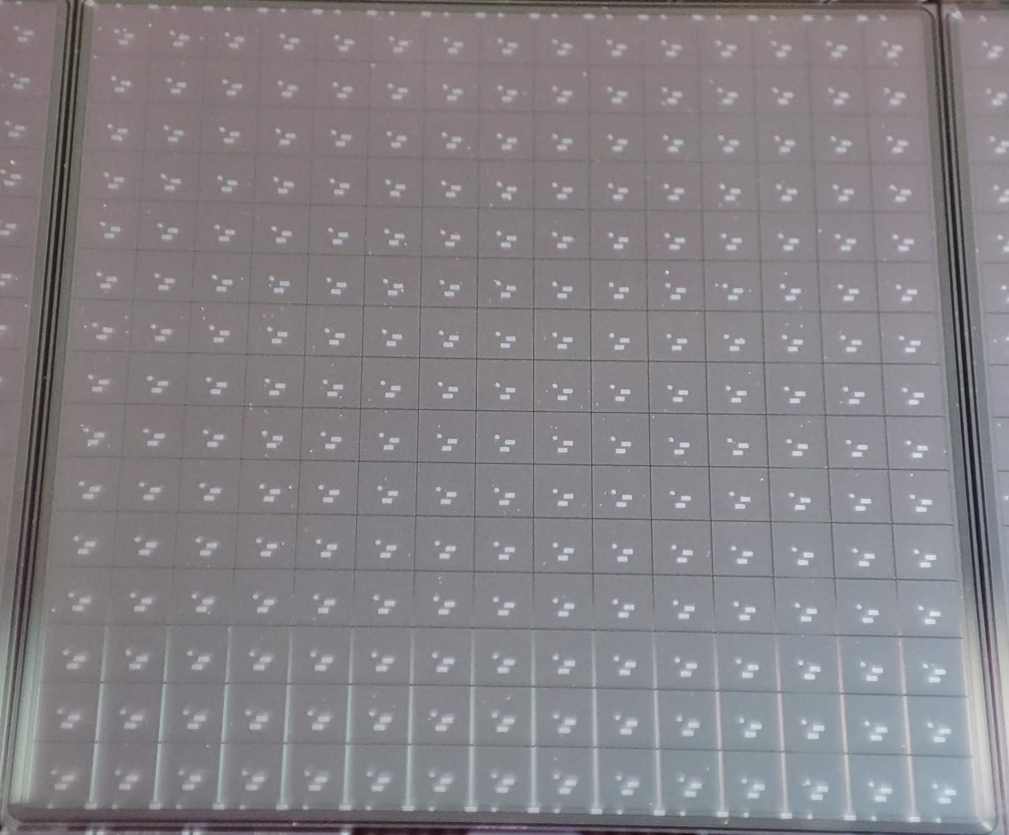
Recipe for fast timing
Production qualification
ATLAS - HGTD
CMS - ETL
Full sensors ~ 2 x 2 cm²
15 x 15 and 16 x 16 arrays
1.3 mm² pads
UFSD 4 batch for final sensor qualification

Slide 17
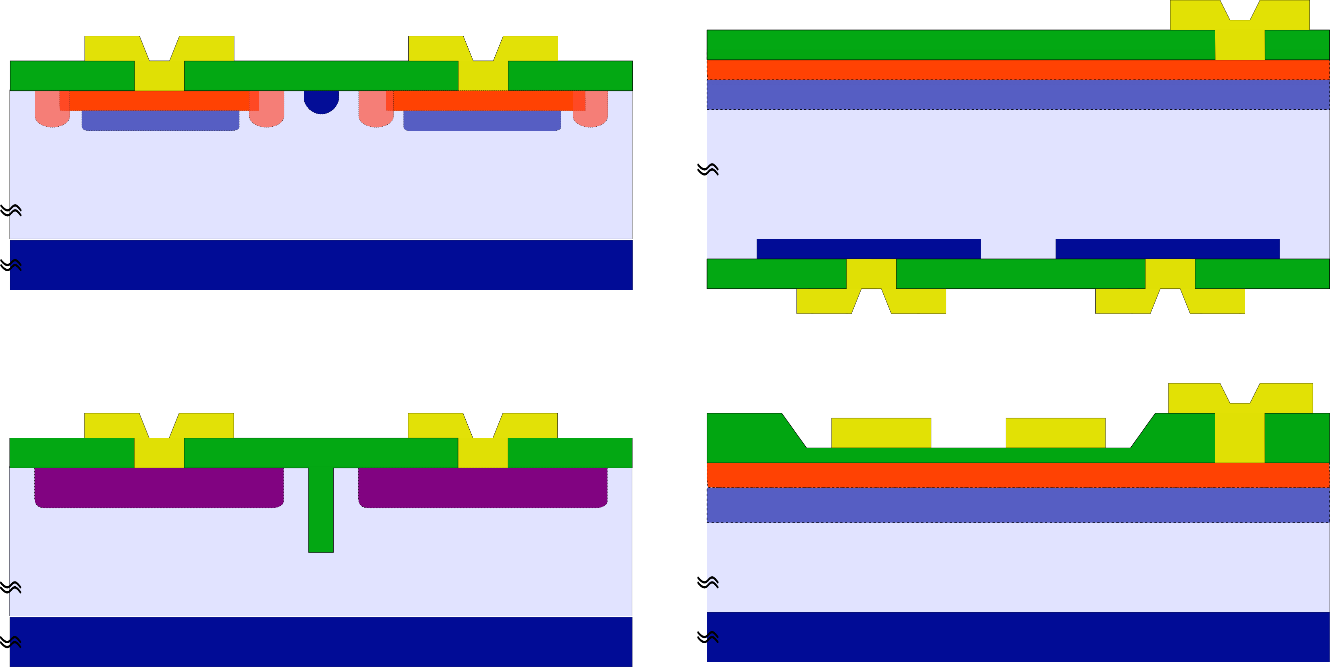
Novel LGAD schemes for fine-segmentation
Trench Isolated - LGAD Technology
Segmented Standard LGAD
Trench-Isolated LGAD
n⁺
n⁺/p⁺
Multiplication region
Gain layer
Epi-silicon (p⁻)
Epi-silicon (p⁻)
Support wafer (p⁺)
Support wafer (p⁺)
no-gain region ~ 60um
no-gain region < 5 um
    No-gain region at the pixel border due to isolation and termination structures: JTE and p-stop
    Dead distance for charge multiplication ~ 40 - 80 μm
    JTE and p-stop are replaced by a single trench (< 1 um wide)
    Trenches act as a drift/diffusion barrier for electrons and isolate the pixels.

Slide 18
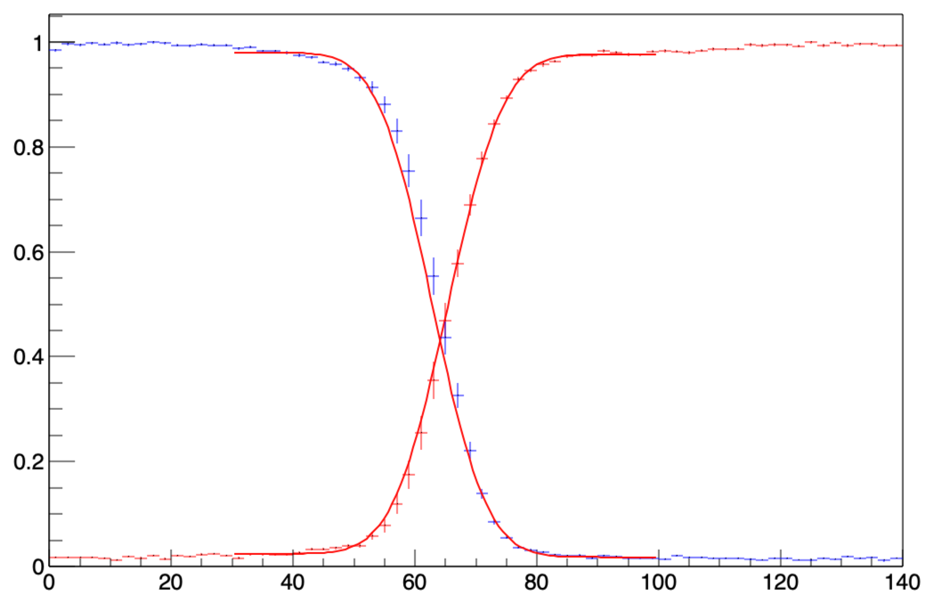
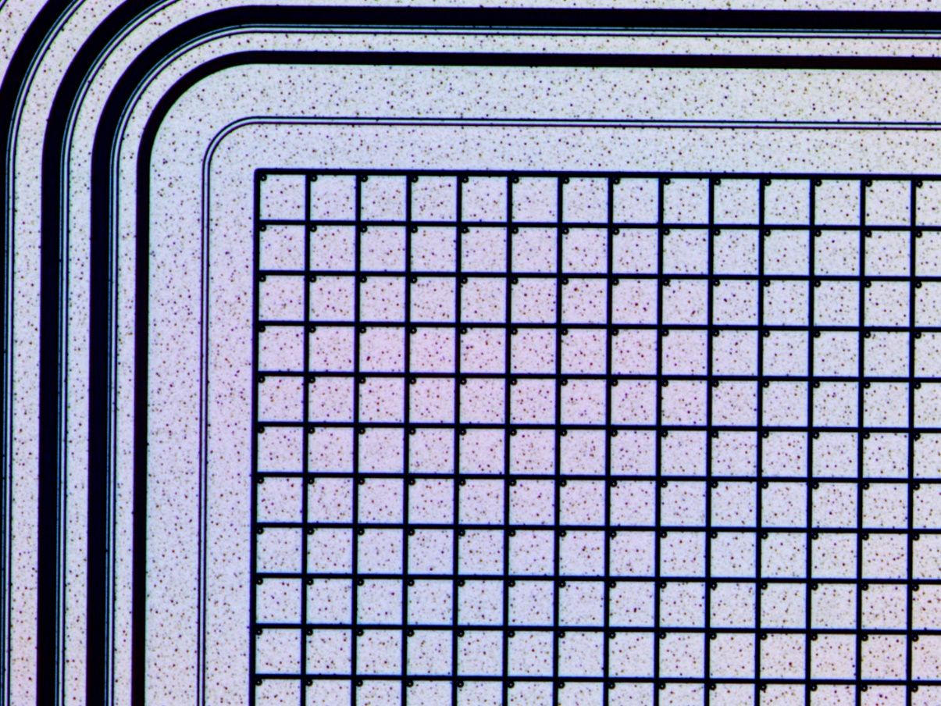
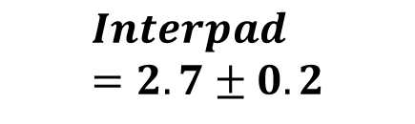
Novel LGAD schemes for fine-segmentation
Trench Isolated - LGAD Technology
Pixels
55 × 55 µm² (Medipix/Timepix)
FF > 80%
Inter-pad distance
Measured with TCT setup (red laser)
Measured at INFN TO
(courtesy of M. Ferrero)
Interpixel distance in the range 2-10 um (depending on the layout split)
Pixel 2
Pixel 1
$$Interpad=2.7±0.2$$
laser scanning

Slide 19
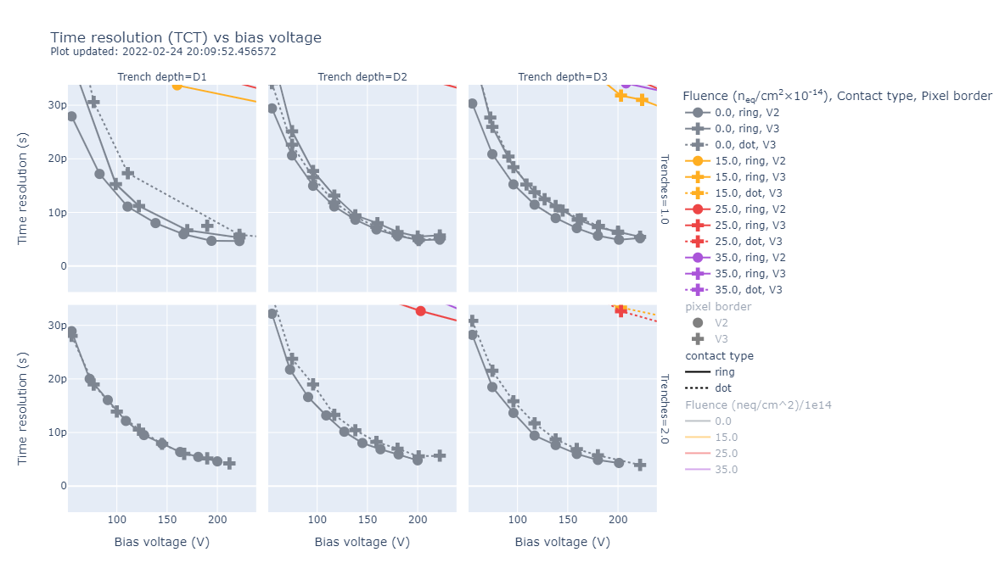
Novel LGAD schemes for fine-segmentation
Trench Isolated - LGAD Technology
Pixels
55 × 55 µm² (Medipix/Timepix)
FF > 80%
Time Resolution (jitter)
Measured with TCT setup (red laser)
M. Senger – VCI 2022
Not-degradated time resolution wrt standard LGADs
Time resolution (laser setup) < 10 ps
Jitter (s)
Bias (Voltage)

Slide 20
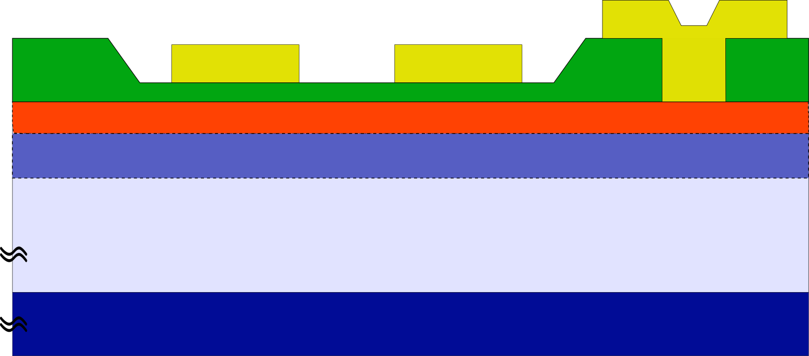
RSD – Resistive Silicon Detectors (aka AC-LGADs)
Resistive Silicon Detectors
Segmented Standard LGAD
Thin coupling dielectric layer
DC Bias Pad
AC pads
n⁺
Gain layer
Resistive n+
p+ implant
Epi-silicon (p⁻)
Support wafer (p⁺)
Main Technological Features
Not-segmented p-gain implant
Resistive n+ implant
AC Metal pads
RSD is not just an LGAD with AC-pads.
It is a different way to read-out the signal and to segment the sensor

Slide 21
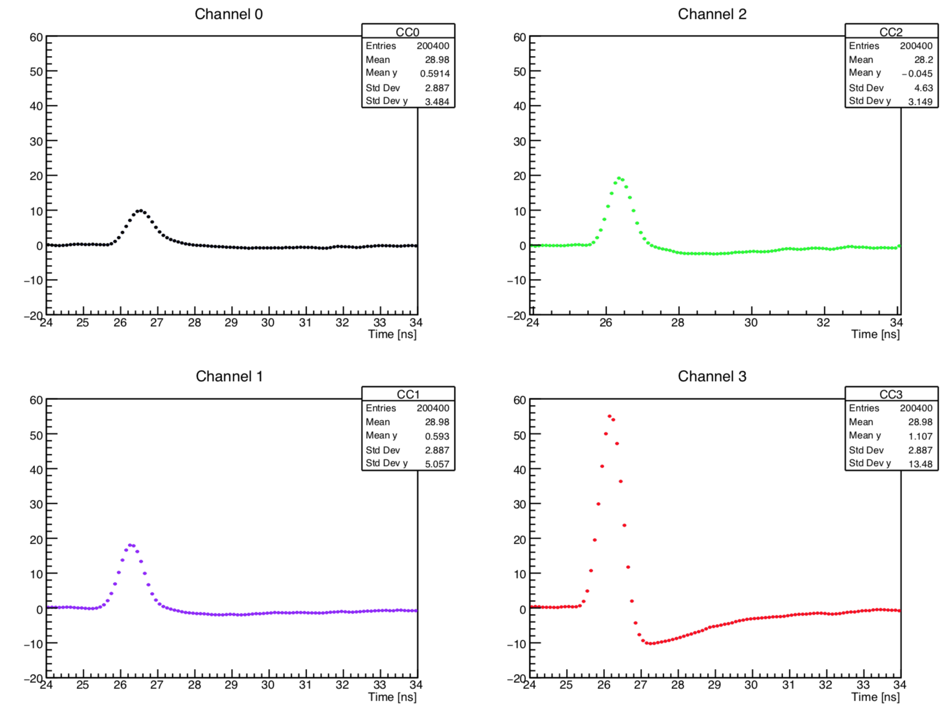
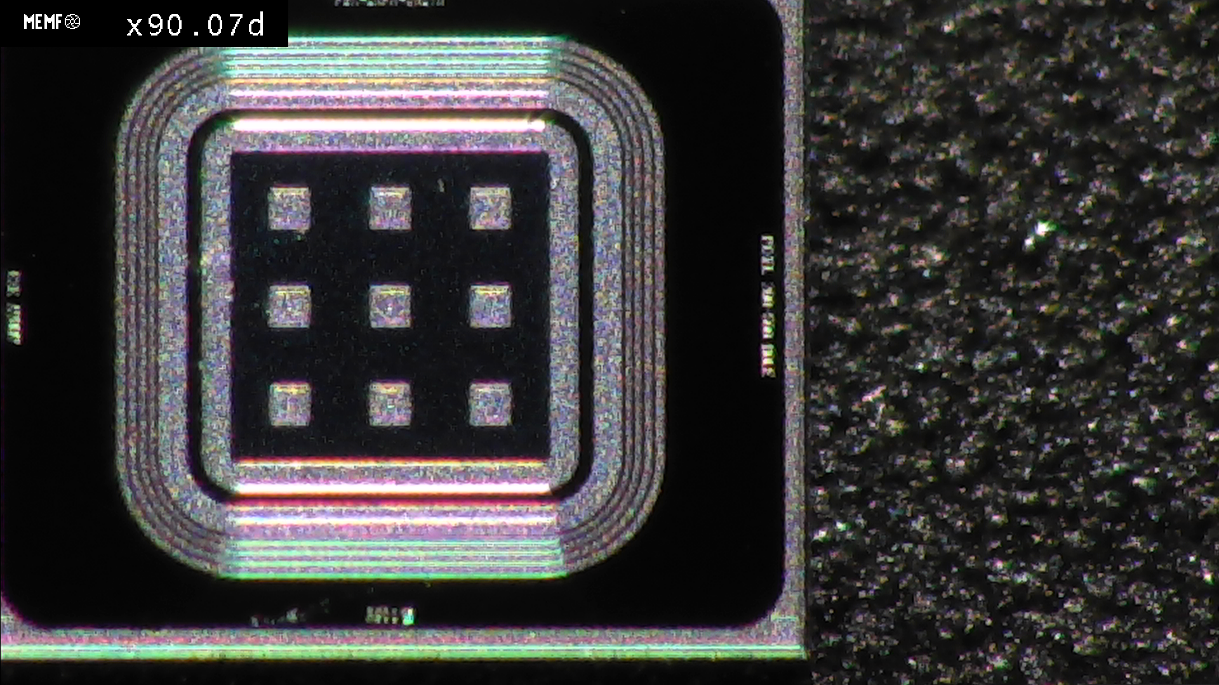
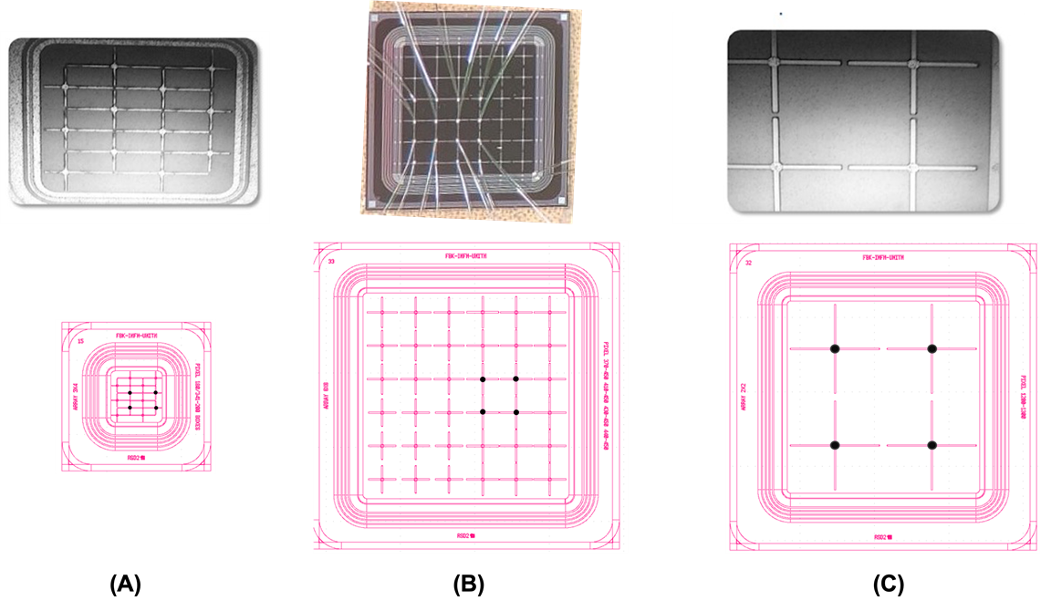
RSD – Resistive Silicon Detectors (aka AC-LGADs)
How does it works
TCT Measurements with IR Laser Setup
The signal spreads on several pads, with amplitude inversely proportional to the hit distance
Laser Spot
N. Cartiglia
RSD2 production
the resolution is 3% of the pixel size

Slide 22
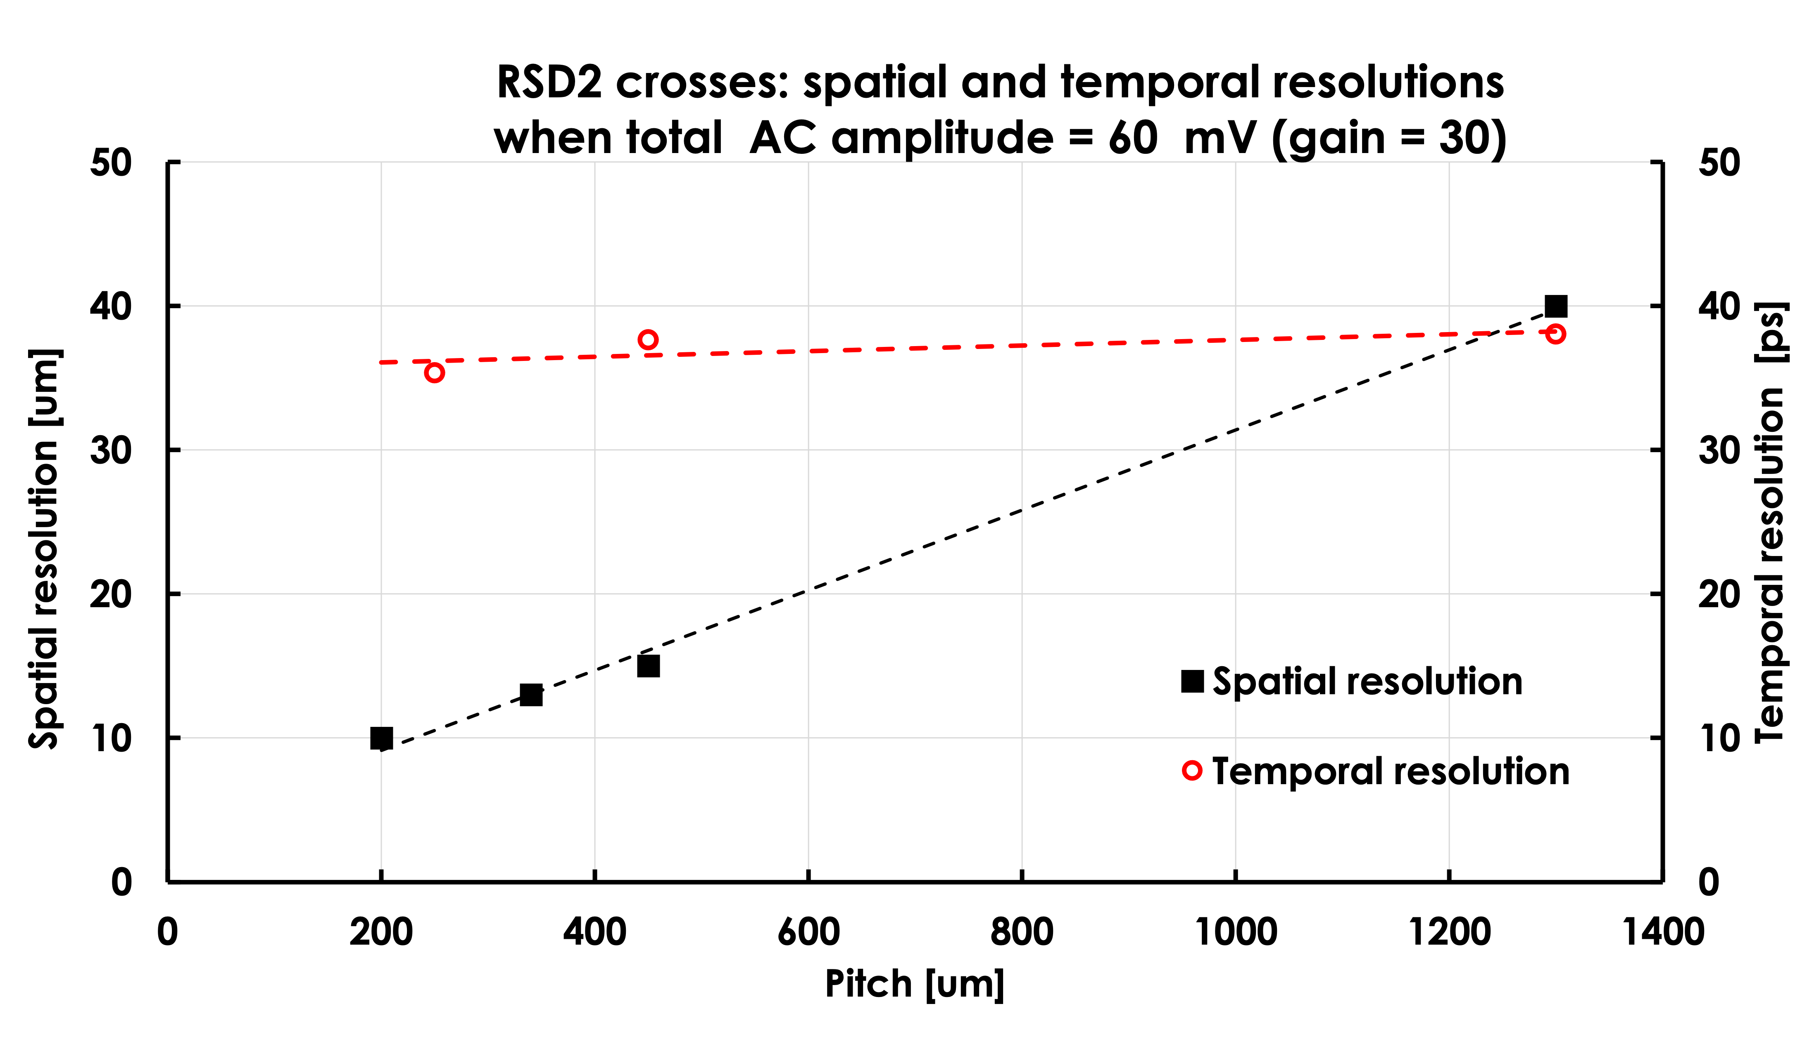
RSD – Resistive Silicon Detectors (aka AC-LGADs)
Time resolution
N. Cartiglia
RSD2 crosse overall result:
Spatial resolution ~ 3% pitch size
Temporal resolution ~ 35 ps, regardless of pitch size
The temporal resolution does not depend on the pize size, only on the total amplitude.
(total amplitude = sum of the amplitudes of the 4 read-out electrodes at the pixel corner)

Slide 23
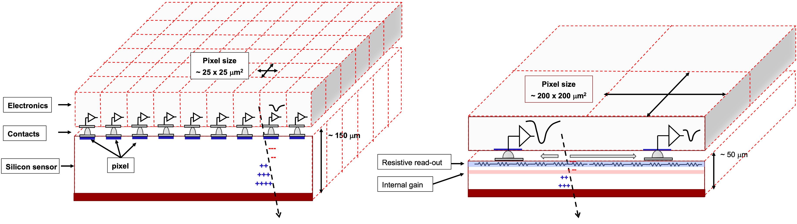
RSD – Resistive Silicon Detectors (aka AC-LGADs)
Final GOAL
Standard tracker
RSD-based tracker
The design of a tracker based on RSD:
It delivers ~ 30 ps temporal resolution and excellent spatial resolution with large pixels
For the same spatial resolution, RSD trackers use 50-100 fewer pixels
The electronic circuitry can be easily accommodated
The power consumption is much lower;
23

Slide 24
Conclusions
In the last years FBK developed LGADs technology for 4D-tracking
Last developments in LGAD lead to time resolution ~30ps up to fluences of 2.5e15 neq, mainly thanks to the using of thin substrates and initial acceptor removal mitigation
The radiation resistance can be further increased by optimizing Carbon co-implantation or dopant co-implantation
The new TI-LGAD technology preserves the time resolution of LGADs scaling down the pixel size to few tens of microns.
RSD technology can combine the 30ps time resolution, few microns space resolution and radiation hardness with a reduced number of read-out channels.

Slide 25
Thank you for your attention
Acknowledgements
Part of the work has been performed in the framework of RD50
Some batches have been produced in the framework of convenzione INFN/FBK
Horizon 2020, grant UFSD669529
Progetto PRIN2017, MIUR, 4DInSide, Prin2017
Progetto FARE, MIUR, R165xr8frt_fare
Dipartimenti di Eccellenza, Torino Physics Dep. (ex L. 232/2016, art. 1, cc. 314, 337)
UFSD group
INFN Torino, Univ. of Turin, Univ. of Piemonte Orient, Univ. of Trento, FBK Trento, Univ. of California at Santa Cruz.
paternoster@fbk.eu

Slide 26
Radiation Hardening at extreme fluences
Psphorous/Boron co-doping
Gain layer is obtained by co-implanting Boron and Phosphorous
1*B -> 5*B + 4*Ph
eXFlu project (V. Sola, INFN To)
GOAL: operate LGADs at fluence > 10¹⁶ neq/cm
F= 1e16 neq/cm2
No acceptor removal after F= 1e16 neq/cm2
It works under the assumption (c_{A} ≈ c_{B})
Production to be completed in October 2022

Slide 27
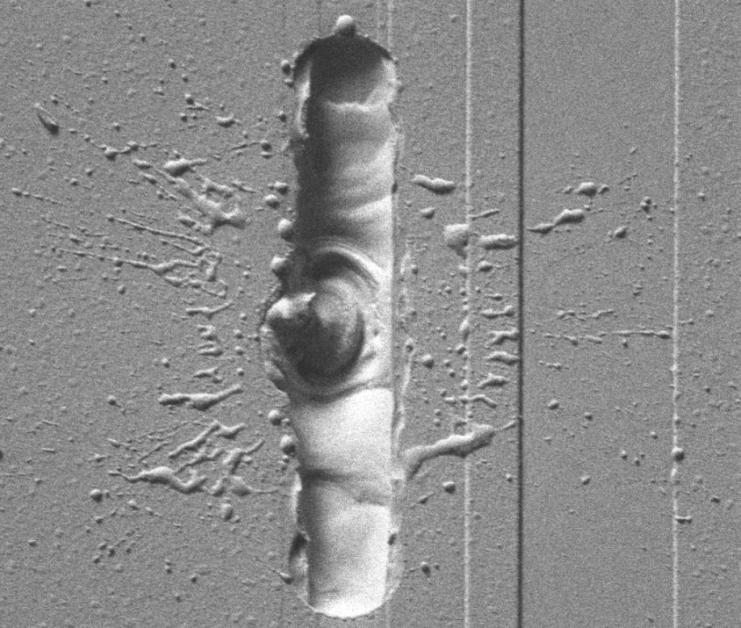
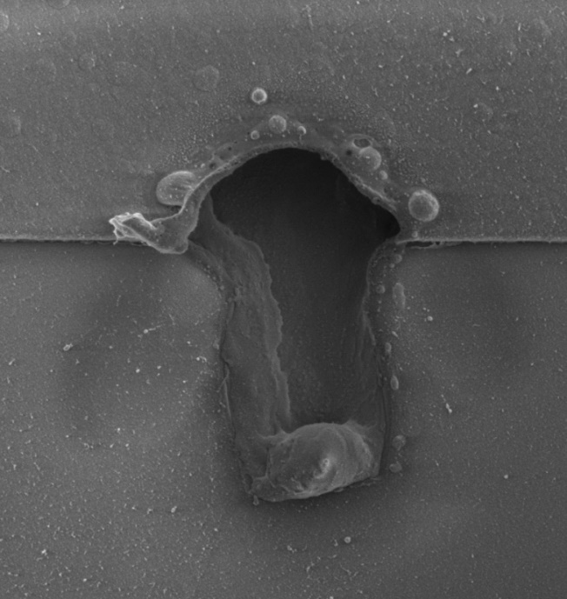
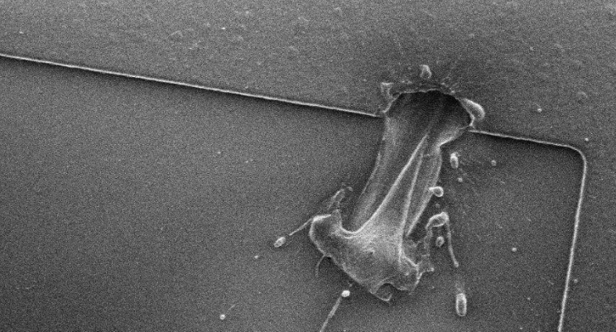
LGAD – Radiation hardness
Thickness
SEB = Single Event Burnout
Death of highly irradiated LGADs at test beam
Probably due to a rare, large ionization events producing large current in narrow path
Mortality is function of sensor thickness and voltage only (Gain is not necessary for death mechanism)
Fatal voltage: > 600V for 50 um Sensors
Fatal Voltage becomes lower for thinner sensors
[Ryan Heller, 38th RD50 Workshop]
[Gordana Lastovicka-Medin, 38th RD50 Workshop]

Slide 28
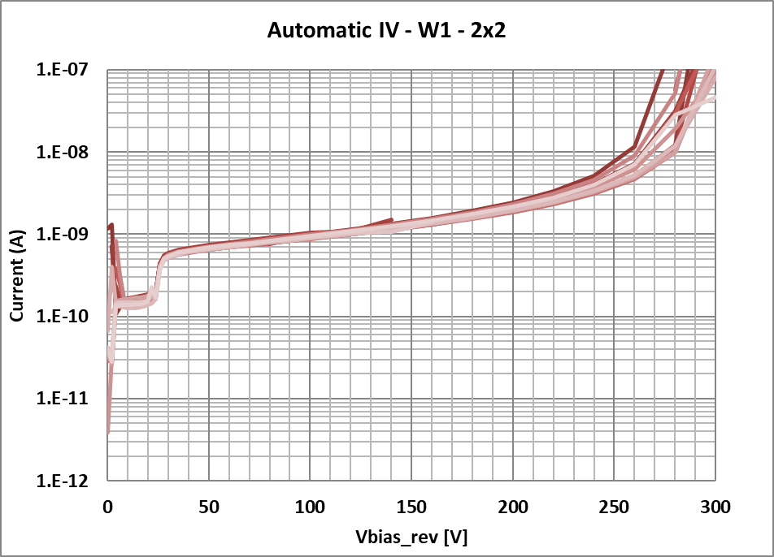
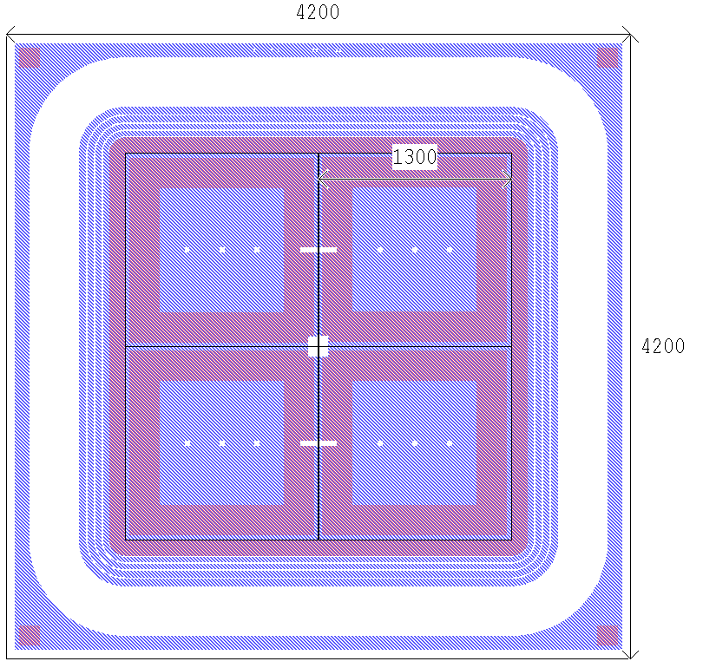
TI-LGAD Production Batch: Electrical characterization
Automatic IV characterization
GAIN
+ light
Dark current ~ 10 pA/mm²
TCT Setup with IR Laser
200V and RT
2x2 pixels
1.3 mm² pixels
ATLAS/CMS Timing Layer

Slide 29
Temporal resolution
The temporal resolution does not depend on the pize size, only on the total amplitude.
(total amplitude = sum of the amplitudes of the 4 read-out electrodes at the pixel corner)

Slide 30
Spatial resolution as a function of the signal amplitude for 4 pitch sizes
Executive summary: the resolution is 3% of the pixel size
(total amplitude = sum of the amplitudes of the 4 read-out electrodes at the pixel corner)

Slide 31

Latest FBK RSD production RSD2
The key feature of RSD2 is to design the electrodes to have as little metal as possible and to maximize sharing among the read-out pads at the corner of the pixel
RSD2 crosse overall result:
Spatial resolution ~ 3% pitch size
Temporal resolution ~ 35 ps, regardless of pitch size

Slide 32
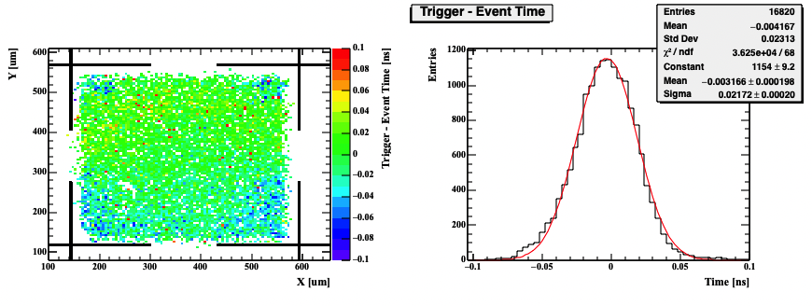
Example of uniformity in the time resolution over the whole pad
(A)
(B)
Plot obtained by shooting laser shots (TCT system) over the whole pixel surface and comparing the trigger time with the reconstructed time

