Slide 1
The development of SDHCAL in Mokka
Gabriel Musat, Ran Han , Gerald Grenie
2011-01-05

Slide 2
Outline
The structure of Videau and Tesla
How to use
Test with geantino and Marlin-Pandora

Slide 3
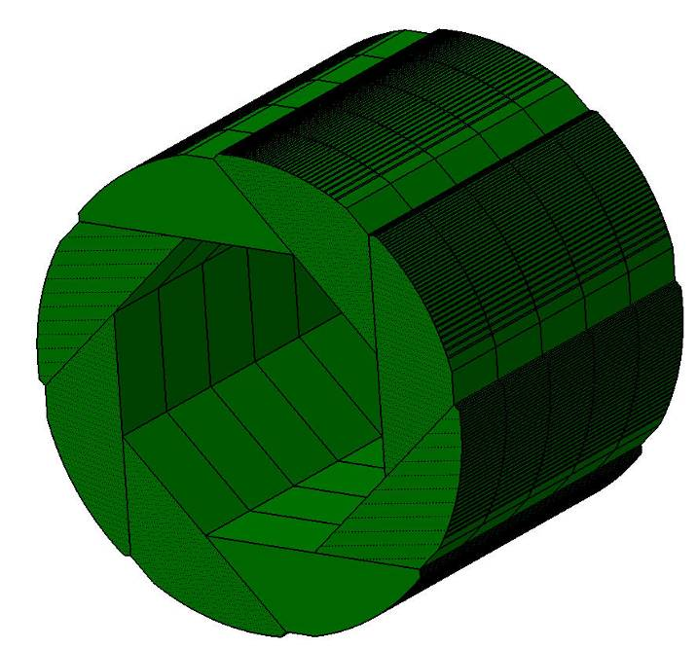
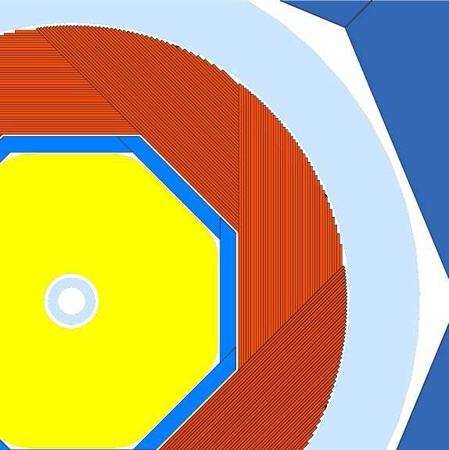
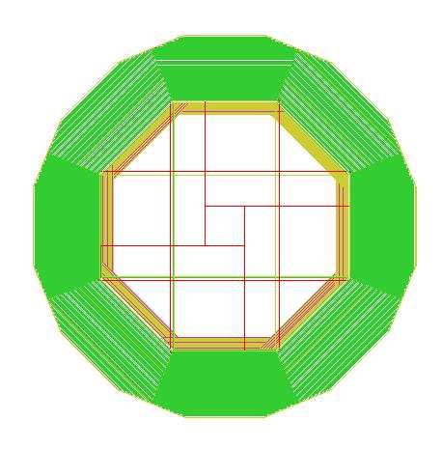
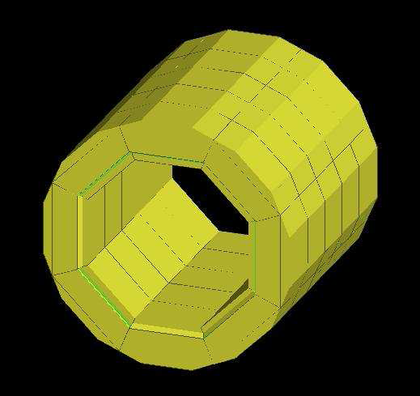
Two SDHcal Mode in Mokka
Videau
Drive: ~/Mokka/source/Geometry/LDC/SHcalRPC01
Tesla
SHcalRPC02:
Keep AHCal information added SDHCal in

Slide 4
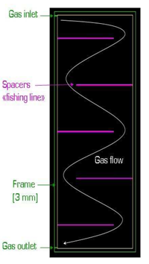
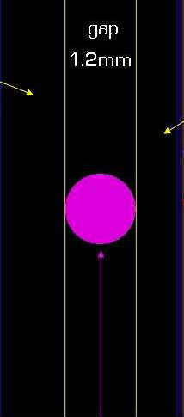
The Changes in Videau
Radius=4mm, Distance=10cm, Material=Nylon.
should be GlassfiberGraphit_thinkess_
Some more details:
Cathode: from 0.1 to 0.05mm,
Mylar_thinkness_Cathode: from 0.20mm to 0.18mm
Chip_Package from 1.4mm to 1.6mm
PCB_Thinkness from 0.8mm to 1.2mm
The usage is the same as before, already sumbit to Mokka

Slide 5
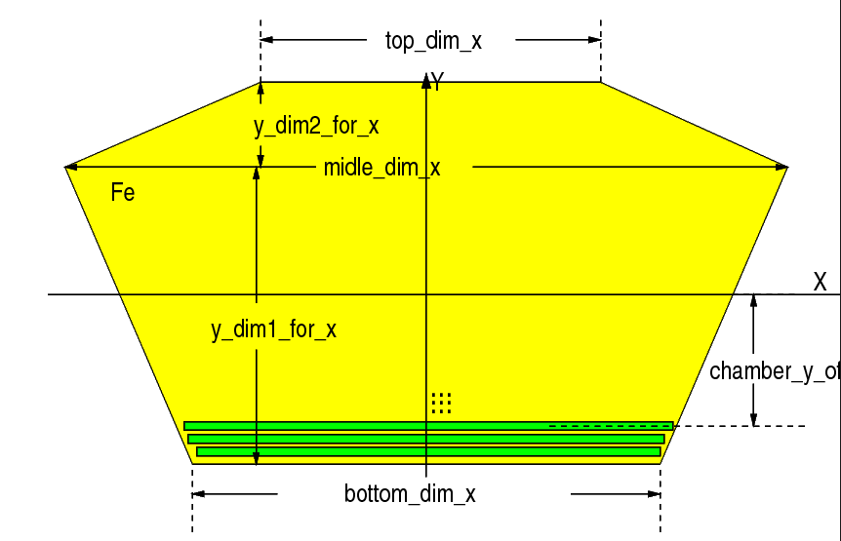
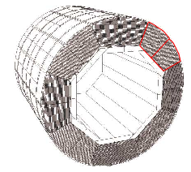
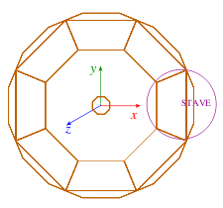
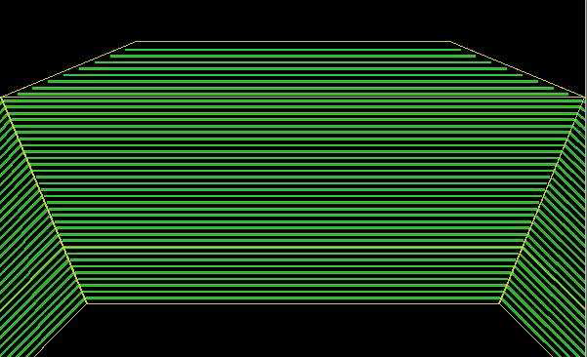
The implantation to AHCAL --TESLA
octahedral structure
each staves divided in two halves in the x,y plane
along the Z-axis, the calorimeter is again divided in two modules, with a gap of 2mm.
eight identical staves

Slide 6
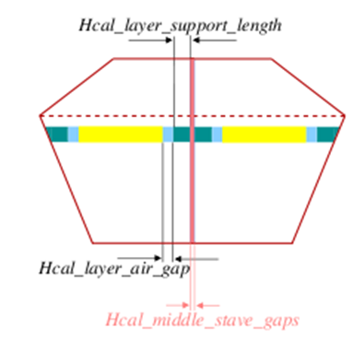
The Stave in Tesla
BarrelChambersSupportTrap: Build layer
Support structure 5mm
BarrelHalfRegularChamberTrap:
Build the chamber
BarrelChambersGap: Build the gap
between chambers and layer support
BarrelModuleGap: simulated the gaps
Between two real halves

Slide 7
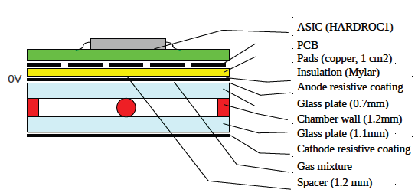
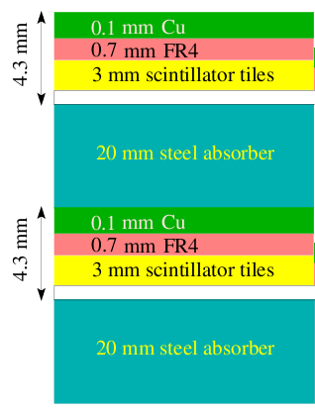
The chambers
BarrelHalfRegularChamberTrap
Rotate in Y direction
The thicknes of Scintilator is 4.3 mm
The thickness of RPC kept 6.5mm(include Electrics)
The 20mm stellabsorber is the same

Slide 8
The size of Hcal with sci and rpc
Hcal_inner_radius=Ecal_outer_radius=Same
Hcal_outer_radius= Hcal_inner_radius+Hcal_total_dim_y= different
SDHCAL
Hcal_total_dim_y=1287
Hcal_outer_radius = 3227
AHCAL
Hcal_total_dim_y=1181.4
Hcal_outer_radius = 3121.4
1287 -1181.4=3227-3121.4= (6.5-4.3)*48

Slide 9
How to use Tesla Model
The file in init.macro like
/Mokka/init/detectorModel ILD_01pre00
/Mokka/init/EditGeometry/rmSubDetector SHcalSc03
/Mokka/init/EditGeometry/addSubDetector SHcalRpc02 110
#/Mokka/init/globalModelParameter Hcal_sensitive_model scintillator
/Mokka/init/globalModelParameter Hcal_sensitive_model SDRPC
/Mokka/init/globalModelParameter Hcal_cells_size 10
/Mokka/init/initialMacroFile mac.mac
/Mokka/init/lcioFilename pi80GeV-100O-80deg.slcio
/Mokka/init/MokkaGearFileName pi80GeV-100O-80deg.xml
1: Mokka checkout
svn co http://llrforge.in2p3.fr/svn/Mokka/trunk Mokka
2: Mokka Compile
cd ~/Mokka/source
make
3:Mokka Run
Mokka init.macro
Gerald ‘s script for Mokka, svn: /analyse/trunk/SDHCAL-offline-tools/run_Mokka_gridSite.sh
Change Mokka version to your own

Slide 10
Use geantino to do test
1 -844 -1.9e+03 365 4e+04 0 2.11e+03 2.11e+03 BarrelHcalModule Transportation
2 -853 -1.92e+03 369 4e+04 0 21.8 2.13e+03 physiRPCFree Transportation
3 -853 -1.92e+03 369 4e+04 0 0.402 2.13e+03 physiRPCmylarCathode Transportation
4 -853 -1.92e+03 369 4e+04 0 0.196 2.13e+03 physiRPCGraphiteCathode Transportation
-853 -1.92e+03 369 4e+04 0 0.0544 2.13e+03 physiRPCThickGlass Transportation
6 -854 -1.92e+03 369 4e+04 0 1.2 2.13e+03 physiRPCGap Transportation
7 -854 -1.92e+03 370 4e+04 0 1.31 2.14e+03 physiRPCThinGlass Transportation
-855 -1.92e+03 370 4e+04 0 0.761 2.14e+03 physiRPCGraphiteAnode Transportation
-855 -1.92e+03 370 4e+04 0 0.0544 2.14e+03 physiRPCmylar Transportation
10 -855 -1.92e+03 370 4e+04 0 0.0544 2.14e+03 physiRPCPCB Transportation
11 -855 -1.92e+03 370 4e+04 0 1.31 2.14e+03 physiRPCElectronics Transportation
12 -856 -1.93e+03 370 4e+04 0 1.74 2.14e+03 BarrelHcalModule Transportation
1 -844 -1.9e+03 365 4e+04 0 2.11e+03 2.11e+03 BarrelHcalModule Transportation
-853 -1.92e+03 369 4e+04 0 21.8 2.13e+03 SteelCassette Transportation
3 -853 -1.92e+03 369 4e+04 0 0.544 2.13e+03 Scintillator Transportation
-855 -1.92e+03 370 4e+04 0 3.26 2.14e+03 PCB Transportation
5 -855 -1.92e+03 370 4e+04 0 0.761 2.14e+03 Cu Transportation
6 -855 -1.92e+03 370 4e+04 0 0.109 2.14e+03 BarrelHcalModule Transportation

Slide 11
Test in Marlin-Pandora process
Two issues exist:
1: If chose RPC model, the GEAR file for HCAL not complete, need to add HCAL information to GEAR file by hand(next step)
2: for ILD_01pre00 mode, default for Ecal is Silicon? For some events there is problem like
“[ ERROR "MySiliconTracking"] SiliconTracking => fatal error in FTD : layer is outside allowed range : 71”
Ecal problem or Our Gear file Problem?

Slide 12
Next step
1; drive SHcalRPC01 (Viedau model) did do any test yet, mainly to see spacers.
2; drive SHcalRPC02: no pad seperation for this moment
3; not yet submit the new SHcalRPC02 to Mokka official yet
acqilc@lyoac20:/home/acqilc/rhan/SHcalRpc02.cc(hh)

