Slide 1

Physics Beyond Collider Technology Working Group
4th Mini Workshop : Cryogenics, 28th September 2022
Physics Beyond Collider Technology Working Group
4th mini-workshop: Cryogenics
Introduction and scope
Perin on behalf of the organizing committee: A. Siemko, H. ten Kate, S. Calatroni
https://indico.cern.ch/event/1180067/

Slide 2
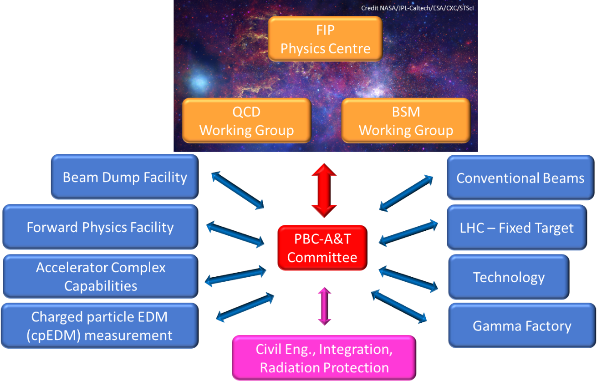
The Physics Beyond Colliders Study Group
Overview
Physics Beyond Colliders (PBC) is an exploratory study aimed at exploiting the full scientific potential of CERN's accelerator complex and technical infrastructure, as well as its know-how in accelerator and detector science and technology. PBC projects complement the goals of the main experiments of the Laboratory’s collider programme. They target fundamental physics questions that are similar in spirit to those addressed by high-energy colliders, but require different types of beams and experiments. The PBC mandate is available here.

Slide 3
The PBC Technology Working Group
Mandate
The Technology WG will explore and evaluate possible technological contributions of CERN primarily to non-accelerator-related experimental physics initiatives and projects that may also be hosted elsewhere, and will survey technologies that could become relevant to CERN accelerator and non-accelerator projects. The working group will favour the exchange of experience and expertise in technological domains such as superconducting and normal conducting magnet and RF technology, cryogenics, optics, vacuum and surface technology to support the development of new physics experiments and detection methods like quantum sensing and new (accelerator and non-accelerator) experiment proposals aiming at fundamental Standard Model physics measurements and/or addressing physics Beyond the Standard Model questions.
4 mini-workshops organized
Sep 2021: Superconducting RF https://indico.cern.ch/event/1057715/
Dec 2021: Lasers & Optics https://indico.cern.ch/event/1092283/
Apr 2022: Vacuum, coating and surface technologies https://indico.cern.ch/event/1134154/
Sep 2022: Cryogenics https://indico.cern.ch/event/1180067/
Possible future PBC technology workshops: superconductivity, quantum sensing

Slide 4
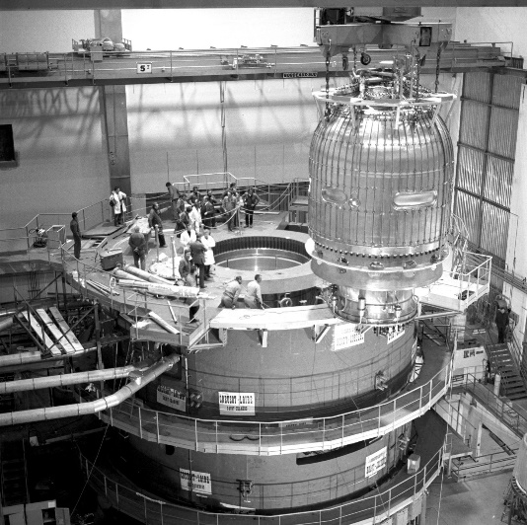
Cryogenic technologies – low temperatures
Very wide and diverse use for
Cooling superconductors
Liquefied gas (e.g. liquid Ar)
High vacuum
Low thermal noise
Cooling of detection devices
etc.
A long history… (BEBC 1970)

Slide 5
Agenda & practical information
09:00 → 09:10 Introduction and scope of the workshop
09:10 → 09:45 CERN Cryolab range of technologies, Torsten Koettig (CERN)
09:45 → 10:10 Cryogenic technologies for the AMS 100 SC magnet, Prof. Stefan Schael (Rhein. Westf. Tech. Hoch.)
10:10 → 10:35 Ultralight cryogenic structures, Maria Soledad Molina Gonzalez (CERN)
10:35 → 11:05 Coffee break
11:05 → 11:30 Liquid Argon cryogenics for the Neutrino platform, Caroline Fabre (CERN)
11:30 → 11:55 Remote ultralow vibration cooling for the Einstein telescope, Stefan Hild (University of Maastricht)
11:55 → 13:45 Lunch
13:45 → 14:10 An overview of sub-Kelvin cooling technologies, Gerard Vermeulen (Institut Neel (CNRS))
14:10 → 14:35 Effective passive thermal heat pipes for cryocooling, Bertrand Baudouy (CEA - SACLAY)
14:35 → 15:00 Overview of cryocooler technologies enabling accelerator science, Dr Srinivas Vanapalli (Uni. of Twente)
15:00 → 15:25 Cryogenic instruments for microscopy and nano-precise sample positioning, Dr Philipp Leubner (Attocube)
15:25 → 15:55 Final discussion and close up

Slide 6
Practical information
The presentations are on the Indico website of the workshop
Participation on-site and remote
Coffee will be served during the morning break just outside the meeting room
For specific Questions and Answers it is possible to use the Google Docs link found on the meeting Indico page: https://docs.google.com/document/d/1wWs4H083h7Xv6m09Tpsy699whQQgjryflW9NLu_6Mxw/edit

