Slide 1
Cryogenic instruments for microscopy and nano-precise sample positioning

Slide 2
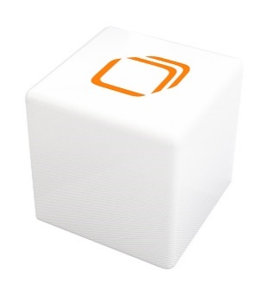
Agenda
1
Attocube – an introduction
2
Cryogenic nanopositioning
3
Closed-cycle cryostats
4
Cryogenic microscopy solutions

Slide 3
Agenda
1
Attocube – an introduction

Slide 4
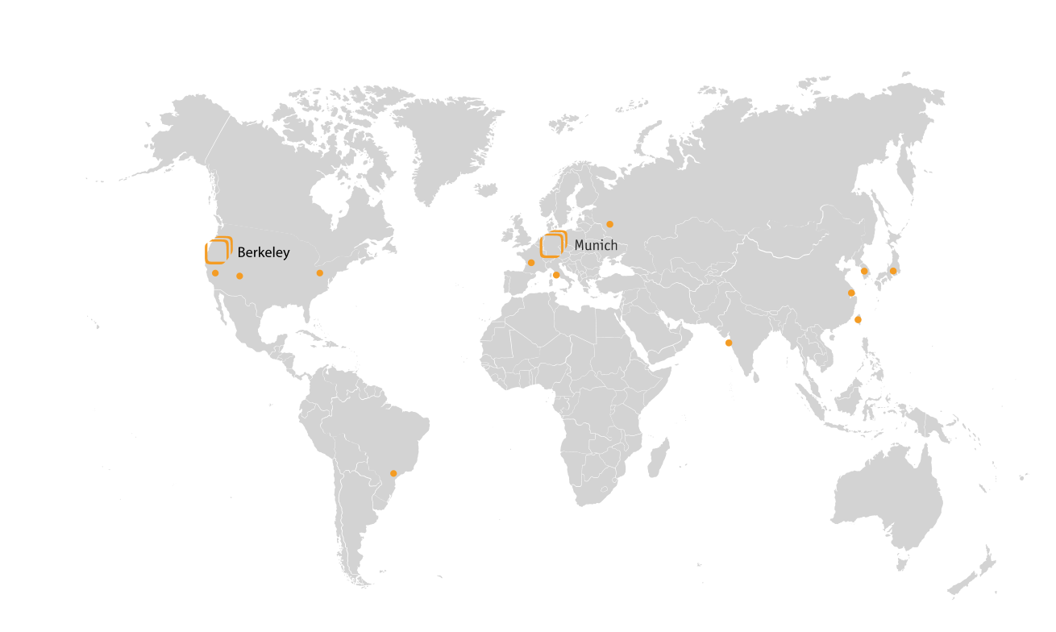




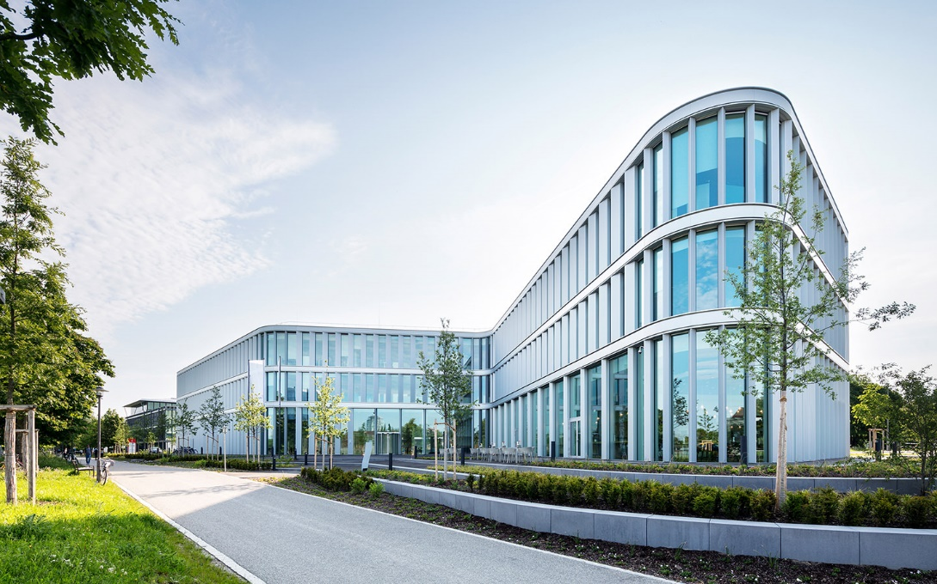







attocube systems AG
facts & figures
The NanoFactory
❭❯❱ modern working & production facilities
founded
2001
2
offices
Munich | Berkeley
3 regional US sales representatives
16 worldwide distributors
220
employees
18 nationalities
18% PhDs
Nanoprecision made in Germany
9.100 m² ground space, 1.200 m² production space
Flexible manufacturing and supply chain
> 4.000
customers in
40 countries
50
Mio. €
Turnover 2021/2022

Slide 5
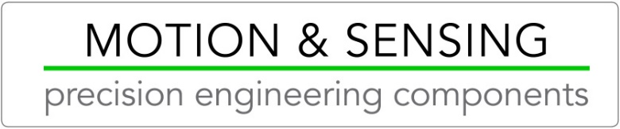
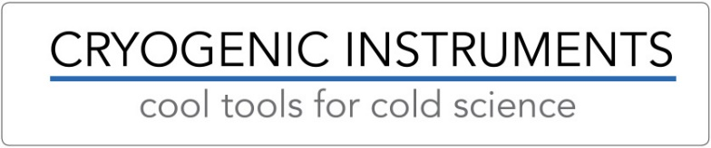

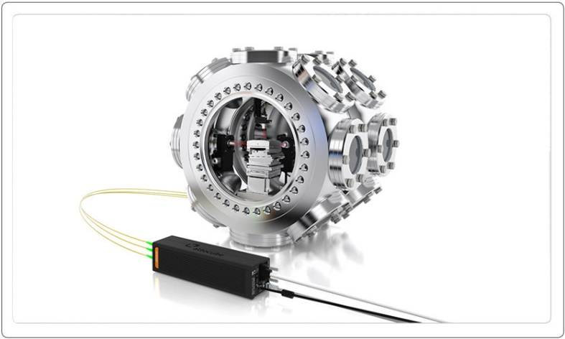
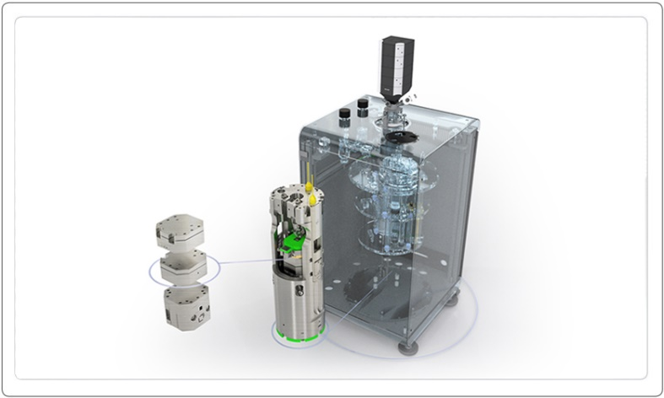
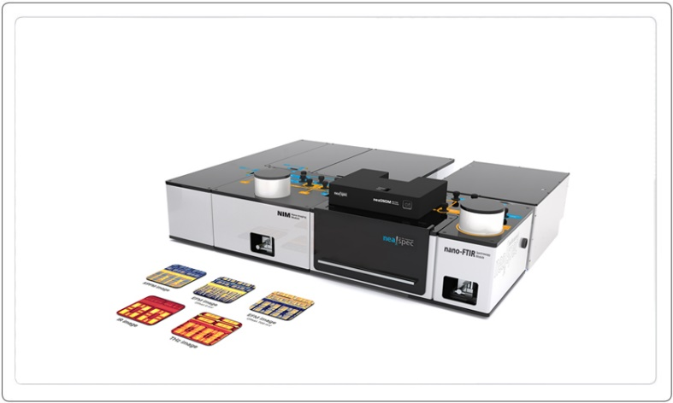


Strategic Business Sectors
3 business sectors optmially serve customers in attocube‘s key markets
From engineers, for engineers.
From physicists, for physicists.
From experts, for experts.
focus on ambient and HV engineering customers
focus on flexible
research customers
focus on ready to use solutions
for dedicated applications
components and modules for
precision engineering customers
components, modules and research platforms for condensed matter physics at cryogenic temperatures
turn key solutions for nanoscale analytics in surface science & inspection

Slide 6
Cryogenic Instruments
cool tools for cold science

Slide 7
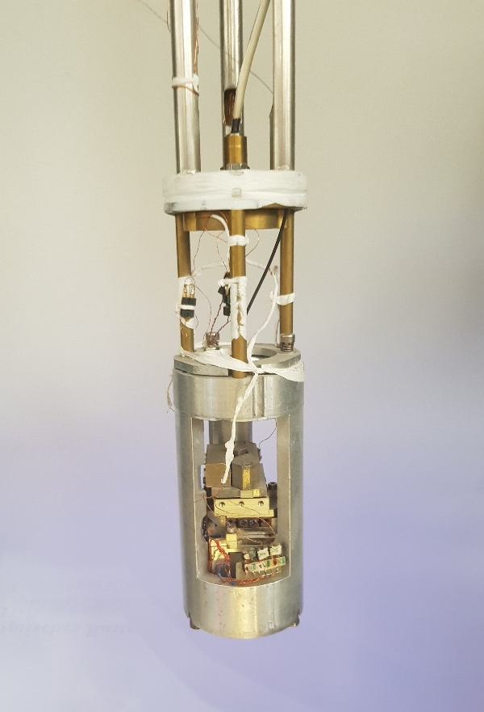
Agenda
1
Attocube – an introduction
2
Cryogenic nanopositioning
The microscope of Prof. Karrai ~ 25 years ago
@ Deutsches Museum

Slide 8
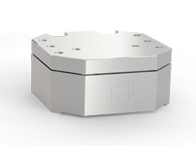
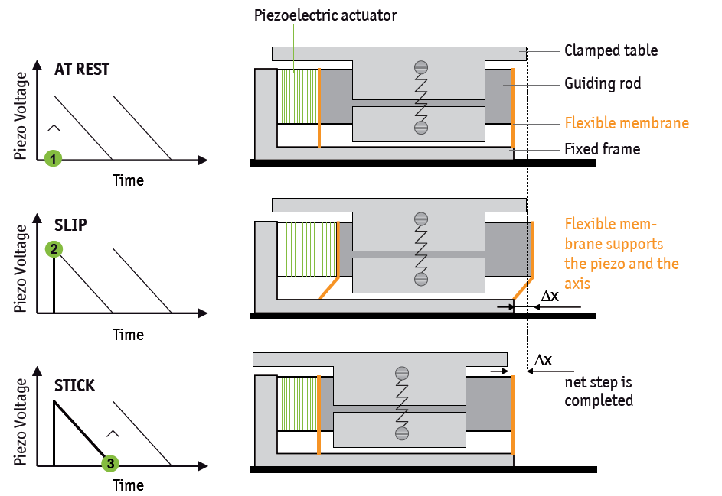
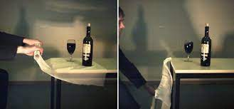
Cryogenic nanopositioning
Selective control of friction – „slip-stick“ - attocube systems nanopositioner working principle
Piezoelectric actuator
At Rest
Clamped table
Guiding rod
Piezo Voltage
Flexible membrane
Fixed frame
1
Time
Slip
Flexible membrane supports the piezo and the axis
2
Piezo Voltage
Time
Physik in unserer Zeit, Volume 46, Issue 4 July 2015 Pages 199-201
Stick
Net step is completed
Piezo Voltage
3
Time
8
Notes:
animierter Film, endlos, mit bewegtem POS + ECS
Schema anpassen, gleiche Farben etc.
+3 key features
Check: Video komplett einbetten (!), sonst funzt’s nicht
Overview á la MJ: Marketing pur ;-)
(4-5 Folien)

Slide 9
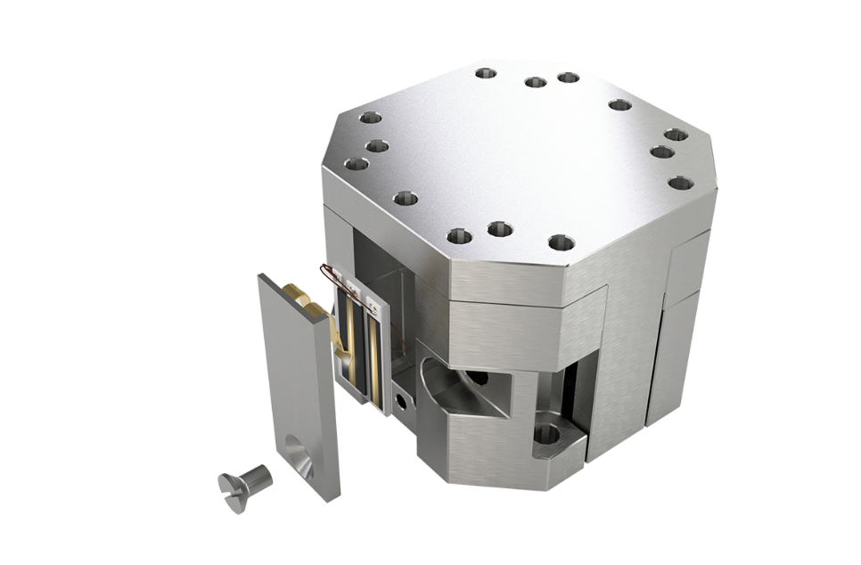
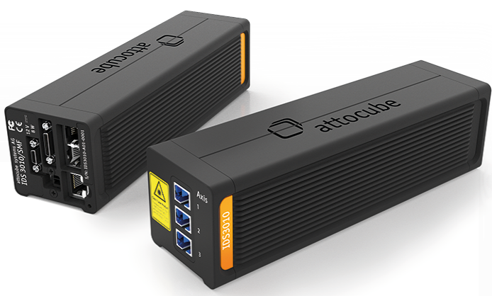
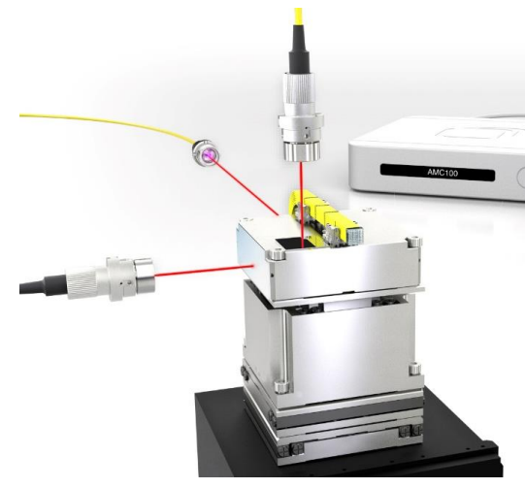
Cryogenic nanopositioning
Position feedback: where is my sample?
How to know where things are?
Resistive feedback
Interferometric feedback
measurement relative to the positioner itself
repeatability 1-2 micron
measurement relative to the sensor head
repeatability on the nm-range (no signal interrupt)
9
Notes:
animierter Film, endlos, mit bewegtem POS + ECS
Schema anpassen, gleiche Farben etc.
+3 key features
Check: Video komplett einbetten (!), sonst funzt’s nicht
Overview á la MJ: Marketing pur ;-)
(4-5 Folien)

Slide 10
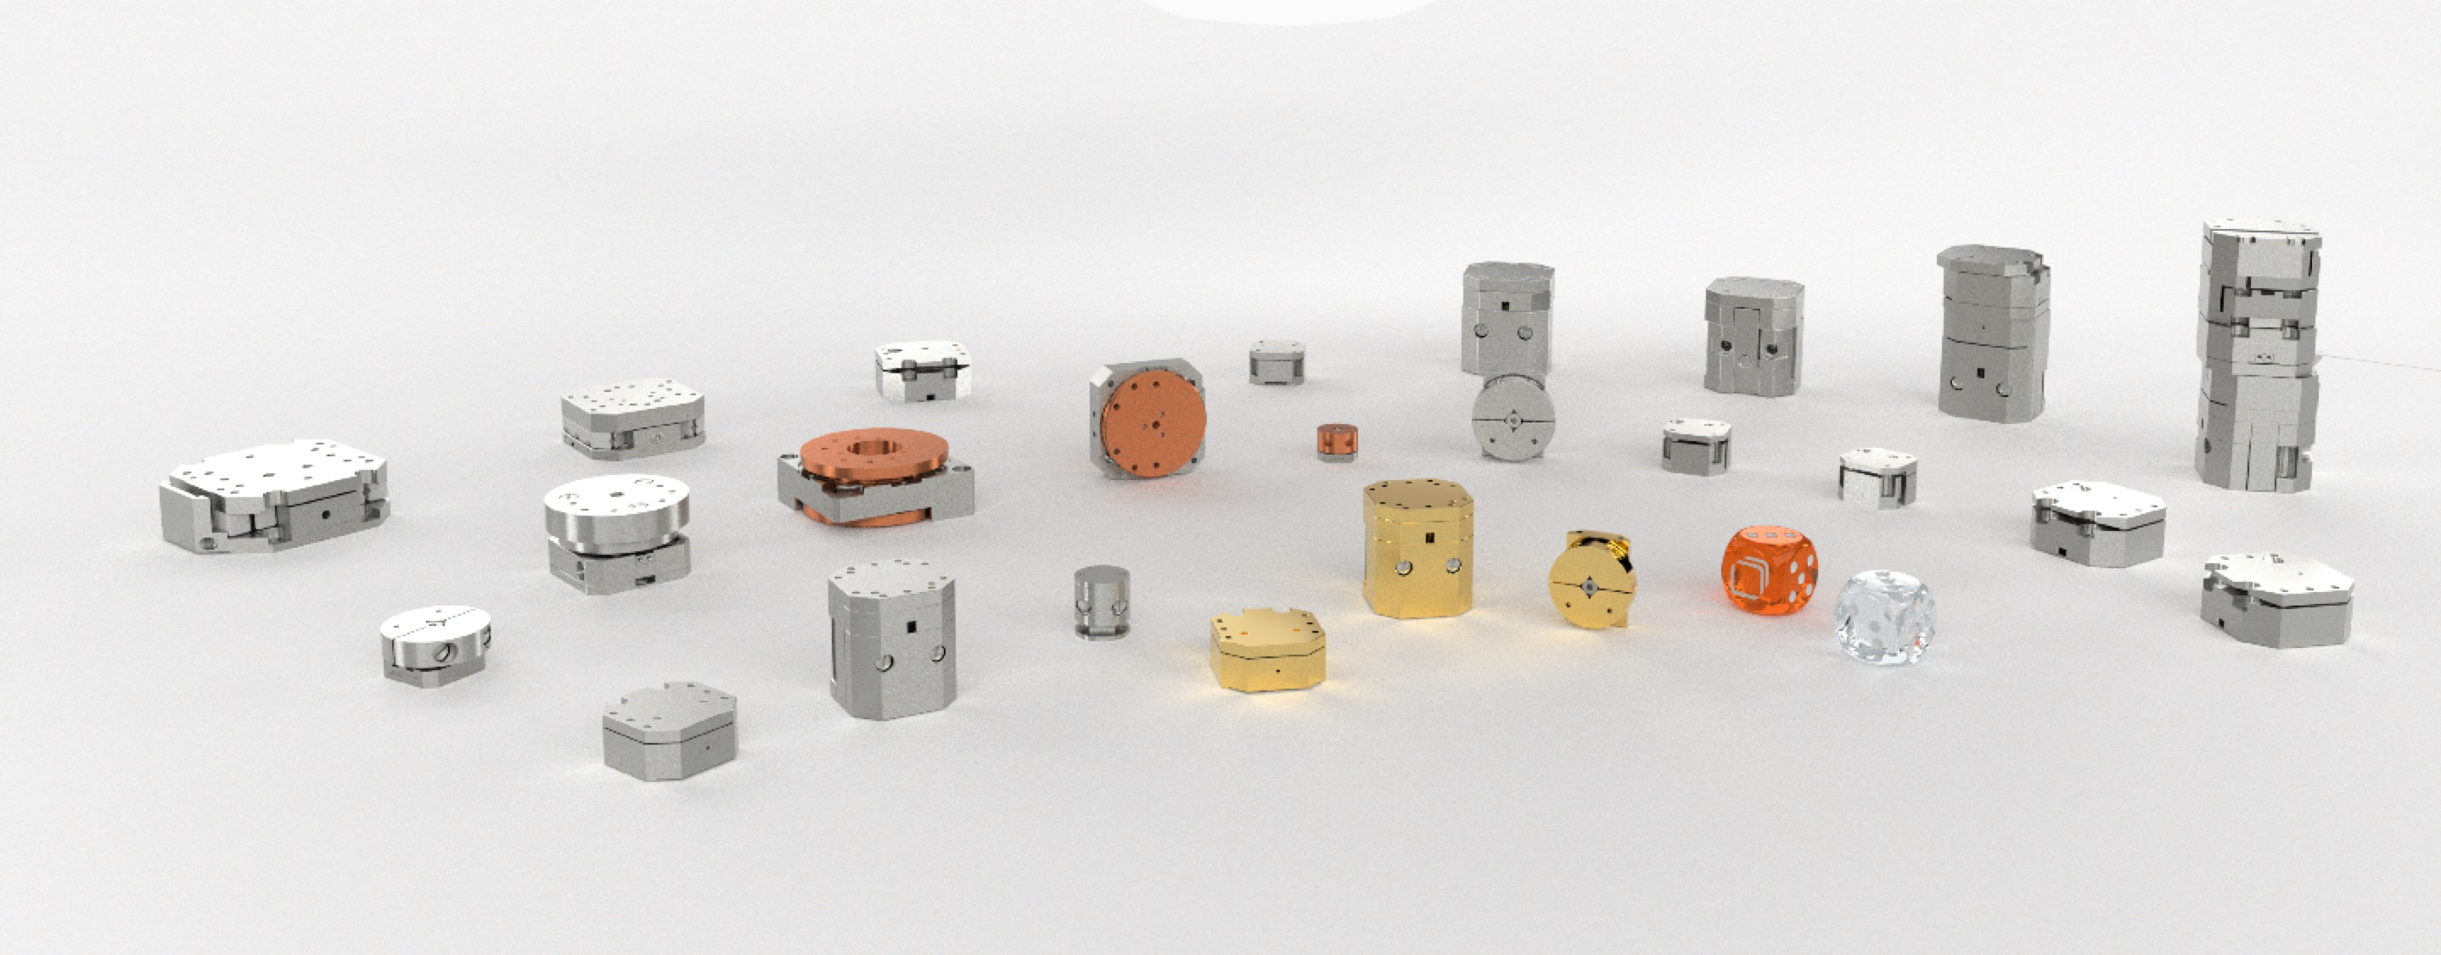

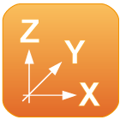


Cryogenic nanopositioning
Choose your degrees of freedom
Extreme Environments
non-magnetic
available for cryogenic temperatures
available for high and ultra high vacuum
Multi Axis Operation
Combination of various positioners
Movements with up to six degrees of freedom
Closed Loop Control
available with implemented encoders
exact and repeatable positioning in absolute and relative terms
Large Travel Ranges
patented inertial drive technology for use in extreme working environments
motion over centimetre ranges with small steps
fine tuning in nm range

Slide 11
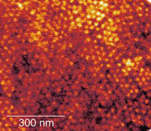
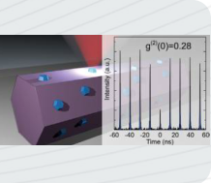
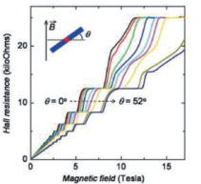
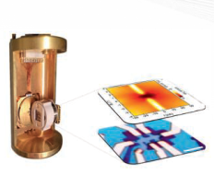
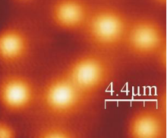
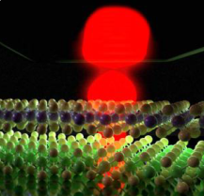
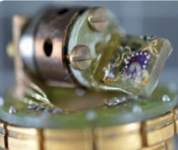
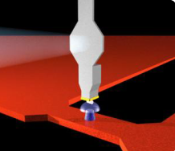
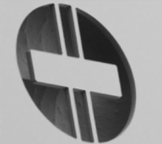
cryogenic nanopositioning
fields of application
Magneto-Transport Measurements
Scanning Probe microscopy
Optical Measurements
Angle-dependent Transport Measurements at 40 mK
SPM using attocube Nanopositioners in Magnetic Fields above 30 T
Single Photon Generation with Controlled Polarization from InGaN Quantum Dots
Van der Waals Heterostructure under Rotation at 40 mK
Scanning Hall Probe Microscopy at 300 mK with ANP Positioners
Light-Matter Coupling in TMD Monolayers and Heterostructures
Transition from Slow Abrikosov to Fast Moving Josephson Vortices
Magnetic Resonance Imaging of Nanoscale Virus at 300 mK
Dissipation in Optomechanical Resonators

Slide 12
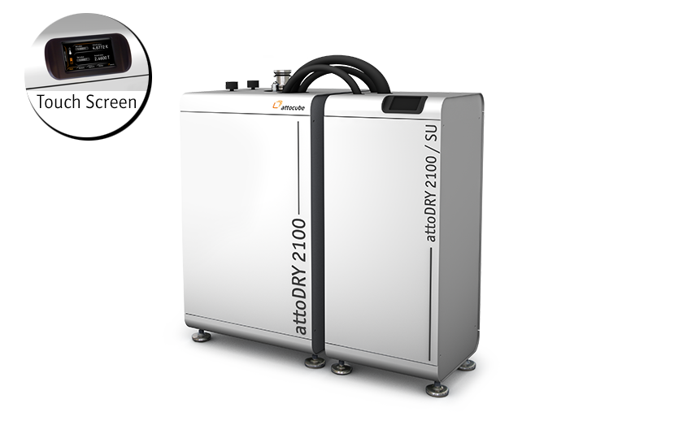
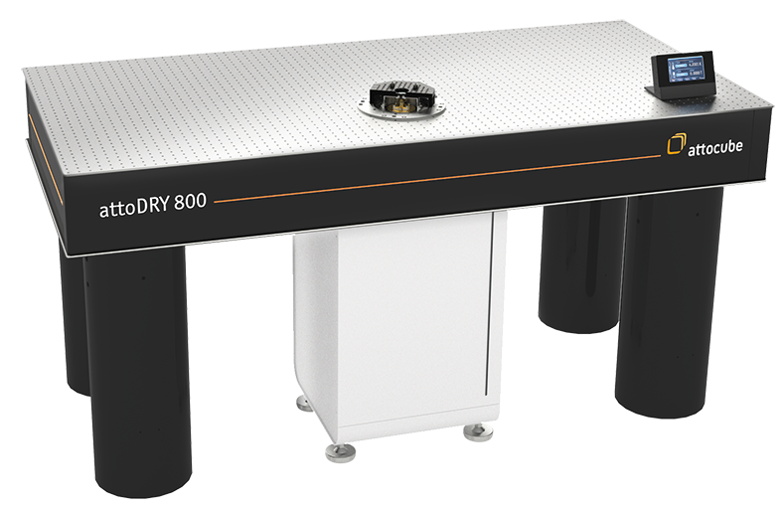
Agenda
1
Attocube – an introduction
2
Cryogenic nanopositioning
3
Closed-cycle cryostats

Slide 13
Agenda
1
Attocube – an introduction
2
Cryogenic nanopositioning
3
Closed-cycle cryostats

Slide 14
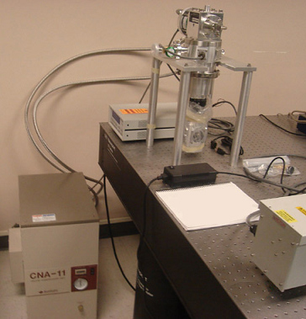
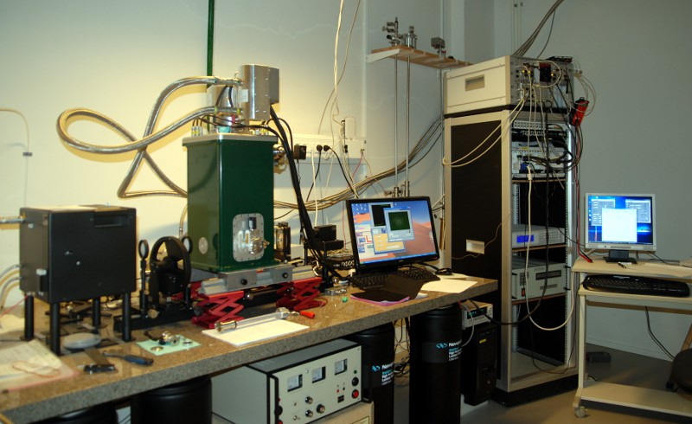
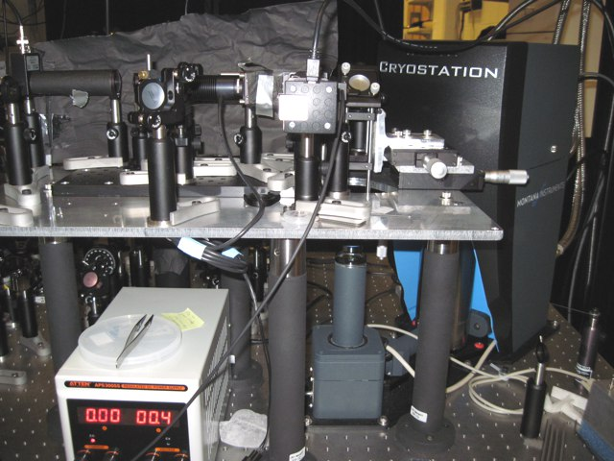
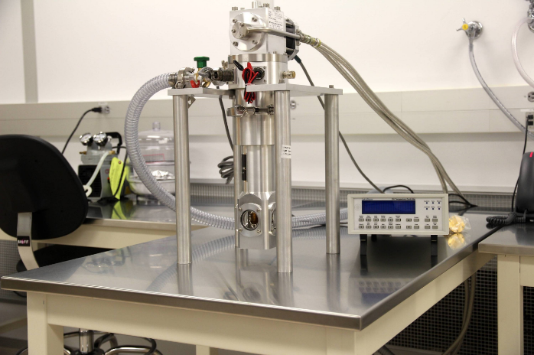
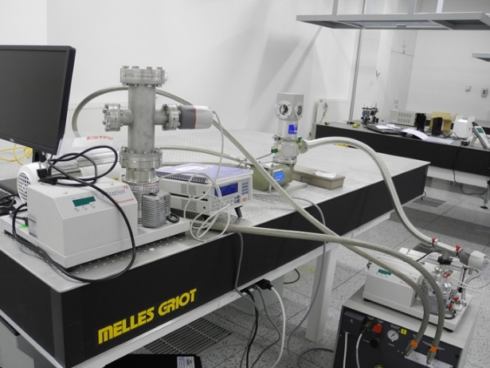
attoDRY800 – the cryooptical table
The usual optical cryo
http://nanotechnology.unlv.edu/tbe346.htm
http://ekmf.physto.se/images/original_size/lab/optocryo_sm.jpg
http://depts.washington.edu/xulab/in-the-lab/
http://nanotechnology.unlv.edu/Cryostat.htm
http://www.hilase.cz/en/news-from-the-lab/

Slide 15
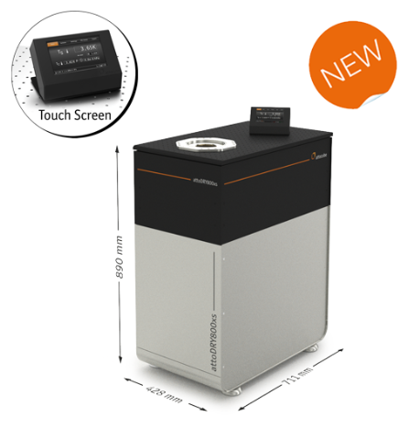



attoDRY800 – the world‘s first cryo-optical table…
Optical closed-cycle cryostat
Touchscreen UI
Vacuum shroud
coldplate
Optical table included (Newport)
cryocooler, pumps, electronics…
300 K
4 K
Temp. range
Low vibration
Cryogen-free
Fully automated
Touchscreen
control
Temp. stability
Fast cooldown
Silent
Notes:
…and so we‘ve created the world‘s first cryo-optical table, the attoDRY800. It consists of a low vibration cold breadboar seamlessly integrated into an optical table. With the cryocooler hidden in the otherwise unused space underneath the table, this ensures a free workspace and unobstructed optical access to the sample from all sides…

Slide 16
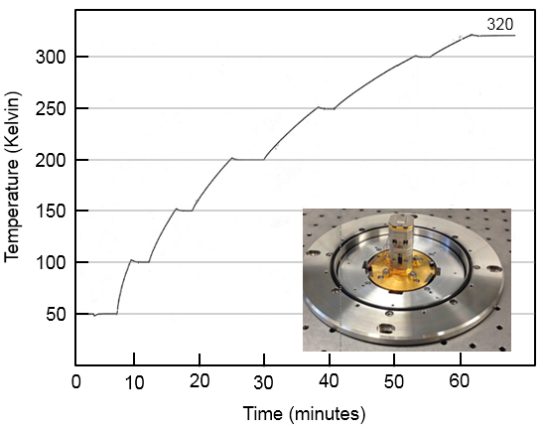
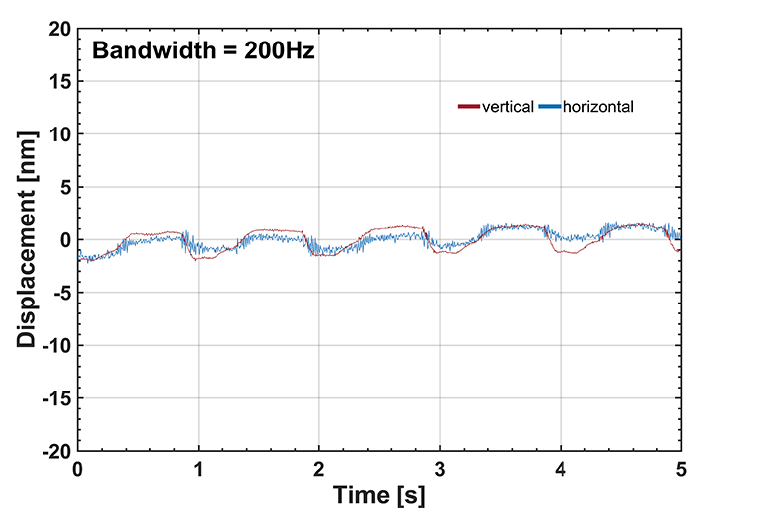
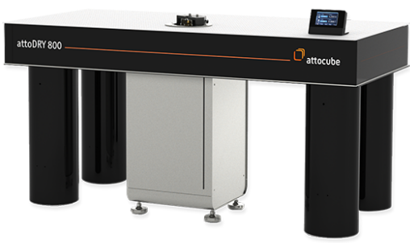
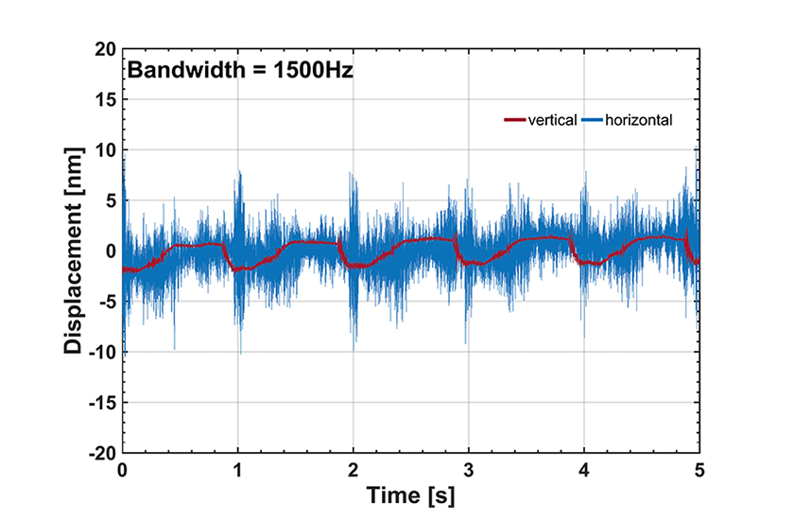
Temperature sweeps, vibrations measurements
attoDRY800
Lowest vibrations
on the market
Base Pressure <5x10⁻⁶ mbars
Base Temperature 3.8 Kelvin
Cooling power 170 mW at 5 K
Turnaround time 4h cooling to 5 K,
2h warming up
p2p vibrations @ 200 Hz (1500Hz)
Vertical: 3 nm (4 nm)
Horizontal: 2 nm (17 nm)

Slide 17
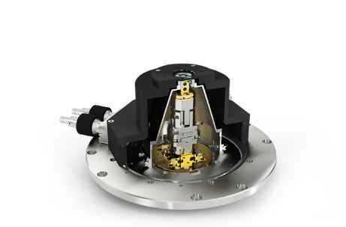
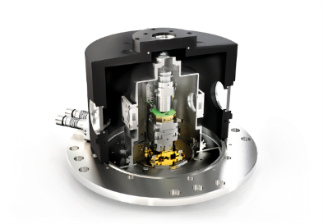
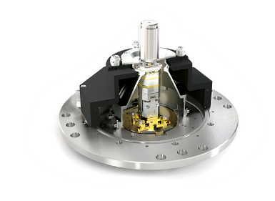
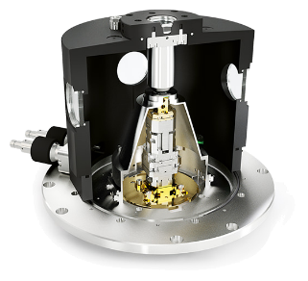
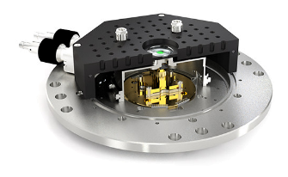
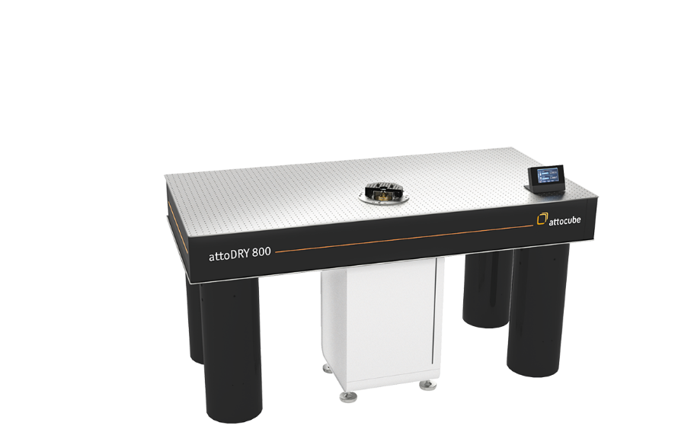
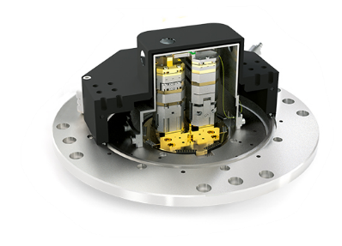
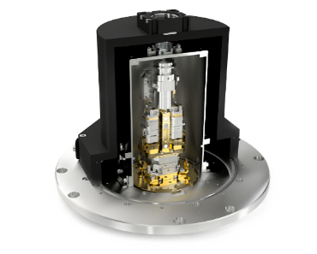
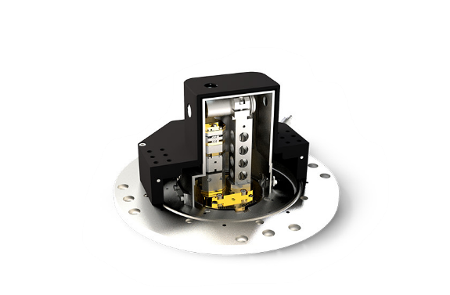
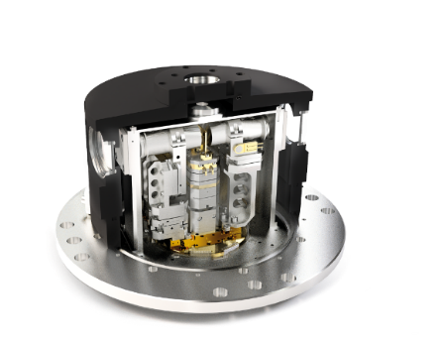
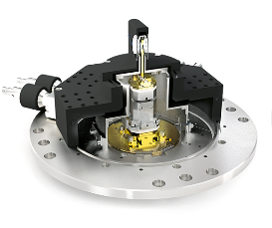
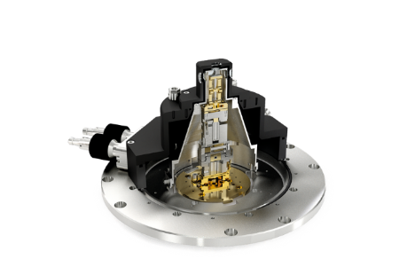
attoDRY800: Endless possibilities for optical configurations…
Choose your vacuum shroud!
LT-APO
RT-SWD
RT-SWD/LCCC
Basic
HV objective
RT-fiber
transmission
Photonic Probe
Station
RT-LT transmission
LT-APO transmission
RT free-beam
5-sides
RT Transmission

Slide 18



LT-APO option (cold objective)
attoDRY800 vacuum shroud options
ANPxy311 stages for sample positioning (6x6mm travel)
Cold apochromatic objective LT-APO with high NA (>0.8)
minimal sample drift, broadband high collection efficiency
sample holder with 12 electrical contacts; temp. sensor & heater included
feedthrough ring with blind flanges included, DC/SMA/fiber feedthroughs optional
Multi-color excitation and detection
Different configurations available

Slide 19








Application example: QDs as single photon sources
In partnership with Quandela – www.quandela.com
Excitation laser
Semiconductor Quantum Dot

Slide 20
Agenda
1
Attocube – an introduction
2
Cryogenic nanopositioning
3
Closed-cycle cryostats

Slide 21
attoDRY2100
automated top-loading cryostat with variable temperature & superconducting magnet
cryogen-free & low vibration cryostat platform
→ no liquid helium required & enables SPM
Different options for superconducting magnet:
→ 9T, 12T, 9/3T, 1/1/1 T, 5/2/2T
automated temperature and magnetic field control
→ fast parameter change via touchscreen
variable temperature (1.65 .. 300 K) @ full field
→ transport measurements & LT-SPM
300 K
1.5 K
Temp. range
Low vibration
Cryogen-free
Fully automated
Touchscreen
control
Temp. stability
Fast cooldown
Silent

Slide 22

Agenda
1
Attocube – an introduction
2
Cryogenic nanopositioning
3
Closed-cycle cryostats
4
Cryogenic microscopy solutions
Scanning probe microscopes
Confocal imaging

Slide 23





attoAFM I
Cantilever-based atomic force microscope
Laser detector module (1310nm with DFB laser diode)
optical fiber
holder
dither piezo
~30µm
cantilever
sample and carrier

Slide 24




attoAFM I – measurement options
Magnetic Force Microscopy (MFM)
optional AFM mode upgrade
Conducting-tip Atomic Force Microscopy (ct-AFM)
optional AFM mode upgrade
Piezoresponse Force Microscopy (PFM)
optional AFM mode upgrade
Kelvin Probe Force Microscopy (KPFM)
optional AFM mode upgrade

Slide 25



Application examples: attoMFM
Imaging of magnetic structures
Size-dependence of Antiskyrmions in Mn_{1.4}PtSn
Further reading:
T. Ma et al., Adv. Mater. 32, 2002043 (2020)
A.K. Sharma et al., Adv. Mater. 33, 2101323 (2021)
A. Chakraborty et al., Adv. Mater. 34, 2108637 (2022)
Skyrmions induced by strain gradient in La_{0.67}Sr_{0.33}MnO₃
Further reading:
Y. Zhang et al., PRL 127, 117204 (2021)
Vortex barriers in high-Tc superconductor Iron-pnictide
Further reading:
A. Yagil et al., Phys. Rev. B 94, 064510 (2016)

Slide 26


attoCFM I
Free-beam confocal microscope

Slide 27



Application examples: attoCFM I
Confocal imaging at cryogenic temperatures
Photoluminescence of Excitons in TMD WSe₂
Further reading:
P. Rivera et al., Nature Commun. 12, 871 (2021)
Photoluminescence of magnetically doped colloidal CdSe/CdS quantum dots
Further reading:
S. Lorenz et al., Nano Lett. 20, 1896 (2020)
Polarized single photon emission from elliptical micro pillars
Further reading:
[1] Hui Wang et al; Nature Photonics, 13, 770 (2019)
[2] Yu-Ming He et al; Nature Physics, 15, 941 (2019)
[3] Hui Wang et al; Phys. Rev. Lett. 123, 250503 (2019)

Slide 28








Application examples: CryoRaman
Confocal Raman imaging at cryogenic temperatures and large magnetic fields
Automatic identification of number of MLs in WSe₂
[a]
Spectra of carbon nanotubes:
Resolution at the diffraction limit
Polarization dependent measurements at varying magnetic fields
Further reading:
Dieing, Altman et. Al. cryoRaman whitepaper © attocube & WiTec (2021)

Slide 29








Conclusion
We are experts in cryogenic nanopositioning! We offer solutions for all levels of integration: from nanopositioning stages and components for customer setups, to fully integrated microscopy systems.
Check our whitepapers for more info, and our webinars at www.attocube.com
We do much more! Reach out:
info@attocube.com or philipp.leubner@attocube.com

Slide 30

Enabling Scientific Impact
selected customer publications (2013 – 2021)
2013
2014
2015
2016
P.J.W. Moll et al., Nature Materials 12, 134–138
O. Gazzanoet et al., Nature Communications 4, 1425
W. E. Shankset et al., Nature Communications 4, 1991
L. Rondin et al., Nature Communications 4, 2279
R.J. Warburton, Nature Materials 12, 483–493
Y.-M. Heet et al., Nature Nanotechnology 8, 213-217
A. Dréau et al., Phys. Rev. Lett. 113, 137601
J.-P. Tetienne et al., Science 344, 1366-1369
M. Montinaro et al., Nano Letters 14 (8), 4454–4460
J. Rieger et al., Nature Communications 5 3345
M.G. Tanner et al., Applied Physics Letters 104 063503
A.K. Nowak et al., Nature Communications 5 3240
M. Timmermans et al., ACS Nano 8 2782
A. Dréau et al., Phys. Rev. Lett. 113, 137601
J.-P. Tetienne et al., Nature Communications 6, 6733
F. Najafi et al., Nature Communications 6, 5873
B. Bryant et al., Phys. Rev. B 91, 134408
J. Herranz et al., Nanotechnology 29, 195301
T. S. Jespersen et al., Phys. Rev. B 91, 041302
V. Stepanov et al., Appl. Phys. Lett. 106, 063111
T. Häberle et al., Nature Nanotechnology 10, 125–128
D. Rugar et al., Nature Nanotechnology 10, 120–124
M. Pelliccione et al., Nature Nanotechnology doi:10.1038/nnano.2016.68
X. Ding et al., Phys. Rev. Lett. doi:10.1103/physrevlett.116.020401
H. Wang et al., Phys. Rev. Lett. doi: 10.1103/physrevlett.116.213601
Y. He et al., Phys. Rev. Lett. doi:10.1103/PhysRevLett.118.190501
T. Hümmer et al., Nature Communications doi: 10.1038/ncomms12155
S. Shuo et al., Nature Nanotechnology doi: 10.1038/nnano.2015.334
L. Thiel et al., Nature Nanotechnology doi: 10.1038/nnano.2016.63
2017
2018
A. Kinikar et al., Nature Nanotechnology doi: 10.1038/nnano.2017.24
B. Wu et al., Nature Communications doi: 10.1038/ncomms14480
G. Wang et al., Phys. Rev. Lett. doi:10.1103/PhysRevLett.119.047401
M. Manca et al., Nature Communications doi:10.1038/ncomms14927
A. Neumann et al., Nature Nanotechnology doi: 10.1038/nnano.2016.282
Y. Luo et al., Nature Communications doi:10.1038/s41467-017-01777-w
I. Gross et al., Nature doi: 10.1038/nature23656
S. Jiang et al., Nature Materials doi: 10.1038/s41563-018-0040-6
S. Jiang et al., Nature Nanotechnology doi: 10.1038/s41565-018-0135-x
M. Massicotte et al., Nature Communications doi:10.1038/s41467-018-03864-y
L. Camenzind et al., Nature Communications doi:10.1038/s41467-018-05879-x
M. Serra-Garcia et al., Nature doi: 10.1038/nature25156
D. Zhu et al., Nature Nanotechnology doi: 10.1038/s41565-018-0160-9
J. Lopez-Cabrelles et al., Nature Chemistry doi: 10.1038/s41557-018-0113-9
more than
160
publications in
Science & Nature
Thank you for your attention!
2019
2020
G. Munoz-Matutano et al., Nature Materials doi: 10.1038/s41563-019-0281-z
Y. J. Chung et al., Nano Letters doi: 10.1021/acs.nanolett.8b05047
P. Schönherr et al., Nano Letters doi: 10.1021/acs.nanolett.8b04608
K. R. Joshi et al., Physical Review Applied doi: 10.1103/physrevapplied.11.014035
S. Kolatschek et al., Journal of Applied Physics doi: 10.1063/1.5050344
J. Qian et al., Optics Express doi: 10.1364/oe.27.004845
P. Wang et al., Review of Scientific Instruments doi: 10.1063/1.5083994
Z. Dai et al., Nature Communications doi: 10.1038/s41467-020-19913-4
A. Bylinkin et al., Nature Photonics doi: 10.1038/s41566-020-00725-3 D. J. Rizzo et al., Nano Letters doi: 10.1021/acs.nanolett.0c03466
F. L. Ruta et al., Nano Letters doi: 10.1021/acs.nanolett.0c02671
A. Möslein et al, Nano Letters doi: 10.1021/acs.nanolett.0c02839
Y. Luo et al., Nature Communications doi: 10.1038/s41467-020-18109-0
S. S. Sunku et al., Nano Letters doi: 10.1021/acs.nanolett.9b04637
W. Lee et al., Nature Nanotechnology doi: 10.1038/s41565-020-0755-9
Y. Hu et al., Nano Letters doi: 10.1021/acs.nanolett.0c01801
P. Li et al., Nature Communications doi: 10.1038/s41467-020-17425-9
A. J. Sternbach et al., Nature Communications doi: 10.1038/s41467-020-17335-w
M. Chen et al., Nature Materials doi: 10.1038/s41563-020-0732-6
L. Mester et al., Nature Communications doi: 10.1038/s41467-020-17034-6
X. Chen et al., Nature Physics doi: 10.1038/s41567-020-0865-1
G. Hu et al., Nature doi: 10.1038/s41586-020-2359-9
Y. Wu et al., Nature Communications doi: 10.1038/s41467-020-16459-3
A. M. et al., Nature Communications doi: 10.1038/s41467-020-15767-y
J. T. Guitierrez et al., Nature Materials doi: 10.1038/s41563-020-0665-0
2021
A. J. Sternbach et al., Science doi: 10.1126/science.abe9163
G. A. Ermolaev et al., Nature Communications doi: 10.1038/s41467-021-21139-x
F. Niroui et al., Nano Letters doi: 10.1021/acs.nanolett.0c04043
S. S. Sunku et al., Nano Letters doi: 10.1021/acs.nanolett.9b04637
Z. Li et al., Nano Letters doi: 10.1021/acs.nanolett.0c04908
A. Heßler et al., Nature Communications doi: 10.1038/s41467-021-21175-7
S. G. Menabde et al., Nature Communications doi: 10.1038/s41467-021-21193-5
… to be continued
Notes:
Although attocube has also many industrial customers, it is a company which has been founded with the main focus on scientific research and enabling scientific impact

Slide 31



Cryogenic nanopositioning
Positioning vs. Scanning
Positioning
long range movement, several mm
slip stick drive
Scanning
short range movement, several µm
toggle lever
31
Notes:
animierter Film, endlos, mit bewegtem POS + ECS
Schema anpassen, gleiche Farben etc.
+3 key features
Check: Video komplett einbetten (!), sonst funzt’s nicht
Overview á la MJ: Marketing pur ;-)
(4-5 Folien)

