Slide 1
Levy HBT correlation measurements from SPS to LHC
Sandor lokos (IFJ PAN)
XV Polish Workshop on Relativistic Heavy-Ion Collisions

Slide 2
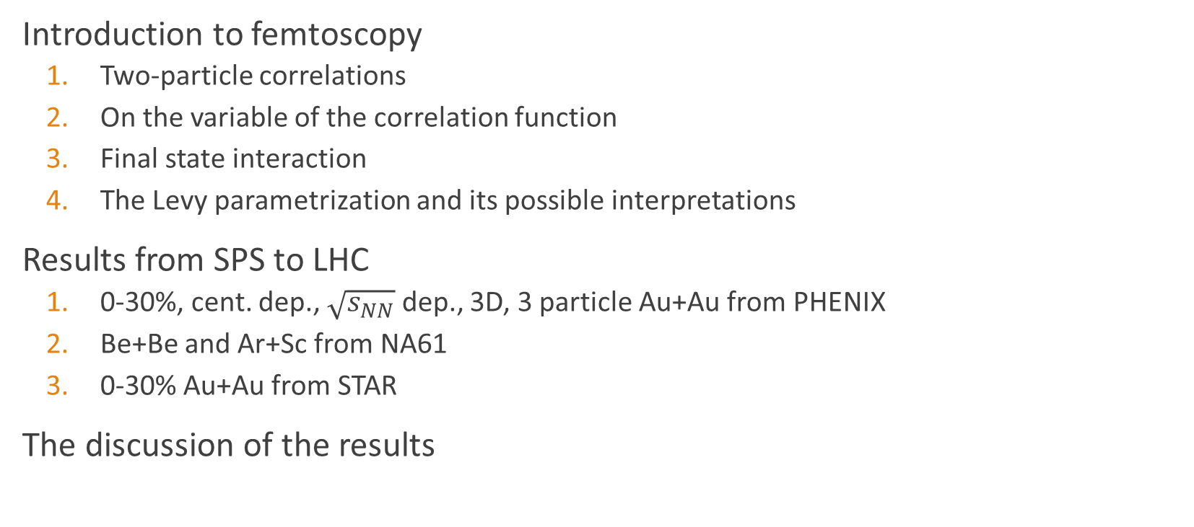
Outline
Introduction to femtoscopy
  Two-particle correlations
  On the variable of the correlation function
  Final state interaction
  The Levy parametrization and its possible interpretations
Results from SPS to LHC
  0-30%, cent. dep., $\sqrt{s_{NN}}$ dep., 3D, 3 particle Au+Au from PHENIX
  Be+Be and Ar+Sc from NA61
  0-30% Au+Au from STAR
The discussion of the results

Slide 3
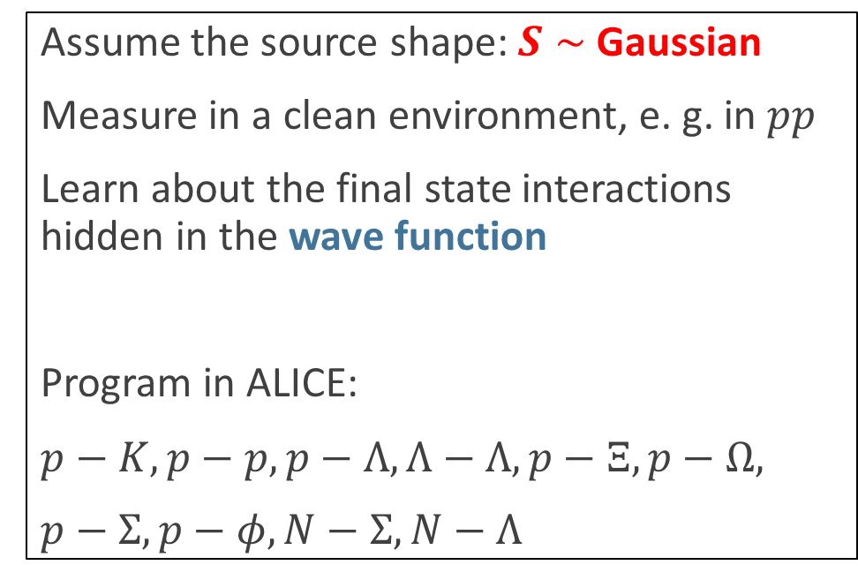
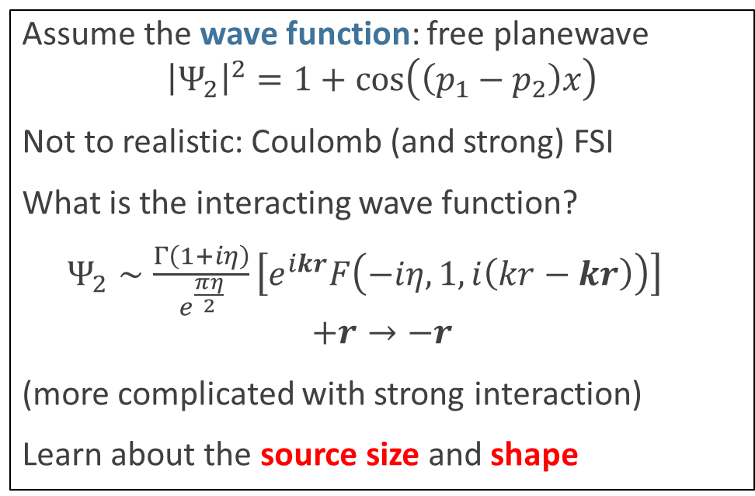
Femtoscopy – two approaches
Yano – Koonin formula
$${C_{2}\left(p_{1},p_{2}\right)=\frac{N_{2}\left(p_{1},p_{2}\right)}{N_{1}\left(p_{1}\right)N_{1}\left(p_{2}\right)}→N}_{2}\left(p_{1},p_{2}\right)=∫dx_{1}dx_{2}S\left(x_{1},p_{1}\right)S\left(x_{2},p_{2}\right){\left|Ψ_{2}\left(x_{1},x_{2}\right)\right|}^{2}$$
Assume the source shape: $S∼$ Gaussian
Measure in a clean environment, e. g. in $pp$
Learn about the final state interactions hidden in the wave function
Program in ALICE:
$p−K, p−p, p−Λ, Λ−Λ, p−Ξ, p−Ω,$
$p−Σ, p−φ, N−Σ, N−Λ$
Assume the wave function: free planewave
$${\left|Ψ_{2}\right|}^{2}=1+\cos\left(\left(p_{1}−p_{2}\right)x\right)$$
Not to realistic: Coulomb (and strong) FSI
What is the interacting wave function?
$Ψ_{2}∼\frac{Γ\left(1+iη\right)}{e^{\frac{πη}{2}}}\left[e^{ikr}F\left(−iη,1,i\left(kr−kr\right)\right)\right]$
$$+r→−r$$
(more complicated with strong interaction)
Learn about the source size and shape

Slide 4
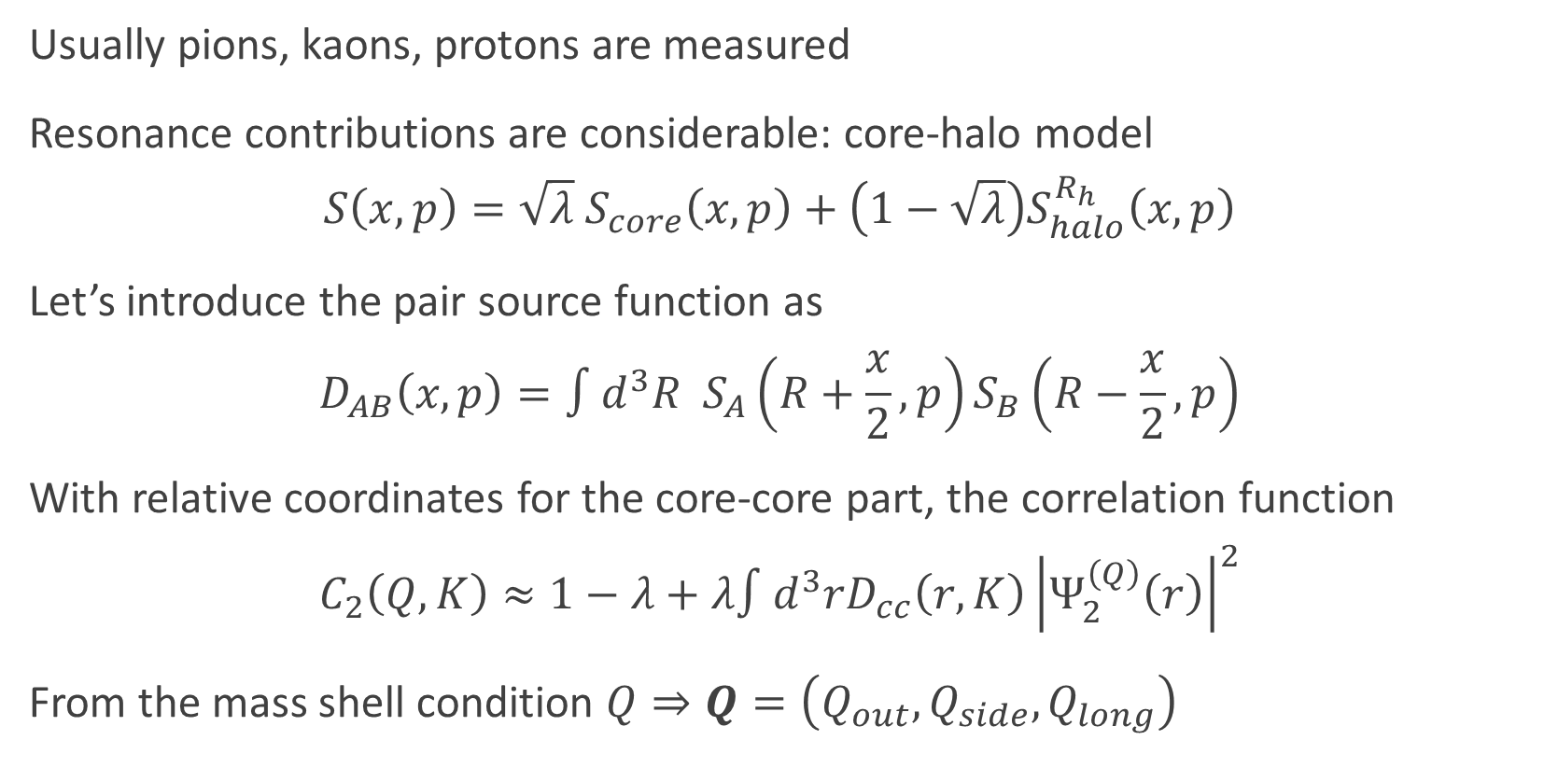
Femtoscopy – the core-halo model
Usually pions, kaons, protons are measured
Resonance contributions are considerable: core-halo model
$$S\left(x,p\right)=\sqrt{λ} S_{core}\left(x,p\right)+\left(1−\sqrt{λ}\right)S_{halo}^{R_{h}}\left(x,p\right)$$
Let’s introduce the pair source function as
$$D_{AB}\left(x,p\right)=∫d^{3}R S_{A}\left(R+\frac{x}{2},p\right)S_{B}\left(R−\frac{x}{2},p\right)$$
With relative coordinates for the core-core part, the correlation function
$$C_{2}\left(Q,K\right)≈1−λ+λ∫d^{3}rD_{cc}\left(r,K\right){\left|Ψ_{2}^{\left(Q\right)}\left(r\right)\right|}^{2}$$
From the mass shell condition $Q⇒Q=\left(Q_{out},Q_{side},Q_{long}\right)$

Slide 5
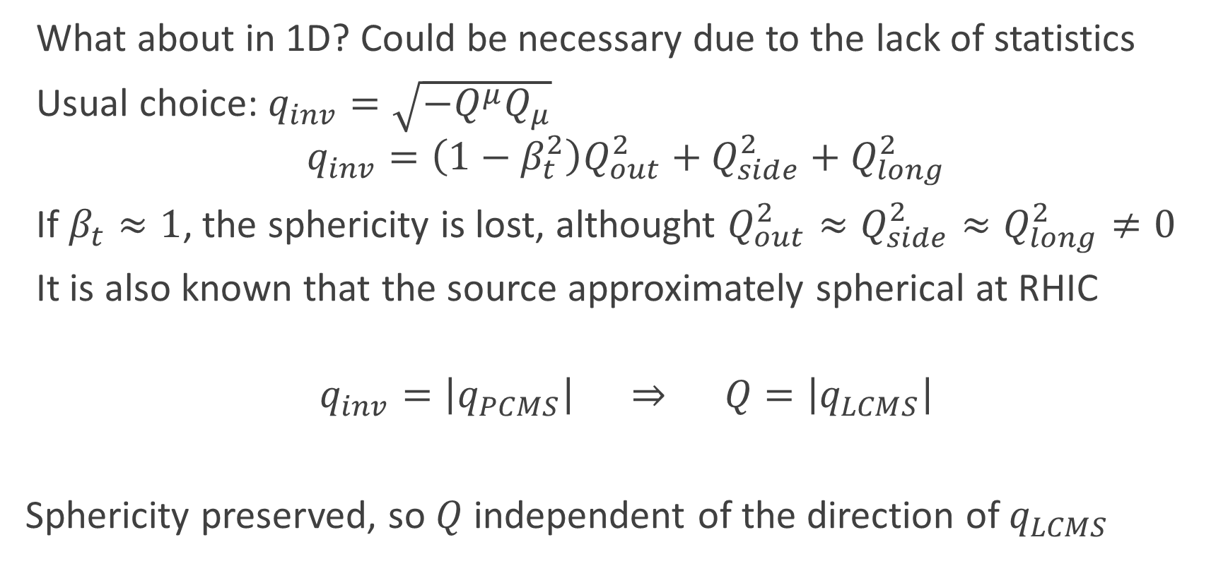
On the 1D variable of the correlation function
What about in 1D? Could be necessary due to the lack of statistics
Usual choice: $q_{inv}=\sqrt{−Q^{μ}Q_{μ}}$
$$q_{inv}=\left(1−β_{t}^{2}\right)Q_{out}^{2}+Q_{side}^{2}+Q_{long}^{2}$$
If $β_{t}≈1$, the sphericity is lost, althought $Q_{out}^{2}≈Q_{side}^{2}≈Q_{long}^{2}≠0$
It is also known that the source approximately spherical at RHIC
$$q_{inv}=\left|q_{PCMS}\right| ⇒ Q=\left|q_{LCMS}\right|$$
Sphericity preserved, so $Q$ independent of the direction of $q_{LCMS}$
1D variable!

Slide 6
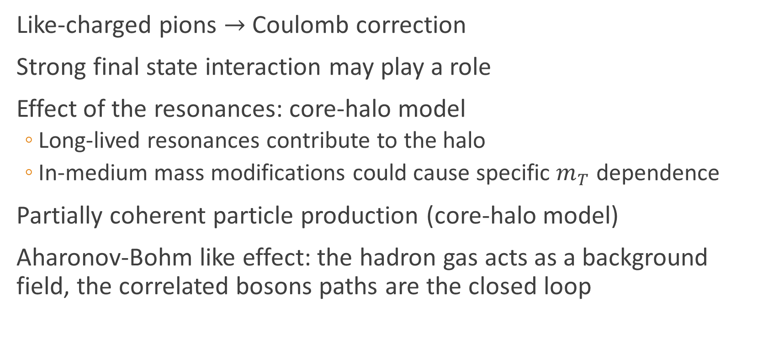
Final state interactions
Like-charged pions $→$ Coulomb correction
Strong final state interaction may play a role
Effect of the resonances: core-halo model
  Long-lived resonances contribute to the halo
  In-medium mass modifications could cause specific $m_{T}$ dependence
Partially coherent particle production (core-halo model)
Aharonov-Bohm like effect: the hadron gas acts as a background field, the correlated bosons paths are the closed loop

Slide 7
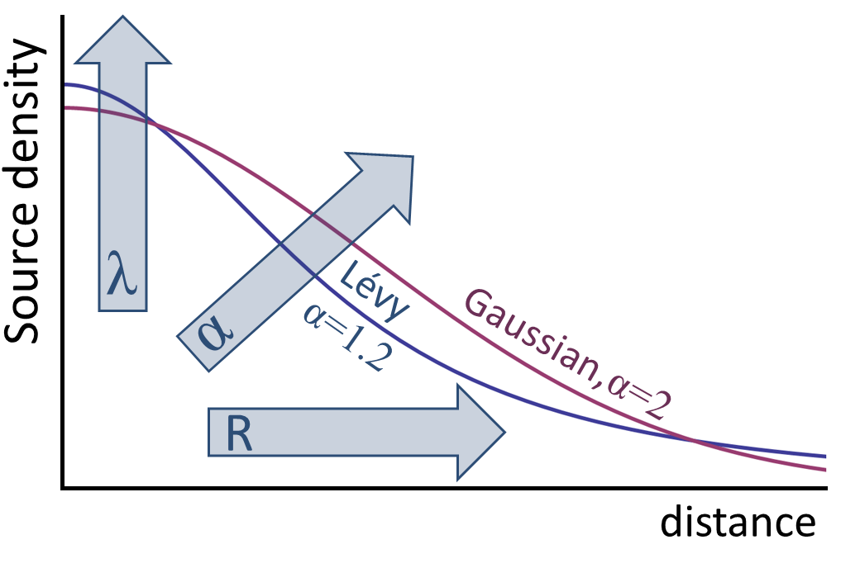
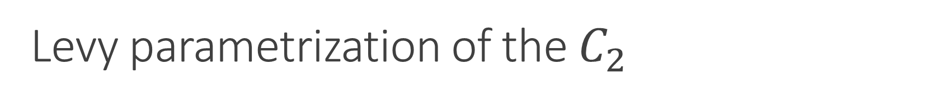
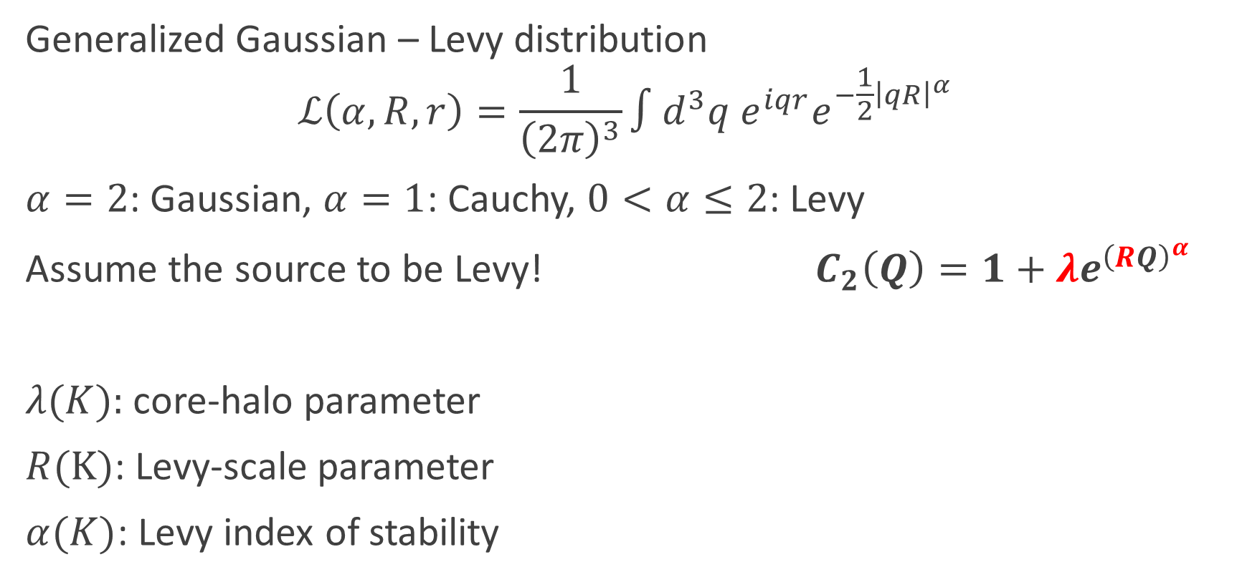
Levy parametrization of the $C_{2}$
Generalized Gaussian – Levy distribution
$$ℒ\left(α,R,r\right)=\frac{1}{{\left(2π\right)}^{3}}∫d^{3}q e^{iqr}e^{−\frac{1}{2}{\left|qR\right|}^{α}}$$
$α=2$: Gaussian, $α=1$: Cauchy, $0<α≤2$: Levy
Assume the source to be Levy! $C_{2}\left(Q\right)=1+λe^{{\left(RQ\right)}^{α}}$
$λ(K):$ core-halo parameter
$R(K)$: Levy-scale parameter
$α(K)$: Levy index of stability

Slide 8

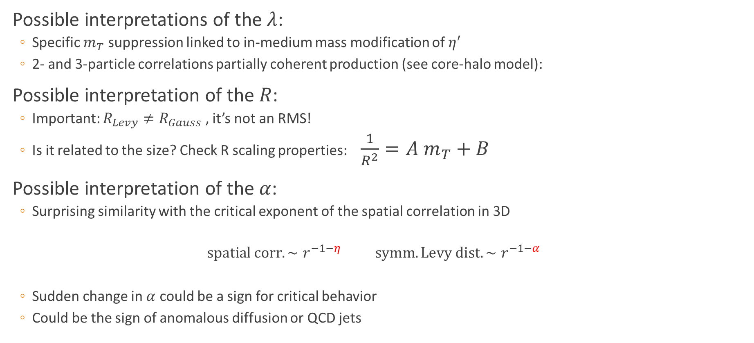
Physics in the parameters
Possible interpretations of the $λ$:
  Specific $m_{T}$ suppression linked to in-medium mass modification of $η^{′}$
  2- and 3-particle correlations partially coherent production (see core-halo model):
Possible interpretation of the $R$:
  Important: $R_{Levy}≠R_{Gauss}$ , it’s not an RMS!
  Is it related to the size? Check R scaling properties: $\frac{1}{R^{2}}=A m_{T}+B$
Possible interpretation of the $α$:
  Surprising similarity with the critical exponent of the spatial correlation in 3D
  $$spatial corr. ∼r^{−1−η} symm. Levy dist. ∼r^{−1−α}$$
  Sudden change in $α$ could be a sign for critical behavior
  Could be the sign of anomalous diffusion or QCD jets
$$κ_{3}=\frac{\left(λ_{3}−3λ_{2}\right)}{2\sqrt{λ_{2}^{3}}}$$

Slide 9
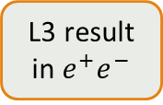
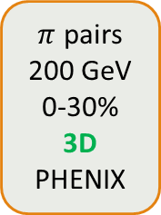
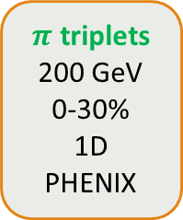
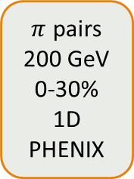
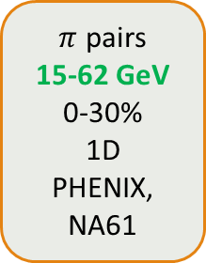
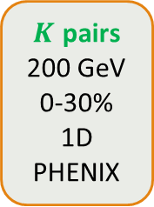
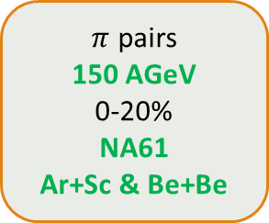
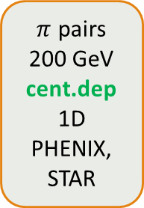
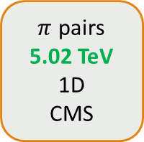
The tree of the Levy analyses – yet …
$π$ pairs
200 GeV
cent.dep
1D
PHENIX, STAR
$K$ pairs
200 GeV
0-30%
1D
PHENIX
$π$ pairs
200 GeV
0-30%
3D
PHENIX
$π$ pairs
15-62 GeV
0-30%
1D
PHENIX, NA61
$π$ triplets
200 GeV
0-30%
1D
PHENIX
$π$ pairs
200 GeV
0-30%
1D
PHENIX
$π$ pairs
150 AGeV
0-20%
NA61
Ar+Sc & Be+Be
$π$ pairs
5.02 TeV
1D
CMS
L3 result in $e^{+}e^{−}$

Slide 10
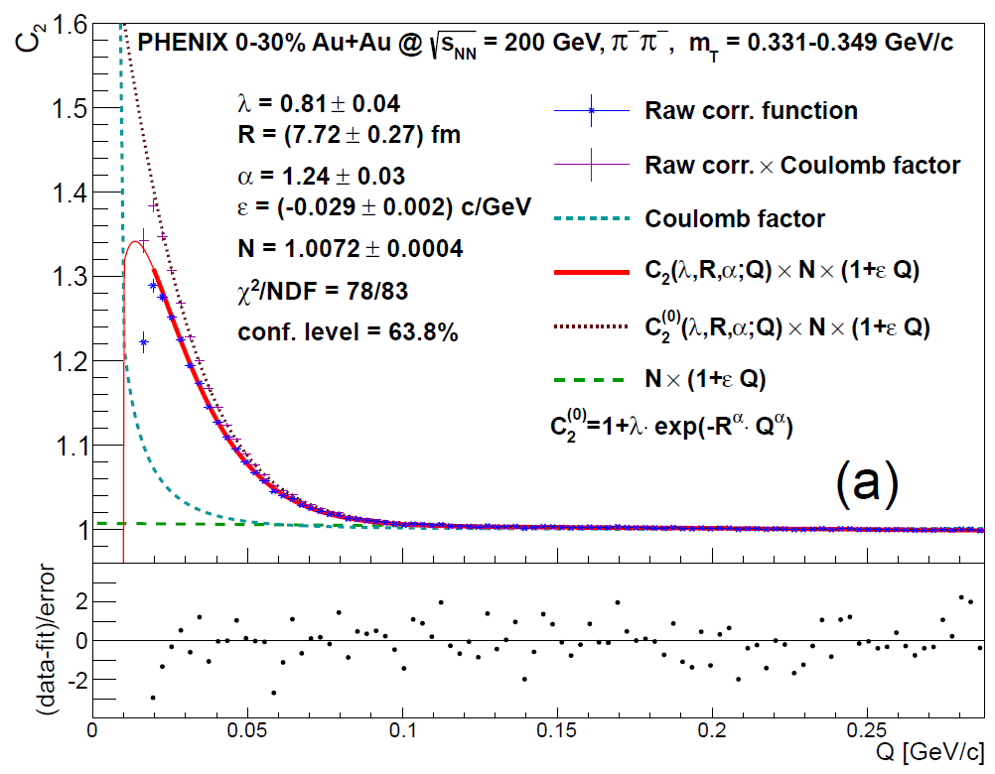
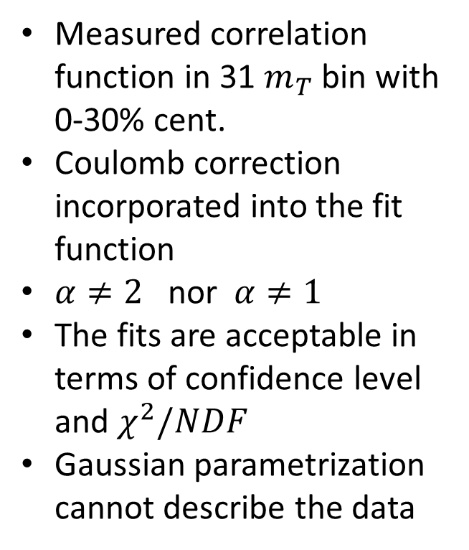
The first results – PHENIX 0-30%, Au+Au
Measured correlation function in 31 $m_{T}$ bin with 0-30% cent.
Coulomb correction incorporated into the fit function
$α≠2$ nor $α≠1$
The fits are acceptable in terms of confidence level and $χ^{2}/NDF$
Gaussian parametrization cannot describe the data

Slide 11
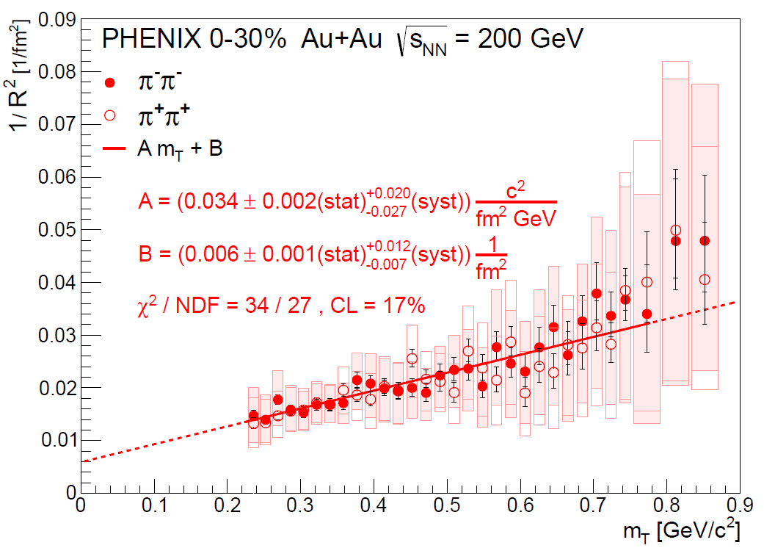
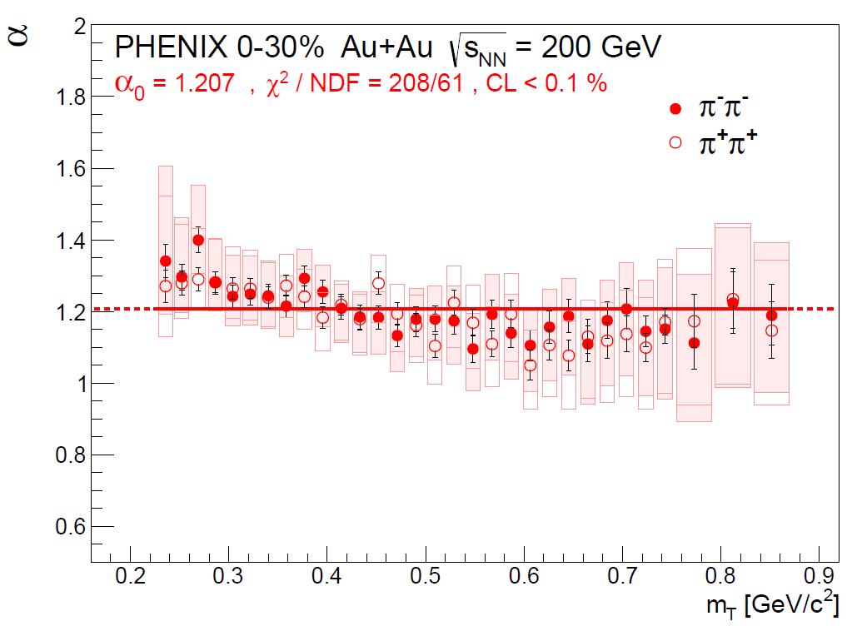
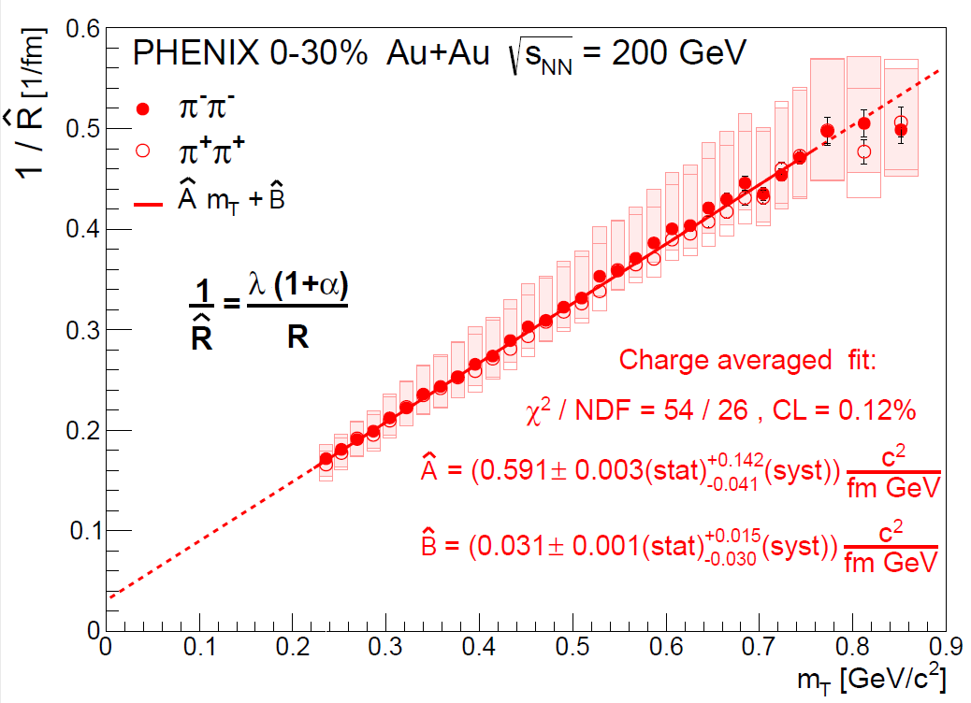
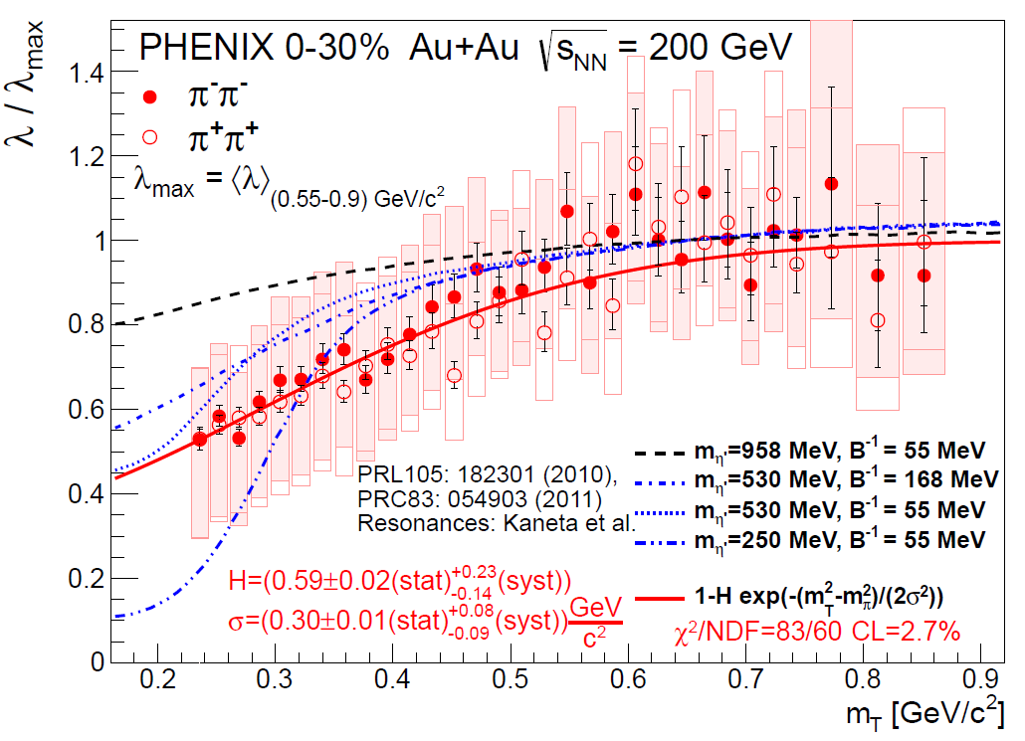
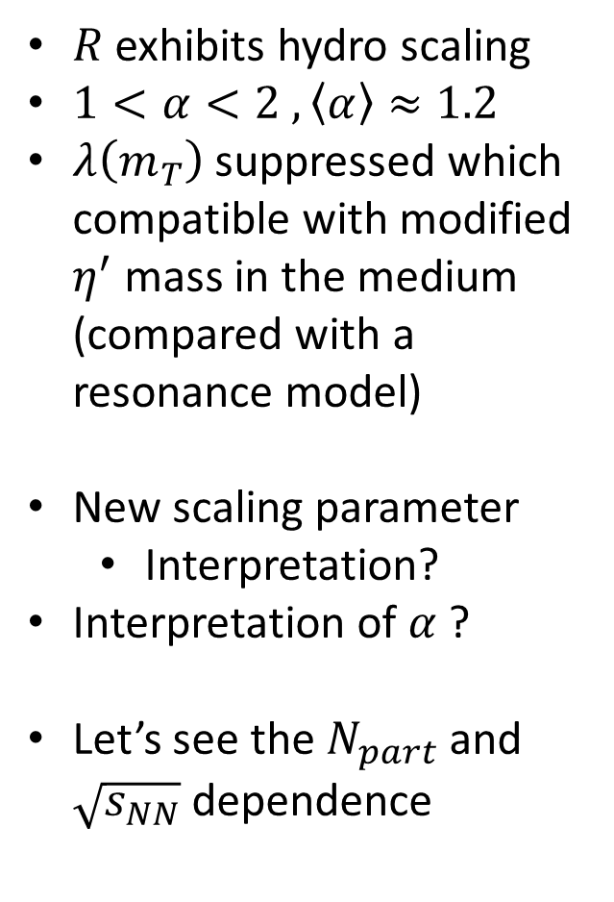
The first results – PHENIX 0-30%, Au+Au
$R$ exhibits hydro scaling
$1<α<2 , \left\langle α\right\rangle ≈1.2$
$λ\left(m_{T}\right)$ suppressed which compatible with modified $η^{′}$ mass in the medium (compared with a resonance model)
New scaling parameter
  Interpretation?
Interpretation of $α$ ?
Let’s see the $N_{part}$ and $\sqrt{s_{NN}}$ dependence

Slide 12
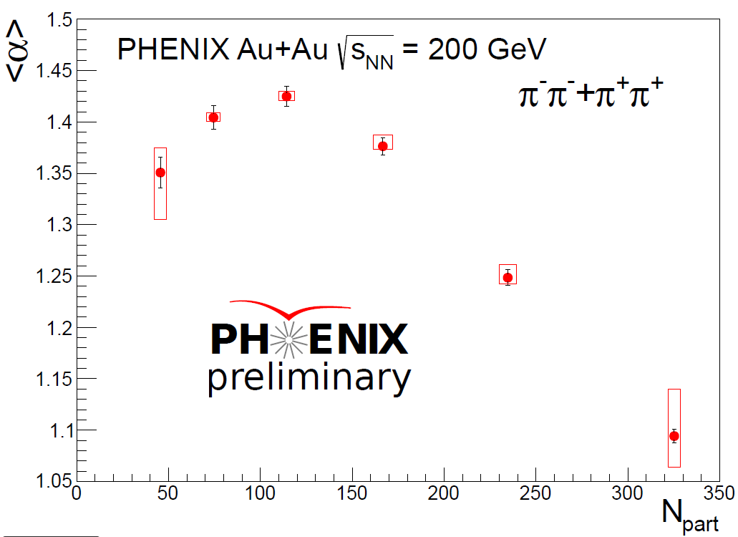
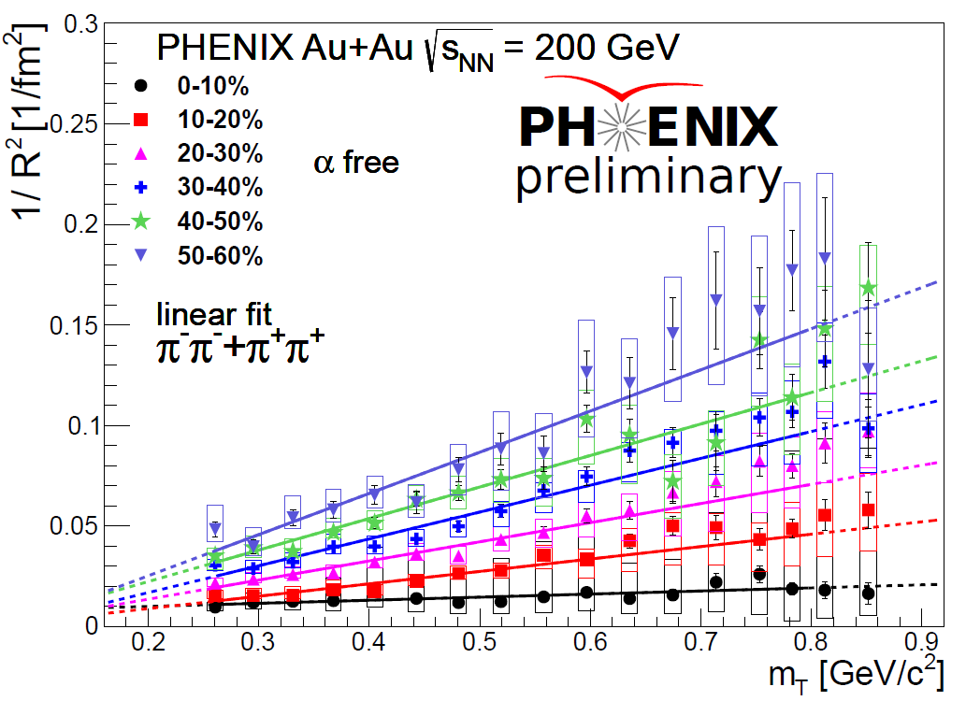
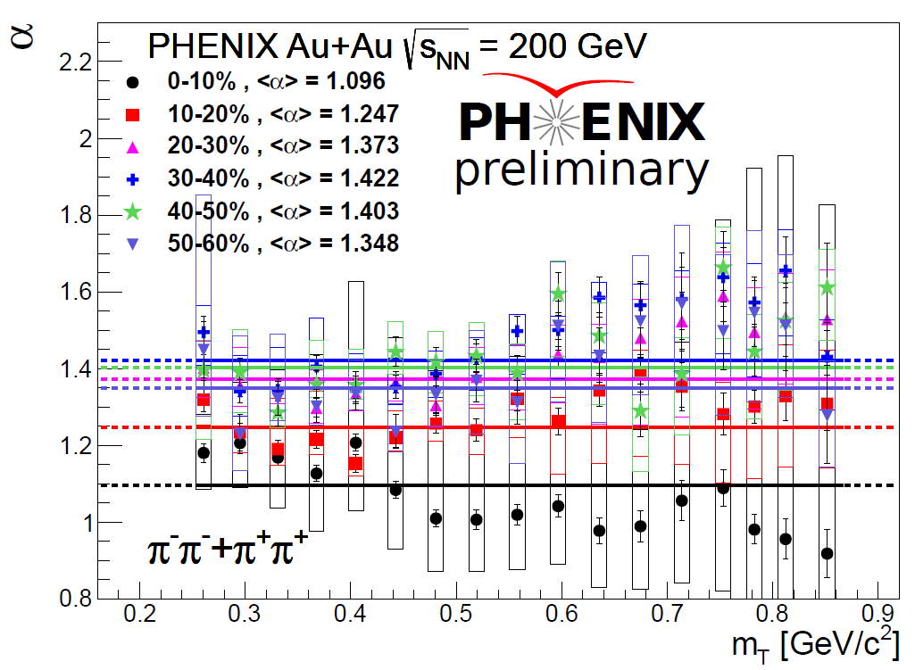
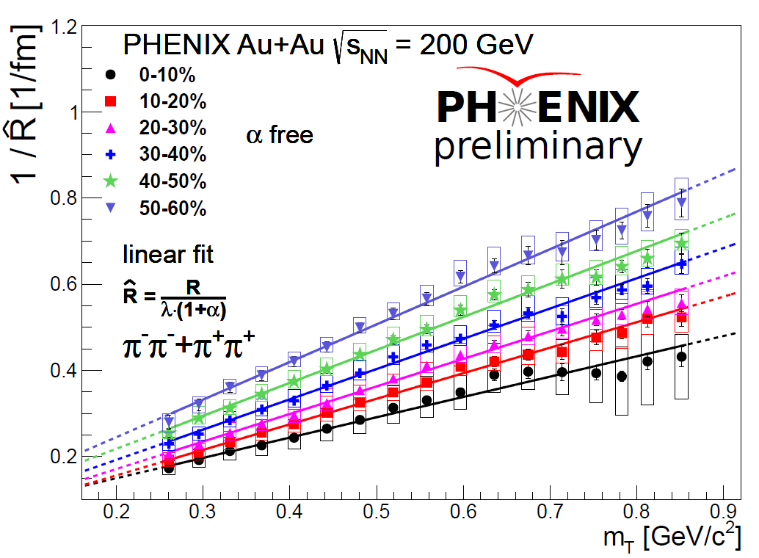
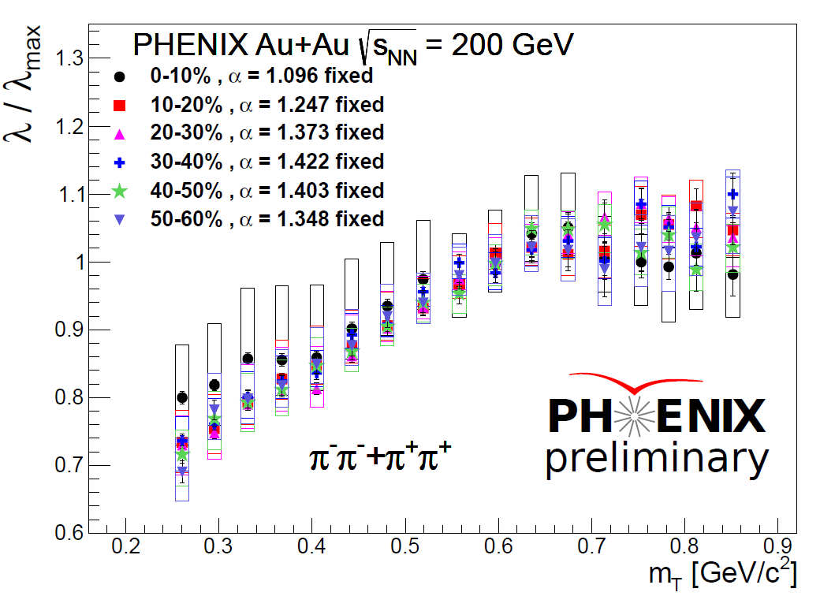
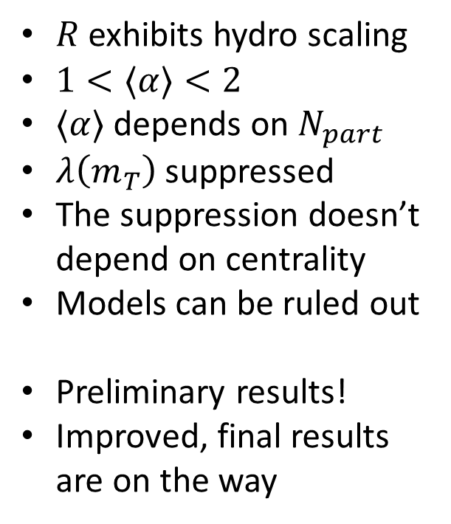
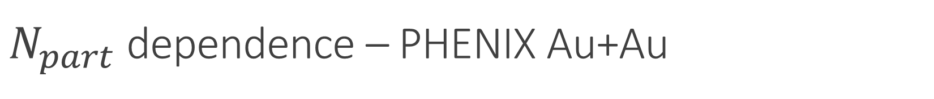
$N_{part}$ dependence – PHENIX Au+Au
$R$ exhibits hydro scaling
$1<⟨α⟩<2$
$⟨α⟩$ depends on $N_{part}$
$λ\left(m_{T}\right)$ suppressed
The suppression doesn’t depend on centrality
Models can be ruled out
Preliminary results!
Improved, final results are on the way

Slide 13
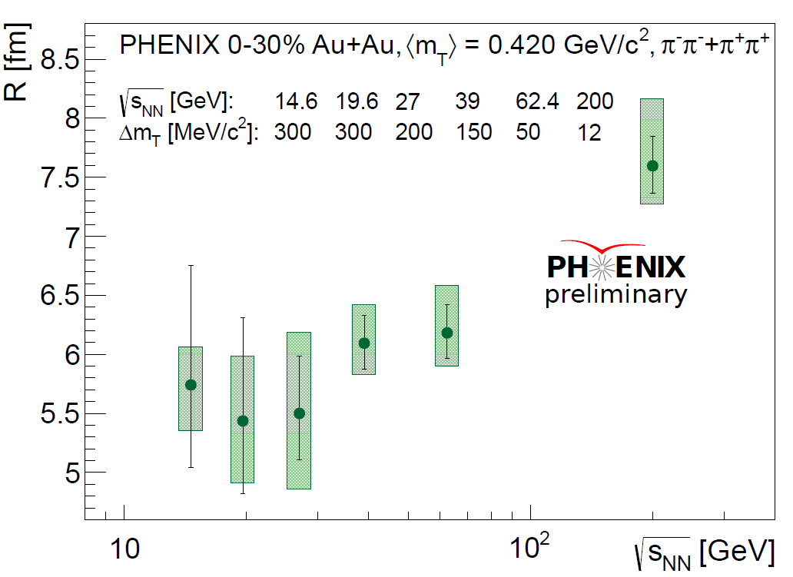
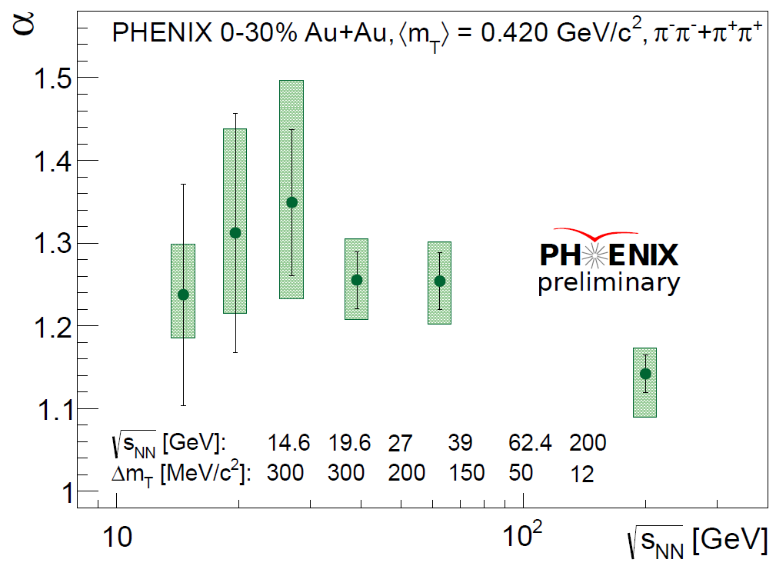
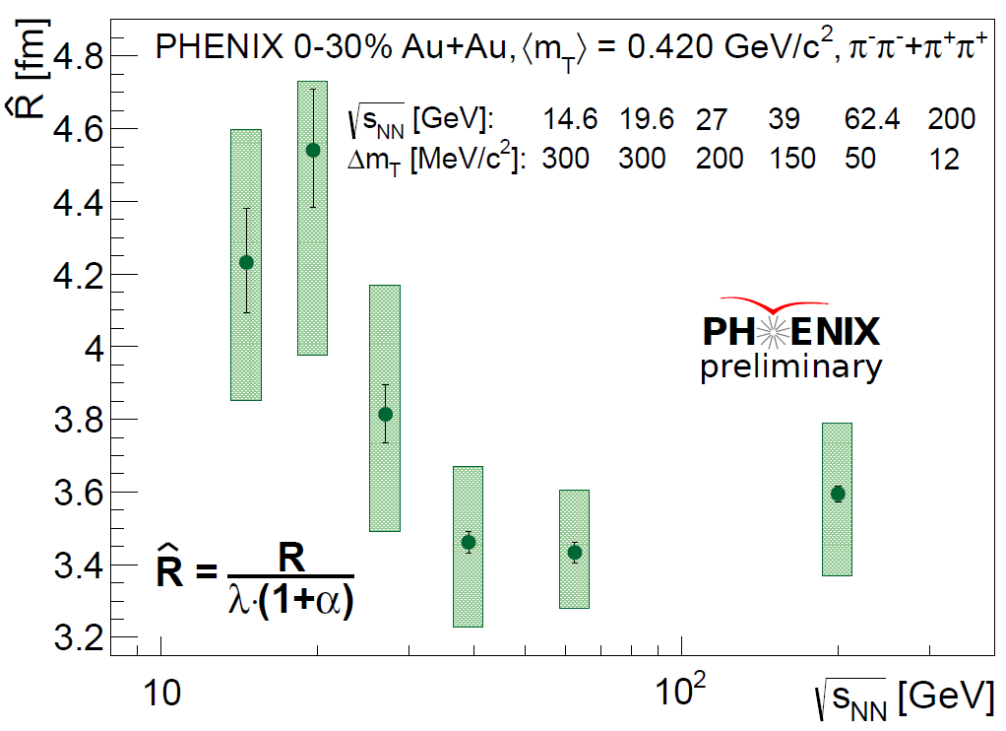
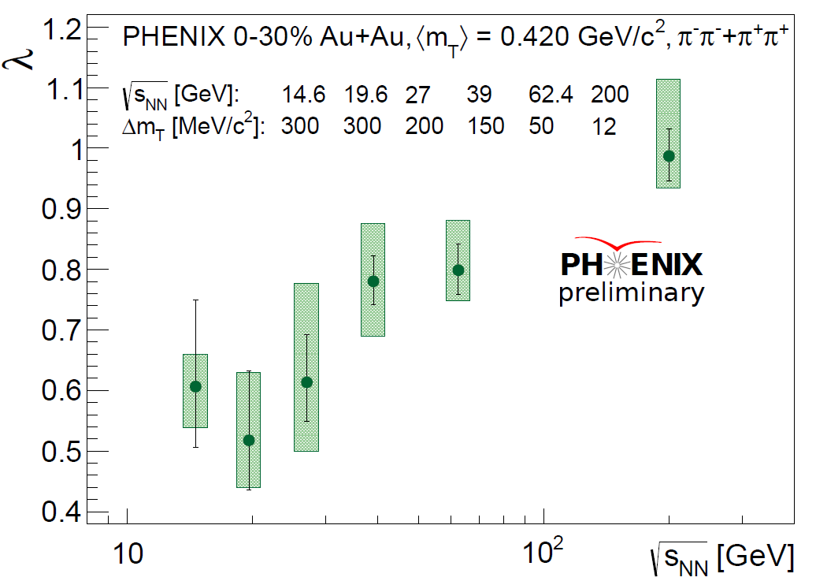
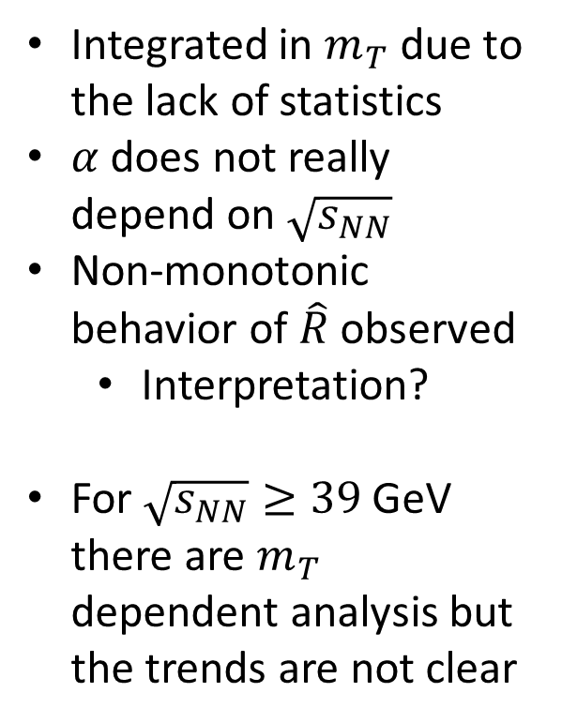
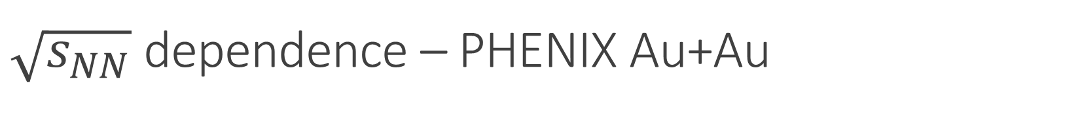
$\sqrt{s_{NN}}$ dependence – PHENIX Au+Au
Integrated in $m_{T}$ due to the lack of statistics
$α$ does not really depend on $\sqrt{s_{NN}}$
Non-monotonic behavior of $\hat{R}$ observed
  Interpretation?
For $\sqrt{s_{NN}}≥39$ GeV there are $m_{T}$ dependent analysis but the trends are not clear

Slide 14
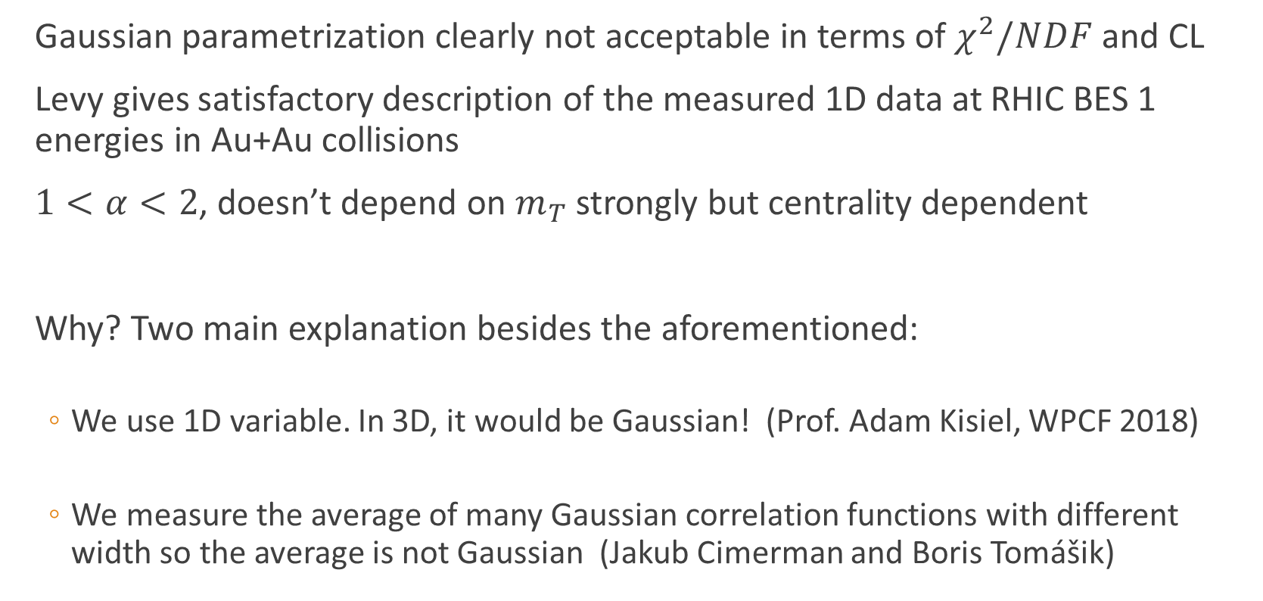
Partial conclusions and critiques
Gaussian parametrization clearly not acceptable in terms of $χ^{2}/NDF$ and CL
Levy gives satisfactory description of the measured 1D data at RHIC BES 1 energies in Au+Au collisions
$1<α<2$, doesn’t depend on $m_{T}$ strongly but centrality dependent
Why? Two main explanation besides the aforementioned:
  We use 1D variable. In 3D, it would be Gaussian! (Prof. Adam Kisiel, WPCF 2018)
  We measure the average of many Gaussian correlation functions with different width so the average is not Gaussian (Jakub Cimerman and Boris Tomášik)

Slide 15
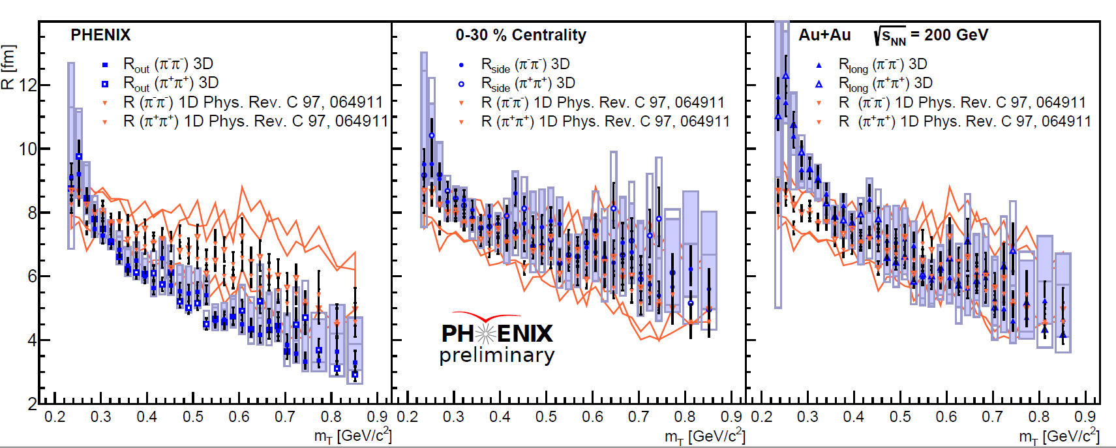
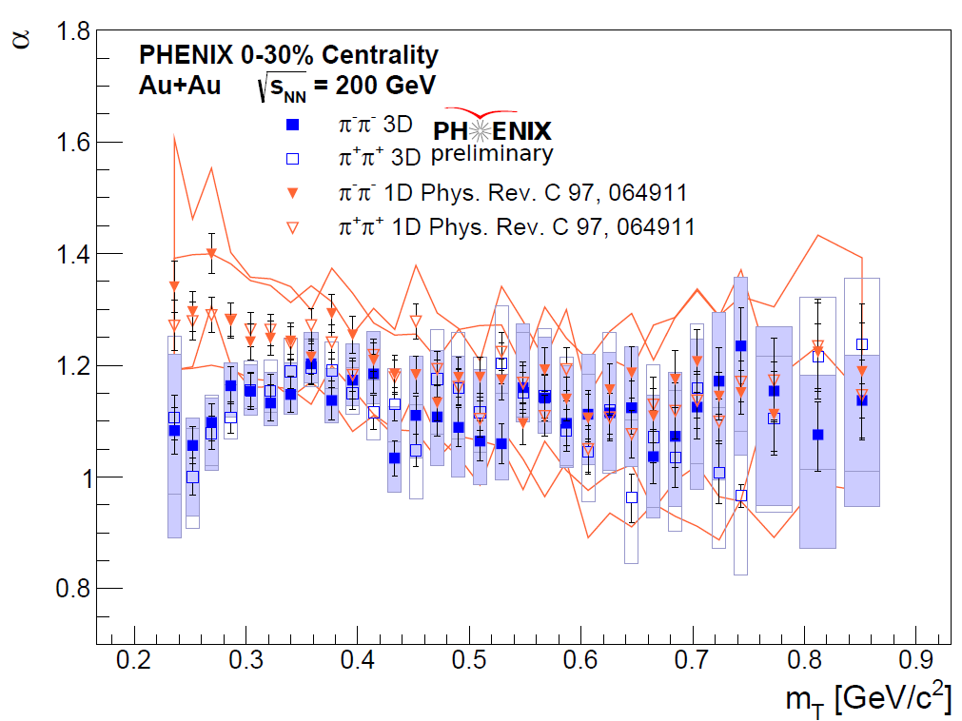
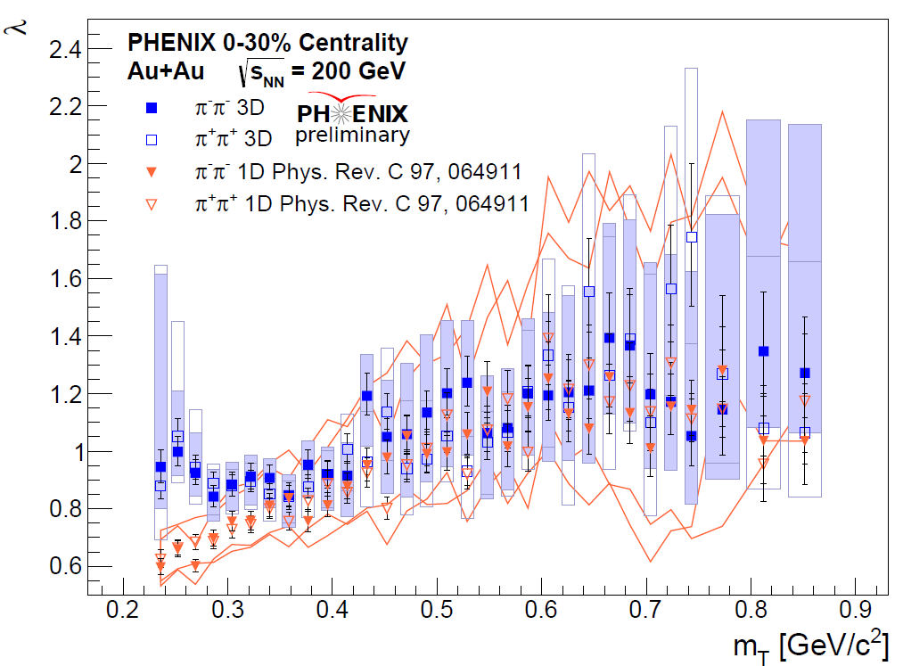
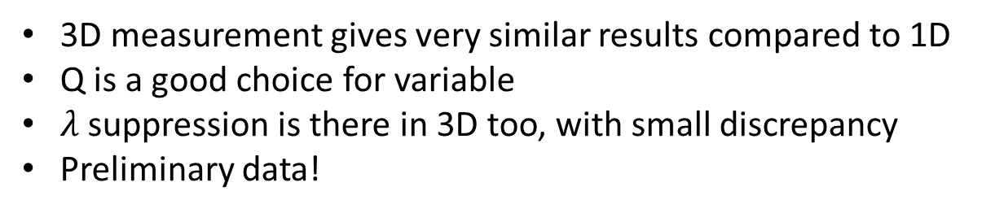
3D correlation – PHENIX 0-30% Au+Au
3D measurement gives very similar results compared to 1D
Q is a good choice for variable
$λ$ suppression is there in 3D too, with small discrepancy
Preliminary data!

Slide 16
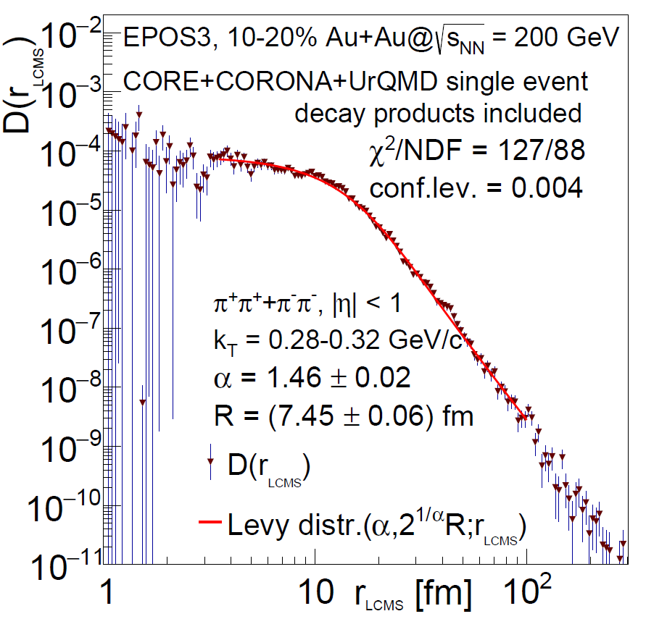
EPOS simulation – event-by-event correlation
Core-halo picture is included
UrQMD for the hadronic cascade
Levy gives the good description
It is a single event!
This analysis support that the origin of the Levy shape could not be explained only with the experimental averaging
This analysis also support the role of the resonances, i.e., anomalous diffusion
With this confidence let’s look at other experiments, energies, particles

Slide 17
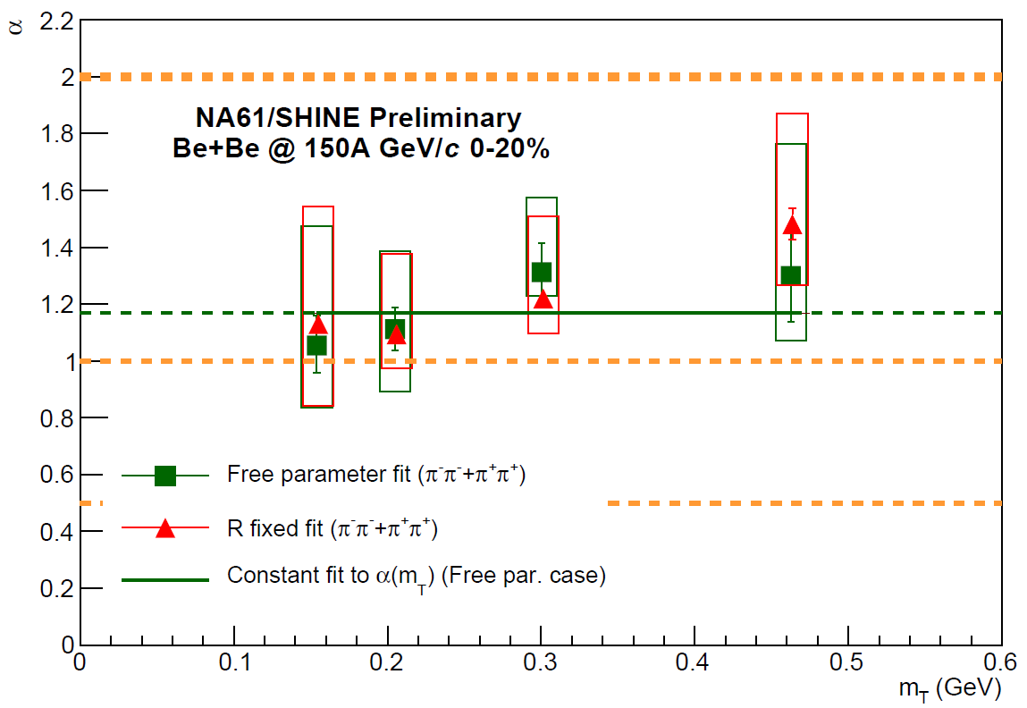
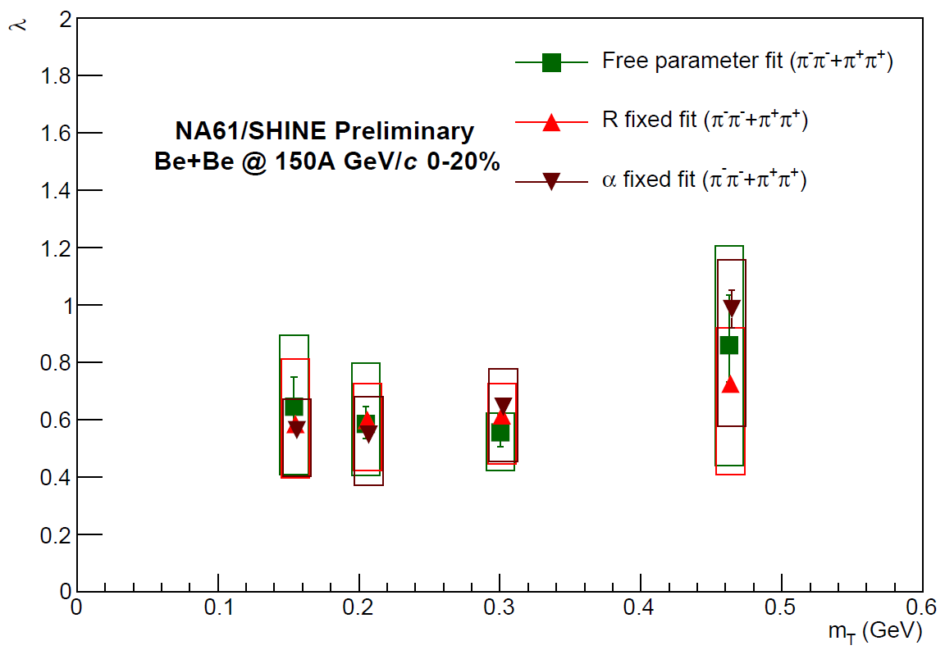
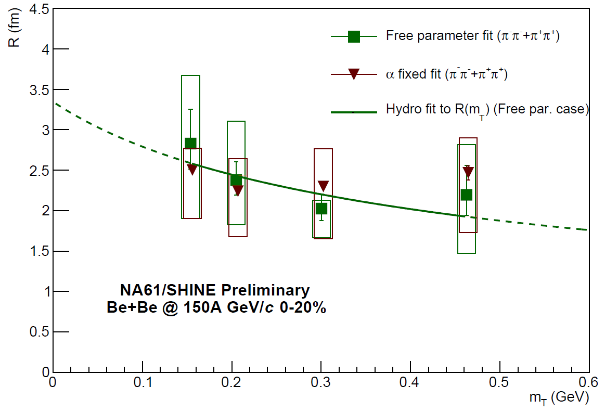
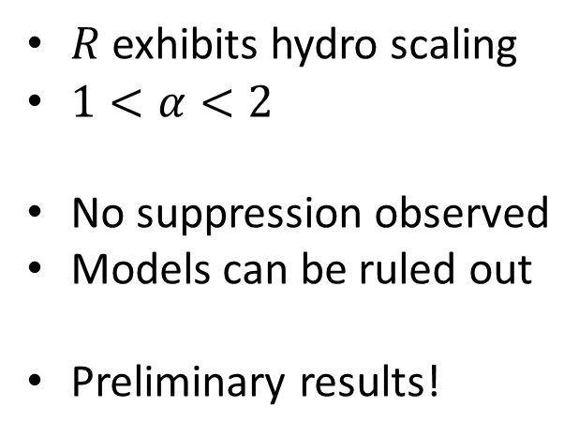
NA61 Ar+Sc and Be+Be at 150 AGeV
$R$ exhibits hydro scaling
$1<α<2$
No suppression observed
Models can be ruled out
Preliminary results!

Slide 18





CMS Pb+Pb @ 5.02 TeV
$α_{RHIC}<α_{CMS}<2$
$λ$ exhibits decreasing trends – unidentified hadrons
R supports its geometrical interpretation as before
Preliminary results

Slide 19





PHENIX @ 200 GeV – kaon correlation in Au+Au
$α_{K}≈α_{π}$ underlying Levy process?
$λ$ exhibits decreasing trends – unidentified hadrons
R supports its geometrical interpretation as before
Preliminary results

Slide 20
Summary
Femtoscopic correlations are measured at different energies, centralities, systems, experiments
Levy parametrization gives satisfactory description in terms of CL
Measured with different type and number of particles
Models supports its appearance
The data favors Levy over Gaussian in all cases
The precise measurements of the parameters are crucial to interpret them
More results on the way and preliminaries will be published with major improvements soon
THANK YOU FOR YOUR ATTENTION!

Slide 21

Invitation
http://zimanyischool.kfki.hu/22/

Slide 22
References
R. H. Brown and R. Q. Twiss, Nature 177, 27 (1956)
Goldhaber et al. Phys. Rev. 120, 300 (1960)
Csörgő et al., AIP Conf.Proc. 828
Metzler et. al, Phys.Rep.339 (2000) 1-77
Csanád et al. Braz.J.Phys. 37 (2007) 1002
Csörgő et al. Acta Phys.Polon. B36
Universe 2019, 5(6), 133
Phys. Part. Nuclei 51, 238-242 (2020)
Gribov-90 Memorial Volume, pp. 261-273 (2021)
Acta Phys.Hung.A 15 (2002) 1-80
Phys.Part.Nucl. 51 (2020) 3, 263-266
Acta Phys. Pol. B Proc. Suppl. vol. 12 (2), pp. 477 - 482 (2019)
Phys.Part.Nucl. 51 (2020) 3, 267-269
Acta Phys.Polon.Supp. 12 (2019) 445
Universe 5 (2019) 6, 154
EPJ Web Conf. 206 (2019) 03004
Universe 4 (2018) 2, 31
Phys.Rev.C 97 (2018) 6, 064911
AIP Conf.Proc. 828 (2006) 1, 539-544

Slide 23

On the 3D variable of the correlation function
$$C_{2}\left(Q,K\right)≈1−λ+λ∫d^{3}rD_{cc}\left(r,K\right){\left|Ψ_{2}^{\left(Q\right)}\left(r\right)\right|}^{2}$$
The $K$ dependence is much smoother than the $Q$ dependence
Use the $Q$ as a variable and the measure the $K$ dep. of the params.
$$Q⋅K=\left(p_{1}−p_{2}\right)\left(p_{1}+p_{2}\right)=p_{1}^{2}−p_{2}^{2}=0→Q_{0}=\vec{Q}\frac{\vec{K}}{K_{0}}$$
$C_{2}(Q)$ can be transformed to $C_{2}\left(\vec{Q}\right)$
Go to LCM system where $\vec{Q}=\left(Q_{out},Q_{side},Q_{long}\right)$

Slide 24




3 particle correlation – PHENIX 0-30% Au+Au
$$κ_{3}=\frac{\left(λ_{3}−3λ_{2}\right)}{2\sqrt{λ_{2}^{3}}}$$
From the definition:
  No coherence: $p_{c}=0⇒κ=1$
  Coherence: $p_{c}>0⇒κ<1$
The source seems to be chaotic

Slide 25






Backup slides

Slide 26

Backup slides

Slide 27


Backup slides

Slide 28


STAR 0-30% Au+Au
Gaussian
Levy

Slide 29


NA61 Ar+Sc and Be+Be at 150 AGeV
$R$ exhibits hydro scaling
$1<α<2$
No suppression observed
Models can be ruled out
Preliminary results!
Can the suppression be turned off?

Slide 30


Femtoscopy – the core-halo model
Usually pions, kaons, protons are measured
Resonance contributions are considerable: core-halo model
$$S\left(x,p\right)=\sqrt{λ} S_{core}\left(x,p\right)+\left(1−\sqrt{λ}\right)S_{halo}^{R_{h}}\left(x,p\right)$$
Let’s introduce the pair source function as
$$D_{AB}\left(x,p\right)=∫d^{3}R S_{A}\left(R+\frac{x}{2},p\right)S_{B}\left(R−\frac{x}{2},p\right)$$
With this the pair source function in the core-halo model:
$$D\left(x,p\right)=λD_{cc}\left(x,p\right)+2\sqrt{λ}\left(1−\sqrt{λ}\right)D_{ch}\left(x,p\right)+{\left(1−\sqrt{λ}\right)}^{2}D_{hh}\left(x,p\right)$$
Notation: $D_{\left(h\right)}/(1−λ)$

Slide 31

Femtoscopy – general form
With $K=0.5\left(p_{1}+p_{2}\right)$ and $Q=p_{1}−p_{2}$! Also assume that $p_{1}≈p_{2}$
$$C_{2}\left(Q,K\right)≈λ∫d^{3}rD_{cc}\left(r,K\right){\left|Ψ_{2}^{\left(Q\right)}\left(r\right)\right|}^{2}+(1−λ)∫d^{3}rD_{\left(h\right)}\left(r,K\right){\left|Ψ_{2}^{\left(Q\right)}(r)\right|}^{2}$$
If we take the $R_{h}→∞$ limit the Bowler-Sinyukov formula is given:
$$C_{2}\left(Q,K\right)≈1−λ+λ∫d^{3}rD_{cc}\left(r,K\right){\left|Ψ_{2}^{\left(Q\right)}\left(r\right)\right|}^{2}$$
The simple planewave case (i.e. no FSI):
$$C_{2}^{\left(0\right)}\left(Q,K\right)=1+λ \frac{{\tilde{D}}_{c}\left(Q,K\right)}{{\tilde{D}}_{c}\left(Q=0,K\right)}$$

Slide 32

Backup slides

Slide 33


Physics in the parameters
Possible interpretations of the $λ$:
  Specific $m_{T}$ suppression linked to in-medium mass modification of $η′$
  Measuring two- and three particle correlations could shed light on partially coherent particle production (see core-halo model):
  $$f_{c}\left(K\right)=\frac{N_{c}\left(K\right)}{N\left(K\right)} and p_{c}\left(K\right)=\frac{N_{c}^{p}\left(K\right)}{N_{c}\left(K\right)}$$
  $$λ_{2}=f_{c}^{2}\left[{\left(1−p_{c}\right)}^{2}+2p_{c}\left(1−p_{c}\right)\right]$$
  $$λ_{3}=2f_{c}^{3}\left[{\left(1−p_{c}\right)}^{3}+3p_{c}{\left(1−p_{c}\right)}^{2} \right]+3f_{c}^{2}\left[{\left(1−p_{c}\right)}^{2}+2p_{c}\left(1−p_{c}\right)\right]$$
  $$κ_{3}=\frac{\left(λ_{3}−3λ_{2}\right)}{2\sqrt{λ_{2}^{3}}}$$
Independent from $f_{c}$

