Slide 1

Adiabatic Focusing in Low Density Plasmas in AWAKE (Pt. 2)
University of Michigan CERN REU
Morgan Cole - University of California, Berkeley
Supervisors: Livio Verra & Edda Gschwendtner

Slide 2
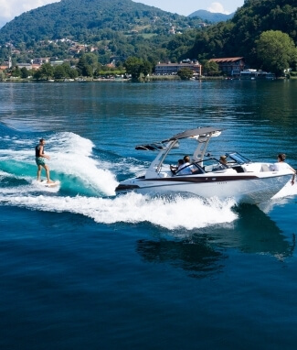
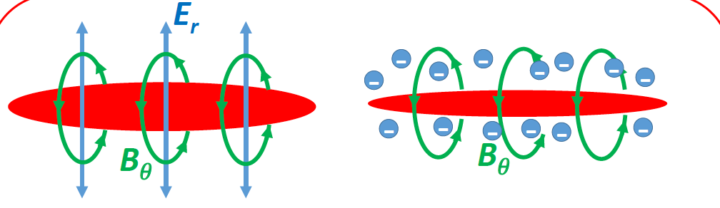
Pt. 1 Recap
“Wake” of space charge instability
AWAKE = Accelerating electrons with a proton bunch in a plasma field
  AWAKE Run 2, running new tests to drive larger wakefield amplitudes
Adiabatic Focusing = The driving proton bunch “self-focuses” in plasma by generating a magnetic field
Electron “witness” bunch
Plasma (Rb⁺)
Proton “driving” bunch

Slide 3
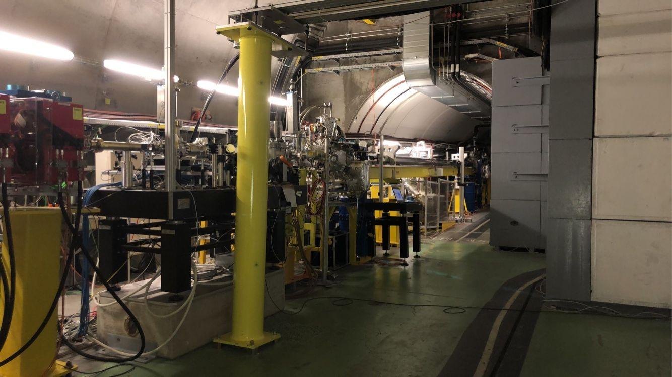
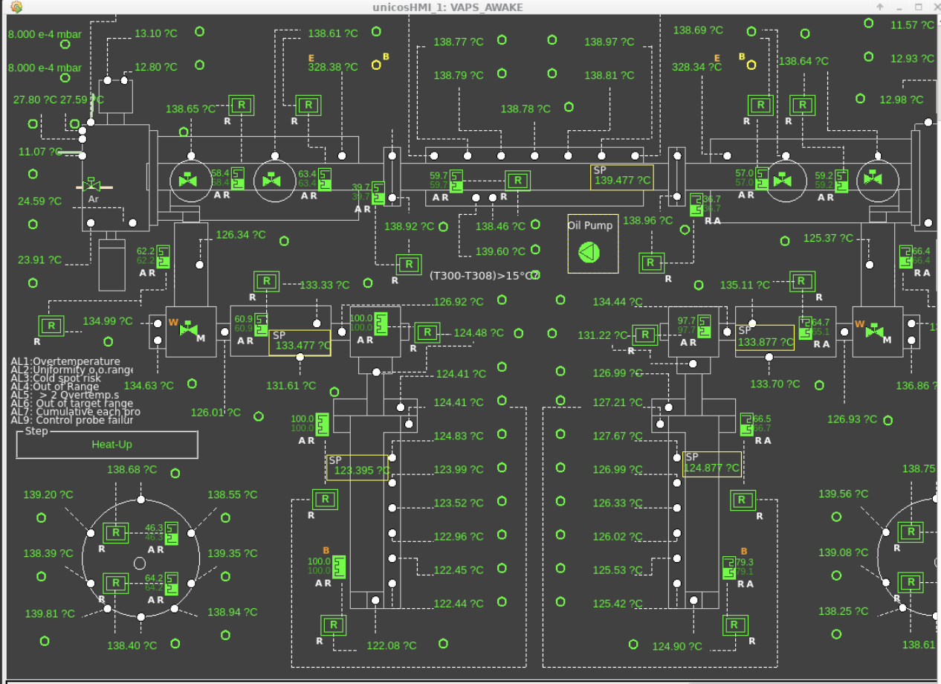
Beam Time!
Got beam/ran adiabatic focusing experiment last week
As proton beams come through, gradually increase plasma density/temperature
Track the beam’s size as the plasma heats up
  Plasma increases → focusing effect increases → bunch width decreases

Slide 4
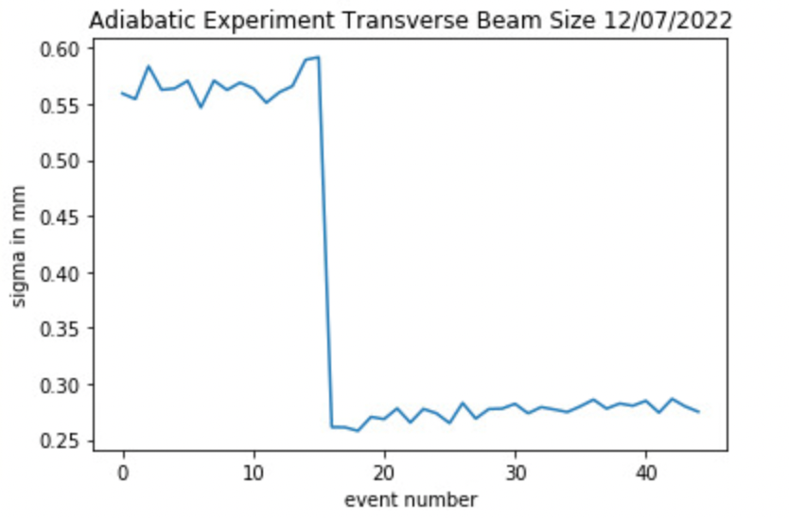
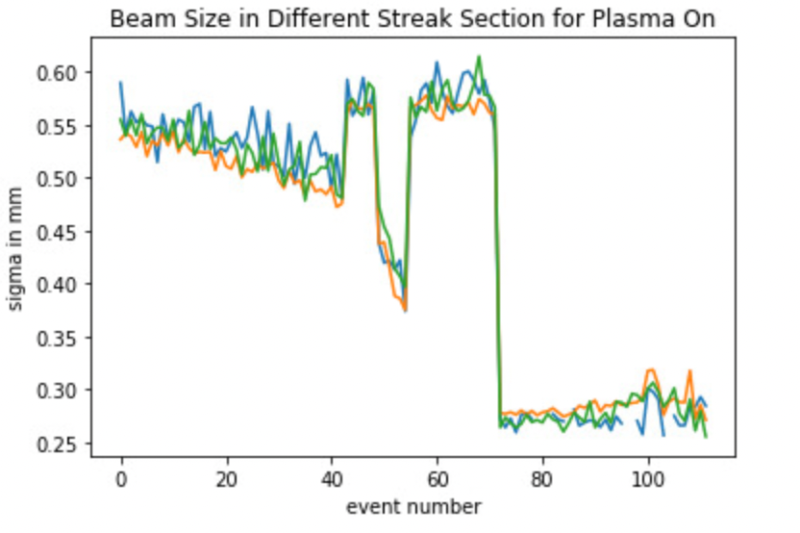
✨Problems✨
Attempt #1: Instant focusing
  Must have already been Rb in the plasma cell, density was too high
Sharing with the LHC
  Both using SPS, lose beam for a long time if LHC is filling
L experiment…

Slide 5
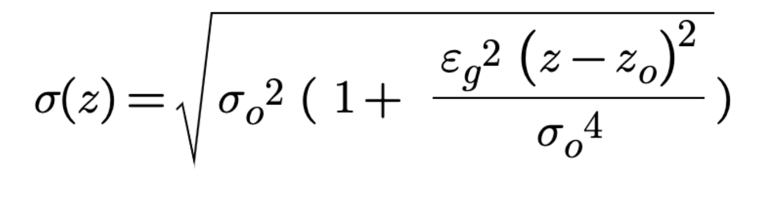
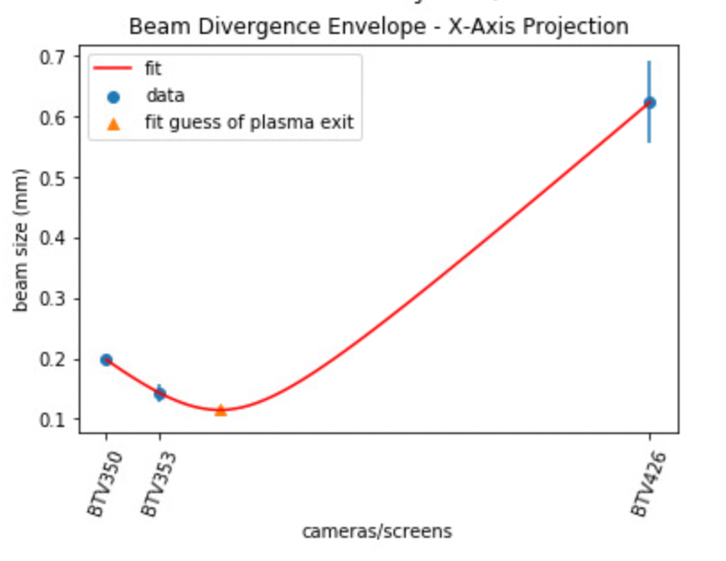
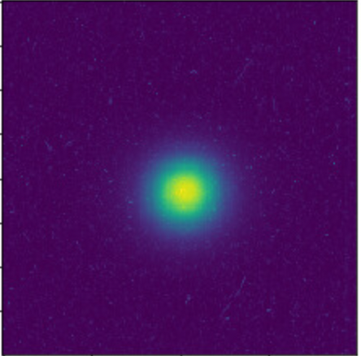
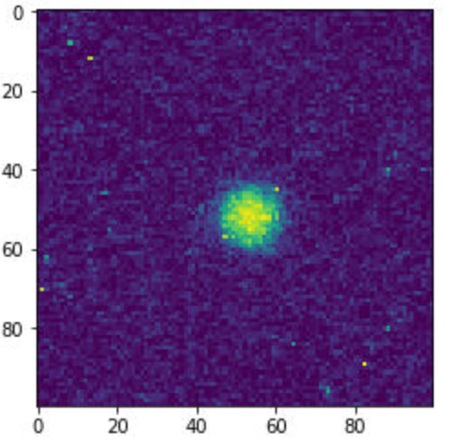
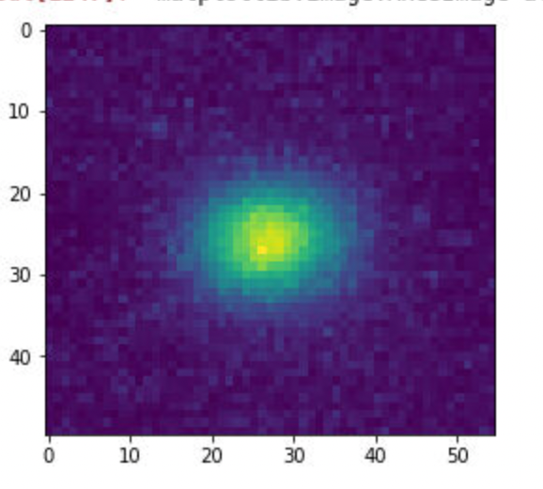
Initial Analysis - “Plasma Off” Checks
Quantifying beam when plasma is off to compare with plasma on
Important to know: beam envelope equation parameters
  Different cameras/screens to look at the bunch in different stages
BTV350
BTV353
BTV426
(images not equivalently scaled)

Slide 6
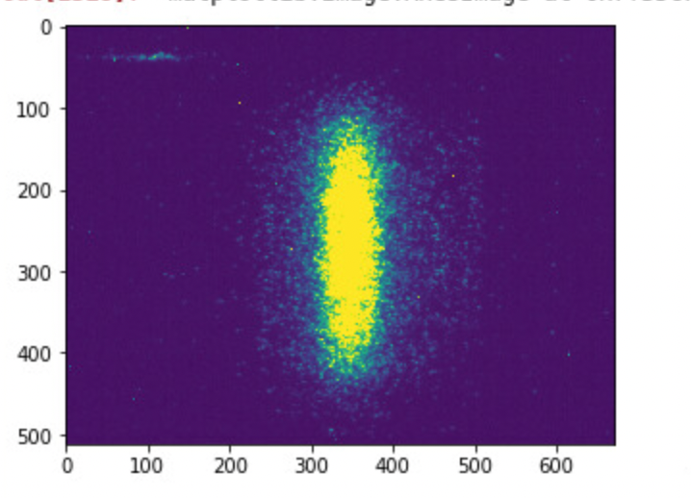
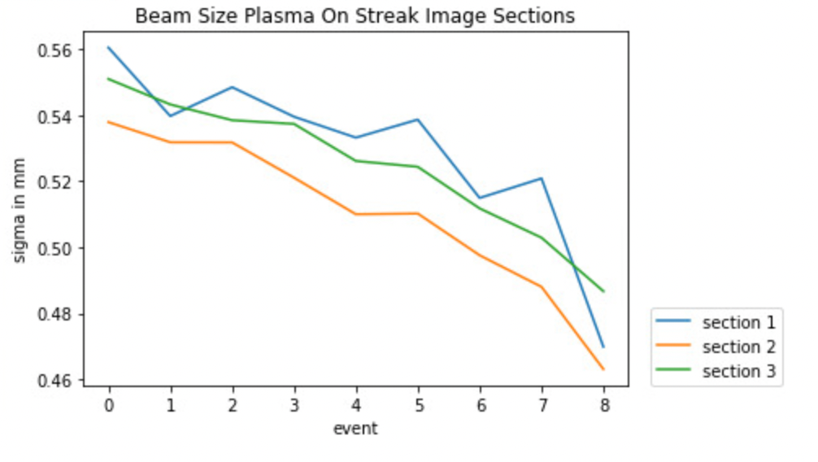
Plasma On, Focusing!
Size gradually decreases over time as plasma density increases
  Divide bunch into subsections
Section 1
Section 2
Section 3

Slide 7
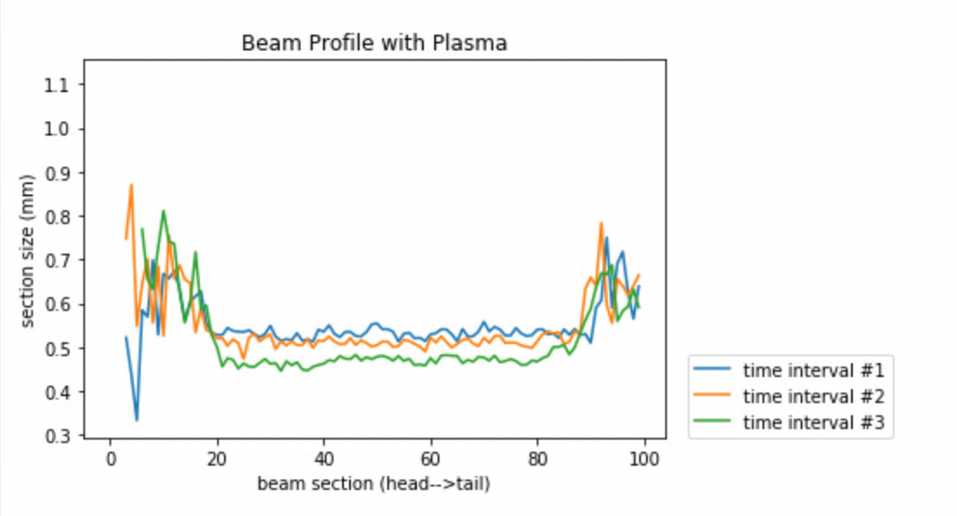
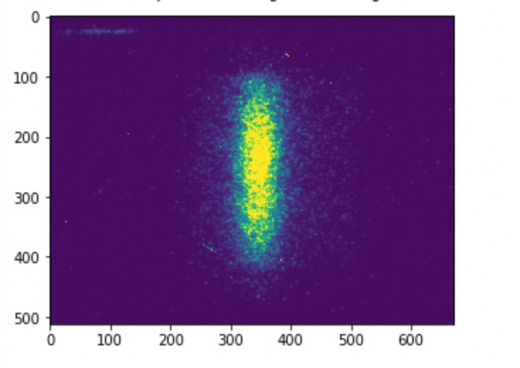
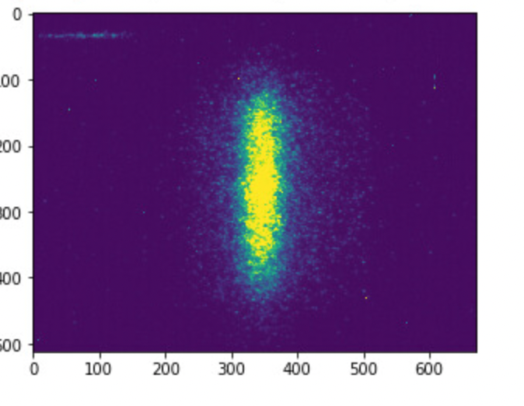
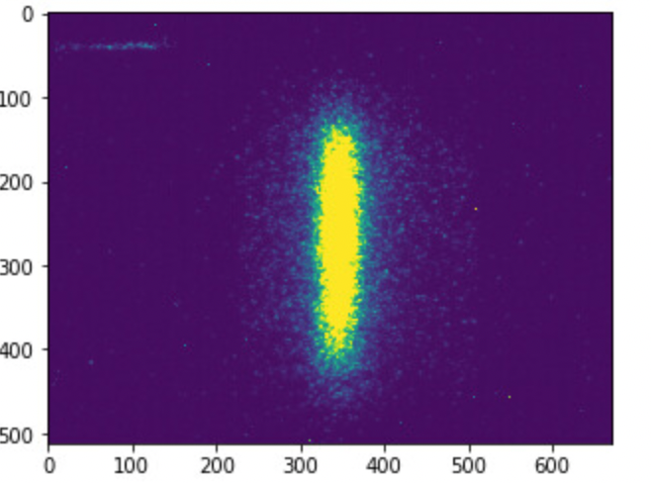
Beam Side Profiles
  Make a bunch more subsections and look at the size along the bunches
  Compare how bunch side profiles change over time
  Going down = focusing
Time interval #1
Time interval #2
Time interval #3

Slide 8
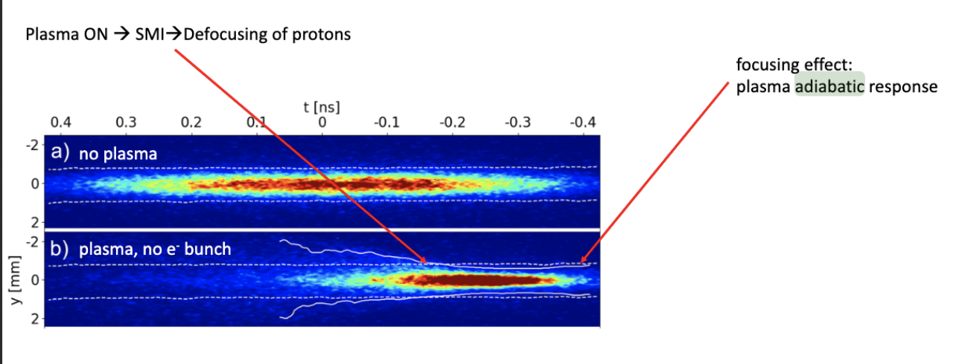
What’s next?
Continue to refine/increase precision of data to see focusing effects better
  Incorporate more camera data into beam envelope fit
  Examine bunch length
  Improve precision of beam profiles
Might see some cool focusing effects on the beam center

Slide 9
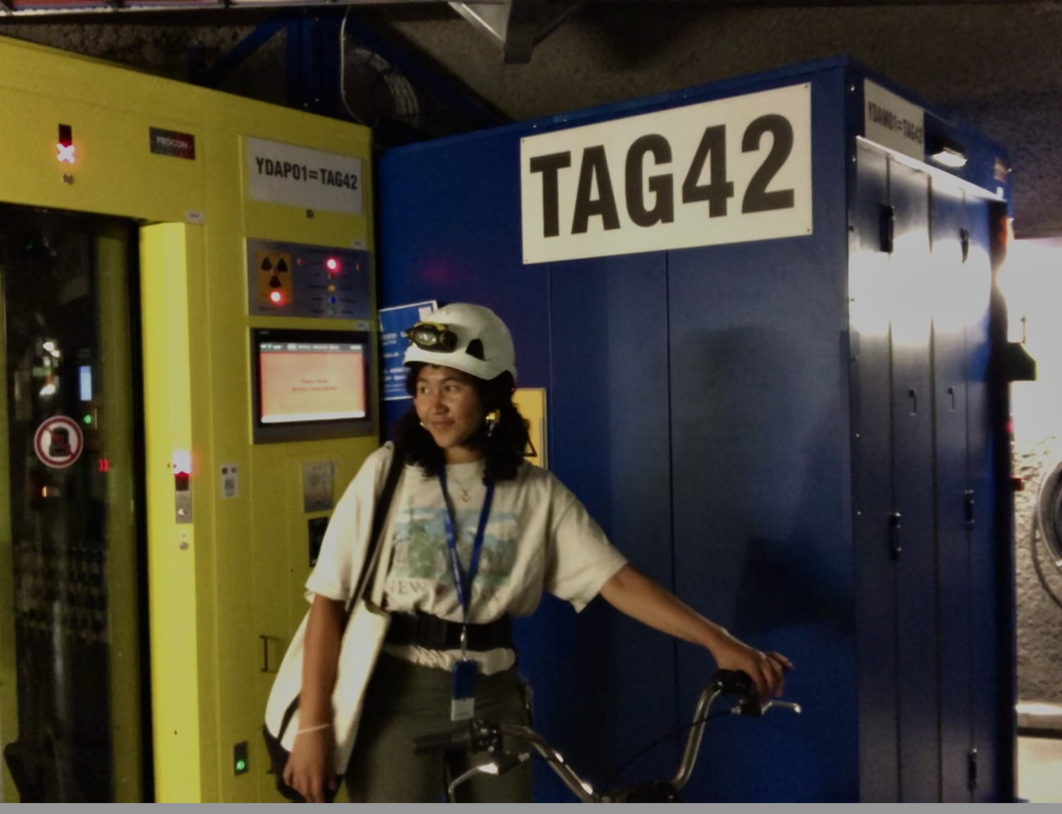
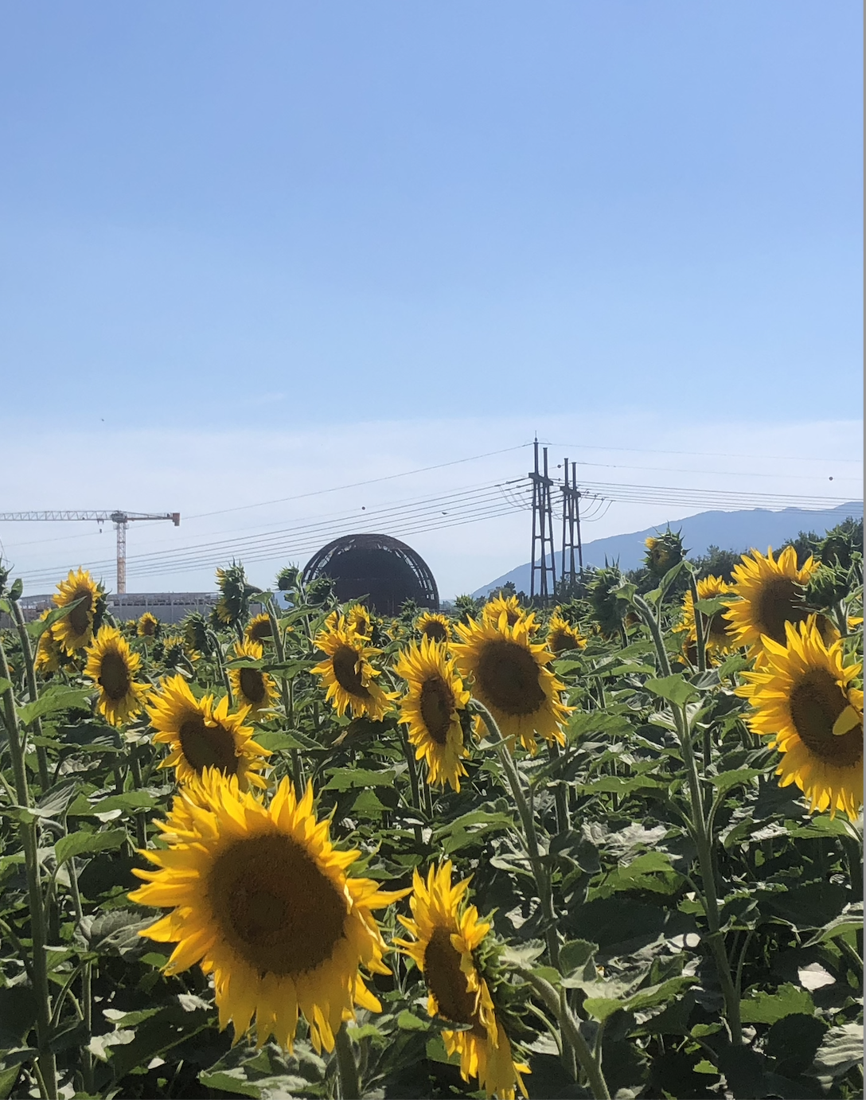
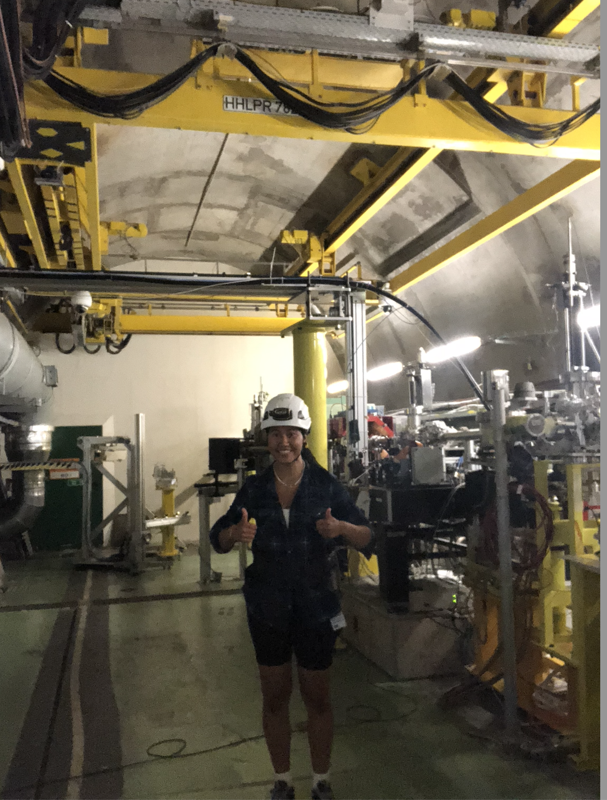
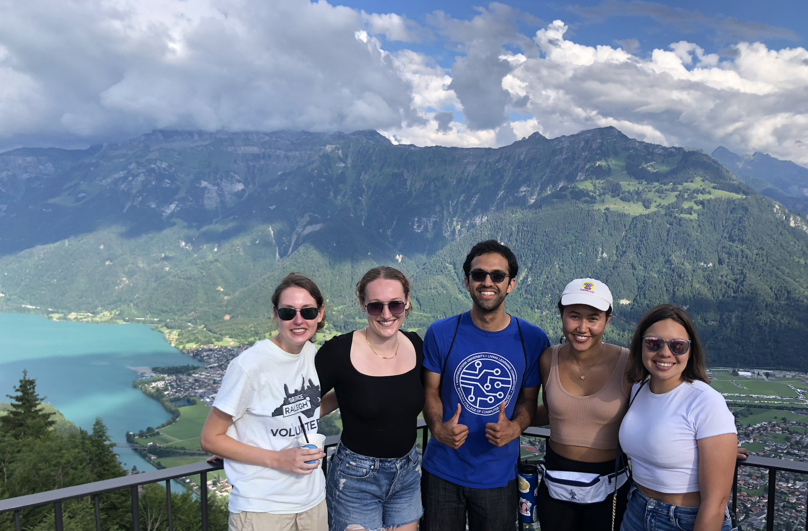
Thank you!

