Slide 1

CMS Detector Upgrade
R&D of GEM Detectors for GE2/1 and ME0
Josh Cameron, UM-CERN REU
Co-Advisors: Francesco Ivone and Pieter Everaerts

Slide 2
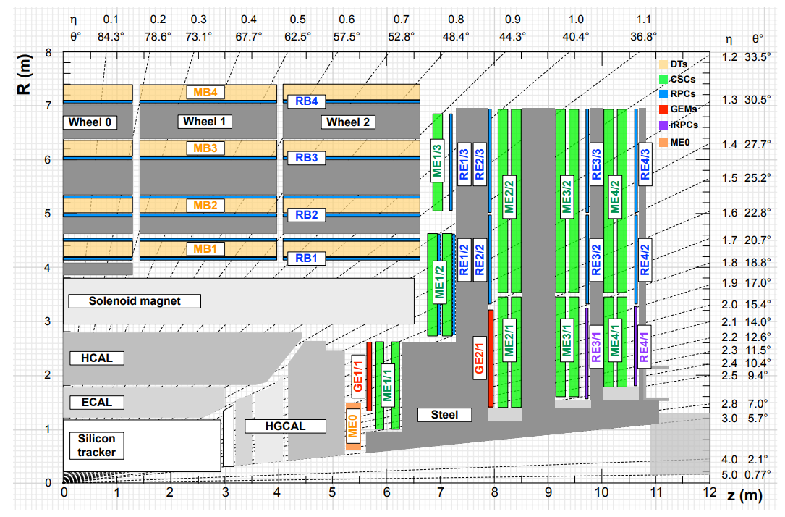
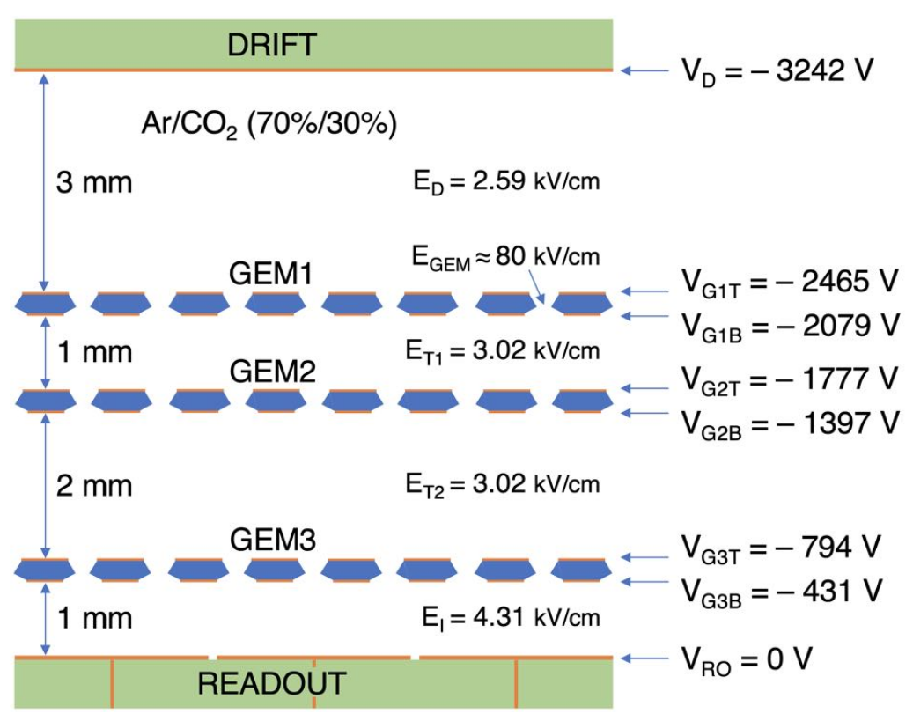
GEM Upgrade

Slide 3
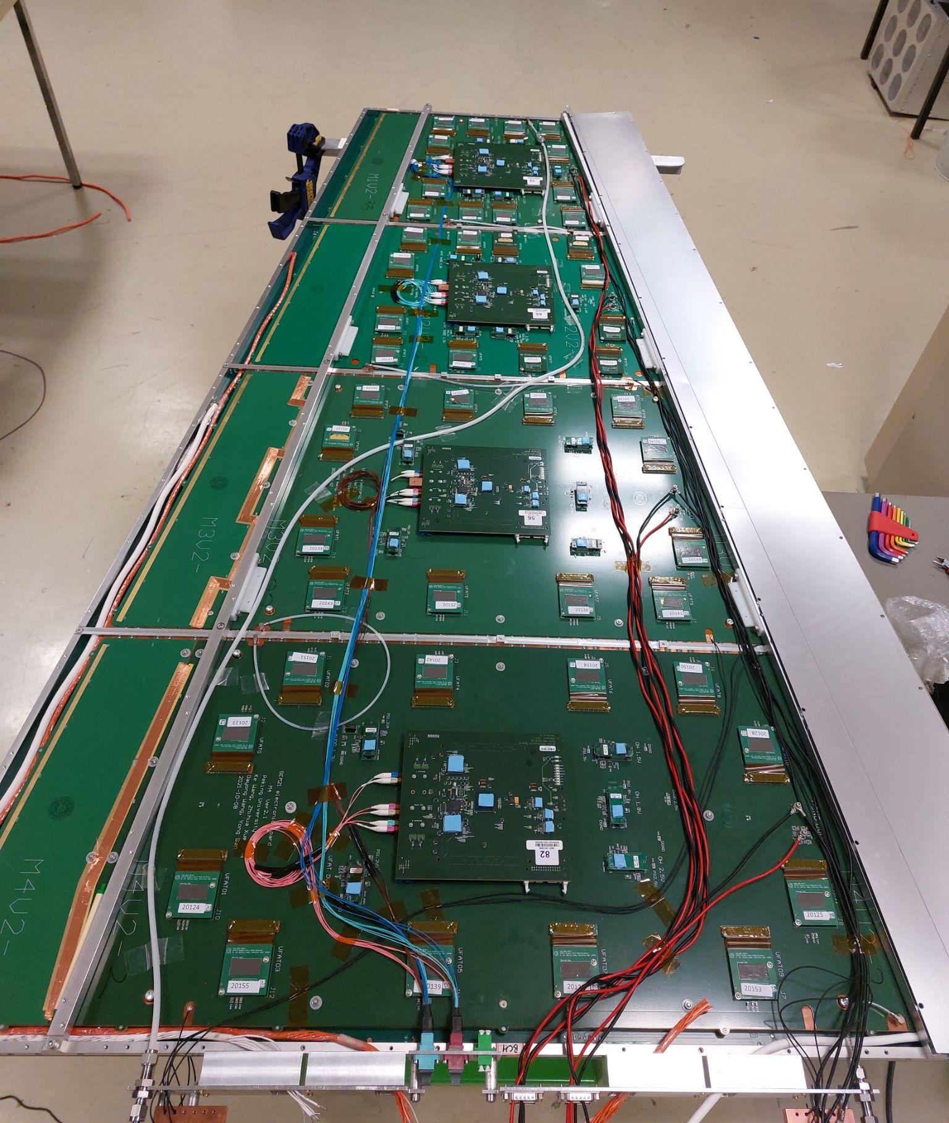
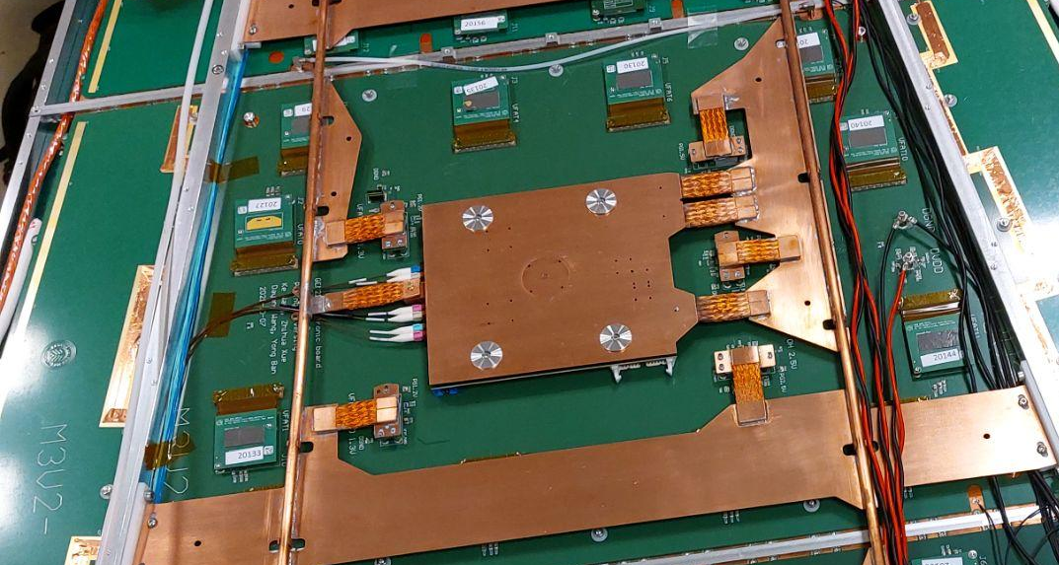
Hardware/Assembly
Assembly of first GE 2/1 Chamber in R&D Lab
  Ensure all components fit well together
    4 modules, cooling, chimney
  Set standard routing for gas lines, wiring, and fibres for mass production of GE2/1 chambers by technicians

Slide 4
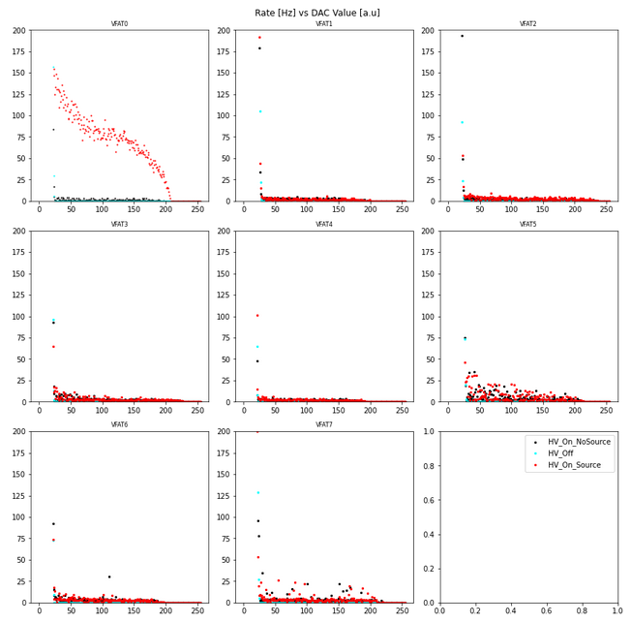
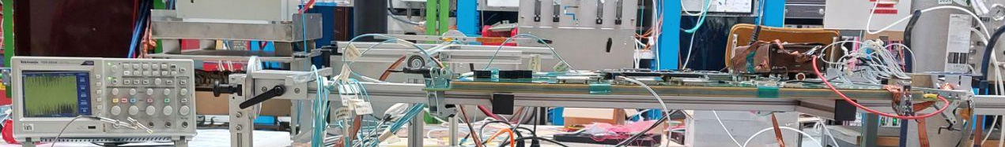
GE 2/1 Tests
Testing of GE2/1 Module
  Sbit Rate Scan - Set threshold per VFAT
    Shows signal amplification and noise
  Efficiency testing using scintillators and cosmics
    97.3 ± .6 % efficiency (N~3,200)

Slide 5
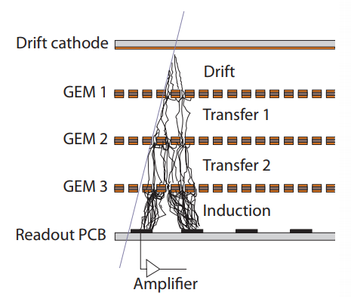
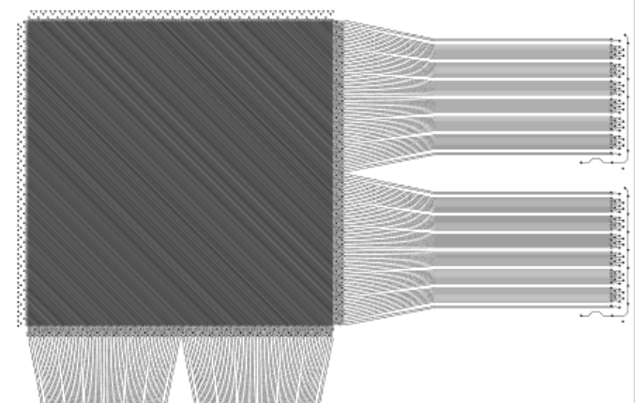
On-going work
Cluster tracking
  Hit reconstruction from raw data
  Avalanche from single muon may trigger several strips
    Impact of GEM current to cluster size?
New XYV GEM Tracker
  Reduce event location uncertainty with a 3rd layer of diagonal strips

Slide 6
On-going work
Cluster tracking
  Hit reconstruction from raw data
  Avalanche from single muon may trigger several strips
    Impact of GEM current to cluster size?
New XYV GEM Tracker
  Reduce event location uncertainty with a 3rd layer of diagonal strips

Slide 7
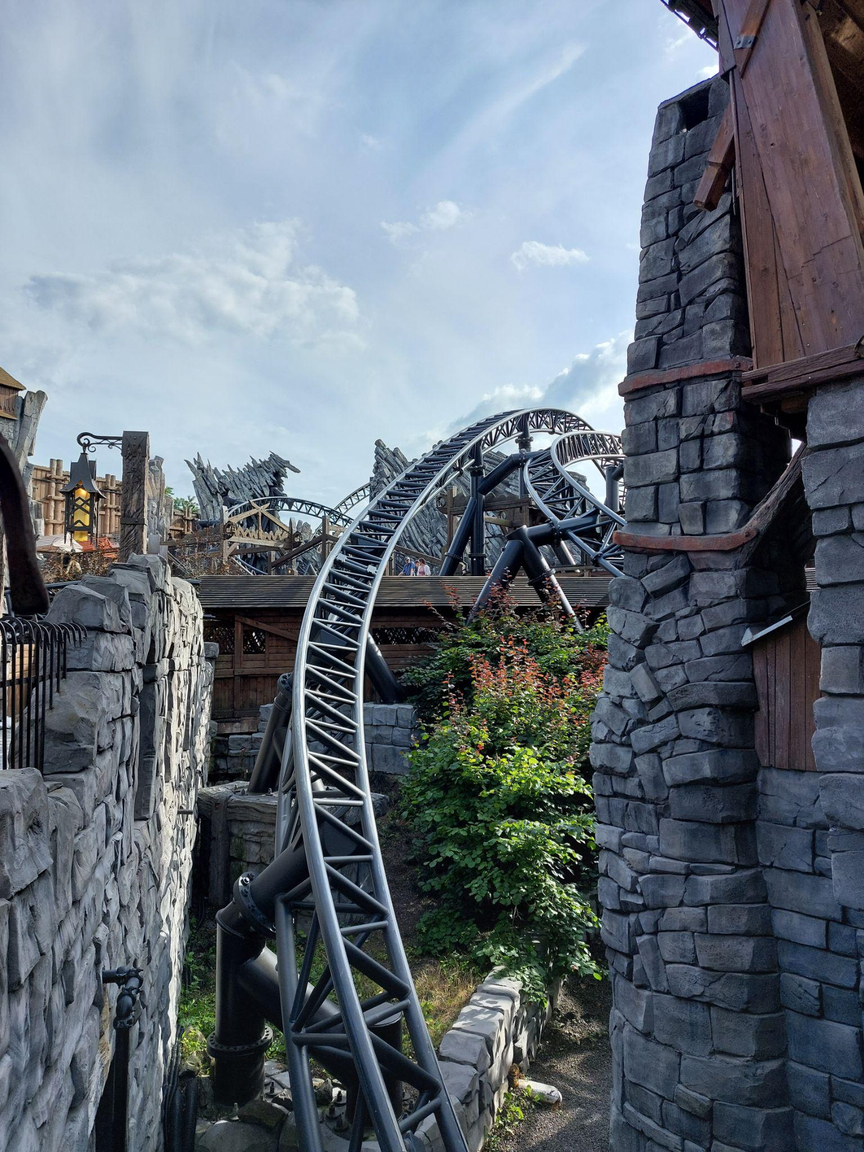
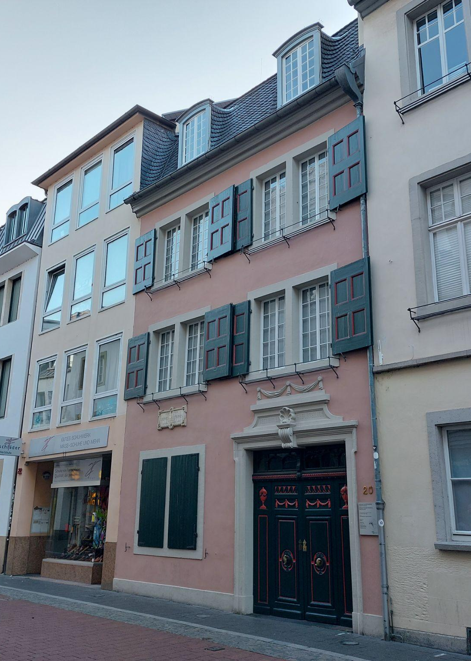
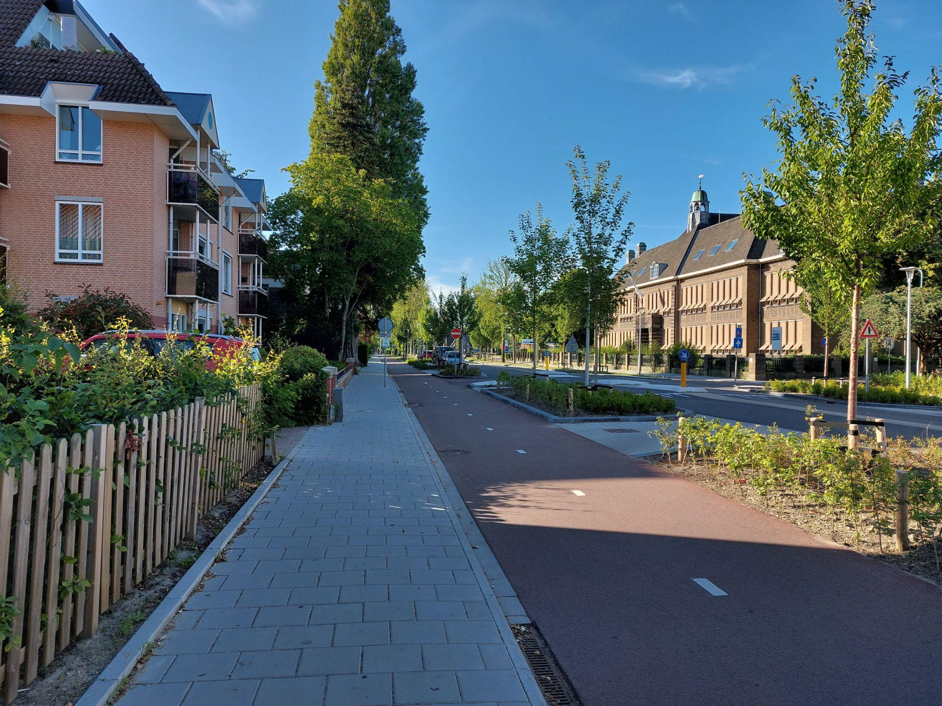

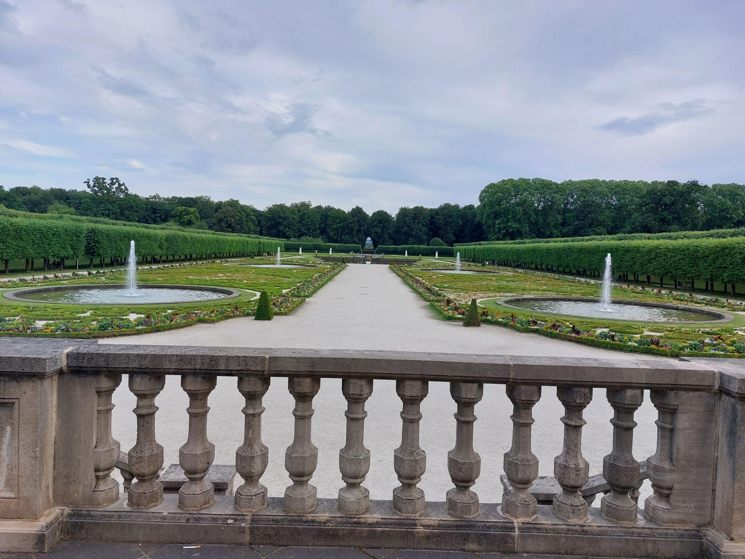
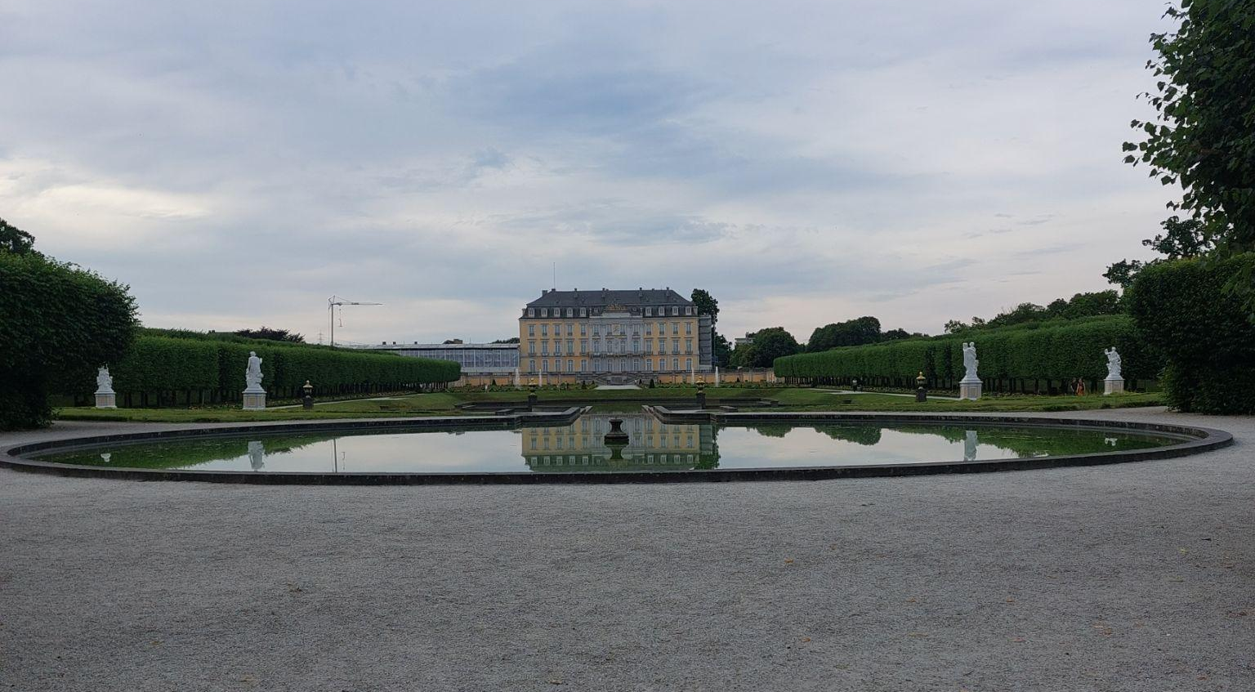
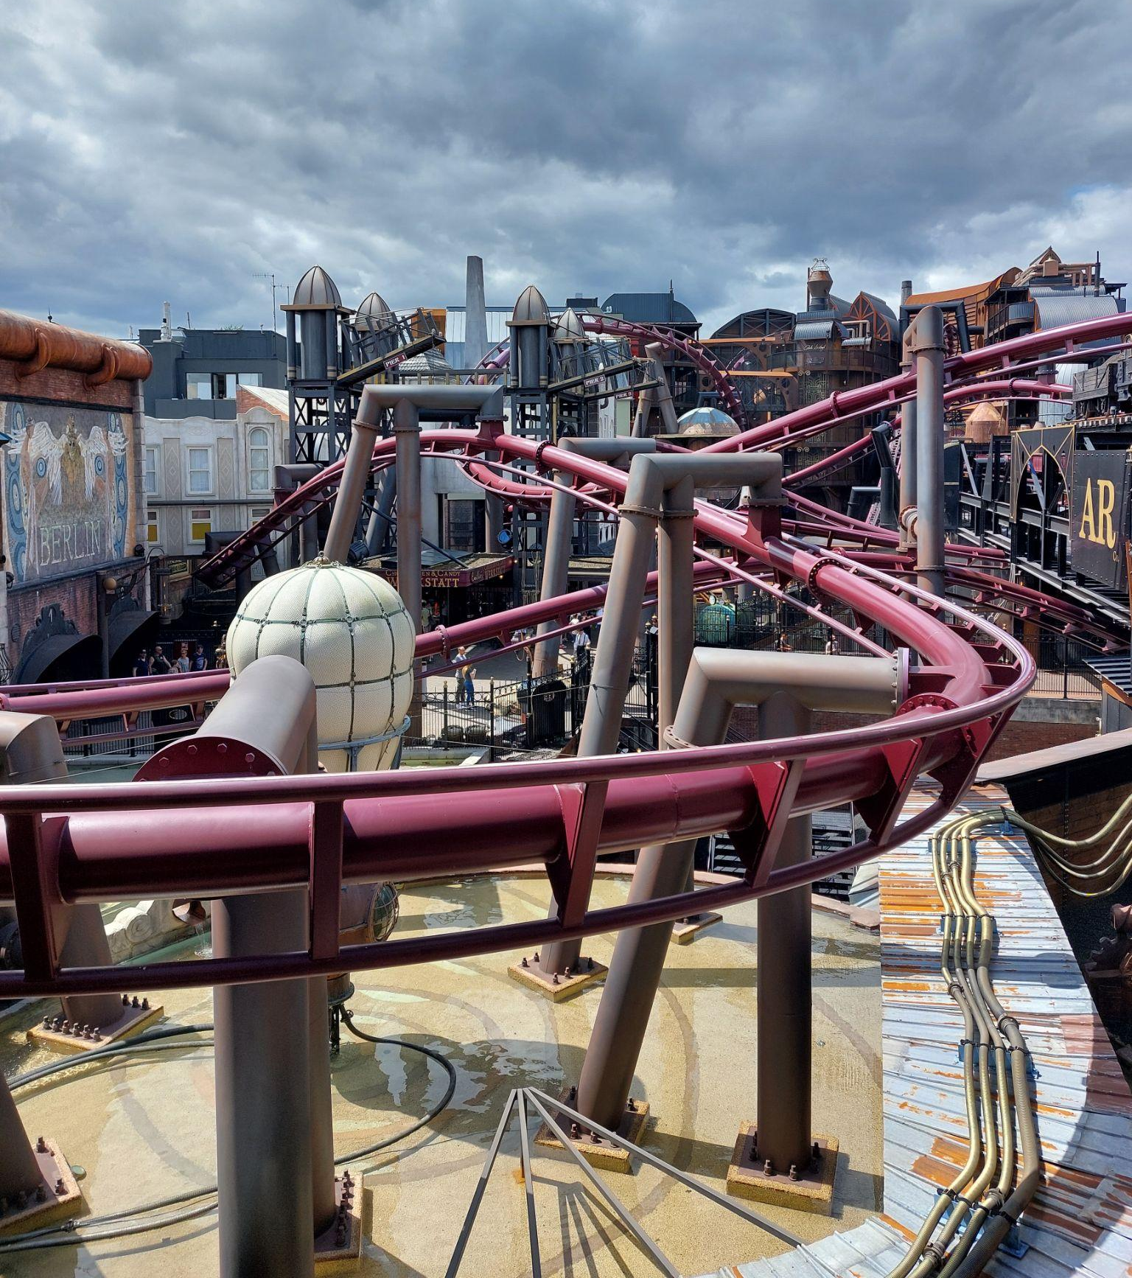
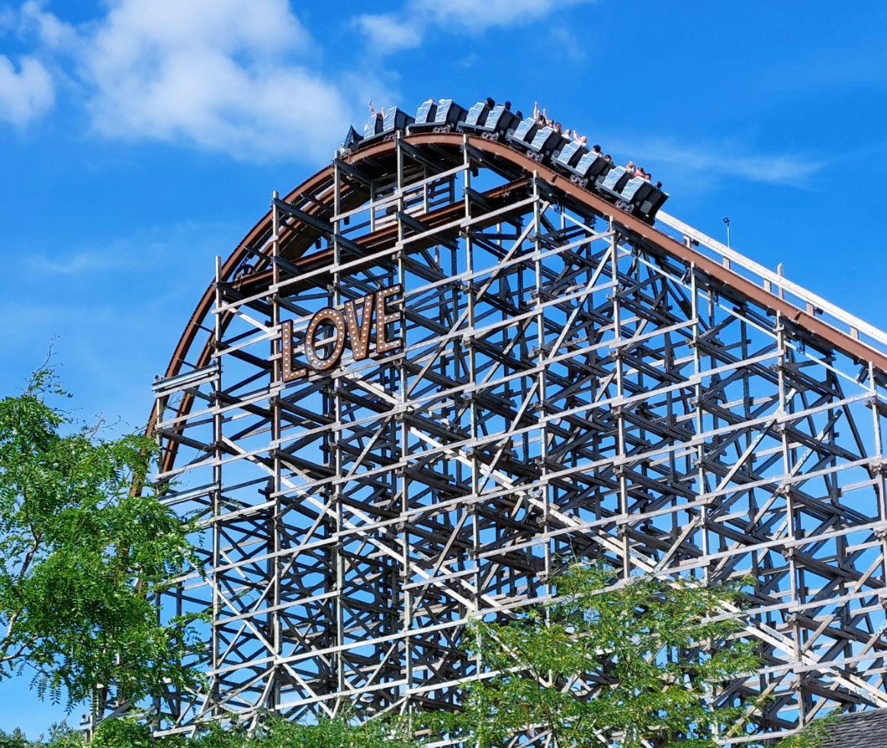
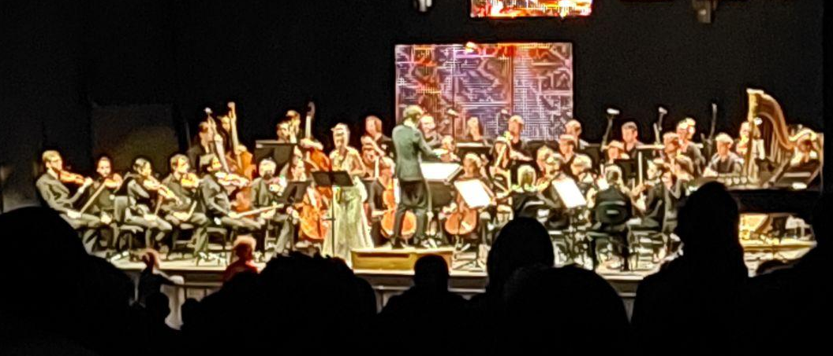
- Beethoven’s Apt - Bonn
- Bruhl Castle Gardens
- Phantasialand
- Orchestre de la Suisse-Romande
- Harderwijk, NL
- Veluwemeer Aquaduct
- Quick stop at Walibi Holland
- Morning Geneva Walks

Slide 8
CMS Detector Upgrade
R&D of GEM Detectors for GE2/1 and ME0
Josh Cameron, UM-CERN REU
Advisor: Peter Everaerts

