Slide 1
ALICE ITS2 ALPIDE Characterization Updates
August Muller
CERN Summer Student Programme 2022

Slide 2
Recap
Testing ALPIDE sensor response to highly ionizing particles
New! Effect of localized radiation damage on ALPIDE chips
New!
“What is this project about?”

Slide 3
Cluster Sizes

Slide 4
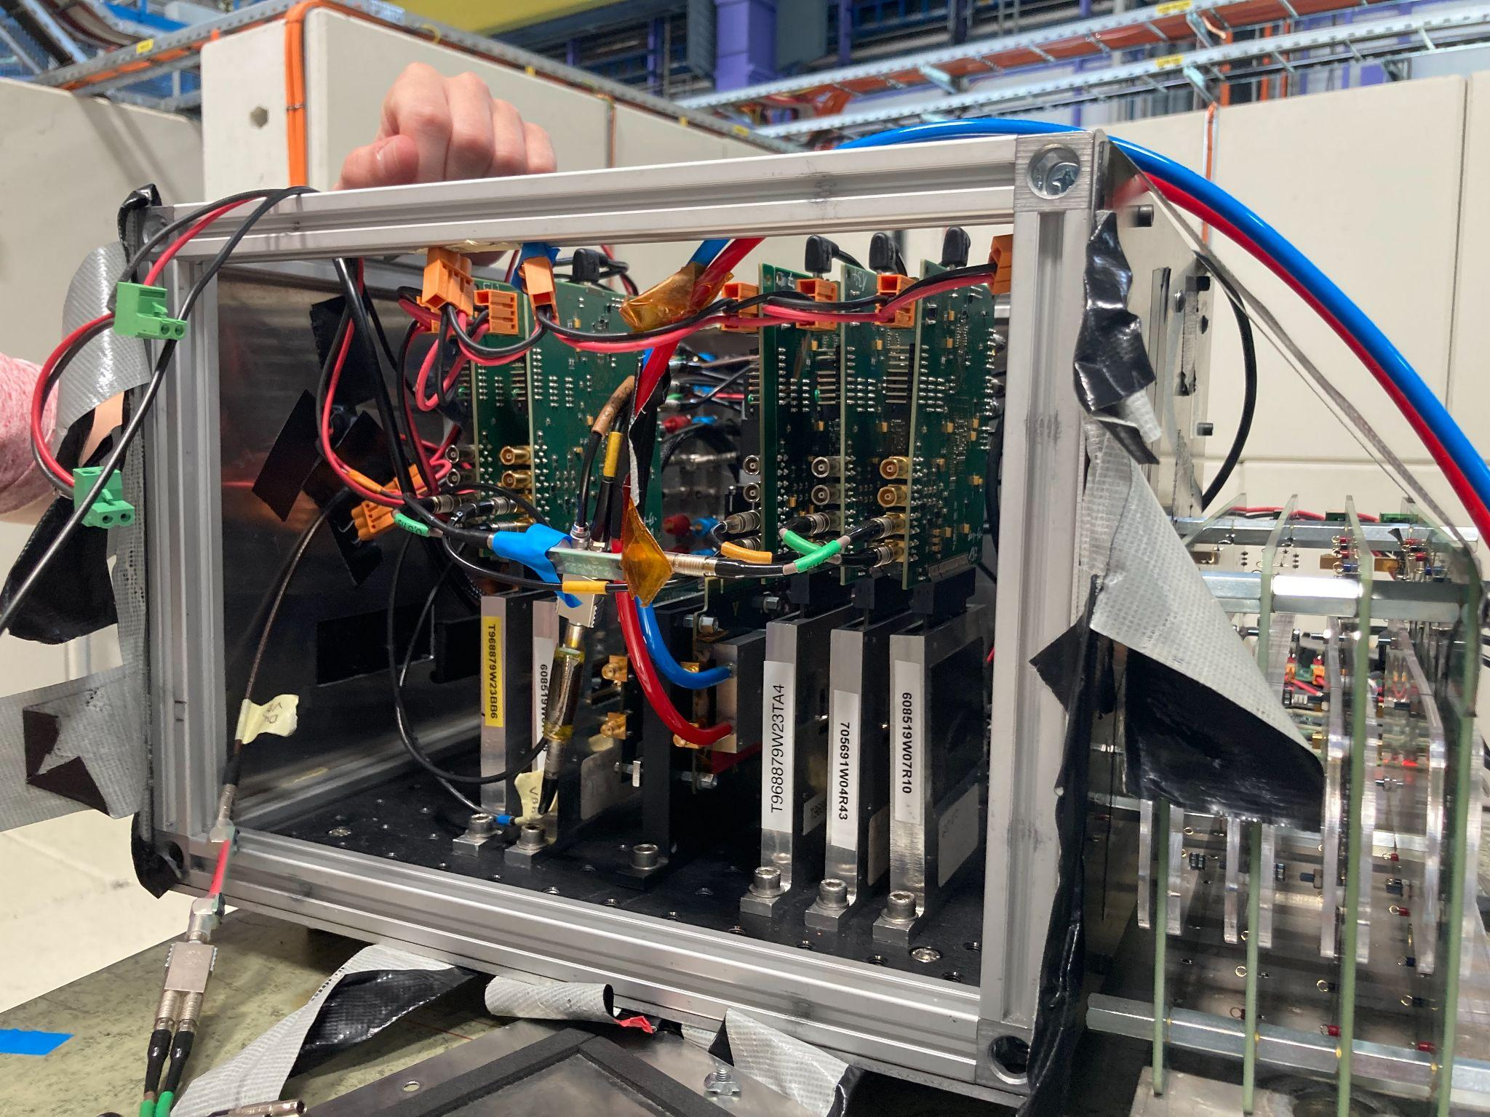

At the Proton Synchrotron: TB10
250 & 500 MeV runs
Notes:
ALPIDEs previously tested with MIPs (minimum ionizing particles)
Stronger signals encountered once in use; identified a need to understand ALPIDE response to non-MIPs

Slide 5
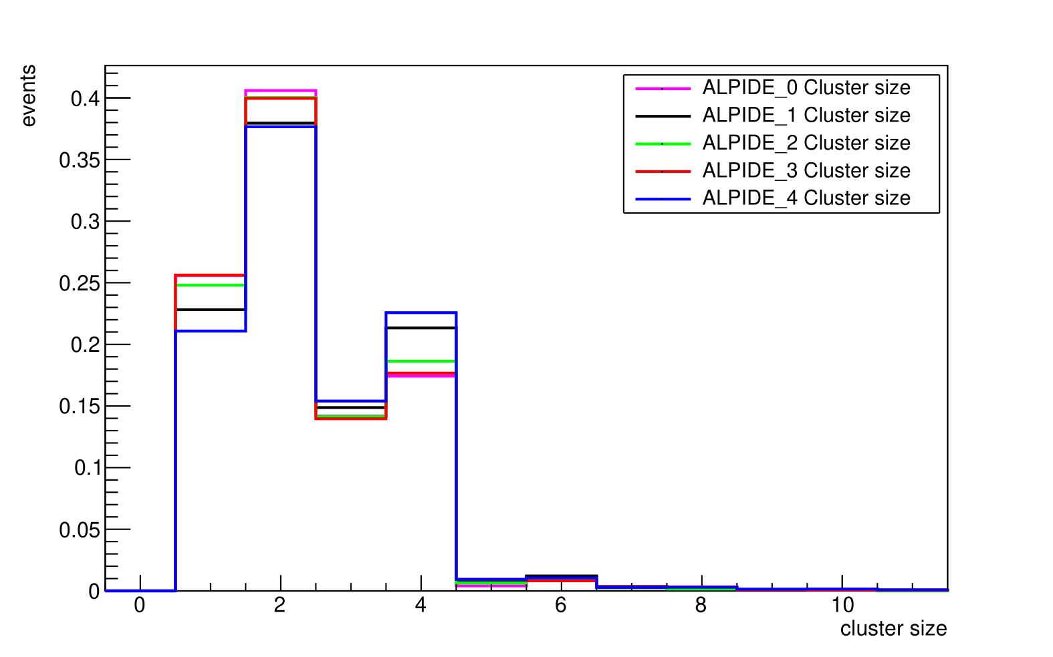
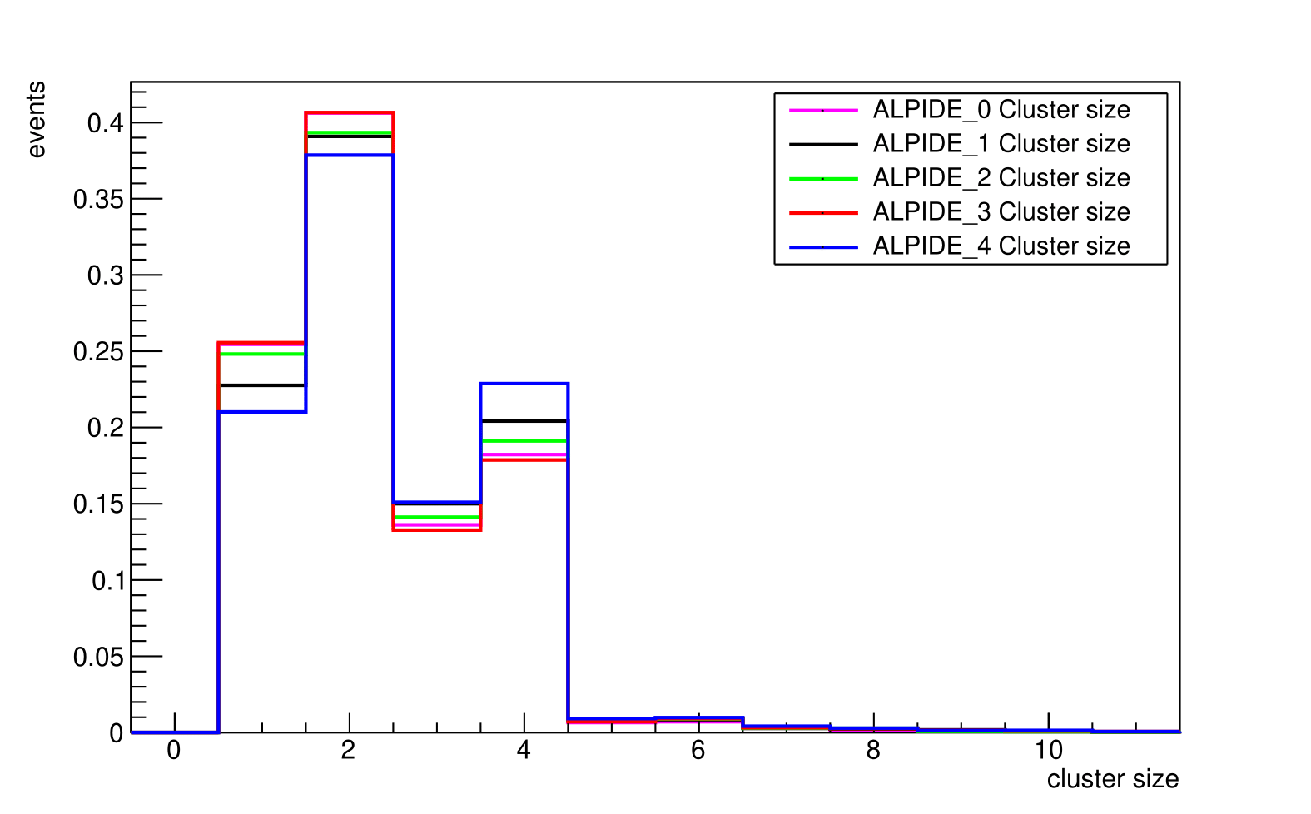
First Results: Low Momentum Clusters
250 MeV
500 MeV

Slide 6
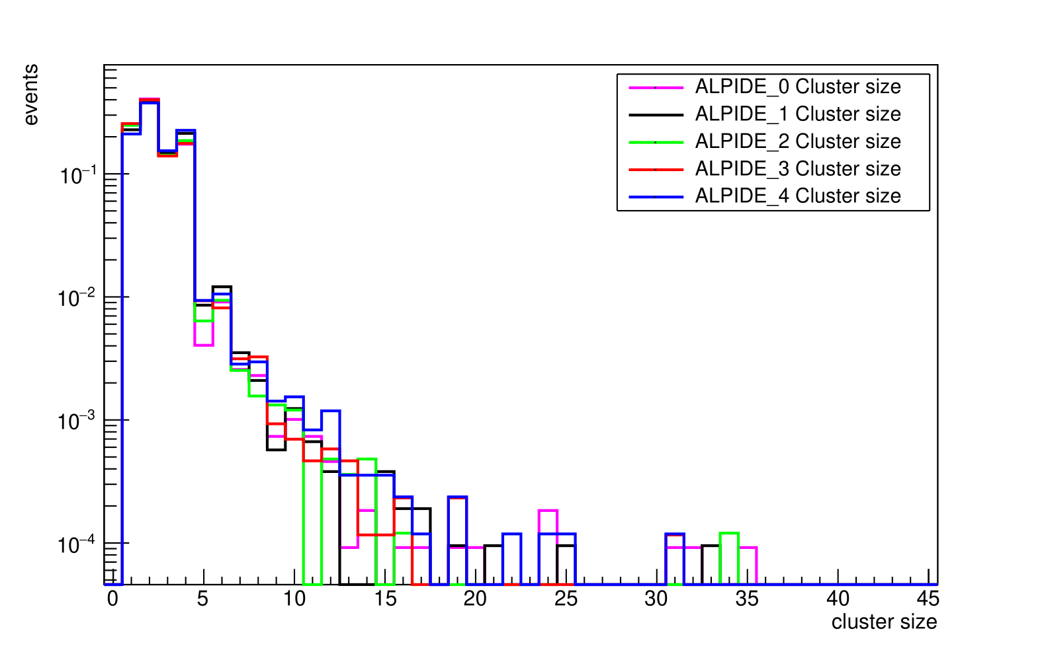
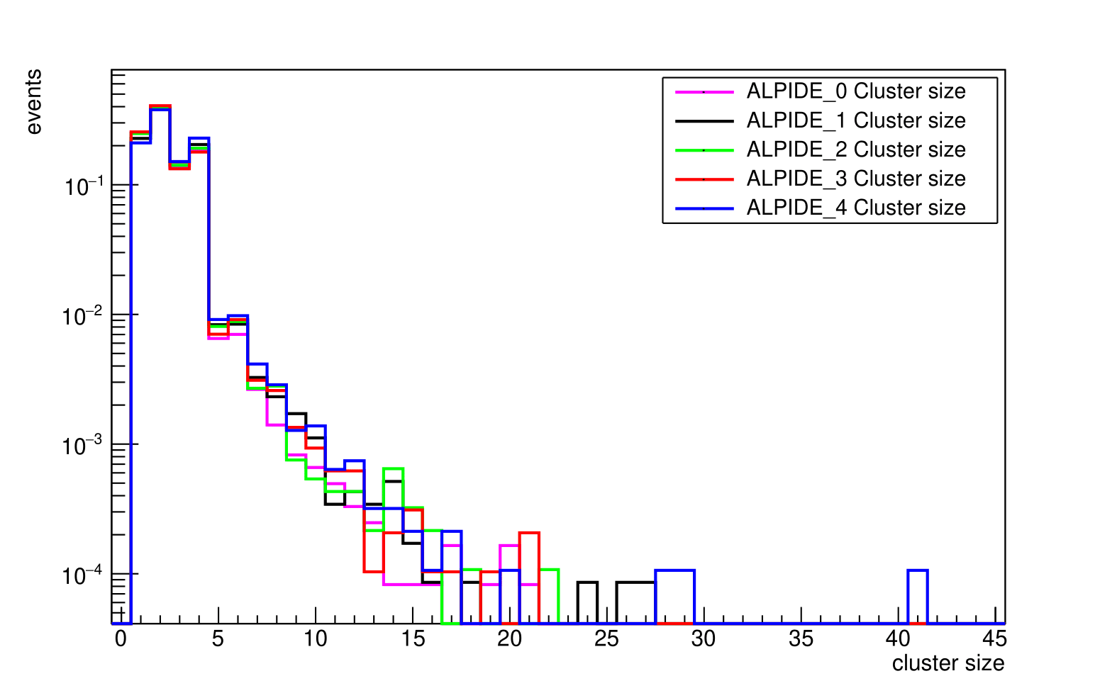
First Results: Low Momentum Clusters
250 MeV
500 MeV

Slide 7

Radiation Damage

Slide 8
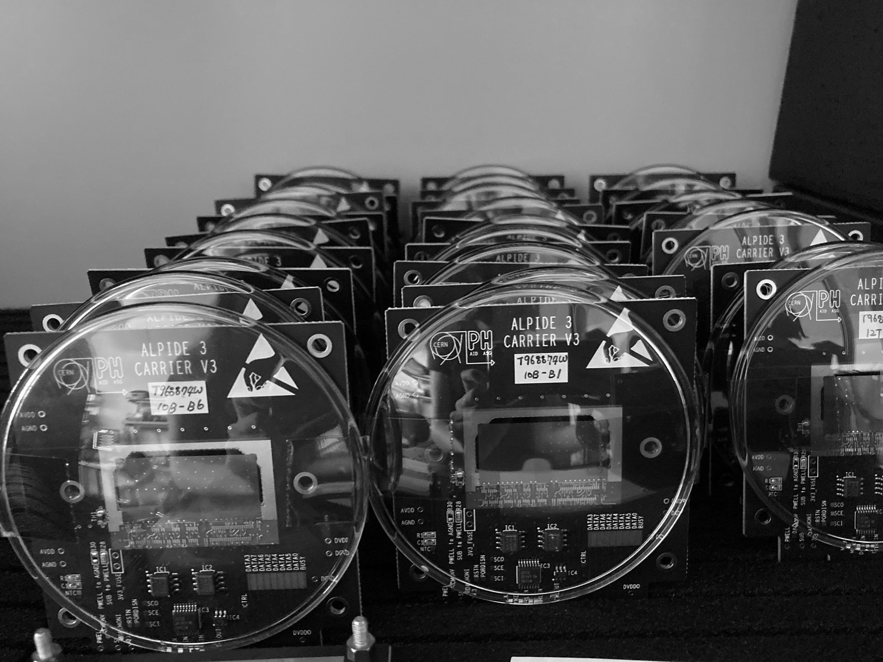
Testing ALPIDEs…

Slide 9
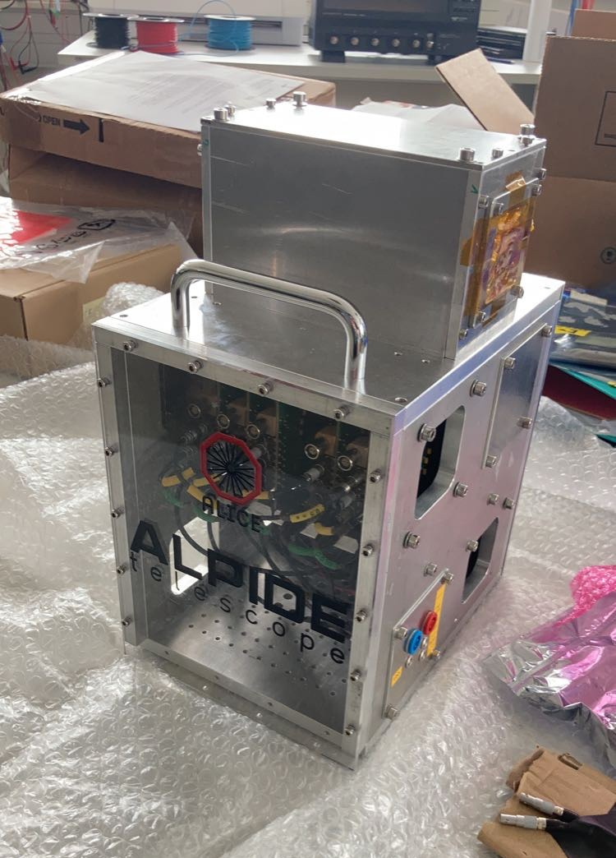
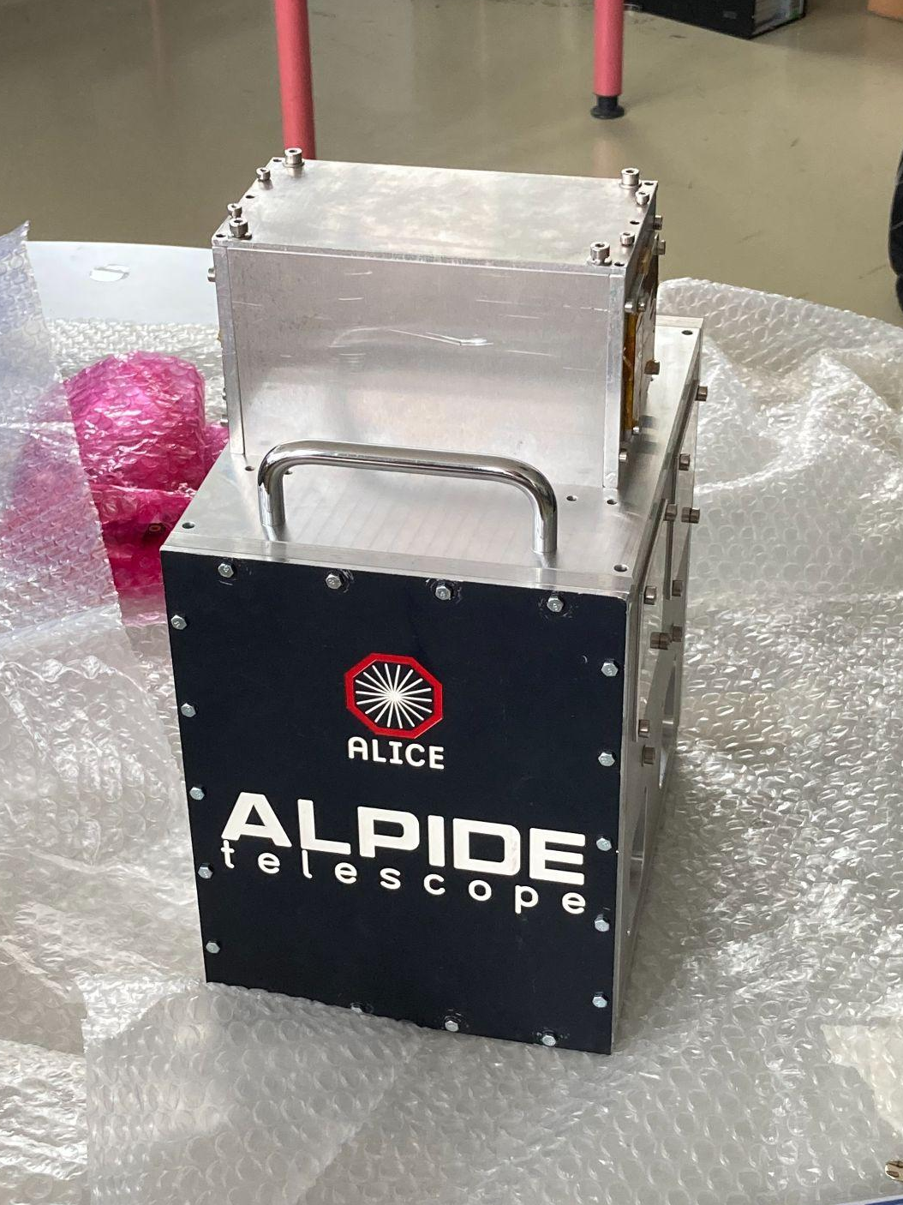

The “Old Telescope”
Received from MAMI (Mainz Microtron) test beam: very small beam profile & high energies

Slide 10
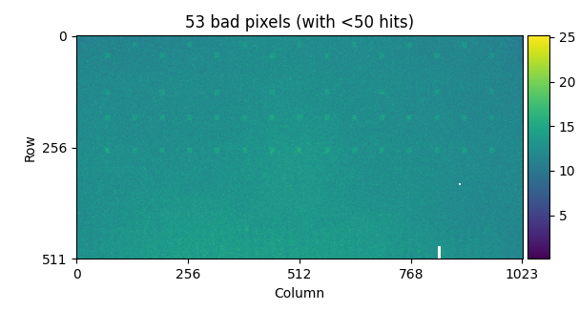
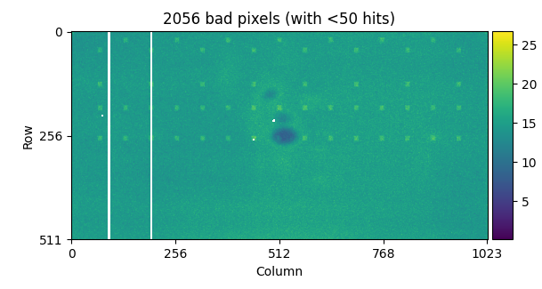
What it should look like…
…vs. what it does

Slide 11
Next Steps
Clustering
PS test beam track reconstruction
Compare 250–500 MeV and MIP data
Damage Analysis
Where is the damage – in each pixel or associated electronics?

Slide 12
Questions?
Thank you!

