Slide 1


Week 4 – Week 6
Towards a New Lepton Flavour Universality Test with Baryons

Slide 2


Quick Recap of My Project
LHCb recently presented the Branching Ratio of the semi-leptonic decay $Λ_{b}^{0}→Λ_{c}^{+} τ^{− }\overline{ν_{τ}}$
$𝔅\left(Λ_{b}^{0}→Λ_{c}^{+} τ^{− }\overline{ν_{τ}}\right)=(1.5±0.16+0.25+0.23)\%$
$τ^{−}$ lepton was reconstructed in the hadronic decay to three charged pions ($π^{+}π^{−}π^{+})$
HOWEVER
There are also other semi-leptonic decays that offer interesting observables
Such as, $Λ_{b}^{0}→Λ_{c}^{∗} τ^{−} \overline{ν_{τ}},$where $Λ_{c}^{∗}$ can be $the Λ_{c}^{+}(2595)$ or $Λ_{c}^{+}(2625)$ excited state
To understand these measurements, it is of paramount importance that we understand the hadronic channels $Λ_{b}^{0}→Λ_{c}^{∗}{ D}_{s}$ and $Λ_{b}^{0}→Λ_{c}^{∗}{ D}_{s}^{∗}$
Also, will understand $Λ_{b}^{0}→Σ_{c}D_{s}$, where $Σ_{c}→Λ_{c}π$
The latter decay modes represent a significant background in $Λ_{b}^{0}→Λ_{c}^{∗} τ^{−} \overline{ν_{τ}}$ decays but would also represent the first observation of them… (hint… hint… we have the data ☺)

Slide 3
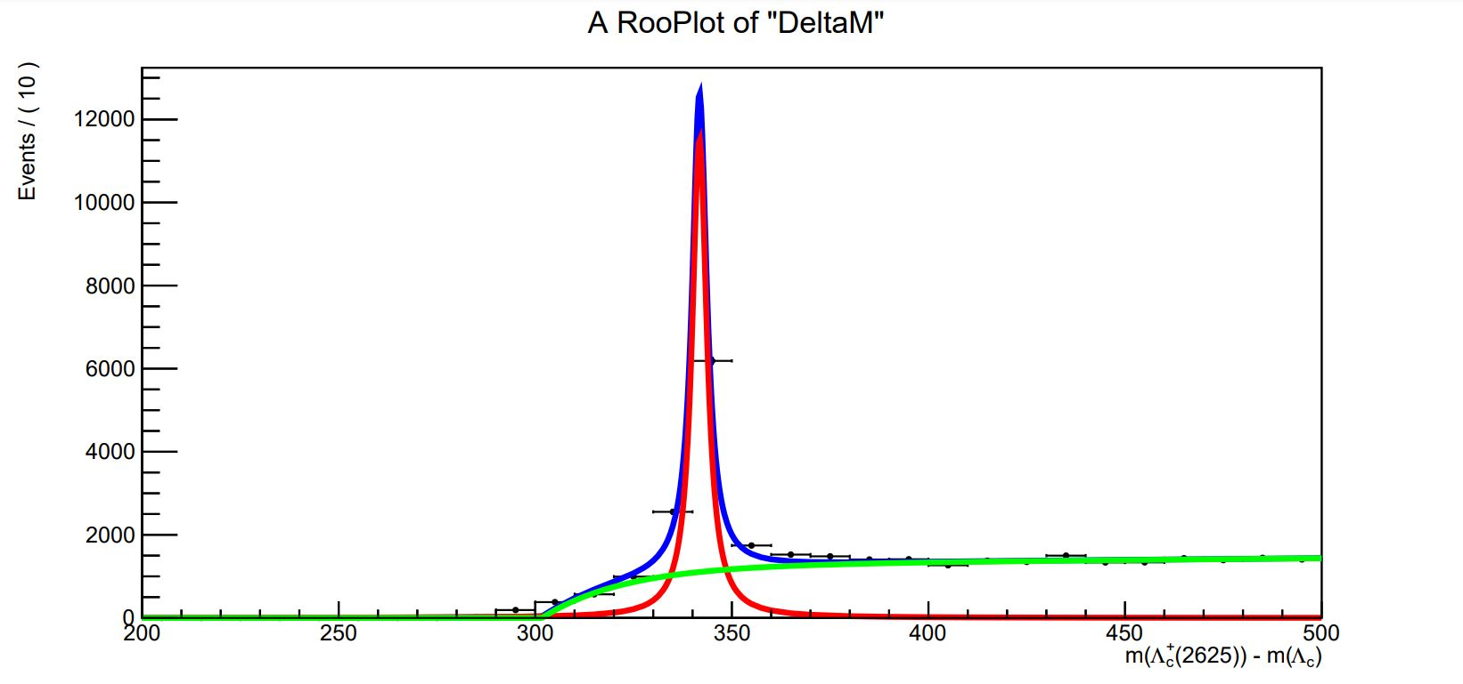
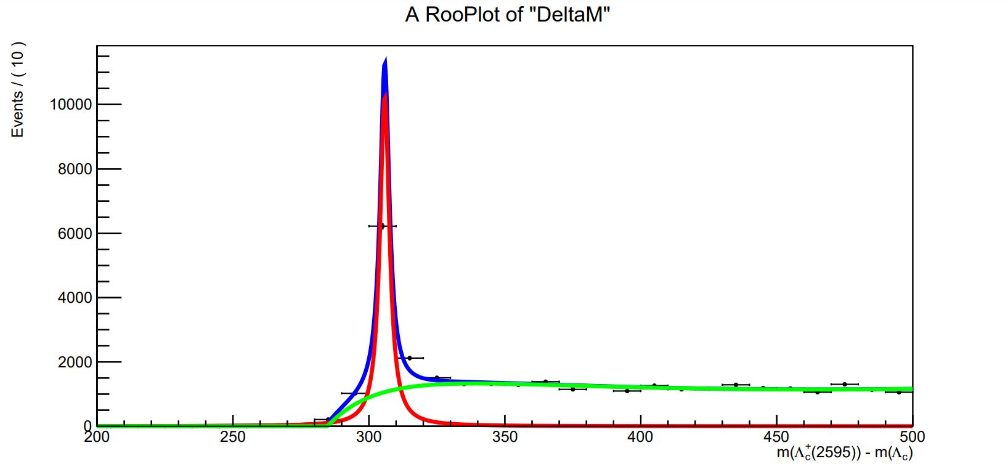



Week 4
Using Monte Carlo Data
Adapting code my supervisor gave me fit DeltaM for both $Λ_{c}^{∗}$ excited states
Used RooBreitWigner Class Reference to fit signal
Tried convoluting a step function with a gaussian function to generate threshold
This was not working due to some ROOT errors (most likely something to do with the compilation of ROOT)
Instead, we used the DstD0BG Class Reference method
This step was most important because it is crucial to obtaining results with the actual data
$m\left(Λ_{c}^{+}\left(2625\right)\right)−m(Λ_{c}^{+})$
$m\left(Λ_{c}^{+}\left(2595\right)\right)−m(Λ_{c}^{+})$

Slide 4
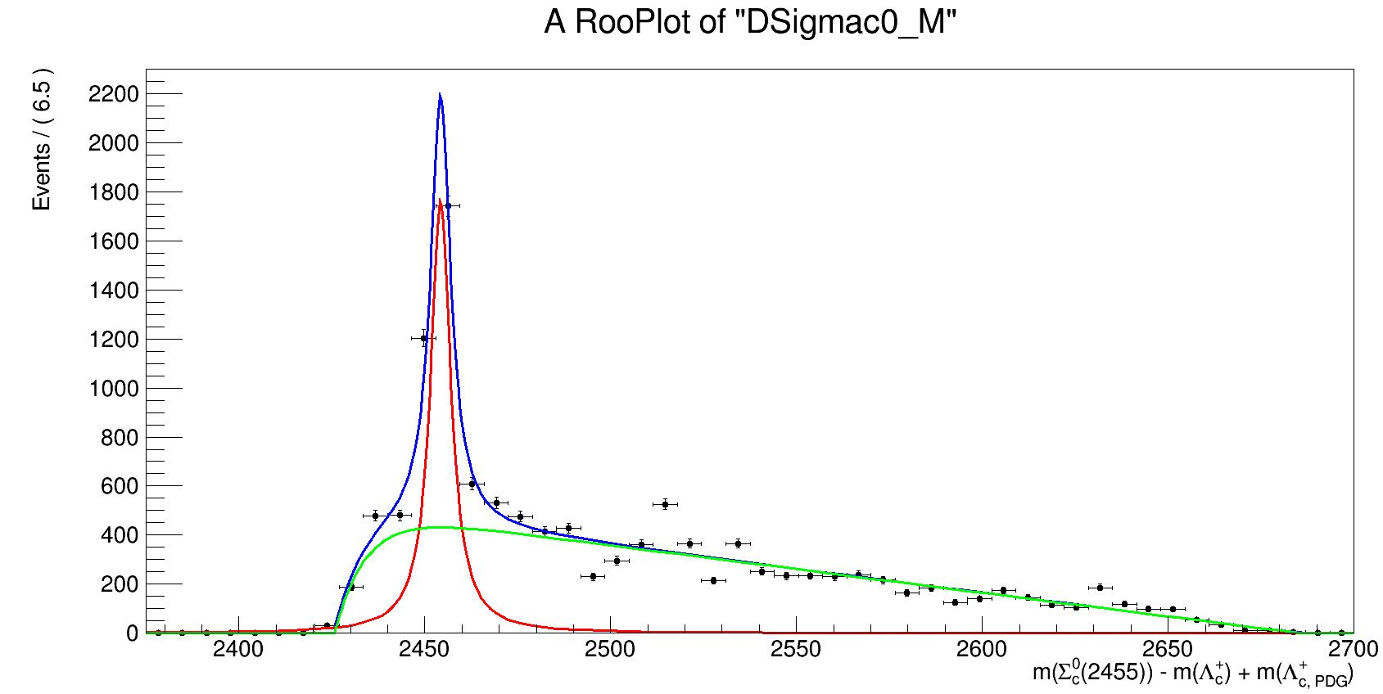
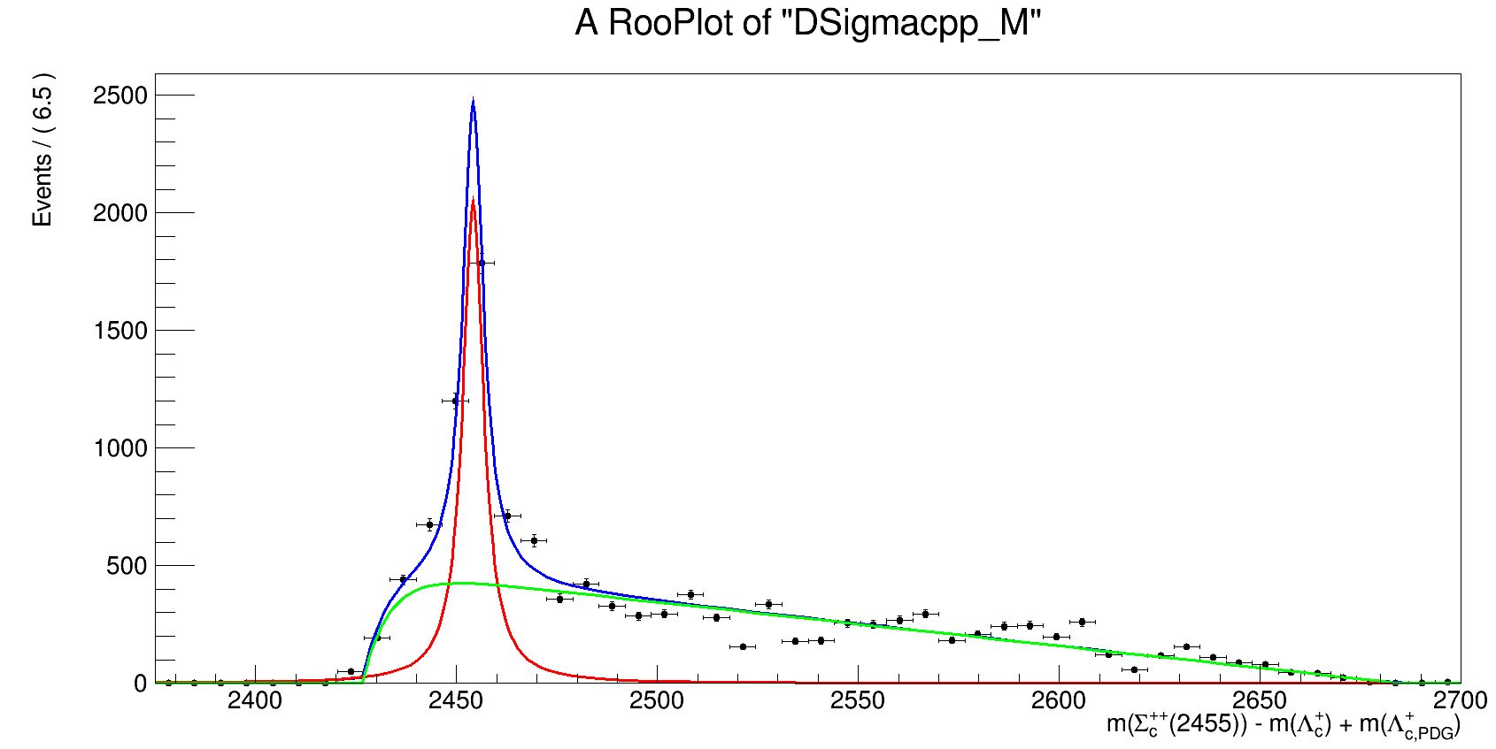


Week 4 cont…(2)
Using Monte Carlo Data
Did the same for $m\left(Σ_{c}^{0}\left(2455\right)\right)−m\left(Λ_{c}^{+}\right)+m\left(Λ_{c, PDG}^{+}\right)$ and $m\left(Σ_{c}^{++}\left(2455\right)\right)−m\left(Λ_{c}^{+}\right)+m(Λ_{c, PDG}^{+})$
$$m\left(Σ_{c}^{0}\left(2455\right)\right)−m\left(Λ_{c}^{+}\right)+m\left(Λ_{c, PDG}^{+}\right)$$
$m\left(Σ_{c}^{++}\left(2455\right)\right)−m\left(Λ_{c}^{+}\right)+m(Λ_{c, PDG}^{+})$

Slide 5
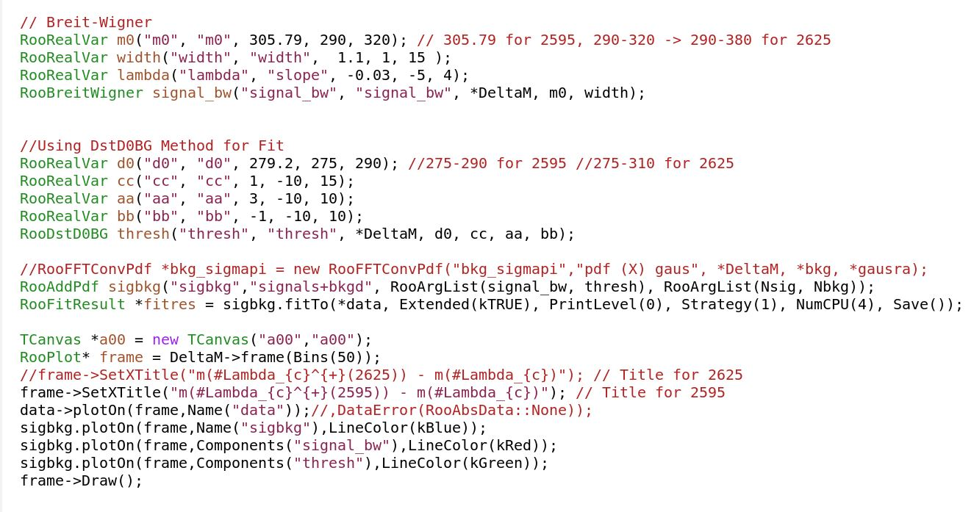
Week 4 cont…(3)
Snippet of the code

Slide 6
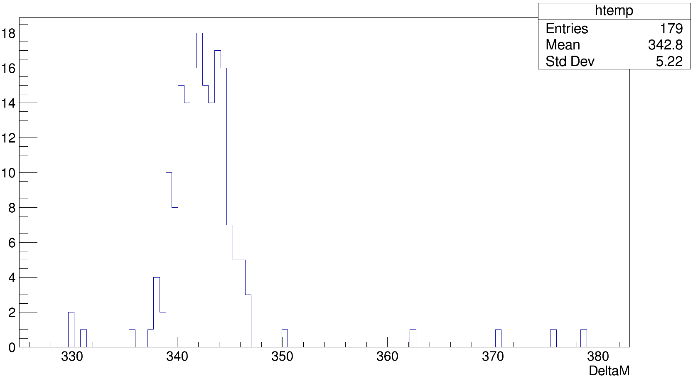

Week 5 – Pietro Selection for $Λ_{c}^{+}(2625)$ (1)
Tuple->Draw("DeltaM", "DeltaM<500 && abs(D_s_TRUEID)<1000 && D_s_M>1900 && abs(lcstar_TRUEID)==104124 && abs(Lambda_b0_TRUEID)==5122 && Lambda_c_ENDVERTEX_CHI2<20 && Lambda_b0_ENDVERTEX_CHI2<15 && Lambda_b0_DIRA_OWNPV>0.999 && lc_p_ProbNNp>0.6 && lc_kaon_ProbNNk>0.6 && lc_pion_PIDK<2 && lc_p_PT>250 && lc_kaon_PT>250 && lc_pion_PT>250 && lc_pion_IPCHI2_OWNPV>9 && lc_kaon_IPCHI2_OWNPV>9 && lc_p_IPCHI2_OWNPV>9 && lc_p_ProbNNghost<.6 && lc_pion_ProbNNghost<.6 && lc_kaon_ProbNNghost<.6 && lcstar_pim_ProbNNpi>.2 && lcstar_pip_ProbNNpi>.2 && D_s_pion0_ProbNNpi>.4 && D_s_pion1_ProbNNpi>.4 && D_s_pion2_ProbNNpi>.4")
Still Using Monte Carlo Data and Trimming Down the Background
Was given by my advisors a selection to add into the plots
This selection was from Pietro Argenton
Wanted to check efficiencies for Monte Carlo Data
Plotting $Δm$Specific Selection ( $Λ_{c}^{+}$ Excited State 2625)

Slide 7
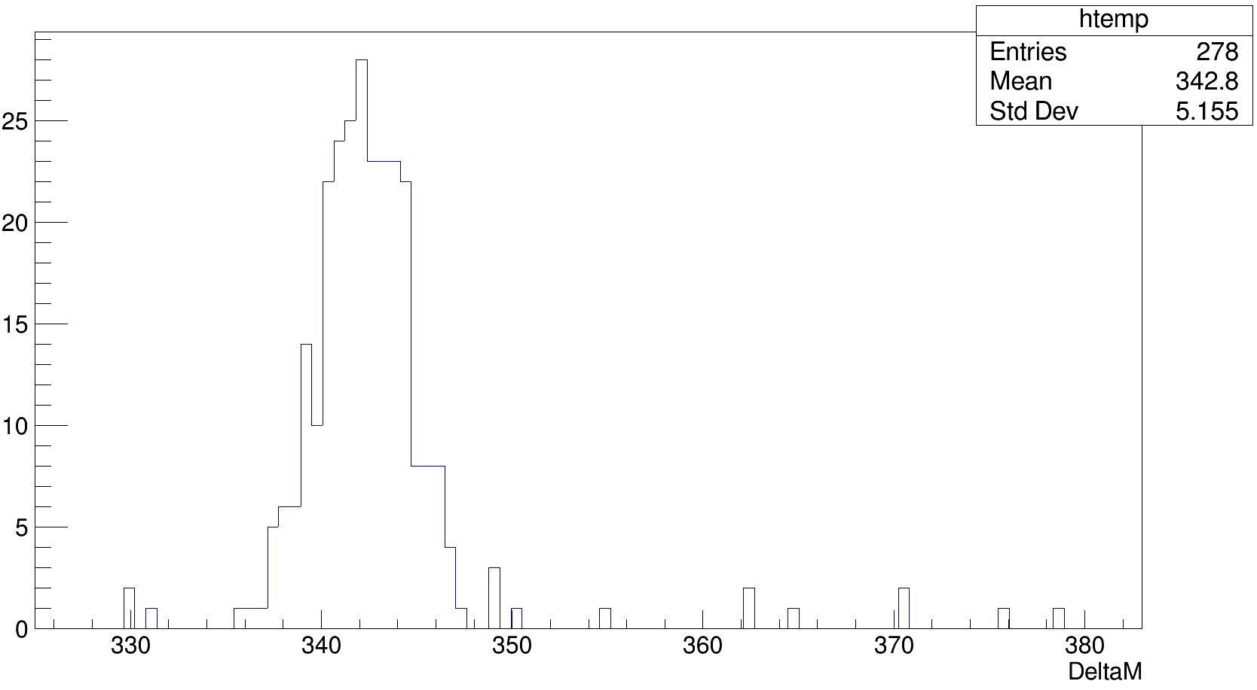

Week 5 – Pietro Selection for $Λ_{c}^{+}(2625)$ (2)
Plotting DeltaM with MC Truths ( $Λ_{c}^{+}$ Excited State 2625)
Tuple->Draw("DeltaM", "DeltaM<500 && abs(D_s_TRUEID)<1000 && D_s_M>1900 && abs(lcstar_TRUEID)==104124 && abs(Lambda_b0_TRUEID)==5122")

Slide 8

Week 5 – Pietro Selection for $Λ_{c}^{+}(2625)$ (3)
Obtaining $ε$for this Selection ( $Λ_{c}^{+}$ Excited State 2625)
$$ε_{PS, 2625}=\frac{Selection Events}{MC Truth Total Events}=\frac{179}{278}=0.64$$

Slide 9

Week 5 – Pietro Selection for $Λ_{c}^{+}(2595)$ (1)
Tuple->Draw("DeltaM", "DeltaM<500 && abs(D_s_TRUEID)<1000 && D_s_M>1900 && abs(lcstar_TRUEID)==14122 && abs(Lambda_b0_TRUEID)==5122 && Lambda_c_ENDVERTEX_CHI2<20 && Lambda_b0_ENDVERTEX_CHI2<15 && Lambda_b0_DIRA_OWNPV>0.999 && lc_p_ProbNNp>0.6 && lc_kaon_ProbNNk>0.6 && lc_pion_PIDK<2 && lc_p_PT>250 && lc_kaon_PT>250 && lc_pion_PT>250 && lc_pion_IPCHI2_OWNPV>9 && lc_kaon_IPCHI2_OWNPV>9 && lc_p_IPCHI2_OWNPV>9 && lc_p_ProbNNghost<.6 && lc_pion_ProbNNghost<.6 && lc_kaon_ProbNNghost<.6 && lcstar_pim_ProbNNpi>.2 && lcstar_pip_ProbNNpi>.2 && D_s_pion0_ProbNNpi>.4 && D_s_pion1_ProbNNpi>.4 && D_s_pion2_ProbNNpi>.4")
Plotting $Δm$Specific Selection ( $Λ_{c}^{+}$ Excited State 2595)

Slide 10
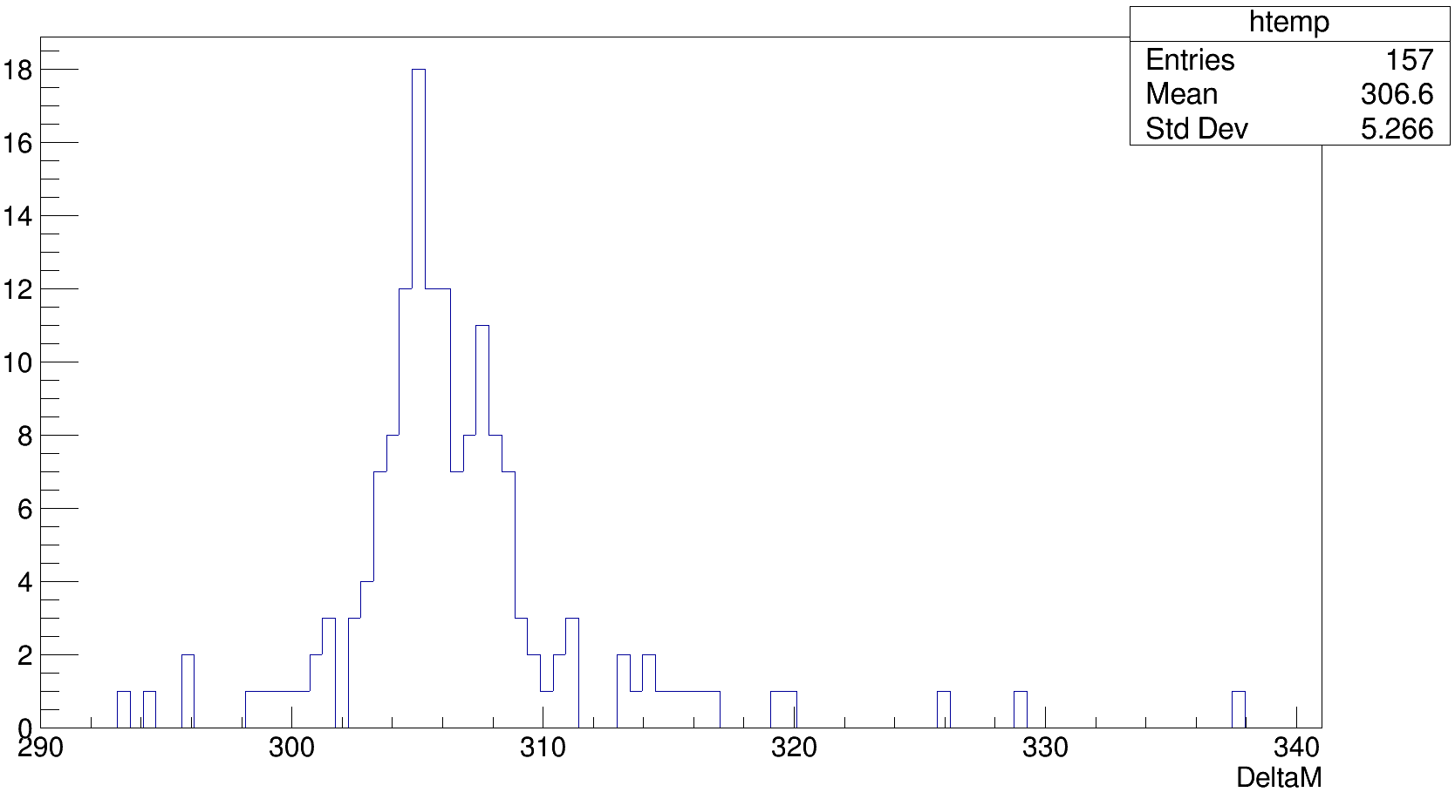

Week 5 – Pietro Selection for $Λ_{c}^{+}(2595)$ (2)
Plotting DeltaM with MC Truths ( $Λ_{c}^{+}$ Excited State 2595)
Tuple->Draw("DeltaM", "DeltaM<500 && abs(D_s_TRUEID)<1000 && D_s_M>1900 && abs(lcstar_TRUEID)==14122 && abs(Lambda_b0_TRUEID)==5122")

Slide 11

Week 5 – Pietro Selection for $Λ_{c}^{+}(2595)$ (3)
Obtaining $ε$for this Selection ( $Λ_{c}^{+}$ Excited State 2595)
$$ε_{PS, 2595}=\frac{Selection Events}{MC Truth Total Events}=\frac{157}{235}=0.67$$

Slide 12
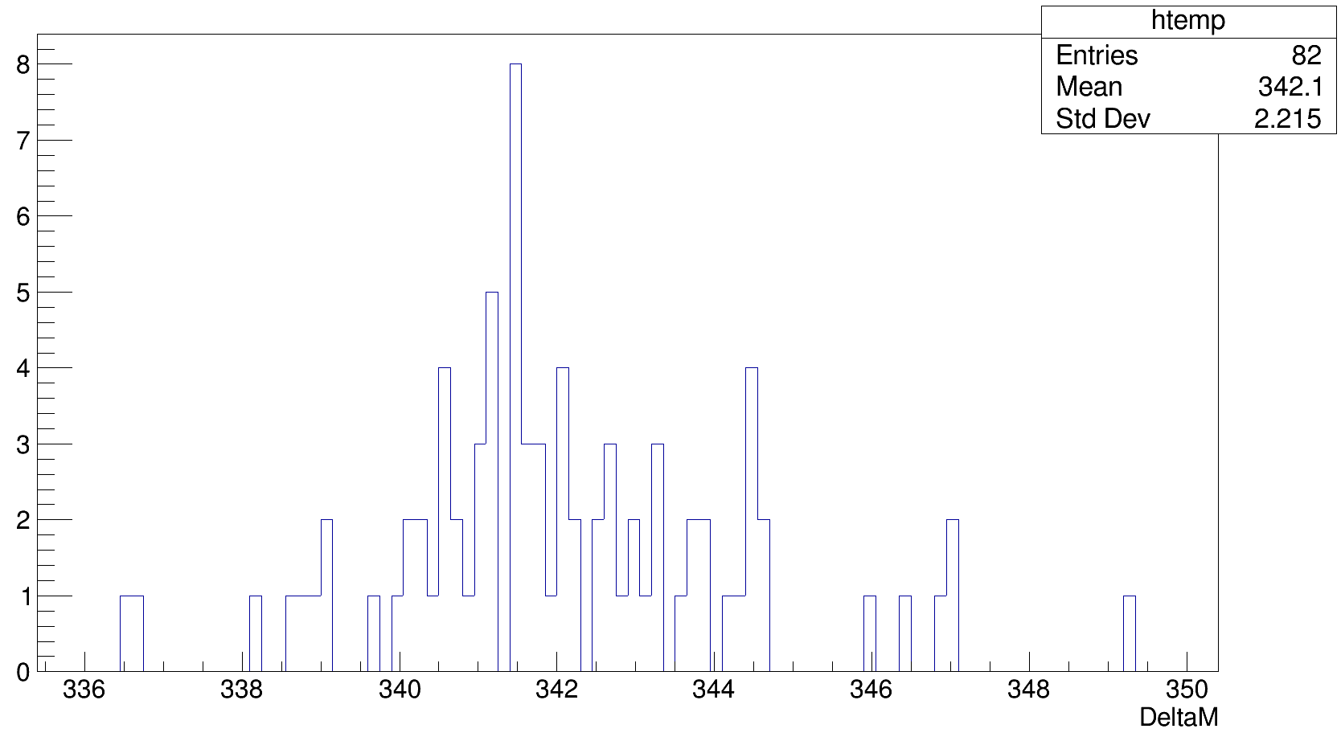

Week 5 – Rotondo Selection for $Λ_{c}^{+}(2625)$ (1)
Still Using Monte Carlo Data and Trimming Down the Background
Was given by my advisors a selection to add into the plots
This selection was from Dr. Marcello Rotondo
Wanted to check efficiencies for Monte Carlo Data
Plotting $Δm$Specific Selection ( $Λ_{c}^{+}$ Excited State 2625)
Tuple->Draw(“DeltaM”, mc_truth && trigger_L0Hlt1_run2 && Topo_run2 && sig && ds_detached && fly )

Slide 13

Week 5 – Rotondo Selection for $Λ_{c}^{+}(2625)$ (2)
- TCut trigger_L0Hlt1_run2 ="(((Lambda_b0_L0Global_TIS)||(Lambda_b0_L0HadronDecision_TOS))&&((Lambda_b0_Hlt1TwoTrackMVADecision_TOS)|(Lambda_b0_Hlt1TrackMVADecision_TOS)))";
- TCut Topo_run2 ="((Lambda_b0_Hlt2Topo2BodyDecision_TOS)||(Lambda_b0_Hlt2Topo3BodyDecision_TOS)||(Lambda_b0_Hlt2Topo4BodyDecision_TOS))";
- TCut sig ="Lambda_c_PT>3000 && abs(Lambda_c_M-2286)<15 && lcstar_pim_PT>350 && lcstar_pip_PT>350";
- TCut ds_detached="(D_s_ENDVERTEX_Z-Lambda_b0_ENDVERTEX_Z)/sqrt(D_s_ENDVERTEX_ZERR*D_s_ENDVERTEX_ZERR+Lambda_b0_ENDVERTEX_ZERR*Lambda_b0_ENDVERTEX_ZERR)>4.";
- TCut fly="( -Lambda_b0_OWNPV_Z+Lambda_b0_ENDVERTEX_Z)/sqrt(Lambda_b0_OWNPV_ZERR*Lambda_b0_OWNPV_ZERR+Lambda_b0_ENDVERTEX_ZERR*Lambda_b0_ENDVERTEX_ZERR)>10.";
- TCut mc_truth = “DeltaM<500 && abs(D_s_TRUEID)<1000 && D_s_M>1900 && abs(lcstar_TRUEID)==104124 && abs(Lambda_b0_TRUEID)==5122”

Slide 14

Week 5 – Rotondo Selection for $Λ_{c}^{+}(2625)$ (3)
Obtaining $ε$for this Selection ( $Λ_{c}^{+}$ Excited State 2625)
$$ε_{RS, 2625}=\frac{Selection Events}{MC Truth Total Events}=\frac{82}{278}=0.29$$

Slide 15
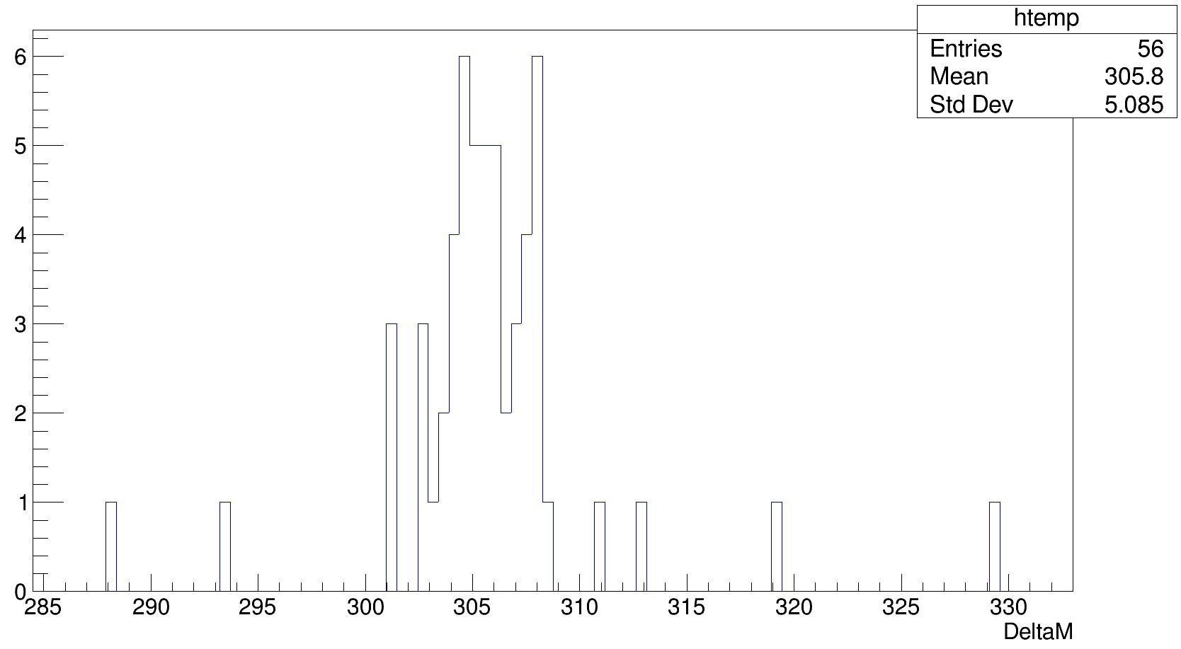

Week 5 – Rotondo Selection for $Λ_{c}^{+}(2595)$ (1)
Still Using Monte Carlo Data and Trimming Down the Background
Was given by my advisors a selection to add into the plots
This selection was from Dr. Marcello Rotondo
Wanted to check efficiencies for Monte Carlo Data
Plotting $Δm$Specific Selection ( $Λ_{c}^{+}$ Excited State 2595)
Tuple->Draw(“DeltaM”, mc_truth && trigger_L0Hlt1_run2 && Topo_run2 && sig && ds_detached && fly )

Slide 16

Week 5 – Rotondo Selection for $Λ_{c}^{+}(2595)$ (2)
- TCut trigger_L0Hlt1_run2 ="(((Lambda_b0_L0Global_TIS)||(Lambda_b0_L0HadronDecision_TOS))&&((Lambda_b0_Hlt1TwoTrackMVADecision_TOS)|(Lambda_b0_Hlt1TrackMVADecision_TOS)))";
- TCut Topo_run2 ="((Lambda_b0_Hlt2Topo2BodyDecision_TOS)||(Lambda_b0_Hlt2Topo3BodyDecision_TOS)||(Lambda_b0_Hlt2Topo4BodyDecision_TOS))";
- TCut sig ="Lambda_c_PT>3000 && abs(Lambda_c_M-2286)<15 && lcstar_pim_PT>350 && lcstar_pip_PT>350";
- TCut ds_detached="(D_s_ENDVERTEX_Z-Lambda_b0_ENDVERTEX_Z)/sqrt(D_s_ENDVERTEX_ZERR*D_s_ENDVERTEX_ZERR+Lambda_b0_ENDVERTEX_ZERR*Lambda_b0_ENDVERTEX_ZERR)>4.";
- TCut fly="( -Lambda_b0_OWNPV_Z+Lambda_b0_ENDVERTEX_Z)/sqrt(Lambda_b0_OWNPV_ZERR*Lambda_b0_OWNPV_ZERR+Lambda_b0_ENDVERTEX_ZERR*Lambda_b0_ENDVERTEX_ZERR)>10.";
- TCut mc_truth = “DeltaM<500 && abs(D_s_TRUEID)<1000 && D_s_M>1900 && abs(lcstar_TRUEID)==14122 && abs(Lambda_b0_TRUEID)==5122”

Slide 17

Week 5 – Rotondo Selection for $Λ_{c}^{+}(2595)$ (3)
Obtaining $ε$for this Selection ( $Λ_{c}^{+}$ Excited State 2595)
$$ε_{RS, 2595}=\frac{Selection Events}{MC Truth Total Events}=\frac{56}{235}=0.24$$

Slide 18
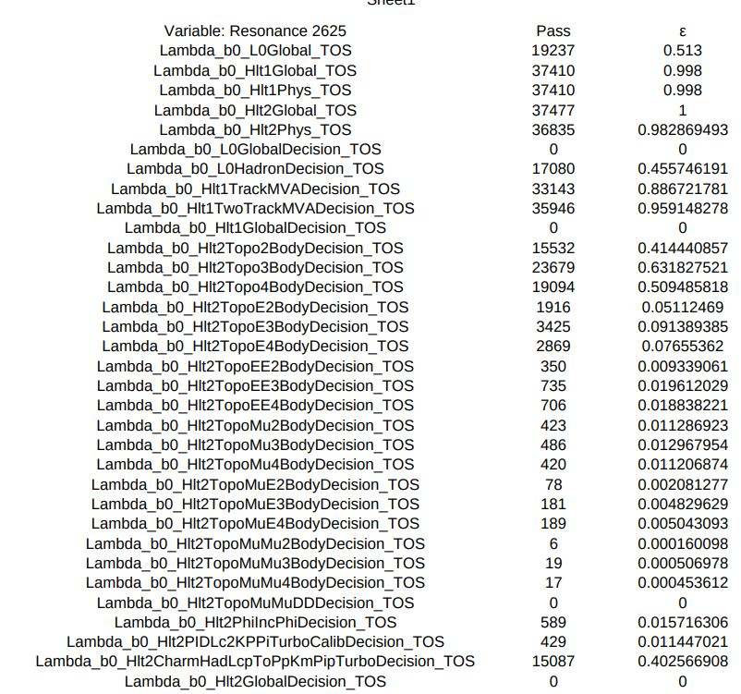
Week 5 - Trigger Lines ( $Λ_{c}^{+}$ Excited State 2625)
Trigger on Signal

Slide 19
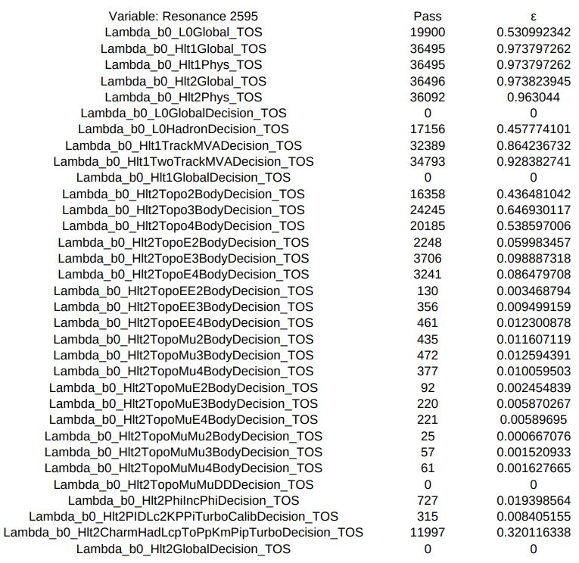
Week 5 - Trigger Lines ( $Λ_{c}^{+}$ Excited State 2595)

Slide 20




Week 6 – Applying Selection on Data
Using 2016 & 2017 Data and Trimming Down the Background with Rotondo Selection
$$Λ_{c}^{+}(2595)$$
$$Λ_{c}^{+}(2625)$$

Slide 21
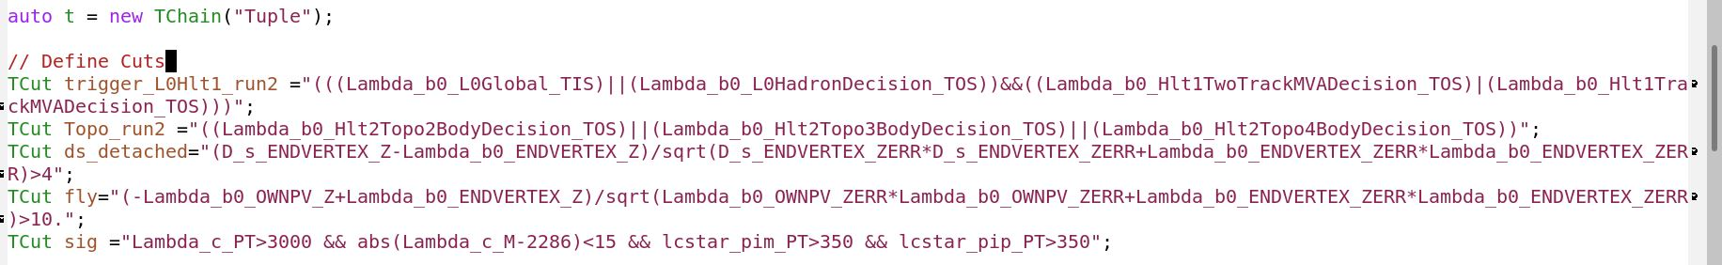
Week 6 – Creating a Script (1)
Using 2016 & 2017 Data and Trimming Down the Background with Rotondo Selection
- Created script that creates all histograms or a specific one

Slide 22
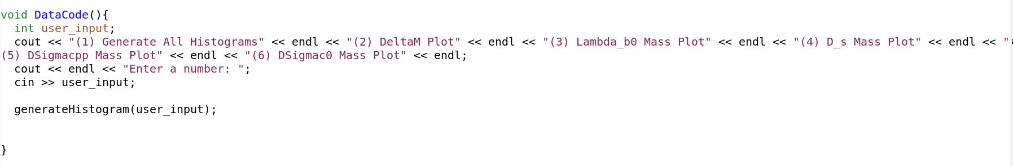
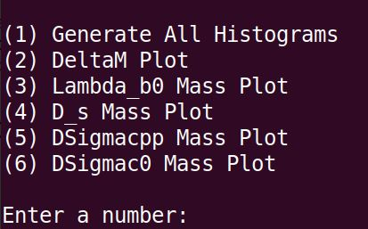
Week 6 – Creating a Script (2)

Slide 23



Week 6 – All Data Plots
DeltaM
$$Λ_{b}^{0} Mass$$
$$D_{s} Mass$$
$m\left(Σ_{c}^{++}\left(2455\right)\right)−m\left(Λ_{c}^{+}\right)+m(Λ_{c, PDG}^{+})$
$$m\left(Σ_{c}^{0}\left(2455\right)\right)−m\left(Λ_{c}^{+}\right)+m\left(Λ_{c, PDG}^{+}\right)$$

Slide 24

Future Outlook
Create a better selection
Obtain Branching Ratio $𝔅\left(Λ_{b}^{0}→Λ_{c}^{∗} D_{s}\right)$
Create two Briet-Wigners and a convoluted threshold to fit DeltaM

