Slide 1
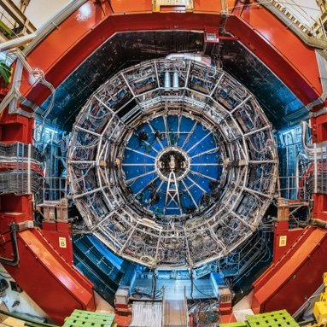
An Update on the Electronic Calibration of the ALICE FoCal and Corresponding Mechanical Structure
By: Morgan Simco
Advisors: Alexandru Rusu and Constantin Loizides
Special Thanks to Ton Van De Brink

Slide 2
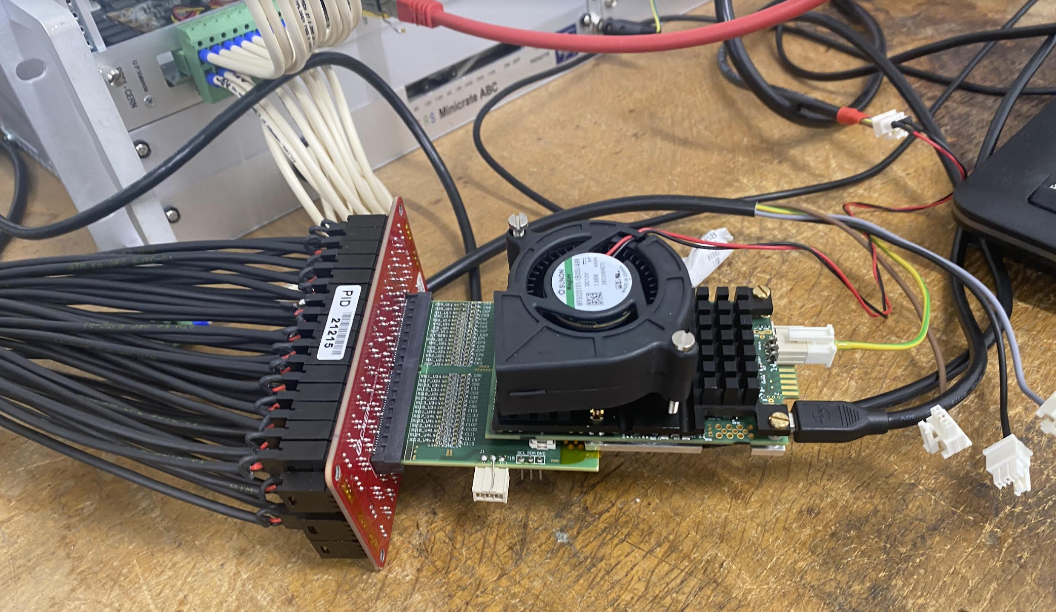
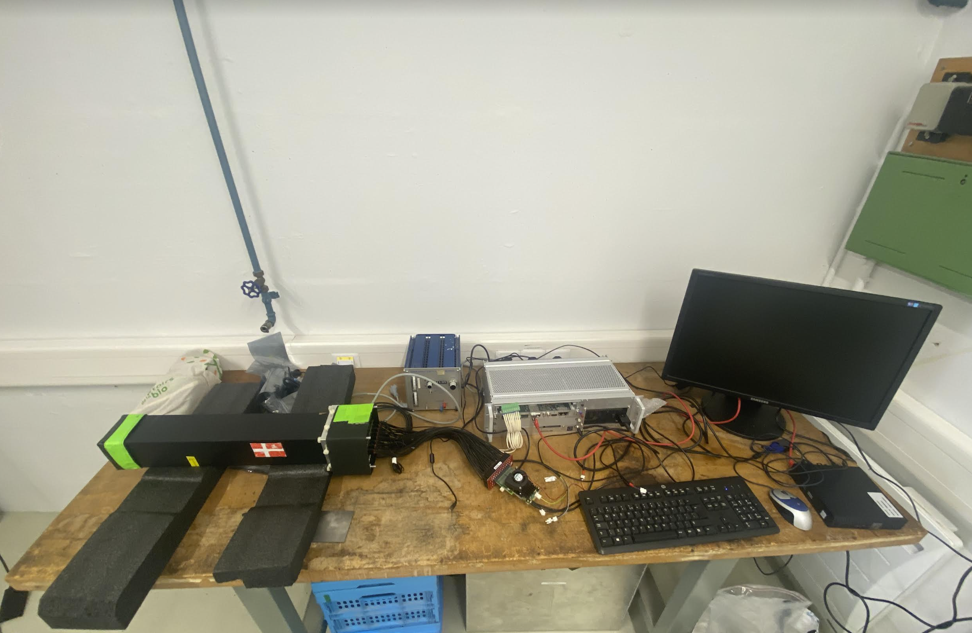
Detector Set Up
This is the ALICE FoCal set up that will be used in the test beam this coming Fall.
Fibers housed inside of copper tubes fill the rectangular black box.
These fibers catch particles that then travel down through the CAEN board, adapter board, and onto one of the two VMM chips connected to the computer.
We tested each channel location using a light pulser to see results on VMM slow control software and a program called Wireshark.
We also allowed the detector to run for a few hours during the day to catch muons or particles coming from SPS dump (which is next store to the lab).

Slide 3
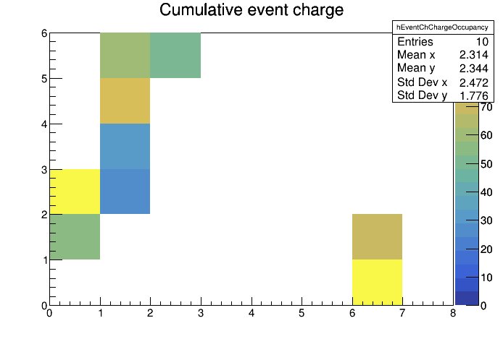
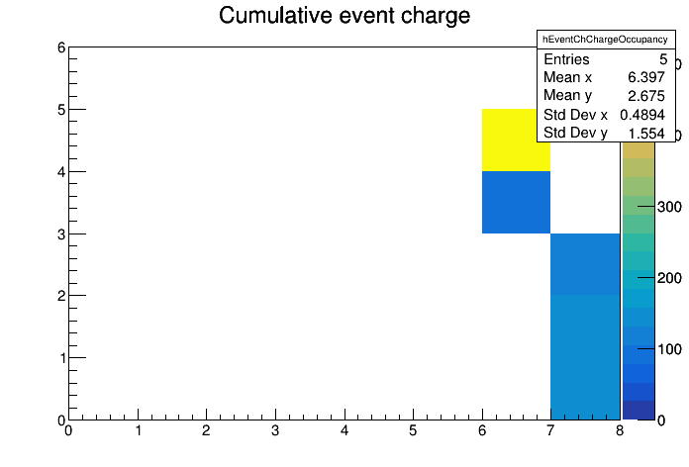
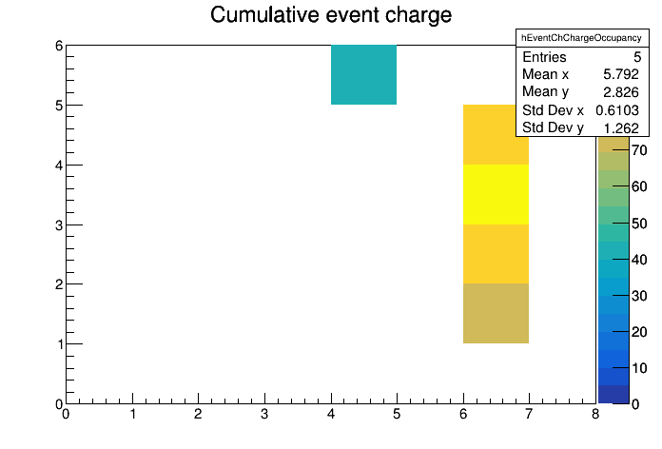
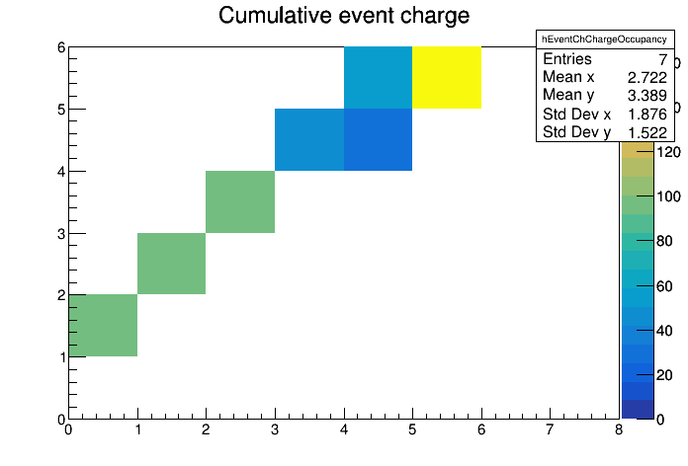
Preliminary Results
Ideally trying to reduce noise while still creating electronics sensitive enough to catch particles.
We do this by changing controls on the VMM slow control software.
An increase in the gain of the VMM, creates a more amplified signal, while changing the threshold creates a level to which the signal must achieve to be recognized.
Had challenges of some channels being disconnected or just overall too noisy so they had to be masked in the software.
Ended up getting the graphs shown which show muon tracks!
Now we have a good idea of the controls necessary for data collection as we have reduced noised while still having a well calibrated set up.

Slide 4
What's next?
With such good results, what is the next step?
SURPRISE SECOND PROJECT!

Slide 5
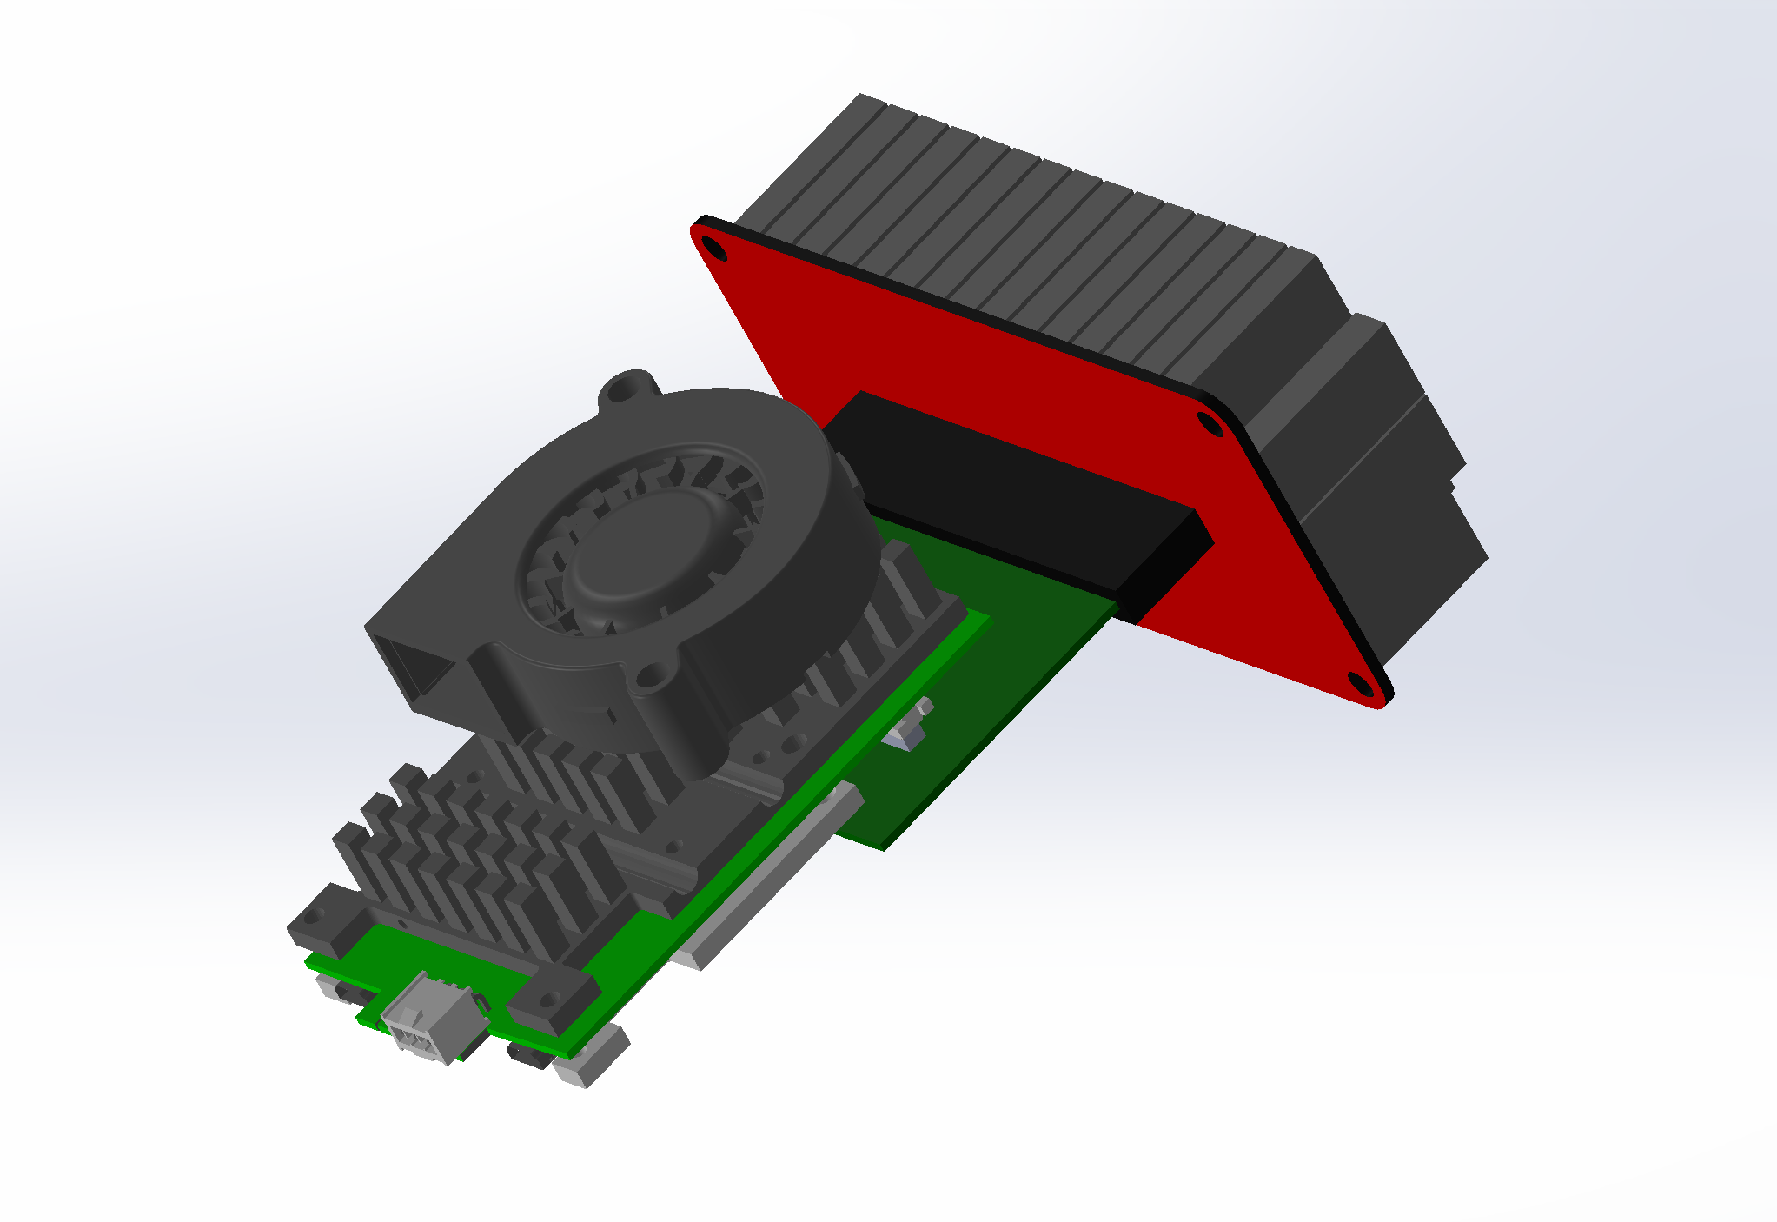
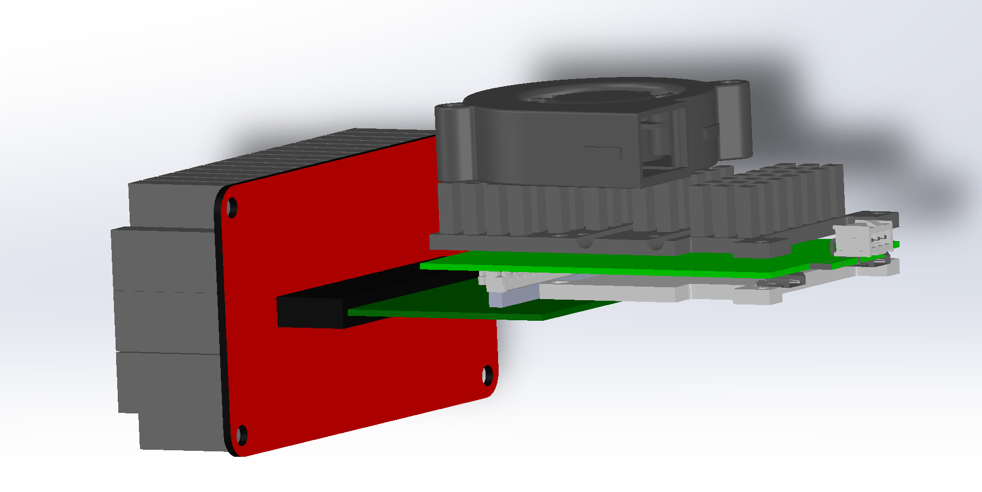
Mechanical Framework for the Test Beam
4 of these PCB set up’s will be going into the test beam this Fall.
On their own, the boards are unstable as they sit on two parallel planes.
Without support, the electrical connection may be comprised, and data collection may be impossible.
Ideally. we want to create an adjustable frame that will hold all 4 setups and support them through testing.

Slide 6
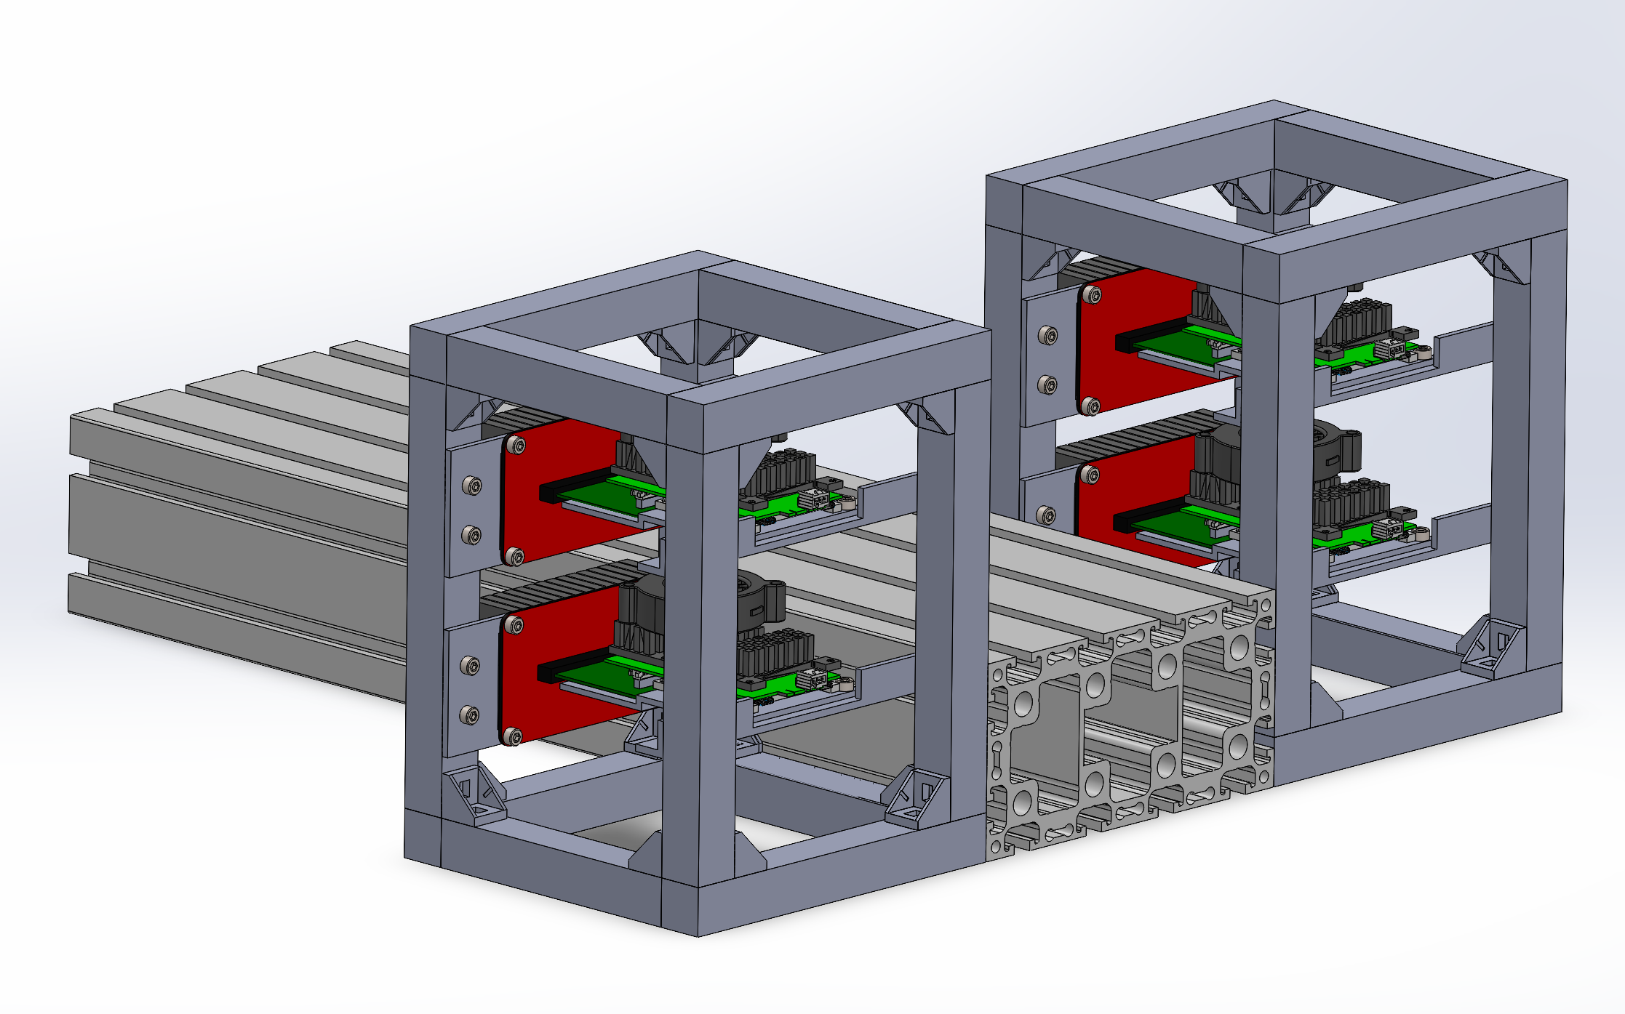
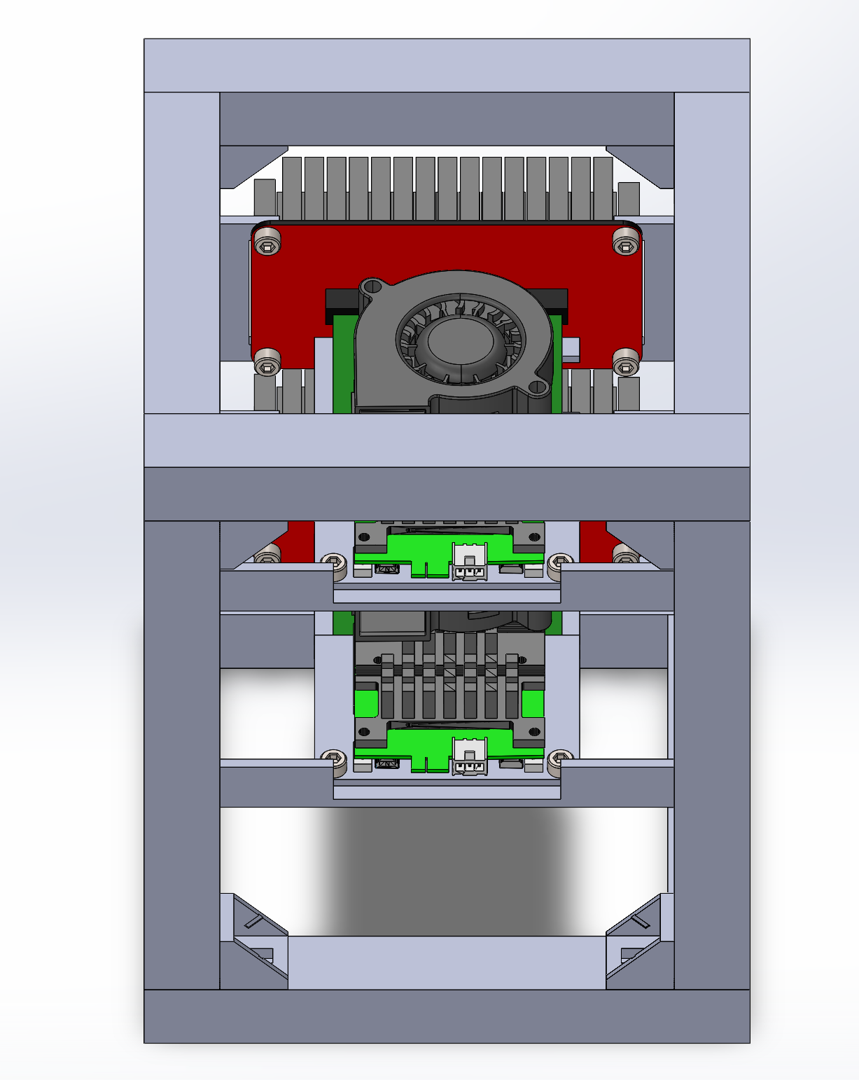
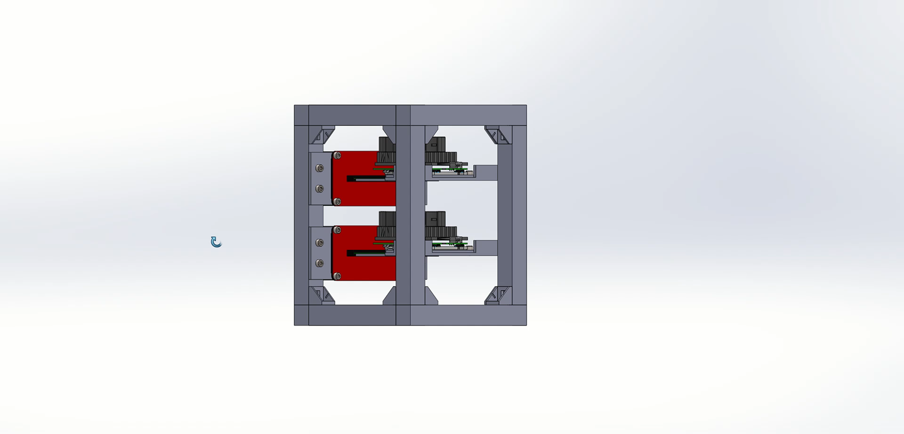
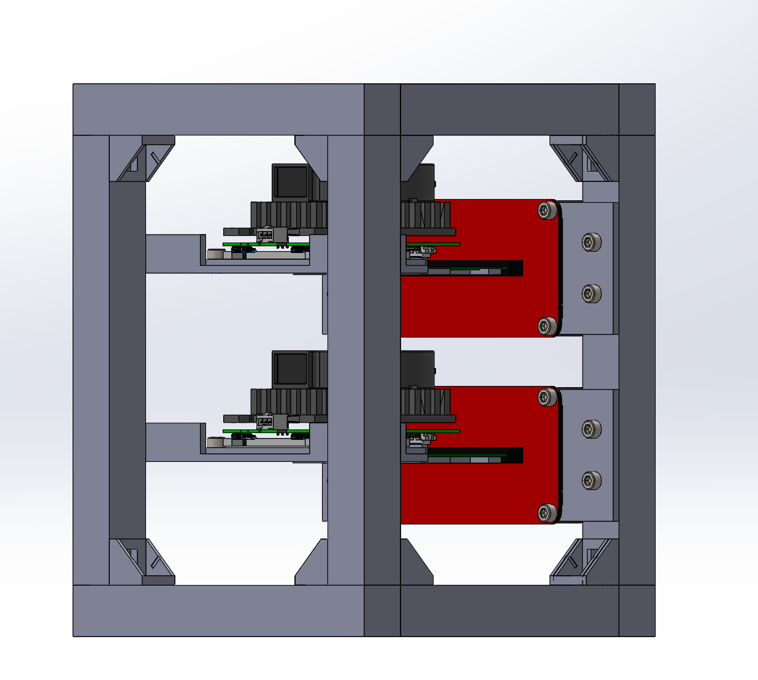
Mechanical Framework for the Test Beam

Slide 7
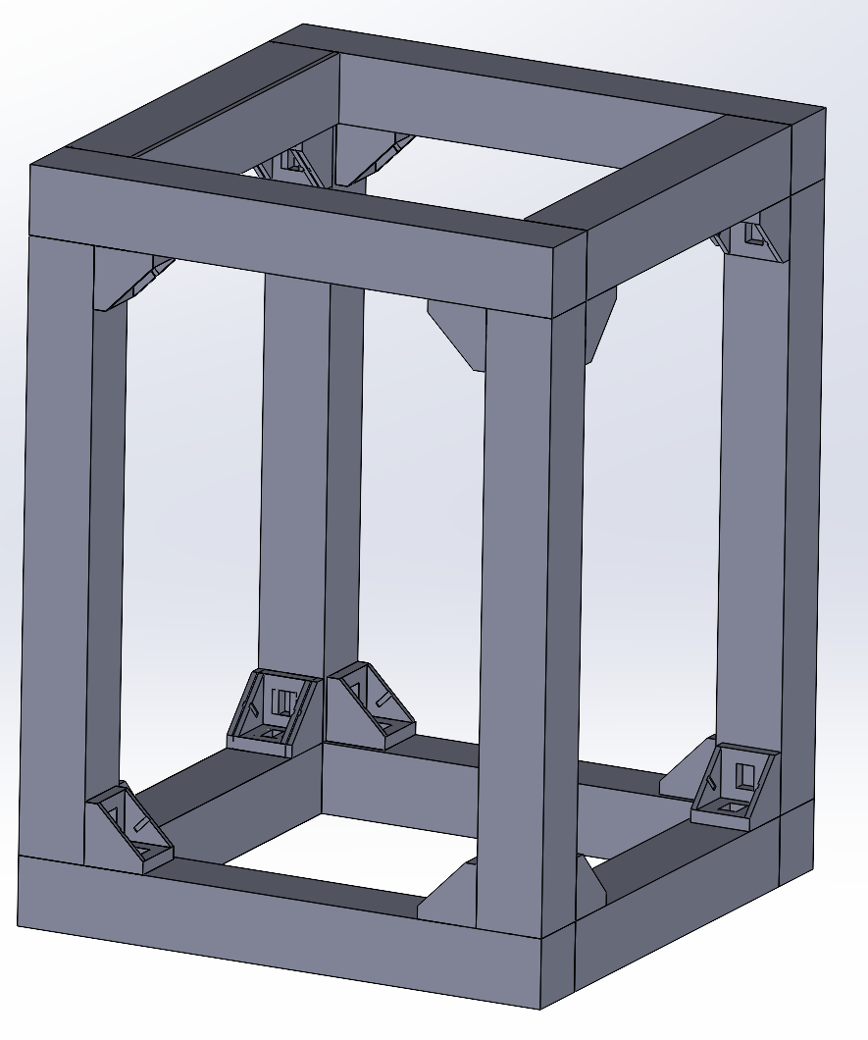
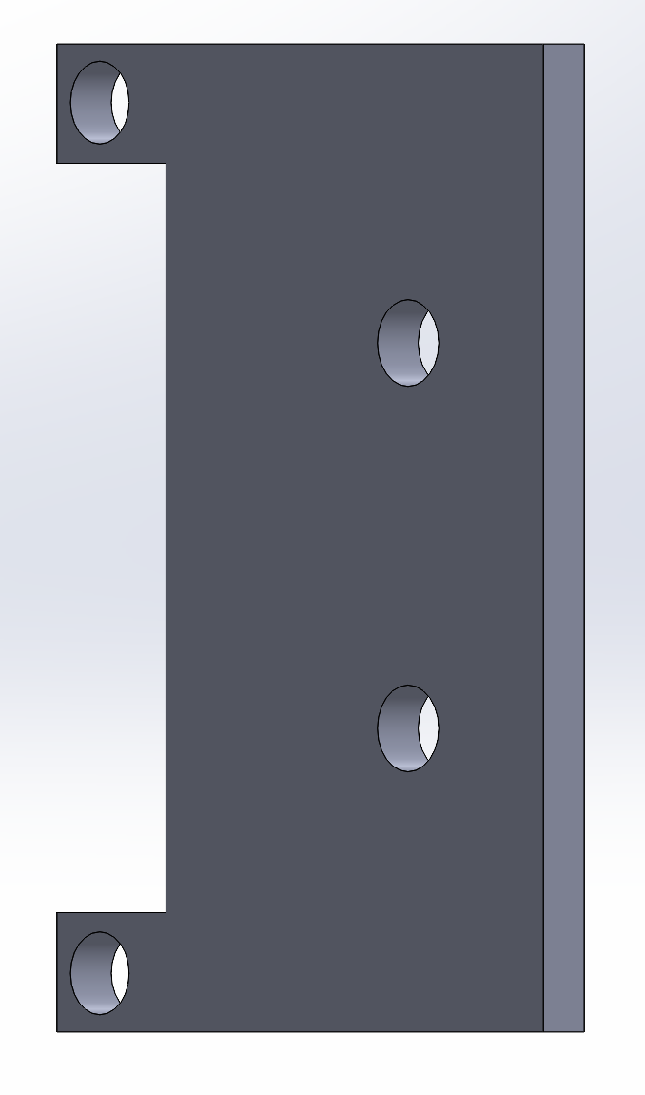
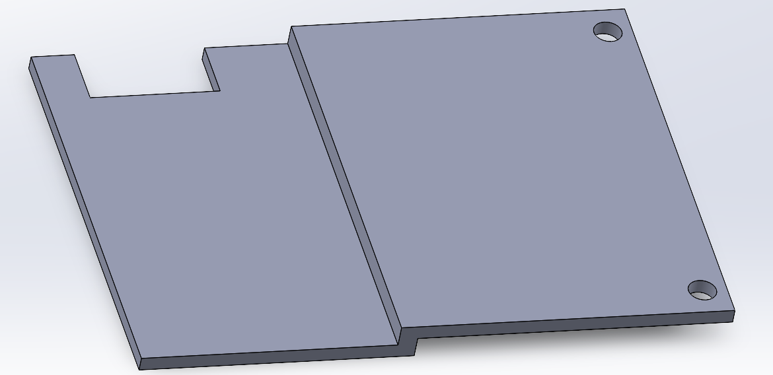
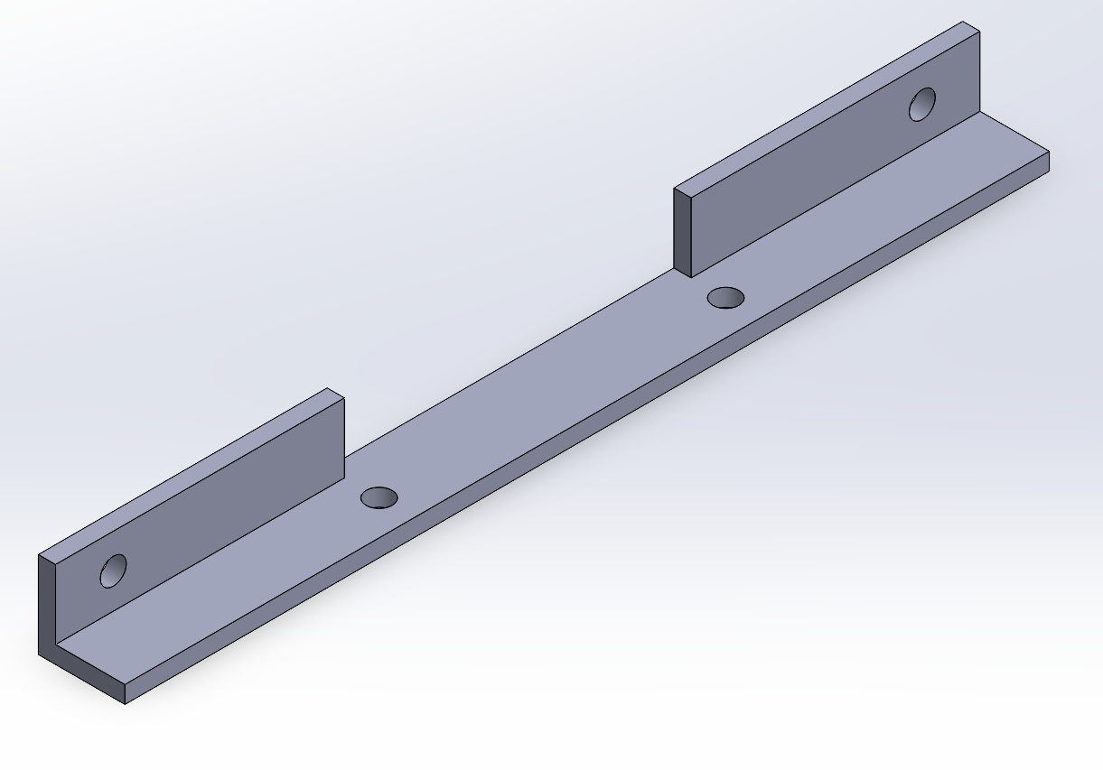
Next Steps
Ideally, I would like to order materials and use one of the CERN machine shops to make the required parts.
Then I would assemble the frame so it can be used this Fall.
Next immediate step is to work on getting final approval, and a backup design for the backup electronics that may be used.

Slide 8
Thank you!
Questions?

