Slide 1

CERNbox UI Metrics Scraping and Analysis Update
University of Michigan CERN REU
Tyler Hellstern – Washington and Lee University
Advisor: Samuel Alfageme

Slide 2

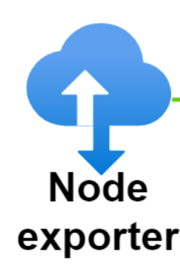


A Refresher
What is CERNbox?
What is Monitoring?
Notes:
Pull vs. Push

Slide 3
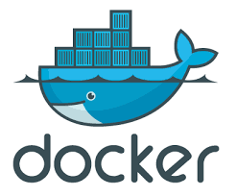
Tools of the Trade
Containers!
Metric Exporting:
  Node Exporter
  Blackbox Exporter
  EOS Exporter
Metric Collecting:
  Prometheus Metric Pulling
  Prometheus Pushgateway
  Prometheus Aggregate Pushgateway
Notes:
Two actions that need to happen: Exporting vs Collecting
How do I simulate a whole network on my machine??

Slide 4

Languages of the Trade
Most of my time: configuring my laptop environment
Important coding languages:
  Bash script
  YAML
  JSON
Becoming very familiar with computer networks
  HTTP – an Application Programming Interface (API)
Notes:
Bash script – conductor
YAML – music in front of each musician
JSON – the different instruments?
HTTP – the actual sound notes

Slide 5
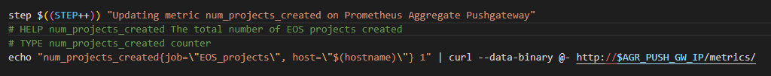

CERNbox code
First contribution to the code:
  num_projects_created
Notes:
Once I got the hang of containers and network simulation….

Slide 6

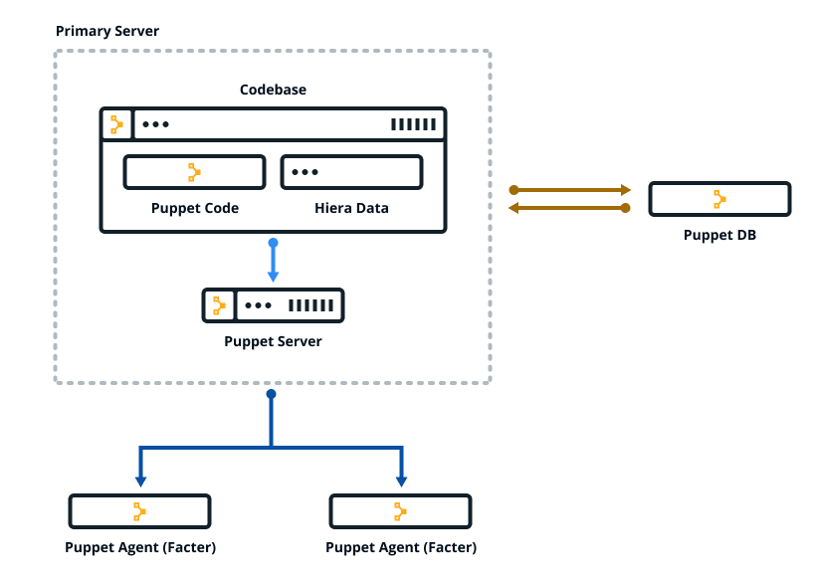
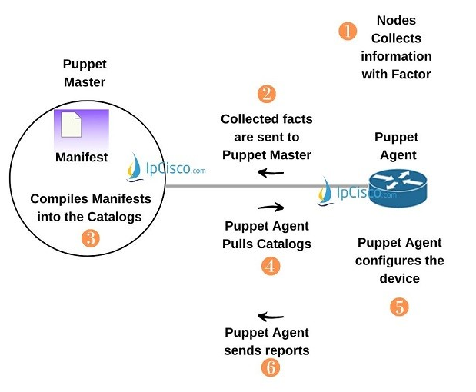
Looking Ahead: Puppet
Make the system work on other Machines:
  Puppet (a CMS)
Notes:
How do I install the program set up I’m creating to other systems?

Slide 7
My Project Goals
Continue to familiarize myself with as many coding languages and programs as possible
Finalize my code for pushing various metrics to Prometheus and get it published in the CERNbox git repository
Edit the Puppet Manifests to configure various exporters and push gateways onto other systems

Slide 8

Questions?

