Slide 1
Analysis of the Phi Resonance using ATLAS Minimum Bias Data for √s = 13.6 TeV pp collisions
-Aidan Nakhleh

Slide 2
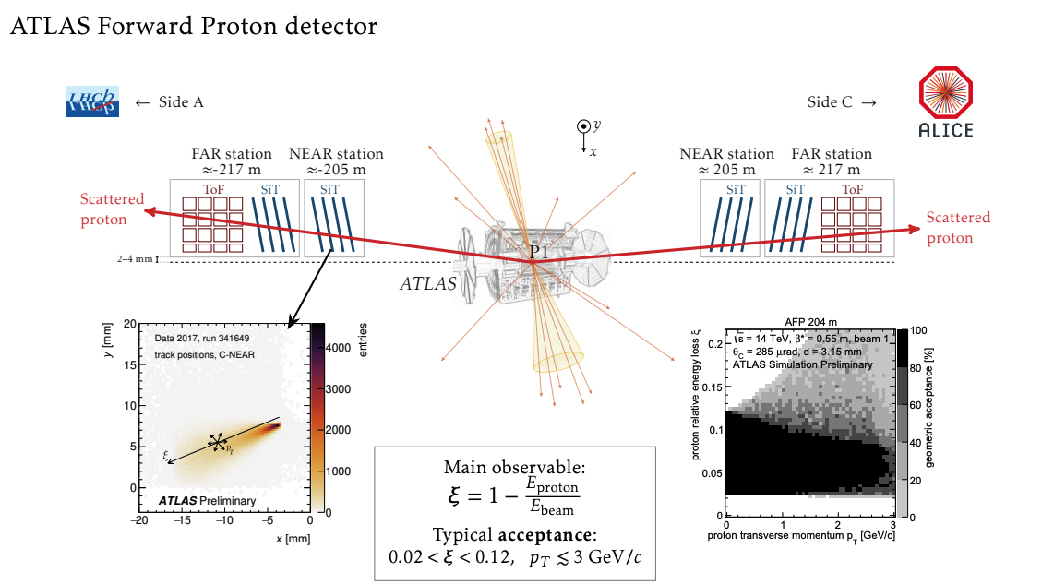
Refresher
Analyzing minimum bias data fed by the main ATLAS detector and MC simulations
  Events selected with a minimally biased trigger (loose kinematic requirements)
  Insight into soft QCD
Provided by Maciej Lewicki

Slide 3
Objectives
Focus on ATLAS minimum bias data
Update software with new data analysis tools
Reproduce results from previous work with new run 3 data
Introduce AFP tagging

Slide 4
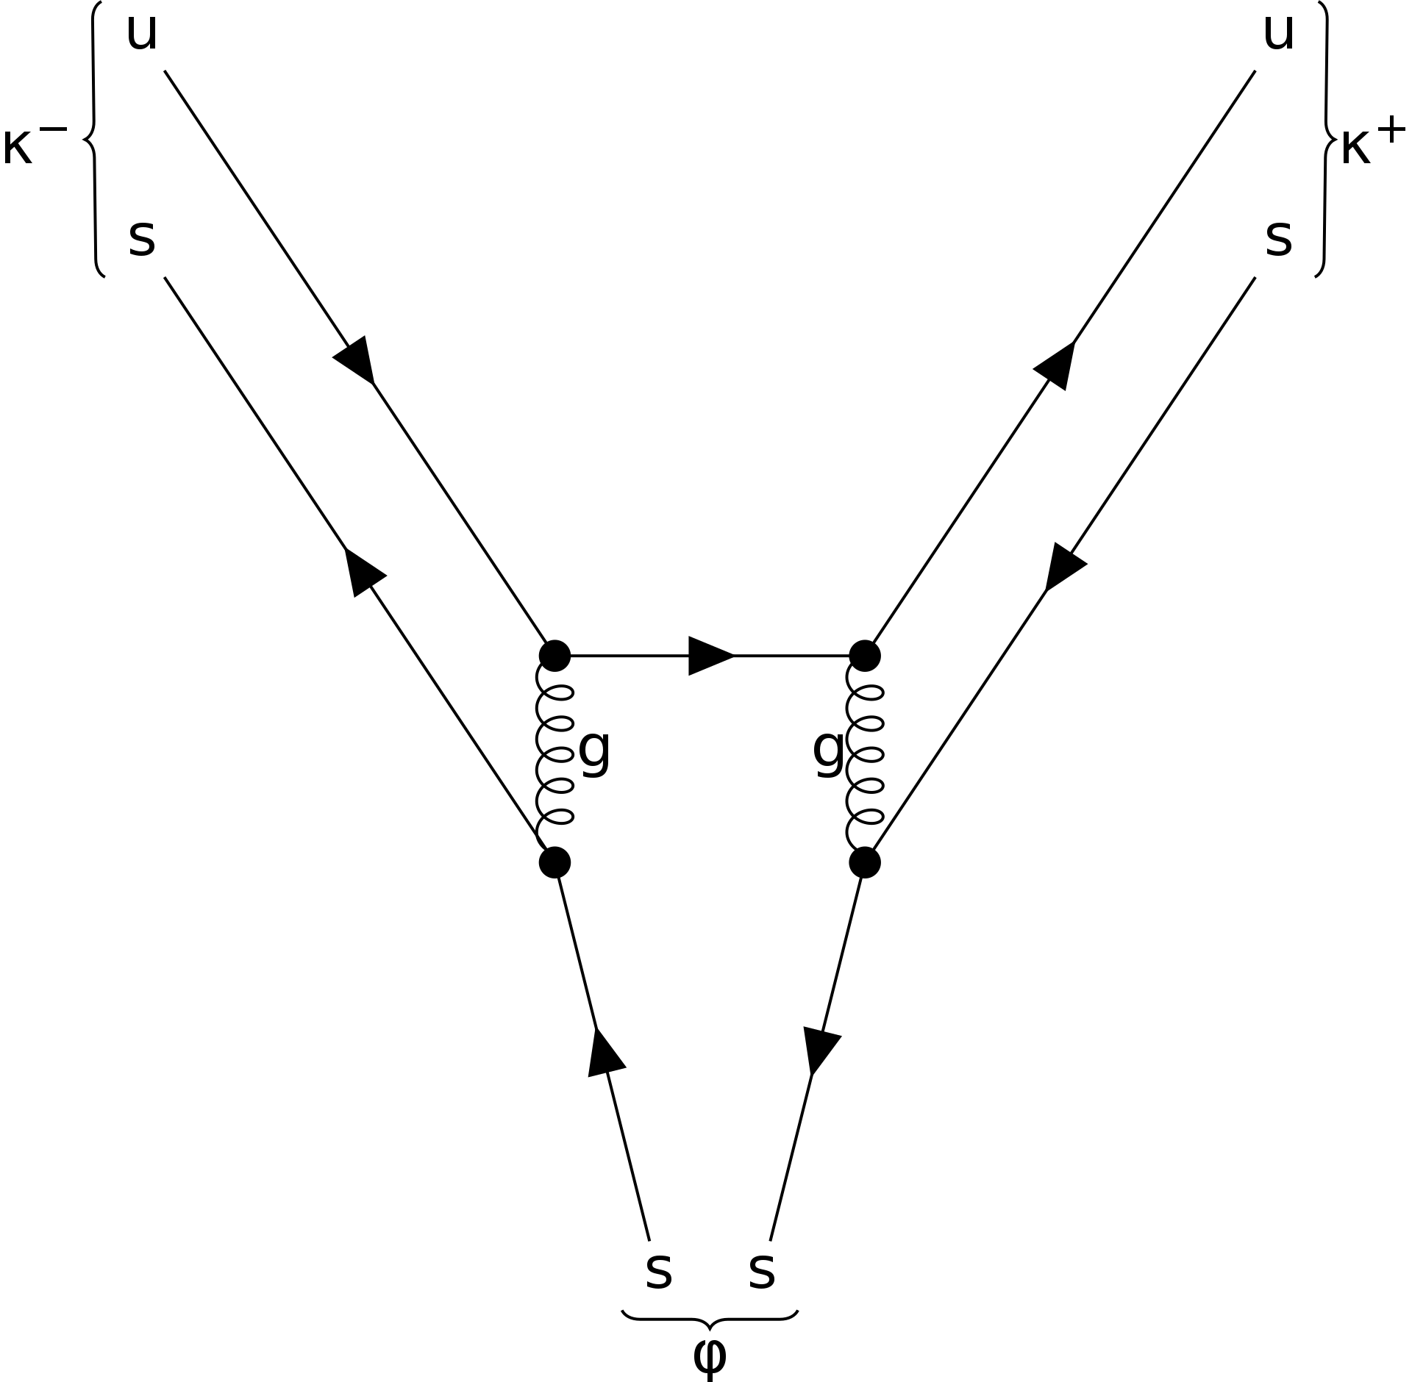
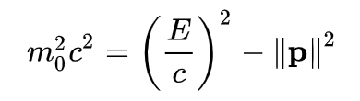
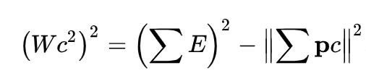
The Physics
Dominant decay mode
positive kaon
negative kaon
One particle:
multiple particles:
Phi meson

Slide 5
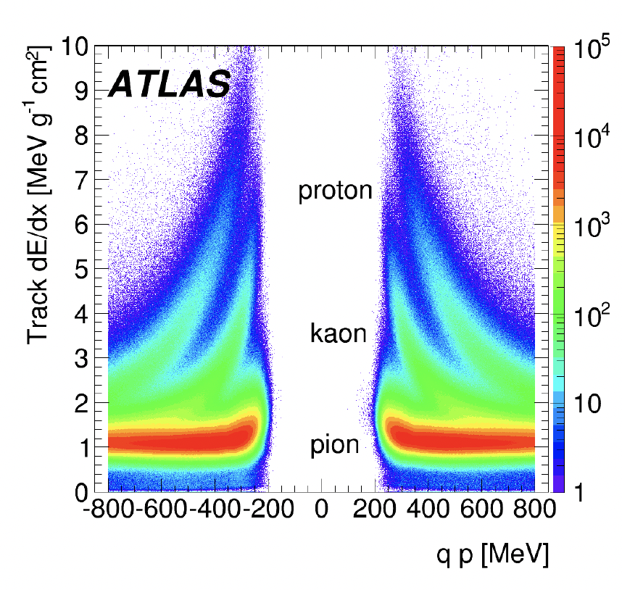
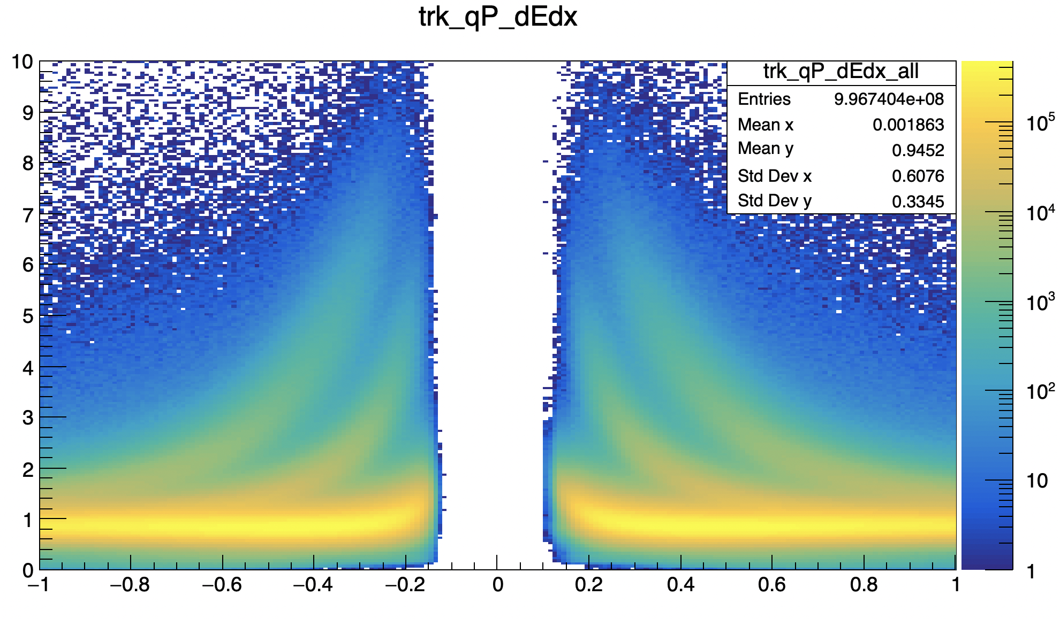
Extracting the Signal
Find unique characteristics for kaons
Filter data down
Make pair guesses

Slide 6
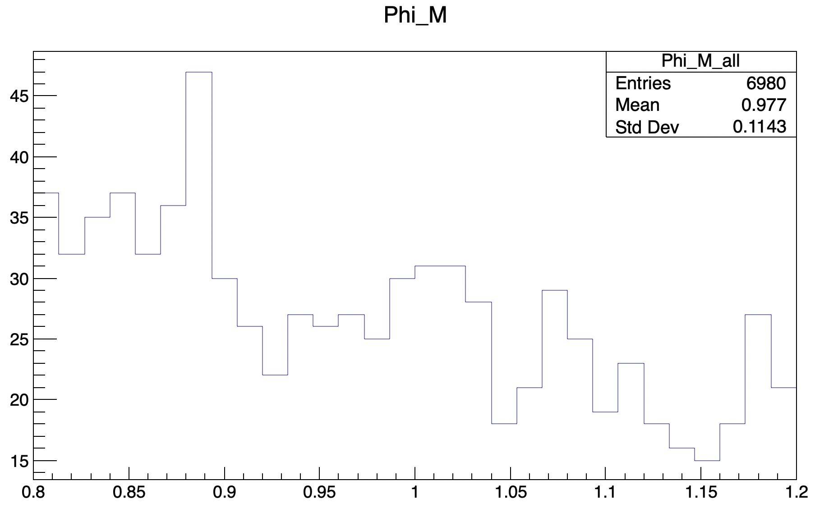
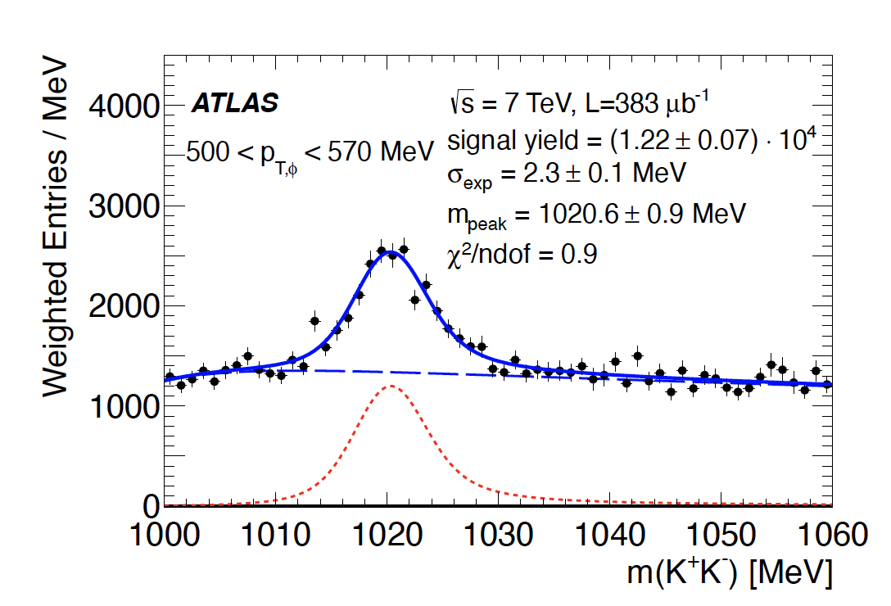
End of Summer Goals
Refine kaon selection
Introduce AFP tagging into the data selection
Compare run 3 data to new MC simulations

Slide 7
backups

Slide 8
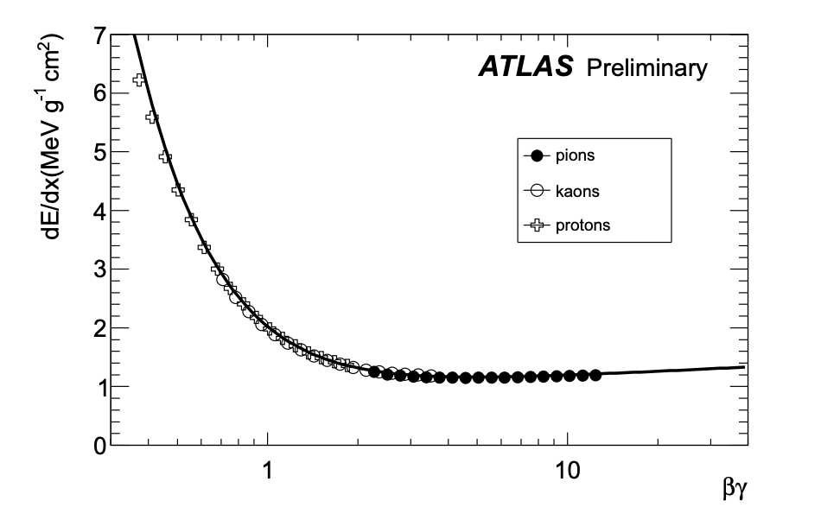

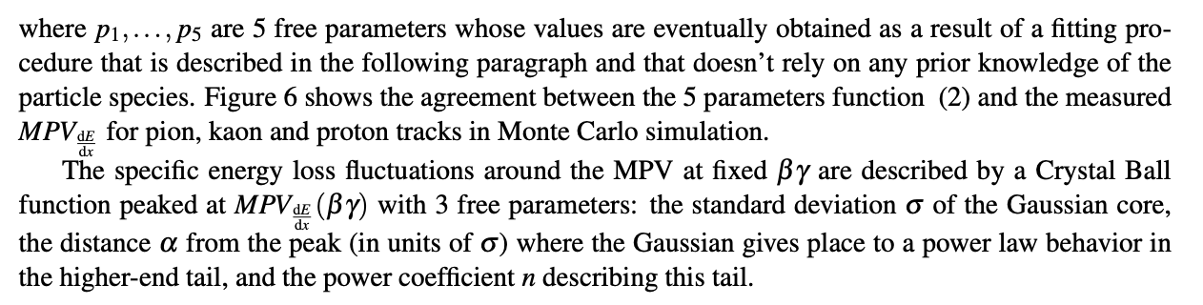
Crystal Ball Fitting

