Slide 1
Analyzing Antihydrogen Annihilation Patterns in ASACUSA’s Cusp Trap
Alison Weiss
Supervised by Dr. Eric Hunter

Slide 2


Project Overview
ASACUSA (Atomic Spectroscopy And Collisions Using Slow Antiprotons) Collaboration
Collaboration Goal: to measure antihydrogen ground state hyperfine splitting, which tests CPT symmetry
I simulate antihydrogen annihilations to help optimize plasma properties for increased antihydrogen production

Slide 3
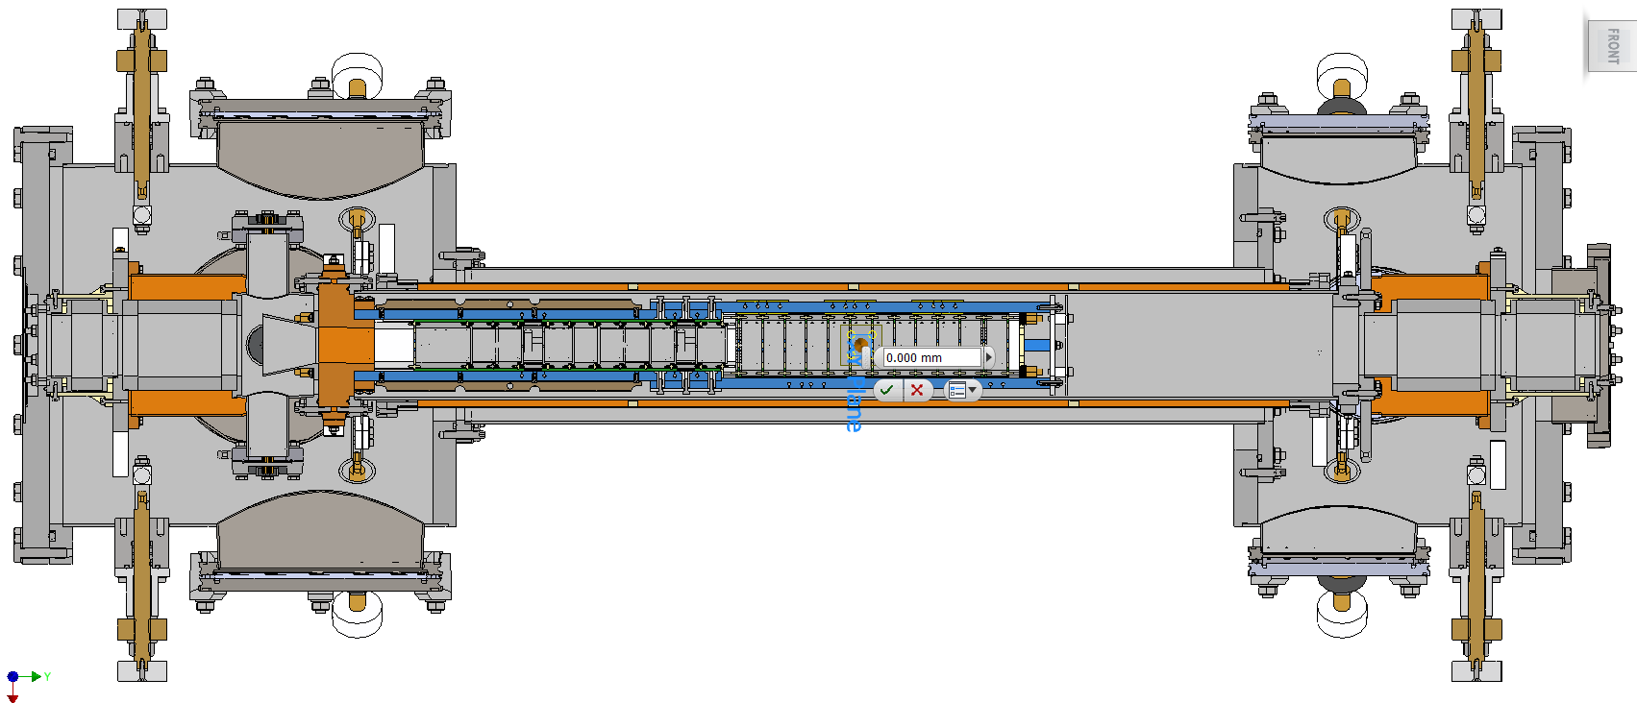
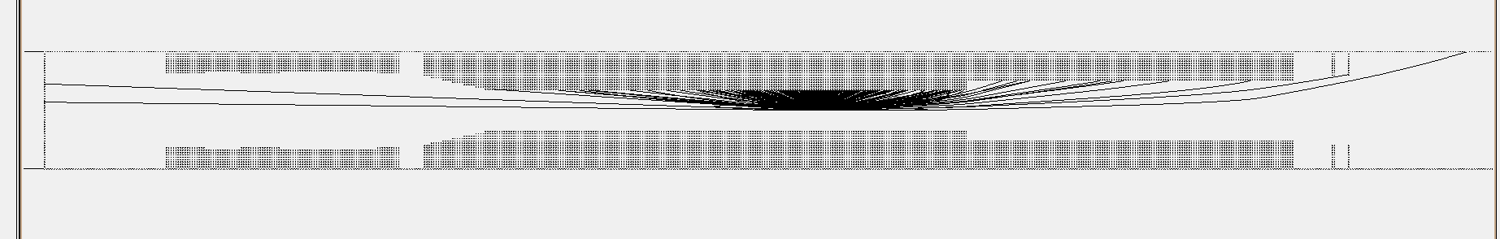
Simulating the Cusp Trap: From Inventor to Simion
Zero point, halfway between the field ionizers
Mixing region
End of electrode stack

Slide 4
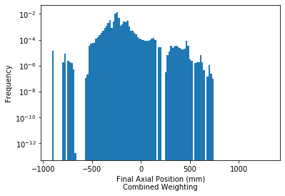
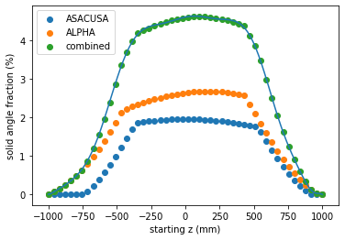
Post-Simion Data Processing
1556 mm
Weighting by
  Brescia panel solid angle
  Isotropic, Maxwellian antihydrogen velocity
  Magnetic moment probability from Robicheaux, 2006
Notes:
Outer panels are 1442 mm and 1716 mm away from the trap, off the slide
Explain that use green which is sum of orange and blue in simulation
Thank Valerio for solid angle

Slide 5
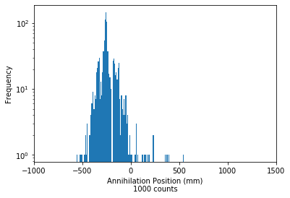
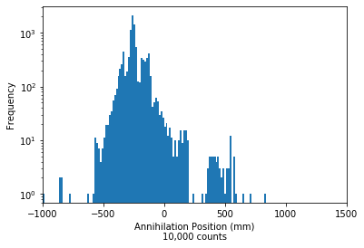
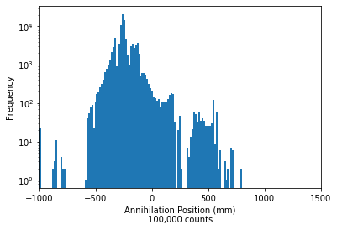
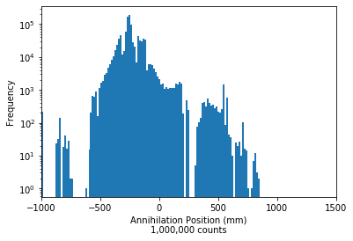
Monte Carlo Simulations
Mixing region
End of electrode stack
Mid point between field ionizers
DAQ rate is limited to ~1000 counts per second
mixing cycle will be ~1 s long

Slide 6
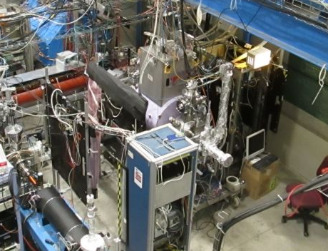
Move Brescia Panels Downstream?
Downstream direction

Slide 7
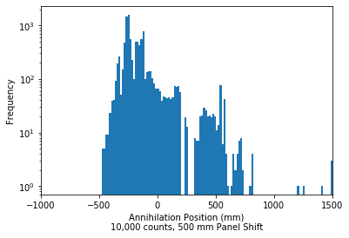
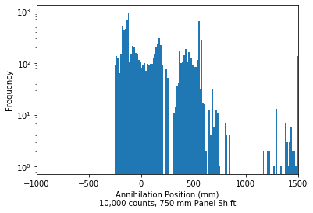
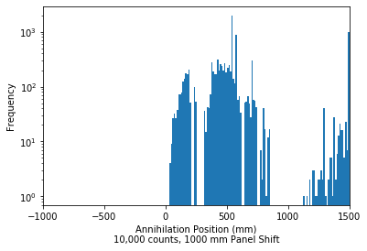
Shifting Panels Downstream
(10,000 counts, ~10 runs)
Mid point between field ionizers
Notes:
1000 counts per mixing cycle
BGO and hodoscope will detect around 1500, so that will give position information in that region

Slide 8
Next Steps
Incorporate plasma rotation into Python code
  Adds two new variables: the rotational angle and the radial distance from the center of the trap
  Simion Array is now a look-up table
Predict quantum state based on estimated time spent in the trap prior to annihilation
  Not much in the way of theoretical predictions for antihydrogen quantum state in the literature
  Match predictions to actual data
The plasma rotation gives the anti-atoms a transverse “kick”
Notes:
General rule: the more time spent in the trap, the more likely for the antihydrogen to reach its ground state

Slide 9
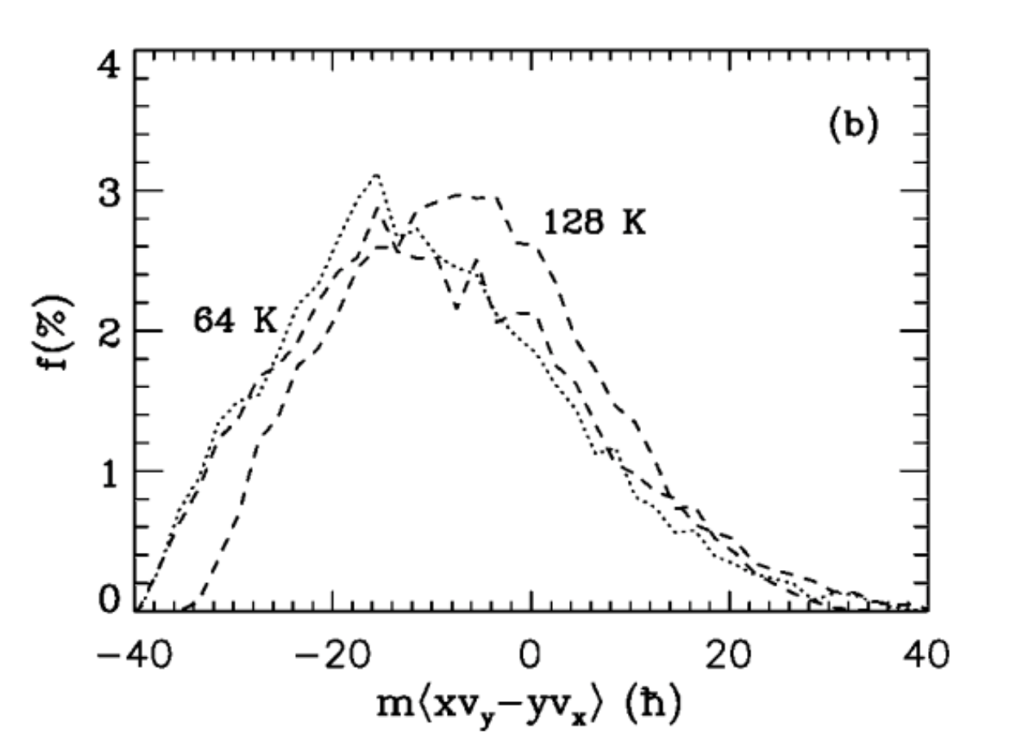
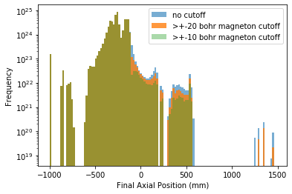

Field Ionizers
$μ$ Weighting from Robicheaux, 2006
Removing higher magnetic moment annihilations occurring downstream of the first field ionizer
Note: no longer weighting by Brescia panels
Notes:
If it is both greater than 20bm and .117 mm cut off for it to be weighted zero. Both past the field ionizer and greater than 20 bm.
See no difference between 20 bm cut off and no cut off, small difference at 10b,
Sum of difference detected in mcp, but lose annihilation position information
Only antiatoms with very large magnetic moment ^^
Histogram shows cannot verify robicheaux data with field ionizers and Brescia panels, maybe mcp to an extent but no position data

