Slide 1
Update on Determining Trends in Silicon Module Production
Anne Graf
NC State University/CMS Experiment

Slide 2
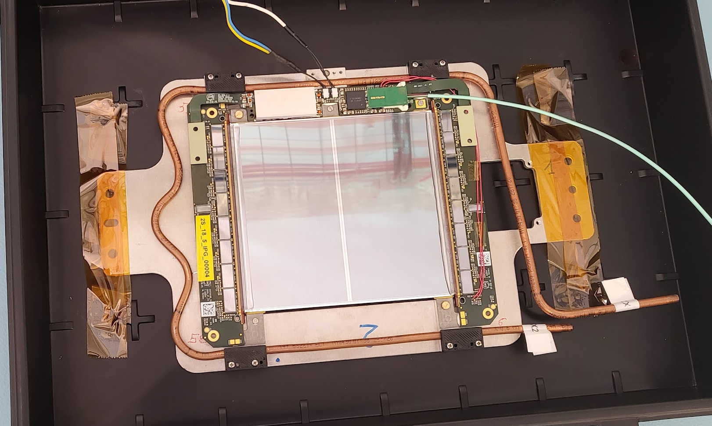
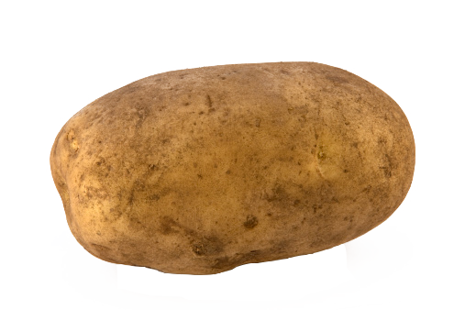
Last Time On My Experiment . . .
Compact Muon Solenoid (CMS)
Working with Lesya Horyn & Stefano Mersi
Specifically, I am working with the silicon modules of the upgrade of the tracker
  Writing a code that show trends in usable silicon modules
  Integrated with Phase 2 Outer Tracker Analyzer of Test Outputs
  Or: POTATO
New Silicon Modules are being made to accommodate for the increase in information with the update to the LHC
  POTATO tests these modules
  I use POTATO to streamline our production of the modules

Slide 3
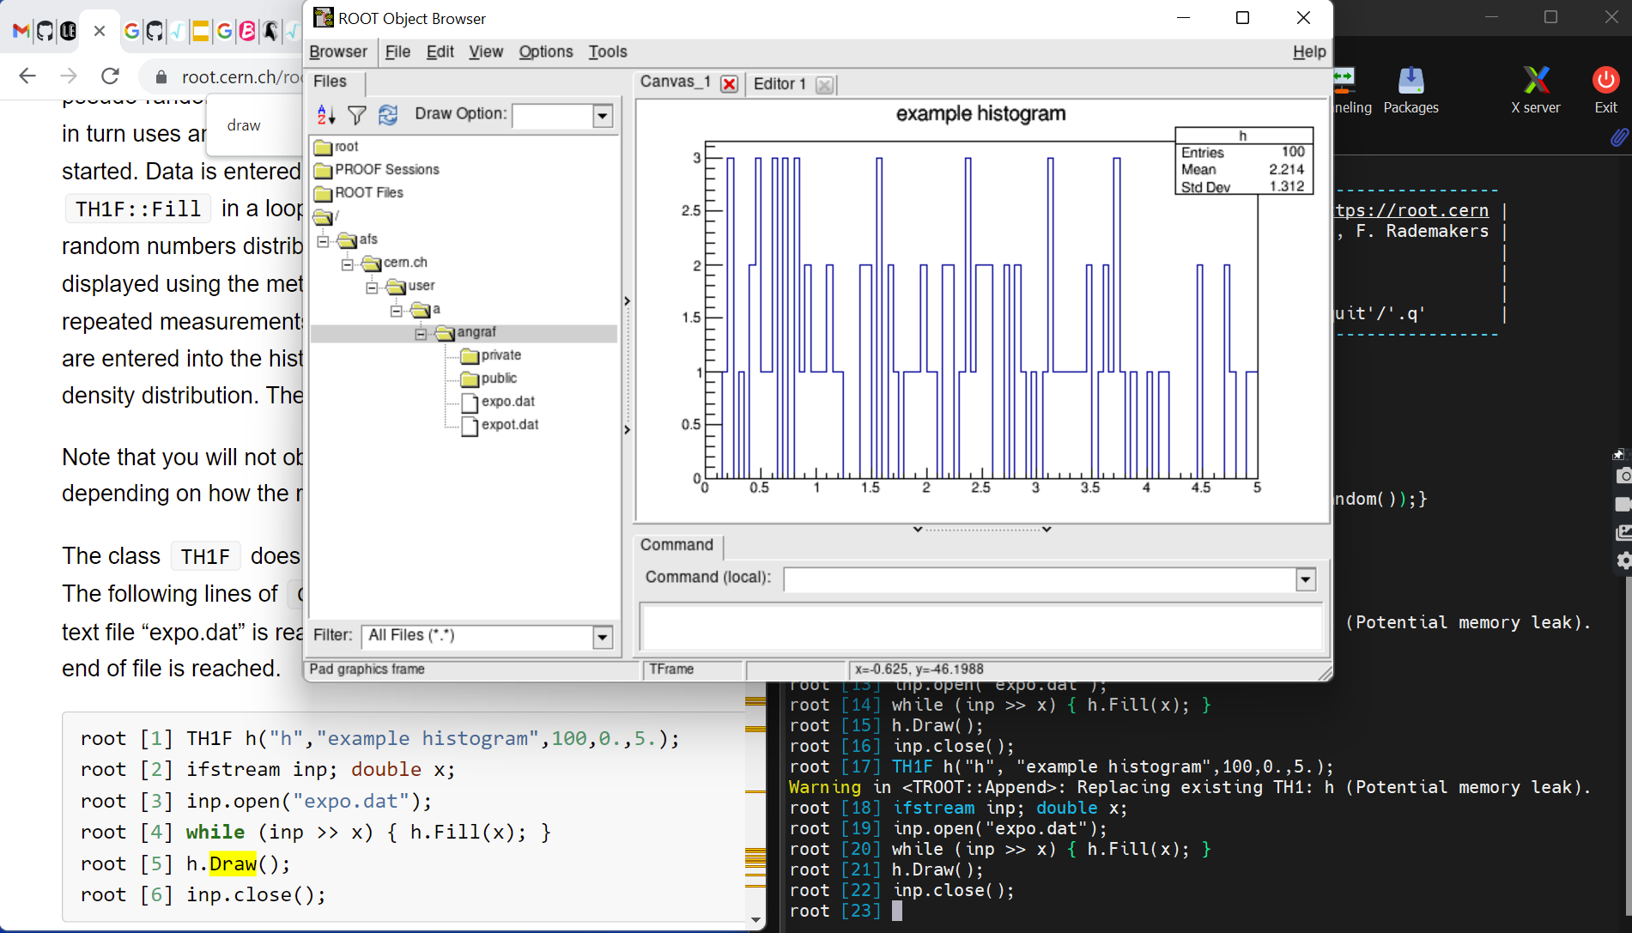
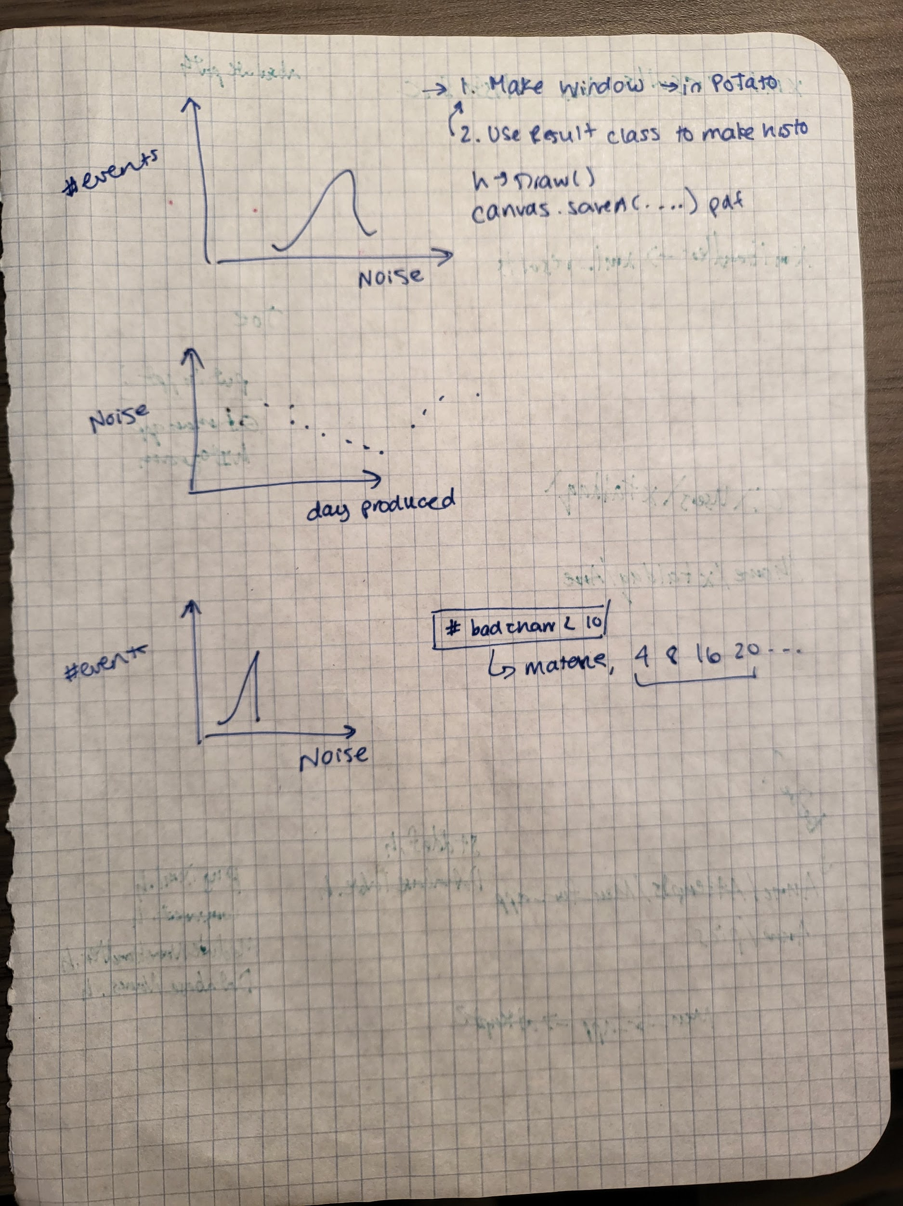
What I’m Actually Doing
What I’m Doing
POTATO already exists
  POTATO determines whether a silicon module is working or defective
POTATO already sort of exists
  POTATO will eventually determine whether a silicon module is working or defective
  It was very broken.
I need to write an additional program
  that reads data files of silicon module output, extracts and collates particular interesting pieces of data, and creates histograms, to visualize issues with the silicon modules
I have written an additional program
  that reads data files of silicon module output, extracts and collates particular interesting pieces of data, and creates histograms, to visualize issues with the silicon modules
  This can show patterns in the modules to determine trends in the production of the modules like
    Different locations producing different levels of quality
    If the modules are improving or worsening with time
This program will be integrated with POTATO and used in the testing of the silicon modules before they are put into the new & improved tracker
  This will show patterns in the modules to determine trends in the production of the modules like
    Different locations producing different levels of quality
    If the modules are improving or worsening with time
This program will be integrated with POTATO and used in the testing of the silicon modules before they are put into the new & improved tracker

Slide 4
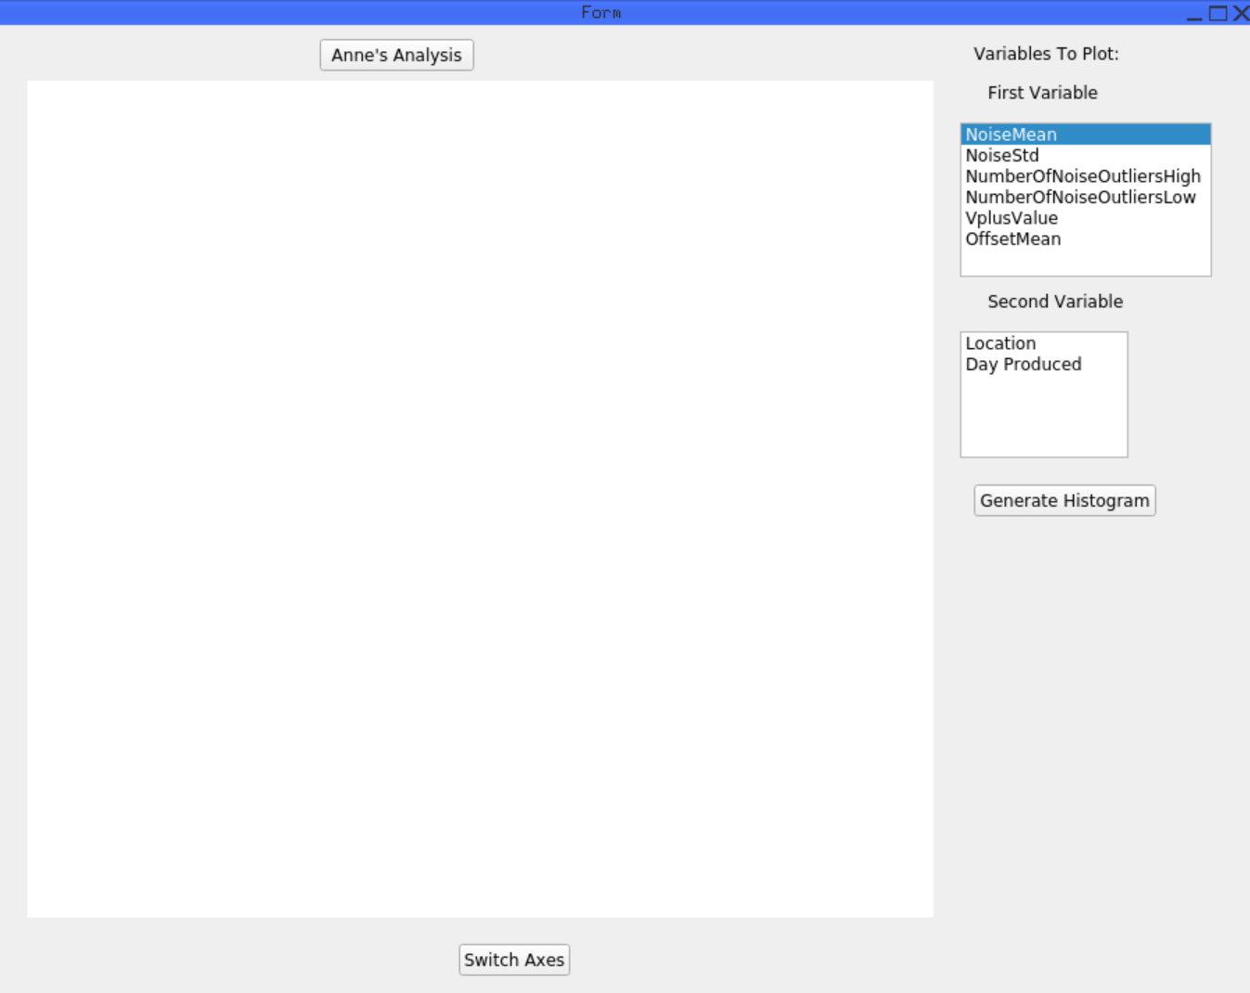
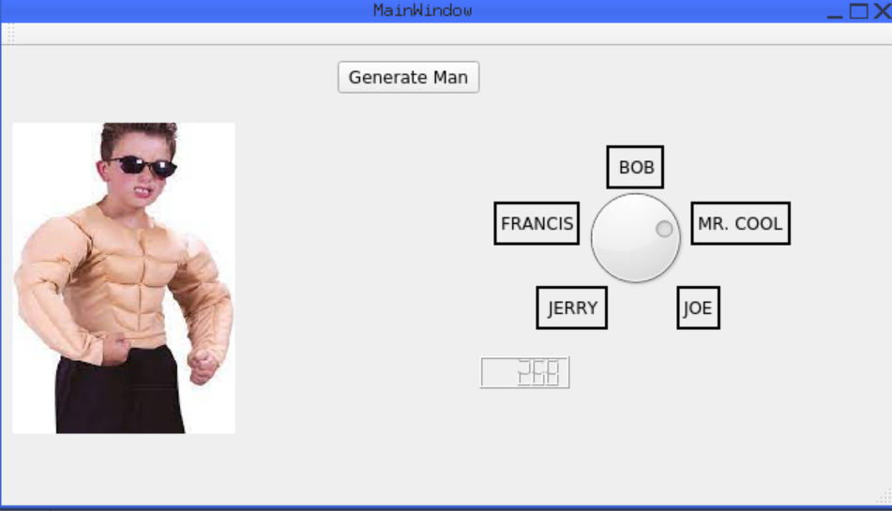
Accomplishment(s)?
Becoming familiar with Root
✔
Make some pretty histograms
Becoming competent at Root
✔
Creating GUIs for the first time
Creating a working GUI to interface with POTATO
✔
✔
Using C++ a lot more
Creating a final, working code to be used in the future LHC upgrade
Maybe learn a little French

Slide 5

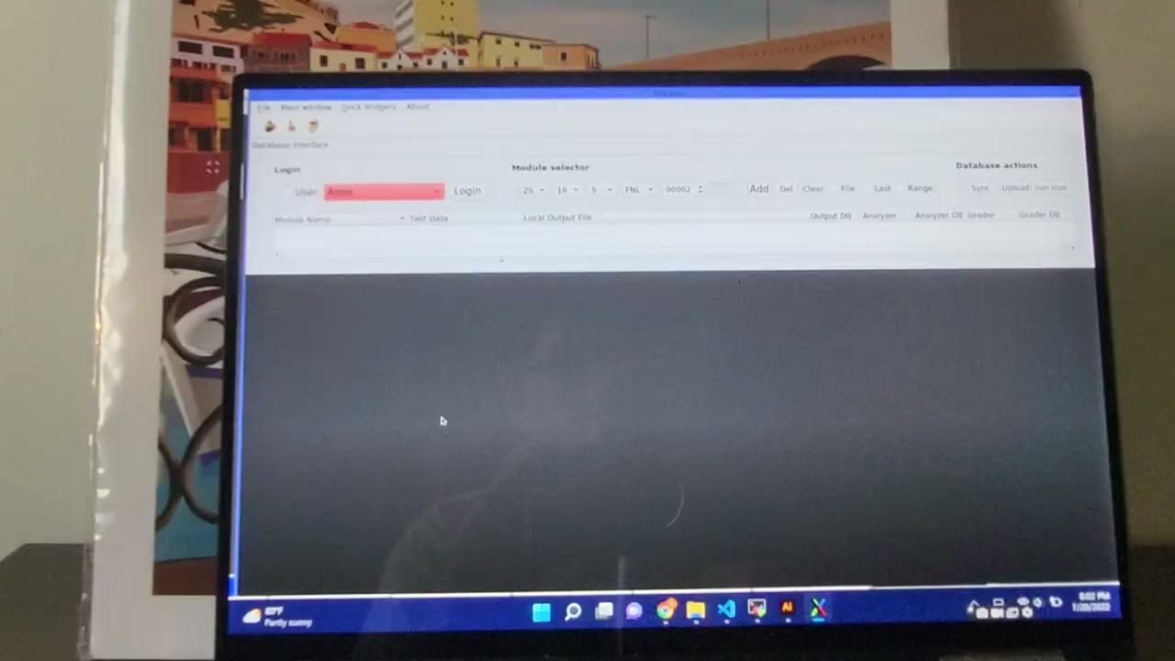
Intermediate Results: The GUI

Slide 6
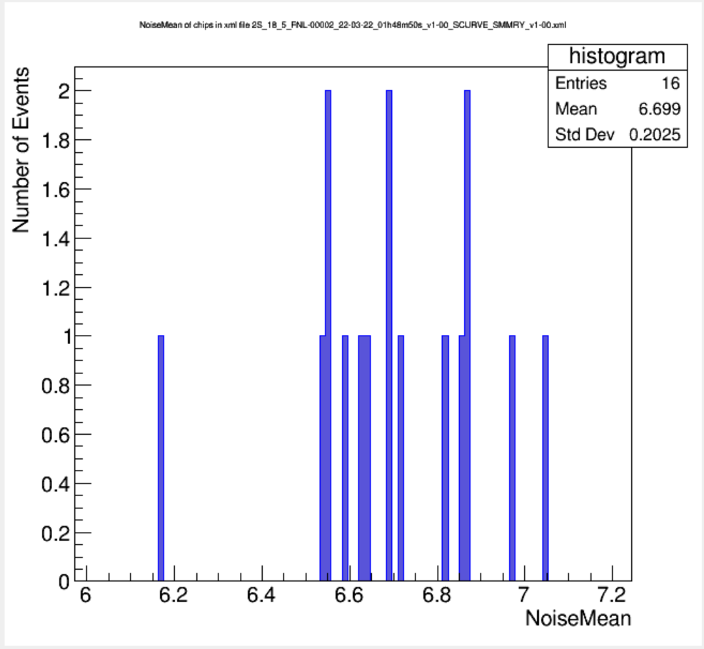
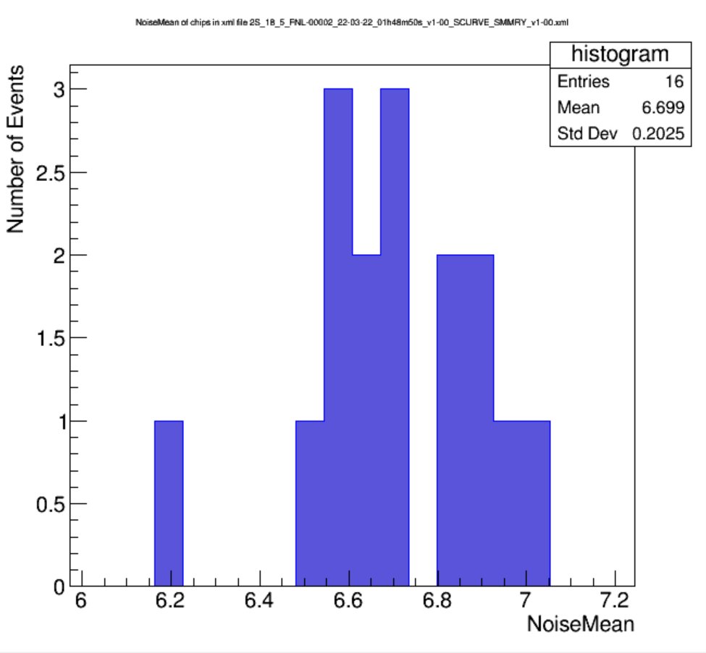
Intermediate Results: The Plots (Noise Mean)

Slide 7
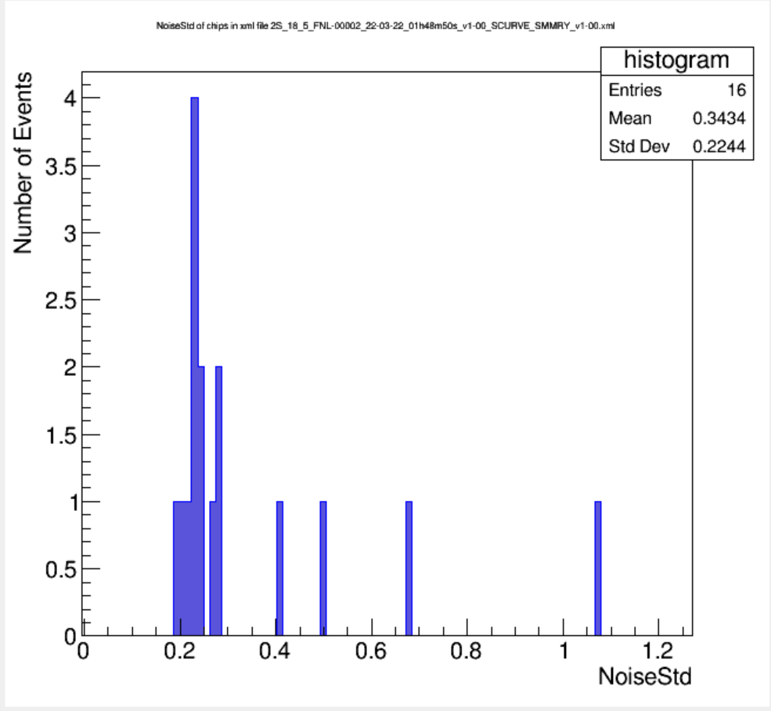
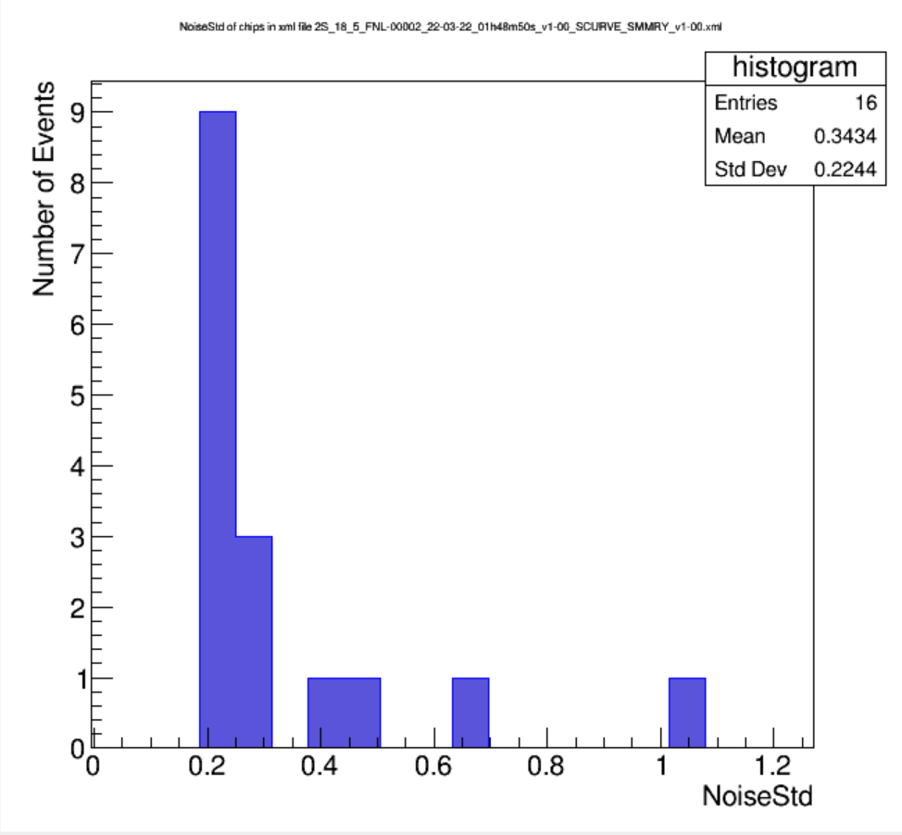
Intermediate Results: The Plots (Noise Std)

Slide 8
What’s Next?
Make the 1D histograms prettier
Make 2D histograms
  With second variable like location or date
  That button is already in the GUI, it just doesn’t work
Get more .xml files to make actually interesting histograms
  Create a file choice system in the GUI
Add special features to the GUI
  axes switching, maybe choices on how the histogram looks, etc.
Thanks from POTATO!

