Slide 1
Decay of Thallium from Nuclear Isomers at ISOLDE Decay Station
Jordan Cory
Bruno Olaizola
CERN

Slide 2
Calibrations with Europium 152
The energies of gamma rays in IDS are measured in units proportional to the induced charge in the semiconductor used to measure them
In order to convert these energies to keV, we must find a linear relationship between the measured values and energy
This is done by using a calibration source, which should have
  A long half life
  A distinctive spectrum
  Decays at many different energies
Notes:
Long half life
Has decays into many different energies
Has a lot of counts in the lower energy gammas (good bc of background)
Distinctive spectrums

Slide 3
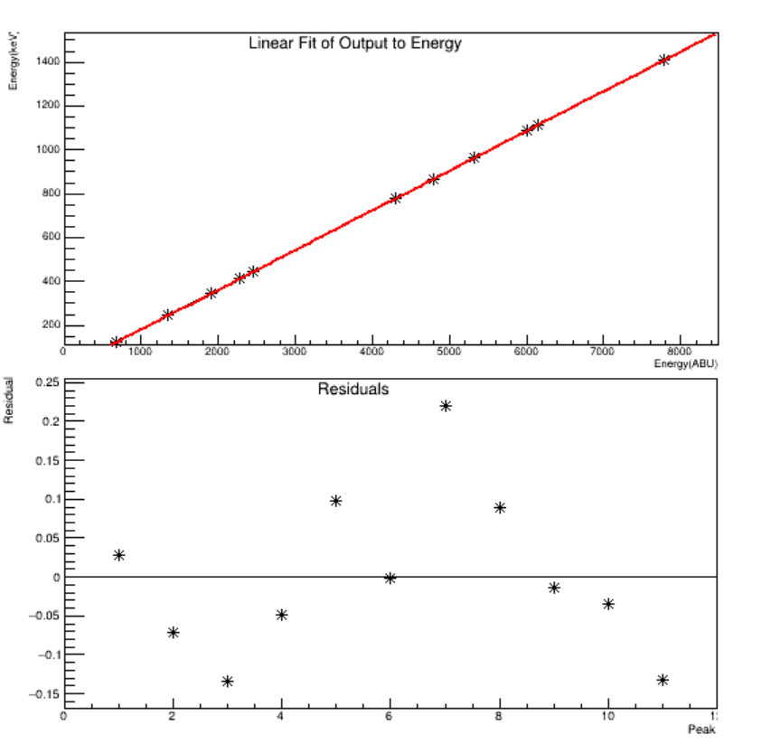
Calibration
The first graph shows the linear relationship between the measurement and the energies
The second shows the difference between the calibrated values and the known energy

Slide 4
Efficiency Calculations
Efficiency calculations are done to see how much of the expected gamma ray is being detected
This is done by fitting the gamma peaks, then comparing their area with the known intensity of the decay
These calculation is very important, as the rest of the project uses the efficiency to interpret the data
Notes:
Explain what is efficiency, how i did it, and show the plots

Slide 5
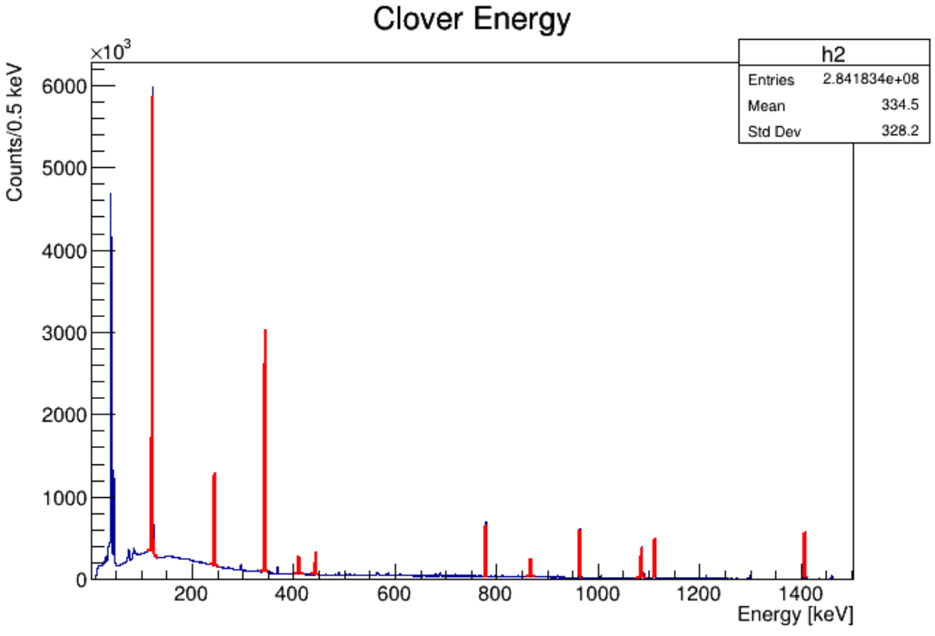
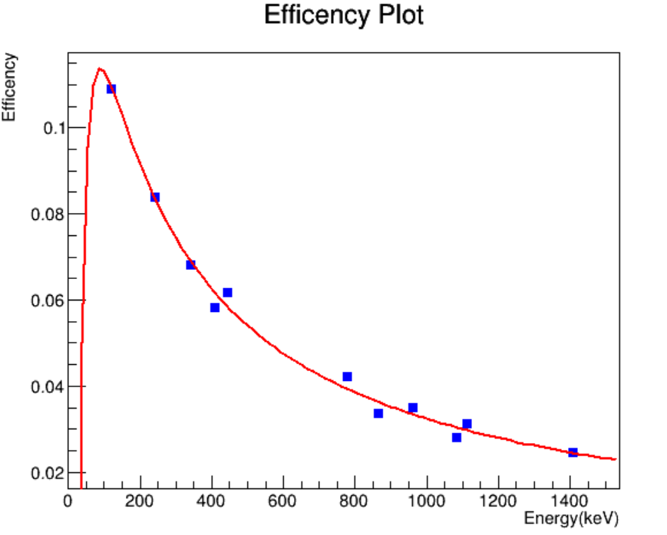
Efficiency Calculations

Slide 6
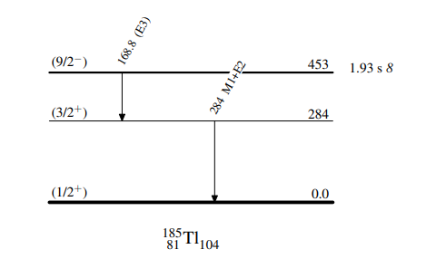
Next Steps
Calibrate all of the data
Look for gamma peaks indicating the isomeric decay I am searching for
Measure the half lives of these decays

Slide 7






Photos!

