Slide 1


Top Cryostat Mechanical integration
CERN TE-MSC, EN-MME, RTU and UNIBS
Luca Piacentini, Diego Perini, Toms torims,
Luca Dassa, Jānis Vilcāns, Andris Ratkus, Stefano Uberti
VPP-IZM-CERN-2020/1-0002

Slide 2
Outline
Dipole and quadrupole data & assumptions
External and internal supporting systems
Mechanical integration and insulation vacuum interconnection
Cryogenic integration
Information transfer/envelope system

Slide 3
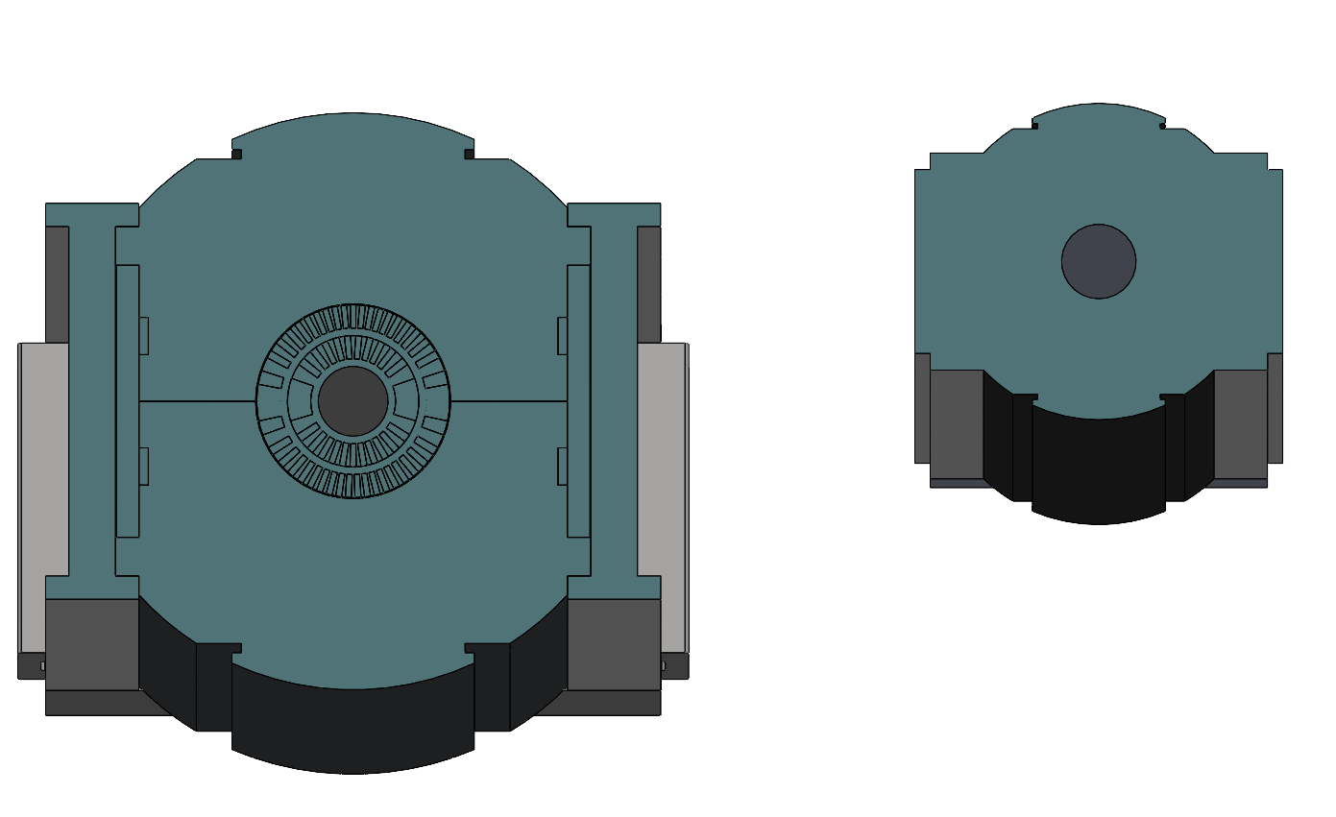
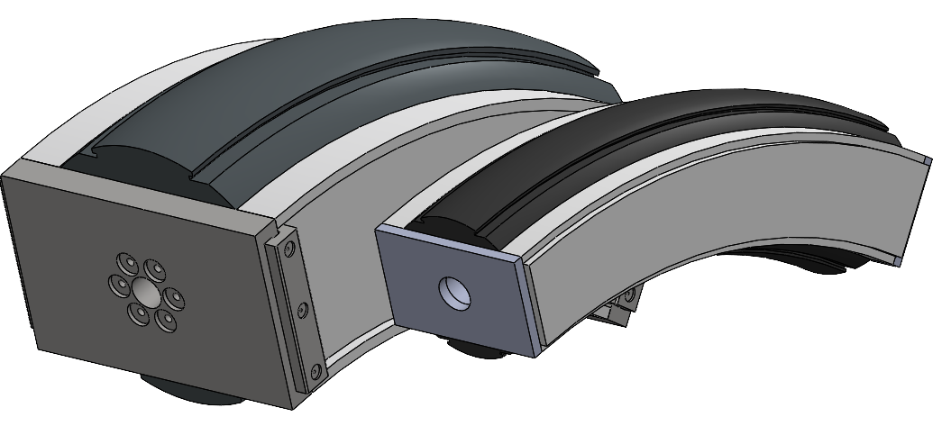
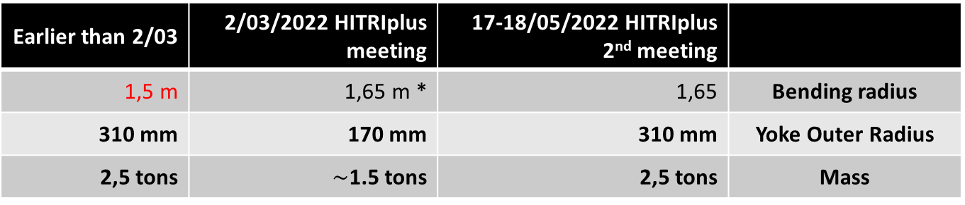
Dipole and quadrupole data/assumptions
Earlier than 2/03 | 2/03/2022 HITRIplus meeting | 17-18/05/2022 HITRIplus 2nd meeting
1,5 m | 1,65 m * | 1,65 | Bending radius
310 mm | 170 mm | 310 mm | Yoke Outer Radius
2,5 tons | $\sim$1.5 tons | 2,5 tons | Mass
Dimensions have been scaled with a ratio: 17/31
* Compatible with the bending radius of the latest beamline studied by CNAO
Since the work was ongoing before the 2nd HITRIplus meeting, dimensions were set on 170 mm and mass 2 tons
By courtesy of G. Ceruti

Slide 4
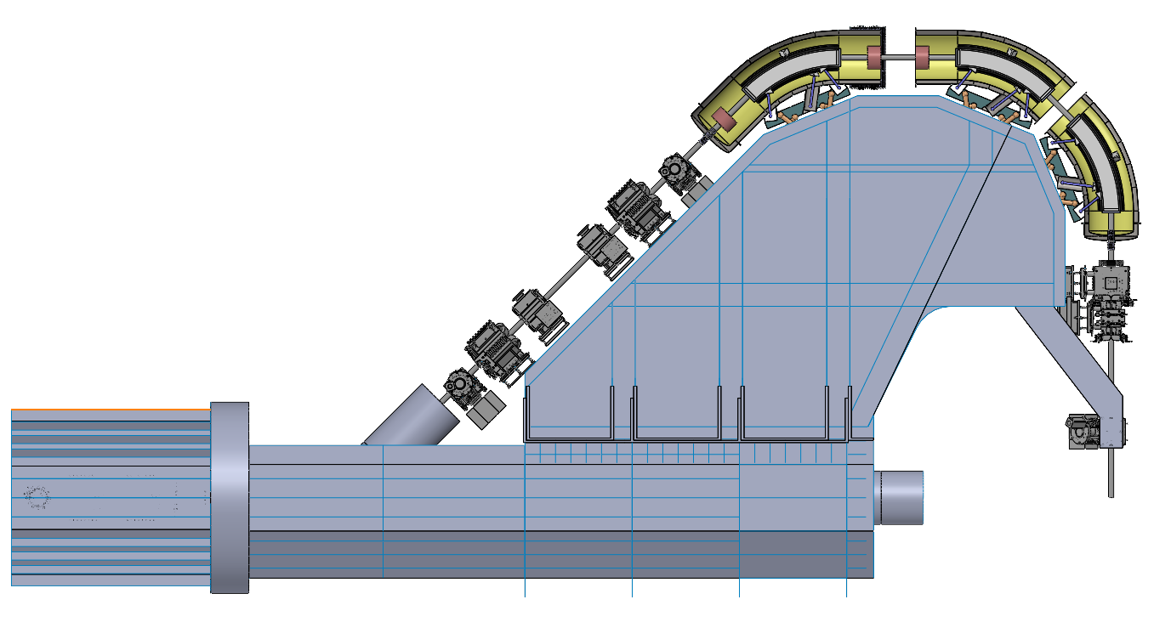
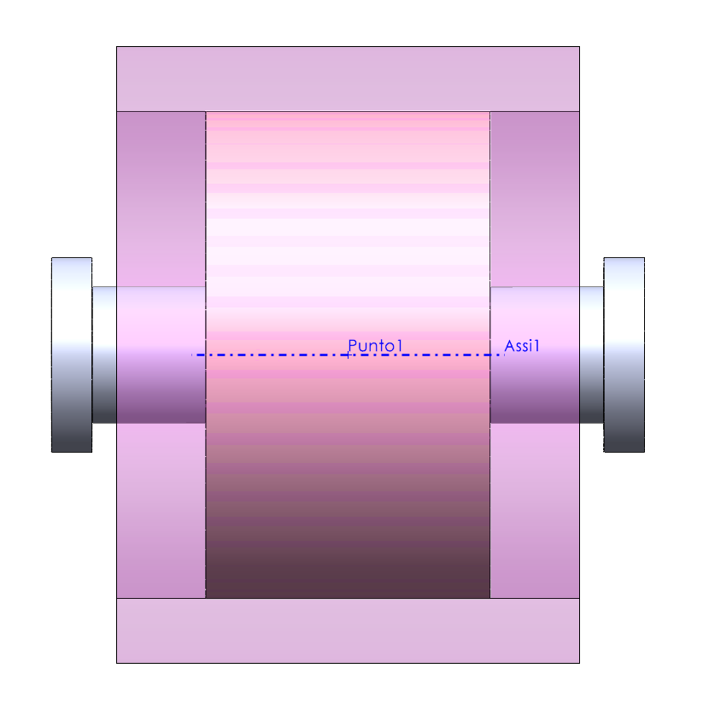
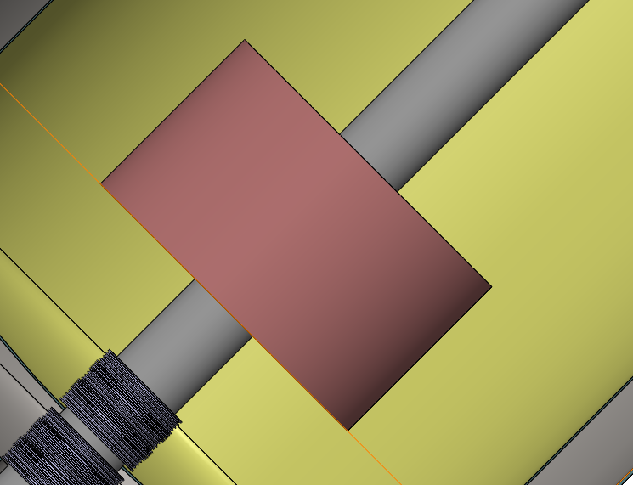
Dipole and quadrupole data/assumptions
Geometry?
Mass?
-> Supports
Assumptions
Diameter = 380 mm
Length = 285 mm
Length ftf = 365 mm
Mass = 400 kg
Dimension margin + support structure margin

Slide 5
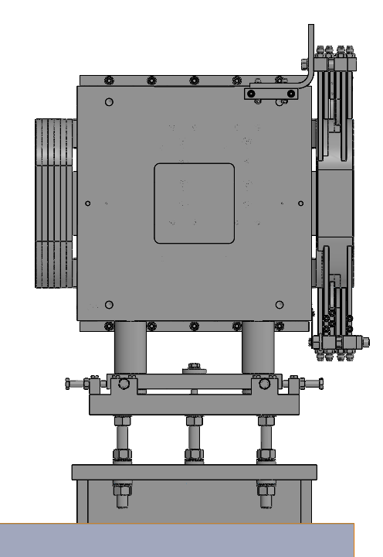
External and internal supporting system
What are the problems:
Due to tolerance chain, deformations, measuring errors ecc… the position of ALL COMPONENTS (SC Dipoles, NC quadrupoles, SC quadrupoles) is uncertain. But can be thought as contained within an error box (position-rotation = 6 degrees of freedom DOF)
How:
need of a positioning system and adjustment system
Characteristics:
Able to maintain the following characteristics around 360°
Designed to work like this:
Not like this:
“Or in all other different from 0°”

Slide 6
External and internal supporting system
What are the problems:
Due to tolerance chain, deformations, measuring errors ecc… the position of ALL COMPONENTS (SC Dipoles, NC quadrupoles, SC quadrupoles) is uncertain. But can be thought as contained within an error box (position-rotation = 6 degrees of freedom DOF)
How:
need of a positioning system and adjustment system
Characteristics:
Parallel Mechanisms?
Able to maintain the following characteristics around 360°
Able to compensate errors in a given workspace
Stiff, to reduce displacements and deformations
Possibly Iso-static, to reduce localized stresses
Compact
Low complexity: easy to assembly/manufacture - easy to operate
Not expensive
6 DOF & 6 constrains

Slide 7
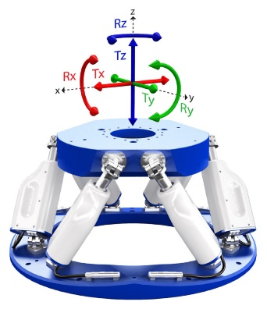
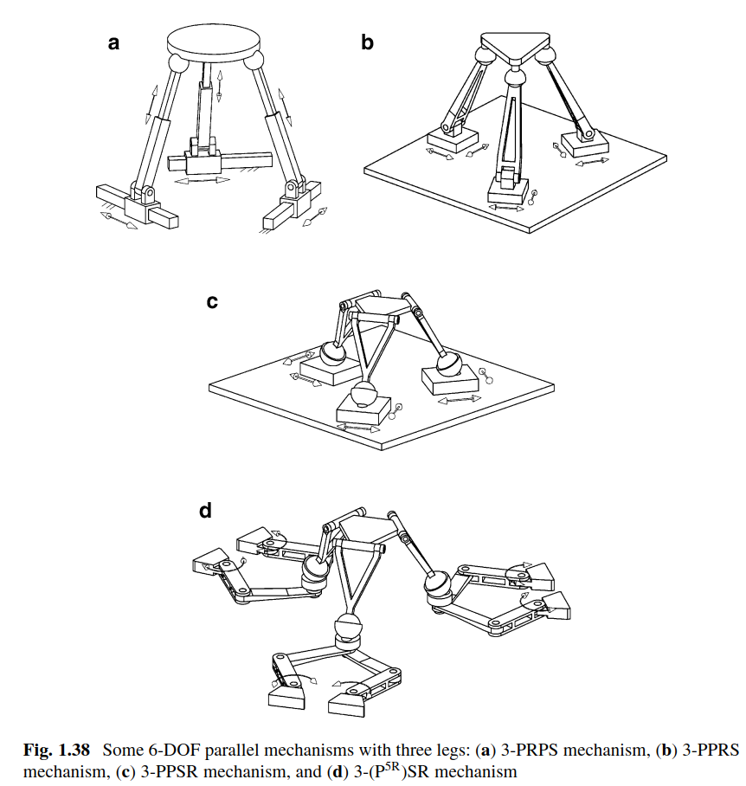
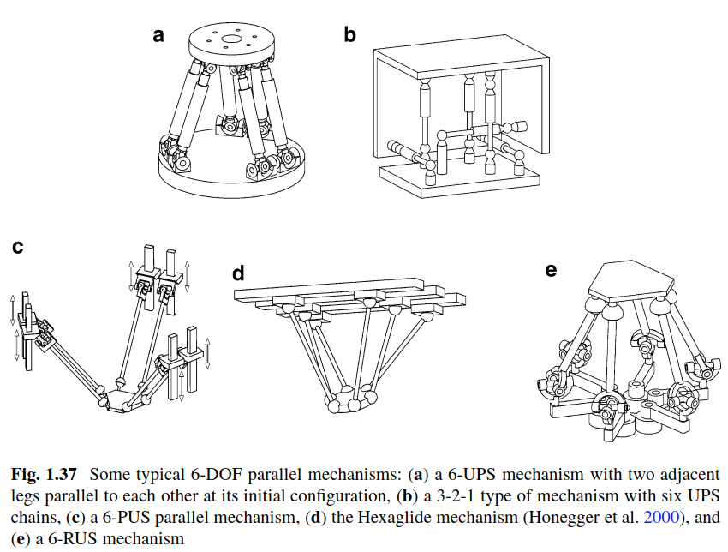
External and internal supporting system
Parallel Mechanisms
6 DOF schemes
Simplicity in adjusting mechanism (push/pull screws) -> no additional actuation systems (hydraulic)
Stiffness -> no length adjustment of the legs
Simplicity of the guide structure (compactness)
Error minimization -> no guides in series
DOI 10.1007/978-3-642-36929-2

Slide 8
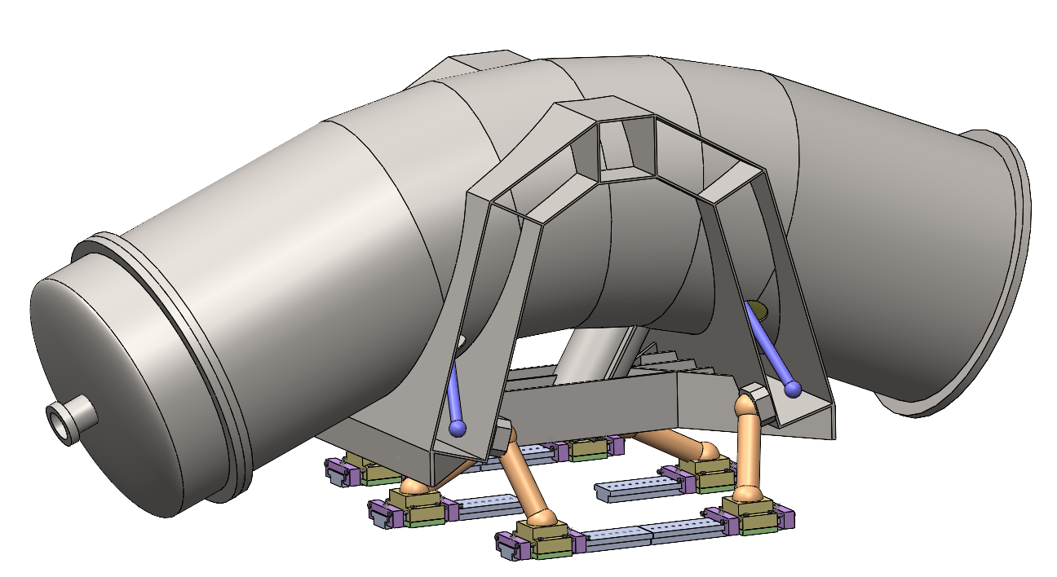
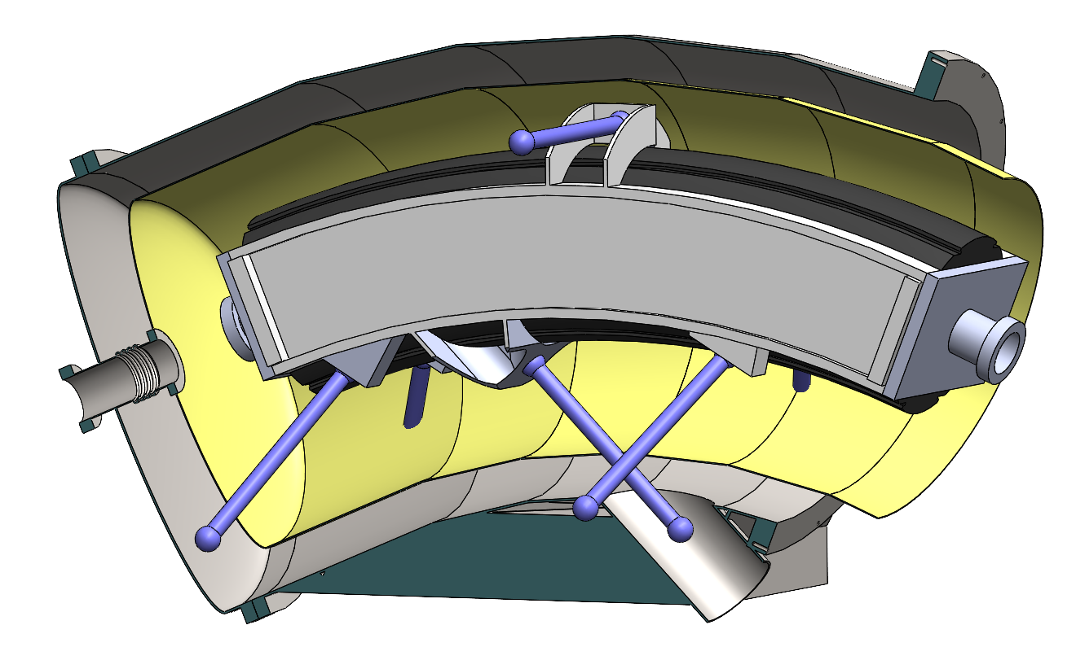
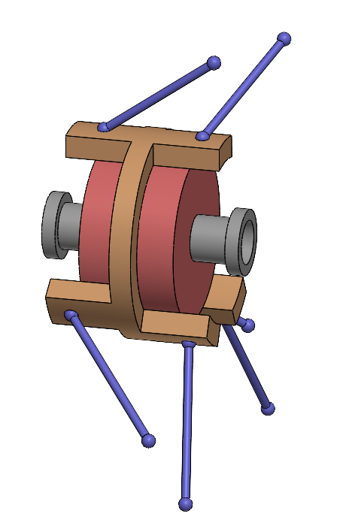
External and internal supporting system
External supports (cryostats and warm components)
**solution not yet integrated
Internal supports (SC dipoles and SC quadrupoles)

Slide 9
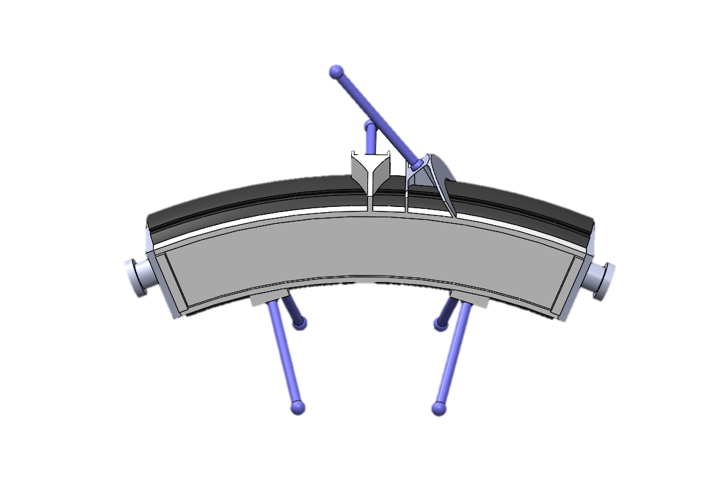
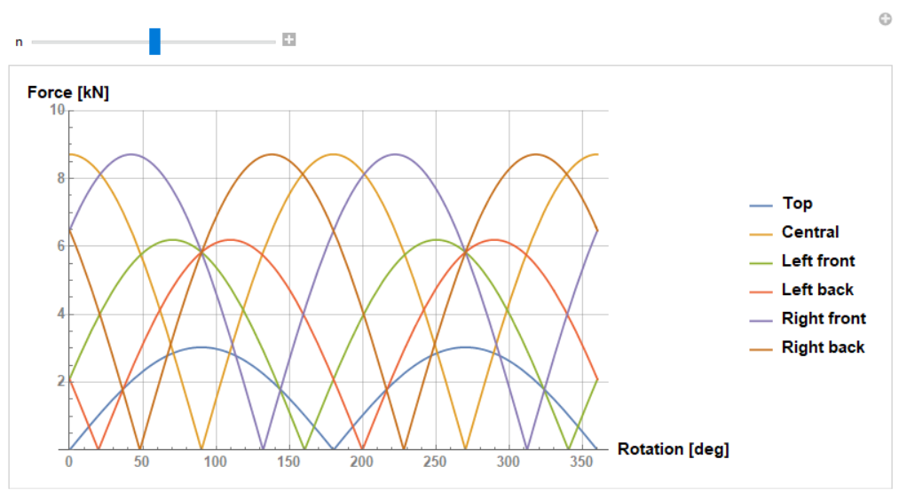
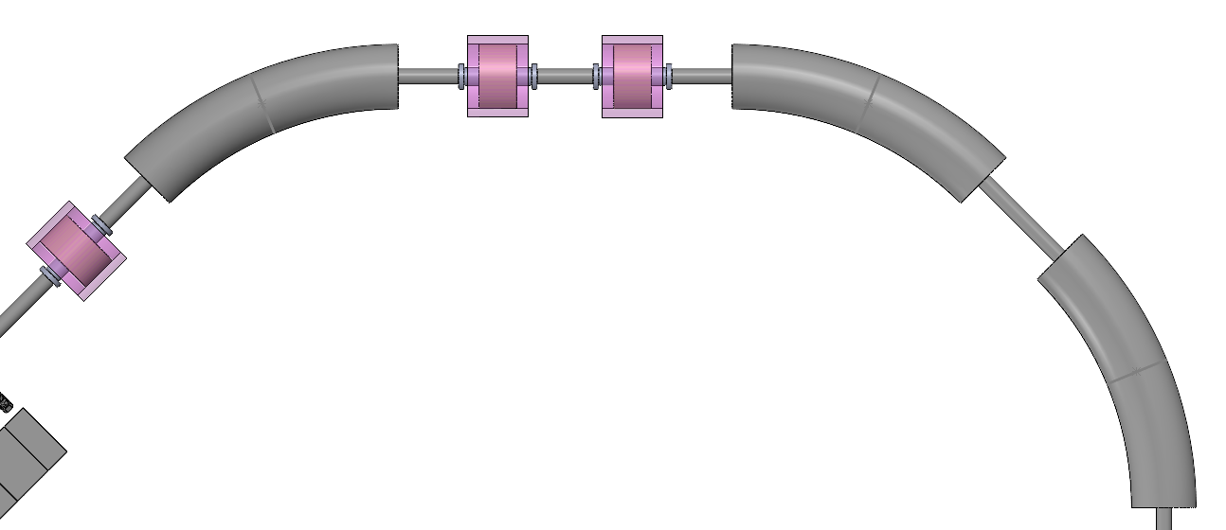
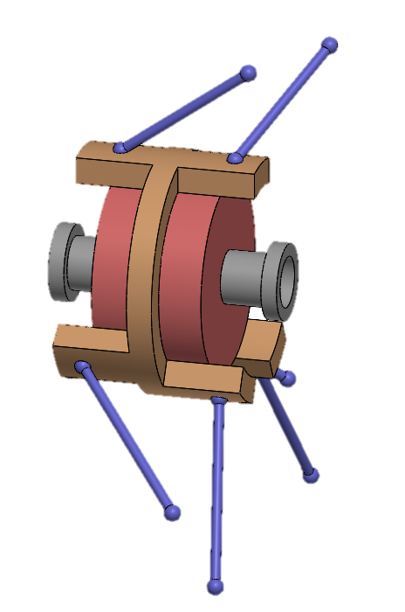
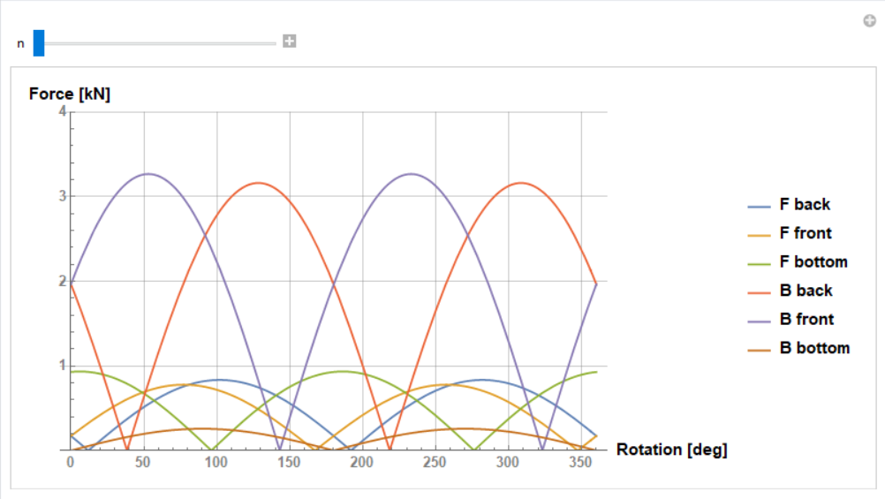
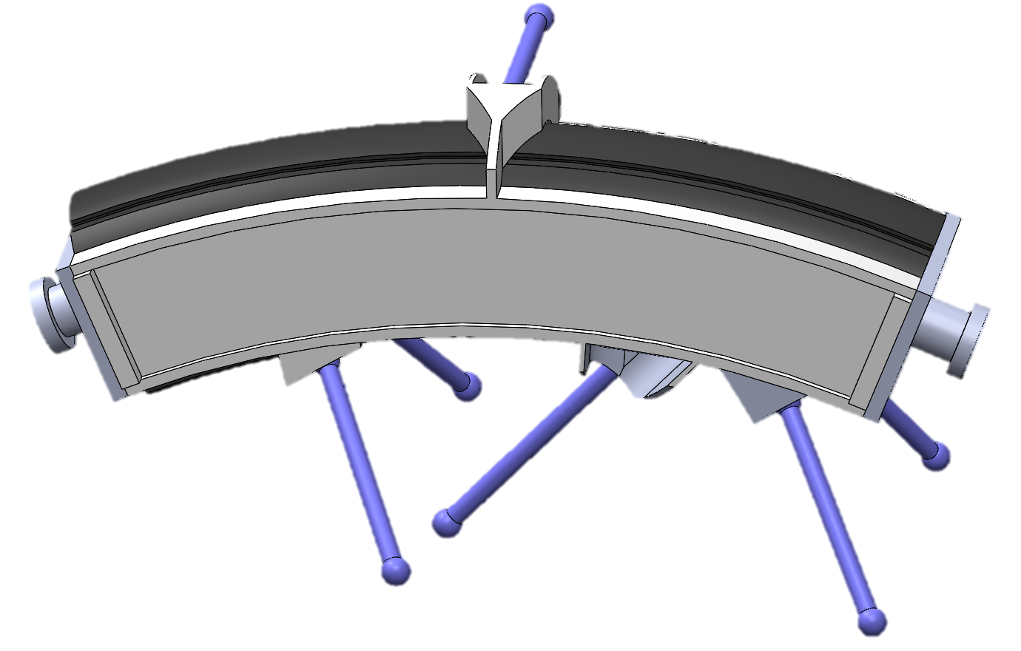
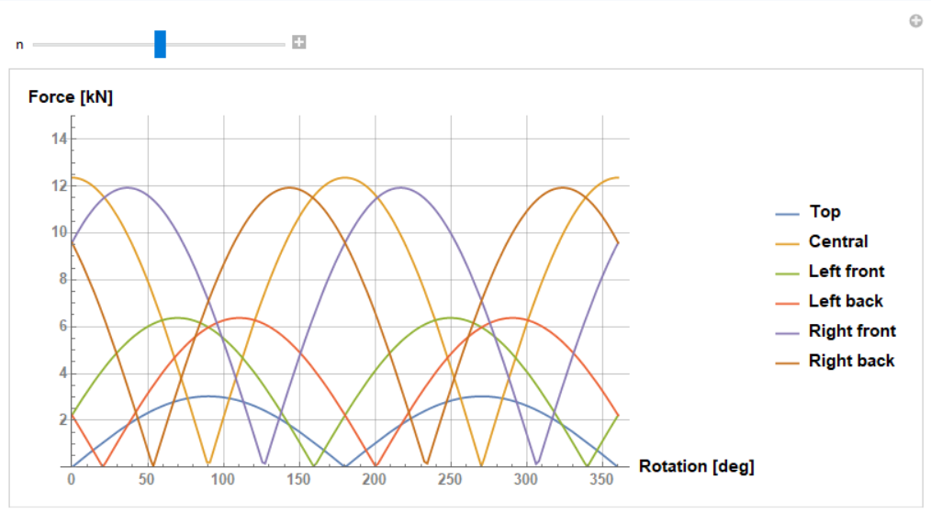
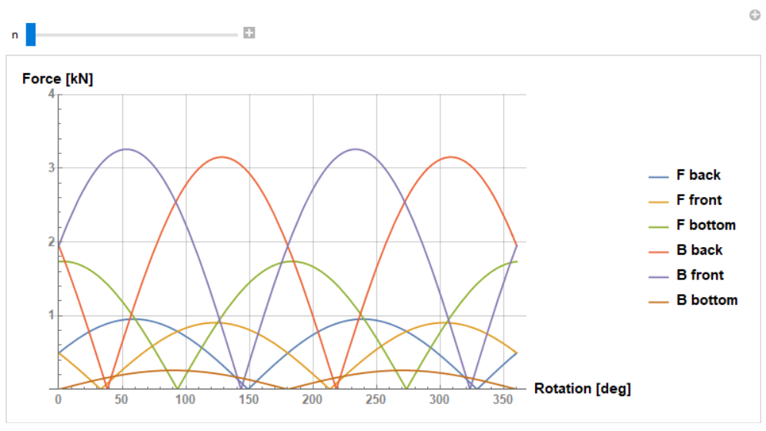
External and internal supporting system
Code for force evaluation
Forces results
Deformation < +- 0.1 mm
Dimensions

Slide 10
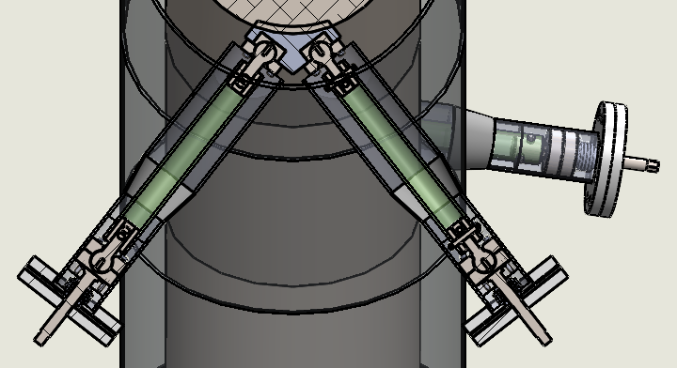
External and internal supporting system
Forces
Rods deformation < +- 0.1 mm
Dimensions
By turning the 6 screws we can adjust all 6 DOF (only passive adjustment is foreseen)
By courtesy of Jānis Vilcāns
*in a preliminary stage
**yet to implement
Required R&D on internal supports thermomechanical behaviour

Slide 11
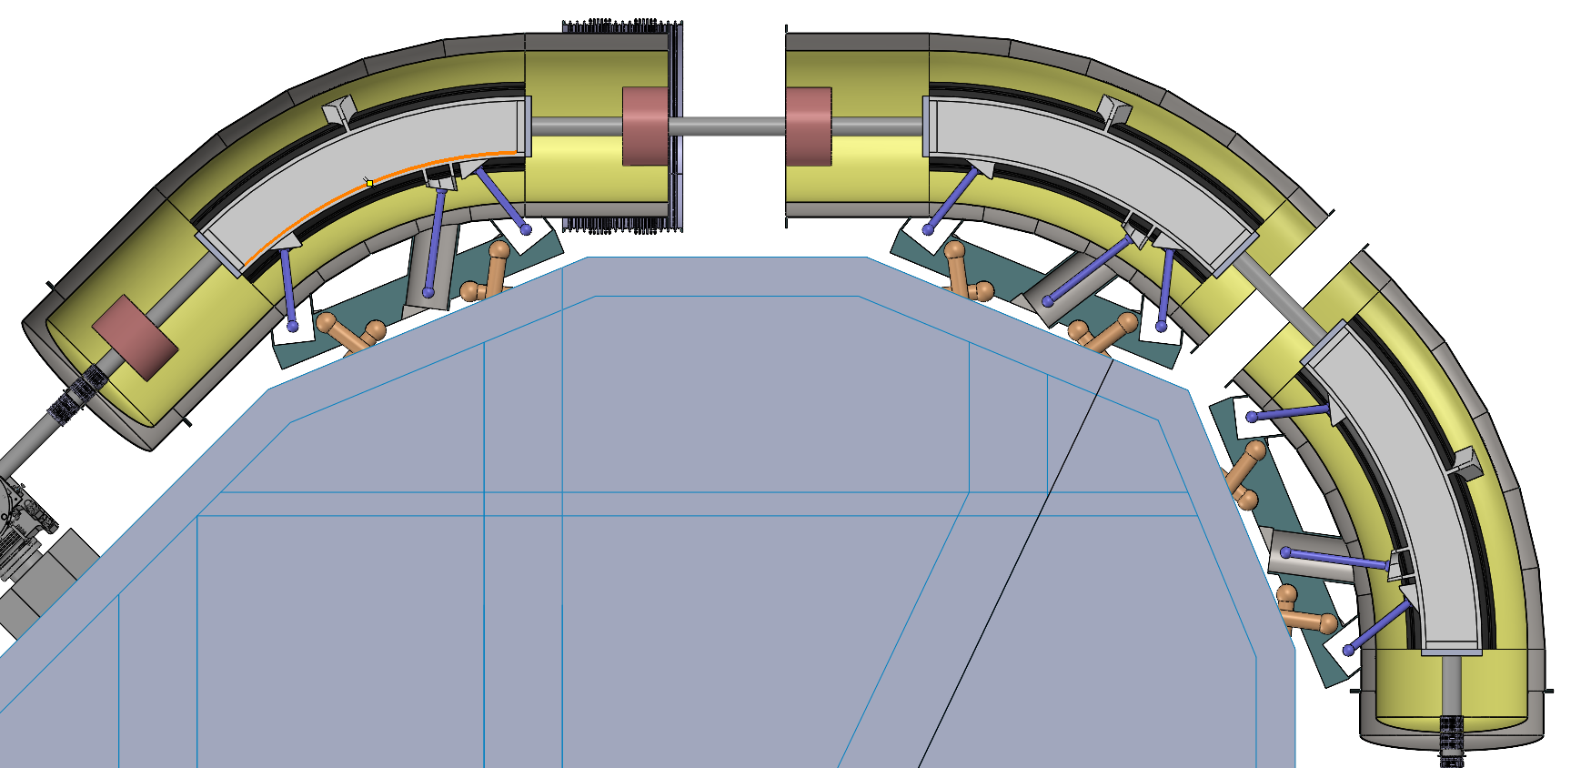
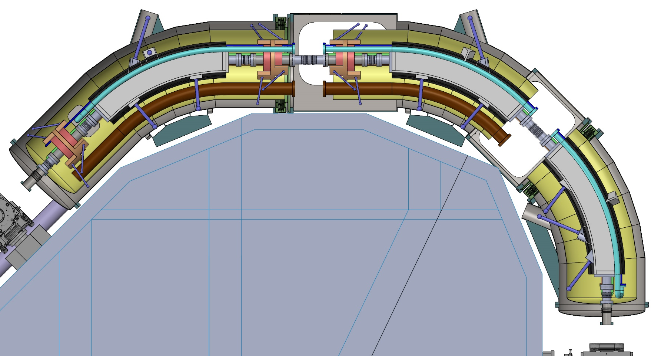
Mechanical integration and insulation vacuum interconnection
Gained space by studying ad hoc leg configuration for dipoles

Slide 12
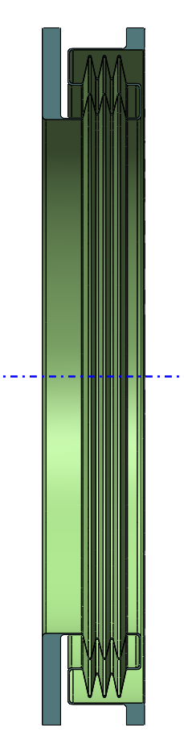

Mechanical integration and insulation vacuum interconnection
Required R&D on a large diameter short bellow:
Stiffness estimation
Impact on the flexibility between the 3 bodies

Slide 13
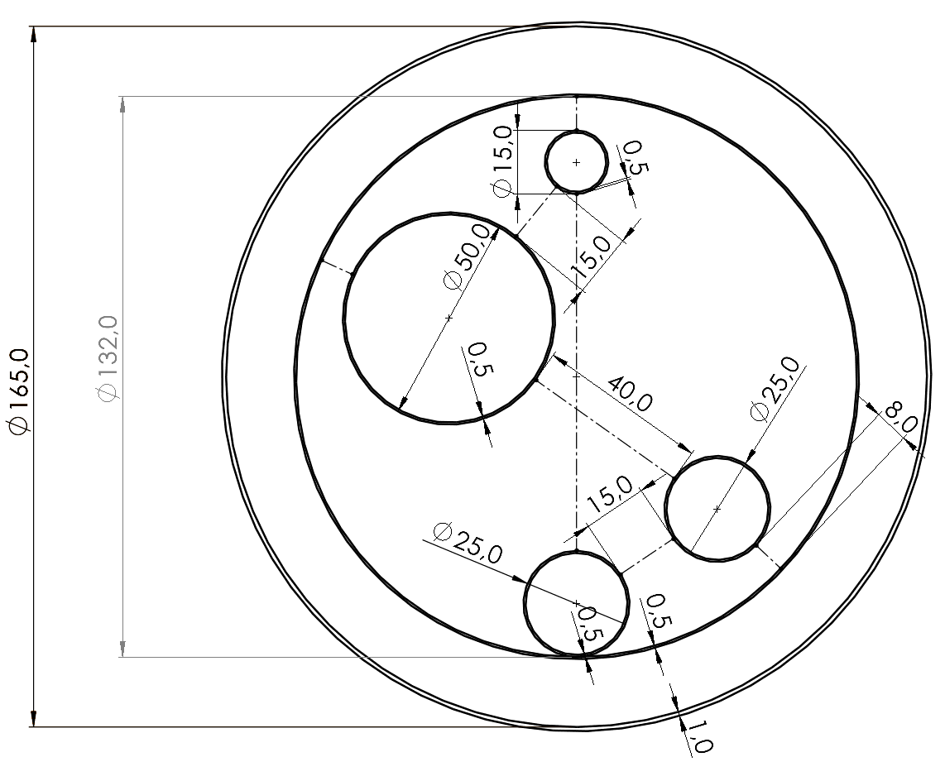
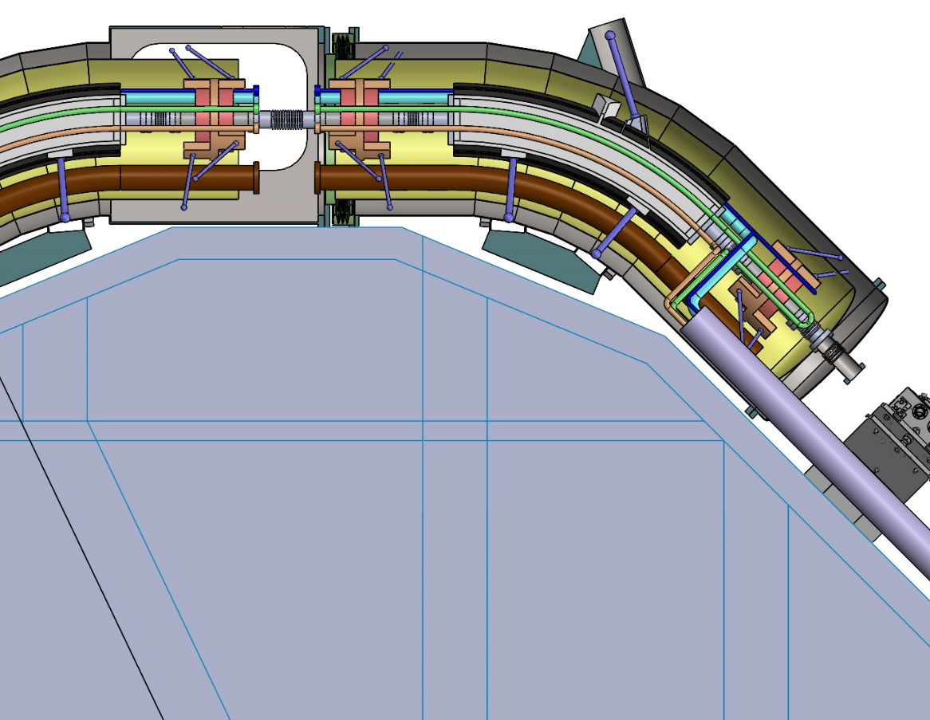
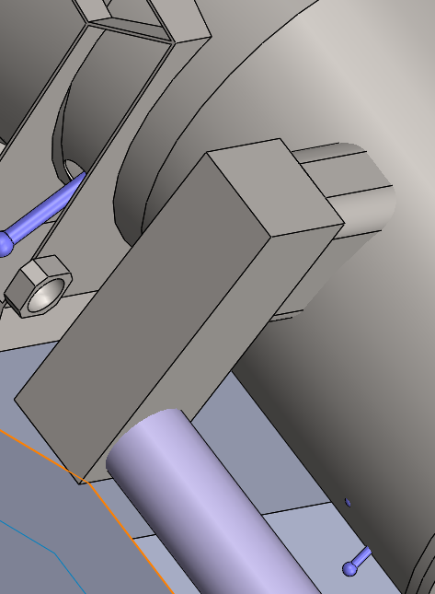
Cryogenic integration
Cold Mass IN
Cold Mass OUT
Thermal Shield OUT
Thermal Shield IN
* Not calculated

Slide 14
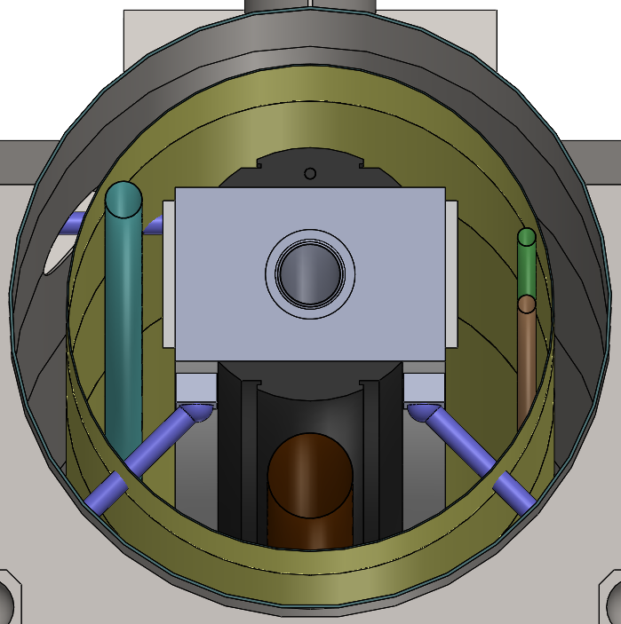
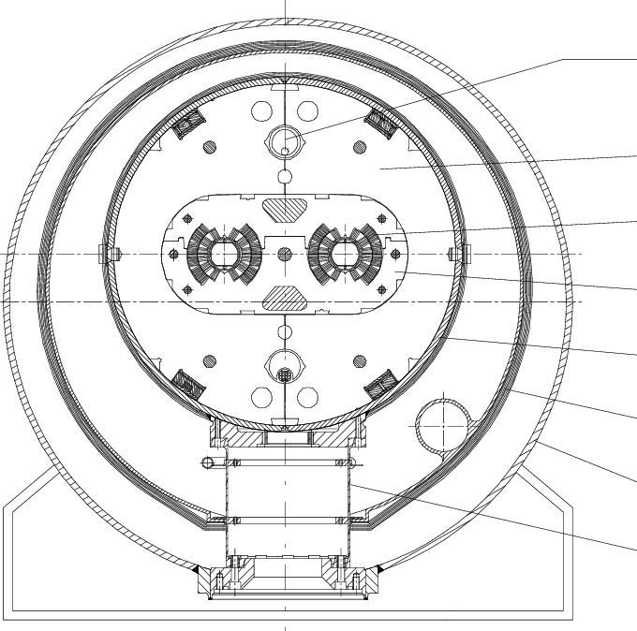
Cryogenic integration
Cold Mass IN
As in LHC, eccentricity is introduced to free space at the bottom
Cold Mass OUT
650 mm
Thermal Shield IN
800 mm
Thermal Shield OUT
Current bus

Slide 15
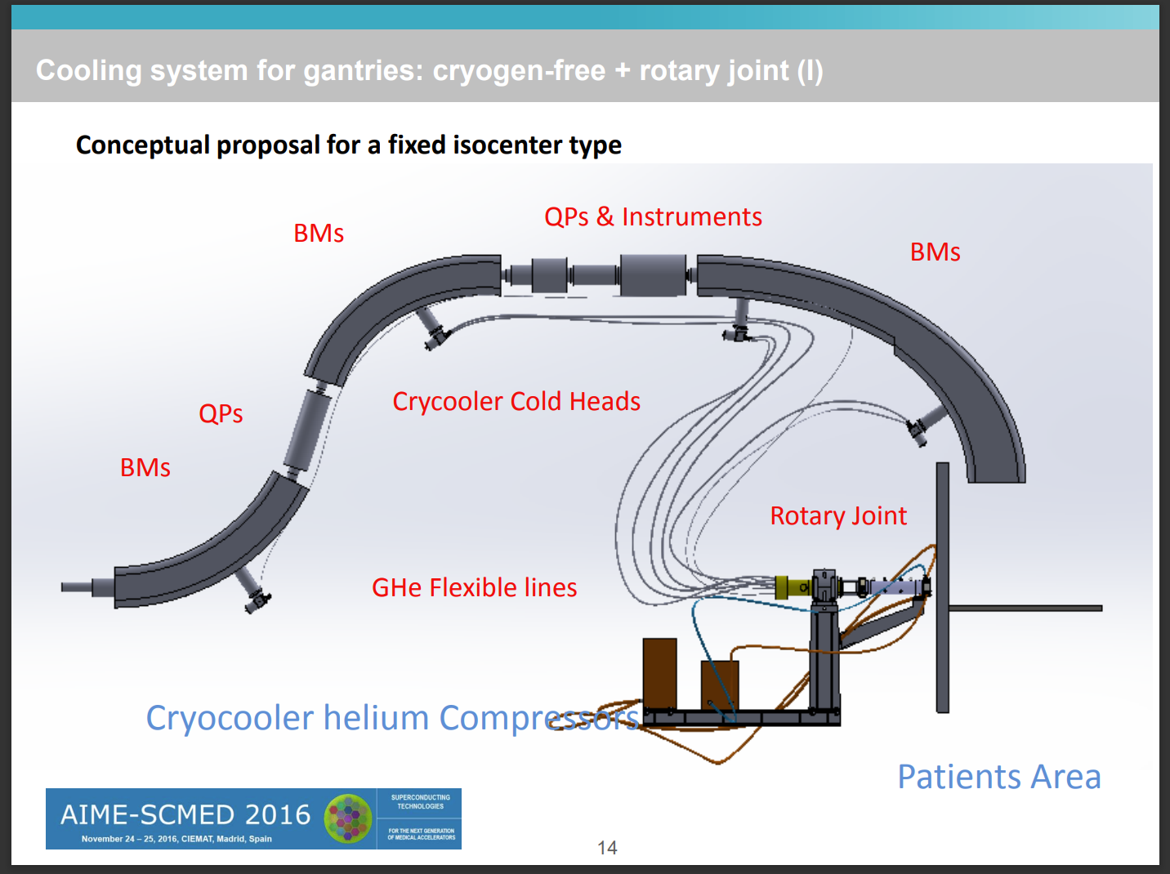
Cryogenic integration
Design and Testing of Real Scale MgB2 Coils for SUPRAPOWER 10 MW Wind Generators (cern.ch)
R&D on cryogenic transfer line flexibility
Rotary joint feasibility?

Slide 16
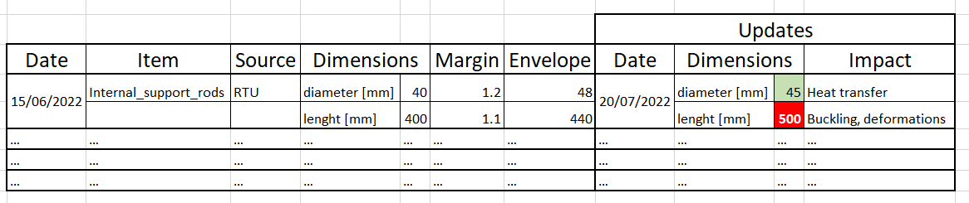
Information transfer/envelope system
Example:
Collect data and updates
Set Margins and Envelopes
Keep track of Impact

Slide 17
Thank you for the attention!

