Slide 1
LSS optics correction with orbit bumps
S. Fartoukh
Acknowledgement: I. Efthymiopoulos and R. de Maria for Python training !
Motivations
Method (including BPM calibration reconstruction, and adaptative damping)
Simulation results for IR5
  b2 imperfections in the IT & Q4/Q5
  BPM calibration errors
  Longitudinal misalignments
  30 cm vs. 60 cm correction
  Finite BPM resolution
  Everything together
Next steps

Slide 2
Motivation
Develop alternative to AC-dipole, not necessarily more precise but
1) Usable by any EiC, as for closed orbit measurement & correction
2) Focused on local optics correction to ease commissioning
→ e.g. LHC low-beta triplet and matching section
3) In particular suitable to the LHC telescopic optics era
→ same Q4/Q5/IT correction, so-called “local correction” when operating at constant pre-squeezed optics but varying tele-index.

Slide 3
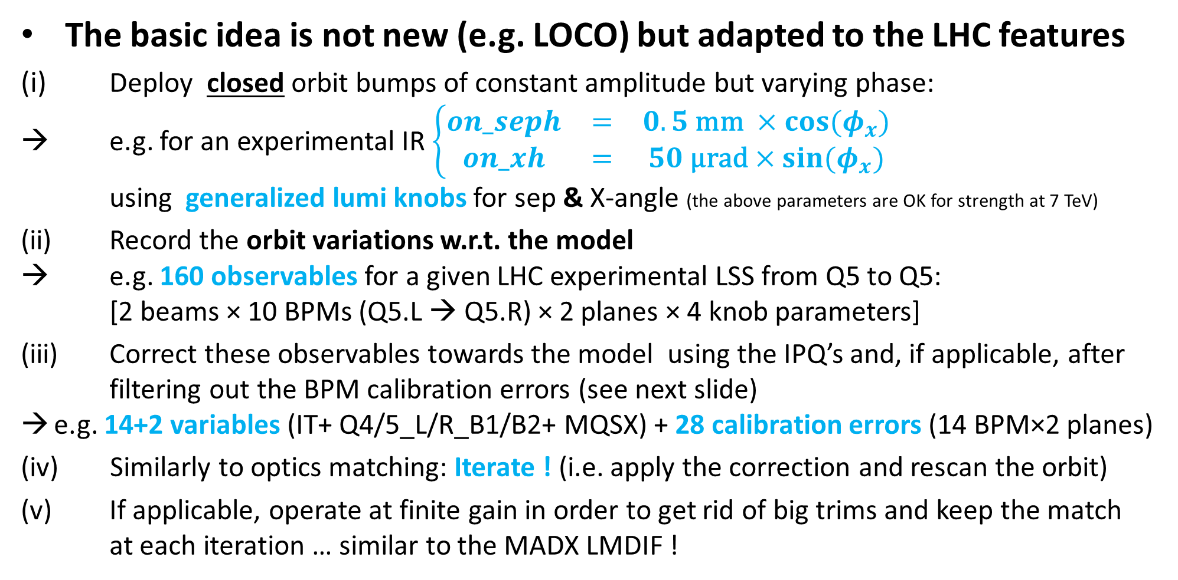
Method (1/2)
The basic idea is not new (e.g. LOCO) but adapted to the LHC features
(i) Deploy closed orbit bumps of constant amplitude but varying phase:
→ e.g. for an experimental IR $\left\{\begin{matrix}on_seph & = & 0.5 \text{mm} ×cos⁡(φ_{x}) \\ on_xh & = & 50 \text{μ}\text{rad}×sin⁡(φ_{x})\end{matrix}\right.$
using generalized lumi knobs for sep & X-angle (the above parameters are OK for strength at 7 TeV)
(ii) Record the orbit variations w.r.t. the model
→ e.g. 160 observables for a given LHC experimental LSS from Q5 to Q5:
[2 beams × 10 BPMs (Q5.L → Q5.R) × 2 planes × 4 knob parameters]
(iii) Correct these observables towards the model using the IPQ’s and, if applicable, after filtering out the BPM calibration errors (see next slide)
e.g. 14+2 variables (IT+ Q4/5_L/R_B1/B2+ MQSX) + 28 calibration errors (14 BPM×2 planes)
Similarly to optics matching: Iterate ! (i.e. apply the correction and rescan the orbit)
(v) If applicable, operate at finite gain in order to get rid of big trims and keep the match at each iteration … similar to the MADX LMDIF !

Slide 4
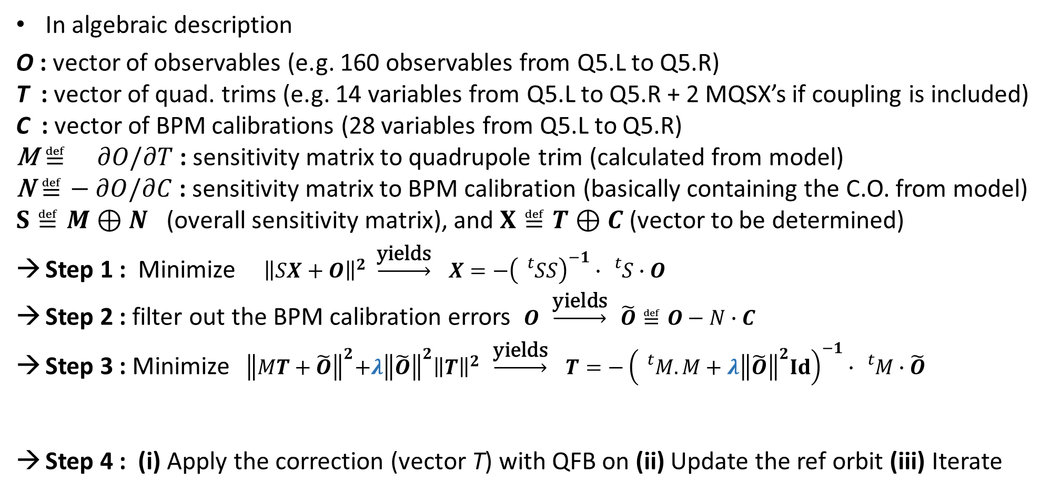
Method (2/2)
In algebraic description
O : vector of observables (e.g. 160 observables from Q5.L to Q5.R)
T : vector of quad. trims (e.g. 14 variables from Q5.L to Q5.R + 2 MQSX’s if coupling is included)
C : vector of BPM calibrations (28 variables from Q5.L to Q5.R)
$\text{M}≝ ∂O/∂T$ : sensitivity matrix to quadrupole trim (calculated from model)
$\text{N}≝− ∂O/∂C$ : sensitivity matrix to BPM calibration (basically containing the C.O. from model)
$S≝M⊕N$ (overall sensitivity matrix), and $X≝T⊕C$ (vector to be determined)
Step 1 : Minimize ${ \left\|SX+O\right\|}^{2} \underset{→}{\text{yields}} X={−\left({}_{}^{t}{SS}\right)}^{−1}∙{}_{}^{t}{S∙O}$
Step 2 : filter out the BPM calibration errors $O \underset{→}{\text{yields}} \tilde{O}≝O−N∙C$
Step 3 : Minimize ${ \left\|MT+\tilde{O}\right\|}^{2}+λ{\left\|\tilde{O}\right\|}^{2}{\left\|T\right\|}^{2} \underset{→}{\text{yields}} T={−\left({}_{}^{t}M.M+λ{\left\|\tilde{O}\right\|}^{2}Id\right)}^{−1}∙{}_{}^{t}{M∙\tilde{O}}$
Step 4 : (i) Apply the correction (vector T) with QFB on (ii) Update the ref orbit (iii) Iterate
Adaptative damping (typically λ × dim(T) set to 2%→ 0.5% @ β*=60 →30 cm)

Slide 5
Simulations
New madx and F77 tools have been created, and a battery of cases has been simulated (no coupling yet, nor COD errors)
100 seeds generated in each case,
optics and machine parameters recorded after each iteration (5 iterations played for each seed of each case)
Case | Description (100 seeds generated) | Case-a) β*=60 cm w/o damping (λ =0) | Case-b) β*=60 cm with damping (λ × dim(T)=2%) | Case-c) β*=30 cm with damping (λ × dim(T)=0.5%)
#1 | B2 field errors in MQX (random of 15 units r.m.s truncated at 3 σ) Q4/Q5 (random of 30 units r.m.s truncated at 3 σ)
#2 | Idem adding BPM calibration errors but no filtering Systematic of 2% r.m.s truncated at 1.5 σ Random of 2% r.m.s. truncated at 3 σ
#3 | Idem with filtering out of the BPM calibration errors
#4 | Idem adding longitudinal misalignments +/- 2.5 cm ptp for the MQX and Q4/Q5 (truncated at 3 σ)
#5 | Idem adding finite BPM resolution (10 μm r.m.s.)
#6 | Idem but Doros @ Q1 (ζ =1 μm r.m.s.)
#7 | Idem but Doros @ Q1 & Q5 (ζ =1 μm r.m.s.)

Slide 6
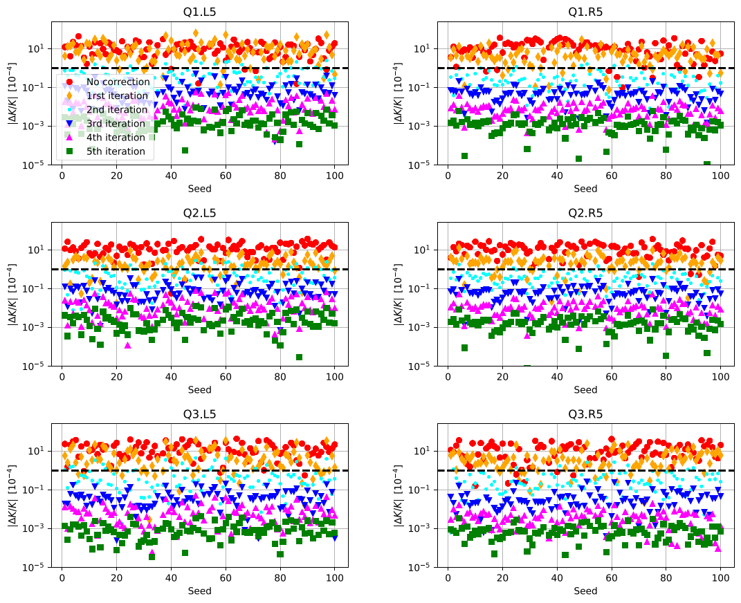
Case 1-a: Triplet correction @ 60 cm (no damping)
The 1 unit precision
level is reached at
the ~ 2nd – 3rd iteration
But slight overshoot on
Q1 at the 1^{rst} iteration

Slide 7
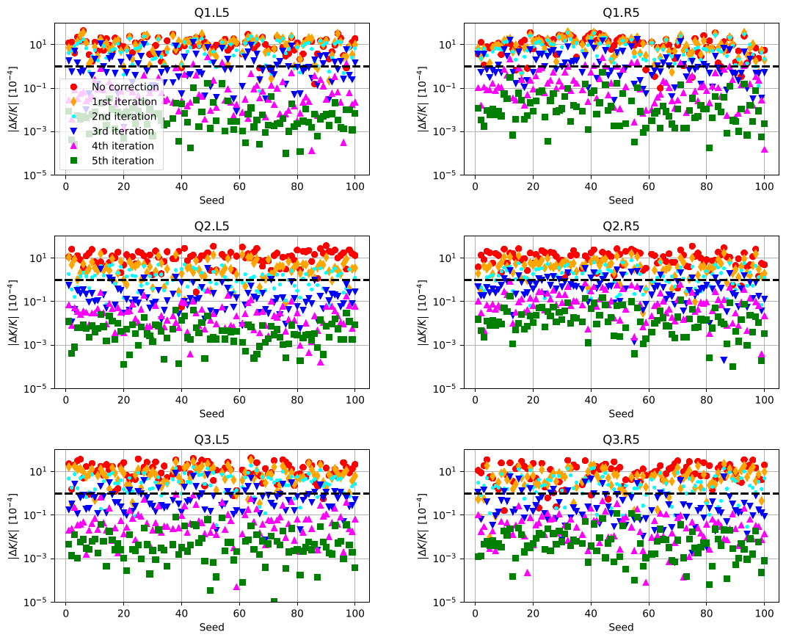
Case 1-b: Triplet correction @ 60 cm with 2% damping
The 1 unit precision
level is reached at
the ~ 3rd – 4th iteration
Slower convergence
but no over-shoot

Slide 8
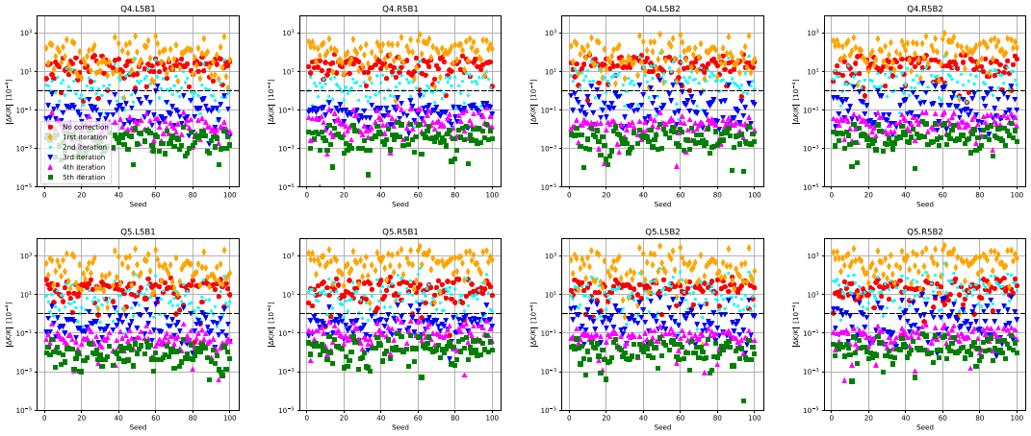
Case 1-a: Q4/Q5 correction @ 60 cm (no damping)
The 1 unit precision level is reached at the ~ 3rd – 4th iteration, but big over-shoots (up to 1000’s of units !) at the 1^{rst} iteration

Slide 9
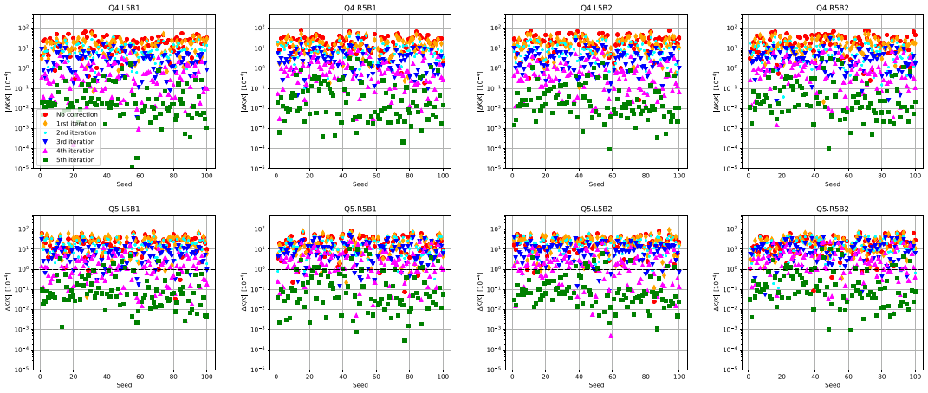
Case 1-b: Q4/Q5 correction @ 60 cm with 2% damping
No over-shoot but slower convergence: 4-5 iterations, maybe one more, are needed for the 1 unit precision level

Slide 10
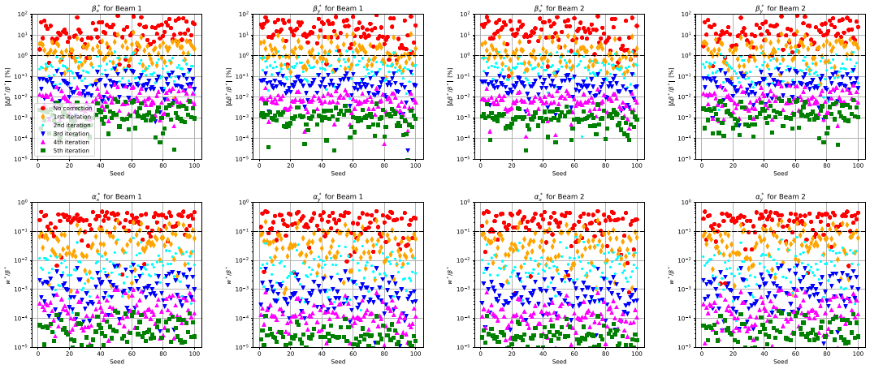
Case 1-a: β* and α* @ 60 cm (no damping)
Excellent optics correction already at the ~ 2nd iteration: Δβ*/β* < 1% & Δw*/β* = α* /(1+ α^{*2}) << 10 %

Slide 11
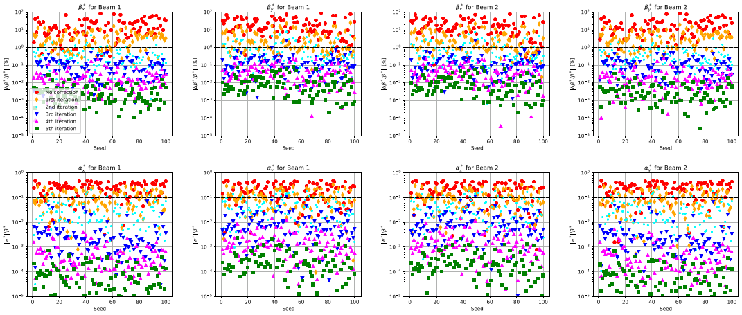
Case 2-a: β* and α* @ 60 cm with 2% damping
Slower convergence. The “state of the art” is reached ~ 3rd – 4th iteration

Slide 12
From now on, damping will always be
implemented in the correction algorithm
(see step 3 in slide 4)
Next: Impact of finite BPM calibration errors
(on top of the rest)

Slide 13
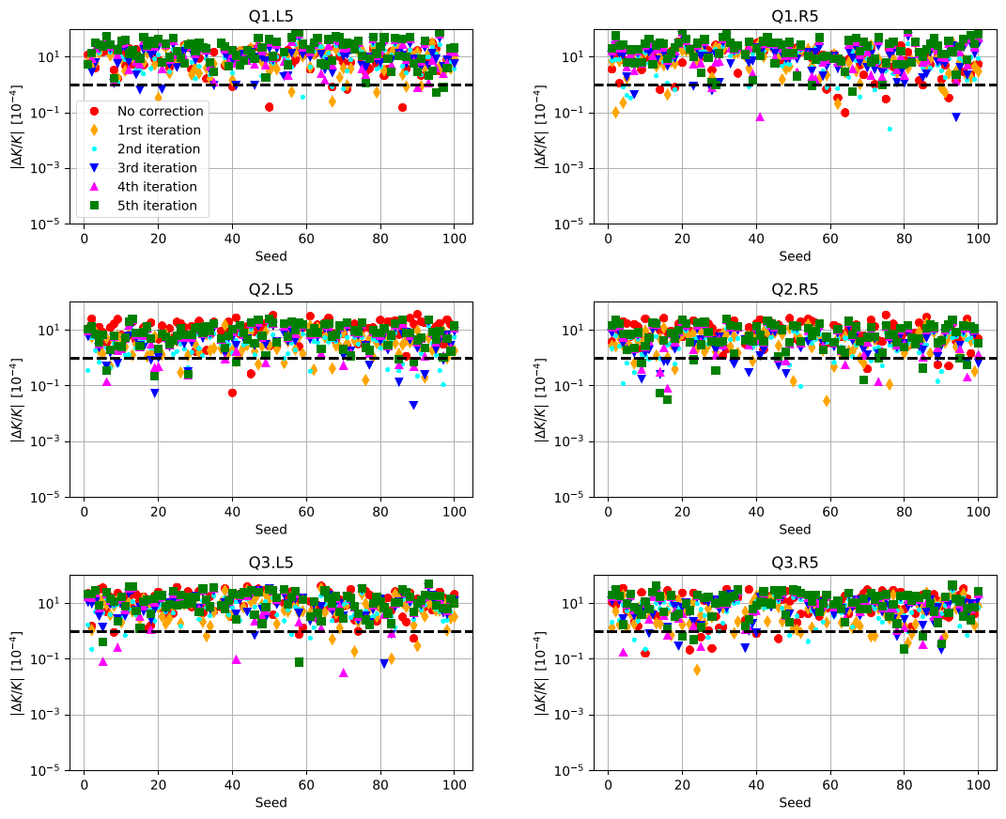
Case 2-b: Triplet correction @ 60 cm (with BPM calib. errors but not fitted)
The BPM calibration errors need to be reconstructed
It does not work !

Slide 14
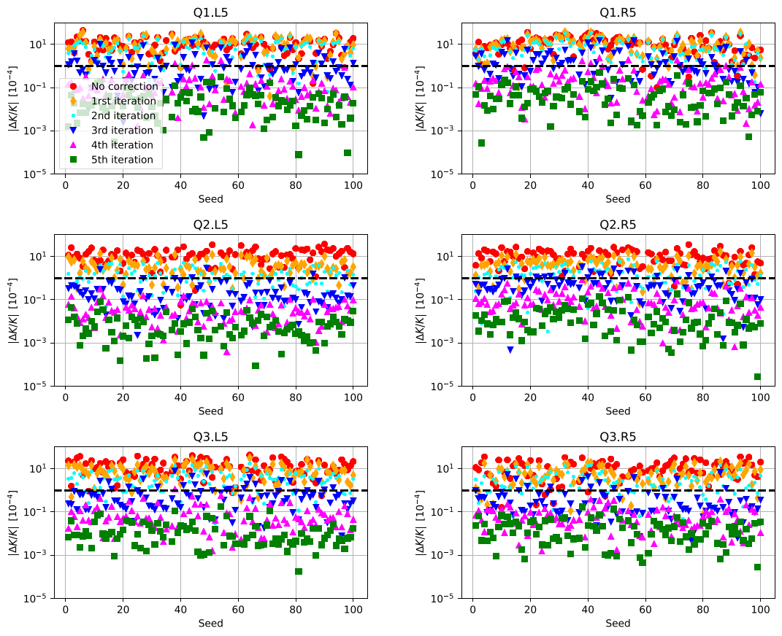
Case 3-b: Triplet correction @ 60 cm (filtering out the BPM calib. errors)
The 1 unit precision
level is reached at
the ~ 3rd – 4th iteration
Very similar to case 1b (w/o BPM calibration errors, see slide 7)

Slide 15
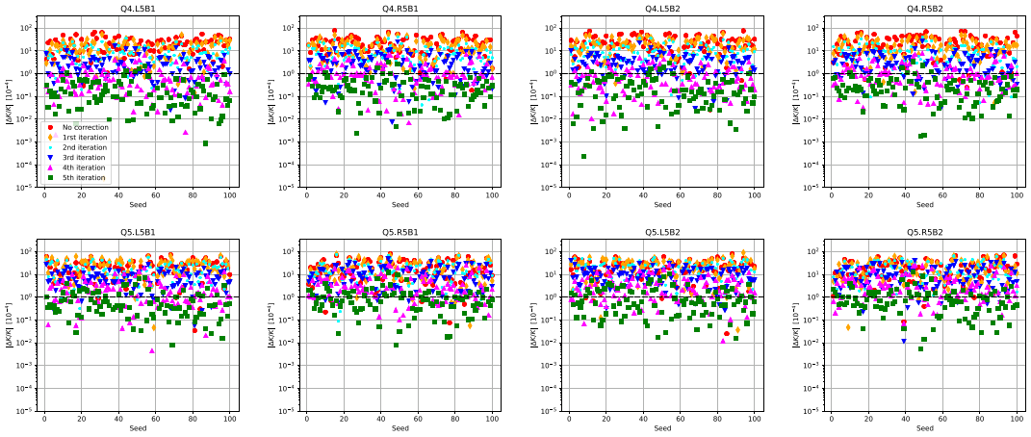
Case 3-b: Q4/Q5 correction @ 60 cm (filtering out the BPM calib. errors)
The 1 unit precision level is reached at the ~ 5th iteration for Q4, maybe a 6th iteration needed for Q5,
but overall very similar to case 1-b (see slide 9)

Slide 16
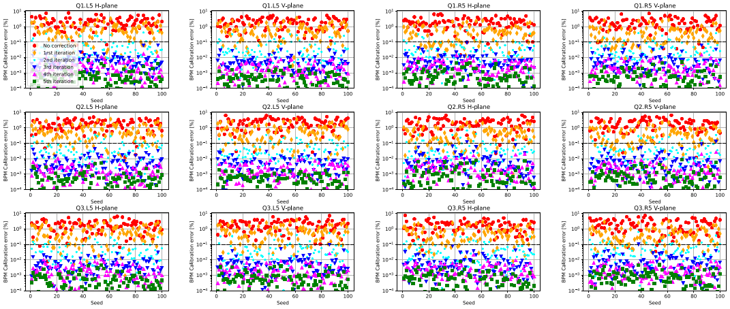
Case 3-b: IT BPM calibration reconstruction @ 60 cm
As of the 3rd iteration, the BPM calibration errors can be reconstructed with a precision better than 0.1%

Slide 17
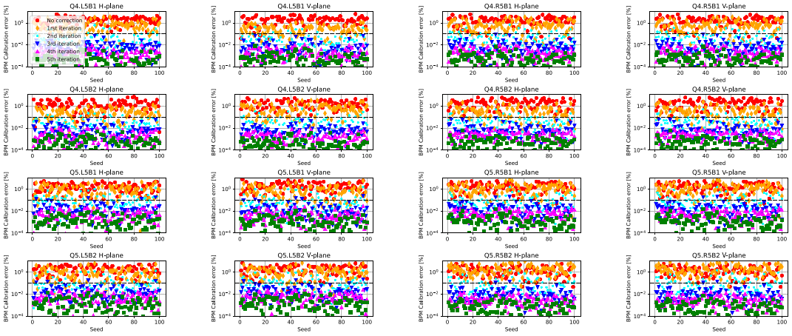
Case 3-b: Q4/Q5 BPM calibration reconstruction @ 60 cm
As of the 3rd - 4th iteration, the BPM calibration errors can be reconstructed with a precision better than 0.1% for the BPMs @ Q4 and Q5

Slide 18
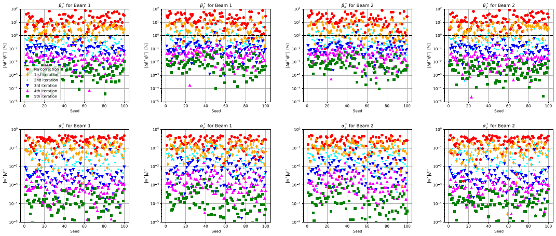
Case 3-b: β* and α* @ 60 cm (filtering out the BPM calib. errors)
The “state of the art” optics correction is reached at the 3rd – 4th iteration. Again very similar to case 1b (compare with slide 11)

Slide 19
From now on, BPM calibration errors will
be assumed & filtered out from the observables
(see step 2 in slide 4)
Next: Impact of magnet longitudinal misalignments
(on top of the rest)

Slide 20
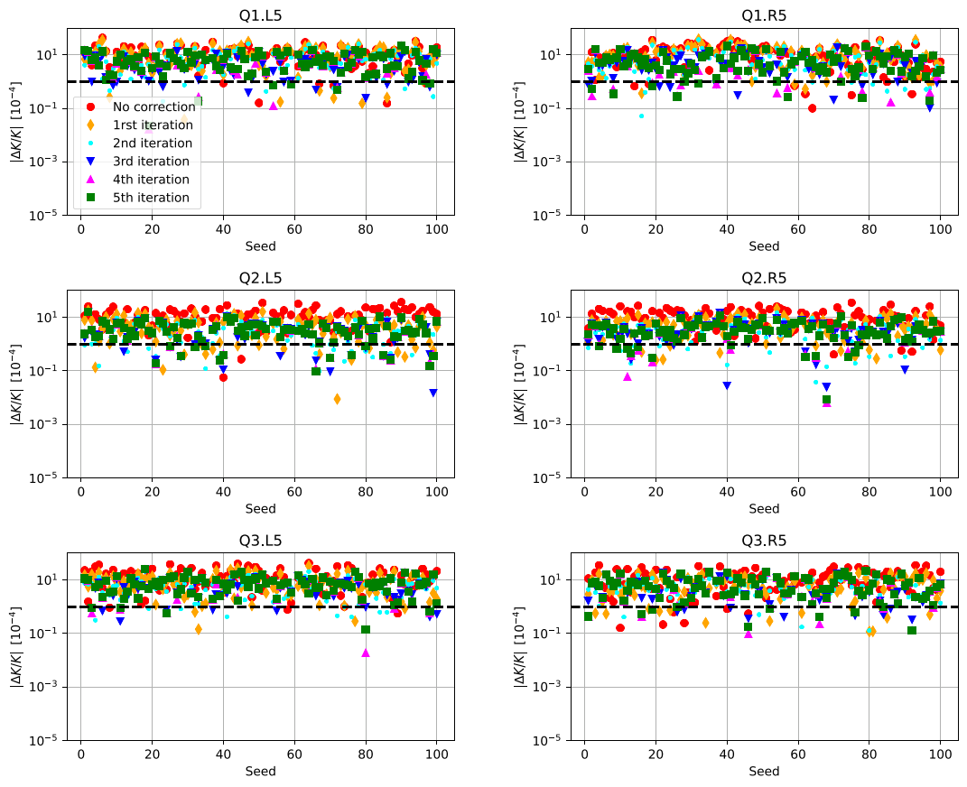
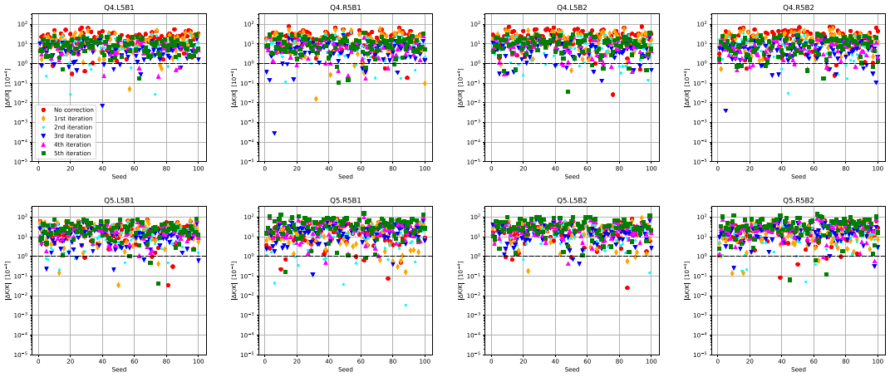
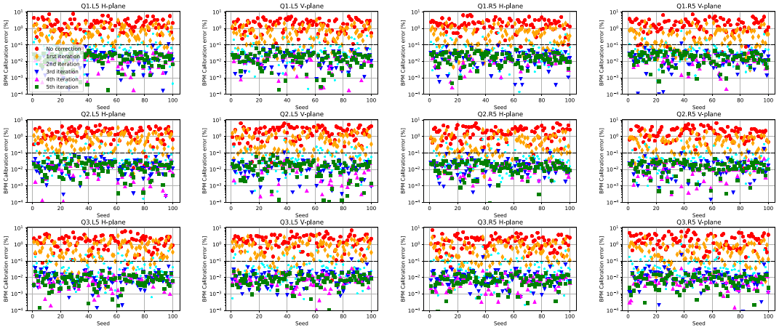
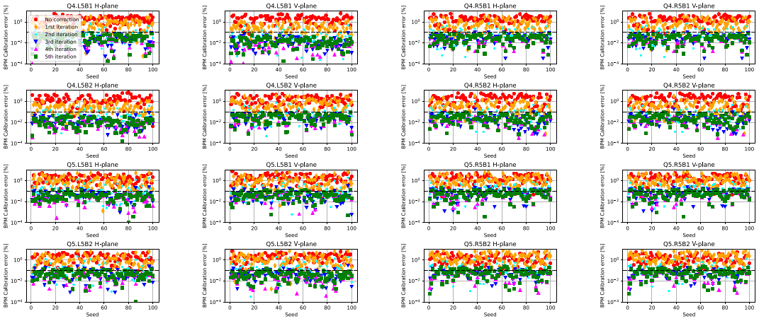
Case 4-b: Triplet & Q4/Q5 “matching” @ 60 cm (with long. misalign.)
IT
Q4/Q5
BPM
BPM
The correction become effective (~optics re-matching), although the magnet misalignments could also in principle be reconstructed (to feed-fwd the model). The BPM calibration reconstruction still work (<0.1% at the 4th – 5th iteration)

Slide 21
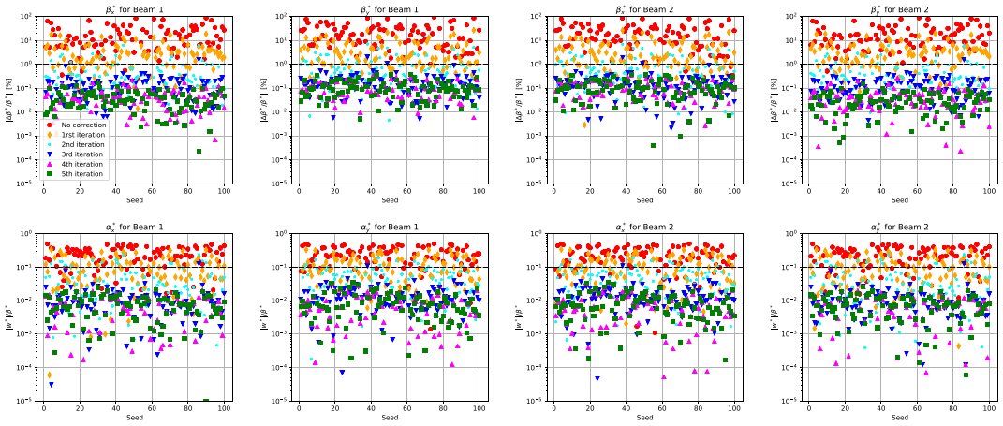
Case 4-b: β* and α* @ 60 cm (with longitudinal misalignement)
The “state of the art” optics correction is reached at the 3rd – 4th iteration, where the precision improvement saturates:
only 14 variables for 16 constraints (twiss parameters at the IP and bump closure location)
.. like in an optics matching when #knobs < #constraints

Slide 22
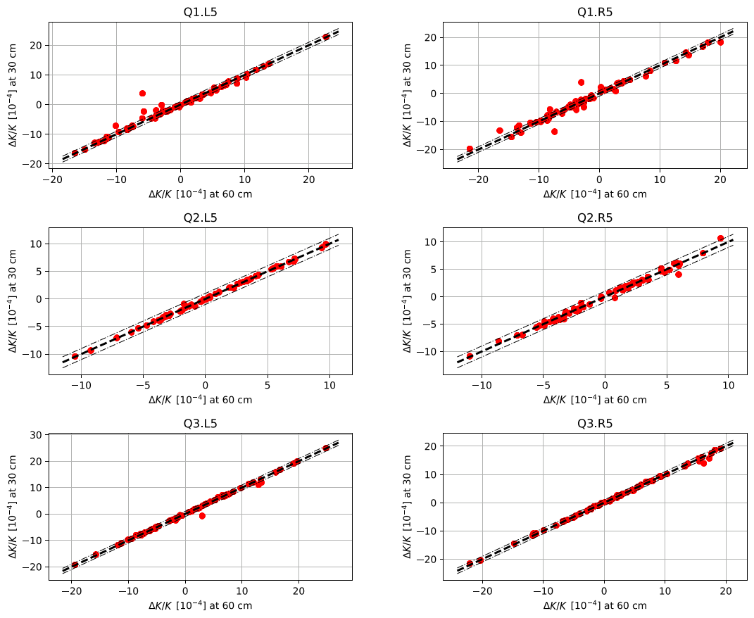
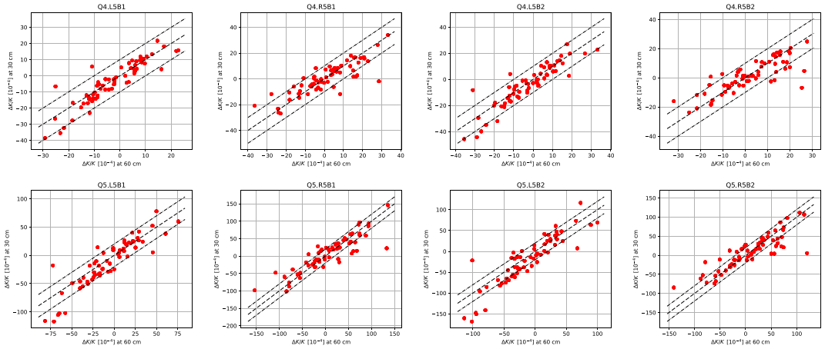
Case 4-b vs. 4-c: IT & Q4/Q5 matching @ 60 cm & 30 cm
IT strength at the 5th iteration
Q4/Q5 strength at the 5th iteration
@ 30 cm
@ 60 cm
Excellent correlation within +/- 1 units !
(with some out-layers for Q1)
Good correlation within +/- 10 (20) units for Q4 (Q5)

Slide 23
From now on, longitudinal misalignments
will be assumed for the IT and Q4/Q5
(+/- 2.5 cm ptp, see slide 5)
Next: Impact of finite BPM resolution
(on top of the rest)

Slide 24
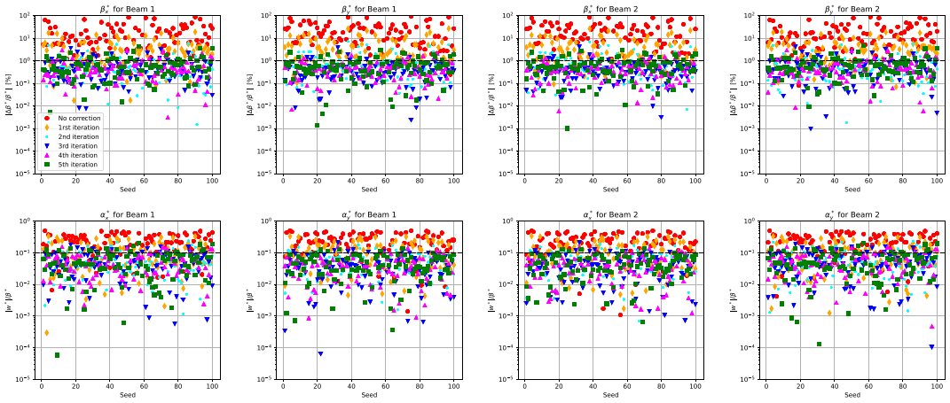
Case 5-b: β* and α*@ 60 cm (with ξ=10 μm r.ms. for the BPM resolution)
ξ=10 μm r.ms. is a bit too much for the BPM resolution

Slide 25
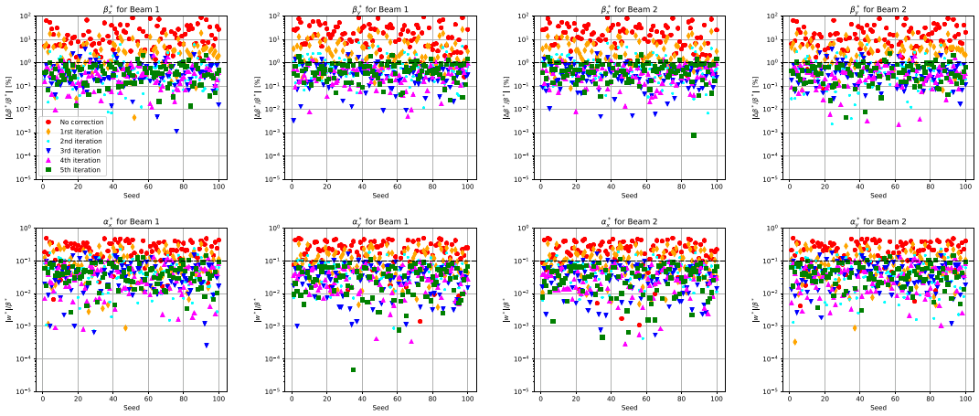
Case 6-b: β* and α*@ 60 cm (with ξ=10 μm r.ms. but ξ=1 μm @Q1 with DOROS )
Using DOROS for the BPMs @ Q1 (ξ=1 μm r.ms.) helps a bit

Slide 26
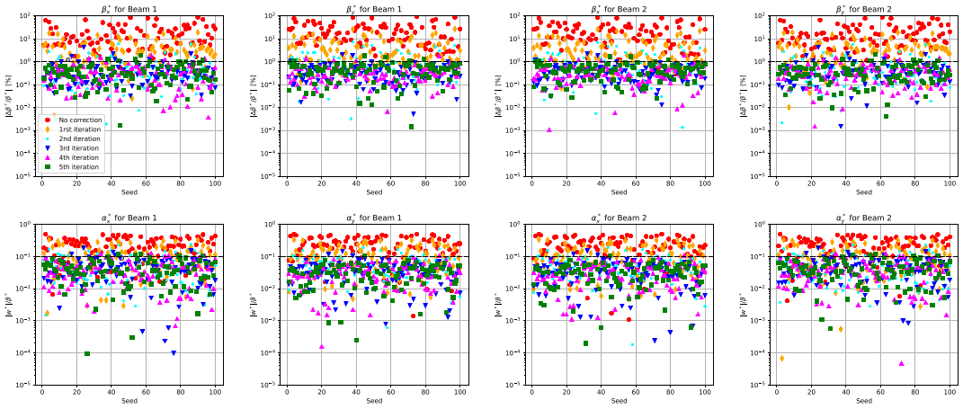
Case 6-b: β* and α*@ 60 cm (with ξ=10 μm r.ms. but ξ=1 μm @Q1&Q5 with DOROS)
Assuming DOROS electronics for the BPMs @ Q5 continues to help

Slide 27
Case 4-b: β* and α* @ 60 cm (for comparison with ξ= 0 μm r.ms.)
.. ξ= 0 μm (i.e. not more than a few μm) for all BPMs is sensibly better

Slide 28
Next steps
Very promising so far
But still some work to complete the tools & simulations with
Coupling correction (and MQSX setting generation)
COD random & systematic errors
a scale factor will be left undetermined: ratio between BPM calibration and COD systematic errors
probably K-mod @Q1 will still be needed to calibrate this factor once a Run, IR by IR
b2/a2 in D1/D2, BPM tilt & azimuthal errors, etc..
Other IRs (optimized bump selection), and extension to the whole ring (??)
Decide if and how to implement and test in the LHC

