Slide 1
Extending GUINEA-PIG with EDM4hep output
Kalina Stoimenova
2022 Summer student
Supervisors: Andre Sailer and Valentin Volkl
EP-SFT group meeting
15.08.2022

Slide 2
Overview
Formation of beam background
The GUINEA-PIG software: simulations, standard input and output
EDM4hep
Developing the new output interface
Main features of the GUINEA-PIG EDM4hep output
15.08.2022 Extending GUINEA-PIG with EDM4hep output Kalina Stoimenova 2

Slide 3
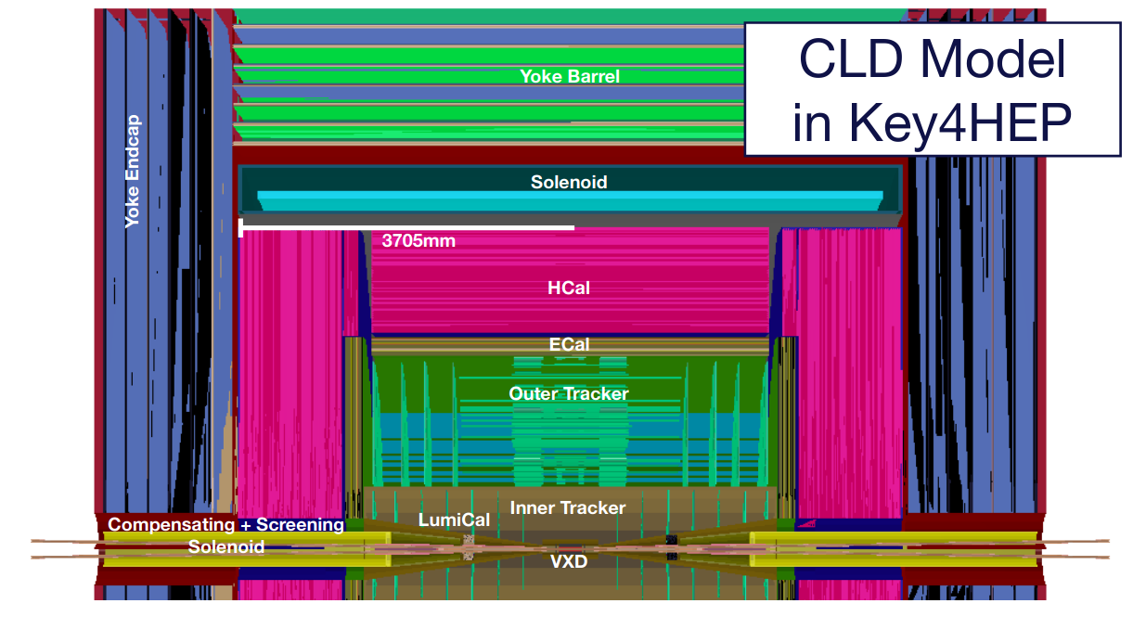
Beamstrahlung and beam background formation
Particle trajectories from dense high-energy bunches are bent due to the EM field
Similarly to synchrotron radiation, photons are emitted → beamstrahlung
  Collimated in a cone with relatively small dimensions around the beam axis → may cause harm to the accelerator
Production of secondary particles (e⁺e⁻ pairs and rarely hadrons) → beam background; particles may enter the detector and need to be simulated for detector studies
  Coherent pair creation: a photon transforms into a electron-positron loop
  Incoherent pair creation: two beamstrahlung photons collide
  Other processes: Bhabha scattering events, trident pairs
e⁺e⁻ pairs
Beamstrahlung
https://indico.cern.ch/event/1064327/contributions/4887414/attachments/2454945/4207762/FCCWEEK2022_ciarma.pdf
15.08.2022 Extending GUINEA-PIG with EDM4hep output Kalina Stoimenova 3

Slide 4
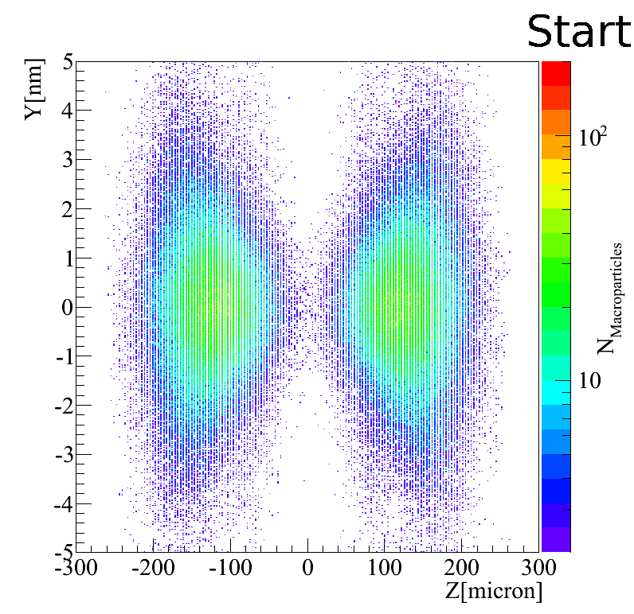
Beam background simulations with GUINEA-PIG
Generator of Unwanted Interactions for Numerical Experiment Analysis – Program Interfaced to GEANT
simulates the background, produced by colliding electron and positron beams
input requires accelerator and simulation parameters
YZ-View of a beam interaction background with density
Animation thanks to Andre Sailer
15.08.2022 Extending GUINEA-PIG with EDM4hep output Kalina Stoimenova 4

Slide 5
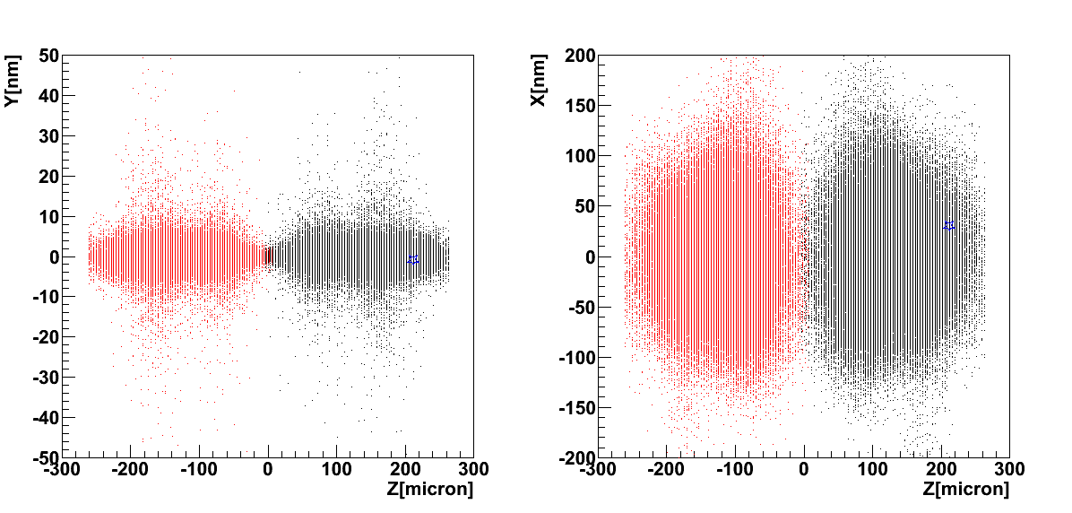
Beam background simulations with GUINEA-PIG
YZ-View and XZ view where a single (macro) particle has been marked with a blue star to show its movement
Animation thanks to Andre Sailer
15.08.2022 Extending GUINEA-PIG with EDM4hep output Kalina Stoimenova 5

Slide 6
GUINEA-PIG output
File | Required flags | Contents
Main output file | - | General information about the simulation
pairs | do_pairs=1; track_pairs=1; store_pairs=1 (do_bhabhas=1 or do_muons=1) | Incoherent pairs, created after the interaction: particle energies, x, y and z betas, x, y and z positions and process index.
beam | store_beam=1 | Two files – particles of the first and second beam: particle energies, x, y and z positions and x and y angles in radians
coh | store_beam=1; do_coherent=1 | Two files – coherent pairs from the first and second beam: particle energies, x, y and z positions and x and y angles in radians
tri | store_beam=1; do_trident=1 | Two files – particles, produced in trident processes: particle energies, x, y and z positions and x and y angles in radians
photons | write_photons=1 | Beamstrahlung photons after the interaction: photon energies, x and y angles in radians
hadrons | do_hadrons=1; store_hadrons=1 | Colliding photons that produce a hadron: photon energies and z of collision
minijets | do_jets=1; store_jets=1 | Energies and momenta of the photons and partons in a jet event
lumi_ee | do_lumi=1 | Colliding particles information for e-e collision: particle energies, x, y and z positions and betas and polarization vectors
lumi_eg | do_lumi=2 | Colliding particles information for e-g collision
lumi_ge | do_lumi=4 | Colliding particles information for g-e collision
lumi_gg | do_lumi=7 | Colliding particles information for g-g collision
15.08.2022 Extending GUINEA-PIG with EDM4hep output Kalina Stoimenova 6

Slide 7
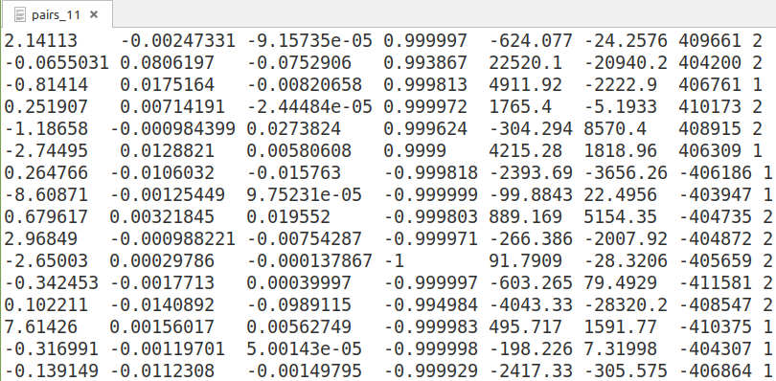
GUINEA-PIG output
pairs | do_pairs=1; track_pairs=1; store_pairs=1 (do_bhabhas=1 or do_muons=1) | Incoherent pairs, created after the interaction: particle energies, x, y and z betas, x, y and z positions and process index.
ASCII-based output format requires additional calculations of the particles' four-momenta
15.08.2022 Extending GUINEA-PIG with EDM4hep output Kalina Stoimenova 7

Slide 8
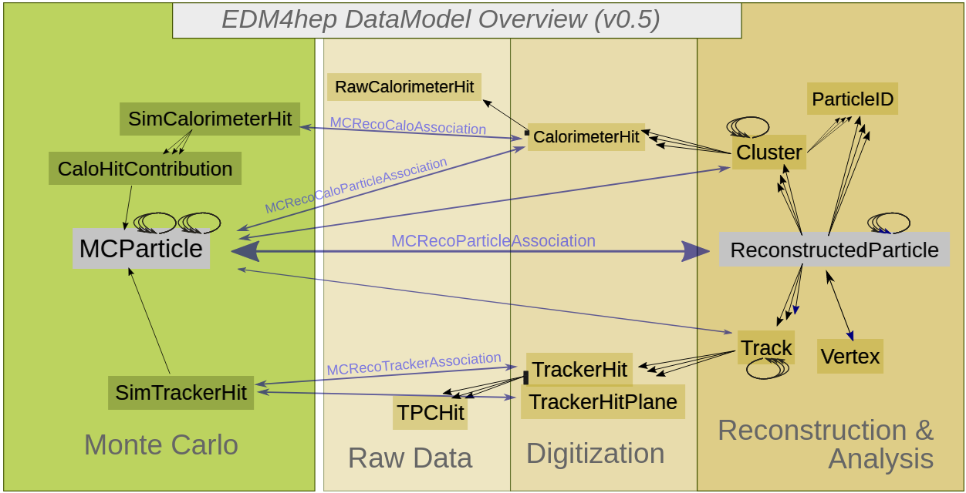
The EDM4hep library
Common data interface for the Key4hep project
PODIO: c++ toolkit for the creation of event data models – creates all EDM code from simple instructive YAML files
MCParticle data type - used to store the simulated background particles
User defined data types – used to store photons, beam particles and luminosities
Allows GUINEA-PIG data to be integrated in the key4hep framework and used for many upcoming studies
https://github.com/key4hep/EDM4hep/blob/master/doc/edm4hep_diagram.svg1
15.08.2022 Extending GUINEA-PIG with EDM4hep output Kalina Stoimenova 8

Slide 9
Developing the EDM4hep output for GUINEA-PIG
FILE_IN_OUT_EDM4HEP class: collection initialization and data saving functions
  switches used to create only the collections that are needed
  pairs (or bhabhas, or muons) and photons saved in MCParticle collections
  user defined collections for all other saved data
EDM4HEPWriter singleton class for creating the root output file and using it throughout the code
FILE_IN_OUT_EDM4HEP functions called throughout the code for saving the simulated particles
15.08.2022 Extending GUINEA-PIG with EDM4hep output Kalina Stoimenova 9

Slide 10
Developing the EDM4hep output for GUINEA-PIG Making the output optional
All of the new EDM4hep writing code limited by the condition that the option is enabled
Users who do not wish to use the new feature have no problem compiling “the old way”
Additional switch added (do_edm4hep=1 in the input file), making the EDM4hep output run-time optional
EDM4hep output stored in output.root file, ASCII files produced as well
The EDM4hep output complements but does not take the place of the original GUINEA-PIG output!
Main output file information stored as event metadata (201 entries)
Compiling GUINEA-PIG with EDM4hep
mkdir build
cd build
cmake .. -DGUINEA_USE_EDM4HEP=ON
C++ code to access metadata:
podio::EventStore store;
auto& MD = store.getEventMetaData() ;
float lumi = MD.getFloatVal( "lumi_ee" ) ;
15.08.2022 Extending GUINEA-PIG with EDM4hep output Kalina Stoimenova 10

Slide 11
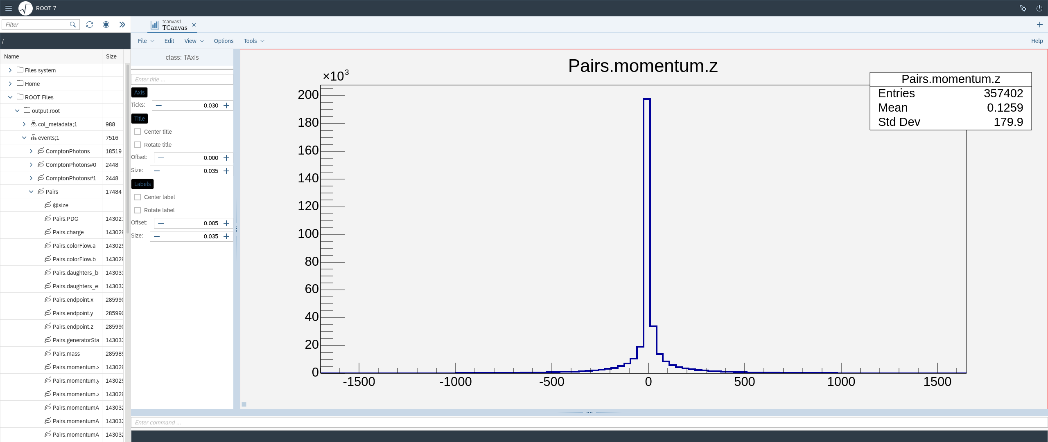
Example of the EDM4hep output in the ROOT Object browser
15.08.2022 Extending GUINEA-PIG with EDM4hep output Kalina Stoimenova 11

Slide 12
Summary
Beam background studies are needed for the development of every new detector
The GUINEA-PIG software is a tool to simulate the secondary particles, produced in beam-beam interactions
A new EDM4hep output was developed for GUINEA-PIG, with the aim to make it easier to use in the Key4hep framework
  All output (general information, primary and secondary particles) is stored in a single ROOT file
  Using the new output is made build-time and run-time optional
https://gitlab.cern.ch/clic-software/guinea-pig/-/merge_requests/3/
Thank you for your attention!
15.08.2022 Extending GUINEA-PIG with EDM4hep output Kalina Stoimenova 12

Slide 13
Backup slides

Slide 14
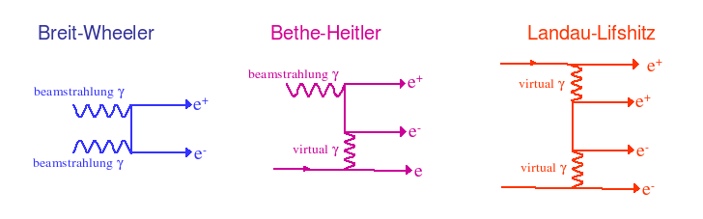
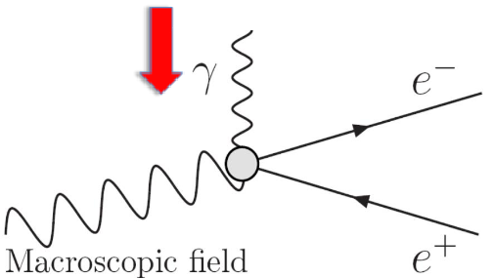
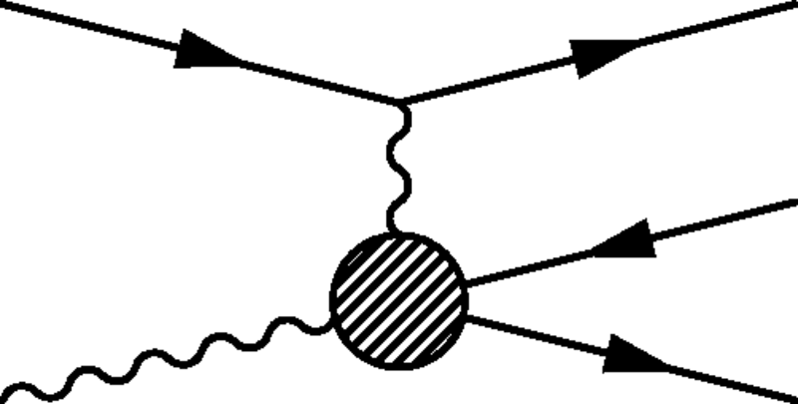
Pair creation
Incoherent pair creation
Coherent pair creation
http://ific.uv.es/~vos/ilc/ilcFastForward/MachineBackground.html
Trident process
https://indico.cern.ch/event/632420/contributions/2557423/attachments/1458049/2251143/GUINEA-PIG.pdf
Esberg, J. & Uggerhøj, U. I & Dalena, Barbara & Schulte, Daniel. (2014). Strong field processes in beam-beam interactions at the Compact Linear Collider. Physical Review Special Topics - Accelerators and Beams. 17. 10.1103/PhysRevSTAB.17.051003.

Slide 15
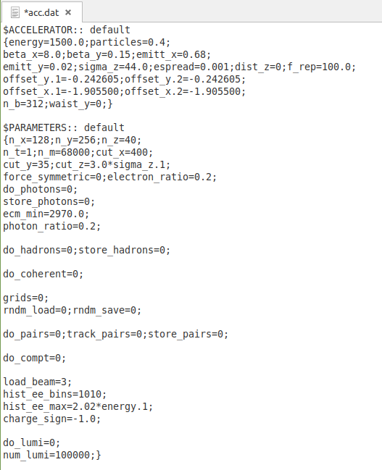
GUINEA-PIG standard input
Input data file: accelerator and simulation parameters
  Accelerator: number of particles per bunch, particle energy in GeV, charge, energy distribution, beam dimensions etc.
  Computational parameters: grid dimensions, methods for calculation etc.
  Flags
Optional electron and positron distribution input files
15.08.2022 Extending GUINEA-PIG with EDM4hep output Kalina Stoimenova

