Slide 1
The CERN Science Gateway
Interactive Calorimeter
Clemens Dittmar
EP-SFT, Supervisor: John Apostolakis
15.08.2022

Slide 2
Overview
Science Gateway
Concept of the exhibit
Technical Task
Programme Structure
Geant4
Geant4 - Python Communication
Demo Video
Future Tasks

Slide 3
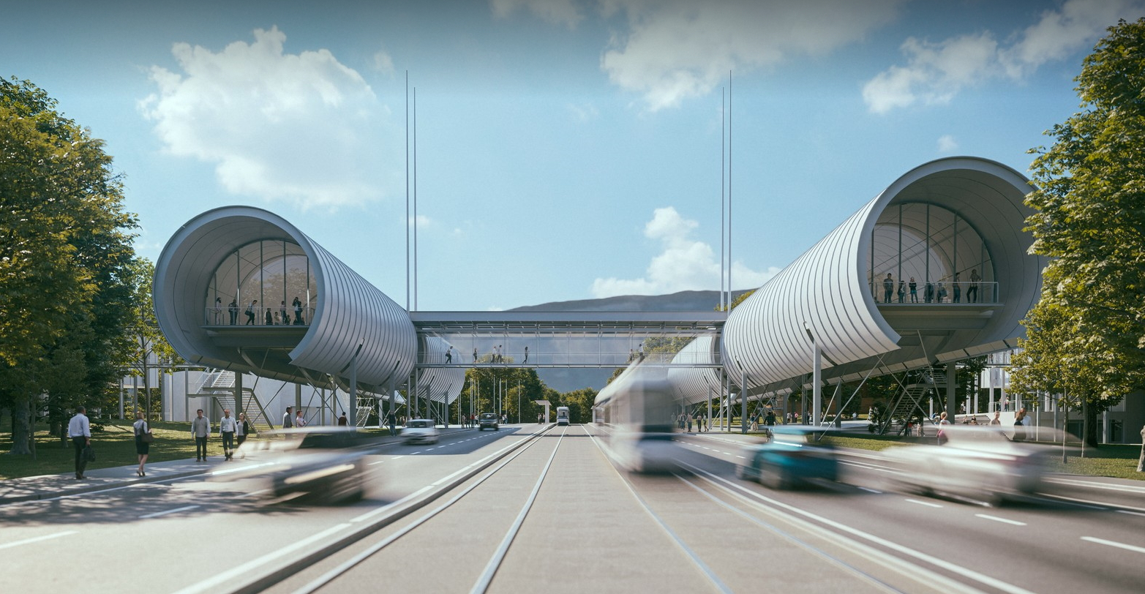
The CERN Science Gateway

Slide 4
The CERN Science Gateway
A visitor and education centre
For schools, families and general public
Focus on the younger audience
"The aim is to explain to the general public what fundamental research is and what we do here at CERN"

Slide 5
Concept of the exhibit
Interactive simulated Calorimeter
How can the kinetic energy of particles be measured?​
How should a component be designed that can do this?
Visitors should get a feeling for the interaction of high-energy particles with different materials.
Visitors should develop an effective sequence of materials to measure total energy of the selected particle.

Slide 6
Concept of the exhibit - Layout
Display
Sandwich Calorimeter
Scintillator
Aluminum
Silicon
Lead
Particle Gun
5 real movable blocks on a table-display

Slide 7

Concept of the exhibit - Layout
Lead
Display
Sandwich Calorimeter
Scintillator
Silicon
Particle Gun
4 real movable blocks on a table-display

Slide 8
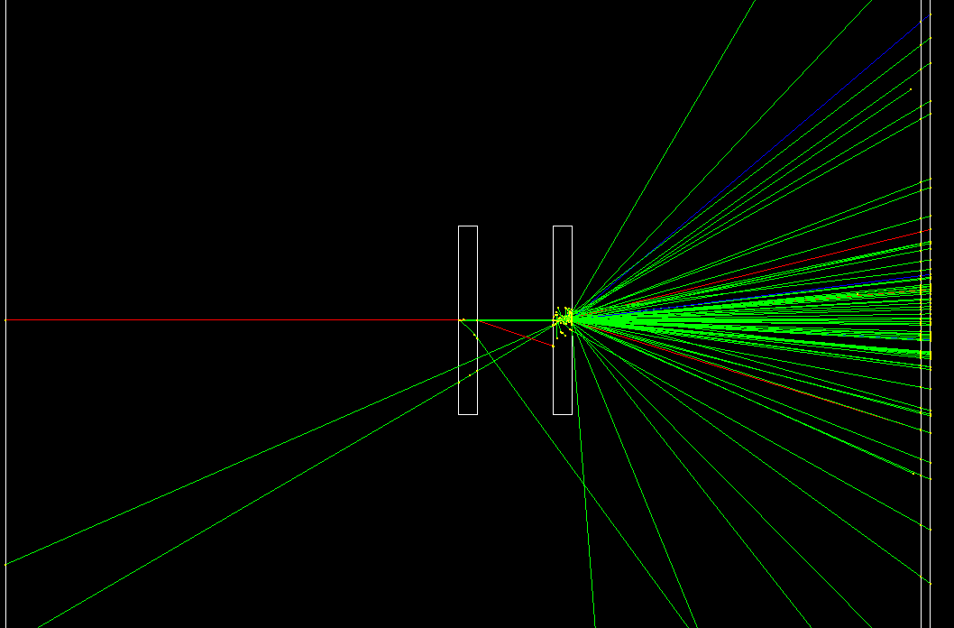
Concept of the exhibit - Layout
Display
Silicon
Lead
Particle Gun
2 real movable blocks on a table-display

Slide 9
Technical Task
Geant4 Simulation
  5 blocks
  Commands which can be executed at run time (without recompiling):
    position, size, material, possible absorber layer, number of copies in a row
  Saving of particle tracks with time axis in a simple file format for visualisation
  Saving energy deposition in each block
Python
  Fast and system-independent control of the Geant4 application
  Data exchange

Slide 10
Programme Structure
Python - Client
Python - Server
Geant4
Send: New geometry
Send: New particle gun
Send: Ask for data
Receive: Track-, ED.-Data
Socket
Receive: New parameter
Check parameter
Execute command
Receive: Ask for data
Execute simulation
Send: Track-, ED.-Data
DetectorMessenger
DetectorConstruction
Reinitialize geometry
Pexpext

Slide 11
Programme Structure
Interactive Table
Linux System
Python - Client
Python - Server
Geant4
Send: New geometry
Send: New particle gun
Send: Ask for data
Receive: Track-, ED.-Data
Socket
Receive: New parameter
Check parameter
Execute command
Receive: Ask for data
Execute simulation
Send: Track-, ED.-Data
DetectorMessenger
DetectorConstruction
Reinitialize geometry
Pexpext

Slide 12
CalSG – Geant4 application
5 blocks, replicas in x-axis and absorber layers
G4UICommand: Set XYZ-Position, Size, Material, Number of Replicas for a specific block
                “/testem/det/setBlock 0 -20 cm 0 cm 0 cm 1.5 cm 10.0 cm 10.0 cm Aluminium 4”
G4UICommand: Add absorber layer with a defined material to a specific block
“/testem/det/setAbsorBlock 0 Lead”
SensitiveDetector class to measure total deposited energy per block
Particle tracks with global step time stored in HepRep file
Already has all information structured in xml format
Total deposited energy is stored in a csv file for each event

Slide 13
Geant4 - Python communication
Python Pexpext
Works like Don Libes’ Expect – Unix automation tool
Spawn a child application and control it as if a human were typing commands
Python Socket
Network communication – with server and client
Special Geant4 command sequences can be executed in the server with callable functions
Client can log in, call functions and receive data
Existing functions:
Change geometry
Change primary particle properties
Resimulate and send track data
Run with N events and send back energy deposition per event
Restart Geant4
Start/Stop Geant4

Slide 14

Demo Video

Slide 15
Future task
Reduction of unnecessary data in the HepRep file.
Speeding up CalSG
Building a test engine with visualisation to optimise the visitor experience

Slide 16




What have I learned here?
How to build a detector simulation and implement commands in Geant4.
How to use Python for system-wide communication.
How to implement a neural network.
A good coffee is served in a hot cup.

Slide 17
Thank you very much for listening!
Are there any questions or comments?

Slide 19
How to use the client
import socket
SERVER = IP #(set by server)
PORT = 5050 #(high number -> free port)
ADDR = (SERVER,PORT)
client = socket.socket(socket.AF_INET,socket.SOCK_STREAM)
client. connect(ADDR) #connect to server
import Client_Vis as Geant4
Geant4.NewGeometry([0,1.5,0,0,0],[0,0,0,0,1])
.
.
.
Change number of Layer
Block hide change in cm

Slide 20
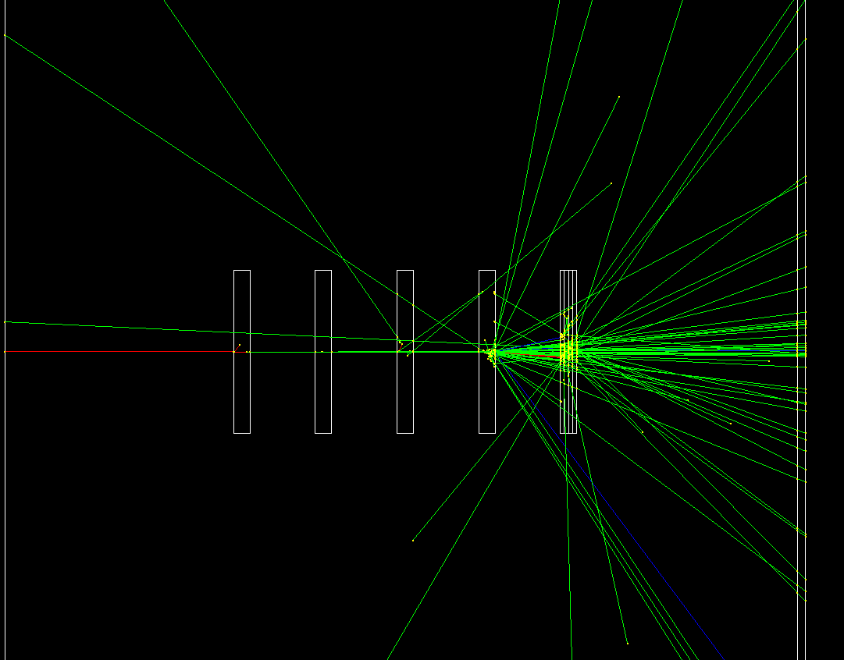
Concept of the exhibit - Layout
Display
Sandwich Calorimeter
Scintillator
Aluminum
Silicon
Lead
Particle Gun
5 real movable blocks on a table-display

