Slide 1
Vertex fitting
Franco Bedeschi, INFN
Phys. Performance meeting
July, 2022
OUTLINE
Intro/Caveats
Vertex fitting
Recent updates
More to come

Slide 2
Introduction
Vertex fit is already available in many existing packages
  ….. That’s the problem:
  Using it usually means you also buy a complex infrastructure
Goal here is to provide a simple standalone code
  Easy to insert in FCC framework
  Based on ROOT libraries only
  More complex implementations can come later

Slide 3
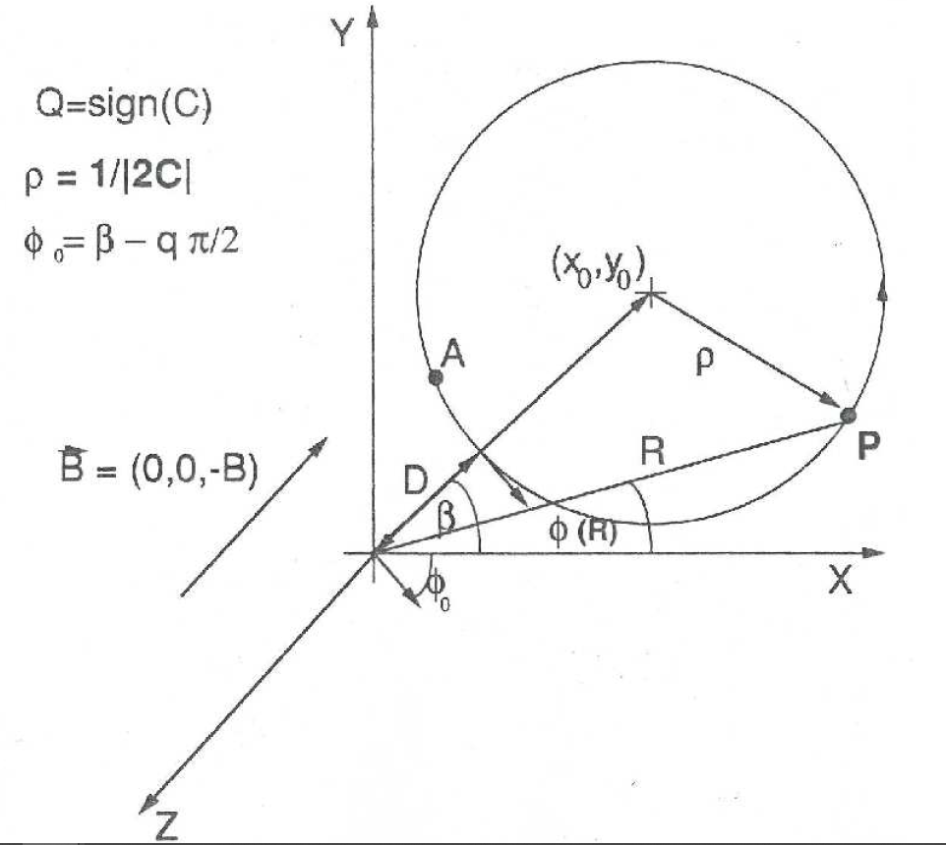
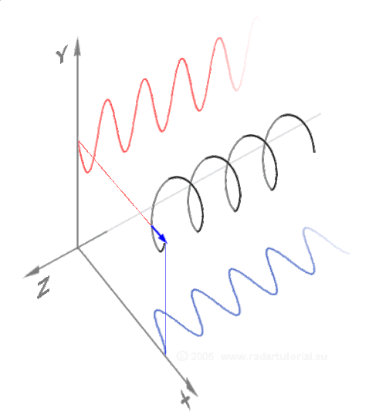
Vertex fit (1)
Input:
  Array of observed tracks
    5 parameters + Cov. Matrix
    Assume perfect helix
      D, φ₀, C, cot θ, z₀
Output:
  3D vertex + covariance
Method:
  χ² minimization with constraints
    Vary parameters and phase and force all tracks to cross at same point

Slide 4
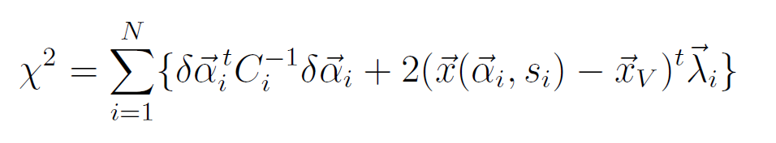
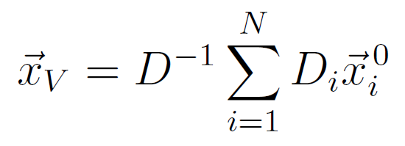
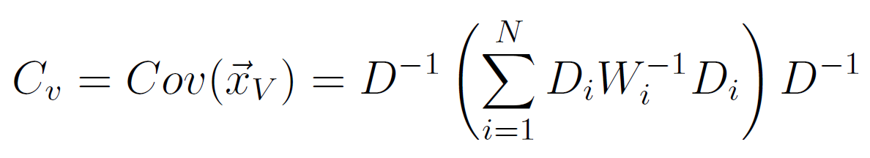
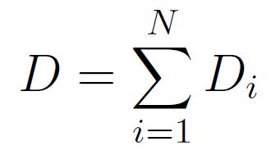
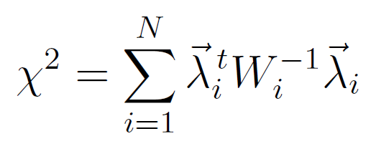
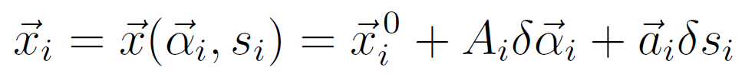
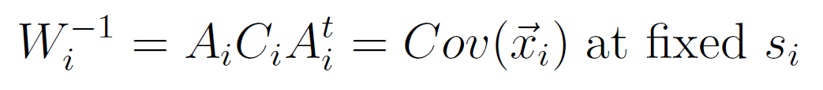
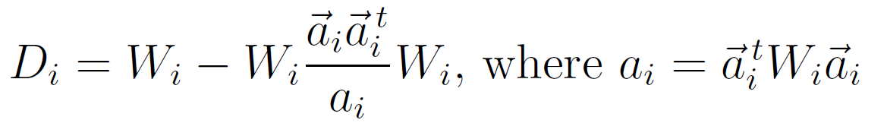

Vertex fit (2)
The χ²:
  $\vec{α}$_{i}, C_{i} = track parameters and covariance matrix
  s_{i} = helix phases, $\vec{λ}i$ = Lagrange multipliers
  Solve by linearization and iteration on s_{i} (mean is 4 iterations)
Solution:

Slide 5
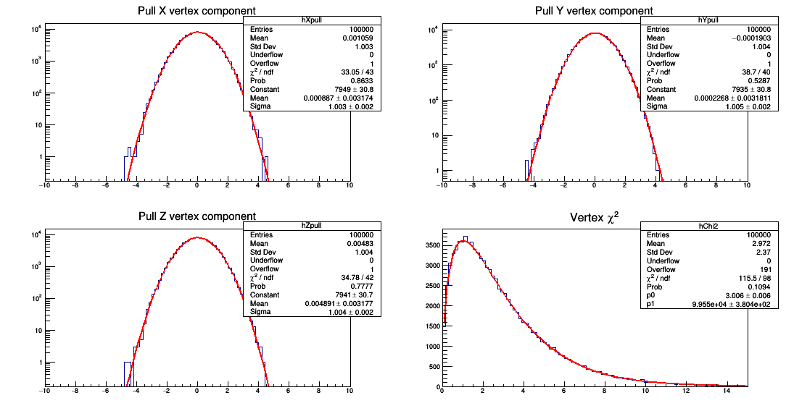
Performance (1)
Example: 100,000 events, 3 tracks, R_{V} (0-1.5 cm), pt (0.5-1.0 GeV)

Slide 6
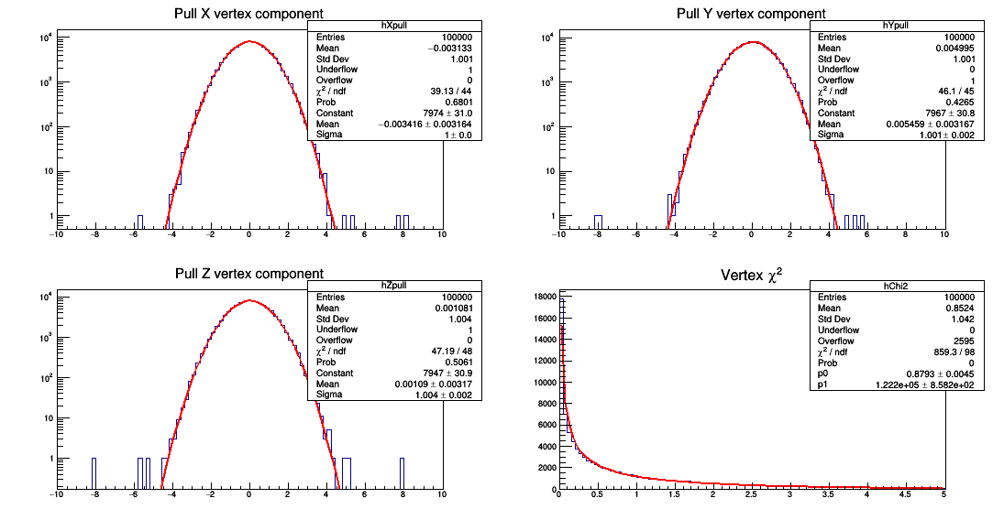
Performance (2)
Example: 100,000 events, 2 tracks, R_{V} (0-1.5 cm), pt (0.5-1.0 GeV)

Slide 7
Implementation
Code location:
  https://github.com/delphes/delphes/tree/master/external/TrackCovariance
    VertexFit.cc, VertexFit.h (basic vertex fitting)
    VertexMore.cc, VertexMore.h (additional features)
How to call:
  Track loop:
  pr[Ntr] = new TVectorD(obsPar); // Parameters
  cv[Ntr] = new TMatrixDSym(covMat); // Error matrices
  VertexFit* Vtx = new VertexFit(Ntr, pr, cv); // Vertex fit TVectorD xvtx = Vtx->GetVtx(); // Vertex found TMatrixDSym covX = Vtx->GetVtxCov(); // Vertex covariance Double_t Chi2 = Vtx->GetVtxChi2(); // Fit Chi2

Slide 8
Additional features (1)
Add/remove track from existing fit:
  AddTrk(TVectorD *par, TMatrixDSym *Cov);
  RemoveTrk(Int_t iTrk);
    Useful in vertex finding loops
Set starting radius:
  SetStartR(Double_t R);
    Separate seagulls and cowboys
    Default is expand at P.C.A.
    New feature in DELPHES to provide lowest hit coordinates
Add vertex constraint:
  AddVtxConstraint(TVectorD xv, TMatrixDSym cov);
    Useful in primary vertex finding

Slide 9
Additional features (2)
Updated track parameters after vertex fit:
  GetNewPar(Int_t i)
  GetNewCov(Int_t i) // Diagonal covariance
  Correlations:
    GetNewCov(Int_t i, Int_t j) // <Par_i*Par_j>
    GetNewCovXvPar(Int_t i) // <Xv*Par_i>

Slide 10
Helper class: VertexMore
Invocation: VertexMore* VM = new VertexMore(Vtx);
Track momentum/errors at vertex:
  TVector3 GetMomentum(Int_t i)
  TMatrixDSym GetMomentumC(Int_t i)
  Total vertex momentum/error:
    TVector3 GetTotalP()
    TMatrixDSym GetTotalPcov()
  TMatrixDSym GetBigCov()
    Full xv, p1, p2, …. pn covariance matrix
Charged vertex only for now!
  Vertex track parameters/errors:
    TVectorD GetVpar()
    TMatrixDSym GetVcov()
    Can then use as track in vertexing chain (e.g. Bs→Ds K)
    Problem with charged vertex tracing in DELPHES
φ
K
K
π
Ds
K
Bs

Slide 11
In progress
Multiple mass constraint:
  AddMassConstraint (Double_t Mass, Int_t Ntr, Double_t* masses, Int_t* list)
  Eg. Ds→φ π (φ→KK)
    Constrain simultaneously φ and Ds mass in vertex fit
      Call twice before refit
  Coded and tested locally
    Waiting for fixing tracking problem in DELPHES
Including neutrals

Slide 12
Conclusions
Fast vertex fitting code dependent only on ROOT libraries is provided
  Very simple to use without any overhead
  Most common features included and more coming
Coming (hopefully) soon:
  Easy new features:
    Mass constraining (basically complete)
    Pointing contraint (math done)
  Hard new features:
    Dealing with neutrals

