Slide 1

CMS Detector Upgrade
GE-2/1 GEM Detector Integration Studies
Josh Cameron, UMich-CERN REU
Co-Advisors: Pieter Everaerts, Francesco Ivone, Antonello Pellecchia

Slide 2
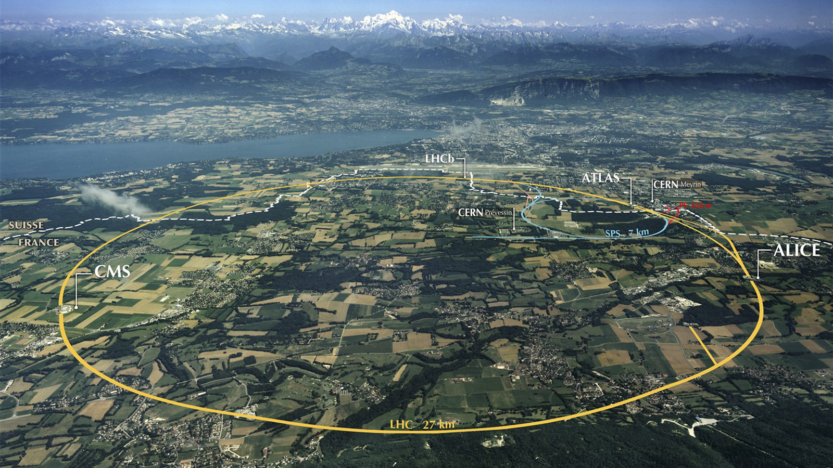
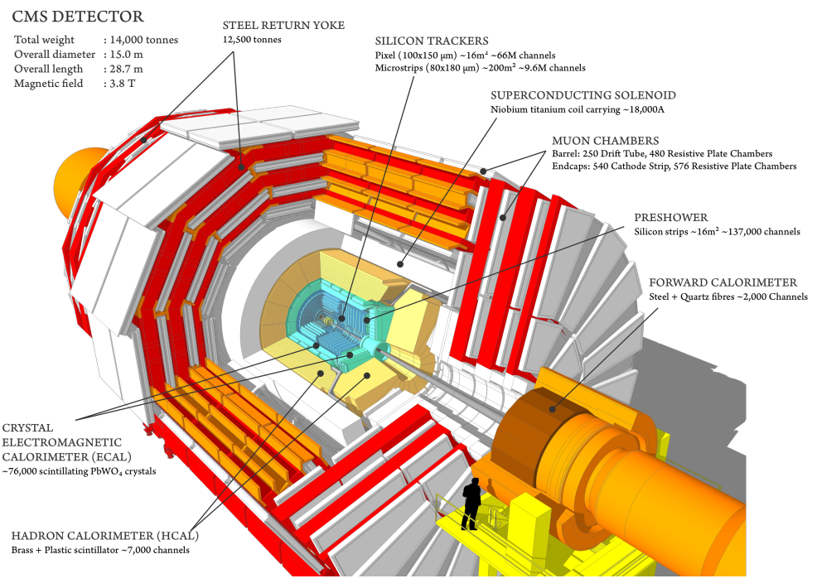
CMS and LHC
Large Hadron Collider (LHC)
27km long proton-proton collider
~40 collisions/25ns at 13.8 TeV
High luminosity upgrade increases rate to ~125 collision/25ns at 14 TeV.
Compact Muon Solenoid (CMS)
General purpose physics detector
Located ~100m underground in Cessy, France
World’s largest solenoid magnet (3.8 T)

Slide 3
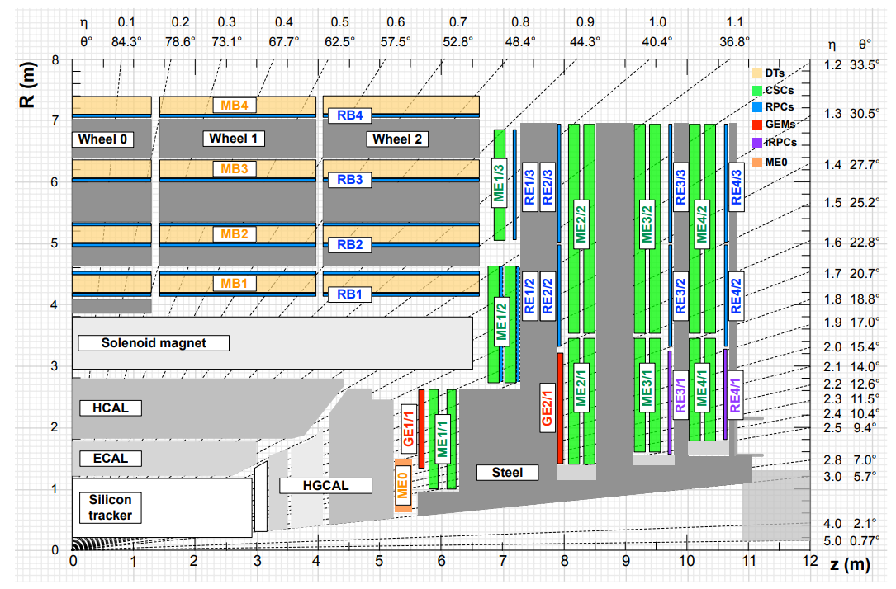
CMS Muon System Upgrade
HL-LHC upgrade increases proton-proton collision rate by 2.5x
CMS Muon System needs upgrade to operate at this high rate
Gas Electron Multiplier (GEM) installations at ME-0, GE-1/1, GE-2/1 increase redundancy and expand range of muon system
  High efficiency, resolution, and rate capability in thin package

Slide 4
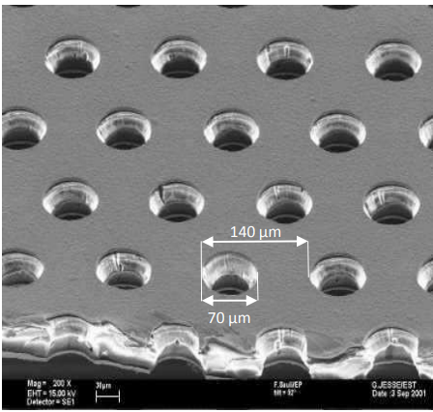
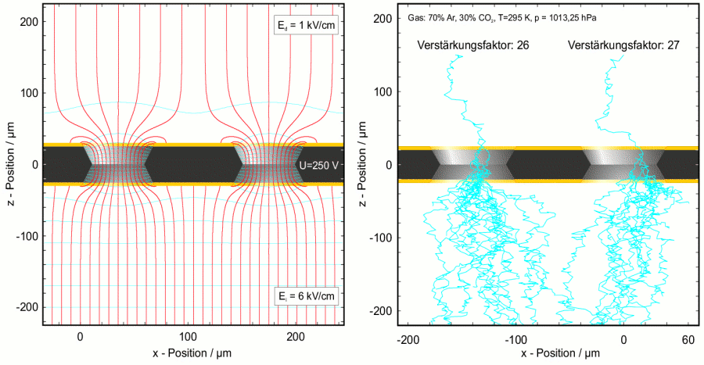
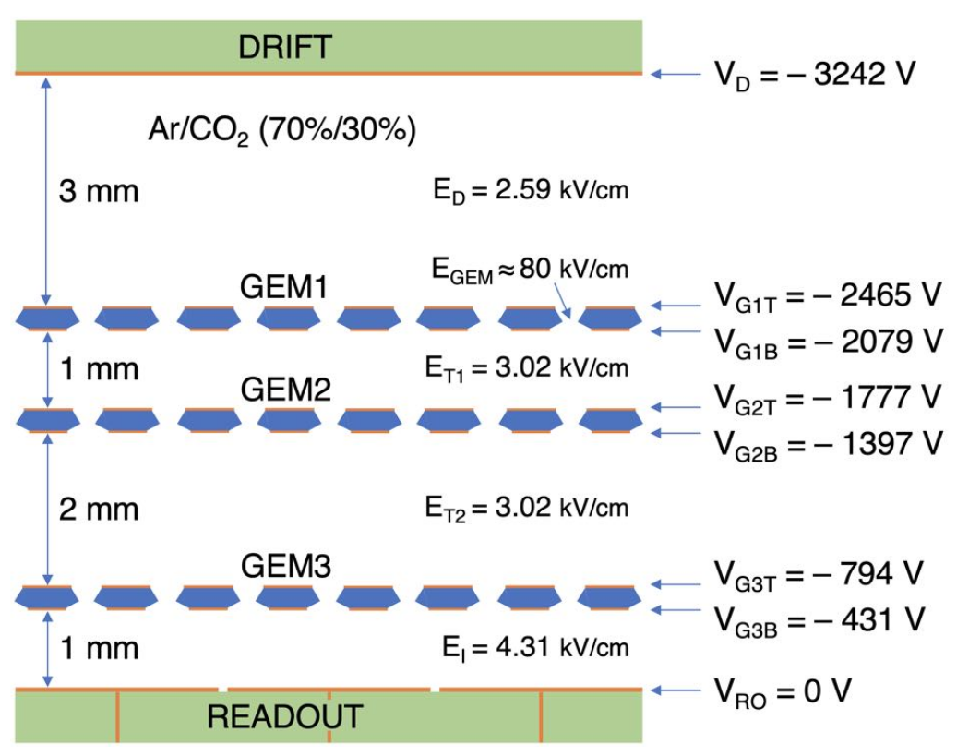
What are GEMs?
Incoming muon ionizes gaseous Ar, triggering electron avalanche in high electric field
Thin layers of copper on either side of polyamide sheet form GEM foil
Microscopic holes photochemically etched to guide electronics
Potential difference between copper layers produces electric field ~80kV/cm
Triple GEM gain ~10⁴-10⁵
Ar:CO2 in 70:30 ratio enables amplification while minimizing risk of discharge and deadtime

Slide 5
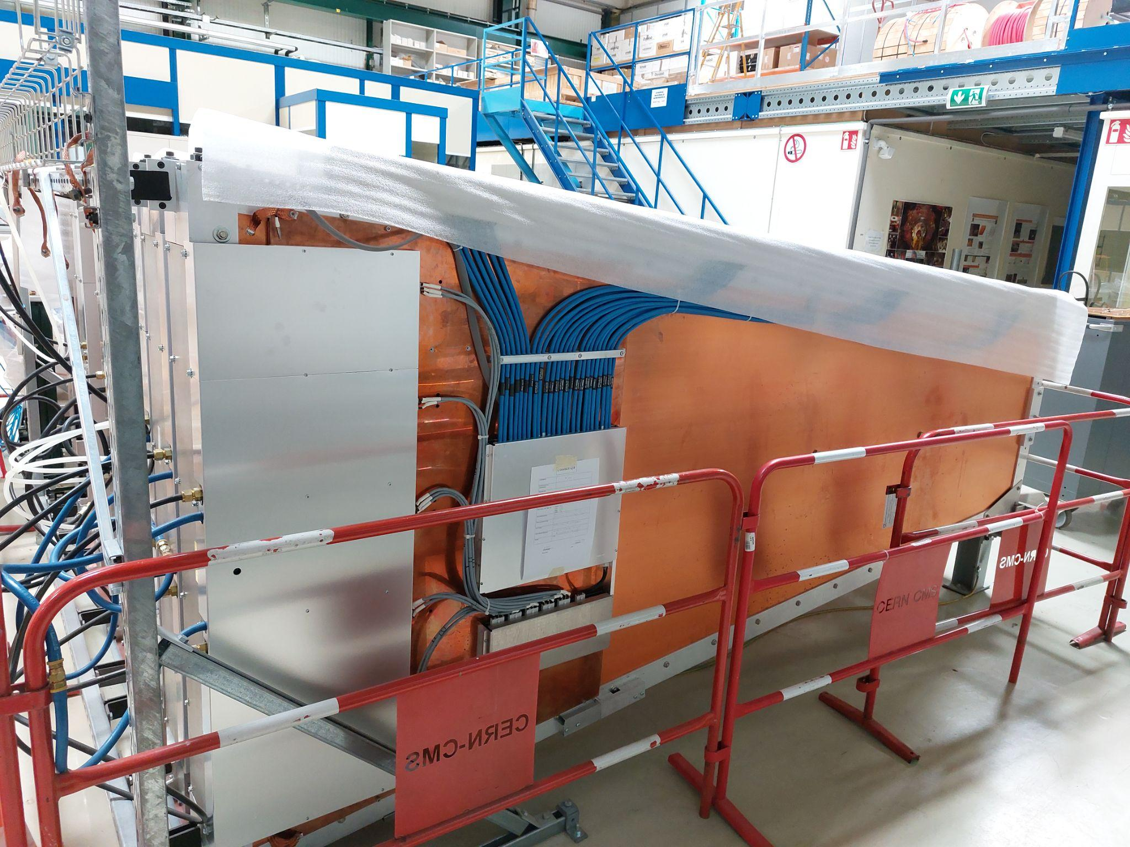
Integration Studies for GE-2/1 GEM Detector
Electronics quality control of GE-2/1 modules
Assembly of first GE-2/1 chambers
Efficiency and Crosstalk studies
New XYV GEM tracker development
Reconstructing muon hits from raw data
Future studies:
  Channel loss observed
  Rate capability of front end electronics

Slide 6
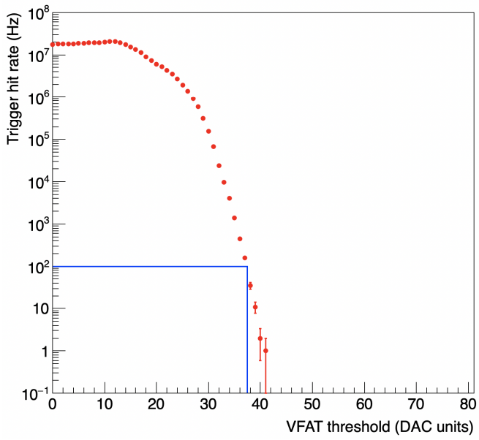
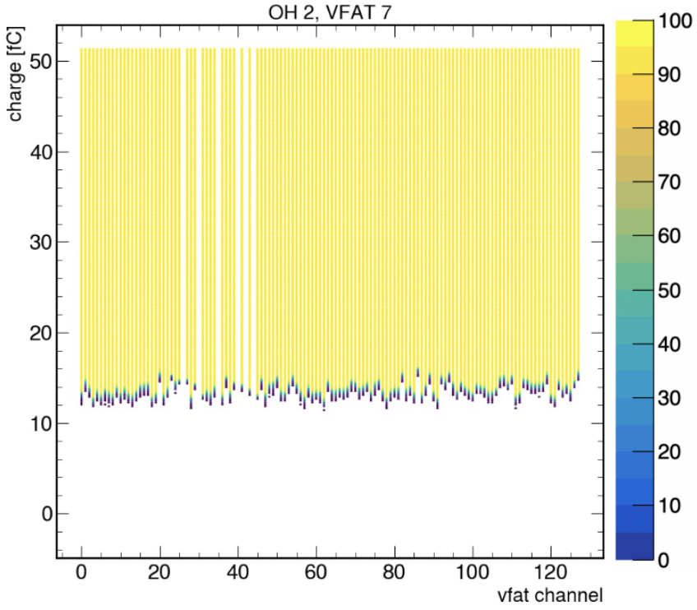
Electronics Quality Control
Electronics test of entire module
  Ensures all readout chips, voltage and signal convertors are connected and communicating well
  Checks for damaged components
Trigger rate scans
  Iterates over threshold setting of binary chip and records trigger rate; set working point and checking proper connectivity
Threshold and Noise Scans
  Channel-level data from charge injections; identify dead and noisy channels
Last quality control stage before chamber assembly, and first performed after assembly

Slide 7
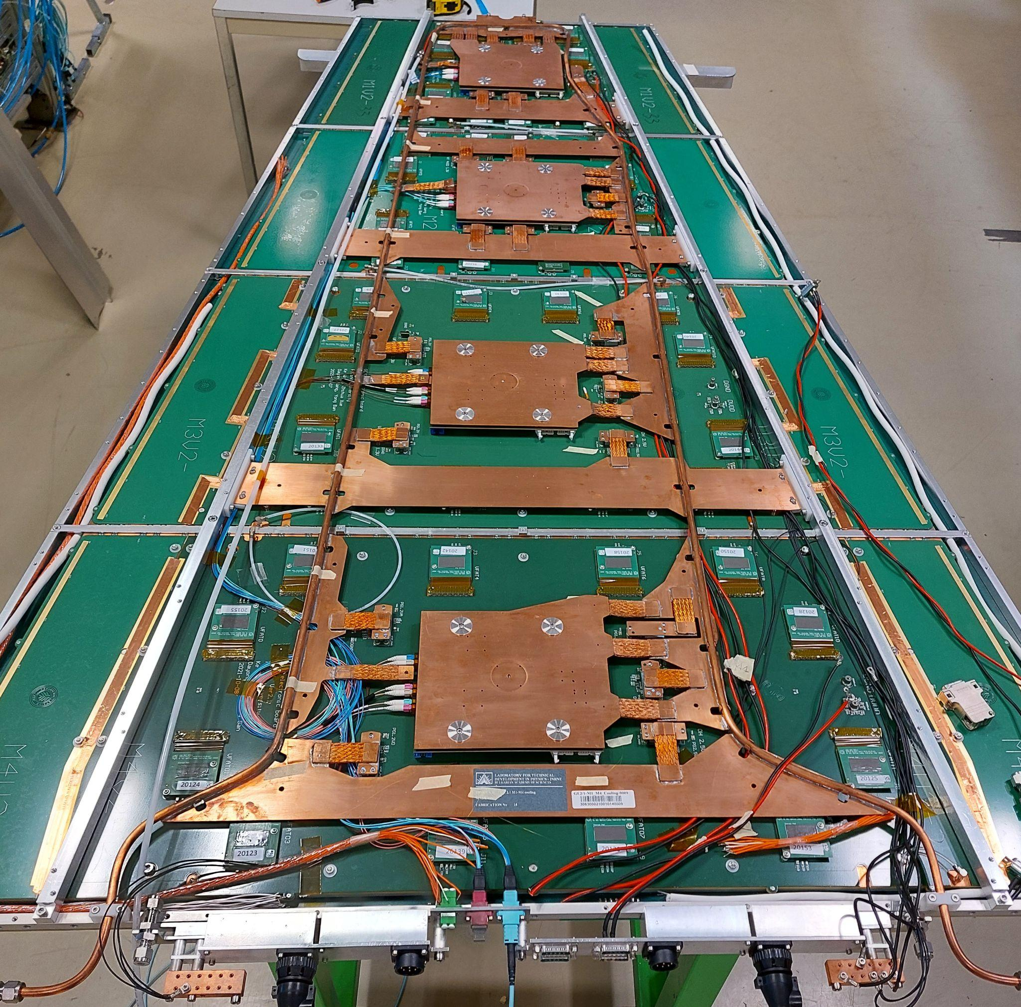
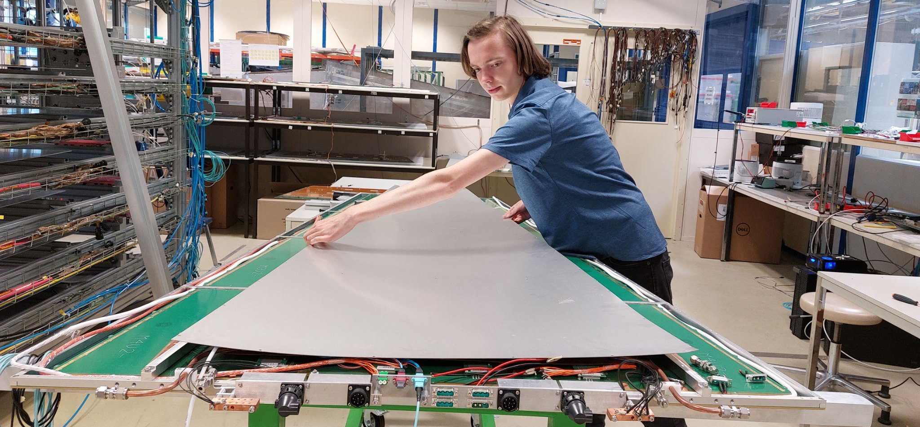
Full Assembly of GE-2/1 Chamber
Assembly of first (!) GE 2/1 Chamber in R&D Lab
  Ensure all components fit well together
    4 modules, cooling, chimney
  Set standard routing for gas lines, wiring, and fibres for mass production of GE2/1 chambers by technicians
    Minimize stress, tension, and curvature to ensure longevity through service life

Slide 8
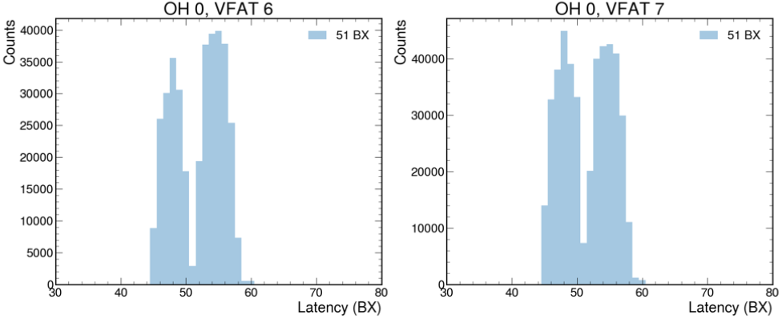
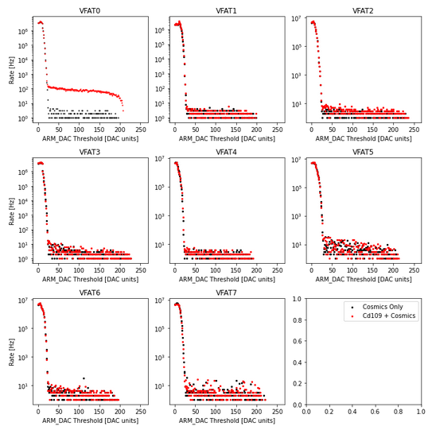
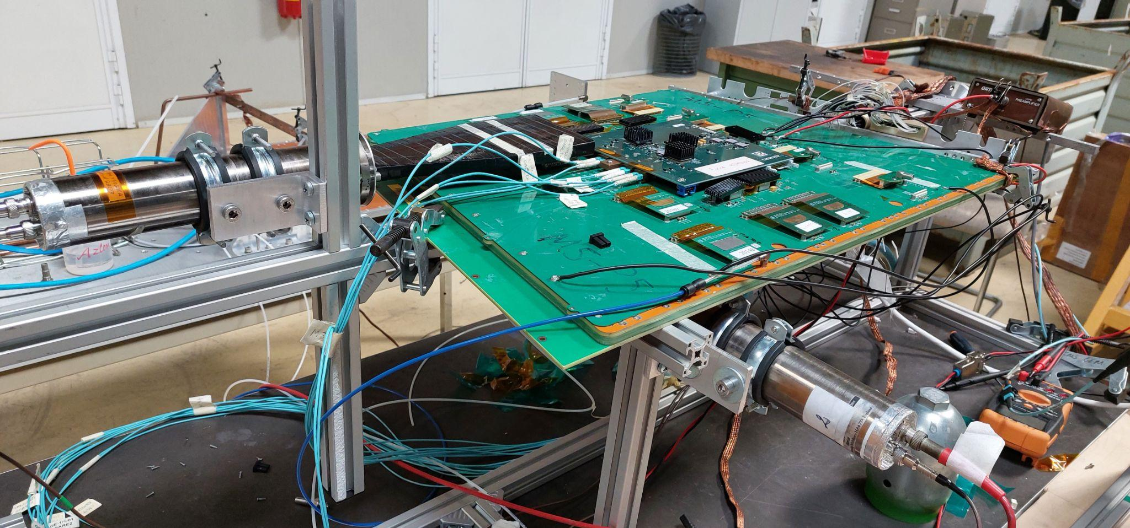
Efficiency and Crosstalk
Efficiency testing with scintillators and cosmics:
  97.3 ± .6 % efficiency (N~3,200)
Consistent signal recorded ~250ns after original signal in Test Beam May 2022 - is it crosstalk?
  Check for spatial crosstalk signature with Cd109 affixed in region below VFAT0
  Not found, turning attention elsewhere in continuing studies

Slide 9
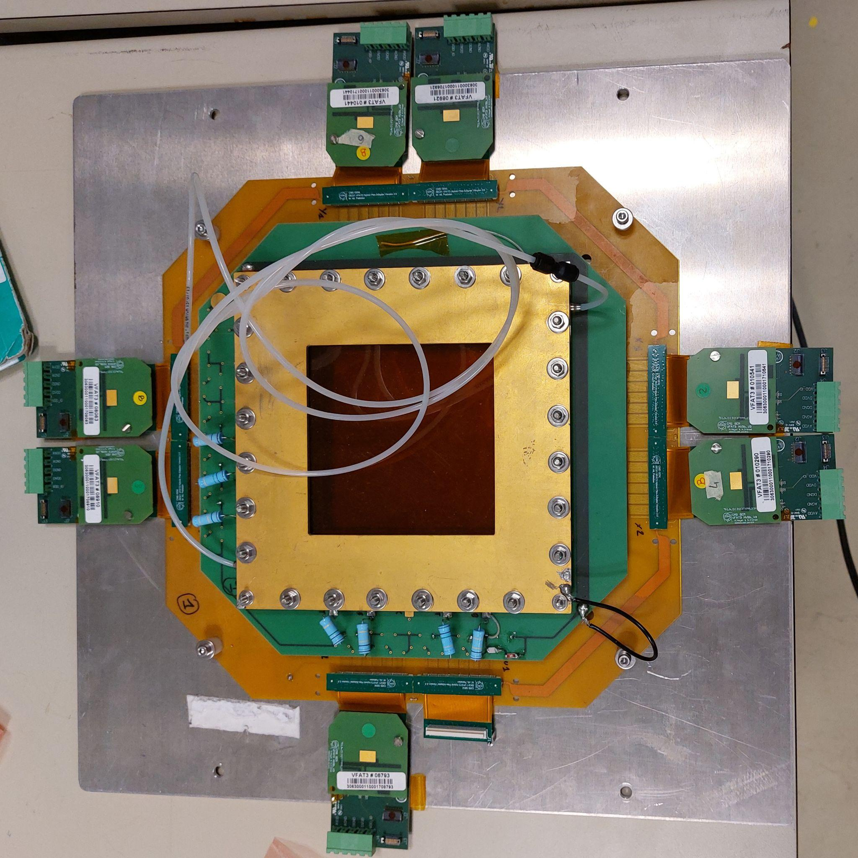
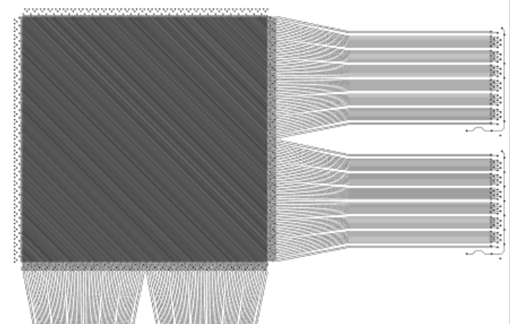
GEM Tracker Development
New XYV GEM Tracker
  Ambiguity in xy trackers when there are multiple muons in a single event trigger
  Reduce event location uncertainty with a 3rd layer of diagonal strips
  Created channel → strip mapping

Slide 10
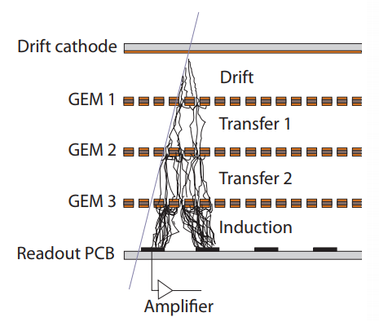
Hit Reconstruction
Cluster tracking
  Hit reconstruction from raw data event data, where many channels may fire in each event
  Avalanche from single muon may trigger several strips - identify and assign coordinate to each muon hit
  HV increase 580 𝜇A to 700 𝜇A showed positive shift in cluster size and efficiency

Slide 11
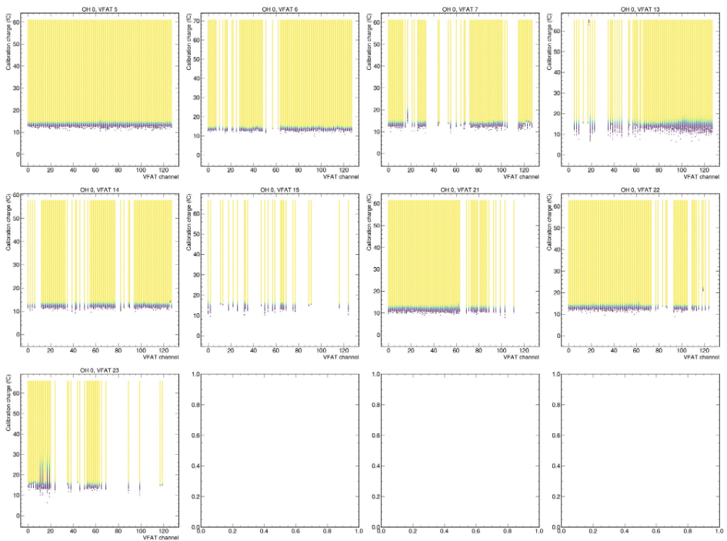
Channel Loss - Ongoing Studies
Channel loss in VFATs observed at production lab and GIF++ test beam
Longevity tests of alpha irradiated GEM module at high voltage
  HV monitoring for detecting discharges in GEM chamber
  Periodic SCurve scans track propagation of dead channels

Slide 12
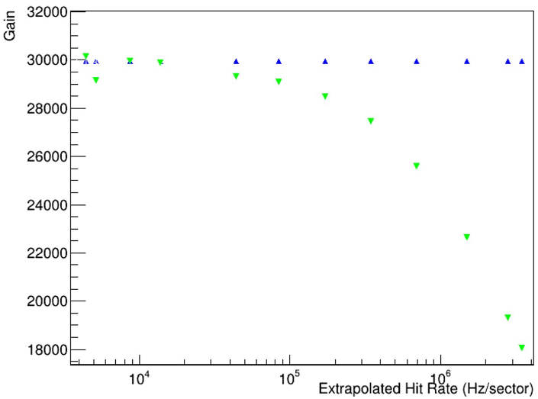
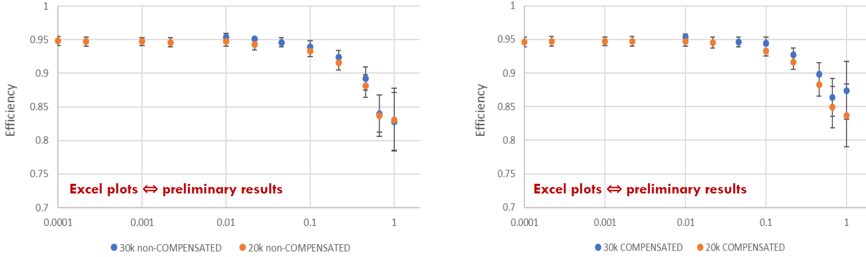
Ongoing Projects
Overvoltage compensation not recovering efficiency as expected - test rate capability of readout chips
Charge injection with various rates, pulse durations, and charge amplitudes
Danylo is continuing charge injection studies
Antonello will perform high rate x-ray studies to test VFAT saturation

Slide 13
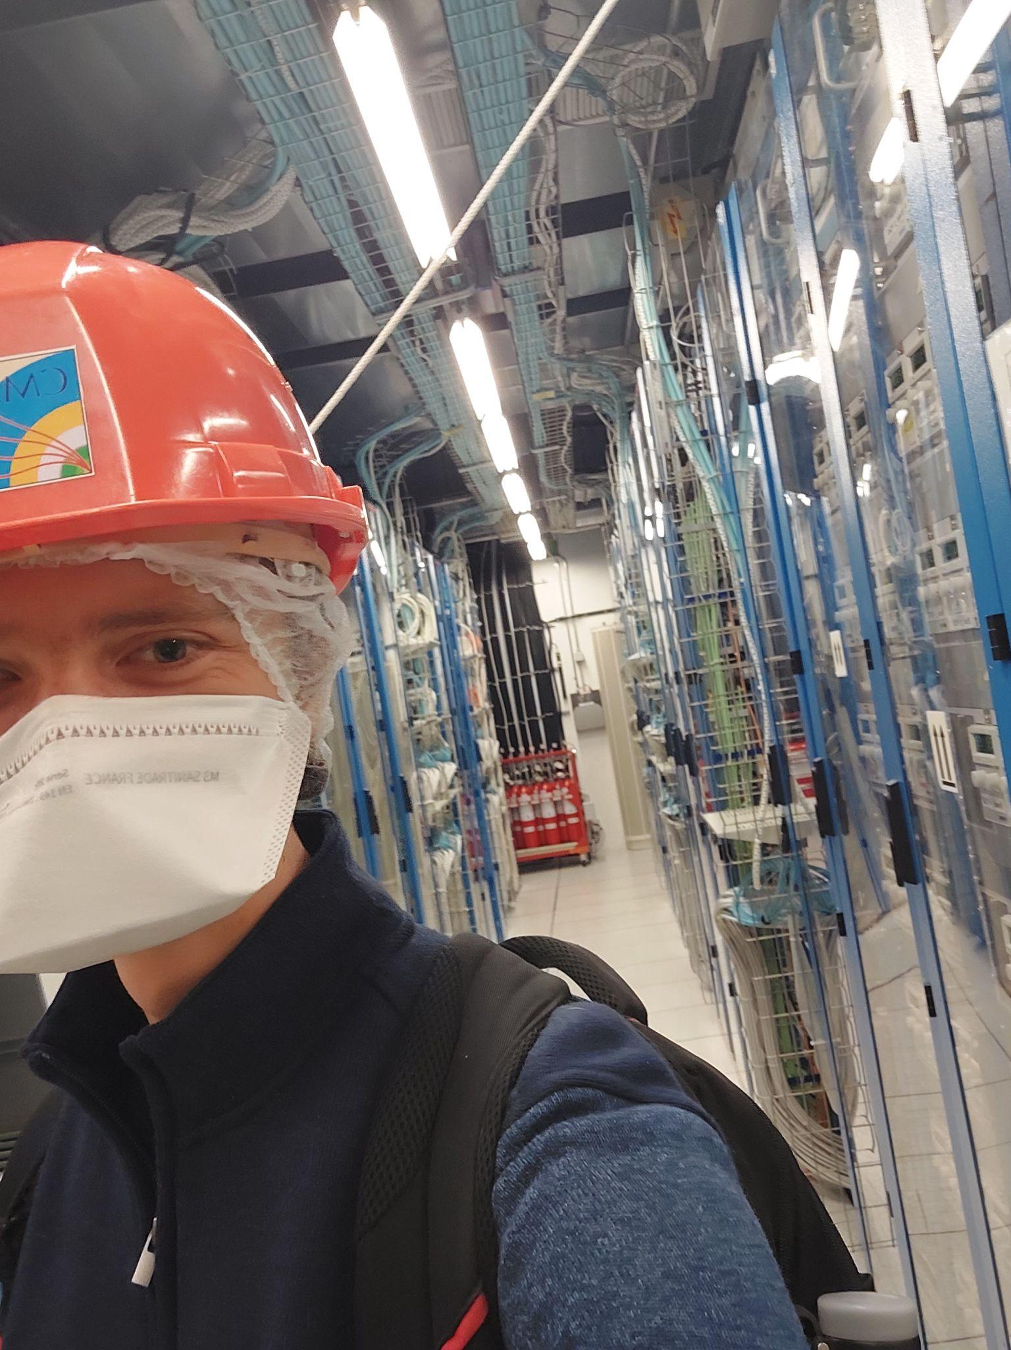


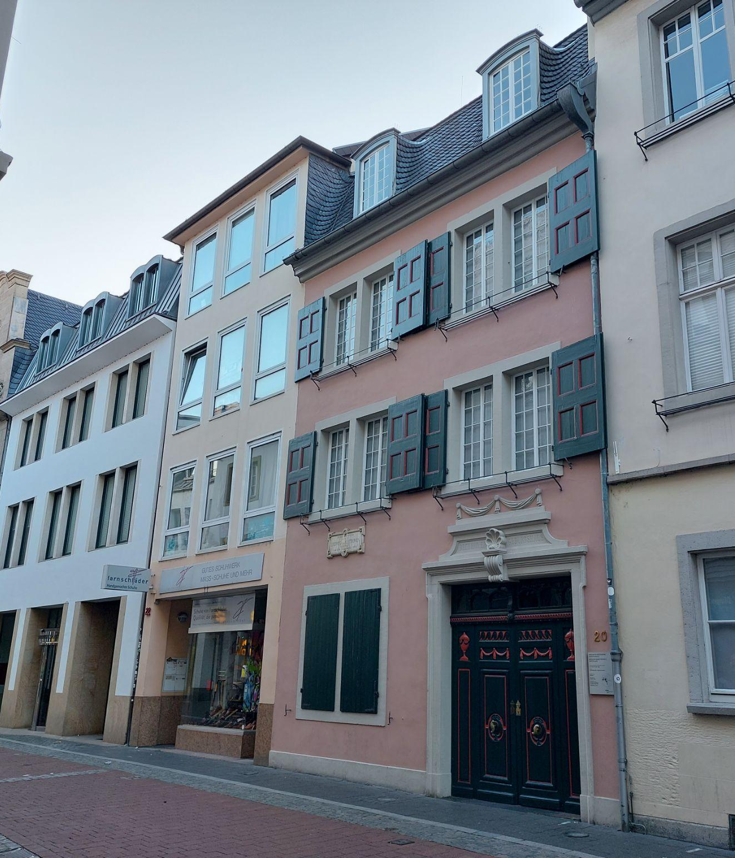
Conclusion
Contributed to wide range of projects within GEM GE-2/1 integration
  Quality control, assembly, timing and crosstalk studies, tracker development, performance testing
Followed the 5-week CERN Summer Student Lecture Series
Enjoyed weekend explorations of Switzerland, Germany, France, and the Netherlands
Thanks to University of Michigan physics department, CERN summer student program, and the National Science Foundation for making this experience possible

Slide 14
CMS Detector Upgrade
GE-2/1 GEM Detector Integration Studies
Josh Cameron, UMich-CERN REU
Co-Advisors: Pieter Everaerts, Francesco Ivone, Antonello Pellecchia

