Slide 1


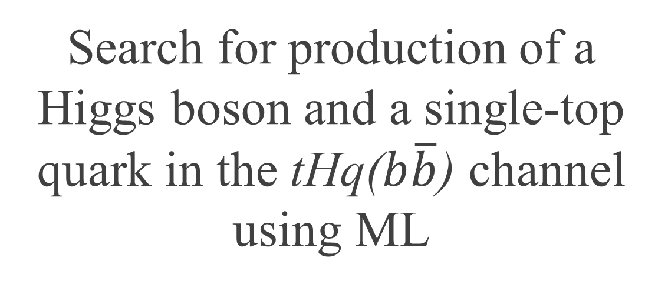
Search for production of a Higgs boson and a single-top quark in the tHq($b\overline{b}$) channel using ML
Arthur Alves

Slide 2
Introductions
Arthur Alves, rising senior at the University of Massachusetts, Amherst
CERN summer student, coming with University of Michigan.
Working at ATLAS under Dr. Nello Bruscino (La Sapienza, INFN)

Slide 3


Overall Project
Overall goal: better understand the Yukawa Coupling of the Higgs boson to a single top quark.
  What is its actual sign? Positive or negative? Only the magnitude squared is understood.
My assigned role: use Machine Learning techniques to discriminate the $tH$ signal from the background
  Create a Graph Convolutional Network
  Use the Deep Graph Library (DGL) as a tool
  Improve the accuracy in the tests

Slide 4
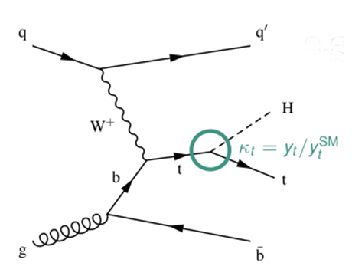
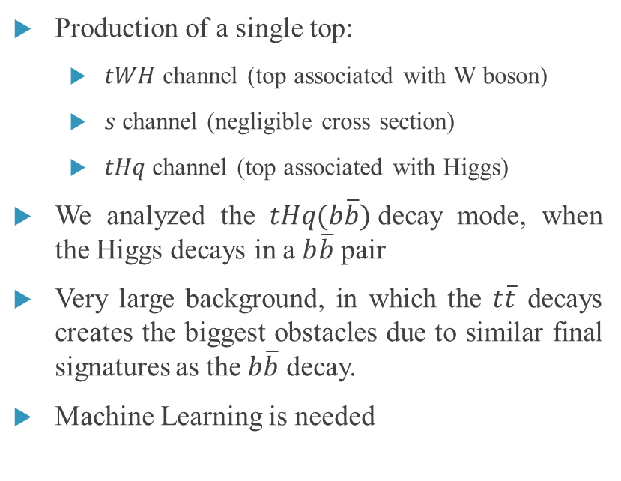
A bit of theory
Production of a single top:
  $tWH$ channel (top associated with W boson)
  $s$ channel (negligible cross section)
  $tHq$ channel (top associated with Higgs)
We analyzed the $tHq(b\overline{b})$decay mode, when the Higgs decays in a $b\overline{b}$ pair
Very large background, in which the $t\overline{t}$ decays creates the biggest obstacles due to similar final signatures as the $b\overline{b}$ decay.
Machine Learning is needed

Slide 5
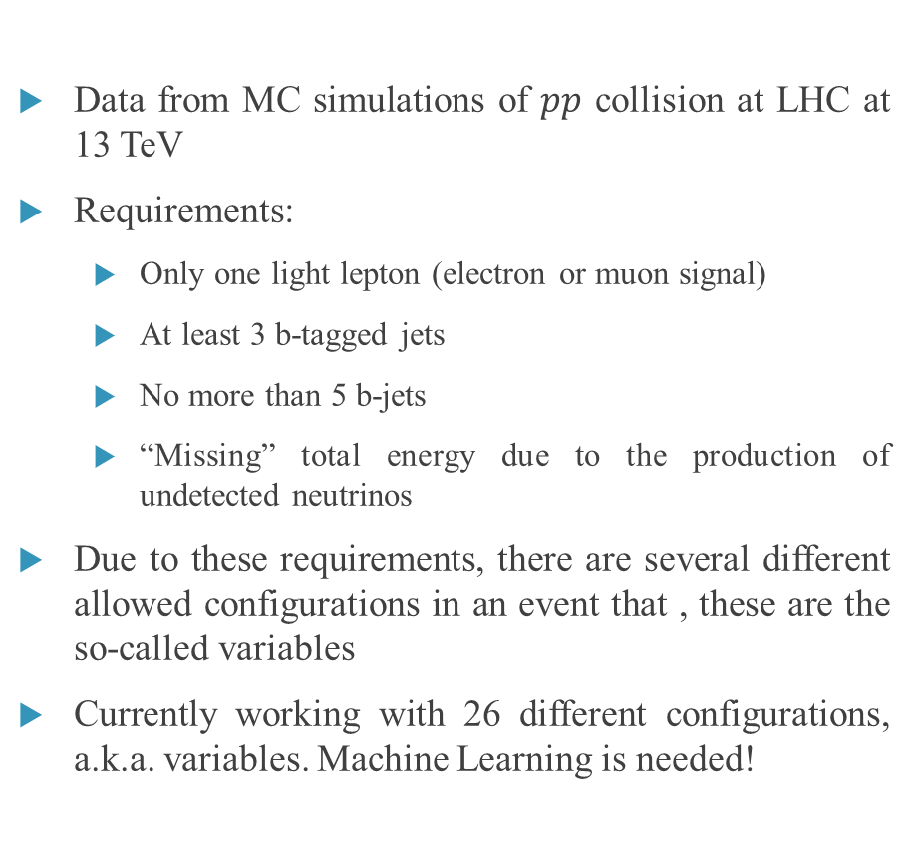
Data and Requirements
Data from MC simulations of $pp$ collision at LHC at 13 TeV
Requirements:
  Only one light lepton (electron or muon signal)
  At least 3 b-tagged jets
  No more than 5 b-jets
  “Missing” total energy due to the production of undetected neutrinos
Due to these requirements, there are several different allowed configurations in an event that , these are the so-called variables
Currently working with 26 different configurations, a.k.a. variables. Machine Learning is needed!

Slide 6
Machine Learning
& GNN
GNN are a powerful tool, e.g., node creation & link prediction
Graph Neural Networks were chosen due to its useful role of graph classification
  Graphs cannot be represented by a normal coordinate system (not in a Euclidean space)
  Consist of nodes (where the information is held) and edges (describes the relations between nodes). Nodes and edges can have as many features as necessary.
  In a GCN nodes are influenced by neighboring nodes through edges
Abstract? What should be treated as a node or an edges in this context in Physics?
https://towardsdatascience.com/an-introduction-to-graph-neural-network-gnn-for-analysing-structured-data-afce79f4cfdc

Slide 7
Nodes and Edges
Due to the requirements previously mentioned, we decided to create the following nodes classes:
  Leptons,
  B-jets,
  Non B-jets,
  Forward jets.
With the node features: pt, eta, phi, e.
The edges features consist of the distances between the nodes, calculated from the TLorentz vector of every node in all events.

Slide 8
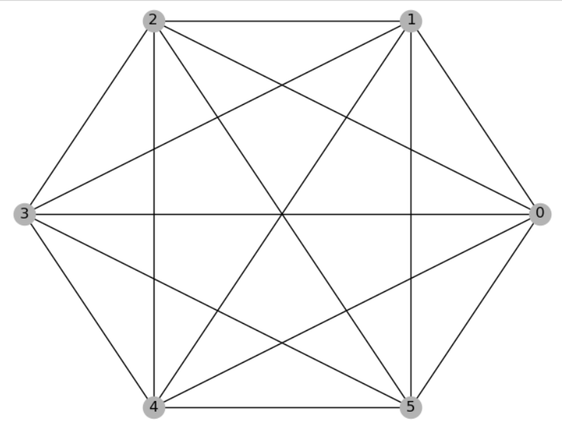
Graph Example
Graph of the first event
Edges:
  Distance and both directions
Nodes:
  0 : lepton
  1, 2, 3: b-jets
  4: non b-jet
  5: forward jet

Slide 9
My work this summer
My work this summer consisted of:
  Searching the best way to turn our RDataFrame into something that can be a DGL input. (Solution: RDataFrame→ Numpy → Pandas DataFrame → Pytorch)
  Write scripts that generate appropriate TLorentz vectors in the right format
  Write scripts that create the graphs
  Create several graphs and load them in a dataset, split them in batches for better processing
  Loop over necessary amount of events
  Train the Neural Network
Summary: Write a lot of code and debug it

Slide 10
Next Steps
Since we are talking about Machine Learning, the natural next step of projects like this is to increase the test accuracy (currently at around 55%)
Increase the epochs, the hidden layers and/or hidden features, etc. It does come with a price: TIME

Slide 11

Thank you!

