Slide 1
Final Report: Analyzing the Internal Decay of Thallium at the ISOLDE Decay Station
Jordan Cory^{1,2}, Bruno Olaizola¹, Andres Illana Sison¹
¹CERN
²Stevens Institute of Technology

Slide 2
Nuclear Isomers

Slide 3
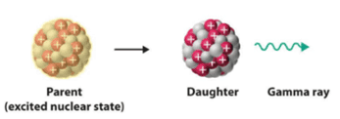
What are Nuclear Isomers?
Long-lived excited state of nucleus
Emits a gamma when it dexcites
Shape coexistence
Notes:
Begin to explain these concepts here and how they are related to nuclear isomers
Bruno: not sure what you will say here, but I think you are mixing concepts. Isomers are long-lived excited states. High-multipole gammas are slower, which could create isomers. Conversion electrons are more likely the higher the gamma multipole. None of these things are directly related to shape coexistence.

Slide 4
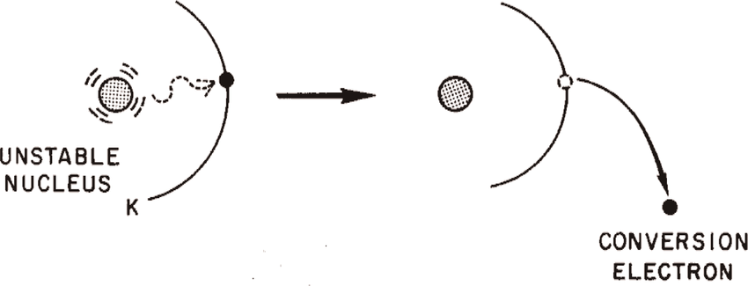
Observables
There are some quantities we can measure to learn more about nuclear isomers:
Mixing ratio of multiple transitions
Electron conversion coefficient
Half-life of excited state
Notes:
What I will be measuring in my project
Bruno: quick definition of what is mixing ratio (one gamma can be emitted with M1 or E2 with some probability) - electron conversion is more likely with higher multipoles

Slide 5
Electron Conversion and Mixing Ratio

Slide 6
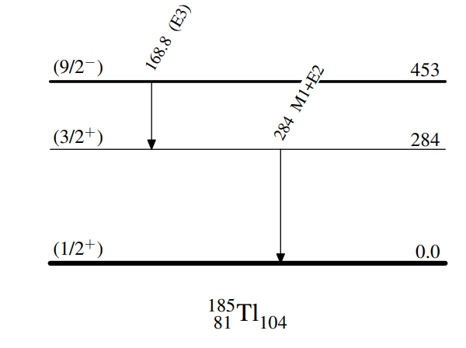
Internal Decay of Thallium
This project studies odd, neutron deficient masses of Thallium, specifically Tl185 and Tl183.
This decay consists of a nuclear isomer decay via E3, then an intermediate state decaying as an M1+E2

Slide 7
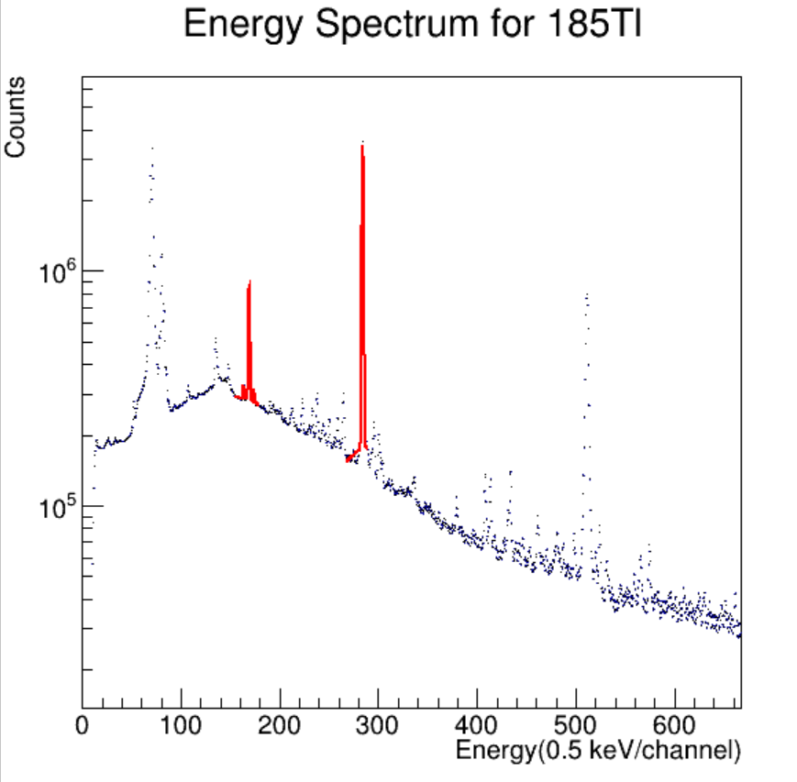
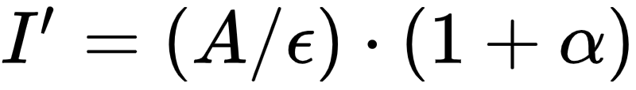
Electron Conversion Coefficient
Pure E3 decay
  Measure ECC from BRICC database
Solve for the next ECC using the equation
Notes:
Explain the equation + variables + what bricc is
Bruno: this can be tricky to explain. Maybe use the level scheme again here, to show how they have to have a 1 to 1 intensity correlation (once corrected by ECC)

Slide 8
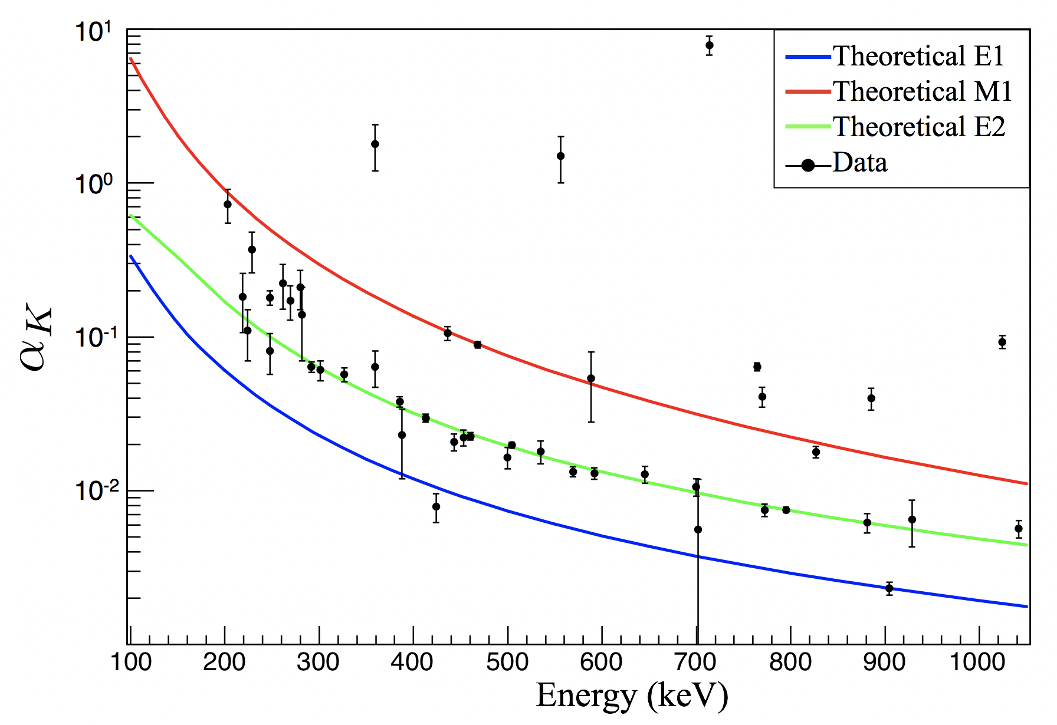
Mixing Ratio
The ratio of expected M1/E2 to happen in the decay
Once the ECC is known, we can find the mixing ratio in BRICC
Notes:
Is this picture necessary? What else could I put here
Consider using that other plot. It shows the alpha (define it) coefficient for E1, M1 and E2 as a function of gamma energy. The black dots are measured values, but I would say to ignore them (they are from 188Hg)

Slide 9
Half-Life

Slide 10
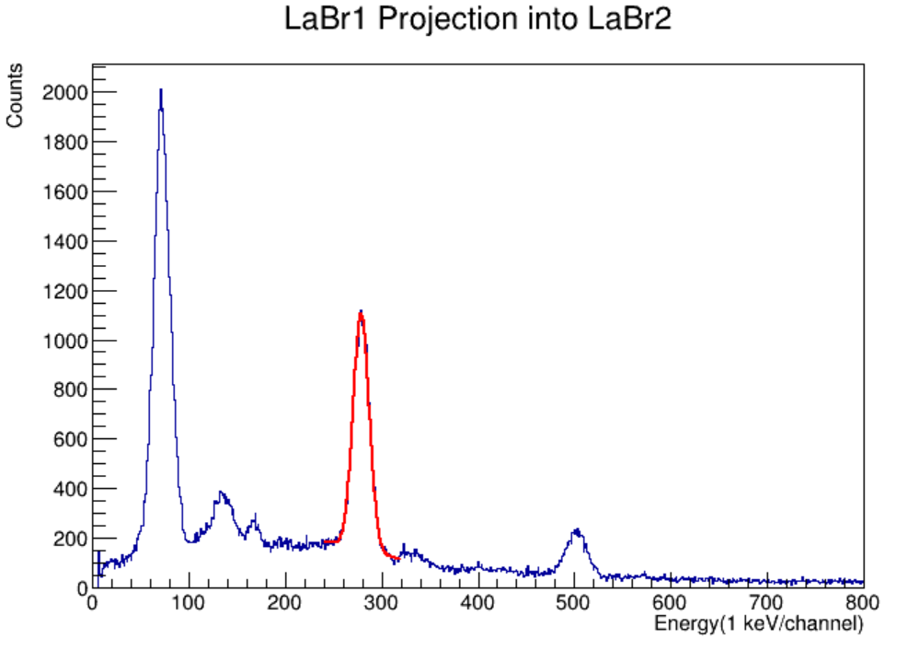
Lanthanum Bromide Data
LaBr detectors are very fast
  View coincidence gammas
Create a gamma-gamma matrix, gate around the first gamma and project into the matrix
Notes:
Explain the process of projection matrix
Bruno: MEntion that they are very fast (x1000) at the cost of worse energy resolution (x50)

Slide 11
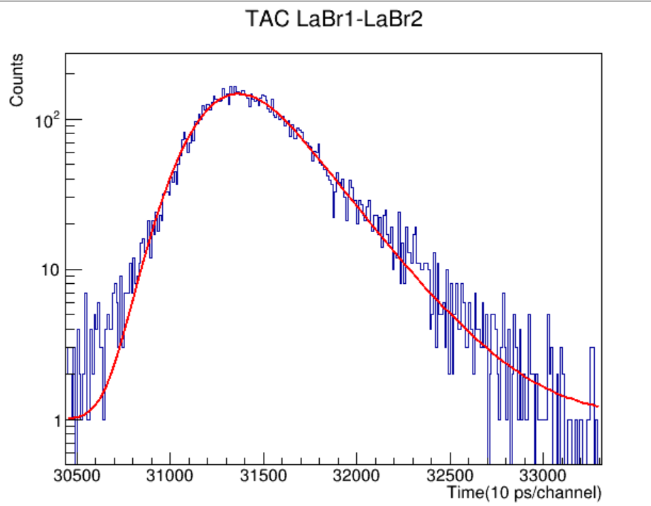
Time-to-Amplitude-Converter (TAC)
Measures time between coincidence gammas
Projecting coincidence gammas into the TAC data gives a convoluted gaussian
Notes:
Change photo, should this be less wordy?
Plot is good, just pick one you like that shows a slope. LEss words

Slide 12
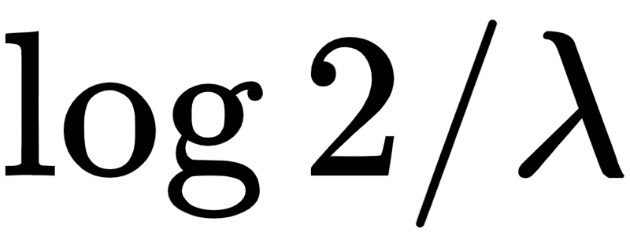
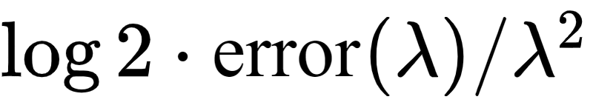
Lifetime Measurement
The TAC data is fit with a Gaussian distribution (prompt component) convoluted with an exponential decay (lifetime component)
gives us the half-life of the gamma we are measuring.
The error is given by
Notes:
Bruno: You can explain that you are using a Gaussian (prompt component) convoluted with a exponential decay (lifetime component). The equation is probably too complex to show or explain in detail

Slide 13
Results and Conclusion

Slide 14
185Tl 183Tl
Electron Conversion Coefficient
  0.319 +- 0.011
Mixing Ratio
  0.74 +- 0.01
Half-Life
  158.9 +- 4.0 ps
Electron Conversion Coefficient
  0.228+-0.023
Mixing Ratio
  1.92+-0.01
Half-life
  183.8+-6.4 ps
Notes:
Finalize errors more
Only one or none decimals. If you have time, you can calculate the B(M1) and B(E2), which is the real result, but it’s not trivial. You cna mention it as work for the future.

Slide 15
Conclusion
For completeness, this analysis needs to be run several more times with different fitting parameters to get a better understanding of the true values and the error
Need to calculate the B(M1) and B(E2)
From this information, we can begin to make inferences about the shape of the excited states. This will allow us to understand how the nucleus behaves at different energy levels
Notes:
Good. It is customary to end with a slide that says “Thank you for listening” or something like that.

Slide 16
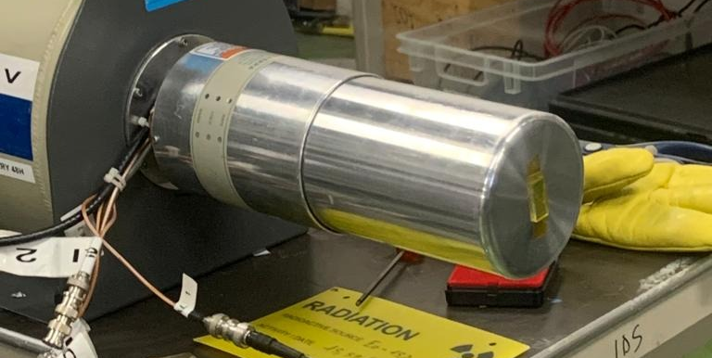
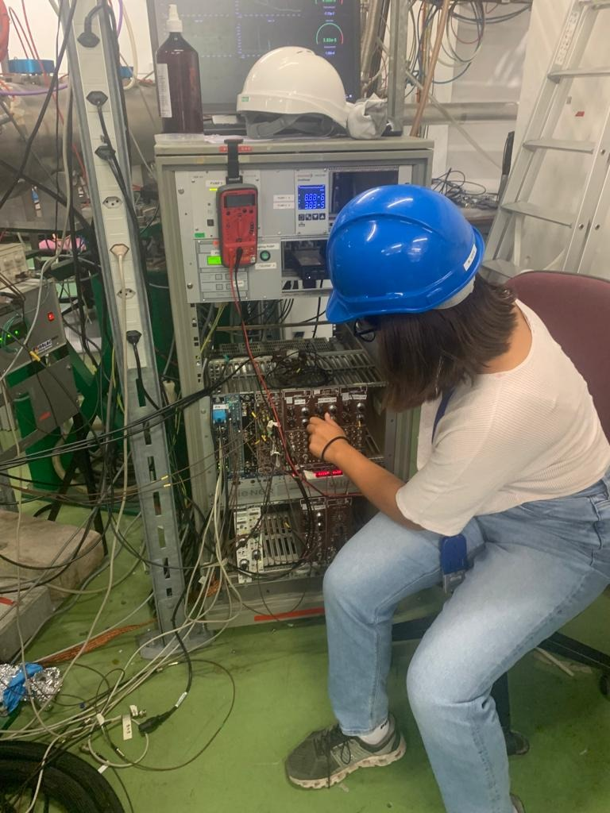
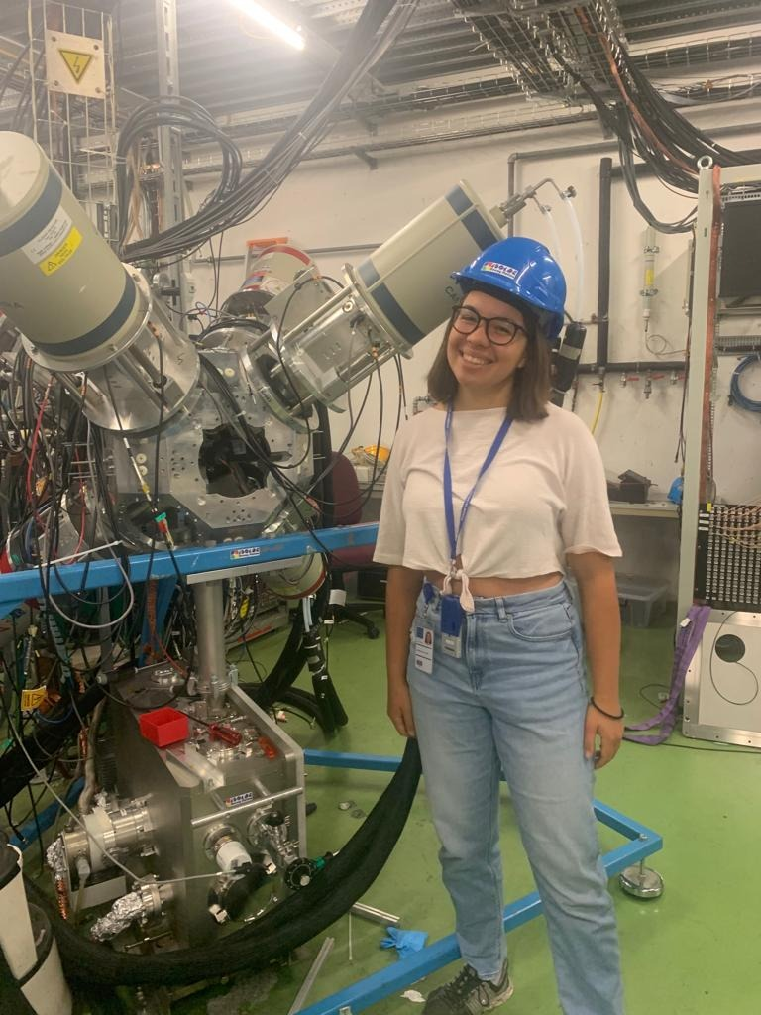
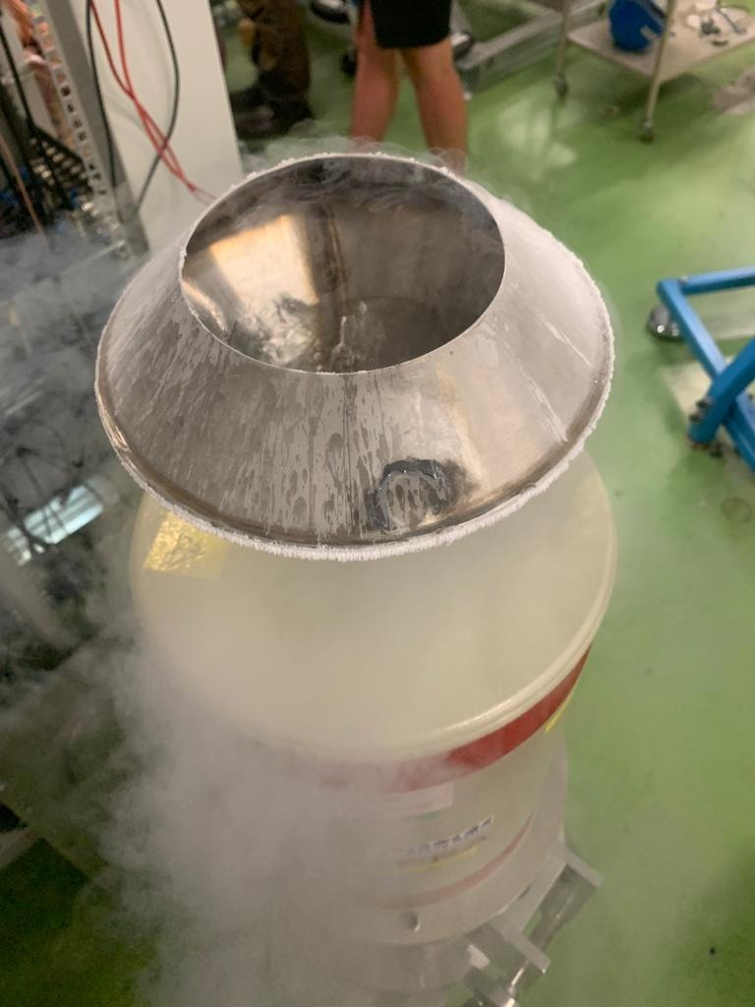
Photos!

Slide 17
Thank you for listening!

