Slide 1

Adiabatic Focusing Response of Low Density Plasma in AWAKE
University of Michigan CERN REU
Morgan Cole - University of California, Berkeley
Supervisors: Livio Verra & Edda Gschwendtner

Slide 2

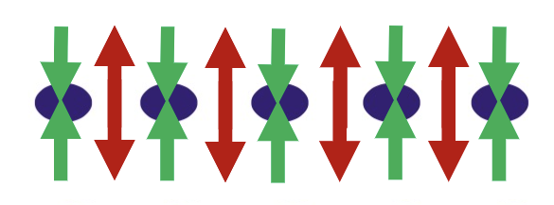
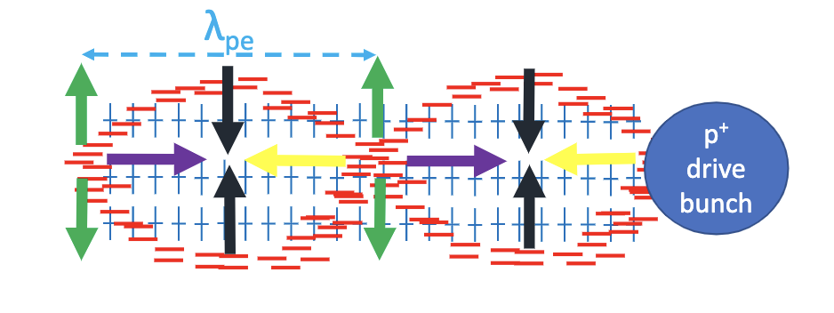
About AWAKE
  Proton-driven plasma wakefield accelerator
  Space-charge disturbance creates oscillations
  Bunch enters → become modulated/drives wakefields → witness bunch injected & gets accelerated
  Modulation at plasma density ~10¹⁴ - 10¹⁵ cm⁻³
Notes:
-AWAKE is a proton driven plasma wakefield accelerator
-we receive proton beam from the SPS
-proton bunch enters plasma, creates disturbance of the space charge, and plasma electrons attract/repel, oscillating at a particular wavelength/frequency
-we have a long proton bunch and high density plasma, so the wavelength is shorter than the length of the proton bunch
-proton bunch becomes modulated, forms what we call microbunches
-then the “witness” bunch, electrons, is injected and follows the driving proton bunch through the plasma, becomes accelerated by the wakefield that the proton bunch has formed
-my interest isn’t really the witness acceleration process, but rather the driving bunch. this modulation of the proton bunch occurs at high densities, btw 10 to the 12 to 10 to the 14th particles per cubic centimeter. But if we observe the proton bunch at lower densities, we can see another effect….

Slide 3
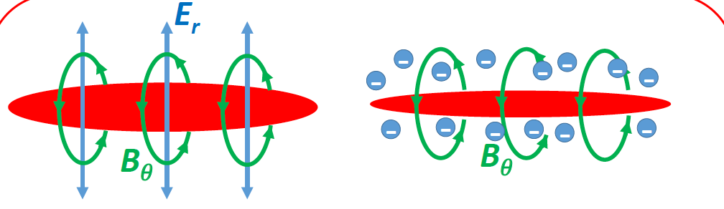
Adiabatic Focusing
Dominant Effect in Low Density Plasma
  Before high density self modulation ~10¹² cm⁻³
  Plasma electrons compensate for radial E-field of relativistic P bunch
    Leaves magnetic field, concentrates the bunch
  Bunch “self-focuses” uniformly
Notes:
Adiabatic focusing!
It can be seen best at densities too low to cause bunch modulation/microbunches
What’s happening here is that as your relativstic bunch propogates, electric field is being generated in the radial direction and thus you have current and magnetic field
The plasma electrons then move to the bunch and compensate for the E field, leaving only the magnetic field which focuses the bunch
Decreases the transverse width of the bunch as you can see.

Slide 4
Expectations/Goals
Observe gradual transition from unfocused (no plasma) to self modulation
  Get sufficient data at intermediate plasma densities
Transverse size decreasing as plasma density increases
Potential patterns - beam waist/center
Longitudinal (length)
Direction of motion
Transverse
(width)

Slide 5
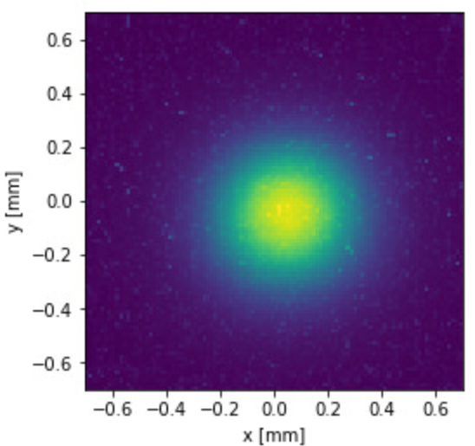
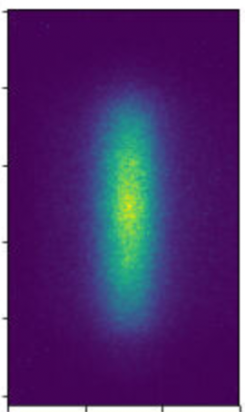
Experimental Setup
Time integrated bunch image, transverse projection
from OTR screens
Ionizing Laser Pulse
Vapor Source (Plasma Cell)
Proton beam
OTR Screens
Rb Reservoir
Rb Reservoir
Streak Camera
Observing Adiabatic Focusing
  Gradually increasing plasma density
  Heating of Rb Reservoirs
  Examine resulting beam “images”
Time resolved bunch image, long. projection
from streak camera
Length [mm]
time [ps]
Notes:
-
-the experiment we conducted to look at the AF effect involved gradually increasing the plasma density as we received beam over the course of several hours
-the rb reservoirs were heated and the gas entered the cell. Then the gas was ionized by the laser pulse each time we received beam such that the beam always entered a preformed plasma
here you have Rb reservoirs which release gas into the cell, and an ionizing laser pulse enters and forms the plasma
-And along the beamline you have these screens creating time integrated OTR light images and the streak camera creating time-resolved streak camera images
-these are examples of the images taken by the beam, here is a transverse projection from one of the BTVs/scintillating screens, and here is a longitudinal projection made from a time-resolved streak camera image
-allows us to take a close look at the size of the bunch from different angles
-so this is what we did a few weeks ago

Slide 6
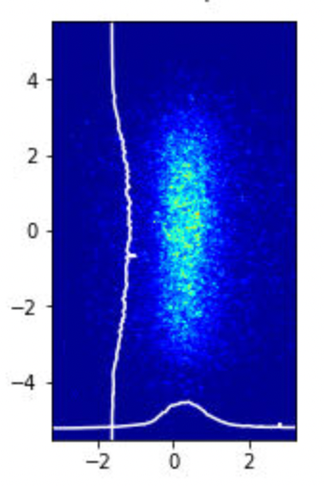
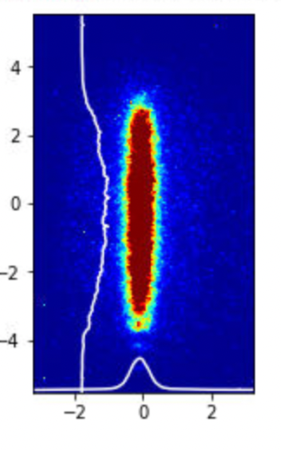
Experimental Results
Clear Focusing of Beam (decrease in width) with increasing plasma density
Transverse projection of images, Gaussian fit to determine width
Plasma Off Temp = ~30 C
Plasma On Temp = ~110 C
time: 1134 ps
time: 1134 ps
[mm]
[mm]
Notes:
-Ok so from the experiment which we performed a few weeks ago, we can clearly see that the beam size decreased as plasma density increased, so the focusing occurred as expected
-[explain the streak profile plots]
-[overall conclusions?]

Slide 7
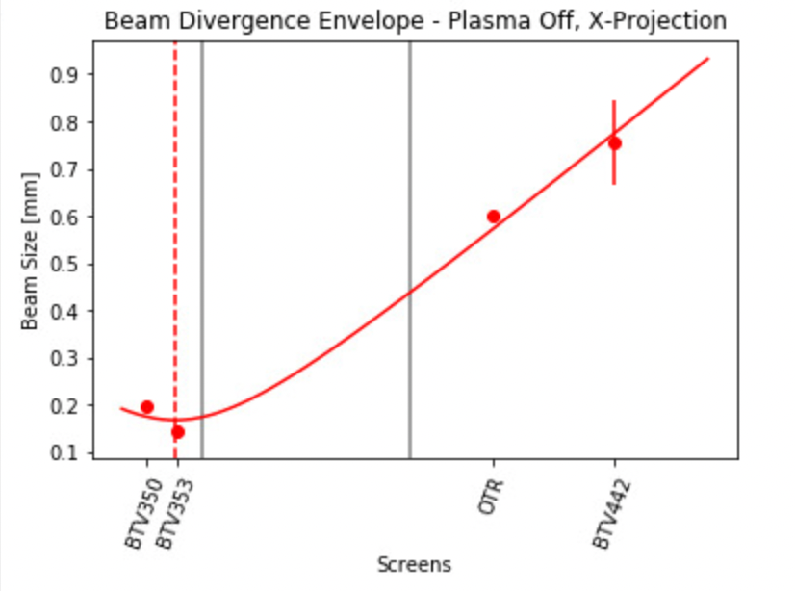
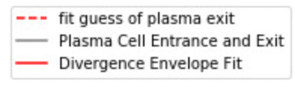
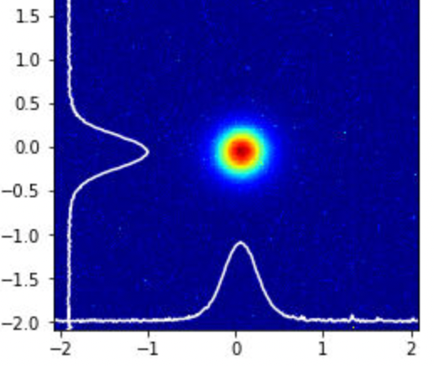
No Plasma - Beam Divergence
Verified that bunch is gaussian for fitting
Taking 𝝈 value from BTVs, plot & fit for divergence of beam/characterized envelope
σ₀: 114.64 microns
ε: 2.541 𝛑 mm mrad
Bunch Length: 226 土4.61 ps
OTR Screens
Transverse Size
Notes:
-so just to give some more detail we have characterized the beam when there was no plasma
- the first thing I had to do was characterize the bunch….
-As you can see the bunch was Gaussian in both the transverse and longitudinal directions
-and here in this graph you see the envelope of the beam at the plasma exit point according to the size measure by the BTV screens
-do i need to include the equation?

Slide 8
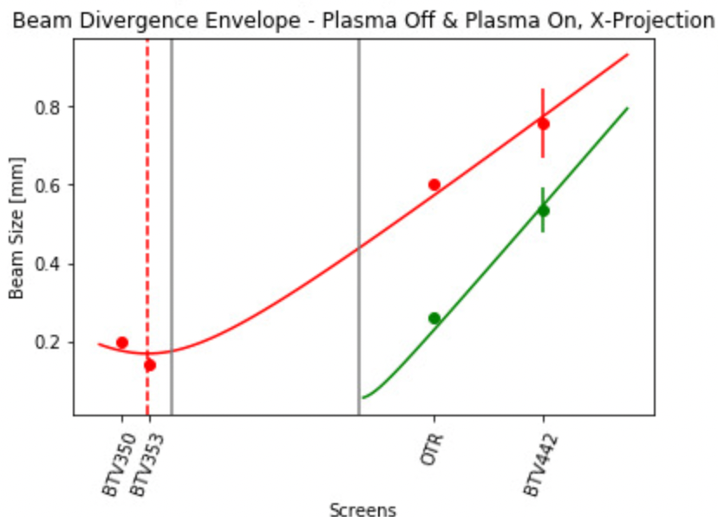
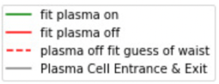
Plasma On - Beam Divergence
Assumed same emittance and that smallest (most focused) point is at the end of the plasma cell
  Agrees well with results!
𝝈₀ = 108.71 microns
(plasma off = 114.64 microns)

Slide 9
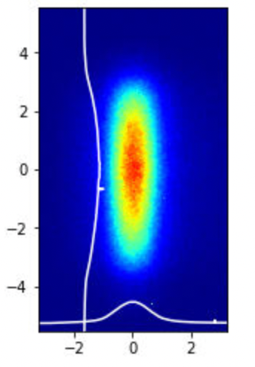
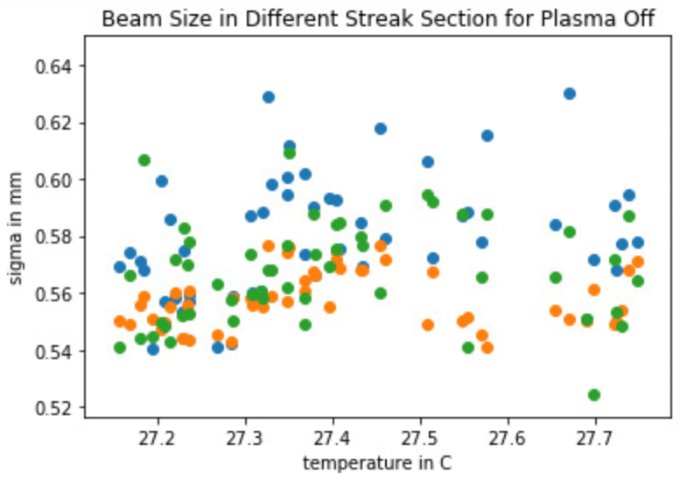
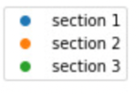
No Plasma - Size by Section
Analyzed the bunch width at different points along length
Plasma off, no pattern in transverse size
Section 3
Section 2
Section 1
Notes:
-Ok so from the experiment which we performed a few weeks ago, we can clearly see that the beam size decreased as plasma density increased, so the focusing occurred as expected
-[explain the streak profile plots]
-[overall conclusions?]

Slide 10
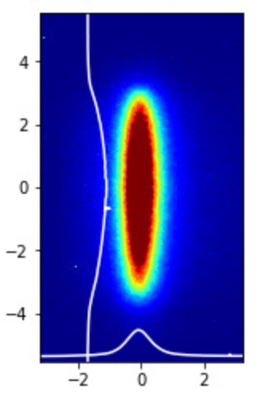
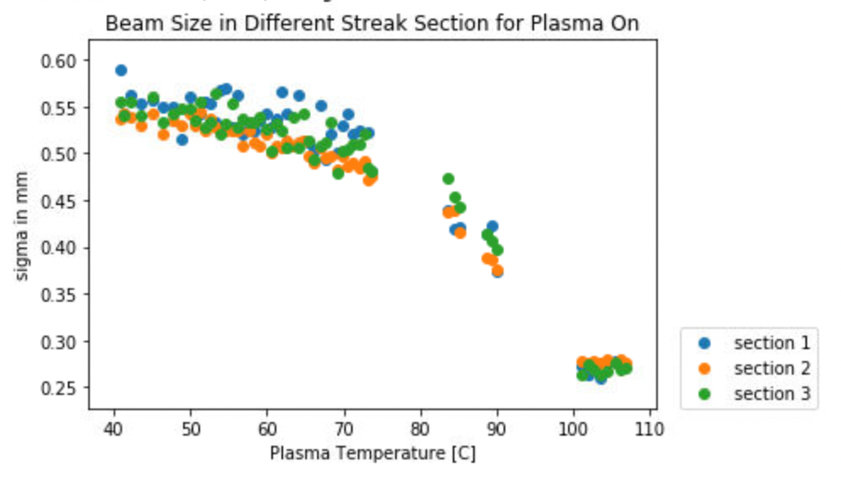
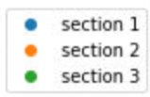
Plasma On - Size by Section
Analyzed the bunch width at different points along length
Section 3
Section 2
Section 1
Notes:
-Ok so from the experiment which we performed a few weeks ago, we can clearly see that the beam size decreased as plasma density increased, so the focusing occurred as expected
-[explain the streak profile plots]
-[overall conclusions?]

Slide 11
Missing Transition Data
Did not have beam consistently during the warm up
Possibly missed transition from over focusing to under focusing of bunch center
Low-resolution and noisy → uncertain about size differences
The fun part
{
{
No beam :/

Slide 12
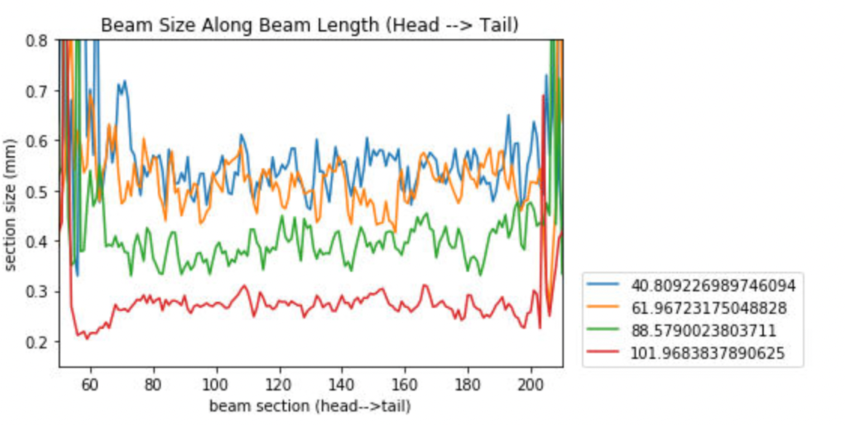
Streak Profiles
Streak Profiles by Event
  Width of bunch along the length
  Later times → higher density → more focused
    One event at a time
Temp [C]
Notes:
-Ok so from the experiment which we performed a few weeks ago, we can clearly see that the beam size decreased as plasma density increased, so the focusing occurred as expected
-[explain the streak profile plots]
-[overall conclusions?]
-what approximate percentage of whole bunch is uniformly focus
-instead of streak times quote plasma density at different intervals
-show self modulation and temperature at the end
-note temps earlier

Slide 13
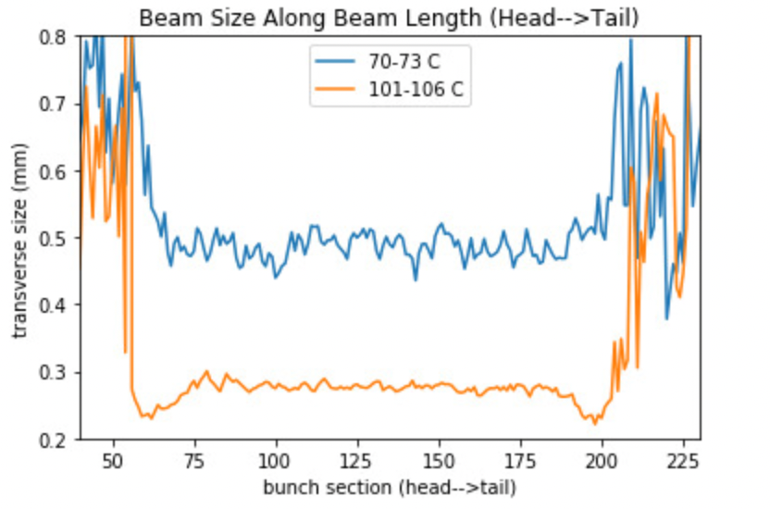
Examining Beam Center

Slide 14
Conclusions/Next Steps
Clearly saw focusing w/increasing plasma density
Possible evidence of bunch center over/under focusing
Another run in a few weeks, hopefully more consistent beam!
  See if transition is reproduced?
Simulations of adiabatic focusing
?

Slide 15
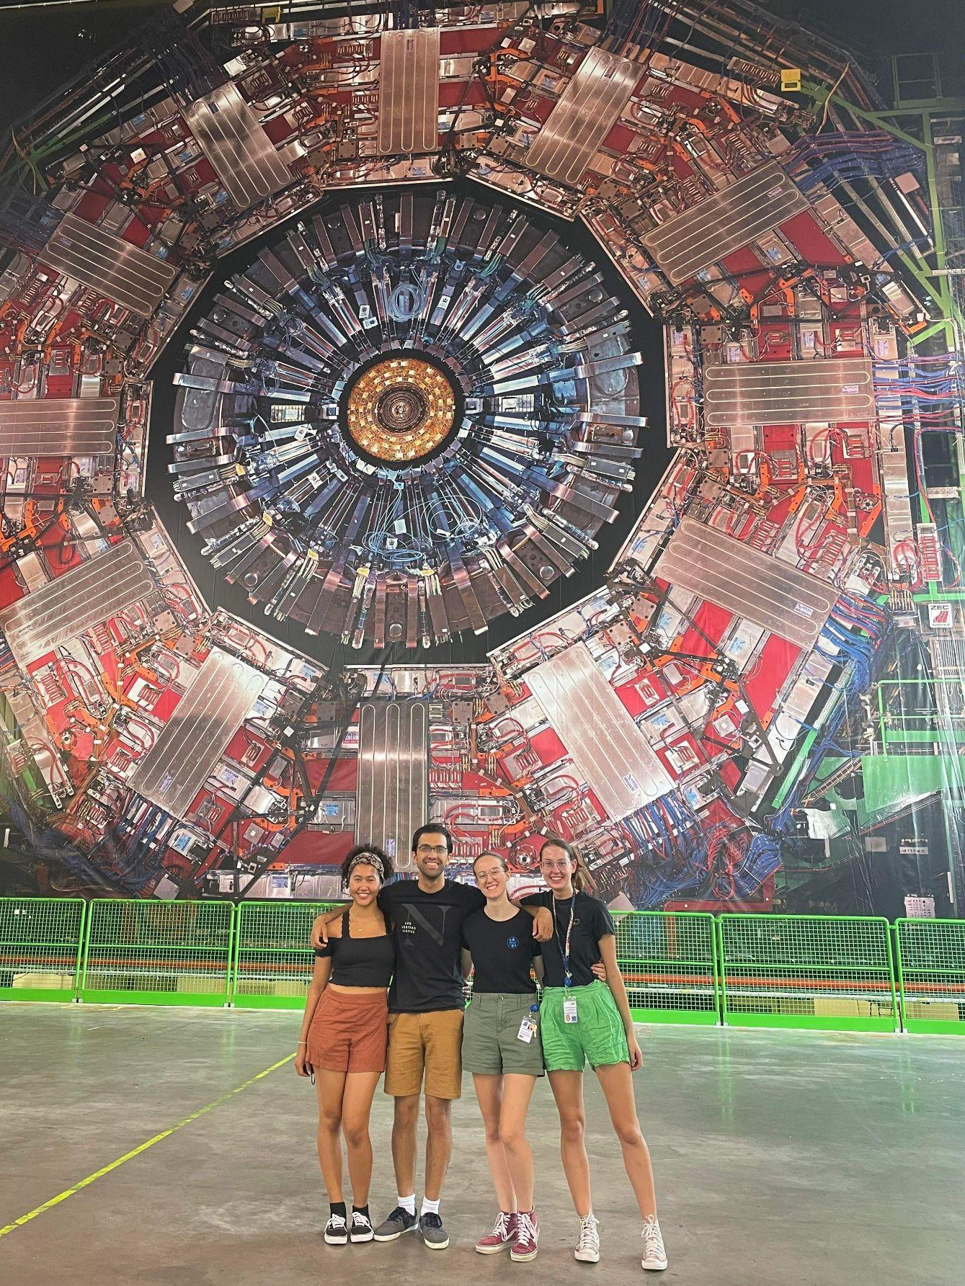
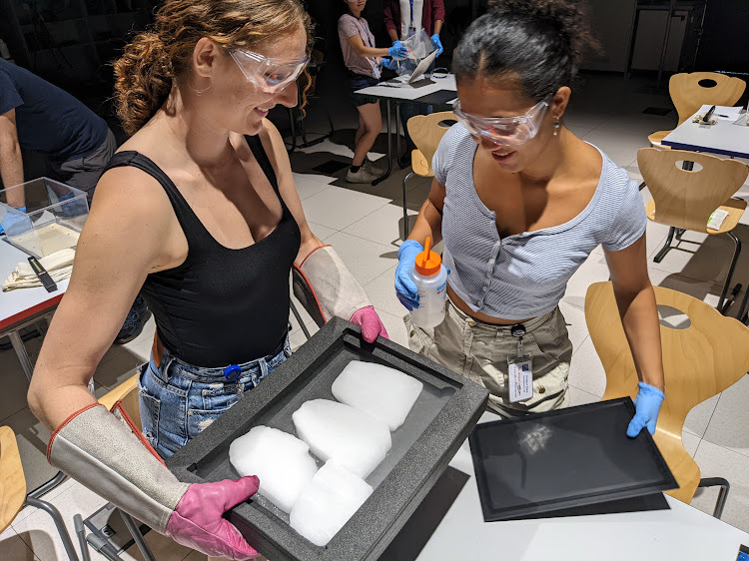
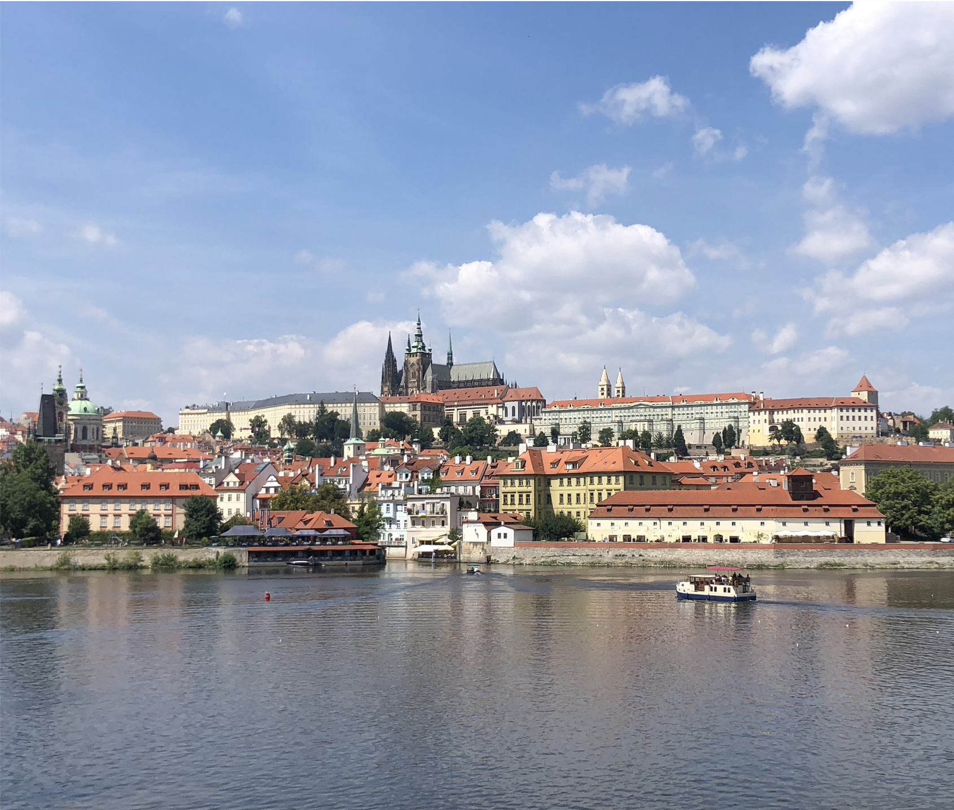
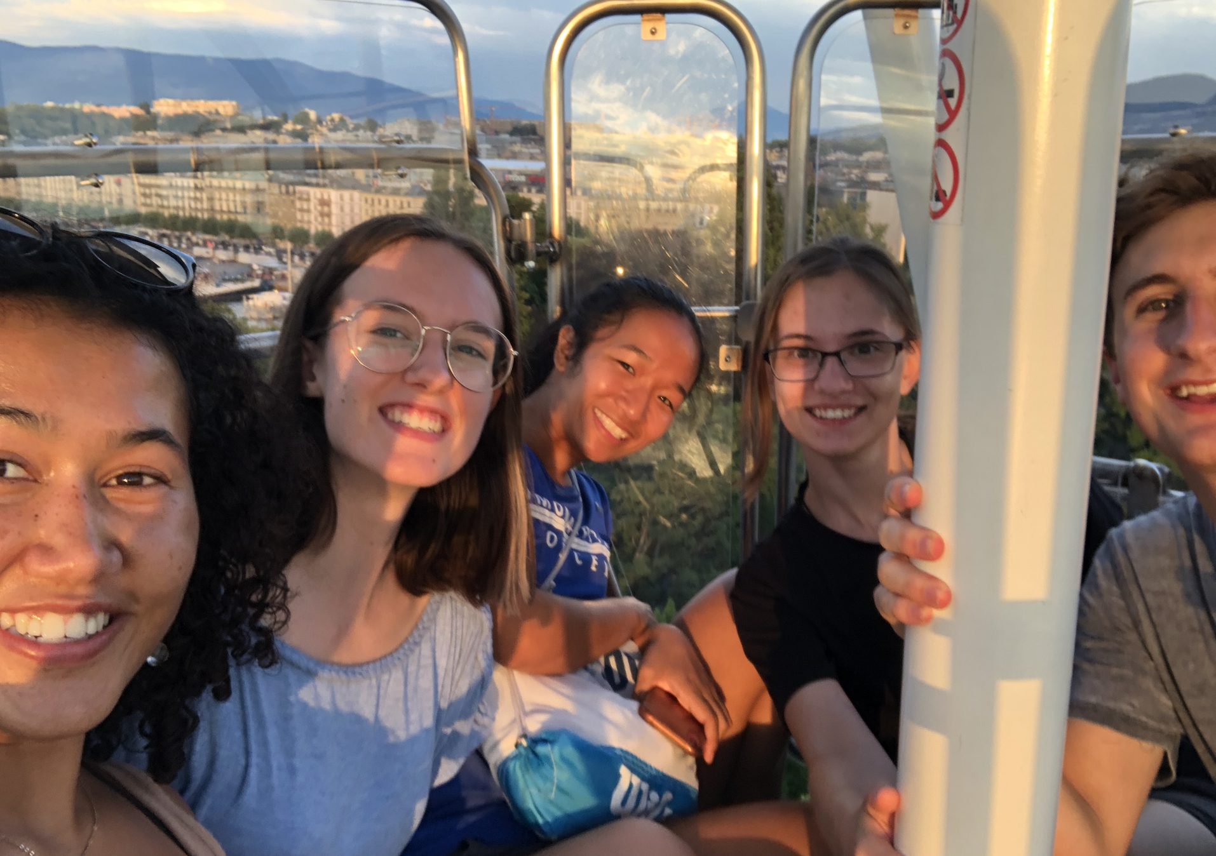
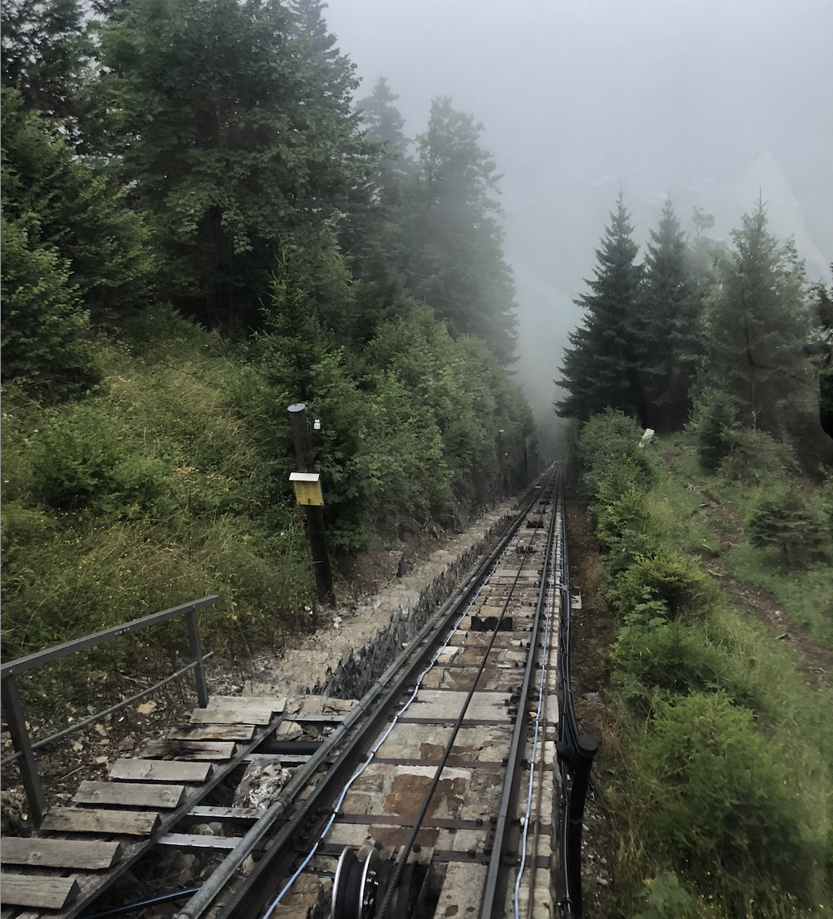
Thank you!!

Slide 16
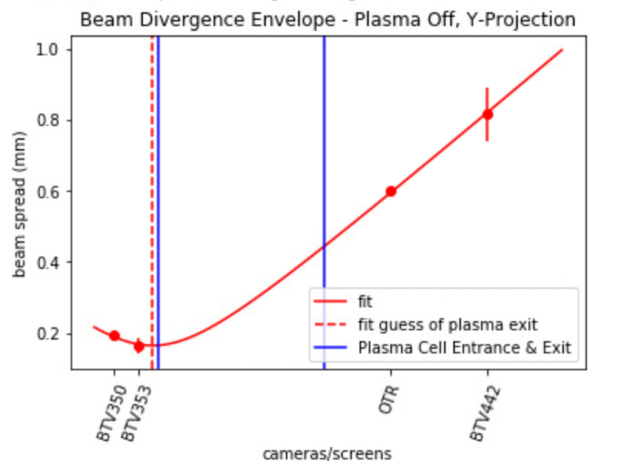
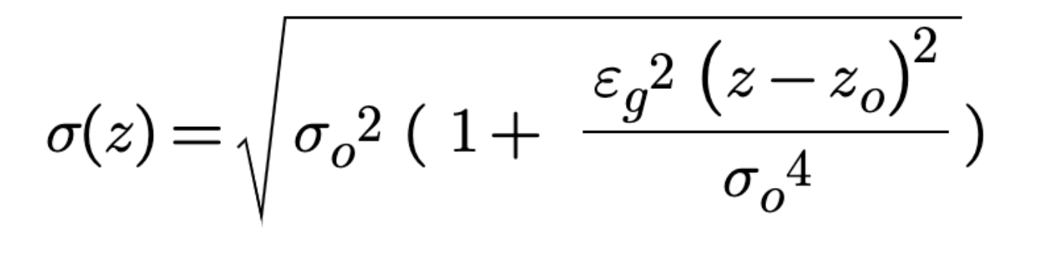
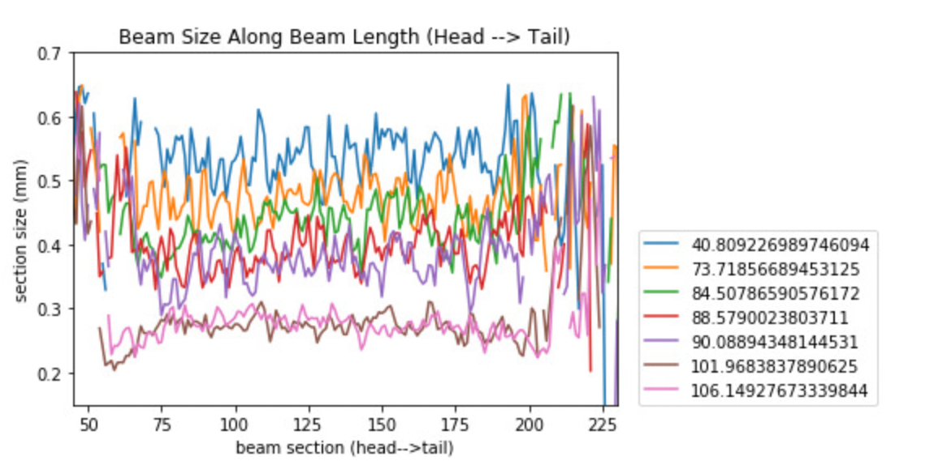
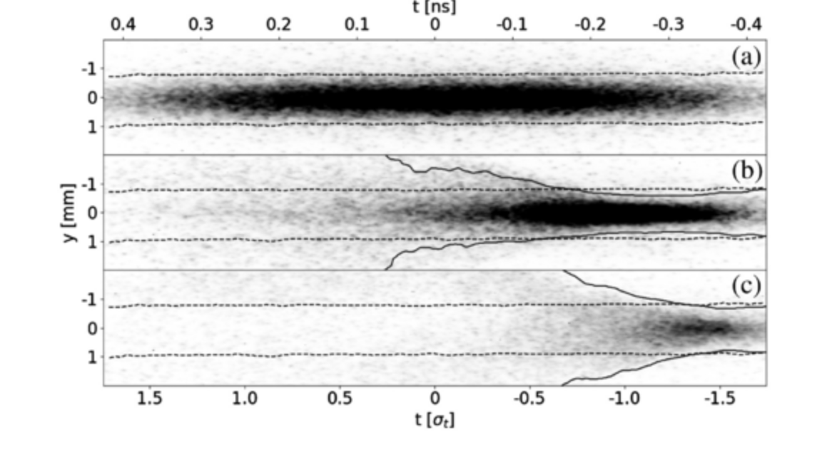
Beam Envelope Equation
Evidence of AF during SMI

